Slide 1

BOOTSTRAP
truongconghieuptit@gmail.com

Slide 2
Overview

Slide 3
What is Bootstrap?
Bootstrap is a free front-end framework for faster and easier web development
Bootstrap includes HTML and CSS based design templates for typography, forms, buttons, tables, navigation, modals, image carousels and many other, as well as optional JavaScript plugins
Bootstrap also gives you the ability to easily create responsive designs

Slide 4
What is Responsive Web Design?
Responsive web design is about creating web sites which automatically adjust themselves to look good on all devices, from small phones to large desktops.

Slide 5
Why Use Bootstrap?
Easy to use: Anybody with just basic knowledge of HTML and CSS can start using Bootstrap
Responsive features: Bootstrap's responsive CSS adjusts to phones, tablets, and desktops
Mobile-first approach: In Bootstrap, mobile-first styles are part of the core framework
Browser compatibility: Bootstrap 4 is compatible with all modern browsers (Chrome, Firefox, Internet Explorer, …)

Slide 6
Environment Setup

Slide 7
Installation
You can download the latest version of Bootstrap from https://getbootstrap.com with two choices:
Download Compiled CSS and JS − Clicking this, you can download the precompiled and minified versions of Bootstrap CSS, JavaScript, and fonts. No documentation or original source code files are included.
Download Source − Clicking this, you can get the latest Bootstrap LESS and JavaScript source code directly from GitHub.

Slide 8
Layout

Slide 9
Containers
Containers are a fundamental building block of Bootstrap that contain, pad, and align your content within a given device or viewport.
.container, which sets a max-width at each responsive breakpoint
.container-fluid, which is width: 100% at all breakpoints
.container-{breakpoint}, which is width: 100% until the specified breakpoint

Slide 10
Grid system
Use our powerful mobile-first flexbox grid to build layouts of all shapes and sizes thanks to a twelve column system, six default responsive tiers.

Slide 11
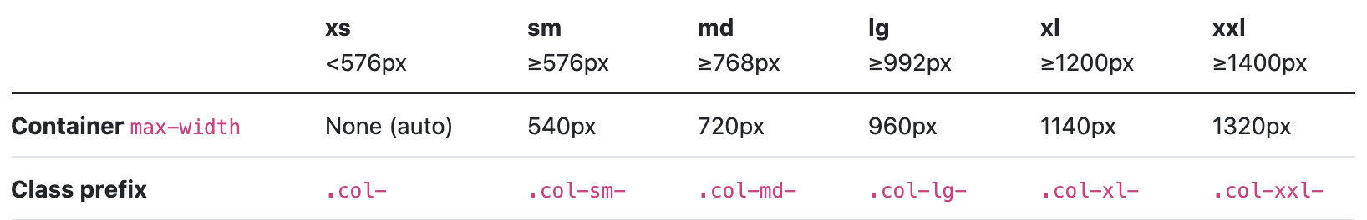
Grid system

Slide 12
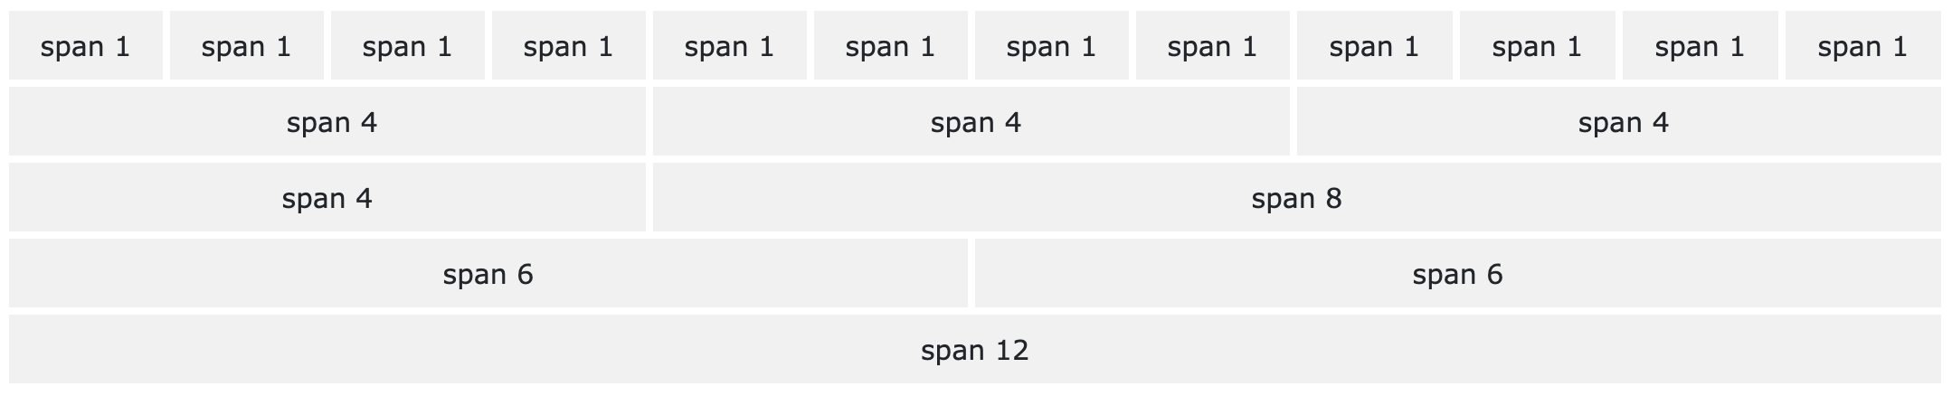
Grid system

Slide 13
Components

Slide 14
Components
Bootstrap provides beautiful and functional built-in components which are easy to customize ( Alert, Button, Card, Dropdown, …)

Slide 15
Practice

Slide 16
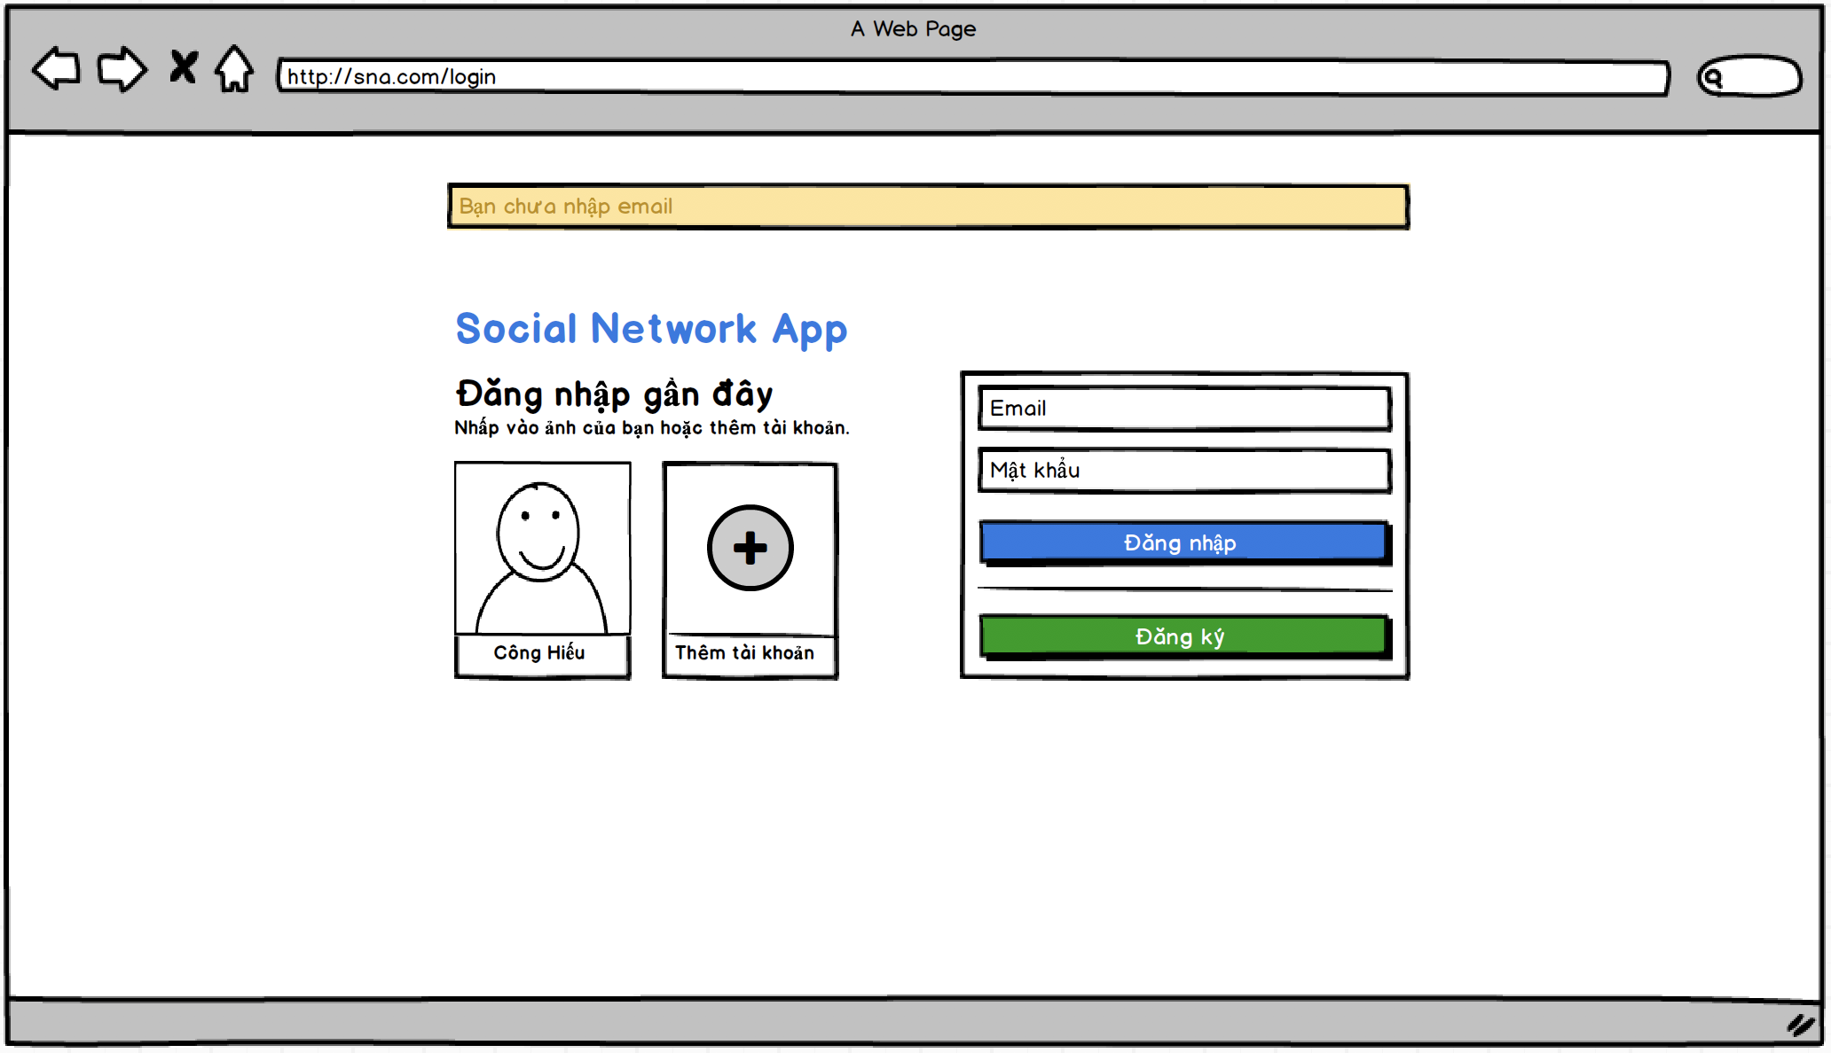
Social Network App

Slide 17
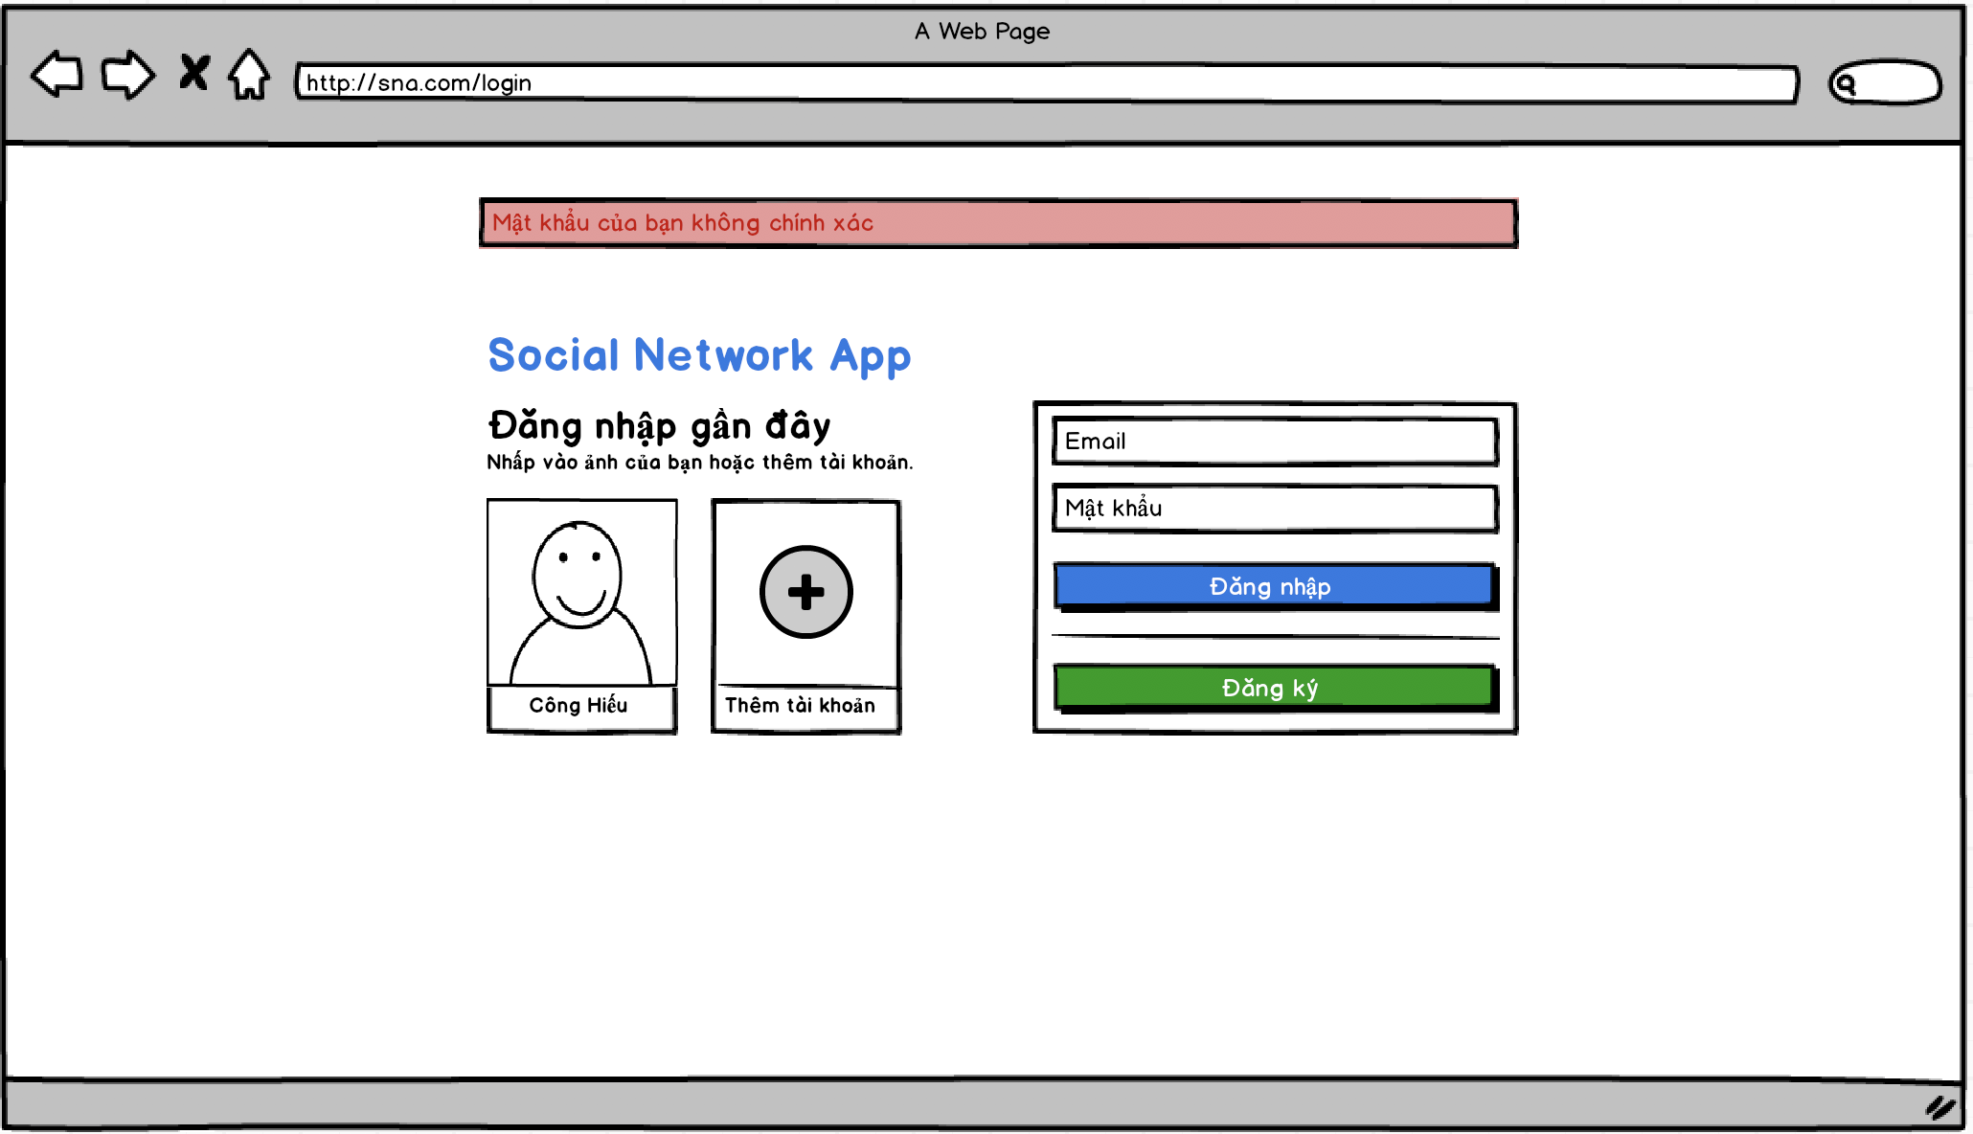
Social Network App

Slide 18
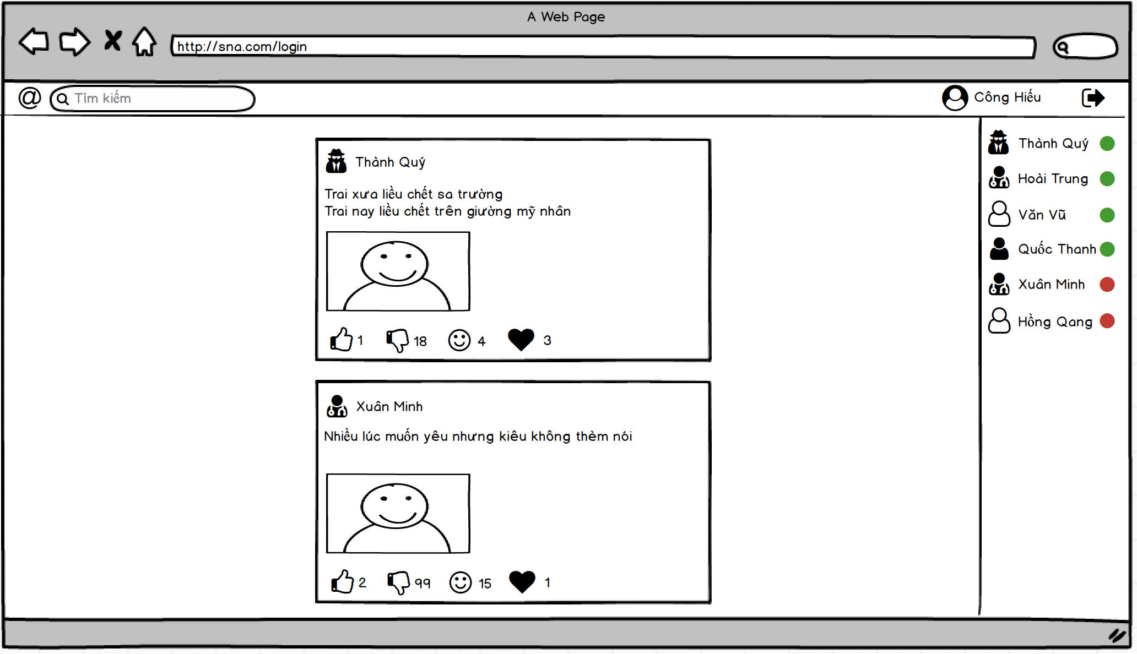
Social Network App

Slide 19
THANKS!
truongconghieuptit@gmail.com

