Slide 1

REACTJS
truongconghieuptit@gmail.com

Slide 2
Overview

Slide 3
Overview
React is a front-end library developed by Facebook.
It is used for handling the view layer for web and mobile apps.
ReactJS allows us to create reusable UI components. It is currently one of the most popular JavaScript libraries and has a strong foundation and large community behind it.

Slide 4
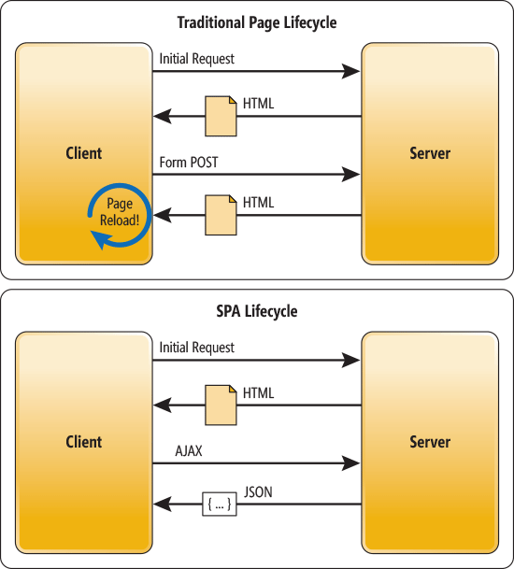
Single Page Application

Slide 5
Environment Setup
NodeJS and NPM
Visual studio code
Create New React App

Slide 6
Main Concepts

Slide 7
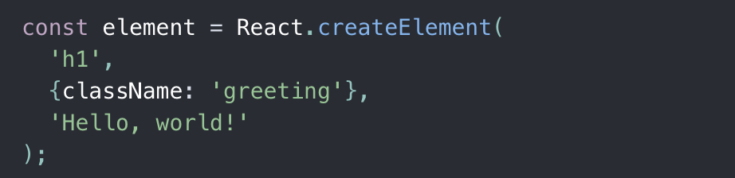
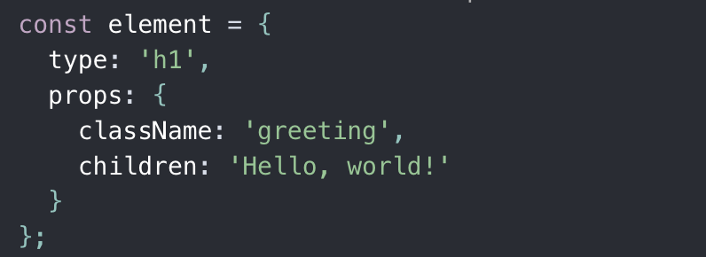
React.createElement
React.createElement() help you creates an object like this:

Slide 8
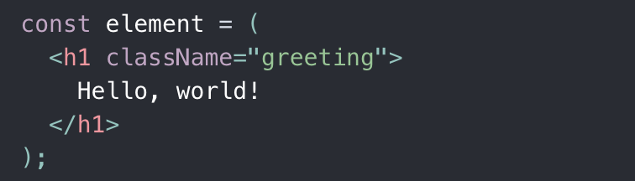
JSX
JSX is a syntax extension to JavaScript.
Using JSX with React to describe what the UI should look like.
JSX produces React elements.

Slide 9
Elements
Elements are the smallest building blocks of React apps.
React elements are plain objects, and are cheap to create.

Slide 10
Components
Components let you split the UI into independent, reusable pieces, and think about each piece in isolation.
Conceptually, components are like JavaScript functions. They accept arbitrary inputs (called “props”) and return React elements describing what should appear on the screen.

Slide 11
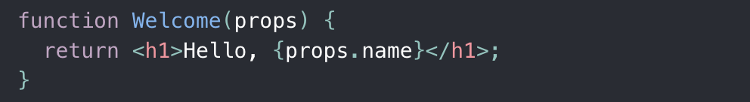
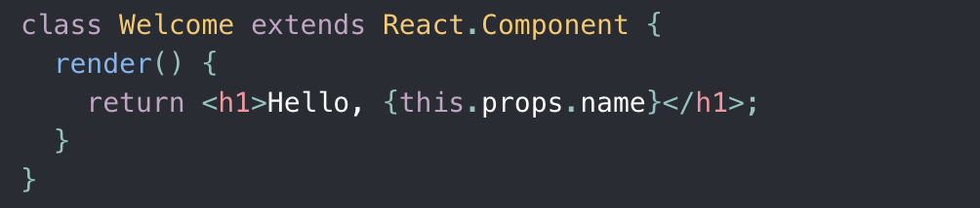
Components
Function Components
Class Components

Slide 12
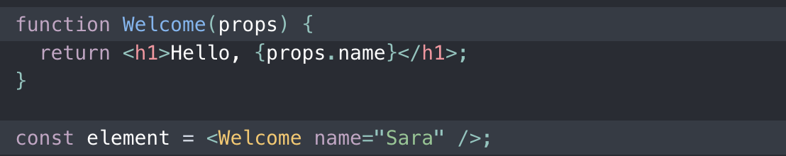
Props
When an element representing a user-defined component, it passes JSX attributes and children to this component as a single object. We call this object “props”.

Slide 13
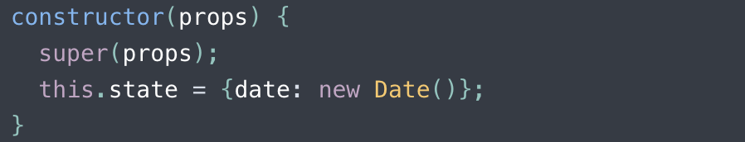
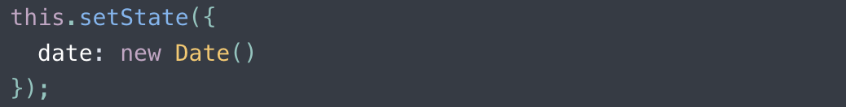
State
State is the place where the data comes from in component.
Do not modify state directly. Instead, use setState()
.

Slide 14
Difference between state and props
The main difference between state and props is that props are immutable.
Container component should define the state that can be updated and changed, while the child components should only pass data from the state using props.

Slide 15
Lifecycle Methods
Mounting
componentWillMount is executed before rendering, on both the server and the client side.
render()
componentDidMount is executed after the first render only on the client side.

Slide 16
Lifecycle Methods
Updating
componentWillReceiveProps() is invoked as soon as the props are updated before another render is called.
shouldComponentUpdate should return true or false value. This will determine if the component will be updated or not. This is set to true by default.
componentWillUpdate is called just before rendering.
render()
componentDidUpdate is called just after rendering.

Slide 17
Lifecycle Methods
Unmounting
componentWillUnmount is called after the component is unmounted from the dom. We are unmounting our component in main.js.

Slide 18
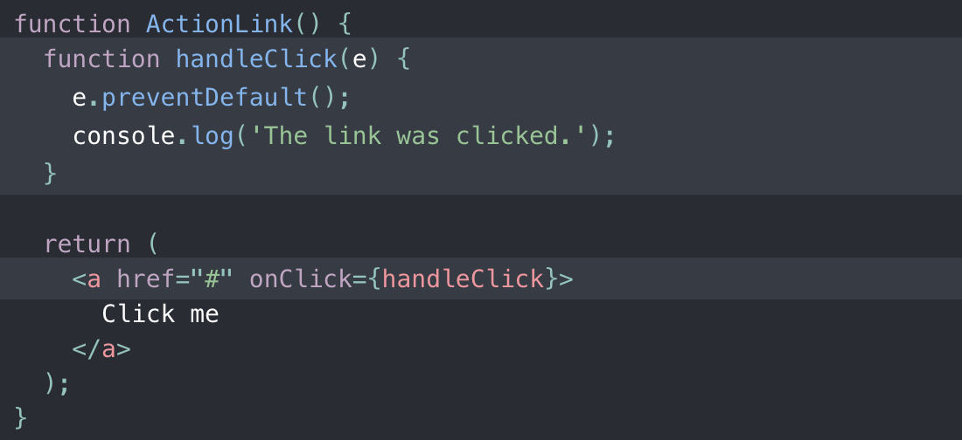
Handling Events
React events are named using camelCase.
With JSX you pass a function as the event handler.

Slide 19
Conditional Rendering
Element Variables
Inline If with Logical && Operator
Inline If-Else with Conditional Operator

Slide 20
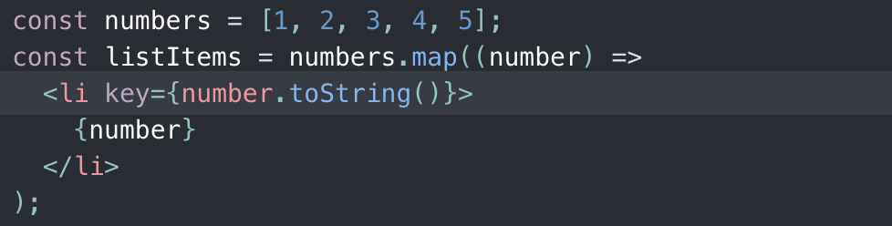
Lists and Keys
React Keys help React identify which items have changed, are added, or are removed. Keys should be given to the elements inside the array to give the elements a stable identity.

Slide 21
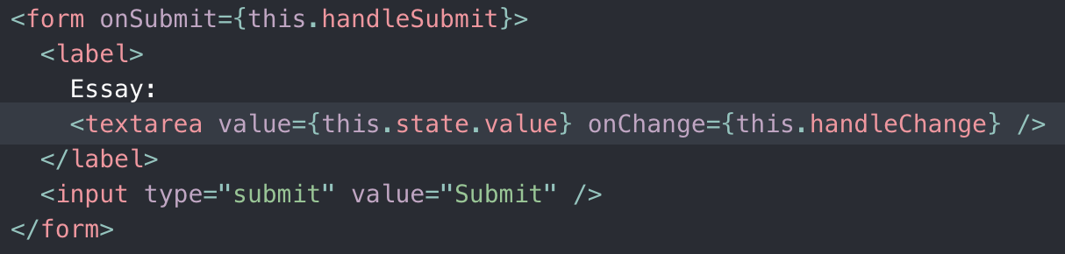
Forms
HTML form elements work a little bit differently from other DOM elements in React, because form elements naturally keep some internal state.

Slide 22
Lifting State Up
Often, several components need to reflect the same changing data. We recommend lifting the shared state up to their closest common ancestor.

Slide 23
Hooks

Slide 24
Overview
Hooks are functions that let you “hook into” React state and lifecycle features from function components.
Hooks don’t work inside classes

Slide 25
Advantages
Hooks solve problems in React
It’s hard to reuse stateful logic between components.
Complex components become hard to understand.
Classes confuse both people and machines.

Slide 26
Rules
Hooks impose two rules:
Only call Hooks at the top level. Don’t call Hooks inside loops, conditions, or nested functions.
Only call Hooks from React function components. Don’t call Hooks from regular JavaScript functions.

Slide 27
useState
useState is used to declare a State Variable.
The only argument to the useState() Hook is the initial state.
useState returns a pair of values: the current state and a function that updates it.

Slide 28
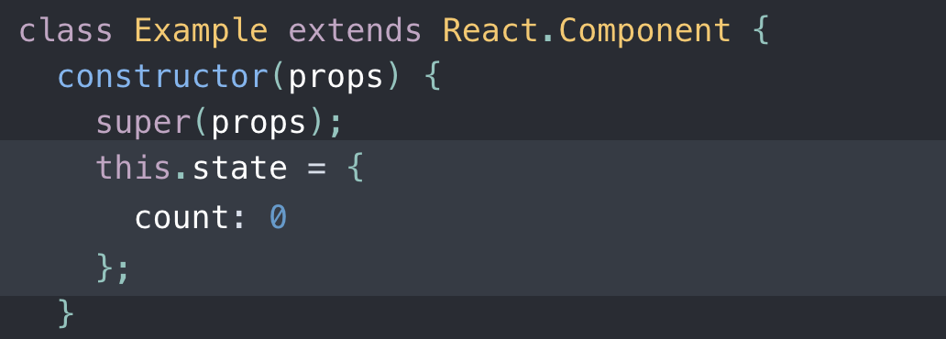
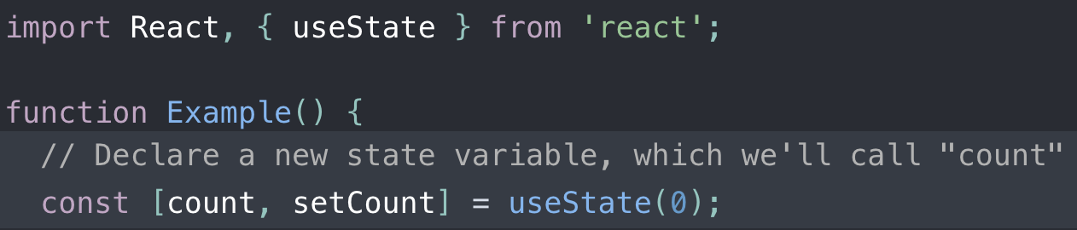
useState

Slide 29
useEffect
Using useEffect to tell React that component needs to do something after render. (equivalent to componentDidMount and componentDidUpdate)
useEffect run after every render (first render and after every update)

Slide 30
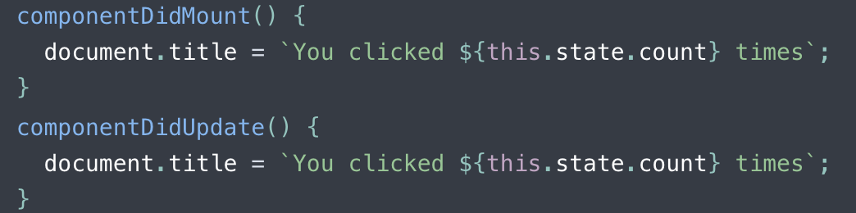
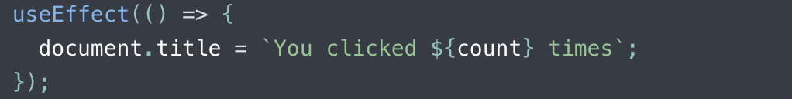
useEffect

Slide 31
THANKS!
truongconghieuptit@gmail.com

