Slide 1
Anyout
Made by Otherwise:
Khoa Tran, Abdel Hussein, Haoxuan Li, Haocun Wang, Jiwon Park

Slide 2
About
Our project is a webpage, working as a platform to let students to create, share, and join events on campus.
Frontend is constructed with vue.js, HTML, JavaScript, and CSS
Backend is constructed using Flask, Python, and MongoDB

Slide 3
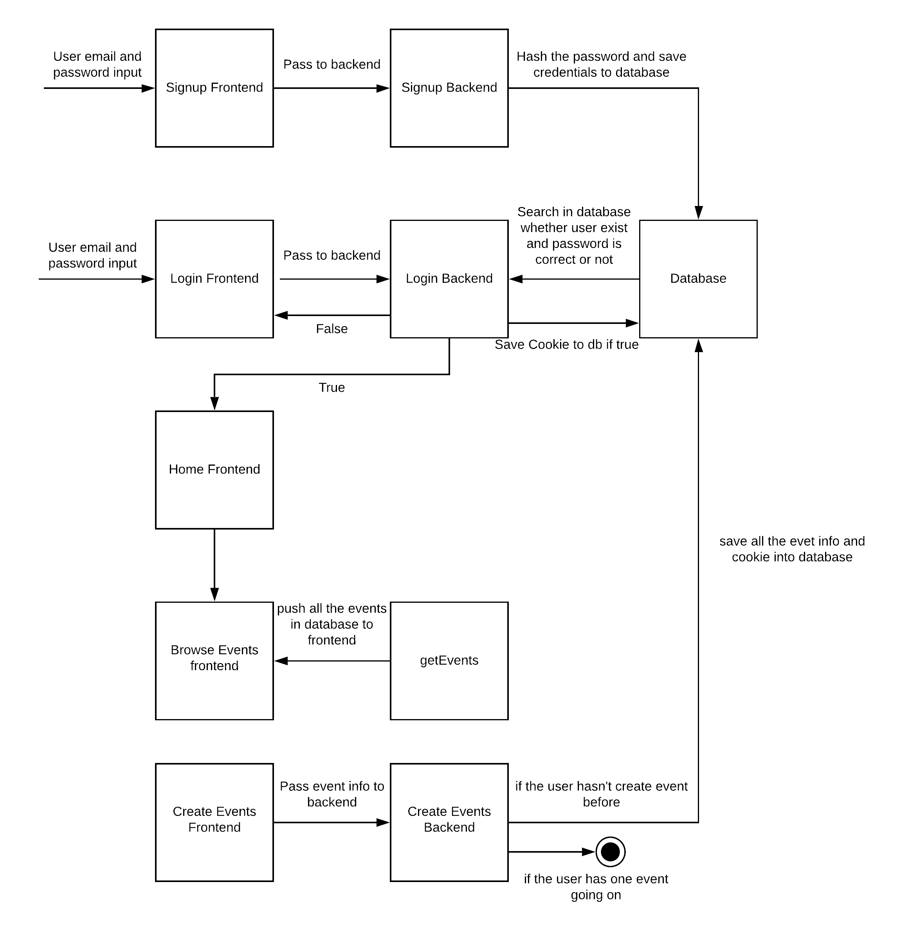
State Diagram

Slide 4
Functionality
Signup Page
Login Page
Event Page
  Create an event
  Ask to join an event
  Show the event’s location on map
  Show the host and the capacity of an event

Slide 5
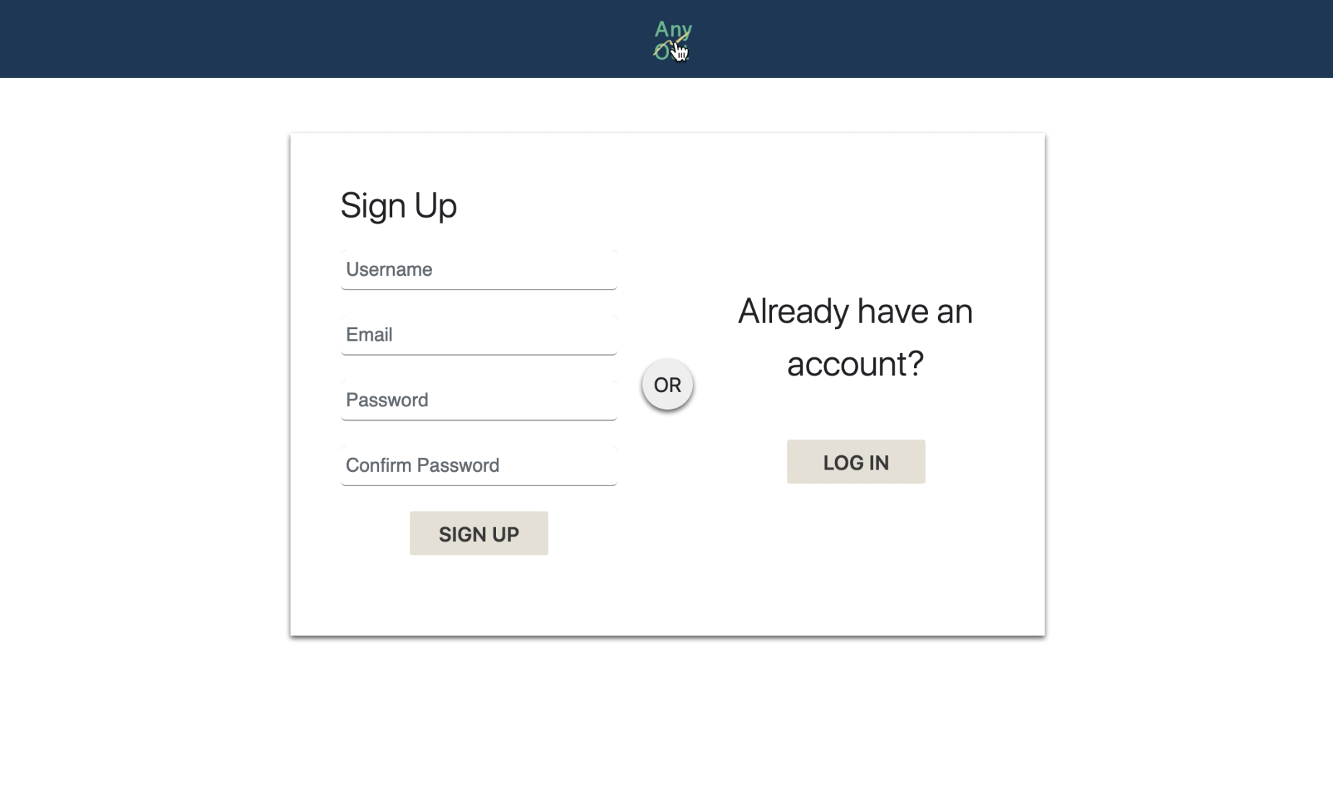
Signup Page
User puts their Email, Username, and password into an html form. After they submit it, backend will hash the password and save them into database.

Slide 6
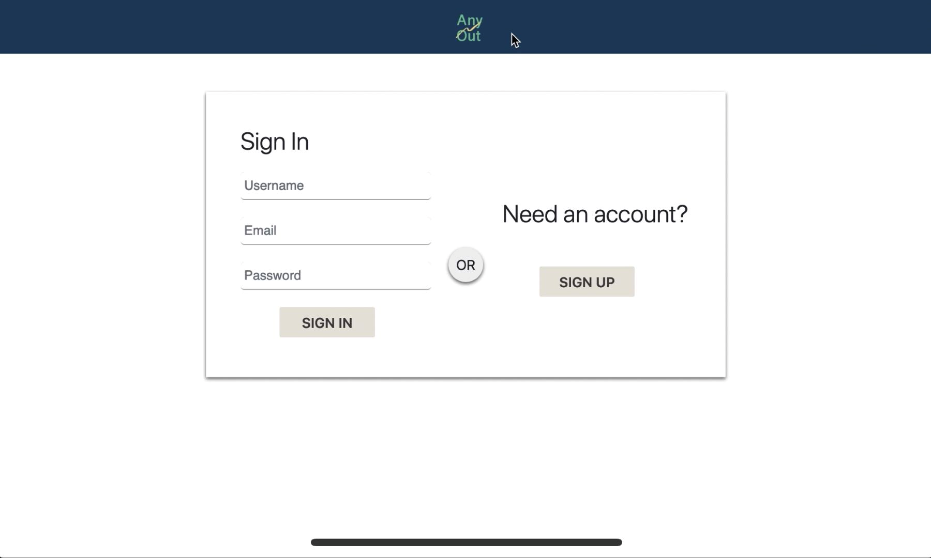
Login Page
User enters login credentials. Backend will pull the credentials and hash the password and search the email and password in the database. If everything looks good, backend will generate a random string and save it into a cookie. The value of the cookie will be the userid and saved into the database.

Slide 7
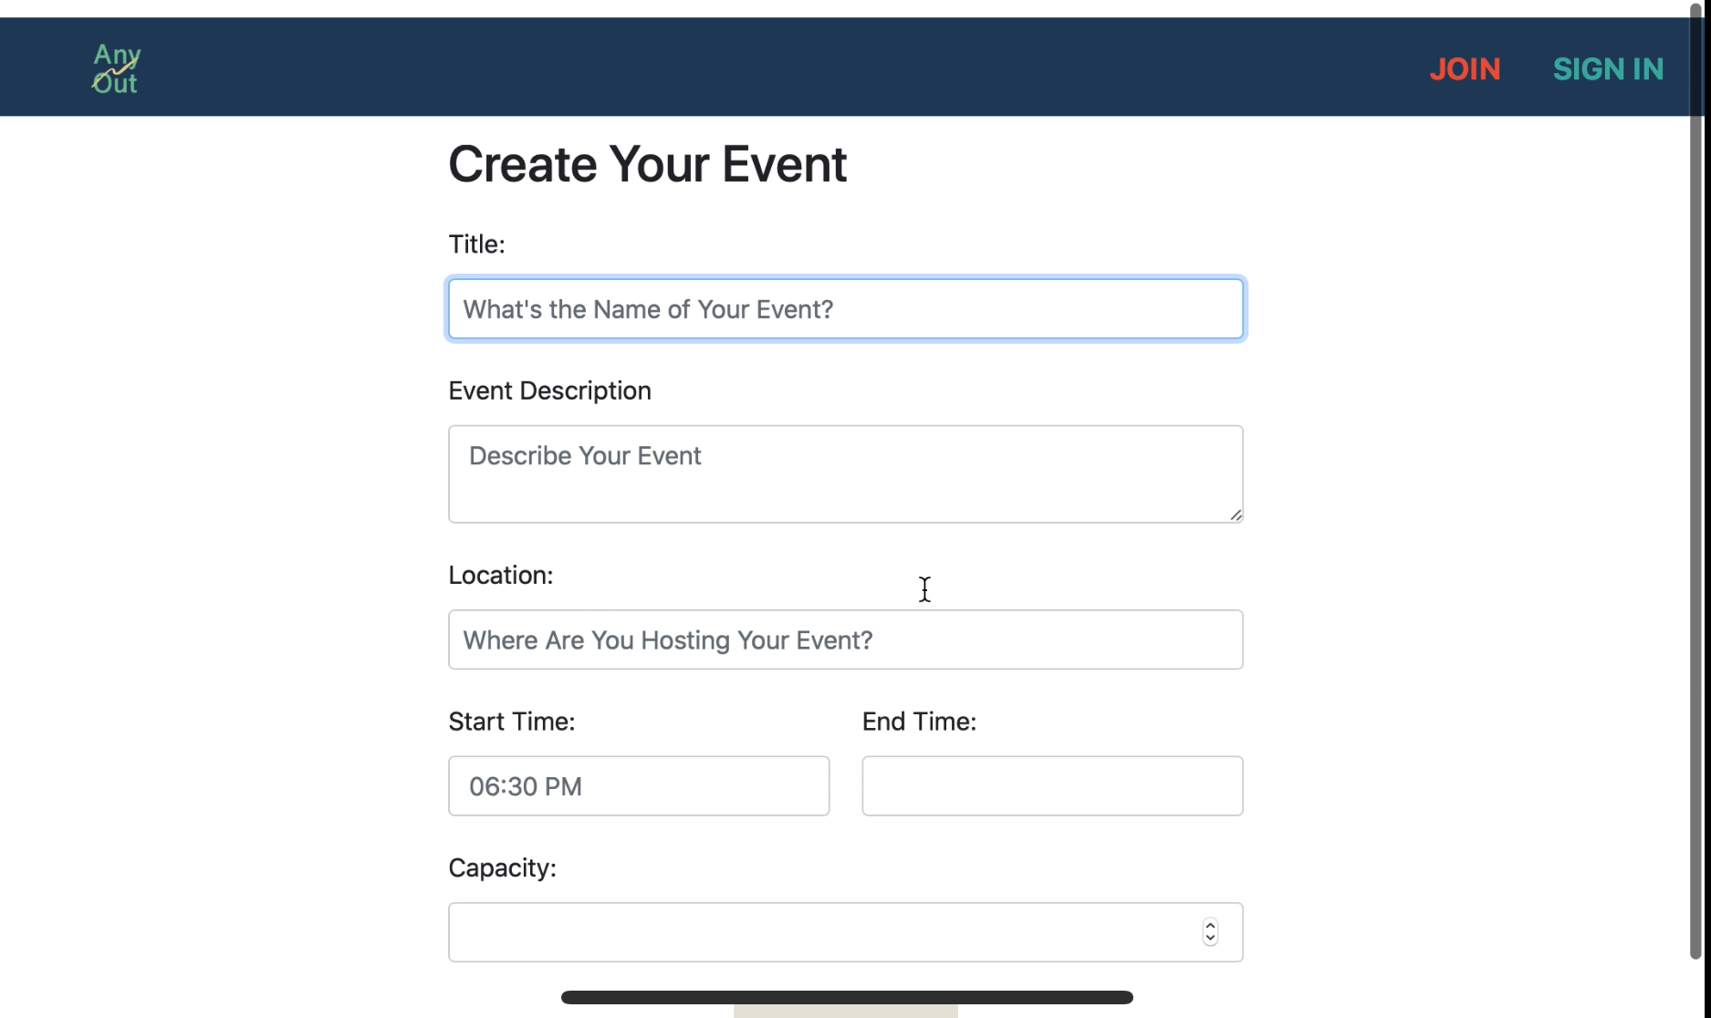
Create Events
User put the name of the event and the description of the event and all the other info into an html form. Backend will pull these and save them into database with the cookie value when the user logged in. The cookie will work as an identifier of the event creator.

Slide 8
Create Events cont.
Since we’re using Google Maps api, we are able to prompt the user when they typed in a vague location. Also, instead of saving the street name, we are saving the latitude and longitude.

Slide 9
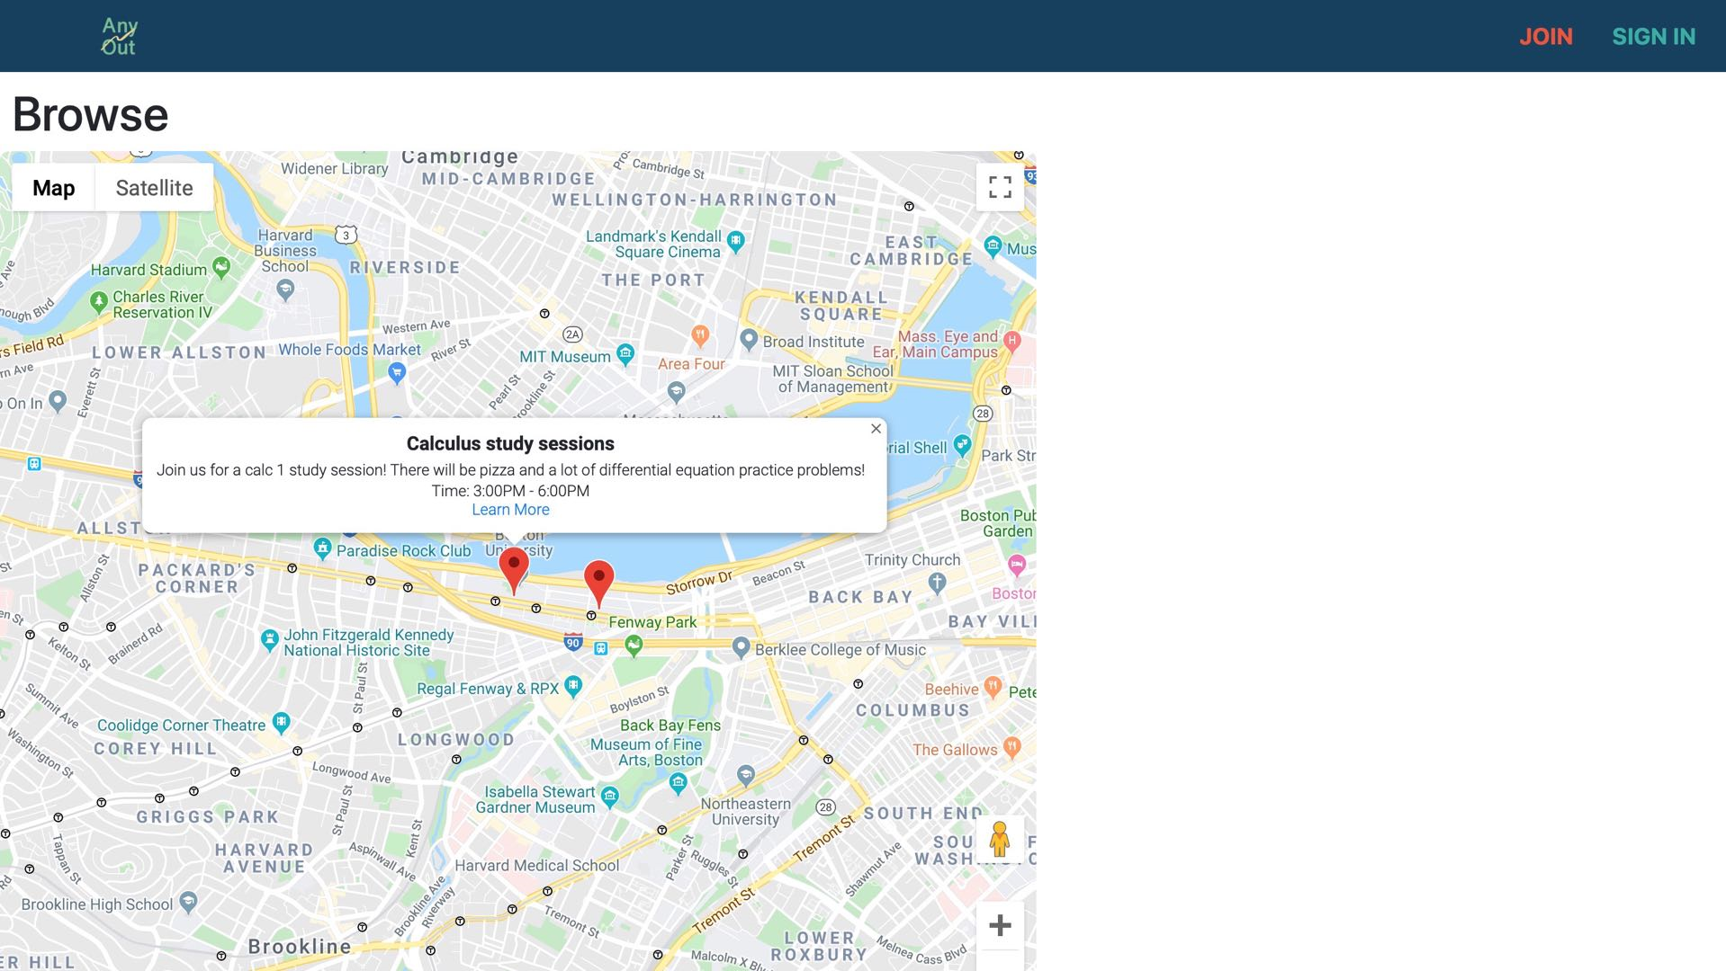
Browse Events
By using Google Maps api, we are able to pin each event based on their saved location on the map. After click on each pin, user can see the information of the event.

