Slide 1


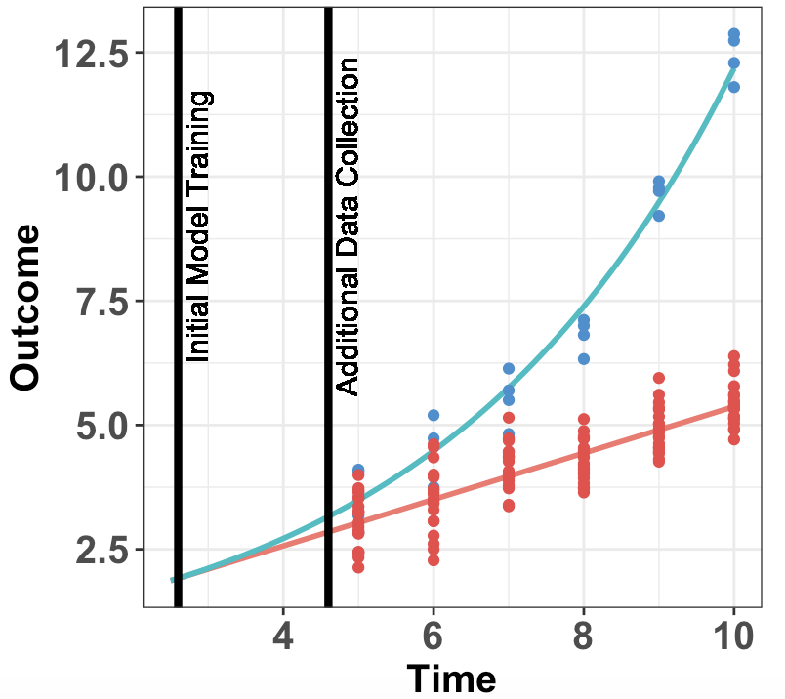
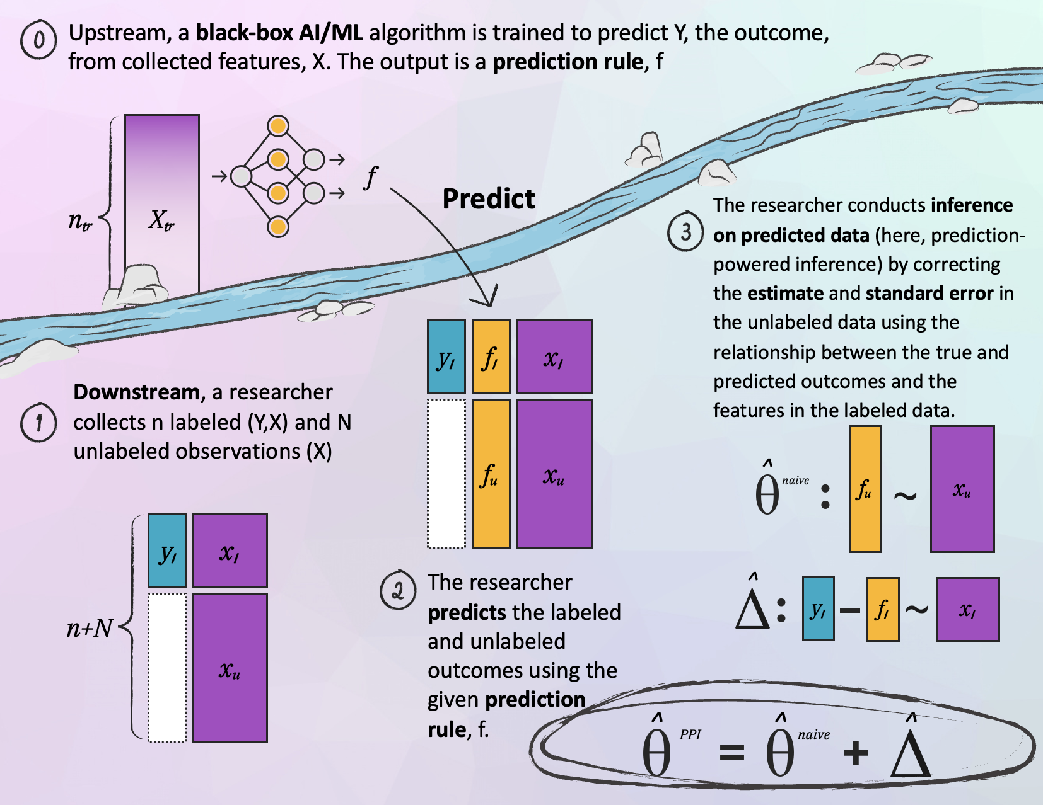
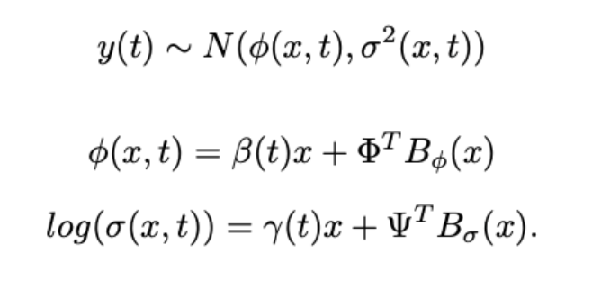
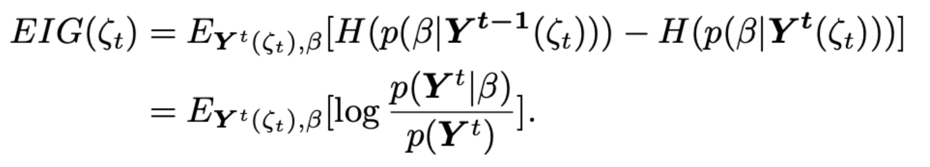
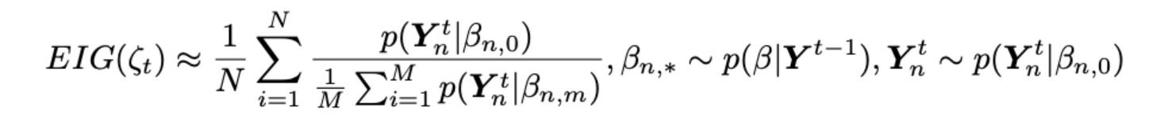
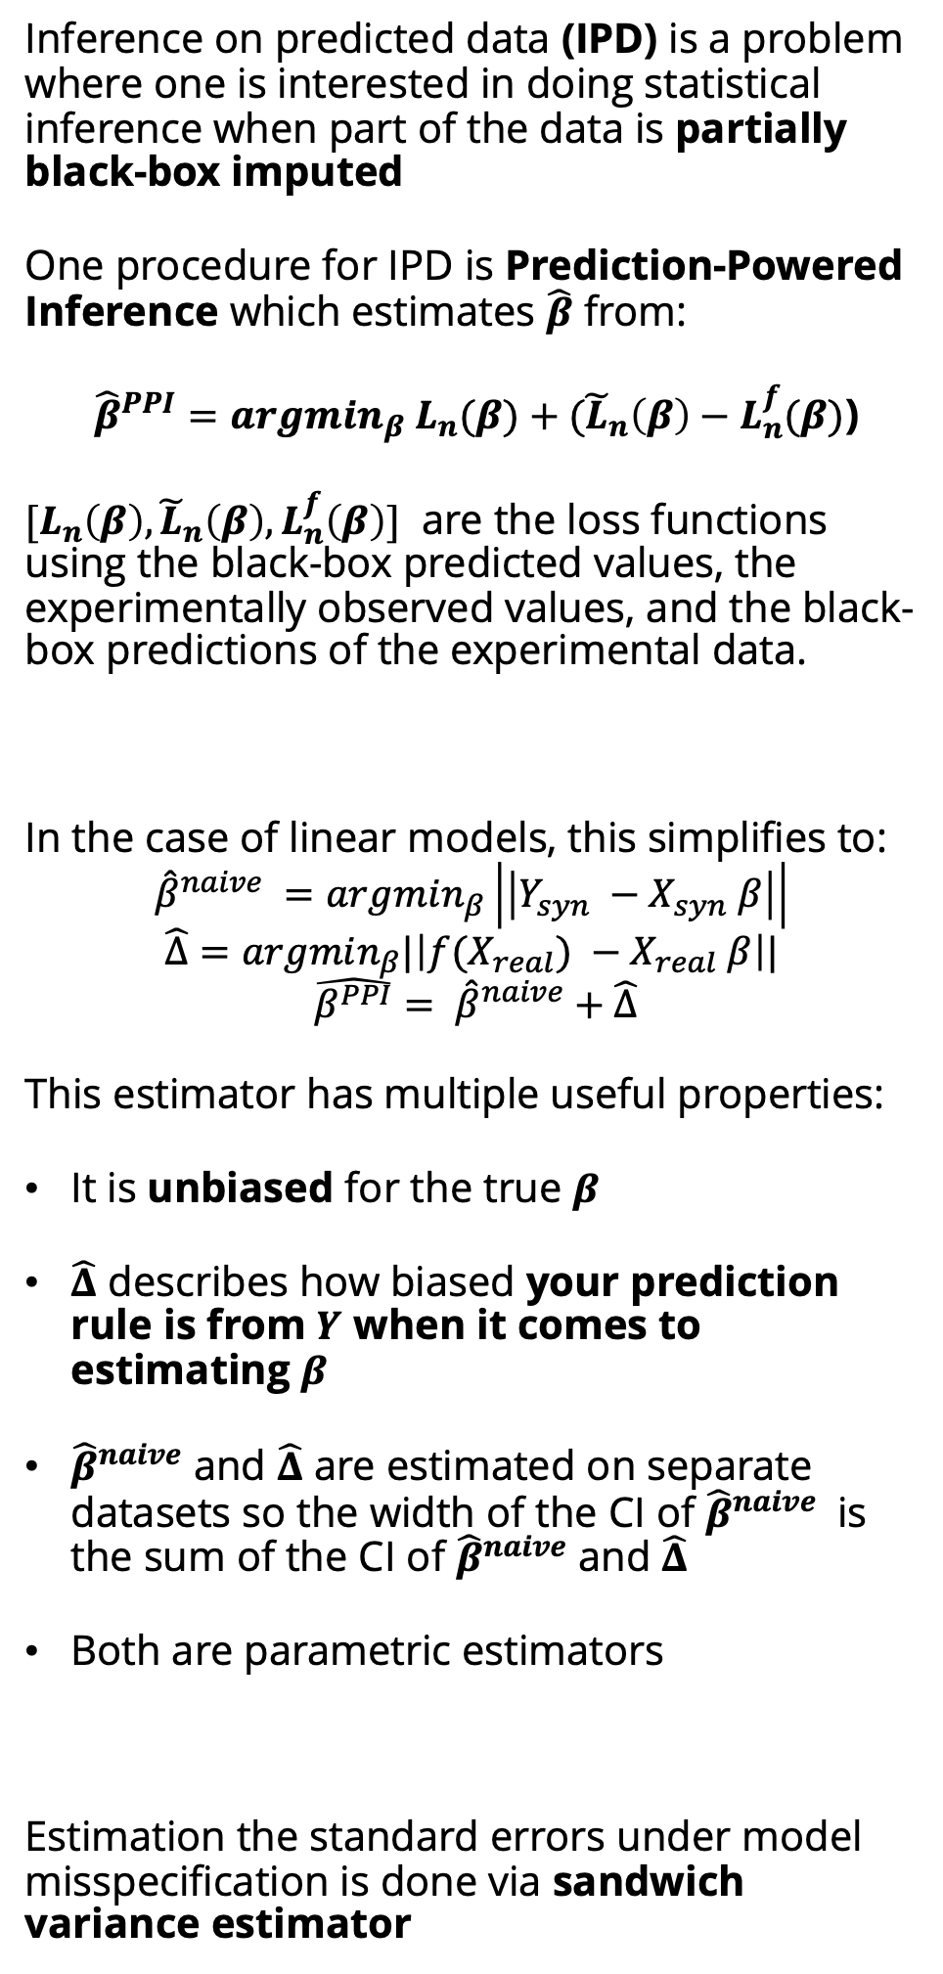
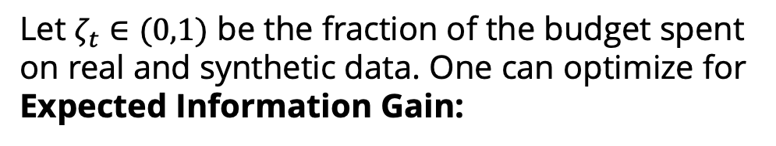
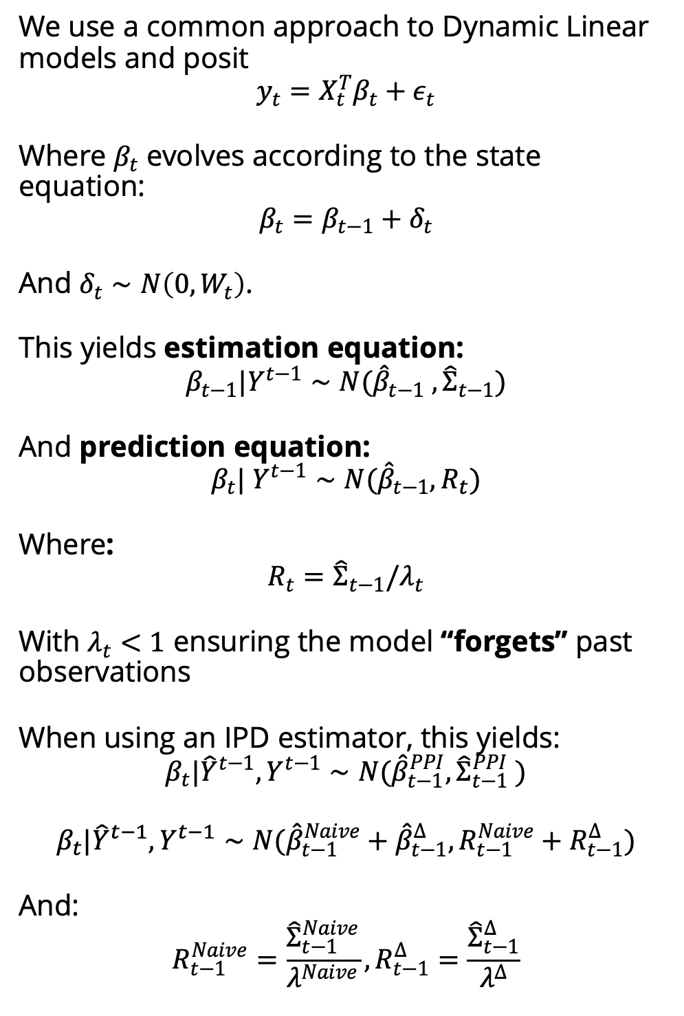
Bayesian Optimal Experimental Design of Streaming Data Incorporating Machine Learning-Generated Synthetic Data
Kentaro Hoffman¹, Tyler McCormick¹
¹ University of Washington Department of Statistics
How do we improve our experimental design when we can get samples from a black box prediction model?
Cheap or Expensive Data?
Data Type | Properties
Real Data | Accurate Expensive
Synthetic Data | Cheaper Biased
Inference on Predicted Data | Gets valid inference Improved Data Efficiency
AI models can be used to generate hard-to-measure outcomes (health events) but due to high training costs, they can’t always be kept up to date
Goal: Use Bayesian Optimal Experimental design to determine the ratio of real-to-synthetic data for a dynamic linear model using AI-imputed data
Inference on Predicted Data (IPD)
Bayesian Sandwich estimation
Bayesian Optimal Experimental Design
Finding a Bayesian analog of the sandwich variance estimator is still an open problem
One practical approach developed [1] is to use a model flexible model where the mean and variance use B-splines
Computationally fast and surprisingly accurate in real data problems
Let $ζ_{t}∈(0,1)$ be the fraction of the budget spent on real and synthetic data. One can optimize for Expected Information Gain:
Which [4] showed can be well approximated by the nested-Monte-Carlo approach:
Intuition: As we get further from the initial model training, EIG is maximized by increasing the ratio of real to synthetic data
Inference on predicted data (IPD) is a problem where one is interested in doing statistical inference when part of the data is partially black-box imputed
One procedure for IPD is Prediction-Powered Inference which estimates $\hat{β}$ from:
${\hat{β}}^{PPI}=argmin_{β} L_{n}(β)+({\tilde{L}}_{n}\left(β\right)−L_{n}^{f}(β)$)
$[L_{n}\left(β\right), {\tilde{L}}_{n}\left(β\right), L_{n}^{f}\left(β\right)]$ are the loss functions using the black-box predicted values, the experimentally observed values, and the black-box predictions of the experimental data.
In the case of linear models, this simplifies to:
$${\hat{β}}^{naive} =argmin_{β}\left|\left|Y_{syn} −X_{syn} β\right|\right|$$
$$\hat{Δ}=argmin_{β}|\left|f(X_{real}) −X_{real} β\right||$$
$$\hat{β^{PPI}}= {\hat{β}}^{naive}+\hat{Δ}$$
This estimator has multiple useful properties:
It is unbiased for the true $β$
$\hat{Δ}$ describes how biased your prediction rule is from $Y$ when it comes to estimating $β$
${\hat{β}}^{naive}$ and $\hat{Δ}$ are estimated on separate datasets so the width of the CI of ${\hat{β}}^{naive}$ is the sum of the CI of ${\hat{β}}^{naive}$ and $\hat{Δ}$
Both are parametric estimators
Estimation the standard errors under model misspecification is done via sandwich variance estimator
Future Work
Dynamic Linear Model
Trial Design for global mortality estimation
Globally, 1/3 of deaths are not given a reliable cause of death, and autopsies are often unavailable due to a lack of local resources. Alternative forms of data collection such as verbal autopsies, phone surveys, or model-based imputation exist but face a transportability bias issue. This procedure can help design more effective ways to combine on-site data collection with cheaper forms of data collection.
Bayesian Model Averaging over Rashomon sets to improve robustness
Here, we only consider the effectiveness of using one black-box imputation model, but different models can be good at different time periods (such as dynamic switching model), by combining Rashomon sets with Bayesian model averaging, we can do our inference over the set of reasonably-accurate models and improve the applicability
We use a common approach to Dynamic Linear models and posit
$$y_{t}=X_{t}^{T}β_{t}+ε_{t}$$
Where $β_{t}$ evolves according to the state equation:
$$β_{t}=β_{t−1}+δ_{t}$$
And $δ_{t}∼N\left(0,W_{t}\right)$.
This yields estimation equation:
$$β_{t−1}|Y^{t−1}∼N({\hat{β}}_{t−1} , {\hat{Σ}}_{t−1})$$
And prediction equation:
$$β_{t}| Y^{t−1}∼N({\hat{β}}_{t−1}, R_{t})$$
Where:
$$R_{t}={\hat{Σ}}_{t−1}/λ_{t}$$
With $λ_{t}<1$ ensuring the model “forgets” past observations
When using an IPD estimator, this yields:
$$β_{t}|{\hat{Y}}^{t−1},Y^{t−1}∼N({\hat{β}}_{t−1}^{PPI}, {\hat{Σ}}_{t−1}^{PPI} )$$
$$β_{t}|{\hat{Y}}^{t−1},Y^{t−1}∼N({\hat{β}}_{t−1}^{Naive}+{\hat{β}}_{t−1}^{Δ},R_{t−1}^{Naive}+R_{t−1}^{Δ})$$
And:
$$R_{t−1}^{Naive}=\frac{{\hat{Σ}}_{t−1}^{Naive}}{λ^{Naive}},R_{t−1}^{Δ}=\frac{{\hat{Σ}}_{t−1}^{Δ}}{λ^{Δ}}$$
References
[1] Adam A. Szpiro. Kenneth M. Rice. Thomas Lumley. "Model-robust regression and a Bayesian “sandwich” estimator." Ann. Appl. Stat. 4 (4) 2099 - 2113, December 2010.
[2] Anastasios N. Angelopoulos et al. Prediction-powered inference.Science 382,669-674(2023).
[3] Kentaro Hoffman, Stephen Salerno, Awan Afiaz, Jeffrey T. Leek, and Tyler H. McCormick. Do we really even need data?, 2024a. ARXIV
[4] Adam Foster, Martin Jankowiak, Eli Bingham, Paul Horsfall, Yee Whye Teh, Tom Rainforth, and Noah D. Goodman. Variational bayesian optimal experimental design. In Neural Information Processing Systems, 2019.

