Slide 1
Shamanic Meditation
Wednesday, May 13, 2020

Slide 2
78
Total Responses
Date Created: Thursday, November 07, 2019
Complete Responses: 78

Slide 3
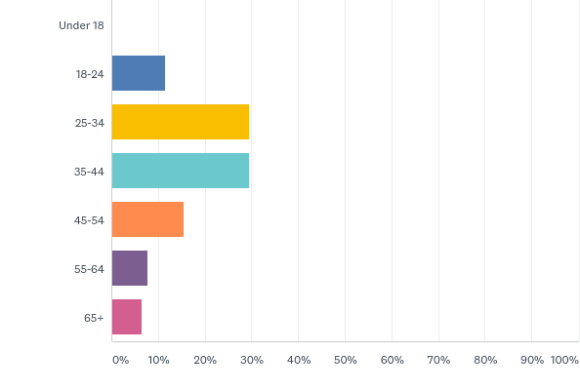
Q2: Which category below includes your age?
Answered: 78 Skipped: 0

Slide 4
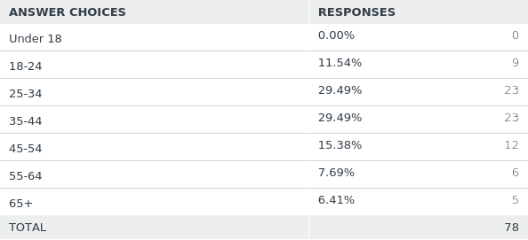
Q2: Which category below includes your age?
Answered: 78 Skipped: 0

Slide 5
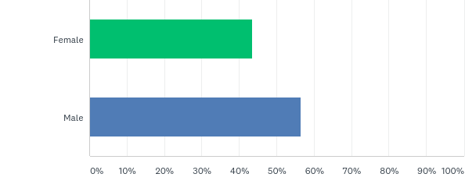
Q3: What is your gender?
Answered: 78 Skipped: 0

Slide 6
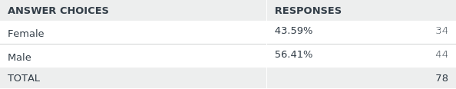
Q3: What is your gender?
Answered: 78 Skipped: 0

Slide 7
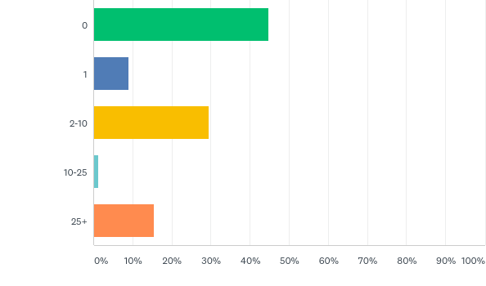
Q5: How many shamanic journeys have you had before?
Answered: 78 Skipped: 0

Slide 8
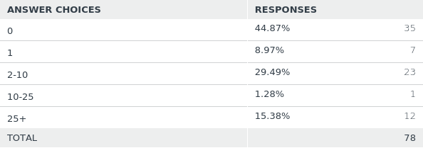
Q5: How many shamanic journeys have you had before?
Answered: 78 Skipped: 0

Slide 9
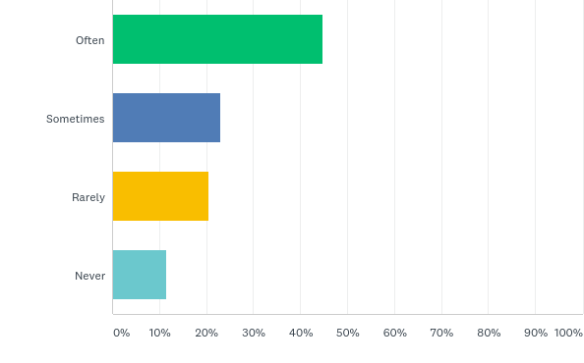
Q6: How often do you meditate?
Answered: 78 Skipped: 0

Slide 10
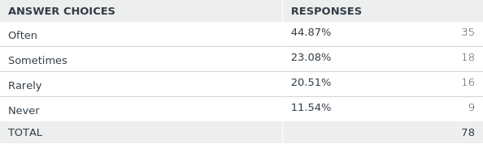
Q6: How often do you meditate?
Answered: 78 Skipped: 0

Slide 11
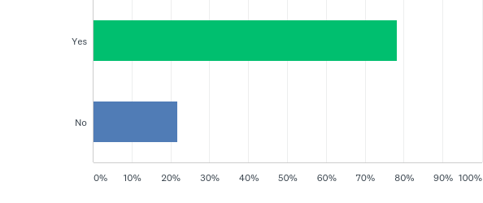
Q7: Are you going to use headphones for the listening part?
Answered: 78 Skipped: 0

Slide 12
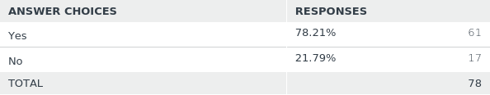
Q7: Are you going to use headphones for the listening part?
Answered: 78 Skipped: 0

Slide 13
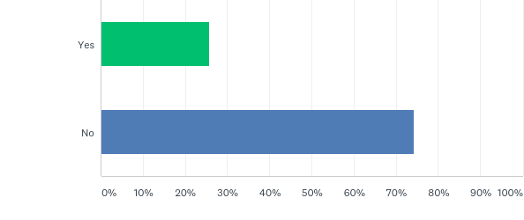
Q8: Have you used any mood altering substances including caffeine or alcohol in the last few hours?
Answered: 78 Skipped: 0

Slide 14
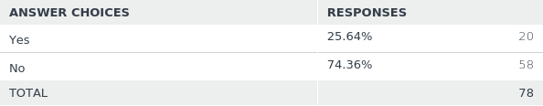
Q8: Have you used any mood altering substances including caffeine or alcohol in the last few hours?
Answered: 78 Skipped: 0

Slide 15
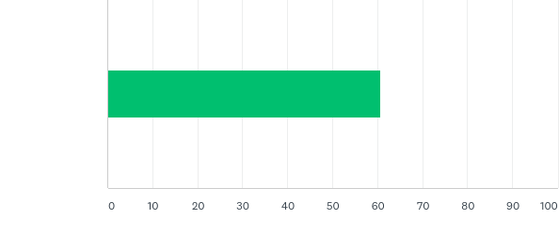
Q9: How focused do you feel now?
Answered: 78 Skipped: 0

Slide 16

Q9: How focused do you feel now?
Answered: 78 Skipped: 0

Slide 17
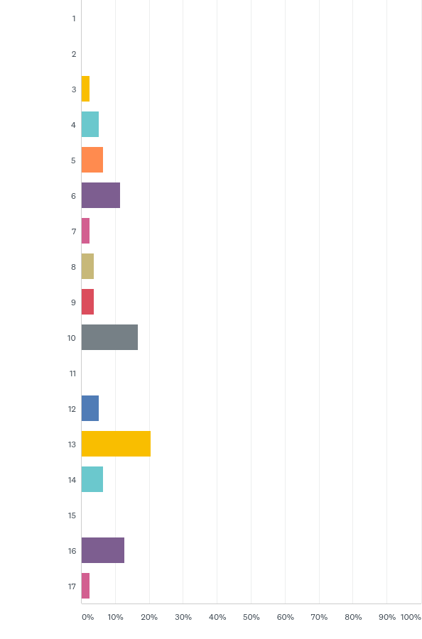
Q10: Choose a number from the circle below to indicate how you feel:
Answered: 78 Skipped: 0

Slide 18
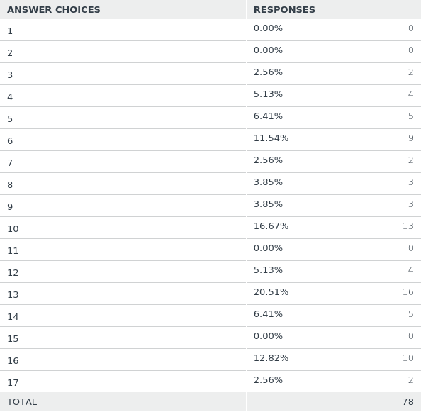
Q10: Choose a number from the circle below to indicate how you feel:
Answered: 78 Skipped: 0

Slide 19
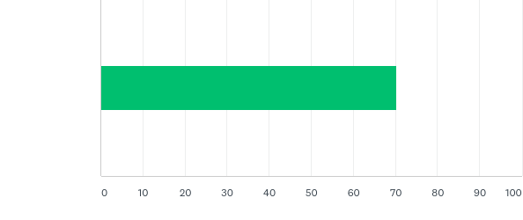
Q11: How focused do you feel now?
Answered: 78 Skipped: 0

Slide 20

Q11: How focused do you feel now?
Answered: 78 Skipped: 0

Slide 21
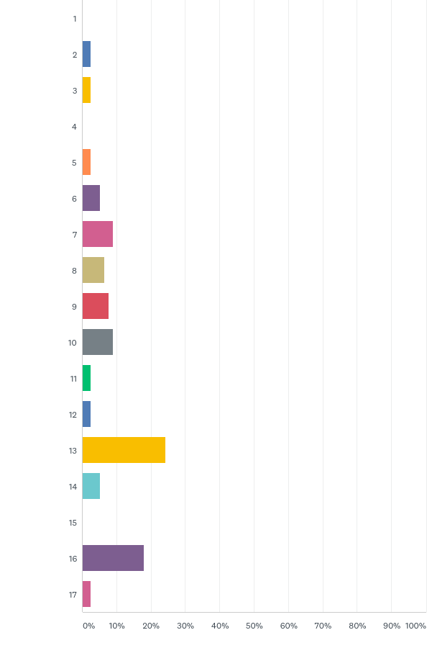
Q12: Choose a number from the circle below to indicate how you feel:
Answered: 78 Skipped: 0

Slide 22
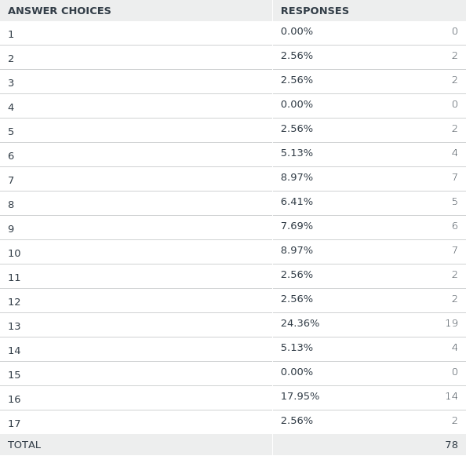
Q12: Choose a number from the circle below to indicate how you feel:
Answered: 78 Skipped: 0

Slide 23
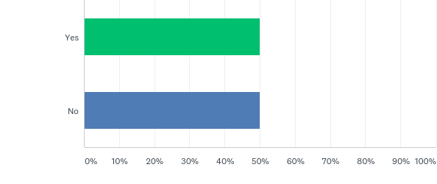
Q13: Did you receive any clarification on your question?
Answered: 78 Skipped: 0

Slide 24
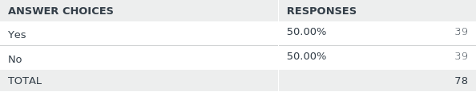
Q13: Did you receive any clarification on your question?
Answered: 78 Skipped: 0

Slide 25
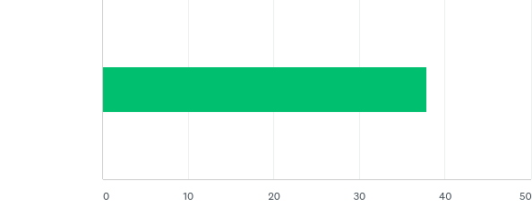
Q14: How easy was it to focus on the most repetitive, monotone rhythms?
Answered: 78 Skipped: 0

Slide 26

Q14: How easy was it to focus on the most repetitive, monotone rhythms?
Answered: 78 Skipped: 0

Slide 27
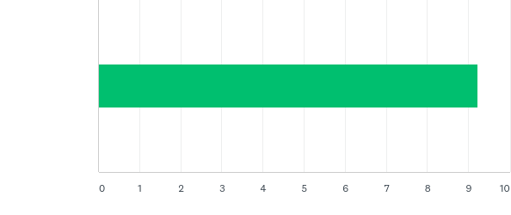
Q15: In which part of the soundscape were you the most focused?
Answered: 78 Skipped: 0

Slide 28

Q15: In which part of the soundscape were you the most focused?
Answered: 78 Skipped: 0

Slide 29
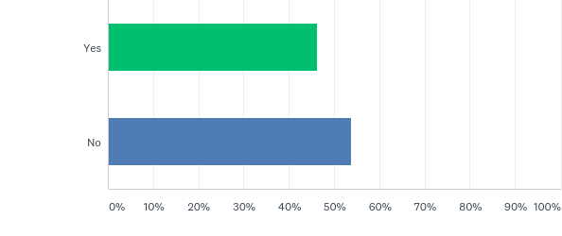
Q16: Did you have visual imagery?
Answered: 78 Skipped: 0

Slide 30
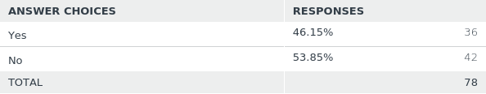
Q16: Did you have visual imagery?
Answered: 78 Skipped: 0

