Slide 1





DESIGN PATTERN
ITERATOR
24A02 - Group 11 - 3rd pattern

Slide 2





Problem
Imagine you have a collection of your favorite songs (around 1000 songs).
On one day, you want to listen in Alphabetic order.
On the next day, you want to listen in popularity order.
On the other day, you want to listen in songs’ length order.

Slide 3

Problem
On a boring day, you just want to spam the order button (toggle between Alphabetic order, popularity order, length order,…).
How would the app developers solve this problem so that their app would’t crash?

Slide 4




Naive solution
Luckily, the music app developers are very good in DSA, so they implemented a very fast sorting algorithm and well-structured data structures.

Slide 5
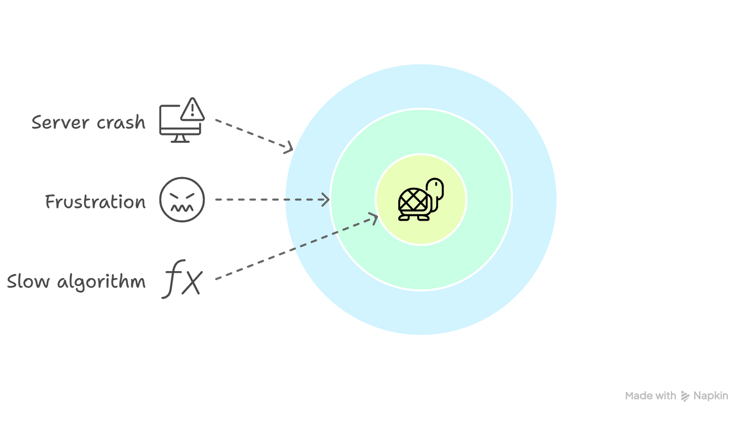

New problem !

Slide 6
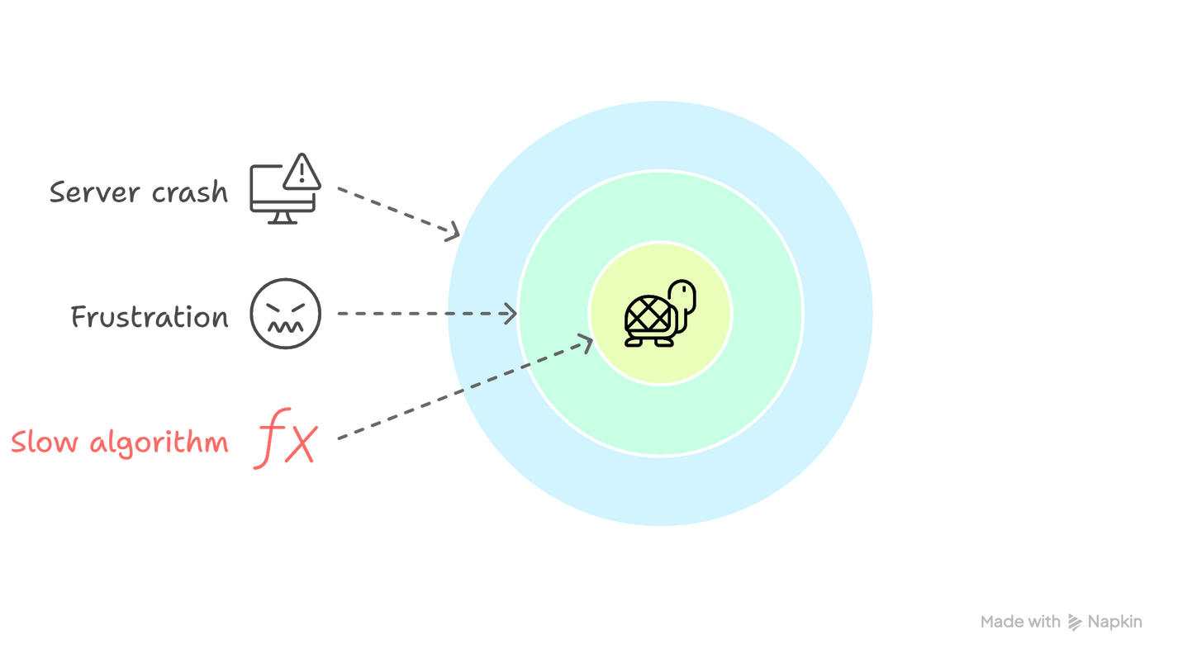
New problem !
For simplicity, let's assume each comparison takes 1 microsecond each comparison and 1 microsecond to swap. So in the worst-case scenario, the sorting algorithm takes around 2 seconds each time you change the order.

Slide 7
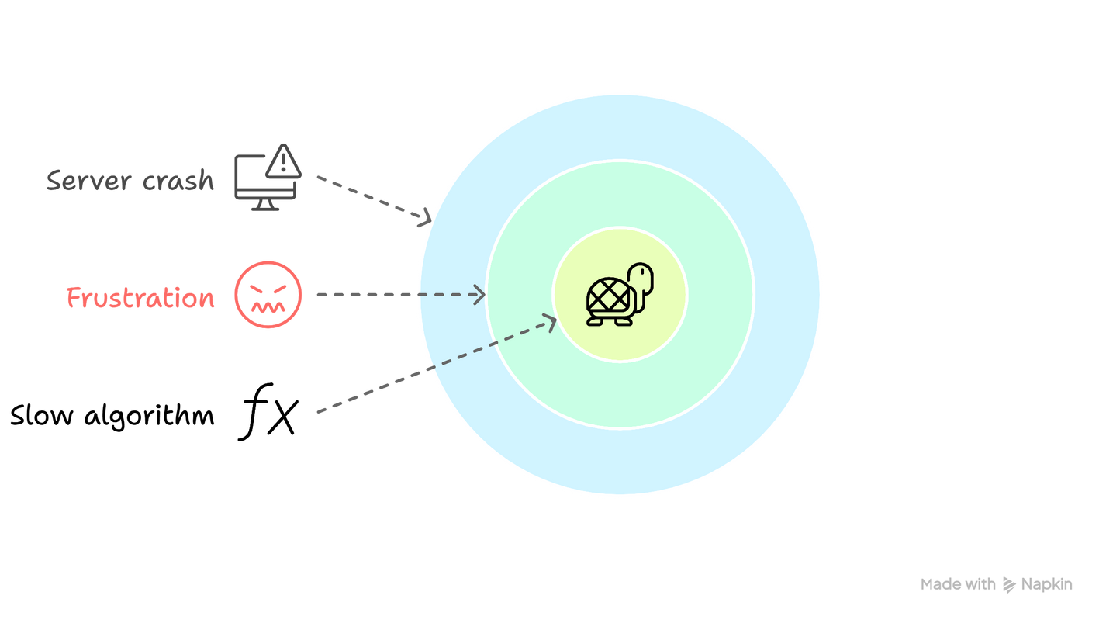
New problem !
2 seconds is too much for you to spam to alleviate your boredom! That makes you frustrated!

Slide 8
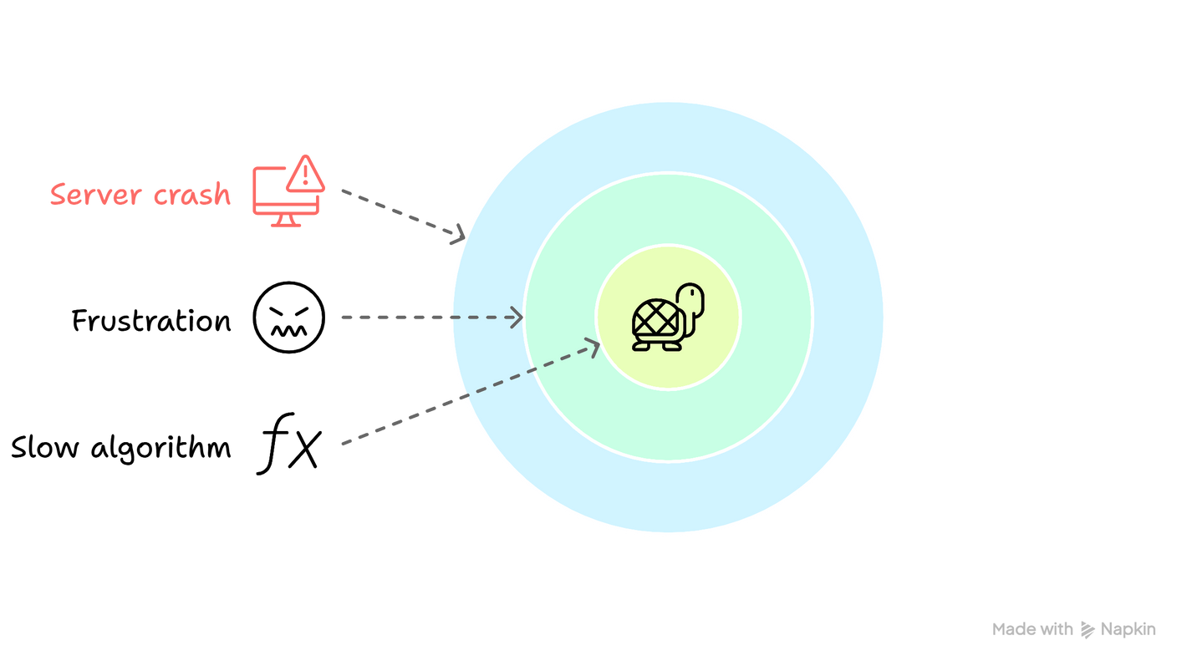
New problem !
Furthermore, the music app does not serve only you, it serves millions of people! The server may crash if you just sort the collection everytime the user wants. What is more, not all orders use the same data structure!

Slide 9
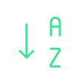





New approach
Just “Iterate” It!
There is a way to tackle this problem: give the user an iterator for each order!
If they want alphabetical order, give them alphabetical iterator
If they want length order, give them length iterator
If they want popularity order, give them popularity iterator

Slide 10

But what is an
Iterator?

Slide 11

The Iterator design pattern is a behavioral design pattern that provides a way to access the elements of an aggregate object (e.g. a list) sequentially without exposing its underlying representation.

Slide 12
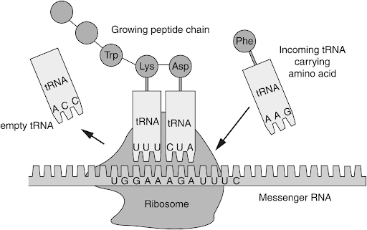
It defines a separate object, called an iterator, which encapsulates the details of traversing the elements of the aggregate, allowing the aggregate to change its internal structure without affecting the way its elements are accessed.
Ribosome inside our cell is also an iterator

Slide 13




You could imagine it as a librarian. She knows how to navigate (iterate) through the library and find the book you want, without revealing you how the books are organized (which you don’t need to know).

Slide 14
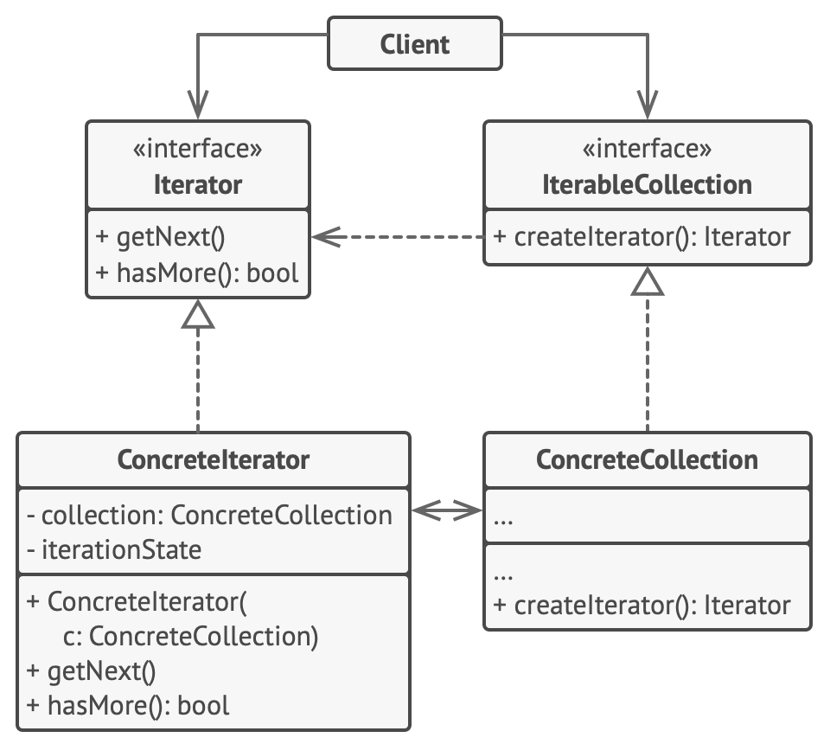


General class diagram

Slide 15
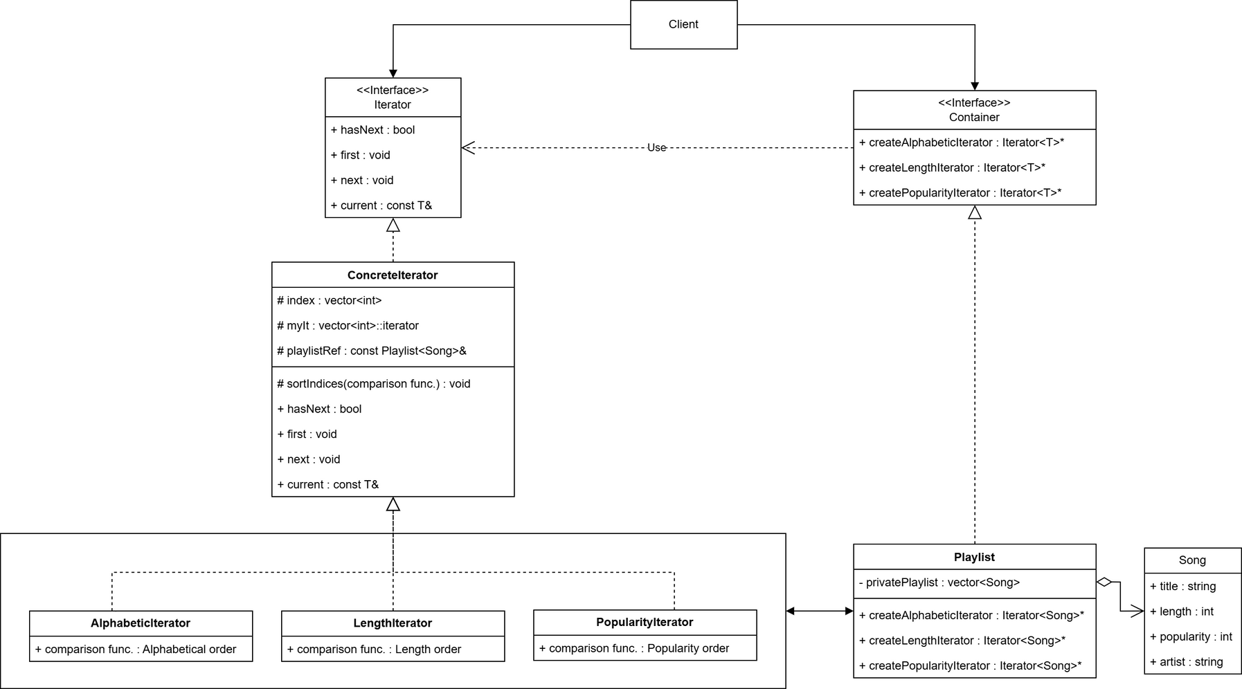
Class diagram

Slide 16



IMPLEMENTATION

Slide 17
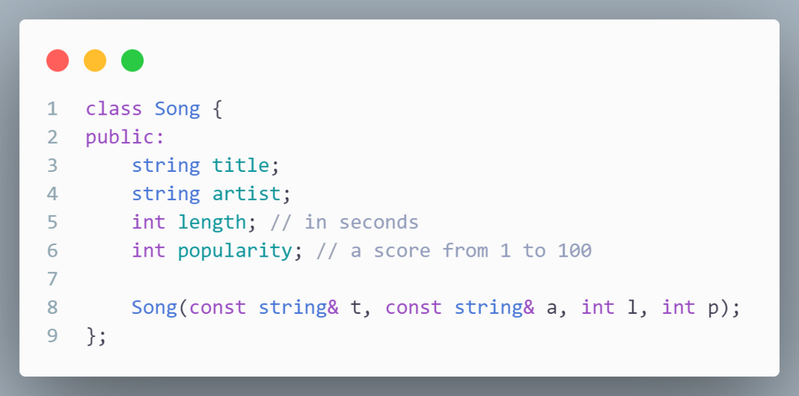
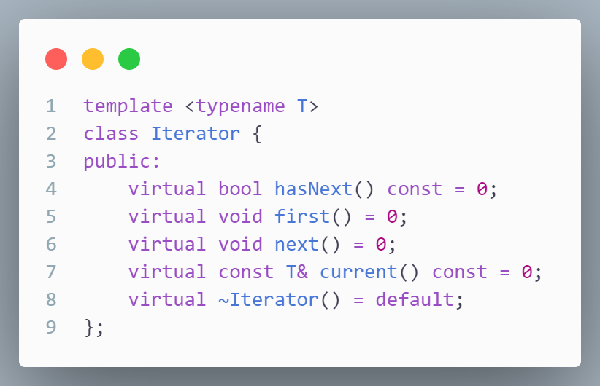
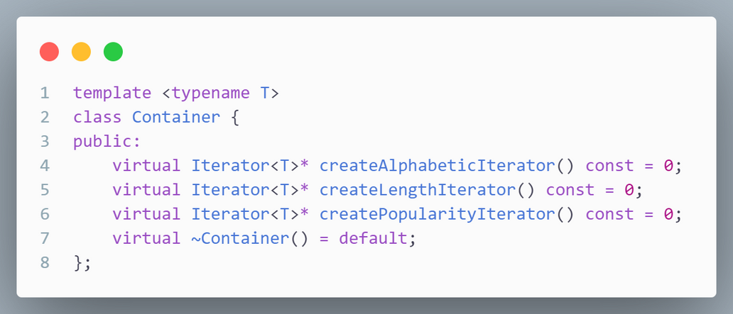
CLASS DECLARATION

Slide 18
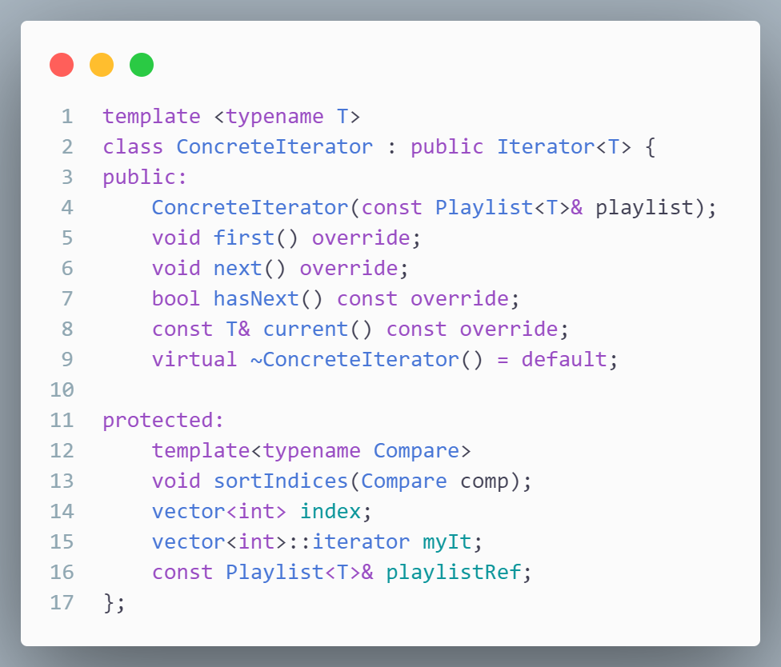
This is the concrete iterator class that implemented from the interface iterator
first() will move our iterator to the first element of the array
next() will move the iterator to the next element
hasNext() return true if the iterator is not at the end of the array and vice versa
And current() return the element of the array at which it is staying

Slide 19
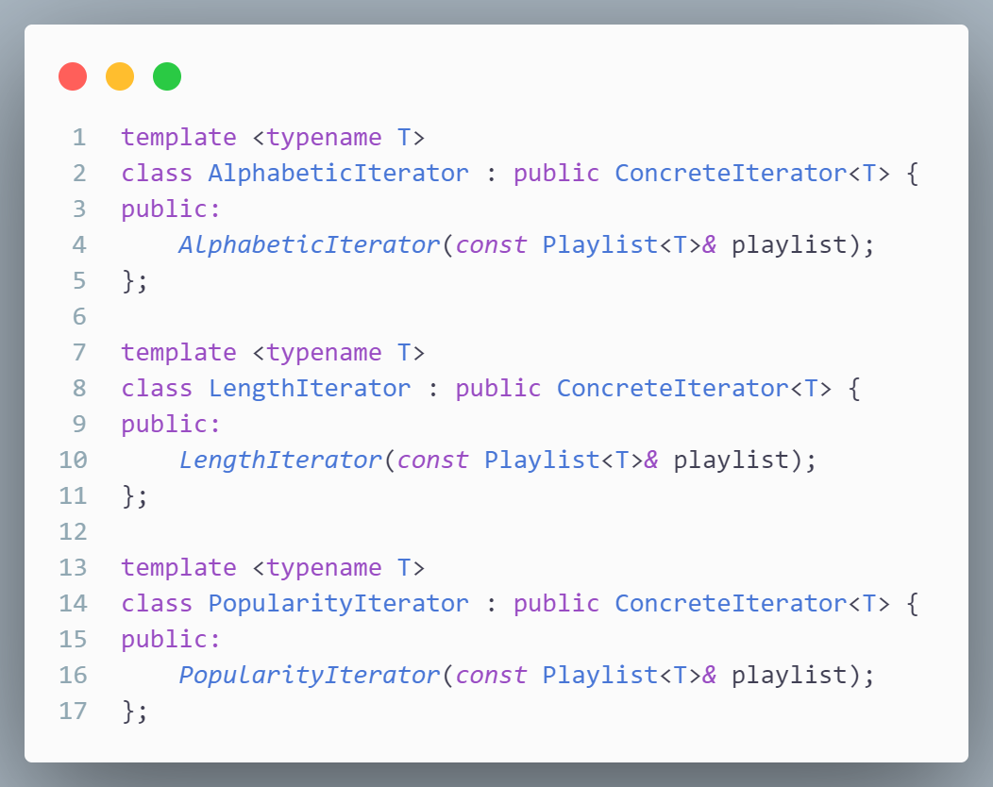
These are iterators inherited from Concrete Iterator
The sorting algorithms are added to these iterators inside their constructors

Slide 20
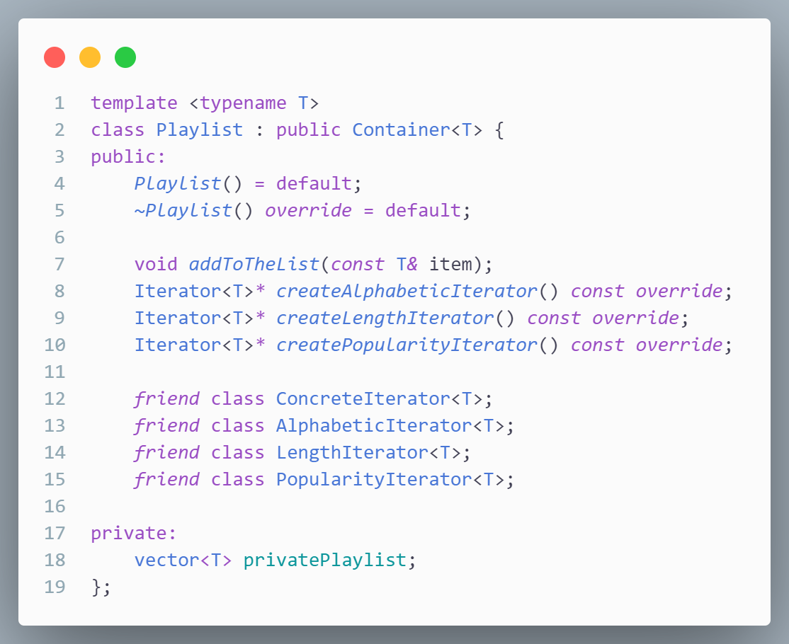
This is the Playlist class inherited from Container
It has 3 iterators, each for a traverse mode that we want
We also declare friend from those iterator so that they can access our collection (privatePlaylist)

Slide 21
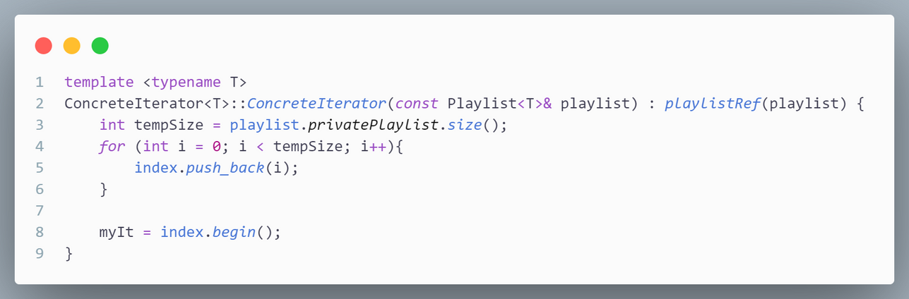
This is the implementation of Concrete Iterator constructor
It stores the reference of the privatePlaylist (Playlist’s member)
It also set the index for every element in the collection
Finally, it sets itself to point to the beginning of the colection

Slide 22
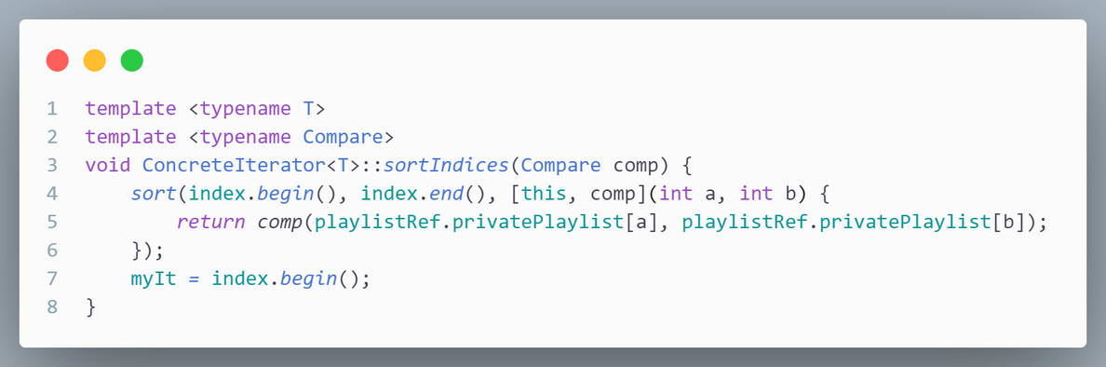
This is the sorting “blueprint” for later sorting logic.
Later, when you pass the comparison for sorting, it will sort the index array
Note that this will sort the index array (ConcreteIterator’s member), not privatePlaylist (Playlist’s member)

Slide 23
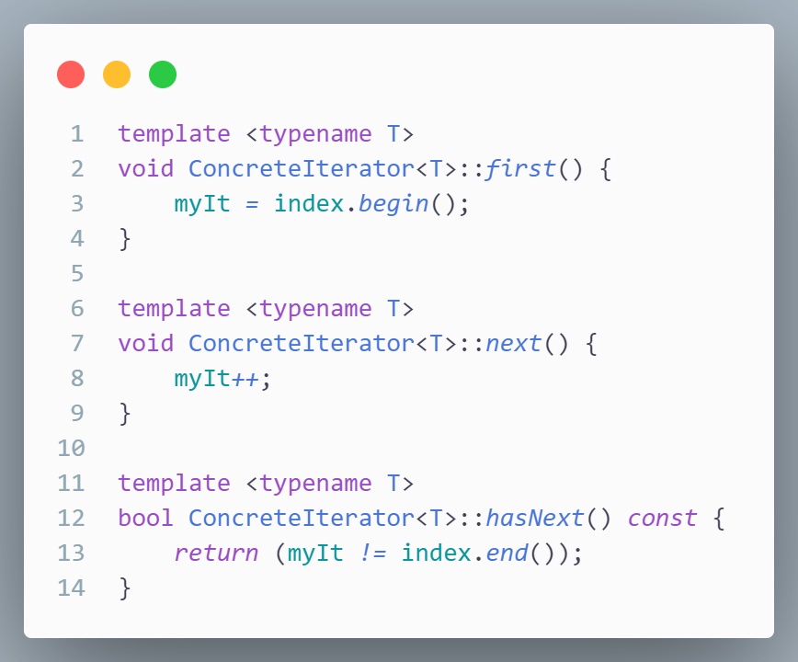
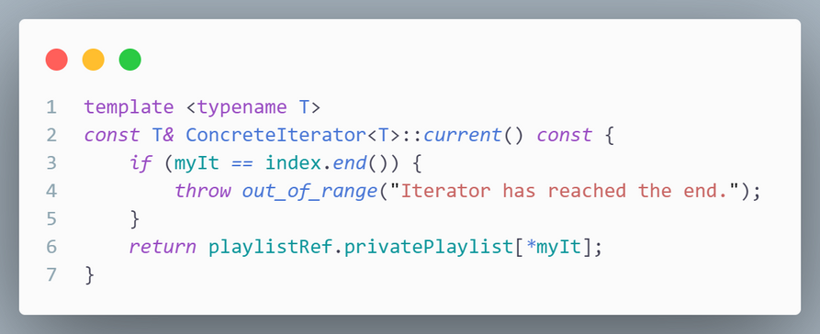
These are functions that we use to move our iterator or get the data that it is pointing to

Slide 24
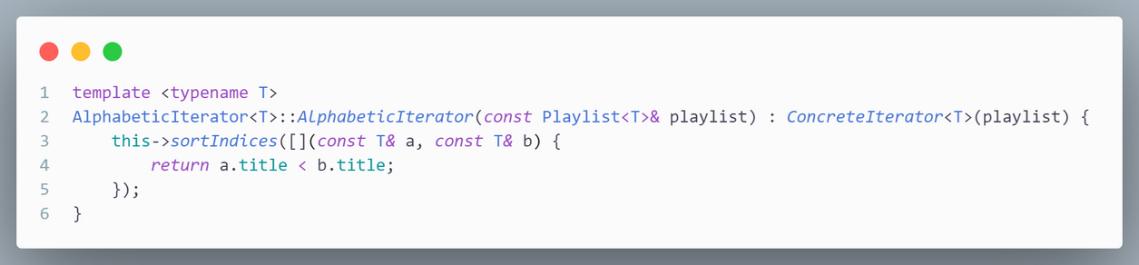
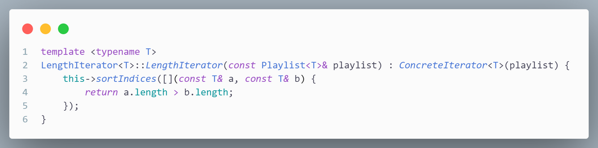
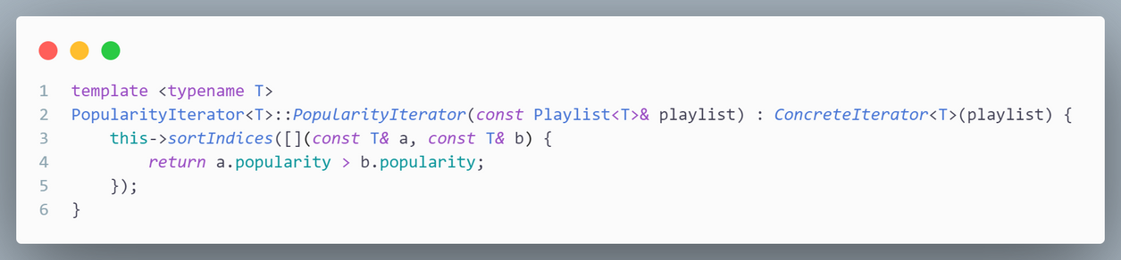
These are the constructors of our 3 iterators
We pass the comparison logic here so that the sorting algorithm can run.
AlphabeticIterator sort the index array in alphabetic order
LengthIterator sorts the index array in length order, from shortest to longest
PopularityIterator sorts the index array in popularity order, from least to most

Slide 25
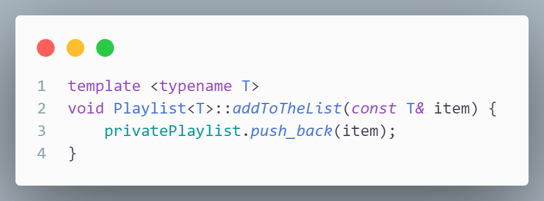
This is the function we use to add elements to our Playlist

Slide 26
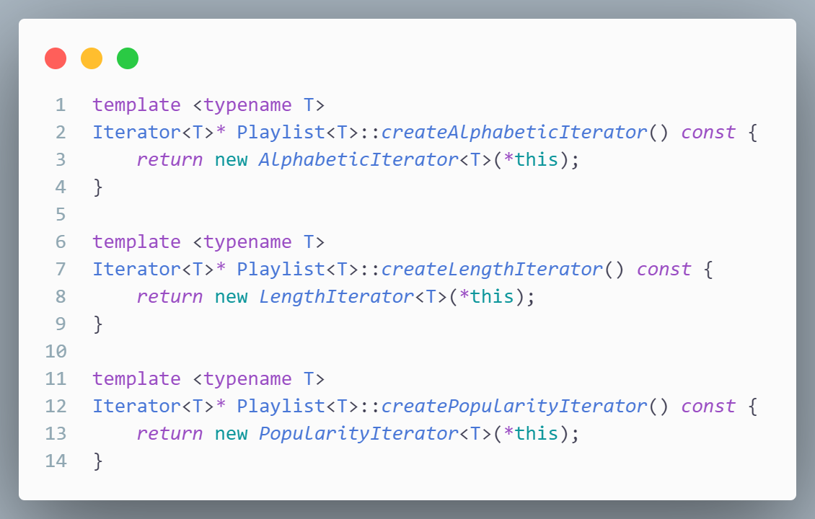
And these are functions that create iterators inside Playlist

Slide 27
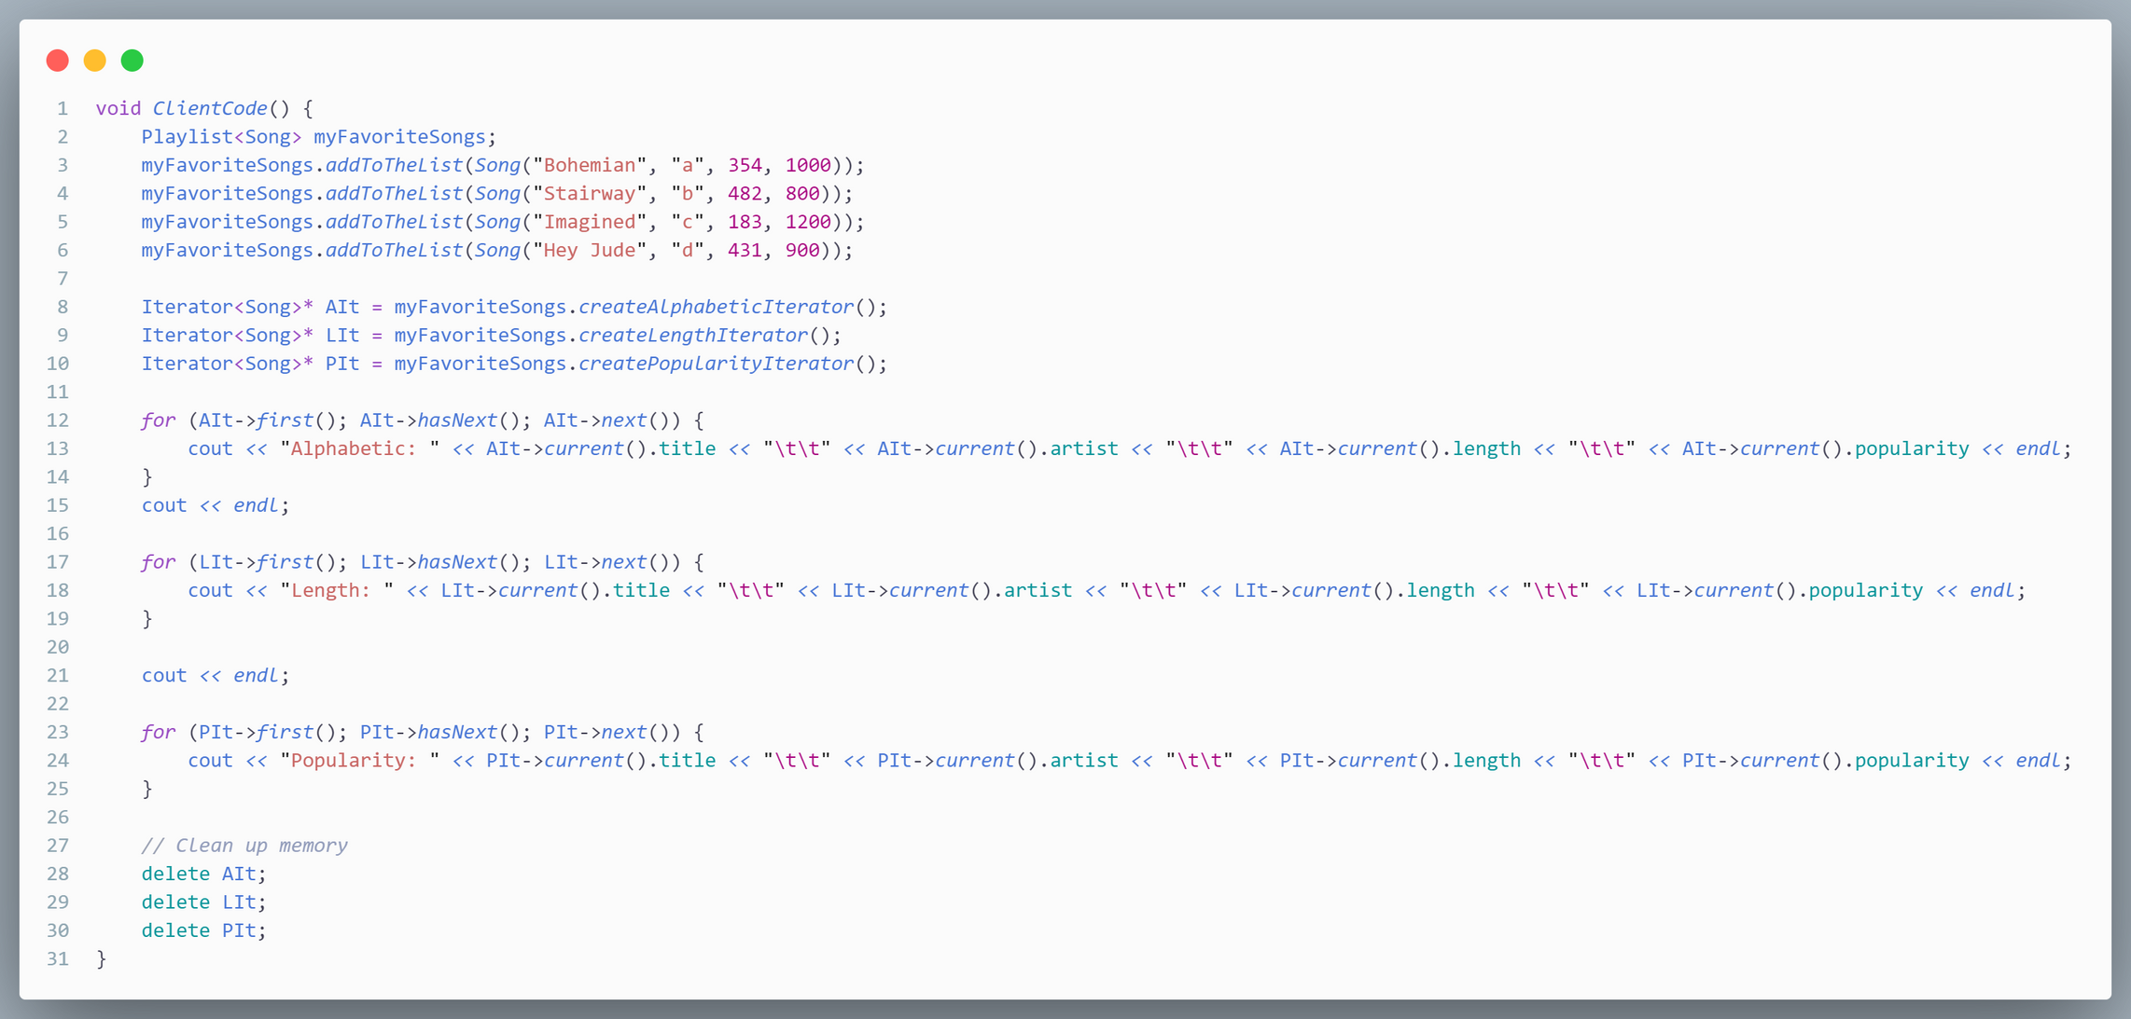
Client code

Slide 28
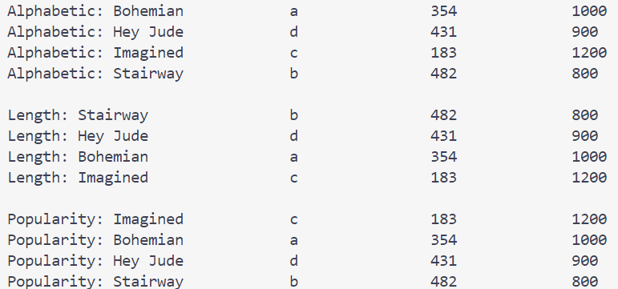
Client code

Slide 29
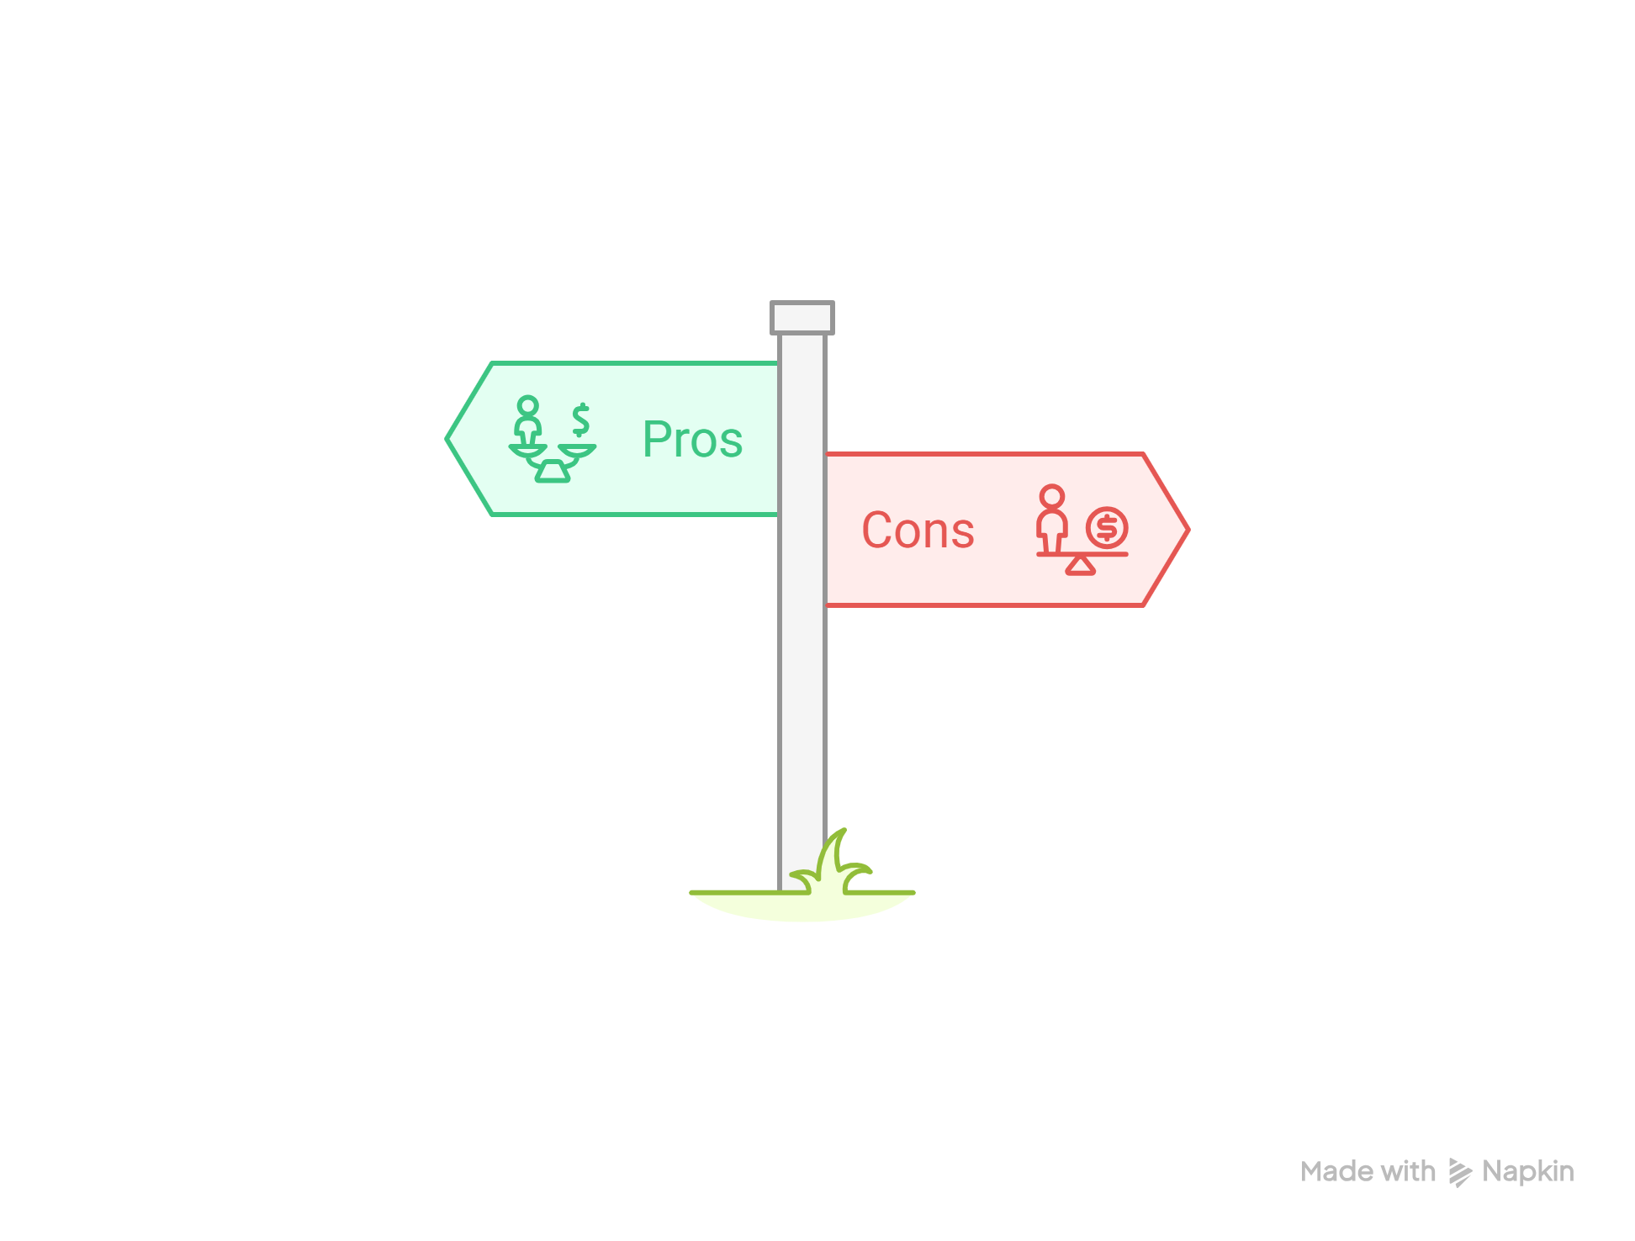
CONS
PROS & CONS
PROS

Slide 30
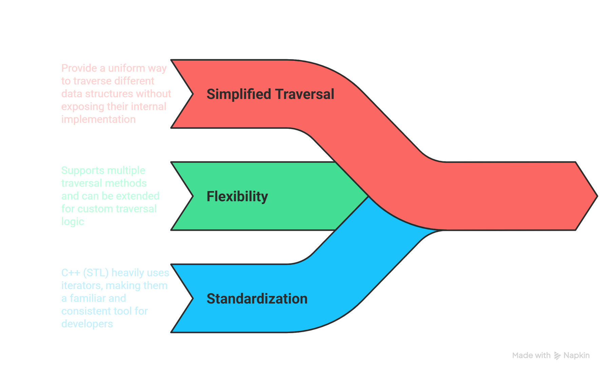
CONS
PROS & CONS
PROS

Slide 31
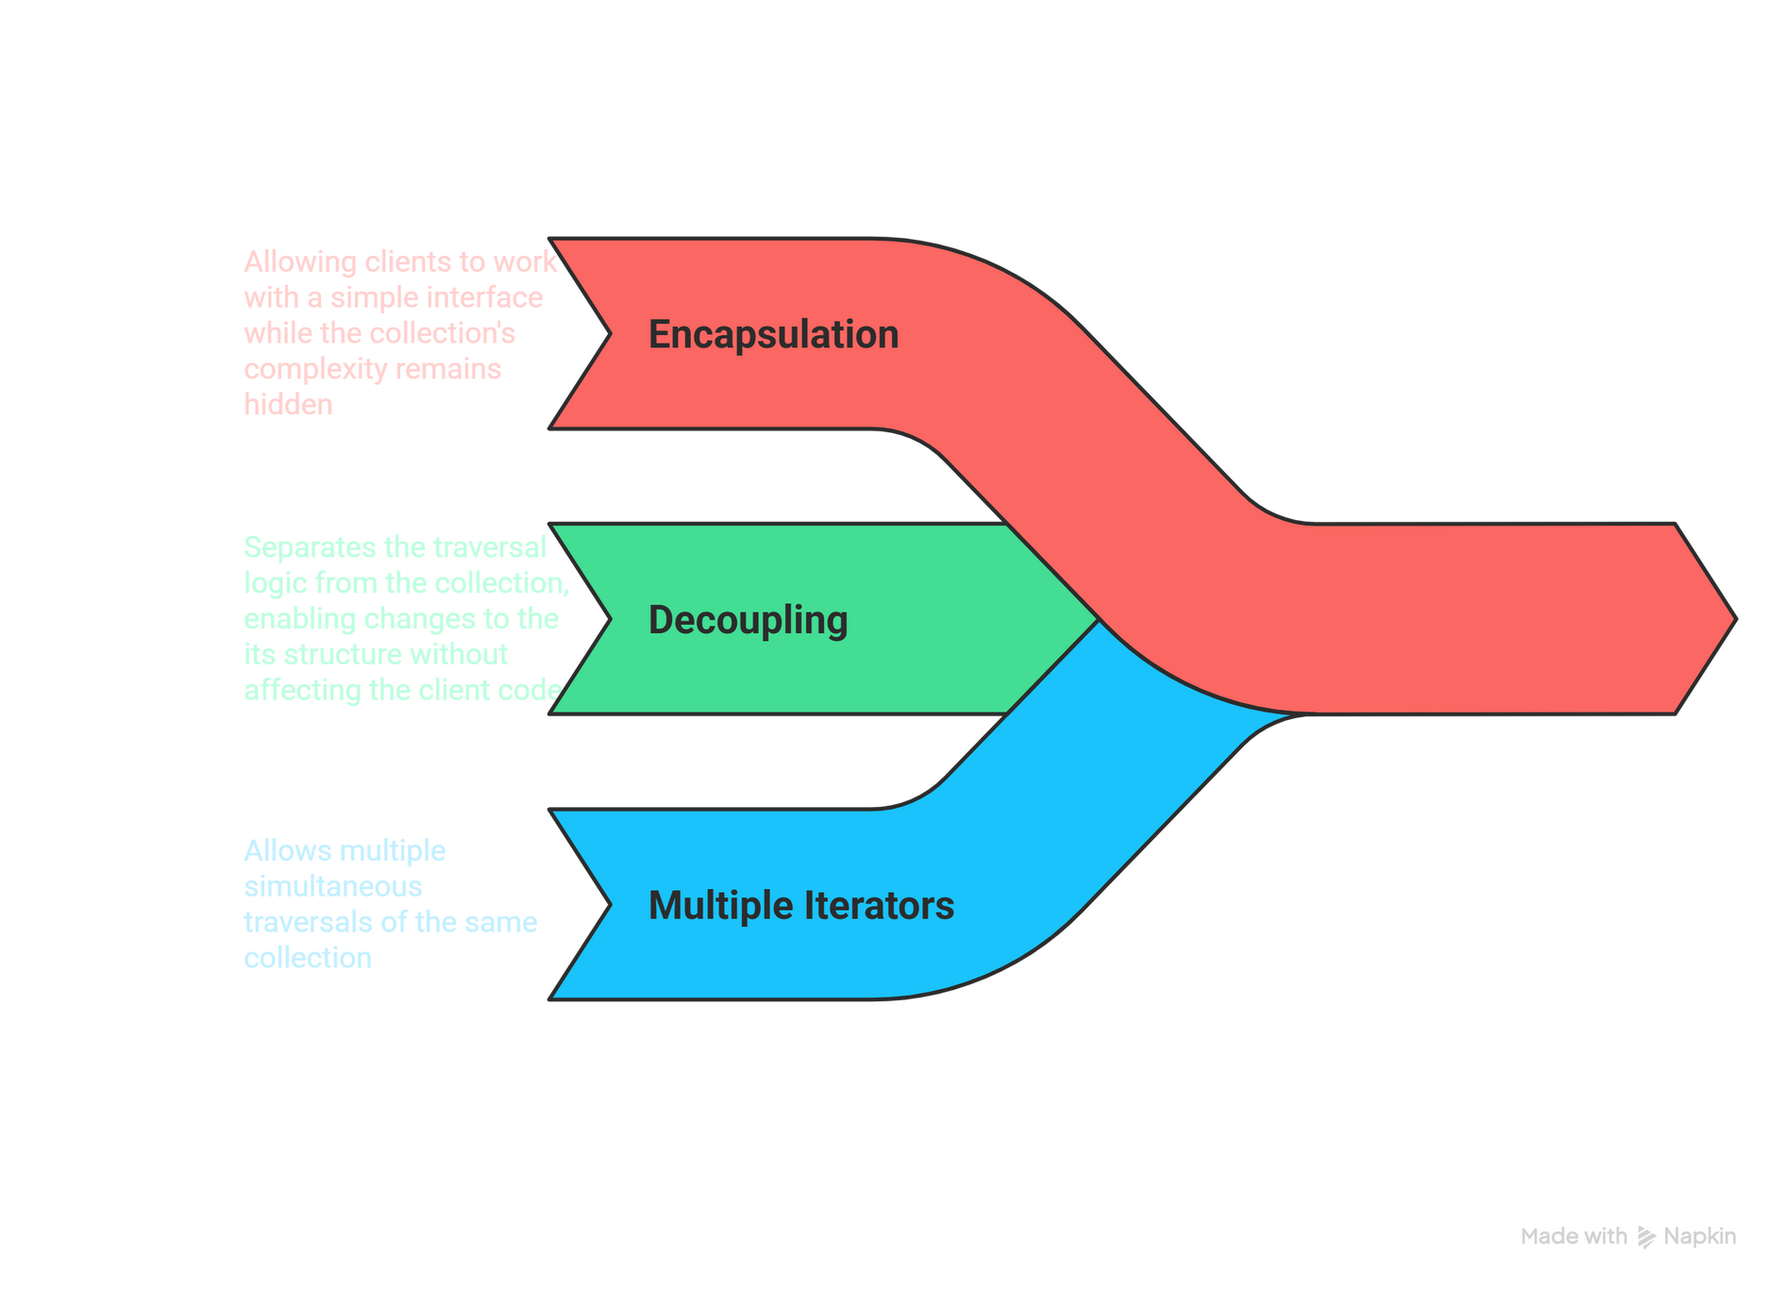
CONS
PROS & CONS
PROS

Slide 32
CONS
PROS & CONS
PROS

Slide 33
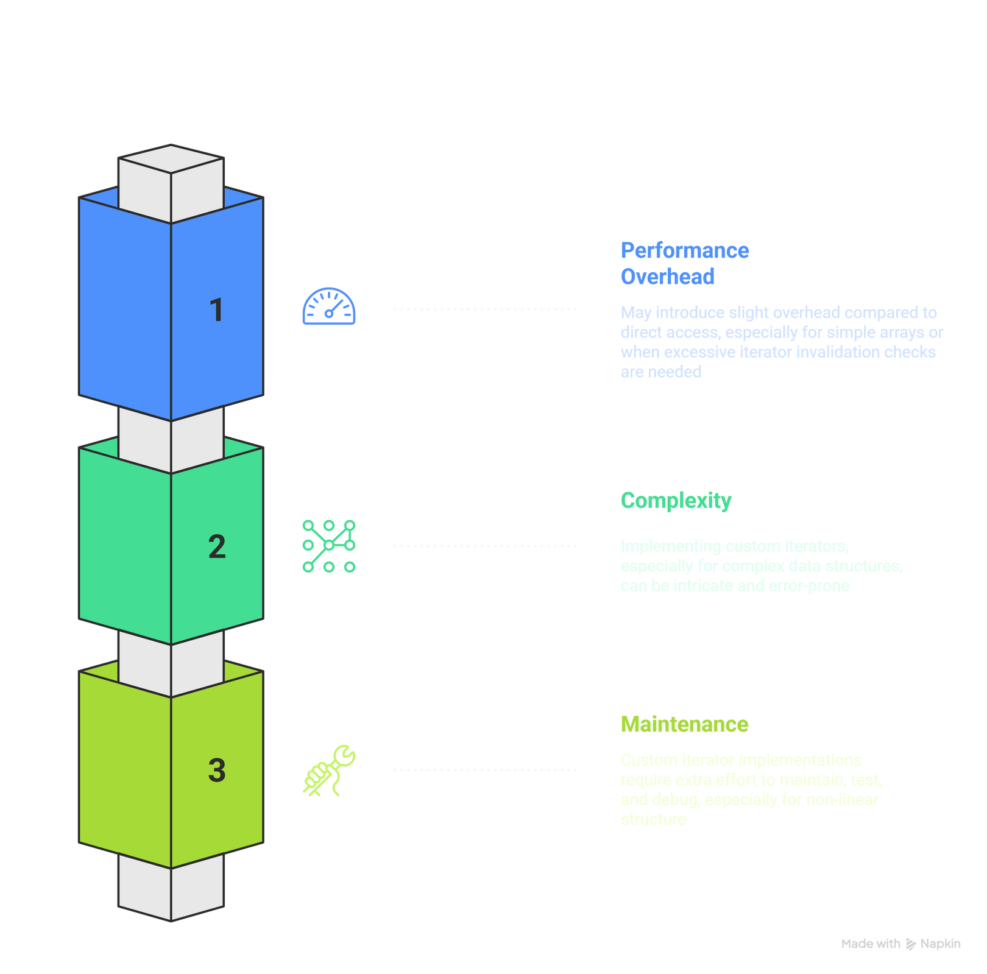
PROS & CONS
PROS
CONS

Slide 34

Real-world
Application

Slide 35

Iterator pattern can be used to traverse a list of user posts
A PostIterator allows the frontend to fetch and display posts one by one, regardless of the backend storage
Web
Development

Slide 36

Iterator pattern can be used to navigate a gallery of images
A GalleryIterator lets the app swipe through images stored in different formats, providing a seamless user experience without exposing the storage details
Mobile app
Development

Slide 37
Reference
https://refactoring.guru/design-patterns/iterator
https://refactoring.guru/design-patterns/iterator/cpp/example
Full code at:
https://github.com/khoiLearnsToCode/CS202-Group3-Seminar.git

