Slide 1


Intro to R
Khoi Trinh
OU Data Science and Analytics Institute
Secretlab
khoitrinh@ou.edu

Slide 2
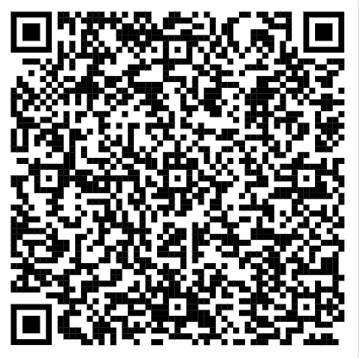
Emma told me to put this slide in

Slide 3
Agenda
Introduction and Setup
R and RStudio
Some light R programming

Slide 4
Who Am I???
Khoi Trinh
Phd Student (hopefully Candidate soon)
SecretLab with Dr. Maiti
Data Science in GenAI and Web3
Backend and API dev at ScooterLab
Notes:
Statically typed: type of a variable is known at compile time, in some languages, need to specify the type (int, char, string, etc.)
Dynamically typed: type is associated with run-time values, can make coding a bit faster

Slide 5
Why (and why not) R?
WHY:
FREE!
Open-source
Many packages
R-markdown
Personally, dynamically typed
WHY NOT:
Syntax can be confusing
Many packages -> option paralysis
Frequent updates (if it ain’t broke, don’t fix it)
Notes:
Statically typed: type of a variable is known at compile time, in some languages, need to specify the type (int, char, string, etc.)
Dynamically typed: type is associated with run-time values, can make coding a bit faster

Slide 6
R and RStudio
Download and install R BEFORE RStudio
Get R here: https://cran.r-project.org/mirrors.html
And RStudio here: https://www.rstudio.com/products/rstudio/download/

Slide 7
RStudio
You can work directly with R through command line
RStudio: the IDE with:
A console
Script editor
Project management
Special tools for plotting, viewing R objects
Tab-completion
Easy access to help and documentation
Themes to make it pretty

Slide 8
Live R Coding!
Questions before we begin?

Slide 9
Emma told me to put this slide in

