Slide 1

Hackathon ML Basics
Stroke Predictor
Khoi Nguyen

Slide 2
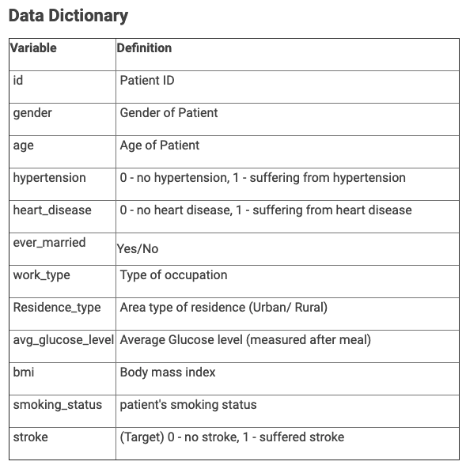
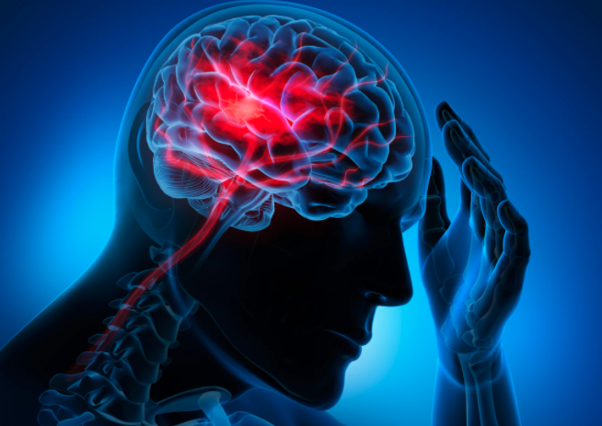
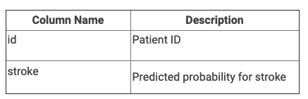
Notes:
Consider talking about:
Financial crisis
Boston
Transatlantic flight in 1928
Celebrity image
Promoting aviation
Competitive flying
Marriage to George Putnam

Slide 3
EDA
Notes:
Consider talking about:
Additional solo flights

Slide 4
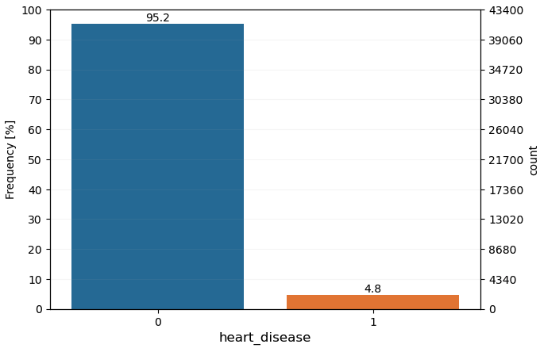
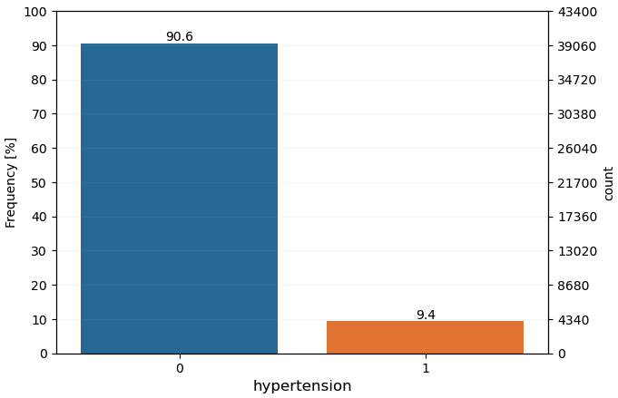
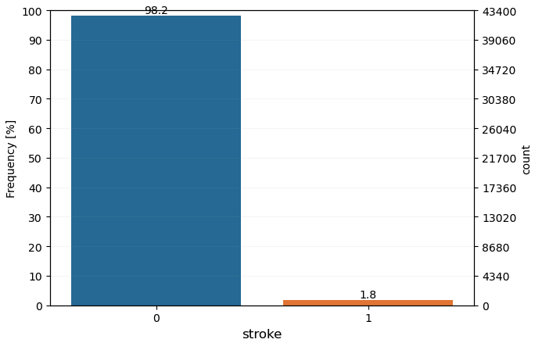
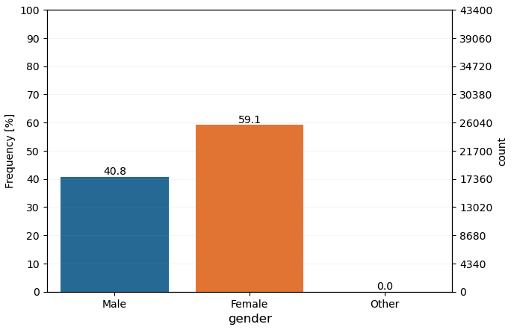
Univariate Categorical Analysis (1/ 2)
We can clearly see the imbalance in the target feature, i.e. stroke. We will address this later in the preprocessing (ROS) and modeling sections.

Slide 5
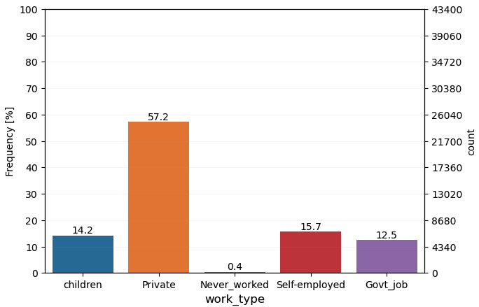
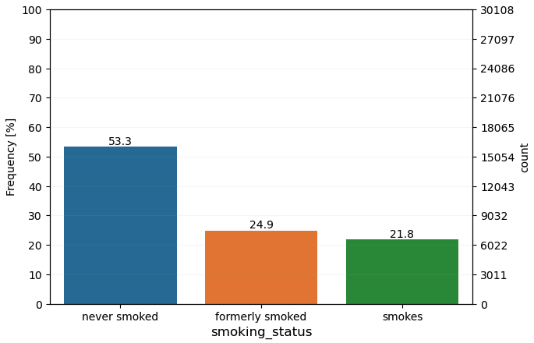
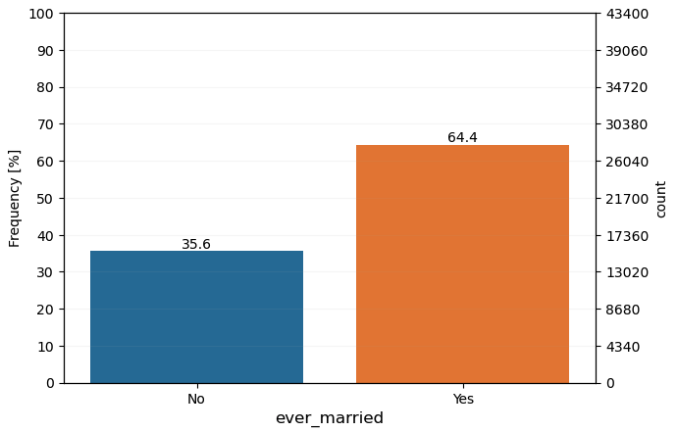
Univariate Categorical Analysis (2/ 2)
We have many people that work in the ‘private’ sector.
For the most part, a little more than have of the people have never smoked, but we do have some missing values for this ‘smoking_status’ feature.
Many people in this dataset are married.

Slide 6
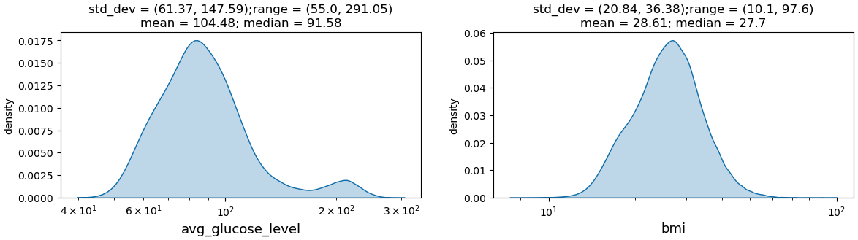
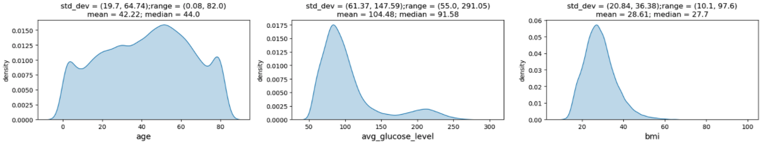
Univariate Numerial Analysis
‘age’ looks somewhat uniform.
Both ’avg_glucose_level’ and ‘bmi’ are right skewed.
As we will see in the preprocessing section, we will log transform these the said features for better digestion with the sklearn Logistic Regression model.

Slide 7
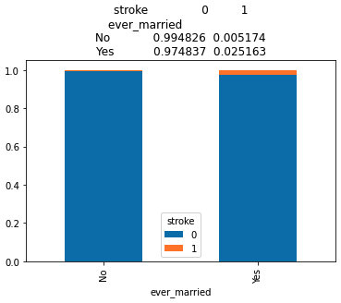
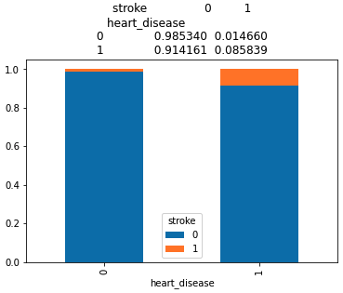
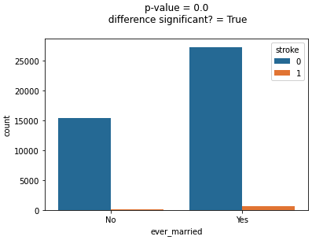
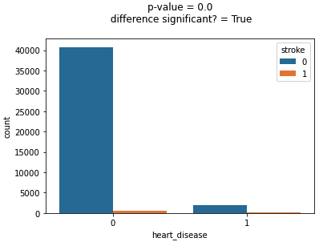
Bivariate Analysis Categorical-Categorical (1/2)
’ever_married’ might be one of those confounding factors for correlation vs causation. However, via our hypothesis test – the p-value is statistically significant and we will keep this feature for digestion with model.
‘heart_disease’ is also statistically significant.

Slide 8
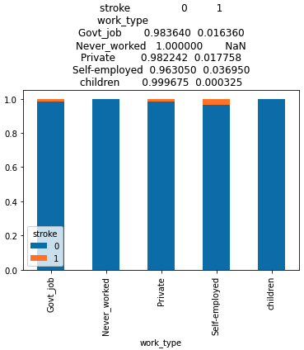
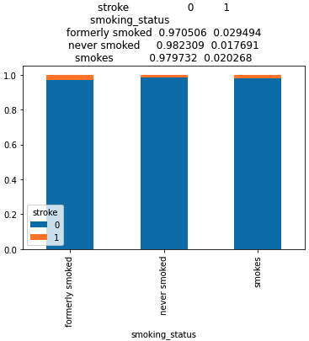
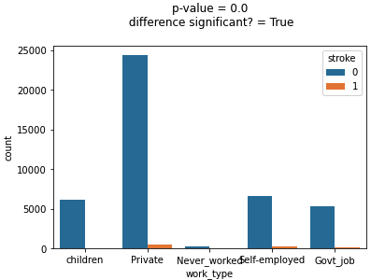
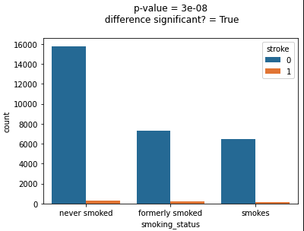
Bivariate Analysis Categorical-Categorical (2/2)
We will keep both ‘work_type’ and ‘smoking_status’ features for model building as well because their p-values are small.

Slide 9
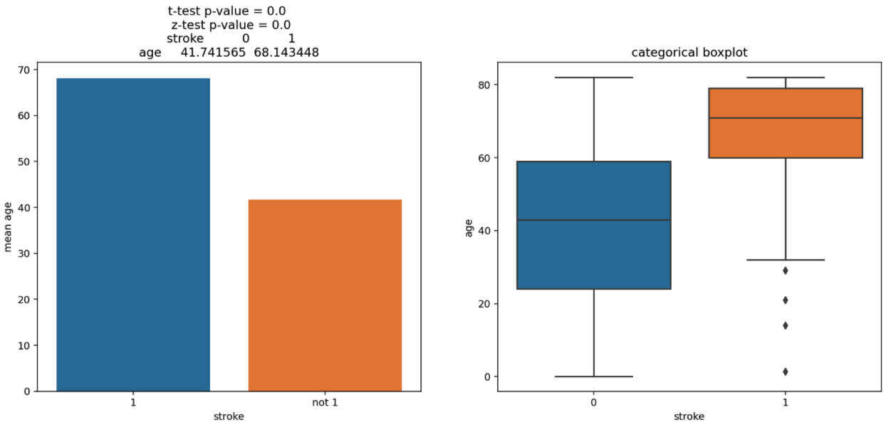
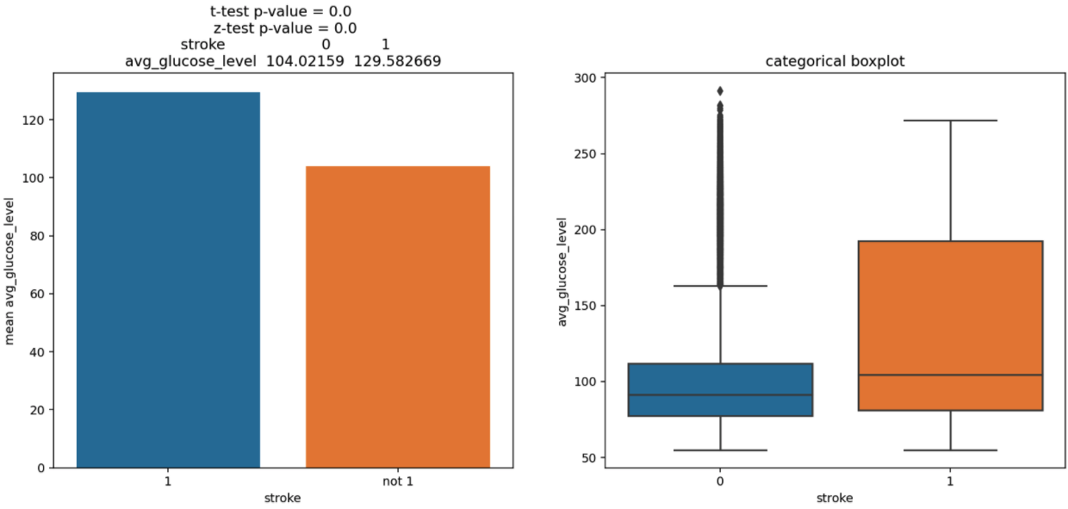
Bivariate Continuous Categorical (1/2)
Both ‘age’ and ‘avg_glucose_level’ are statistically significant

Slide 10
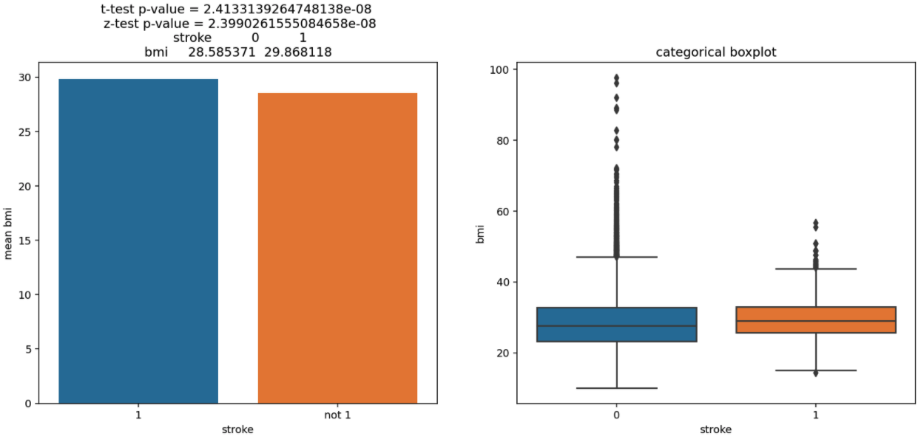
Bivariate Continuous Categorical (2/2)
Finally, ‘bmi’ is also statistically significant. This makes sense because bmi is commensurate of one’s health.

Slide 11
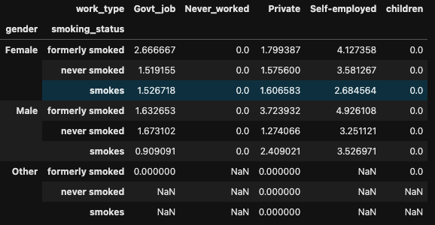
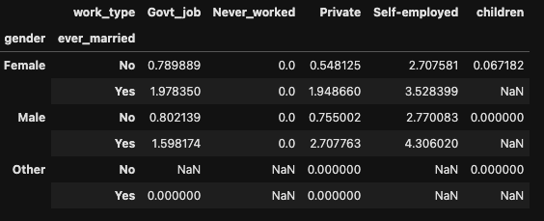
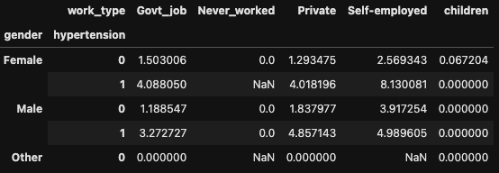
Multivariate Analysis
female, hypertension, and self-employed seemed to have the highest percentage of a stroke.
both male and female who formerly smoked and are self-employed seemed to have higher percentage of stroke!
self-employed, married, and female have 3.5% to 4.3% - so higher chances.

Slide 12
Data Preprocessing/Cleaning/Feature Selection
Notes:
Quotes by Amelia Earhart:
"“Adventure is worthwhile in itself.”"
"“Never interrupt someone doing something you said couldn't be done.”"
"“Everyone has ocean's to fly, if they have the heart to do it. Is it reckless? Maybe. But what do dreams know of boundaries?”"
"“Courage is the price that life exacts for granting peace.”"
"“The most effective way to do it is to do it.”"
"“Being alone is scary, but not as scary as feeling alone in a relationship.”"
"“I did for the fun of it”"
"“...decide...whether or not the goal is worth the risks involved. If it is, stop worrying....”"
"“Never do things others can do and will do, if there are things others cannot do or will not do.”"
"“You haven't seen a tree until you've seen its shadow from the sky.”"

Slide 13
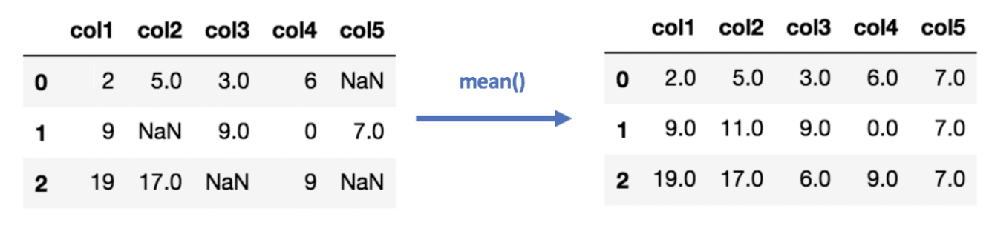
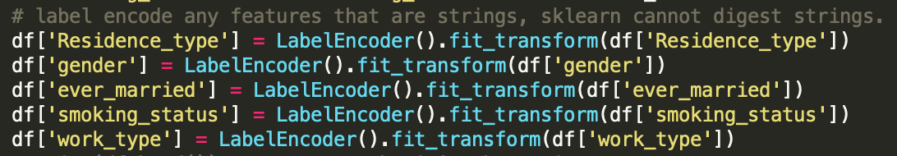
For the preprocessing steps – please refer to the preprocessing.py file. It performs the following steps
Impute missing value for both ‘smoking_status’ and ’bmi’, using mode and mean to impute respectively.
Features on the left are strings. Sklearn does not jive well with strings and we will encounter errors.
We can use sklearn’s built-in LabelEncoder to easily convert these strings into categorical Integers.
Notes:
Quotes by Amelia Earhart:
"“Adventure is worthwhile in itself.”"
"“Never interrupt someone doing something you said couldn't be done.”"
"“Everyone has ocean's to fly, if they have the heart to do it. Is it reckless? Maybe. But what do dreams know of boundaries?”"
"“Courage is the price that life exacts for granting peace.”"
"“The most effective way to do it is to do it.”"
"“Being alone is scary, but not as scary as feeling alone in a relationship.”"
"“I did for the fun of it”"
"“...decide...whether or not the goal is worth the risks involved. If it is, stop worrying....”"
"“Never do things others can do and will do, if there are things others cannot do or will not do.”"
"“You haven't seen a tree until you've seen its shadow from the sky.”"

Slide 14


We will select features from our EDA that have statistically significance.
We will also engineer additional features that have decent correlation with that dependent variable (stroke)
We have engineered the following additional features
Age_group
Obesity_ranges
Critical_condition
Diabetic_ranges
Please refer to preprocess.py for more details.

Slide 15

Feature Selection
From heuristics and many simulation runs, we have chosen the following features.
We have also run a random feature selector algorithm that cycles through each feature and re-calculates the score, evidently giving us an optimized choice of features. They somewhat converge to the above hand chosen features above and from our EDA.
Finally, we have also used L1 Lasso regularization and taken advantage of its sparsity characteristics to further help us select features. More on this in the model building section.

Slide 16
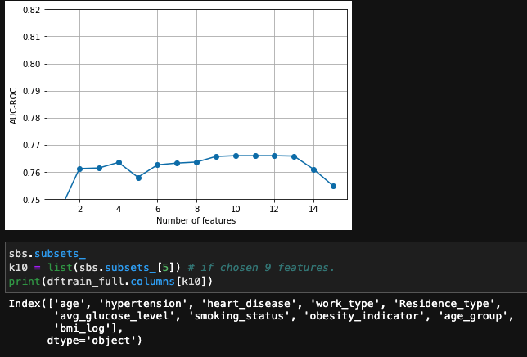
Brute Force Feature Selection
This model is not computationally heavy. For this reason, we were able to run training and evaluation across random feature selections.
Big thanks to Prashant for sharing this function during live lessons, please see main jupyter notebook for more details.
The algorithm had selected the above features as they yield the highest AUC-ROC.
I tried to use the same exact features above but it did not turn out that way ☺

Slide 17
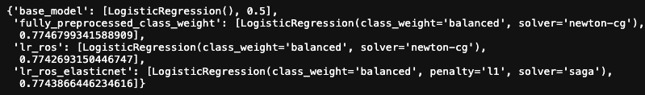
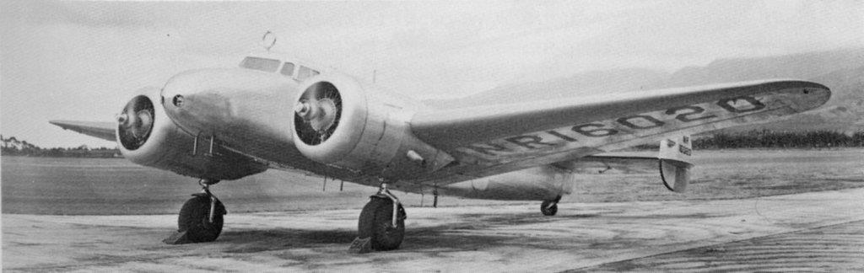
Model Building & Cross Validation
Snapshot of model dict() from the console
A Total of 4 models have been built
Baseline model (minimal preprocessing, i.e. no feature engineering) with default LR()
Fully preprocessed model with feature engineering and using ‘balanced’ class weights to deal with imbalance target.
Same model as #2 but with also ‘Random Over Sampling’, to oversample the minority stroke class and make it even with that of the majority no stroke class.
A final model same as #3 with with L1 lasso regularization for further feature selection.
In the next slide, all cross-validation curves have been displayed. #4 is the final submission.
Notes:
Consider talking about:
Planning
First attempt
Second attempt
Departure from Lae
Radio equipment
Nearing Howland Island
Radio signals
Contemporary search efforts

Slide 18


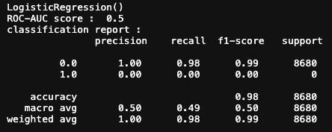
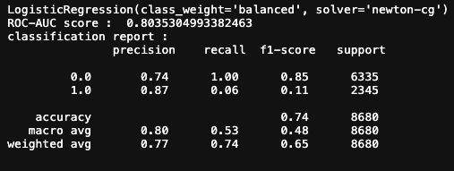


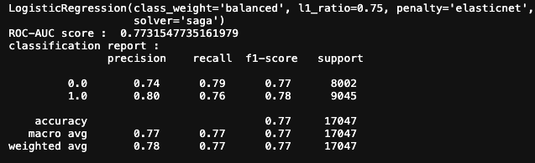
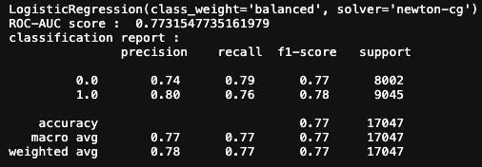
AUC-ROC Scores
Please refer to main jupyter notebook for more model building and details: ‘ml_basics_main_notebooks.ipynb’

Slide 19
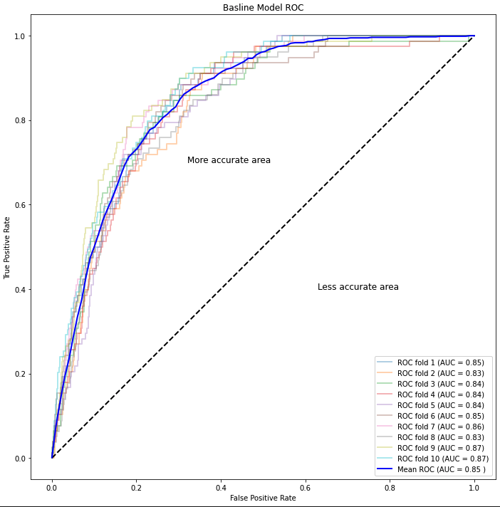
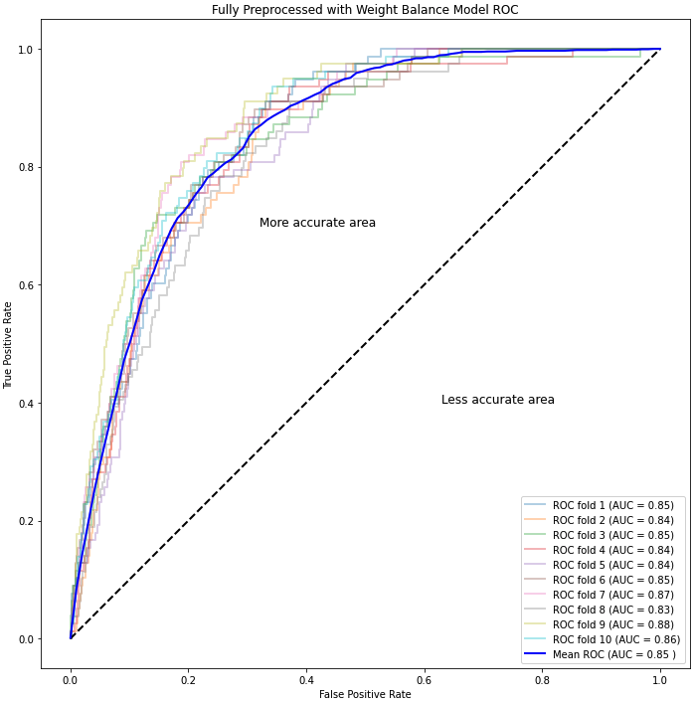
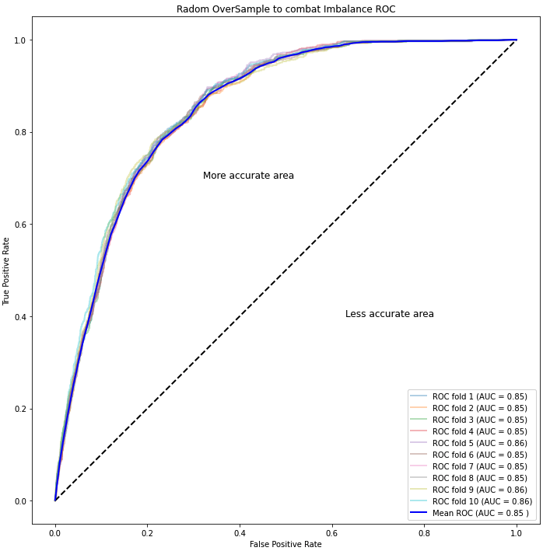
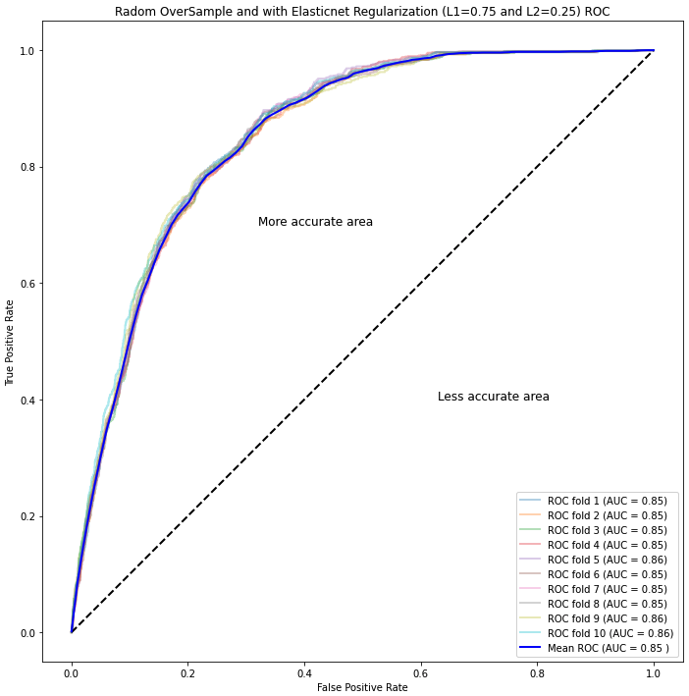
Cross-Validation KFold AUC-ROC Plots

Slide 20
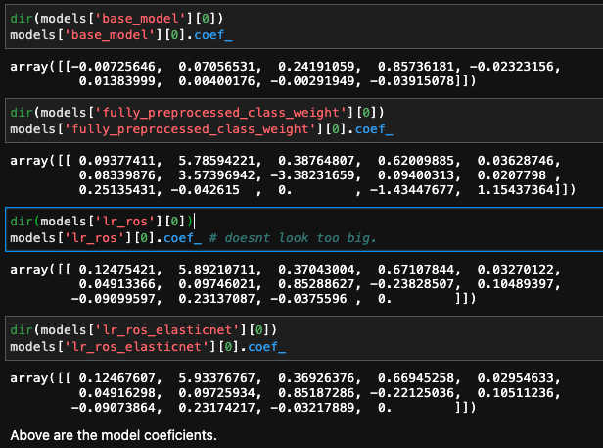
Model Parameter and Coefficients
Please refer to main jupyter notebook for more model building and details: ‘ml_basics_main_notebooks.ipynb’

Slide 21
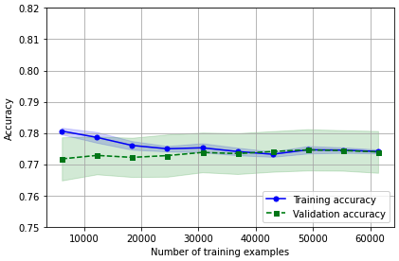
Learning Curve and Checking for overfitting
The learning curves above is for our #4 model (L1 + fully preprocessed with feature engineering + ROS)
Both curves are fairly close together. For this reason, there is no overfitting. This makes perfect sense because Logistic Regression, per the API has L2 regularization as default. We went the extra mile and tried ‘elasticnet’ and set L1 to 75%

Slide 22
Thank You AV !!!
Notes:
Quotes by Amelia Earhart:
"“Adventure is worthwhile in itself.”"
"“Never interrupt someone doing something you said couldn't be done.”"
"“Everyone has ocean's to fly, if they have the heart to do it. Is it reckless? Maybe. But what do dreams know of boundaries?”"
"“Courage is the price that life exacts for granting peace.”"
"“The most effective way to do it is to do it.”"
"“Being alone is scary, but not as scary as feeling alone in a relationship.”"
"“I did for the fun of it”"
"“...decide...whether or not the goal is worth the risks involved. If it is, stop worrying....”"
"“Never do things others can do and will do, if there are things others cannot do or will not do.”"
"“You haven't seen a tree until you've seen its shadow from the sky.”"

