Slide 1
Machine Learning
Titanic survival prediction
Group 6:
Nguyen Tiet Nguyen Khoi
Nguyen Duong Tung
Nguyen Hoang Trung Dung

Slide 2
Outline
Our team achievement
Preprocessing
Model 1: Logistic regression
Model 2 & 3: Decision Tree & Random Forest
Conclusion

Slide 3
Our team achievement
Our achievement
Some important updates

Slide 4
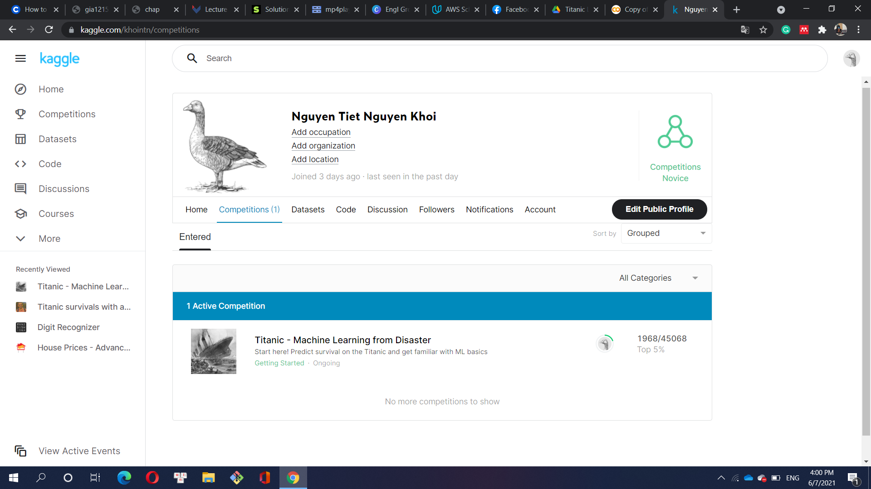
Our achievement
Top 5% on Kaggle
Accuracy 0.80143
No cheating !
Link to our Colaboratory
Link to Kaggle profile

Slide 5
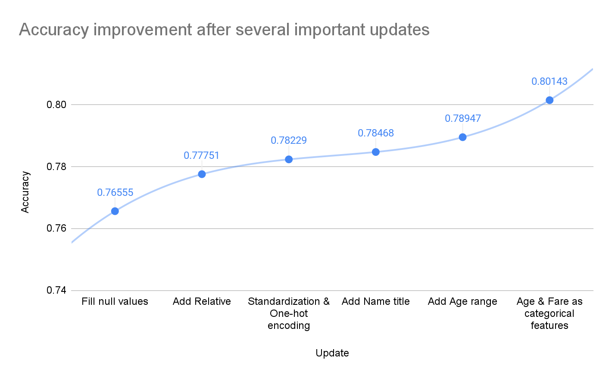
Some important updates

Slide 6
Preprocessing
Fill null values
Add new features
Standard scaling with numerical values
One-hot encoding with categorical values

Slide 7
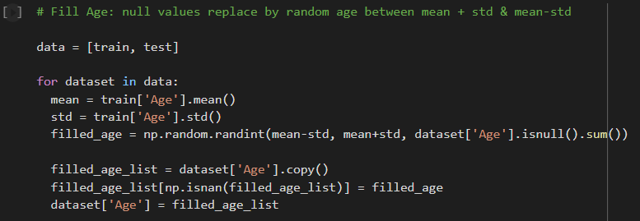
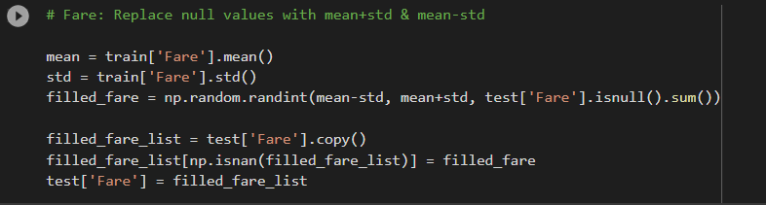
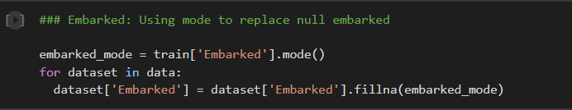
Fill null values
Fill age & fare null values using mean & std
Fill embarked null value using mode

Slide 8
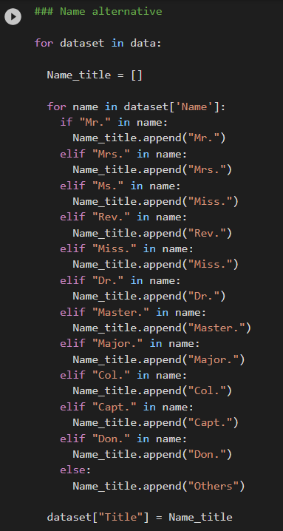
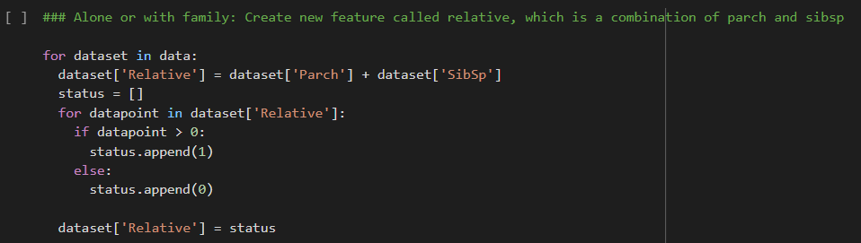
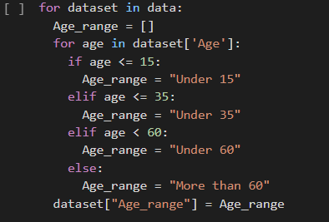
Add new features
Relative: Go alone or with family
Age range
Name title

Slide 9
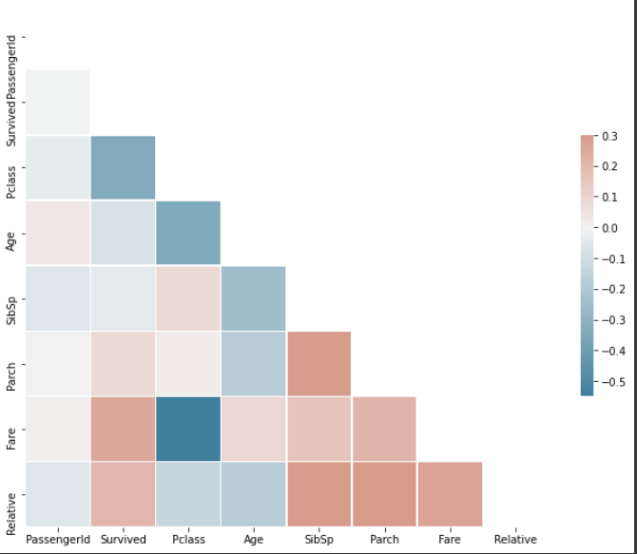
Add new feature
The correlation of new features to the survivability

Slide 10
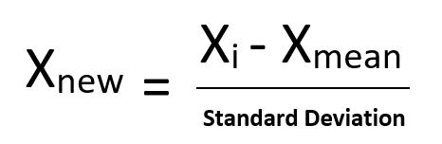
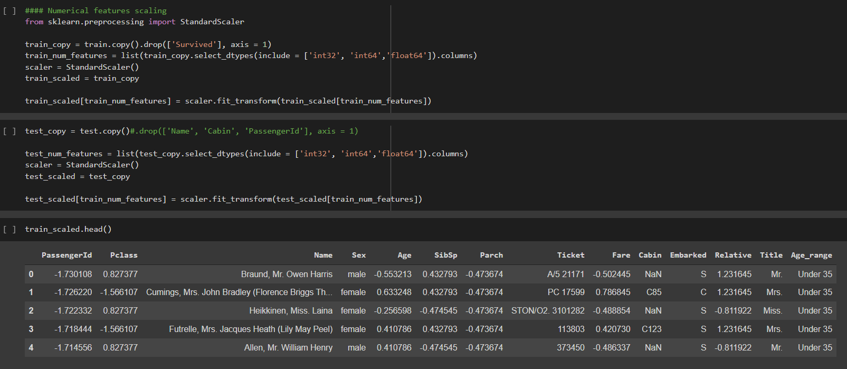
Standard scaling with numerical values
Formula for standardization (standard scaler)
Standard scaling process

Slide 11
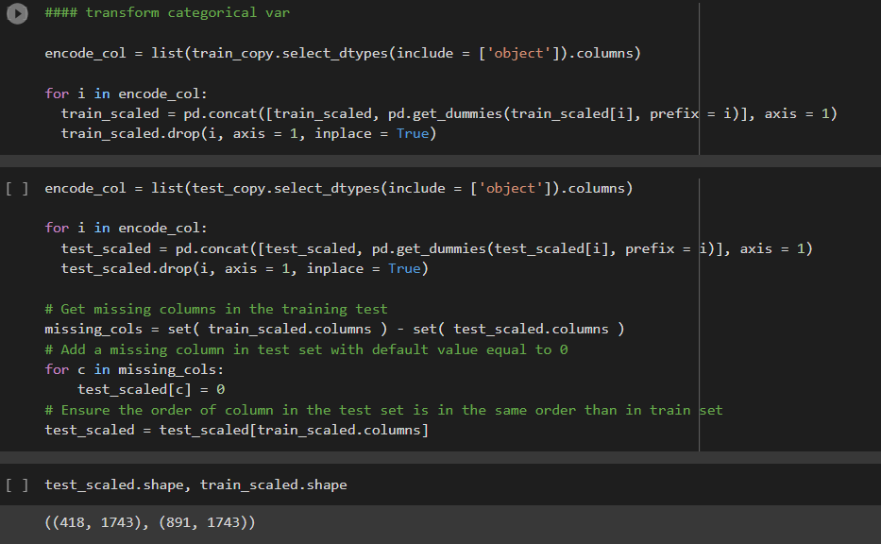
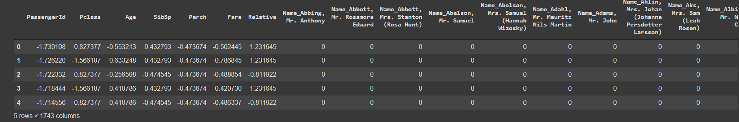
One-hot encoding with categorical values
One-hot encoding process
Data after one-hot encoding

Slide 12
Model 1: Logistic regression
Brief about logistic regression
Implementation
Accuracy

Slide 13
Brief about logistic regression
Statistical model which use logistic function.
Use to model a binary dependent variable.
In regression analysis, logistic regression[1] (or logit regression) is estimating the parameters of a logistic model (a form of binary regression)

Slide 14
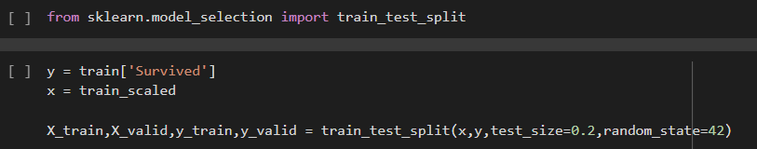
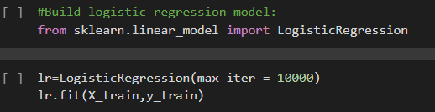
Implementation
Split the train set to train and validation set.
Implement the logistic regression
Change the maximum iteration and fit the training set into the logistic regression

Slide 15
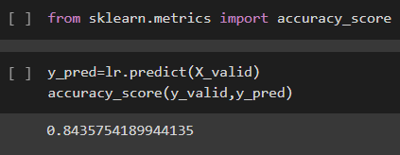
Accuracy
Using the validation set to calculate the accuracy.

Slide 16
Model 2 & 3: Decision Tree & Random Forest
Brief about decision tree & random forest
Implementation & accuracy of decision tree
Implementation & accuracy of random forest

Slide 17
Brief about decision tree and random forest
A decision tree is a decision support tool that uses a tree-like model of decisions and their possible consequences, including chance event outcomes, resource costs, and utility. It is one way to display an algorithm that only contains conditional control statements.
Random forests or random decision forests are an ensemble learning method by constructing a multitude of decision trees at training time. For classification tasks, the output of the random forest is the class selected by most trees.

Slide 18
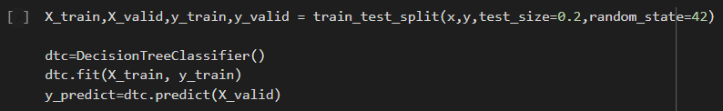

Implementation & accuracy of decision tree
Split the train set to train and validation set.
Train model
The accuracy of model on the valid set
Notes:
First, we split the dataset into two sets for training and validation
THen we use the DecisionTreeClassifier function from the Sklearn library to
Then we fit the data
Finally, we check the accuracy of the model on the validation set

Slide 19
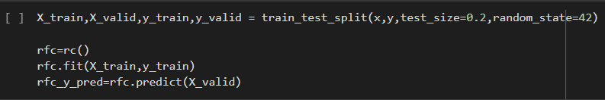

Implementation & accuracy of random forest
Split the train set to train and validation set.
Train model
The accuracy of model on the valid set

Slide 20
Conclusion

Slide 21
Conclusion
The performance of Logistic Regression is better than the other (submitted on Kaggle).
Pre-processing is one of the most important part.
The accuracy would increase if we use standardization and feature engineering at the right time.
Create new features, in some specific cases, would be beneficial and make the trained model performs better.

Slide 22
Thank you!

Slide 23
References
Deotte, C. (2018, October 6). Titanic using Name only [0.81818]. Kaggle. https://www.kaggle.com/cdeotte/titanic-using-name-only-0-81818
Ritchie, N. (2018, May 20). Titanic Survival Data Exploration. Ritchieng.Github.Io. https://www.ritchieng.com/machine-learning-project-titanic-survival/
Schmidt, P. (2021, January 15). Titanic Data Set – How I increased my score from 79% to 82%. That Data Tho. https://thatdatatho.com/titanic-data-set-increased-prediction-scores-82/
S. (2018, October 15). Titanic survivals with age prediction. Kaggle. https://www.kaggle.com/sedrak/titanic-survivals-with-age-prediction
Roberts, J. (2018, June 1). Titanic Using Ticket Groupings. Kaggle. https://www.kaggle.com/jack89roberts/titanic-using-ticket-groupings#

Slide 24
References
Ananyd36. (2020, October 5). 7 Feature Engineering Techniques in Machine Learning You Should Know. Analytics Vidhya. https://www.analyticsvidhya.com/blog/2020/10/7-feature-engineering-techniques-machine-learning/
Laura, F. (2019, April 12). Titanic Dive Through: Feature scaling and outliers. Kaggle. https://www.kaggle.com/allunia/titanic-dive-through-feature-scaling-and-outliers

