Slide 1

Proton Structure in the LHC Era
Tutorial
Klaus Rabbertz, Daniel Britzger
KIT Karlsruhe, DESY

Slide 2
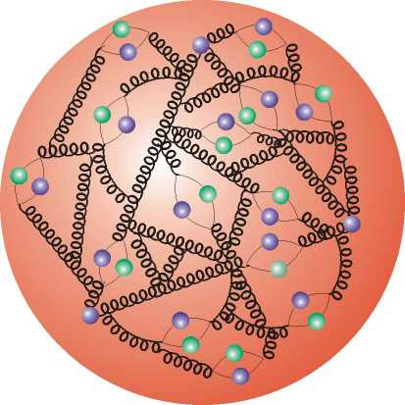


Outline
?
Introductory Part
  Motivation
  General Concept and Application Overview
  Application to Jet Analysis at LHC
  News/Outlook
Tutorial Part
  Walk-through of Installation
  Demonstration of Example Evaluation
  Code Explanation
Exercise: Your Turn for at least 45 min !!!

Slide 3

Disclaimer
This is not meant as a report giving all the latest details on the fastNLO development!
For this you can go for example to the fastNLO web page at http://fastnlo.hepforge.org and check Daniels presentation at the QCDatLHC 2012 conference
My aims for the tutorial today are much more modest and concentrate on a simple application example

Slide 4
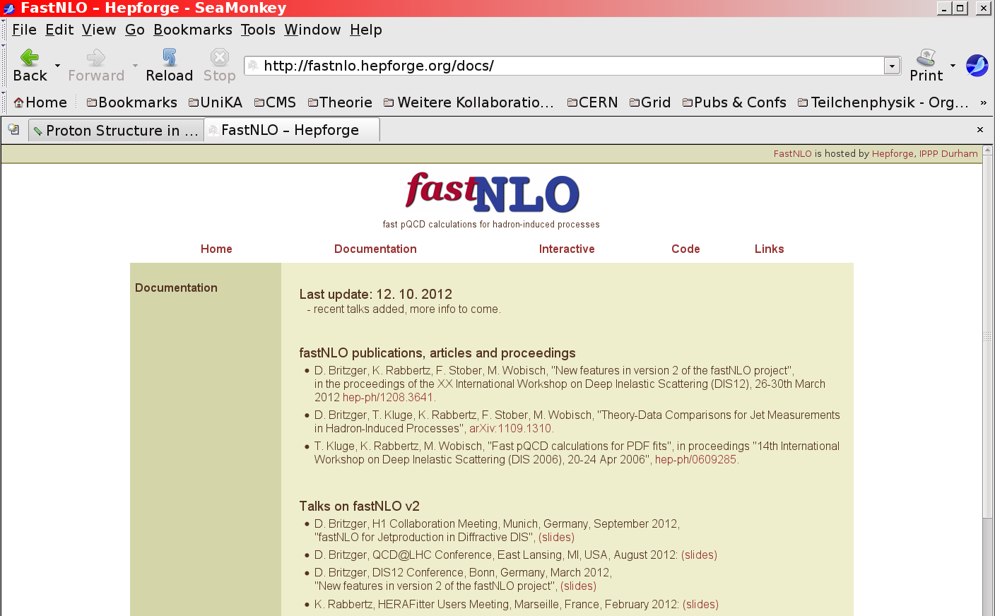
FastNLO at HepForge

Slide 5




Motivation
  Interpretation of experiment data relies on:
    Availability of reasonably fast theory calculations
    Often needed: Repeated computation of same cross section
  Examples for a specific analysis:
    Estimate accuracy of perturbative QCD (scale uncertainties)
    Use of various PDFs (CTEQ, MSTW, NNPDF, HERAPDF, AB(K)M …)
    Determine PDF uncertainties (PDF error sets)
    Use data set in fit of PDFs and/or αs(MZ)
  Sometimes NLO predictions can be computed fast
  But some are very slow, esp. jets, O(1000 CPU h)
  Need procedure for fast repeated computations of NLO cross sections
  Even more so at NNLO when available!

Slide 6
Jet Cross-Sections
Jet production in hadron-hadron collisions depends on
  strong coupling α_{s} to order n
  PDFs of two hadrons f₁, f₂
  Parton flavors a, b
  perturbative coefficients c_{a,b,n}
  renormalization and factorization scales
  Parton momentum fractions x
PDF and α_{s} are external input
Perturbative coefficients are independent from PDF and α_{s}
Idea: Avoid folding integrals and factorize the PDFs and α_{s}

Slide 7
The fastNLO concept
Use interpolation kernel
  - Introduce set of n discrete x-nodes, x_{i}'s being equidistant in a function f(x)
  - Take set of Eigenfunctions E_{i}(x) around nodes x_{i}
  → Interpolation kernels
  - Actually a rather old idea, see e.g.
C. Pascaud, F. Zomer (Orsay, LAL), LAL-94-42
→ Single PDF is replaced by a linear combination of interpolation kernels
  → Then the integrals are done only once
  → Afterwards only summation required to change PDF
Store a table with the convolution of the pert. coefficients with the interpolation kernel

Slide 8

Remarks
  In detail a bit more complicated. For each observable bin:
    Cubic interpolation in x (also used in digital imaging)
    2-dimensional binning in (log) x for hh collisions
    Use reasonable number of x nodes and lower x limit
    Interpolate reweighted PDFs for improved approximation
    Scale bins also need interpolation
    Exploit symmetries between different QCD subprocesses
    Many optimizations done to keep table small and programs fast
  Strategy applicable in general, NOT restricted to NLO or jets or ...
  Here: Concentrate on jets with NLOJet++ and fastNLO
  Assume that the APPLGRID tutorial covers e.g. other processes
NLOJet++, Z.Nagy, PRD68 2003, PRL88 2002

Slide 9
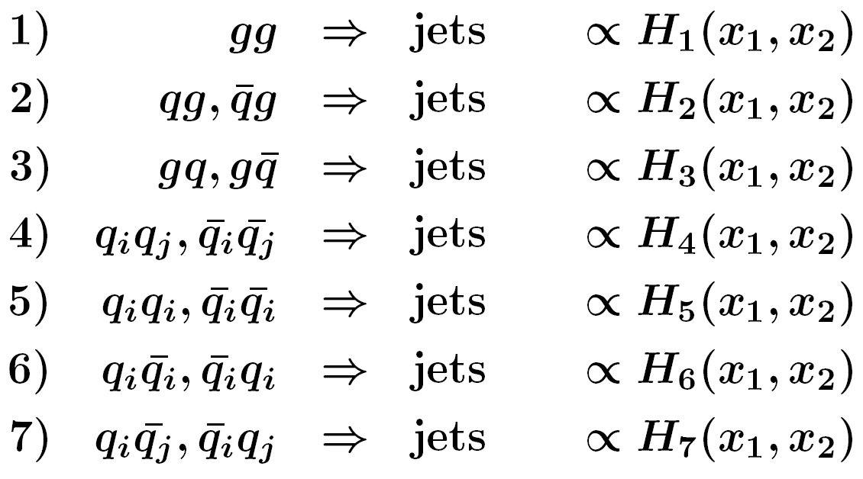


Partonic Subprocesses
  Don't want to deal with 13 X 13 PDFs
  For hh → jets seven relevant partonic subprocesses
  Need only seven linear combinations Hi of PDFs

Slide 10
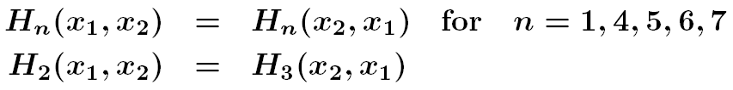
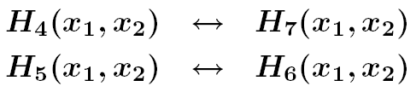


Symmetries
  In addition, symmetries can be exploited:
  For hadron anti-hadron collisions, replace:
  Minimize required table size and computing time!
  Otherwise number of bins in observable times x₁-, x₂-, μ-nodes, … can quickly get huge

Slide 11
hh Jet Cross-Section with fastNLO
Hadron-hadron collisions
  2D interpolation kernels
Final fastNLO cross sections
    Compute σ-table in each bin and store it in fastNLO table
    Contains all information on the observable
Final cross section formula

Slide 12



Table Production
  Not the topic of today's tutorial, somewhat too involved for that
  If somebody wants to try talk to Daniel or me for code and instructions; needs fastNLO, fastjet, slightly mod. NLOJet++.
  Here the general scheme:
    Program the C++ code for your process, selection and observable (easy when it can be almost copied from existing scenarios)
    Run a number of NLO jobs to determine lower x and scale limits for each observable bin → to be used in future jobs
    Do some comparison jobs between original NLOJet++ and rederived fastNLO x sections to make sure the approximation is fine (deviations below permille level or even less); if not start again optimizing settings :-(
    Start large scale production, i.e. submit O(some 100) jobs on the grid or a batch system in parallel → order of n 1000 CPU hours to harvest
    Possible to get all tables within a day, fastNLO is set up to combine all the statistically independent calculations into one table
    As a bonus one gets an estimate of the statistical precision

Slide 13
Conceptual Overview
Standard
Method
Table
Generation
fastNLO
Evaluation
Or use it within a fitting framework

Slide 14

Example Applications
CMS inclusive jets
    Study of PDF dependence
    Determination of PDF envelopes
    PDF-error prediction à la PDF4LHC
D0 three-jet invariant mass
    Study of PDF dependence
    Study of scale dependence
    μ_{r}= μ_{f} = (p_{T1}+ p_{T1} +p_{T1})/3
    μ = 2.0 × μ_{o}
    μ = 0.5 × μ_{o}
    Study of α_{s} dependence using
    α_{s} dependent PDF sets
PLB 704 (2011) 434-441
239 repeated NLO calculations
3138 repeated NLO calculations
Each rederivation takes fractions of a second!

Slide 15
New in fastNLO Version 2.0
Features of pre-computed fastNLO tables
  Automatic adjustment of phase space boundaries
  Flexible # x-nodes for analysis bins
  Improved interpolation in ren./fact. scales
  Arbitrary number of dimensions for binning of observable
Features of fastNLO reading tools
  α_{s} evolutions provided via
    2-,3-,4-loop iterative solution
    Interface to external α_{s} evolutions, e.g. LHAPDF, QCDNUM, …
    Interface to CrunDec (B. Schmitt, M. Steinhauser, KIT)
  Interface to PDFs/evolution from LHAPDF and QCDNUM
  Easy implementation of new interfaces
  Easy to install (autotools)
  Easy to implement in fitting codes and to interface PDFs
  Independent C++ and Fortran versions
    agreement at double precision O(10⁻¹⁰)
Pre-release version fastnlo_reader_2.1.0_1273 for this tutorial today!
FastNLO Table
FastNLO
Reader
Reader_f
Reader_cc
No further dependencies (No ROOT, No CERNLIB, etc…)

Slide 16
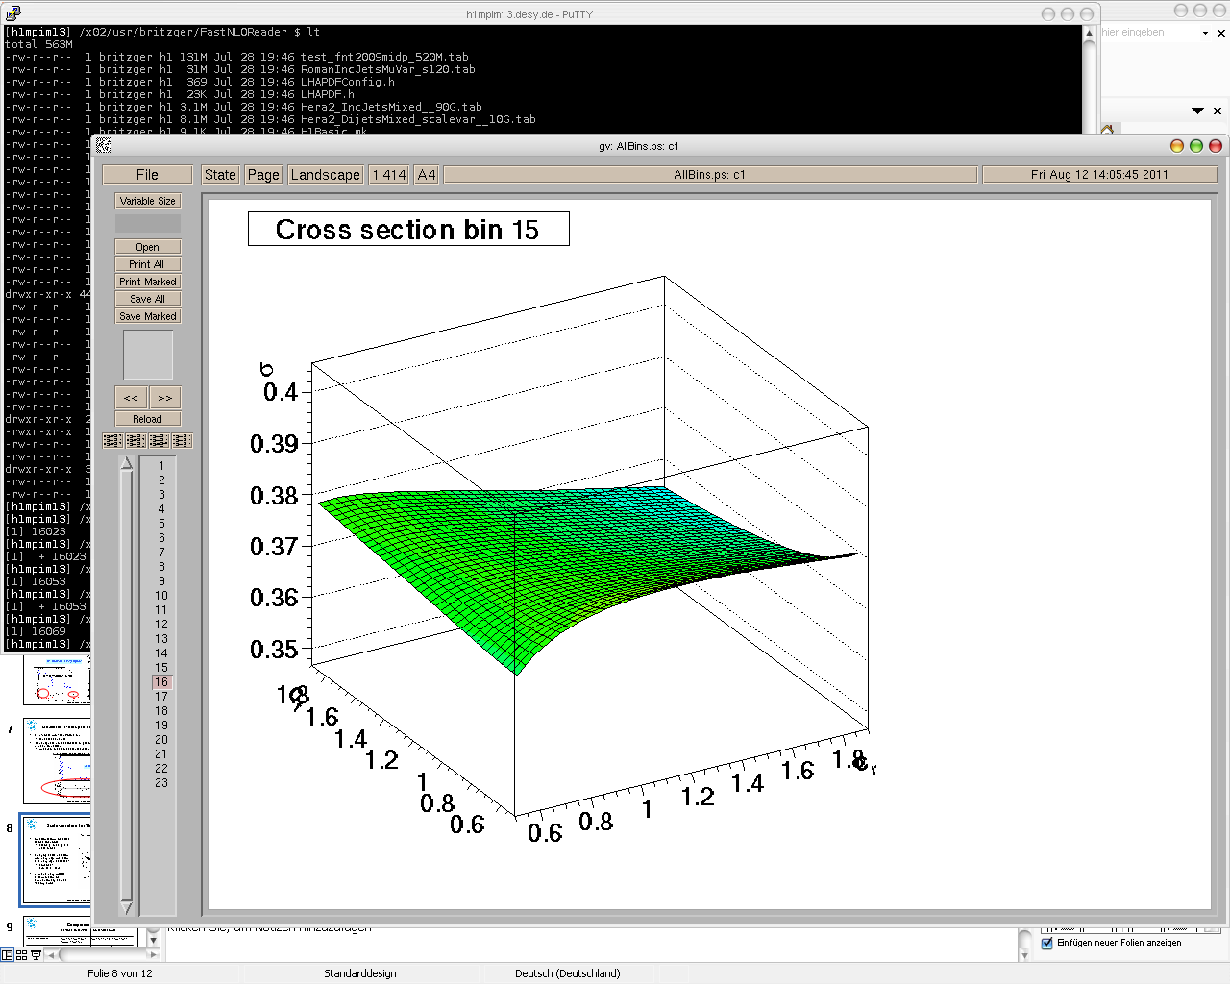

New in v2: Scales
Scales can be functions of multiple observables
  e.g. for DIS jets
  Scale observables are p_{T} and Q²
  Scales can be
  μ_{r}² = (Q² + p_{T}²) / 2
  μ_{r}² = Q²
  μ_{r}² = p_{T}²
  μ_{r}² = 0.8 Q² + 0.3 p_{T}² + Q·p_{T}
Independent scale variations
of μ_{r} and μ_{f} are possible
  μ_{R}² = c²_{R} × (Q² + p_{T}²) / 2
  μ_{F}² = c²_{F} × Q²
σ [pb]
Scale factor c_{F}
Scale factor c_{R}
More flexibility for studies of scale dependencies

Slide 17


Outlook
Prerelease of fastNLO_reader_2.1.0_1273 for this tutorial
Changes to previous release of fastNLO_reader_2.1.0_1062
  Check and reactivate asymmetric scale variations in Fortran part
  Some small inconsistencies between Fortran and C++ fixed
  Numerous changes in interface to improve flexibility and user-friendliness (this is sometimes in contradiction :-) ).
  Improved documentation
Short-term plan
  Provide this as a linkable library
Further developments
  Provide more and new-type precalculated tables for DIS and LHC
  Improve user-friendliness and docu for the production code and release
  Integrate new processes and corrections, e.g. electroweak, and much more ...
Your feedback is very welcome here!

Slide 18
Tutorial Part

Slide 19
Installation
  Install packages produced with standard autotools, just run
    ./configure - -prefix=your/local/dir
    make; make install
  In case of different location of LHAPDF use
    ./configure –prefix=your/local/dir --with-lhapdf=path/to/lhapdf
    Error message with hints if still not found
  For more options check
    ./configure -help
  And also look into the README file
  Executables: fnlo-fread and fnlo-cppread, type
    fnlo-fread -h (or fnlo-cppread -h)
  for command line arguments (table file, PDF file)

Slide 20
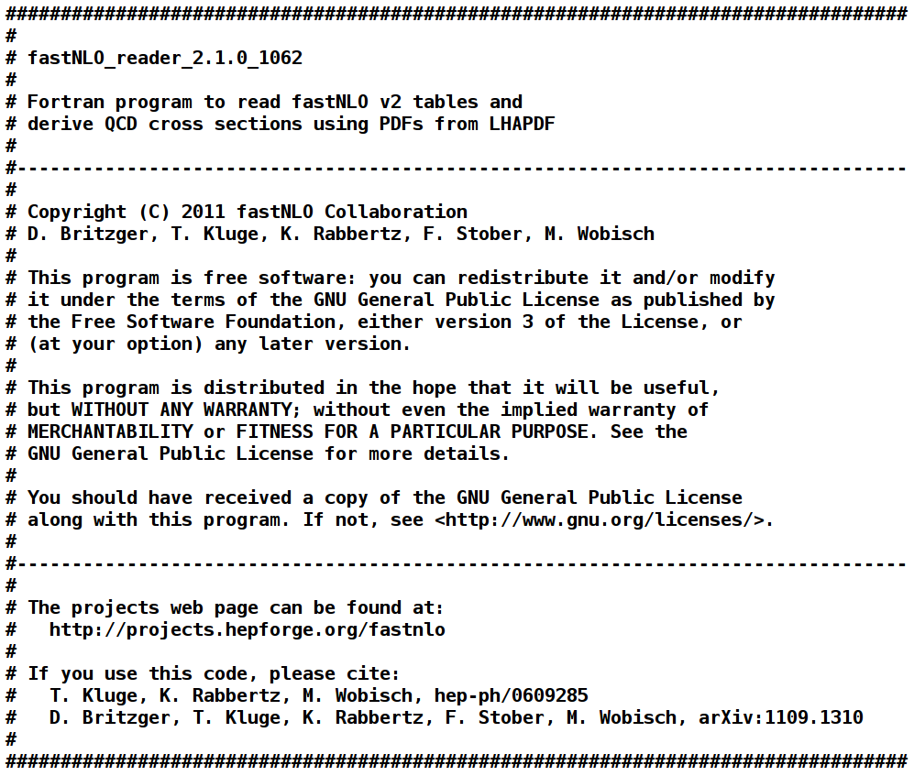
Initial Output
Version and svn
revision number
People
GPLv3 License
Web Page
References
(will be updated)

Slide 21
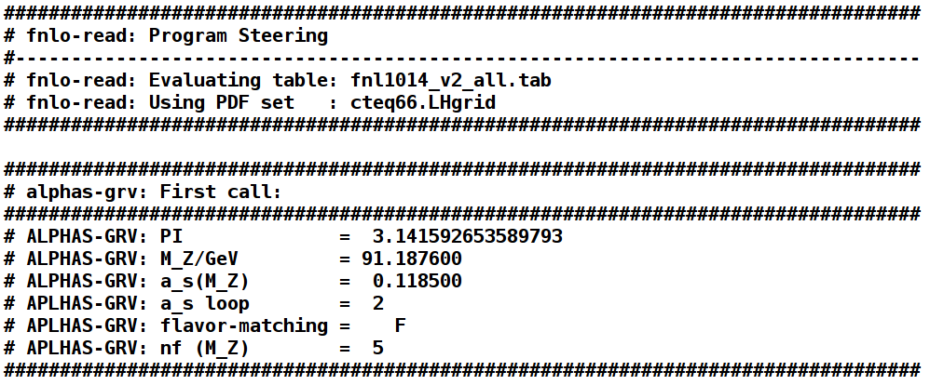
Program Start
Start parameters
of default internal
alpha_s code for
comparison
Basic evaluation code ...
Other evolution code can be used/interfaced e.g. from LHAPDF
→ edit, recompile
Default output: List of LO and NLO x sections for selected PDF
Loop over scale variations, PDF members, alpha_s variations …
→ edit, recompile

Slide 22
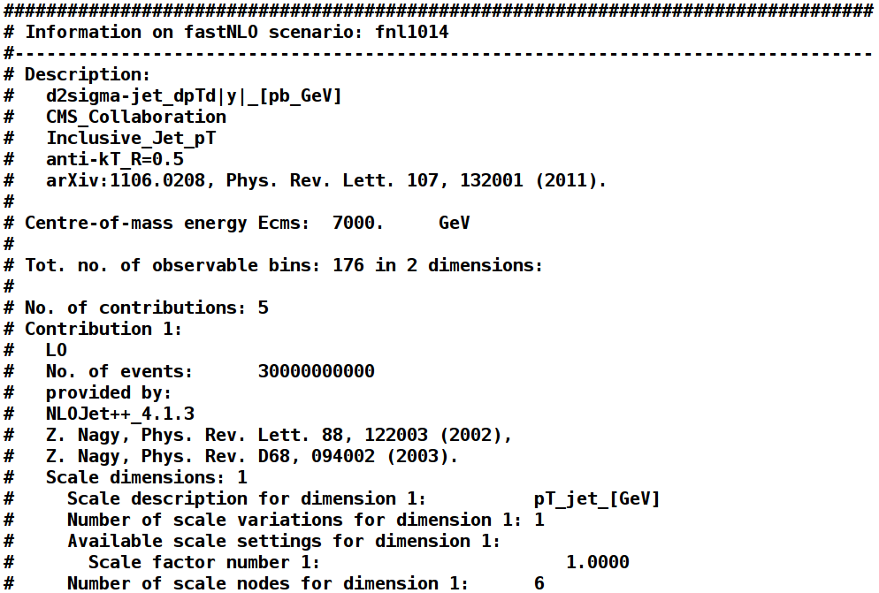
Scenario Information 1
Measurement
Total no. of bins
Exceptional!
Normally 2 or 3.
No. of table contributions
Info for 1st contribution:
LO from NLOJet++
Referenz for used code is
included in table where it
belongs!

Slide 23
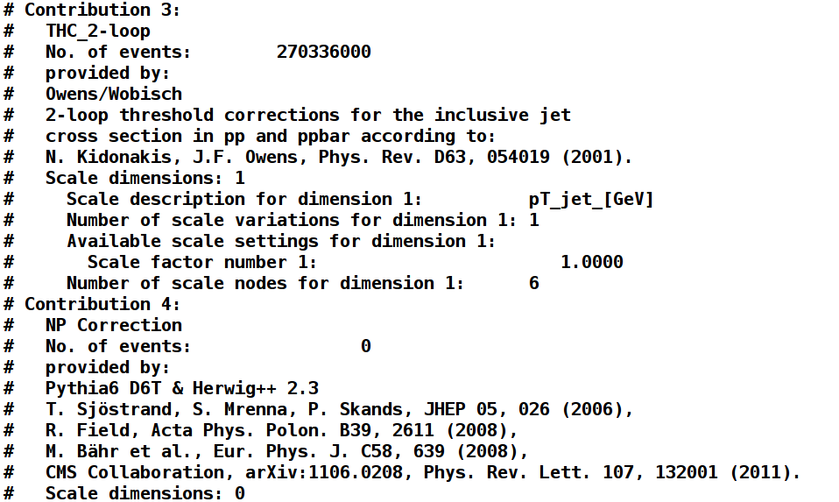
Scenario Information 2
Threshold Corrections
Non-perturbative
Corrections

Slide 24


Jets Data / Theory
Comparison of jet data from
  STAR at RHIC
  H1 and ZEUS at HERA
  CDF and D0 at Tevatron
Compatible with QCD
Includes measurements from LHC
New: Updated with ATLAS inclusive jets
fastNLO, to be uploaded, arXiv:1109:1310v2, 2012

Slide 25
Backup Slides

Slide 26
Scale flexibility in fastNLO v2.0
Perturbative coefficients beyond LO have scale dependence
Scale dependence can be factorized
Store individual scale independent coefficients
Scales can be arbitrary values - or functions of observables
  Scales can be functions of multiple variables e.g. p_{T} and y*
  Final scale can be chosen to be any function of both
Scales can be functions of multiple observables

Slide 27
Jets in diffractive DIS with fastNLO
1. Fixed center-of-mass calculation
  Calculate only one fastNLO table at proton energy E_{p}
  Increased number of x-nodes
  in low-x region
2. Adapt the slicing method
  Define arbitrary x_{IP} slicing
  Calculate cross section by Rieman-integrating x_{IP}
  Integrate over x wrt. E_{p}
Integral becomes a standard fastNLO evaluation
  Upper integration interval needs to be respected properly
FastNLO procedure improves previously used approach

