Slide 1




Physics at the Terascale
Extension of
to arbitrary processes
Daniel Britzger, Klaus Rabbertz, Georg Sieber, Fred Stober,Markus Wobisch
(DESY, KIT * 3, Louisiana Tech University)

Slide 2
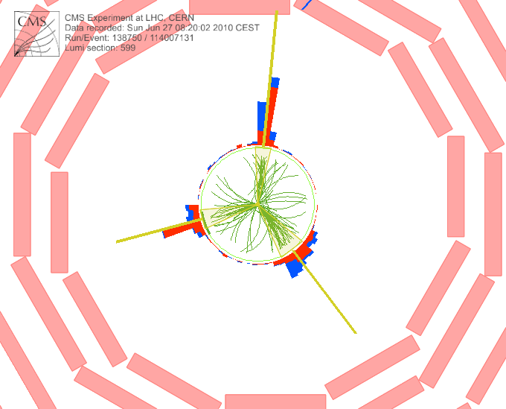
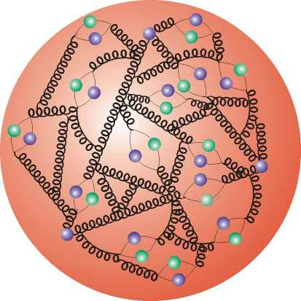

Outline
Introduction & History
Application & Latest Status
Current Developments
Outlook

Slide 3




Motivation
  Interpretation of experiment data relies on:
    Availability of reasonably fast theory calculations
    Often needed: Repeated computation of same cross section
  Examples for a specific analysis:
    Estimate accuracy of perturbative QCD (scale uncertainties)
    Use of various PDFs (AB(K)M, HERAPDF, CTEQ, MSTW, NNPDF, …)
    Determine PDF uncertainties (PDF error sets)
    Use data set in fit of PDFs and/or αs(MZ)
  Sometimes NLO predictions can be computed fast
  But some are very slow, esp. jets, O(1000s CPU h)
  Need procedure for fast repeated computations of NLO cross sections
  Even more so at NNLO when available!
See talk from Nigel!

Slide 4

Jet Cross-Sections
Jet production in hadron-hadron collisions depends on
  strong coupling α_{s} to order n
  PDFs of two hadrons f₁, f₂
  Parton flavors a, b
  perturbative coefficients c_{a,b,n}
  renormalization and factorization scales
  Parton momentum fractions x
PDF and α_{s} are external input
Perturbative coefficients are independent from PDF and α_{s}
Idea: Avoid folding integrals and factorize the PDFs and α_{s}

Slide 5
The fastNLO concept
Use interpolation kernel
  - Introduce set of n discrete x-nodes, x_{i}'s being equidistant in a function f(x)
  - Take set of Eigenfunctions E_{i}(x) around nodes x_{i}
  → Interpolation kernels
  - Actually a rather old idea, see e.g.
C. Pascaud, F. Zomer (Orsay, LAL), LAL-94-42
→ Single PDF is replaced by a linear combination of interpolation kernels
  → Then the integrals are done only once
  → Afterwards only summation required to change PDF
Store a table with the convolution of the pert. coefficients with the interpolation kernel

Slide 6
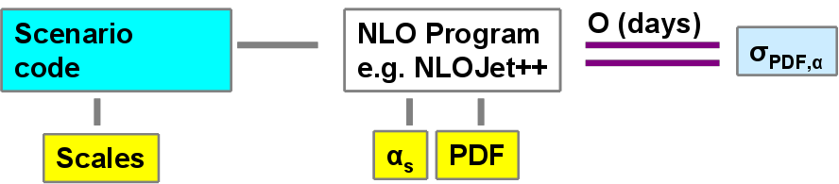
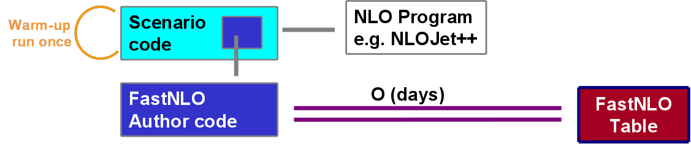
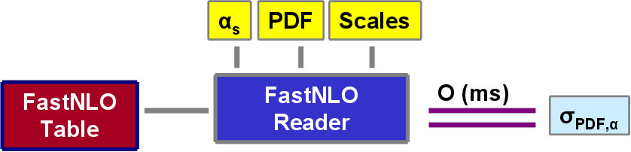
Conceptual Overview
Standard
Method
Table
Generation
fastNLO
Evaluation
Or use it within a fitting framework

Slide 7

Example Applications
CMS inclusive jets
    Study of PDF dependence
    Determination of PDF envelopes
    PDF-error prediction à la PDF4LHC (not recommended ...)
D0 three-jet invariant mass
    Study of PDF dependence
    Study of scale dependence
    μ_{r}= μ_{f} = (p_{T1}+ p_{T1} +p_{T1})/3
    μ = 2.0 × μ_{o}
    μ = 0.5 × μ_{o}
    Study of α_{s} dependence using
    α_{s} dependent PDF sets
PLB 704 (2011) 434-441
3138 repeated NLO calculations
239 repeated NLO calculations
Each rederivation takes fractions of a second!
Didn´t count any more for the fits presented next ...

Slide 8
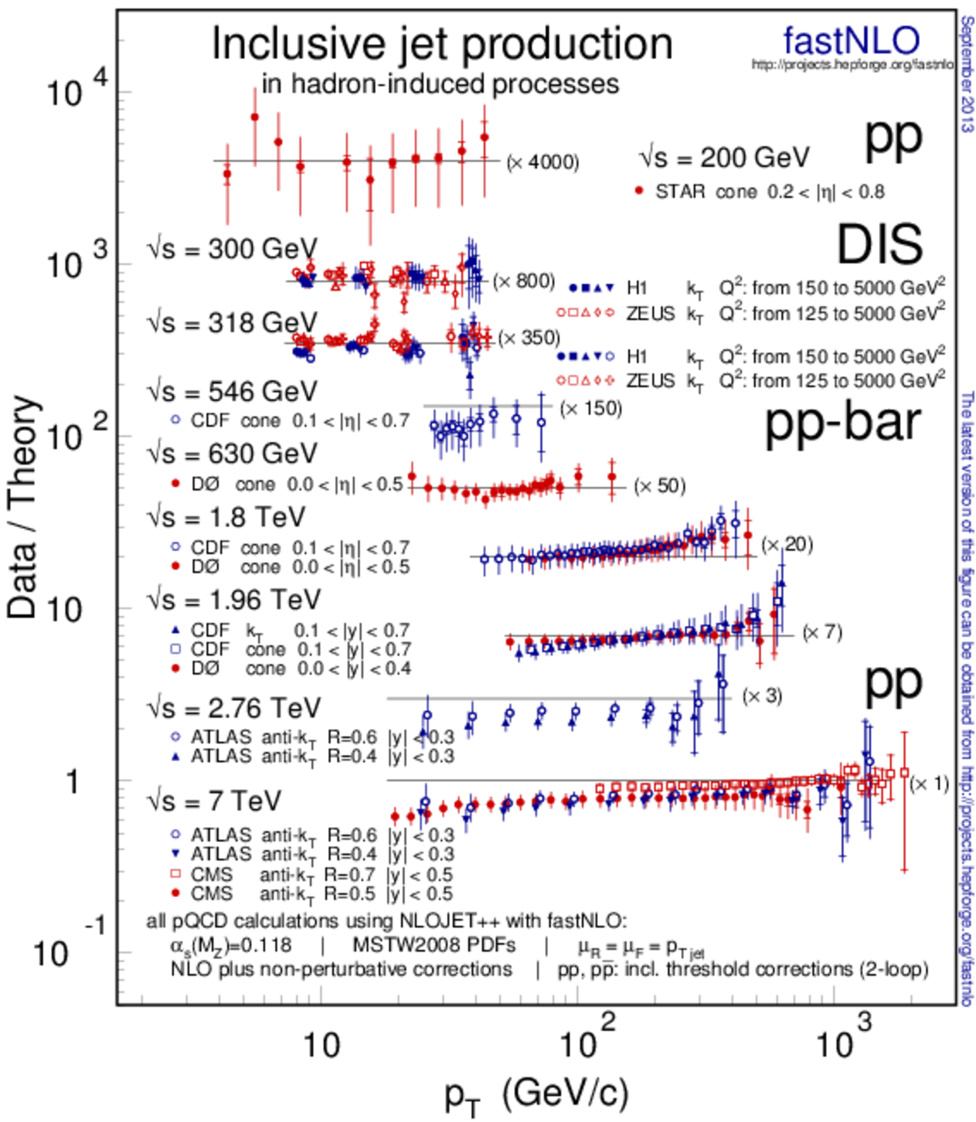



Jets Compilation Plot in PDG Book
Comparison of jet data from
  STAR at RHIC
  H1 and ZEUS at HERA
  CDF and D0 at Tevatron
Compatible with NLO pQCD
Updated last month with ATLAS 2010 and CMS 2010 & 2011 published LHC measurements

Slide 9

New in fastNLO Version 2.1
Features of pre-computed fastNLO tables:
  Automatic adjustment of phase space boundaries
  Flexible # x-nodes for analysis bins
  Improved interpolation in ren./fact. scales
  Arbitrary number of dimensions for binning of observable
  Support for diffractive PDFs
Features of fastNLO reading tools:
  Easy to install (autotools)
  Comes as a library linkable from other programs + one example executable
  Easy implementation of new interfaces
  Easy to implement in fitting codes and to interface PDFs
  Independent C++ and Fortran versions
    agreement at double precision O(10⁻¹⁰)
Latest release fastnlo_reader_2.1.0_1488 including some fixes for threshold corrections in C++
FastNLO Table
FastNLO
Reader
Reader_f
Reader_cc
No further dependencies (No ROOT, No CERNLIB, etc…)

Slide 10
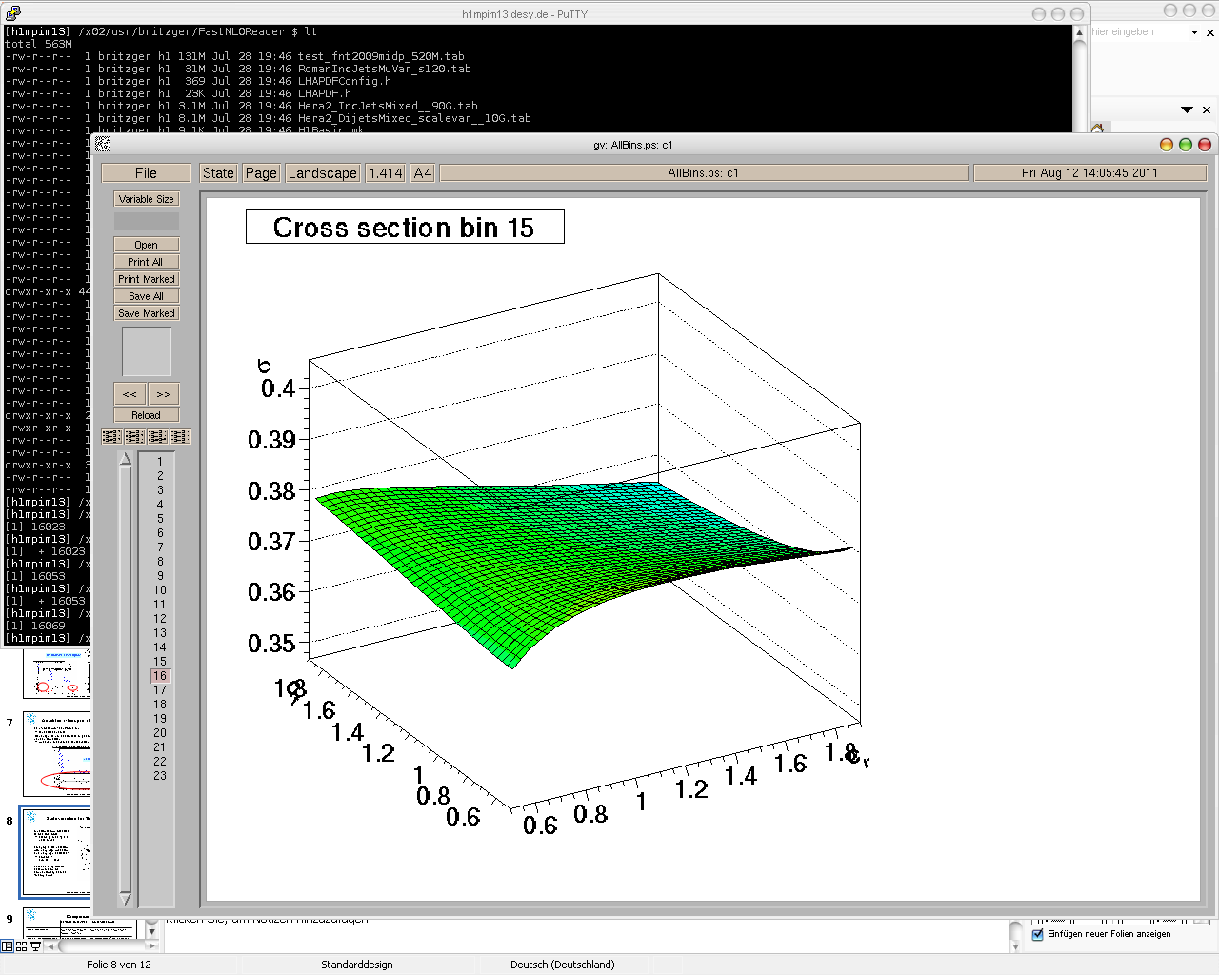

New in v2: Scales
Scales can be functions of multiple observables
  e.g. for DIS jets
  Scale observables are p_{T} and Q²
Functional form of combination can be changed
  Scales can be
  μ_{r}² = (Q² + p_{T}²) / 2
  μ_{r}² = Q²
  μ_{r}² = p_{T}²
  μ_{r}² = 0.8 Q² + 0.3 p_{T}² + Q·p_{T}
Independent scale variations with arbitrary factors of μ_{r} and μ_{f} are possible
  μ_{R}² = c²_{R} × (Q² + p_{T}²) / 2
  μ_{F}² = c²_{F} × Q²
Extensively tested and used in new HERA results to come, not yet exploited for hh tables
σ [pb]
Scale factor c_{F}
Scale factor c_{R}
More flexibility for studies of scale dependencies

Slide 11
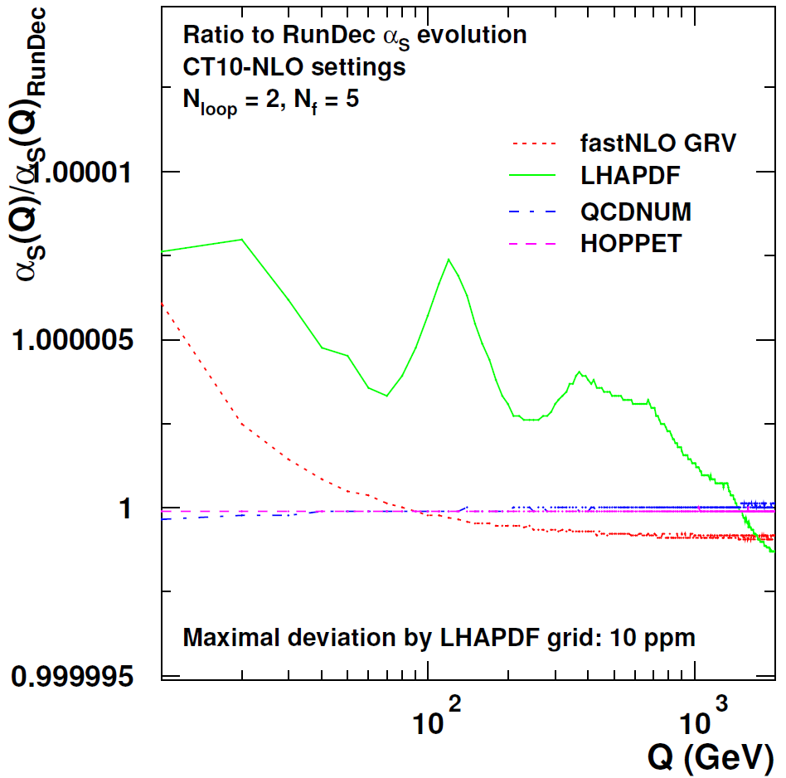



Next fastNLO reader release
One further release imminent:
  with optional Python interface to C++ library
  with optional interface to alternative α_{S} evolution code from
    CRunDec (included already since a longer time)
    QCDNUM (used in HERAFitter)
    HOPPET (used by CTEQ, NNPDF(?))
RunDec, B. Schmidt, M. Steinhauser, CPC183, 2012;
K. Chetyrkin, J. Kühn, M. Steinhauser, CPC133, 2000.
QCDNUM, M. Botje, CPC182, 2011.
HOPPET, G. Salam, J. Rojo, CPC180, 2009.

Slide 12
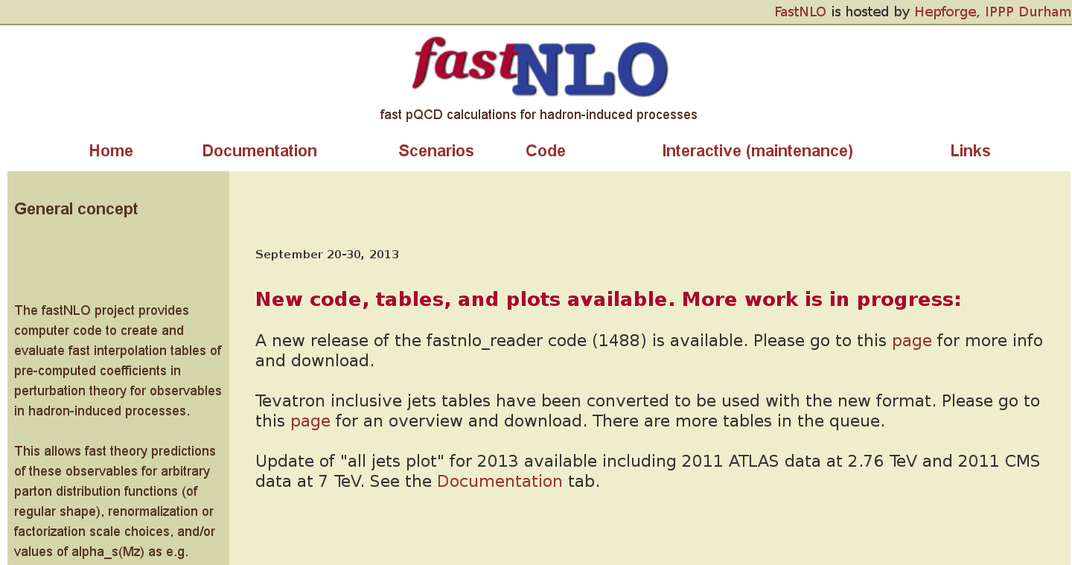
fastNLO page at HepForge
New version with plotting tool exists (G. Sieber), needs some optimization

Slide 13
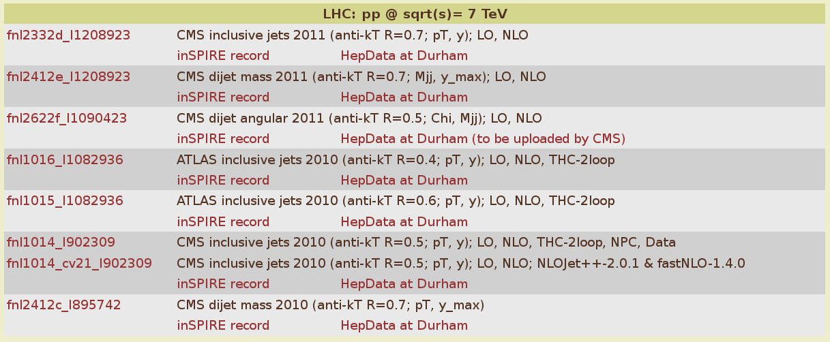
Available Tables in v2.1: LHC
Changed table numbering scheme, now contains two parts:
- our internal development number fnlxxxx
- the reference number of the publication in inSPIRE, similar as in RIVET
- makes it easy to connect with relevant publication and HepData files

Slide 14


FastNLOCreator v2.2
  1. Cross check old v1.4 versus new v2.1 tables … Done!
  2. Cross check new reader code in C++ vs. Fortran … Done!
  3. Public release of reader code as autotools tarball … Done!
  4. Transform C++ reader code into linkable library … Done!
  5. Transform table creation code into linkable library as independent as possible from NLOJet++!
  In progress, first test version exists.
  Make interface available for other N?LO codes.

Slide 15
Basic Interface to other Codes
Generator | Interface | fastNLO
Executable Calculation of coefficients (weights) Calculation of observables and scales Phase space definition Event count Must provide: x-values weights process IDs Observable and scale values | Weight(s) x-values Process-ID Observable(s) Scale(s) Optional: pass executable specific information to fastNLO during initialization | Binning Bingrid Interpolation Warmup handling Steerfile must provide correct Process dependent information Generator dependent information
fastNLO library can always be compiled without generator specific code !!
Interface knows about generator specific issues and holds fastNLOCreate instance
Generator has not to be modified !
If generator code is complicated: modify code to pass information to interface

Slide 16
Logic of Table Creation
Initialization step
Event loop
End of program
fastNLOCreate
fastNLOCreate(steerfile)
fnloEvent
fnloScenario
fastNLOCreate
WriteTable()
Initialize fastNLOCreate
All (ALL) information is read from steer-file.
Only quantities, which are given by user to ‘program-steering’ (e.g. LO or NLO run) are passed to the fastNLOCreate class.
fastNLOCreate may also pass steering values to program!
fastNLOCreate
Fill(event,scen)
Write table
(pass number of events to table [event count is left to generator])
Pass information to fastNLOCreate
For every subprocess/event

Slide 17

Outlook
Several releases of fastNLO table reading library done. One more to come with optional interfaces to C++ lib via Python and to other α_{S} evolutions.
Work on generalized library and interface for table reading AND creation in progress; expect first stable version beginning of next year.
In particular working on integration of
  Threshold correction code with Kumar and S. Moch
  ttbar with M. Guzzi
  Jets at NNLO with N. Glover, J. Pires, T. Gehrmann, Gehrmann-de Ridder
  Contact Interaction @ NLO code from J. Gao (he actually implemented his own version of such an interpolation a la fastNLO or APPLGRID)
  MCFM (available in APPLGRID)

Slide 18
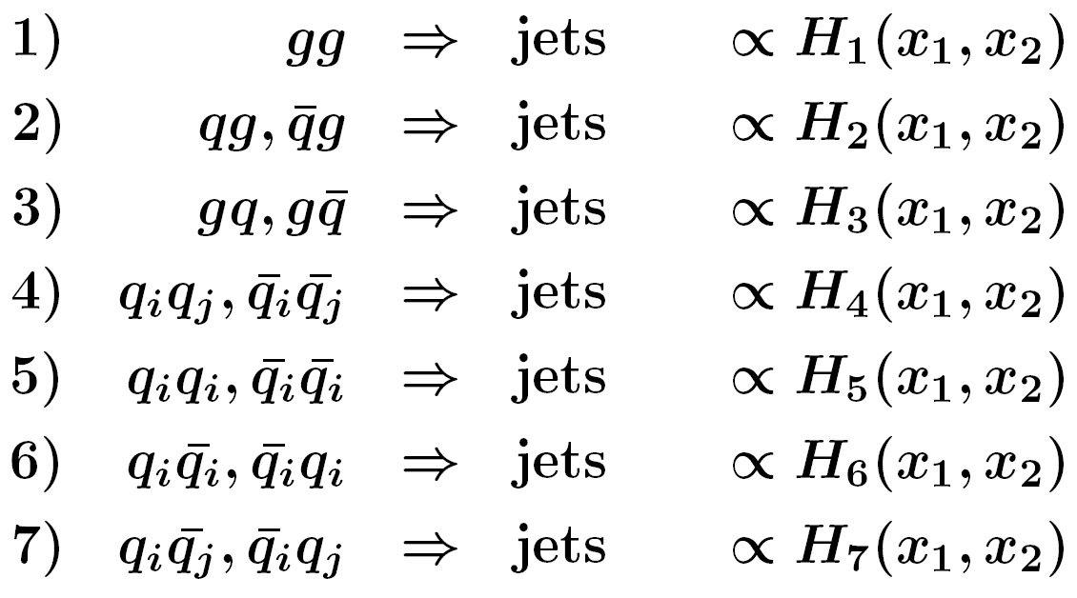


Partonic Subprocesses
  Our test case in 2005/6: Jets @ NLO with NLOJet++
  Don't want to deal with 13 X 13 PDFs
  For hh → jets seven relevant partonic subprocesses
  Need only seven linear combinations Hi of PDFs
NLOJet++, Z.Nagy,
PRD68 2003, PRL88 2002

Slide 19
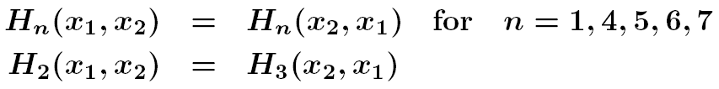
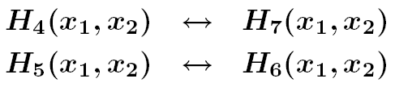
Symmetries
  In addition, symmetries can be exploited:
  For hadron anti-hadron collisions, replace:
  Minimize table size, otherwise number of bins in observable times x₁-, x₂-, μ-nodes, … can quickly get huge!
  Very relevant in 2005/6 because of limited disk space in mass production of tables, problem to fit table into memory, Fortran limitations
  Cumbersome: Adaptation to be done for each new process
  Today: Partially solved using C++ and memory/disk nowadays
  Could even try using 13x13 in a first step for new processes

Slide 20
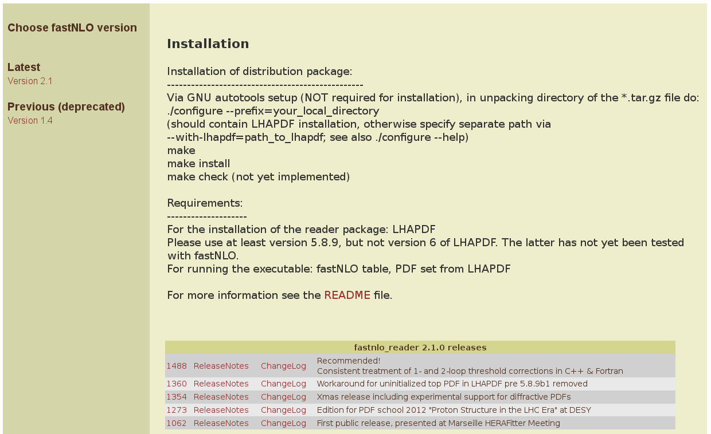
Reader Code Download

Slide 21
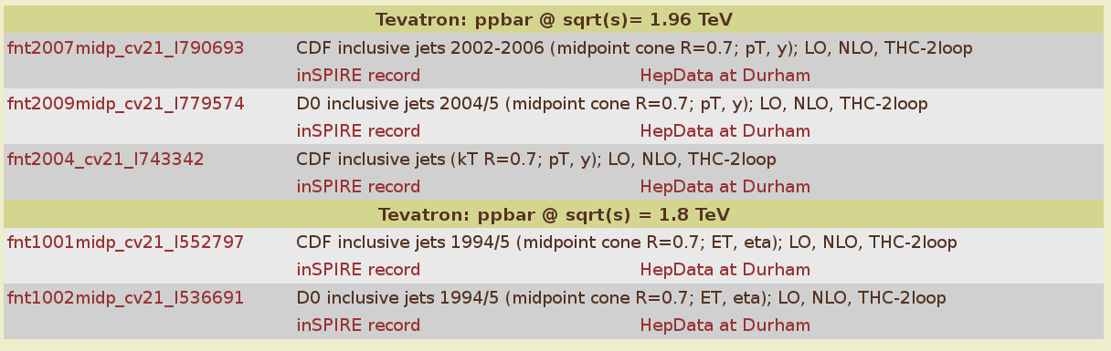
Available Tables in v2.1: Tevatron
Tables with “cv21” refers to tables produced with the old versions
of NLOJet++ 2.0.1 and fastNLO v1.4 that have been converted to the
new format. More tables to come. Will be replaced at some point
by newer tables from scratch.
Waiting for new tables for HERA in new flexible scale format.

Slide 22
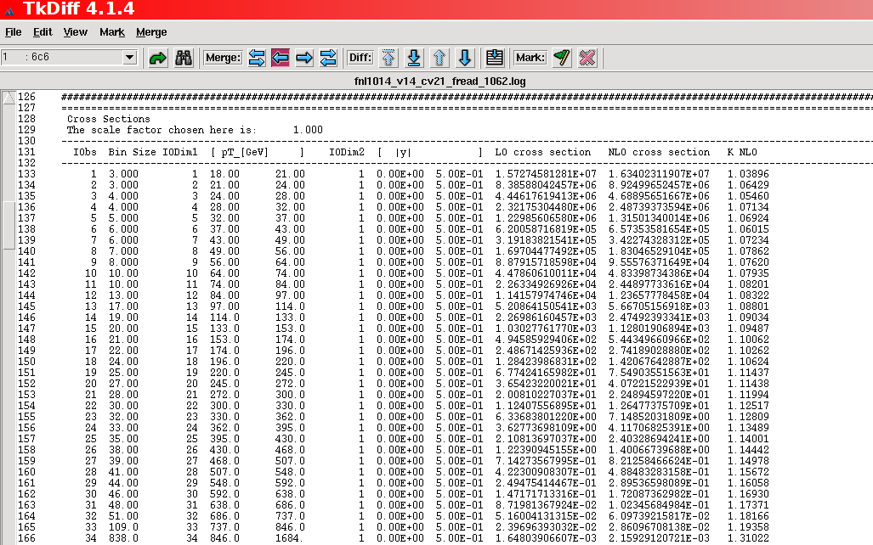
Technical Cross-check
tkdiff between Fortran and C++, ALL differences in color ...!
Identical at O(10⁻¹⁰)

Slide 23
Cross-check v2 vs. v14
Feature known from discussion with CTEQ:
Small scale offset in highest pT XXL bin → resolved in v2!
LO
NLO
O(1-2%)
Expected due to:
Stat. independent calculations, NLOJet++_2.0.1 → NLOJet++_4.1.3, improved
x limits/binning, …

