Slide 1


Parton Distributions for the LHC
Toolkit
Daniel Britzger, Klaus Rabbertz, Georg Sieber, Fred Stober, Markus Wobisch
(DESY, KIT * 3, Louisiana Tech University)
in cooperation with
Enrico Bothmann, Steffen Schumann
(Uni Göttingen)

Slide 2
Parton Distributions for the LHC
Part 1
fastNLO v2 &
Toolkit Development

Slide 3



From v1.4 to v2.1
1. Cross-checked old v1.4 versus new v2.1 tables
2. Converted existing v1.4 tables to new format
3. Cross-checked new table reader code in C++ vs. Fortran
4. Public release of table reader code as autotools tarball:
  First release 14.02.2012: fastNLO_reader 2.1.0-1062
5. Transformed C++ reader code into linkable library
  Latest release 14.02.2014: fastNLO_reader 2.1.0-1689
Installation:
  Requirements: LHAPDF5 or 6
  ./configure --prefix=/path/to/install/directory [--with-lhapdf=/path]
  fnlo-tk-config available to list config info and compiler/linker options
6. Implemented new functionalities …
LHAPDF, M. Whalley et al., hep-ph/0508110,
LHAPDF6, A. Buckley et al., arXiv:1405.1067.

Slide 4
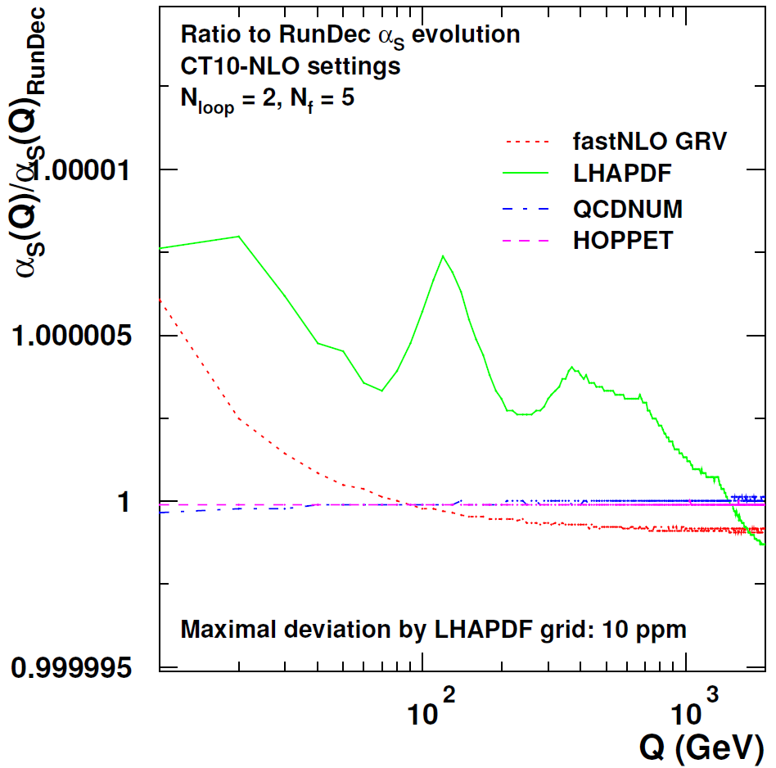
Use of alternative α_{s} evolutions
LHAPDF5/6
CRunDec 08/2012
  included in fastNLO
QCDNUM v17-00-06
  … [--with-qcdnum=/path/...]
  Makefiles adapted, need -fPIC on x86_64 systems
HOPPET v1.1.5
  … [--with-hoppet=/path/...]
5
5 ppm
RunDec, B. Schmidt, M. Steinhauser, CPC183, 2012;
K. Chetyrkin, J. Kühn, M. Steinhauser, CPC133, 2000.
QCDNUM, M. Botje, CPC182, 2011.
HOPPET, G. Salam, J. Rojo, CPC180, 2009.
RunDec, B. Schmidt, M. Steinhauser, CPC183, 2012;
K. Chetyrkin, J. Kühn, M. Steinhauser, CPC133, 2000.
QCDNUM, M. Botje, CPC182, 2011.
HOPPET, G. Salam, J. Rojo, CPC180, 2009.

Slide 5
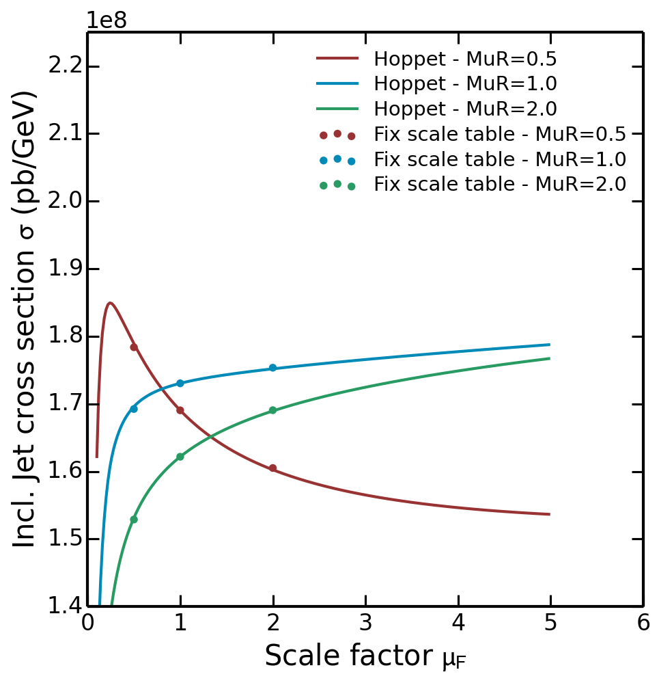
Use of HOPPET for μ_{f} variation
fastNLO v1.4 used extra tables for μ_{f} variation with fixed scale factors
  straightforward also @ NNLO
  avoids additional integrations
  increases table size
In fastNLO v2.3 can also use HOPPET for μ_{f} variation
  Same method as used in APPLgrid
  continuous curve
Points pre-
calculated
(fixed-scale
table @ μ_{f} =
0.5, 1.0, 2.0)
Lines derived
using HOPPET
APPLgrid, T. Carli et al., EPJC 66 (2010) 503.

Slide 6


Calculations with fastNLO in NNLO
Problem
    Scale variations become more difficult in NNLO than in NLO
Current available implementations for NLO calculations
Renormalization scale variations
    Scale variations applying RGE
        Use LO matrix elements times nβ₀ln(c_{r}) [fastNLO, APPLgrid]
    Flexible-scale implementation
        Store scale-independent weights: [fastNLO]
Factorization scale variations
    Calculate LO DGLAP splitting functions using HOPPET [APPLgrid, fastNLO]
    Store coefficients for desired scale factors [fastNLO]
    Flexible-scale implementation [fastNLO]
Scale variations for NNLO calculations
    renormalization scale variations become more complicated
    NLO splitting functions are needed for factorization scale variations e.g. with HOPPET
        Calculations become slower again => Not desired for fast repeated calculations

Slide 7
Flexible-scale tables
Storage of scale-independent weights enable full scale flexibility also in NNLO
    Additional logs in NNLO
    Store weights: w₀, w_{R}, w_{F}, w_{RR}, w_{FF}, w_{RF} for order α_{s}^{n+2} contributions
Advantages
    Renormalization and factorization scale can be varied independently and by any factor
        No time-consuming ‘re-calculation’ of splitting functions in NLO necessary
    Only small increase in amount of stored coefficients
fastNLO implementation
    Two different observables can be used for the scales
        e.g.: H_{T} and p_{T,max}
        or e.g.: p_{T} and |y|
        …
    Any function of those two observables can be used for calculating scales
log’s for NLO
additional log’s in NNLO
‘Flexible-scale concept‘: Best choice for performant NNLO calculations

Slide 8
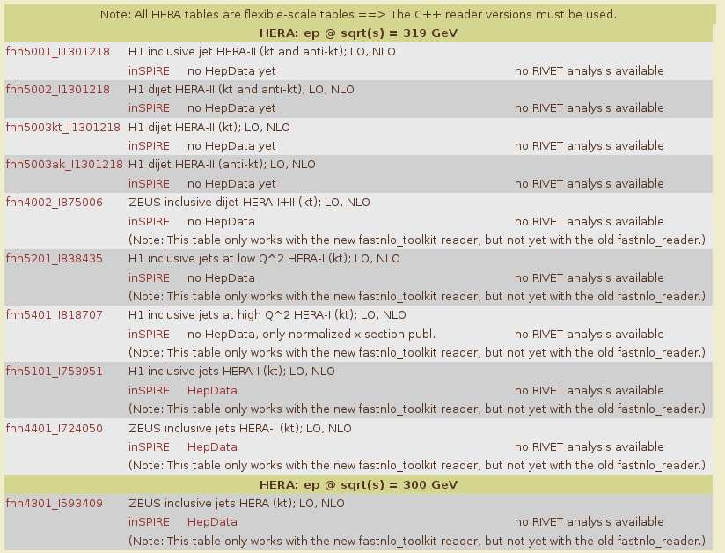
Flexible-scale tables in DIS
fastnlo @ HepForge
Tables from recent
H1 multi-jet study
use √Q² and pT
Use of this method in fastNLO dates back to 2011 when going from v1.4 to v2.1.
Useful for DIS, now also for pp,
e.g. with scales M_{Z} and pT_{Z}.

Slide 9
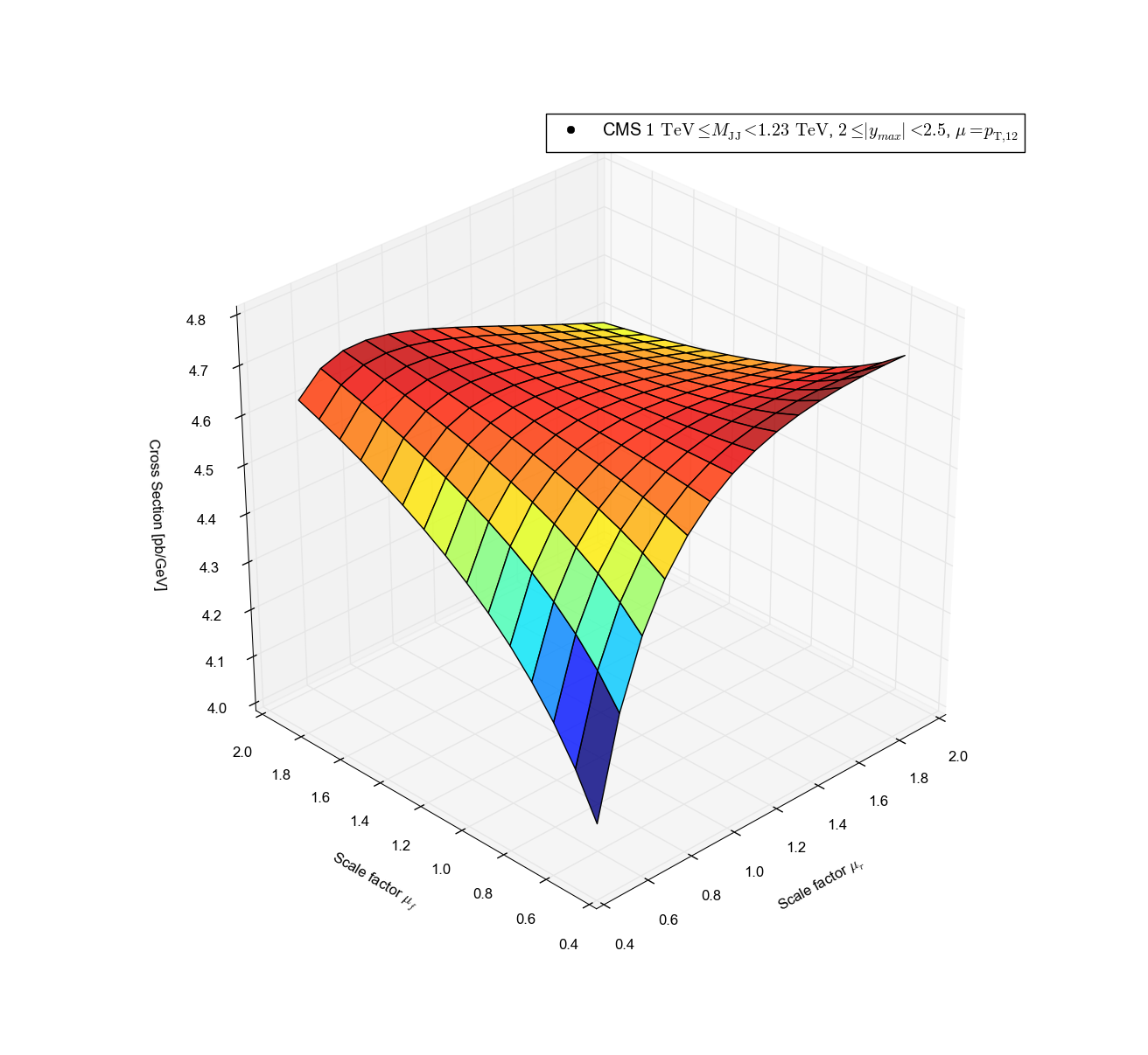
Demo plot using Python extension
Setup Python
with fastNLO
Python extension available
  … [--enable-pyext]
Easy example plotting 2D scale dependence:
#! /usr/bin/env python2
from fastnlo import fastNLOLHAPDF
import matplotlib
import matplotlib.pyplot as plt
from matplotlib import cm
from mpl_toolkits.mplot3d import axes3d
import numpy as np
fnlo = fastNLOLHAPDF('fnlotable.tab')
fnlo.SetLHAPDFFilename('CT10nlo.LHgrid')
fnlo.SetLHAPDFMember(0)
mufs = np.arange(0.1, 1.5, 0.10)
murs = np.arange(0.1, 1.5, 0.10)
xs = np.zeros((mufs.size, murs.size))
for i, muf in enumerate(mufs):
for j, mur in enumerate(murs):
fnlo.SetScaleFactorsMuRMuF(mur, muf)
fnlo.CalcCrossSection()
xs[i][j] = np.array(fnlo.GetCrossSection())[0]
fig = plt.figure(figsize=(13,13))
… plotting details
ax.set_ylabel('Scale factor $\mu_F$')
ax.set_xlabel('Scale factor $\mu_R$')
ax.set_zlabel('Cross Section [pb/GeV]')
plt.show()
… plotting details
Select table,
PDF & mem.
Define μ_{r}, μ_{f}
ranges
Loop over
μ_{r}, μ_{f}
Plot

Slide 10
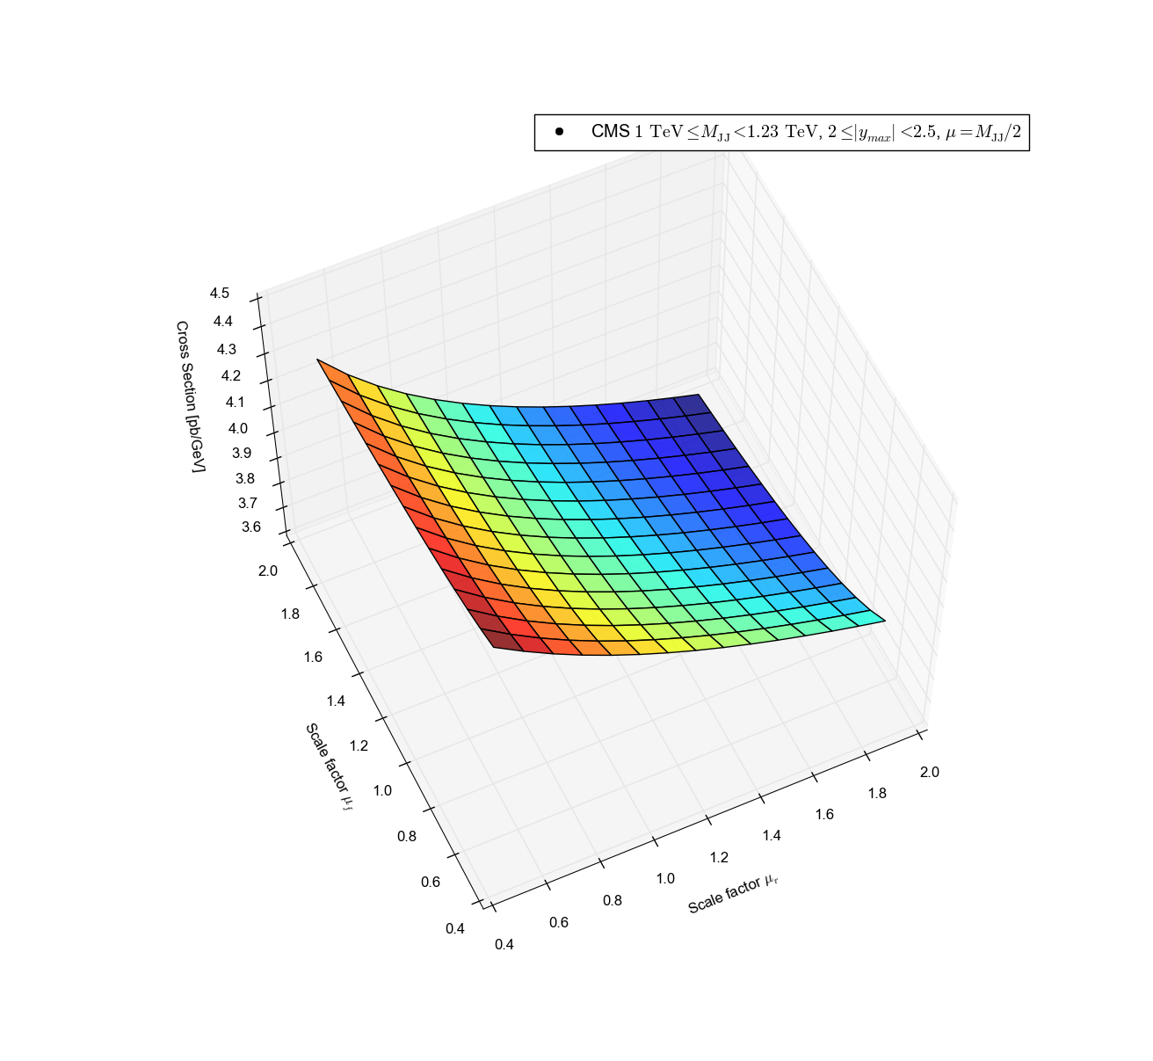
Extra slide: CMS dijet mass
Central scale: μ = <pT_{1,2}>
Outer |y_{max}| bin!
Central scale: μ = M_{JJ}/2
Derived from one fastNLO flexible-scale table

Slide 11
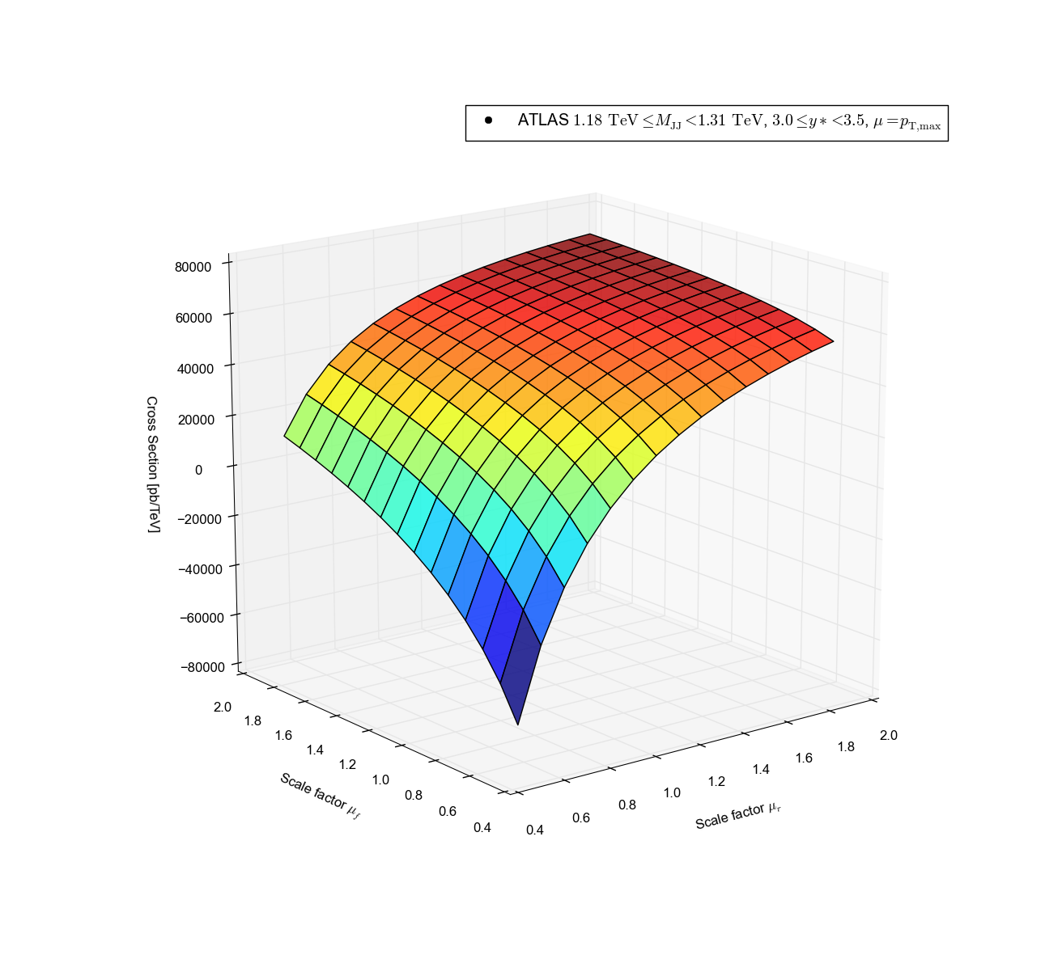
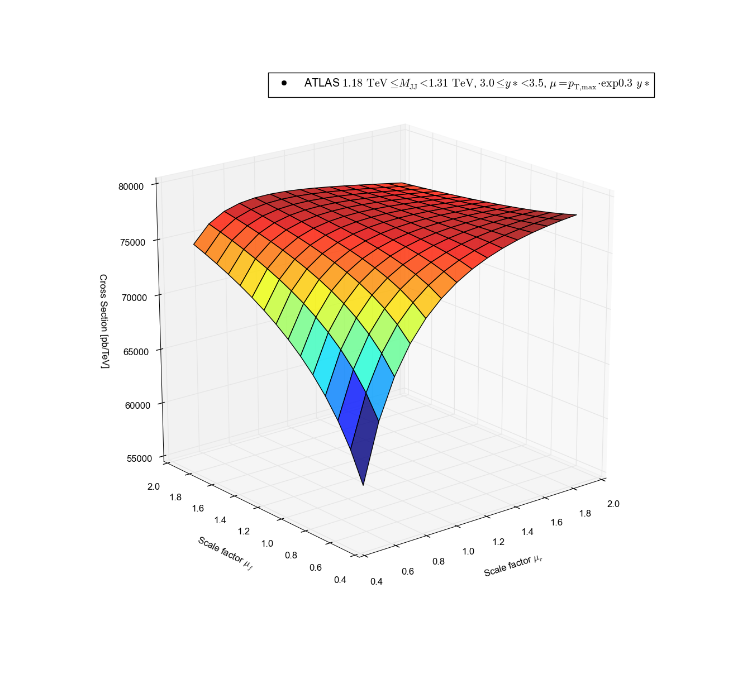
Extra slide: ATLAS dijet mass
Central scale: μ = pT_{max}
Outer y* bin!
Central scale: μ = pT_{max}· exp(0.3 y*)
+80k
+80k
Negativ!
-80k
+55k
Derived from one fastNLO flexible-scale table

Slide 12
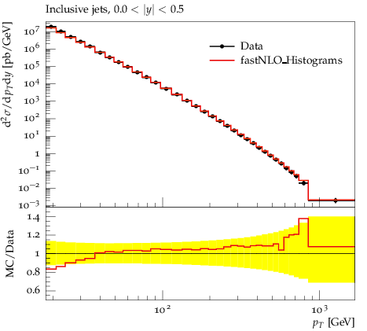
Use with Rivet 2 & YODA Format
Summer student project of Stefanos Tyros (with Peter Skands):
Provide YODA formatted output for fastNLO tables
  fnlo-tk-yodaout fnlotable.tab
Compare with data (or MC) histograms using Rivet
  rivet-mkhtml fnlotable.yoda
  browser plots/index.html
Can provide e.g. NLO plots to mcplots.cern.ch
Test inclusion of fastNLO in GENSER successful
It is very desirable to have the RIVET
analyses from the experiments!
RIVET, A. Buckley et al., CPC184 (2013),
rivet.hepforge.org, yoda.hepforge.org.

Slide 13
Re-factoring v2.1 into Toolkit
1. Code split into:
Toolkit library for creating & evaluating interpolation grids
  Independent of any generator
  First pre-release 17.07.2014: fastnlo_toolkit 2.3.1pre-1854
Specific helper interfaces, if required, to N(N)LO programs
  e.g. to use with NLOJet++: fastnlo_interface_nlojet 2.3.1pre-1855
2. Checked backwards compatibilty with v2.1
3. Facilitated use with extensible steering files
4. Interface other theory programs ...
NLOJet++, Z.Nagy,
PRD68 2003, PRL88 2002

Slide 14
Simple example for use of Toolkit
Program Start
fastNLOCreate fnlo(„steering.str“);
fnlo.SetOrderOfCalculation(int order);
Initialize fastNLO class(es)
(N)NLO Program
fnlo.fEvent.SetProcessID(int id);
Pass the process specific variables during the ‘event loop’ to fastNLO
    Order does not matter
    Many other convenient implementations possible
fnlo.fEvent.SetX1(double x1);
fnlo.fEvent.SetX2(double x2);
fnlo.fEvent.SetWeight(double w);
MC Integration
fnlo.fScenario.SetObservable0(double pt);
fnlo.fScenario.SetObsScale1(double s1);
fnlo.Fill();
Pass all information to fastNLO
fnlo.SetNumberOfEvents(double nevents);
fnlo.WriteTable();
Set normalization of the MC integration and write table
Program End
Minimum implementation:
11 lines of code
(N)NLO Result
fastNLO Table
Convenient implementation of fastNLO into any (N)NLO program possible!

Slide 15
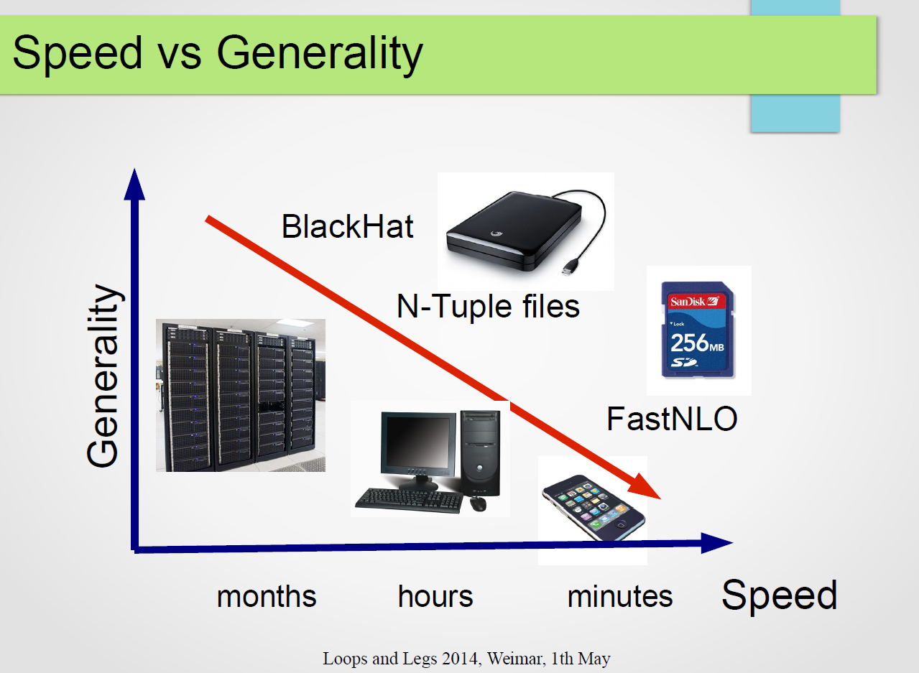
Use with BlackHat N-Tuples
Slide from Daniel Maitre

Slide 16
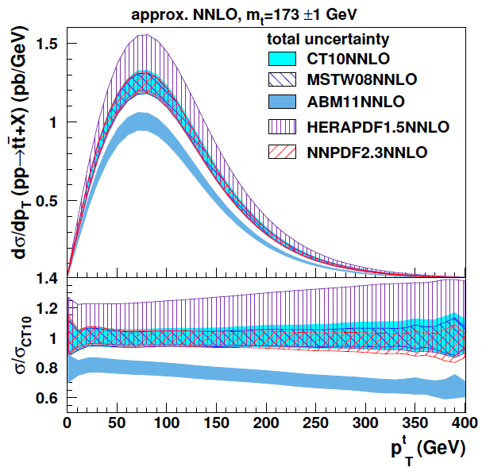
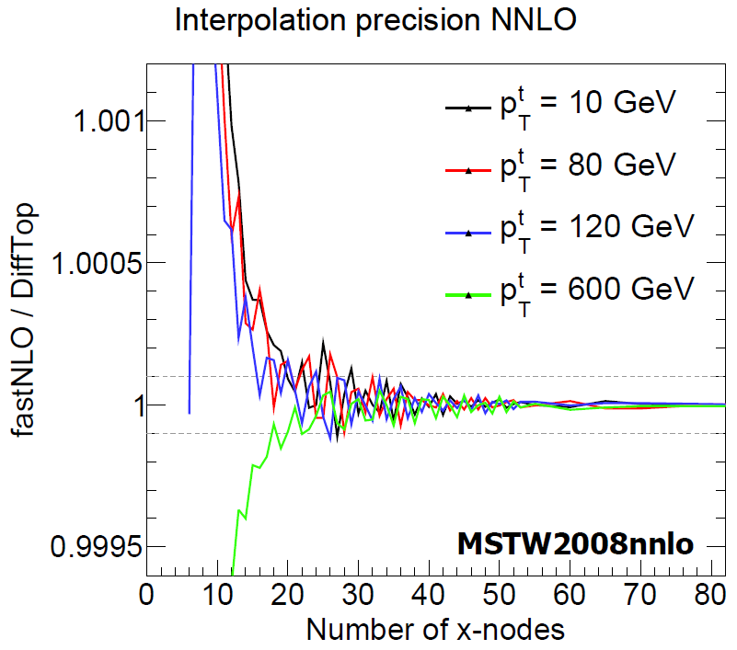
Use with DiffTop
Differential ttbar in approx. NNLO:
dσ/dp_{T} , dσ/dy
(total uncertainty: quadr. sum of PDF, scale, α_{s}, m_{t} variations)
Precision study of fastNLO tables over
DiffTop standalone vs. no. of x nodes
0.1 permille
786 repeated calculations needed including (separate) variation of m_{t}
DiffTop, M. Guzzi et al.,
JHEP01, 2015.
Perfect agreement for probed x-range of 2 ∙10⁻³ < x < 1

Slide 17
Parton Distributions for the LHC
Part 2
New: Interface
to Sherpa via MCgrid
in collaboration with
Enrico Bothmann & Steffen Schumann

Slide 18
Use with Sherpa & MCgrid
fastNLO Toolkit access implemented:
  Events generated with Sherpa 2.1.1
  Two analyses from Rivet 2.2.0 tested
  MCgrid 2.0 for cross section projection into grids (to be released)
  Same toolkit functions accessed either via direct calls from MCgrid-enabled Rivet analysis or via steering file
  Usable with large number of processes available via Sherpa and one-loop generators like BlackHat, GoSam, OpenLoops, NJET, ...
ME Generator
LO/NLO QCD events
HepMC
Rivet
observable projections
MCgrid
MCgrid, L. Del Debbio
et al., CPC185, 2014.
Sherpa, T. Gleisberg et al., JHEP02, 2004; JHEP02, 2009.
BlackHat, C.F. Berger et al., PRD78, 2008.
GoSam, G. Cullen et al., EPJC72, 2012.
OpenLoops, F. Cascioli et al., PRL108, 2012.
NJET, S. Badger et al., CPC184, 2013.
...
APPLgrid/fastNLO
differential xsec grids

Slide 19
Snippets of Rivet+MCgrid analysis
#include "Rivet/Analysis.hh”
#include "mcgrid/mcgrid.hh"
...
namespace Rivet {
/// CDF Z boson rapidity modified to generate grid files
class MCgrid_CDF_2009_S8383952 : public Analysis {
public:
...
using namespace MCgrid;
Histo1DPtr _hist_yZ; // Rivet histogram
gridPtr _grid_yZ; // Corresponding grid
// Init phase
subprocessConfig subproc("DY-ppbar.str", BEAM_PROTON, BEAM_ANTIPROTON);
fastnloGridArch arch(50, 1, "Lagrange", "OneNode", "sqrtlog10", "linear");
fastnloConfig config(0, subproc, arch, 1960.0);
_hist_yZ = bookHisto1D(2, 1, 1); // Book Rivet
_grid_yZ = bookGrid(_hist_yZ, histoDir(), config); // Book MCgrid/fastNLO
// Analyse phase
PDFHandler::HandleEvent(event, histoDir()); // Update subprocess statistics
_hist_yZ->fill(yZ, weight); // Fill Rivet
_grid_yZ->fill(yZ, event); // Fill MCgrid/fastNLO
// Finalise phase
scale(_hist_yZ, normalisation); // Scale Rivet
_grid_yZ->scale(normalisation); // Scale MCgrid/fastNLO
PDFHandler::CheckOutAnalysis(histoDir()); // Finalise
Setup Rivet
with MCgrid
Basic scheme very similar with APPLgrid,
differences in steering & functionalities.
Book & config
grid and histos
Fill events in
event loop.
Final check out,
normalize, write
table.

Slide 20
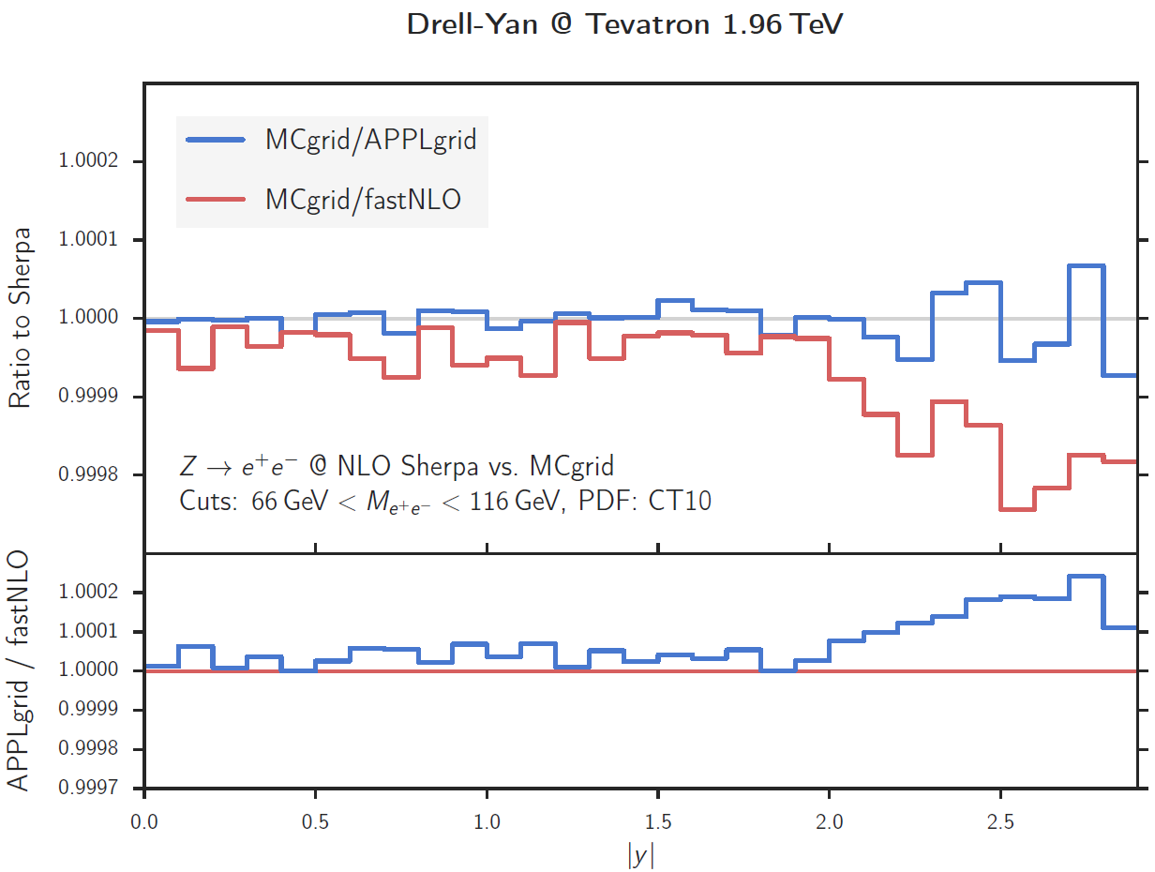


Drell-Yan @ Tevatron
Drell-Yan Z rapidity:
1M (phase space)/10M (fill) events
Interpolation in x only
No optimizations performed for either fastNLO or APPLgrid
Agreement between
interpolations
and to Sherpa at
sub-permille level!

Slide 21
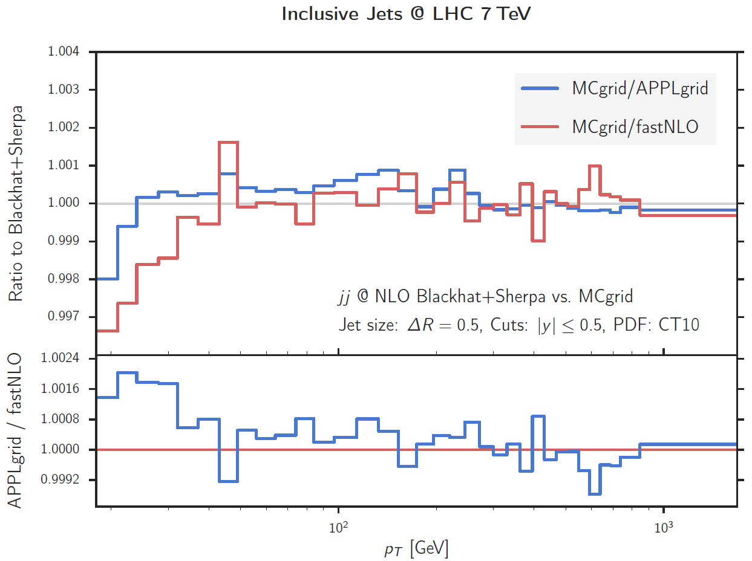
Jets @ LHC
Jet pT distribution:
10M (phase space)/10M (fill) events
Interpolation in x and scales
No optimizations for either fastNLO or APPLgrid
Updated versions of
fastNLO Toolkit
and MCgrid to be
released soon.
Agreement between
interpolations and to
BlackHat+Sherpa at
permille level!

Slide 22


Outlook
The toolkit provides simple access to full capability of creating, filling, reading, and evaluating fast interpolation tables in the fastNLO format
A simplified interface to NLOJet++ is publically available as well
Uses flexible-scale table format, well-suited for NNLO
Tested at (approx.) NNLO with DiffTop and by BlackHat ==> well prepared for i.a. jets at NNLO :-)
Other theory programs can be/have been interfaced
Demonstrated new application with MCgrid and Sherpa
New release of the fastNLO Toolkit imminent
Will be synchronized with new release of MCgrid
Work in progress with Herwig++/Matchbox
Work on inclusion of statistical uncertainty of calculation within table
and last but not least ...

Slide 23
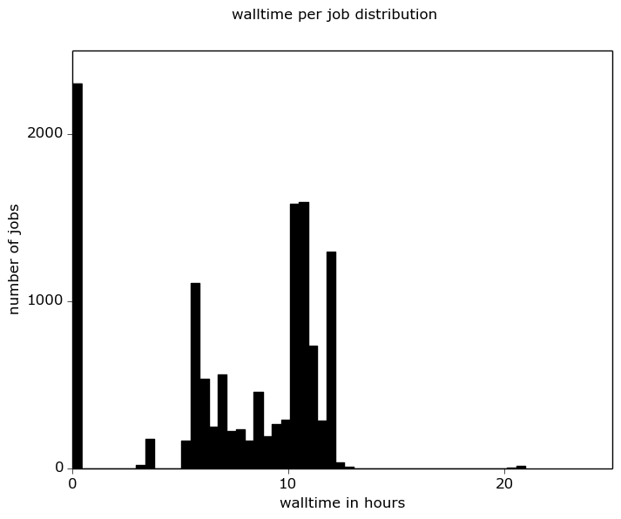
Table production initiative
Started large-scale table production as stress test on computing centers as private cloud providers
  Uses Karlruher generic grid submission tool grid-control and HTCondor & OpenStack
Test production at Xmas:
  800 virtualised CPUs
  13000 jobs
  95000 h of CPU time
  10¹² events
  13 fastNLO tables
Anything on your wishlist?
Many thanks to the Computing
Centre of the University Freiburg
for providing the bwForCluster
test system!
Summary of
job timings
warm-up
NLO
LO

Slide 24
Backup Slides

Slide 25
Excerpt of steering.str
ScenarioName fnl2342b_I902309_v23_flex # Name and describe scenario
ScenarioDescription {
"d2sigma-jet_dpT_dy_[pb_GeV]"
…
JetAlgo 2 # fastjet jet algorithm: 0,1,2=kT,CA,anti-kT
Rjet 0.5 # Jet size parameter: Required for all jets
ptjmin 18. # Minimal jet pT
yjmin 0.0 # Minimal jet rapidity
yjmax 3.0 # Maximal jet rapidity
… extensible
LeadingOrder 2 # Number of jets for the LO process
DifferentialDimension 2 # Dimensionality of binning
DimensionLabels { # Labels (symbol and unit) for dimensions
"|y|" # Defines the observables to be calculated!
"pT_[GeV]"
}
FlexibleScaleTable true # Create table fully flexible in mu_f
ScaleDescriptionScale1 "pT_jet_[GeV]" # This defines the scale to be used
ScaleDescriptionScale2 "pT_max_[GeV]" # Specify 2nd scale name and unit
DoubleDifferentialBinning {{
1stDimLo 1stDimUp "----- Array of bin-grid for 2nd dimension -----"
0.0 0.5 18. 21. 24. 28. 32. 37. 43. 49. 56. …
…
}}
Running any other scenario can be as simple as adapting some
kinematical cuts & binning, often not even a recompile necessary!

Slide 26
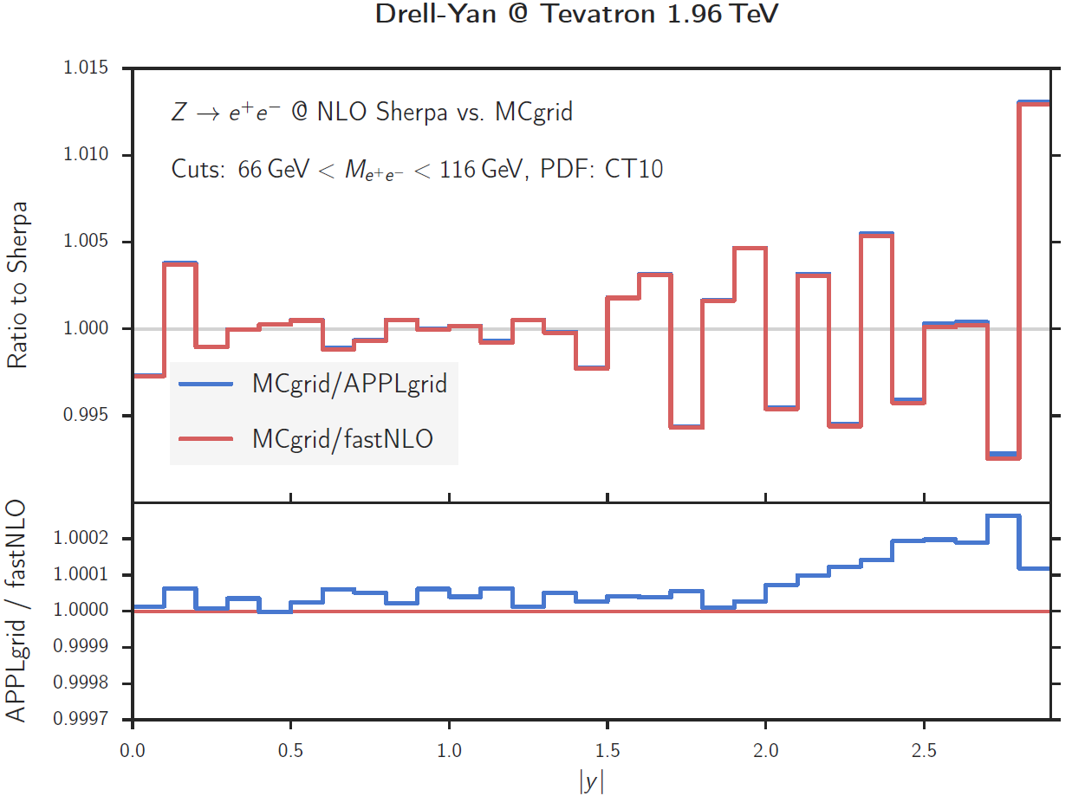
DY with reduced flavour-basis
Store identical subprocesses into same “process bin” instead of full 121 flavour basis
  Dramatic reduction in required storage space!
But not exactly an apple-to-apple comparison anymore
  Statistical variations visible between exclusive Sherpa events and interpolated results
Anyway still ok at sub-percent level

