Slide 1


DPG Frühjahrstagung 2011
Application of
to Jet Analyses
Thomas Kluge, Klaus Rabbertz, Markus Wobisch
Hamburg, KIT Karlsruhe, Louisiana Tech University

Slide 2
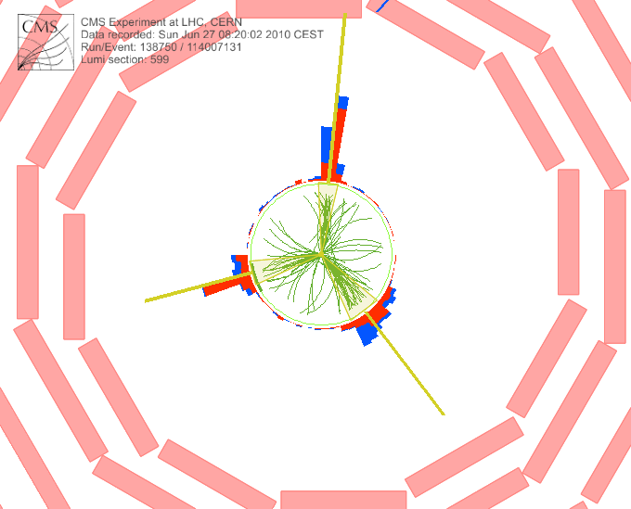
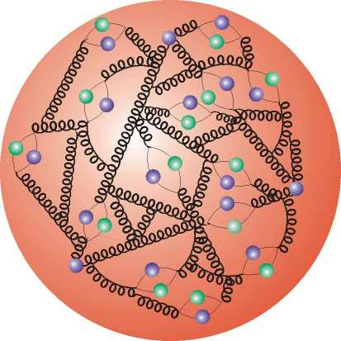

Outline
Motivation & Concept
Application to Jet Analyses at LHC
Outlook

Slide 3




Motivation
  Interpretation of experiment data relies on:
    Availability of reasonably fast theory calculations
    Often needed: Repeated computation of same cross section
    On the following pages: Repetition counter: # NLO = nnn
  Examples for a specific analysis:
    Use of various PDFs (CTEQ, MSTW, NNPDF, HERAPDF, ABKM ...)
    Determine PDF uncertainties (PDF error sets)
    Use data set in fit of PDFs and/or αs(MZ)
  Sometimes NLO predictions can be computed fast
  But some are very slow, esp. for Drell-Yan and jets
  Need procedure for fast repeated computations of NLO cross sections
  Use fastNLO (ATLAS mostly uses another project: APPLGrid)

Slide 4
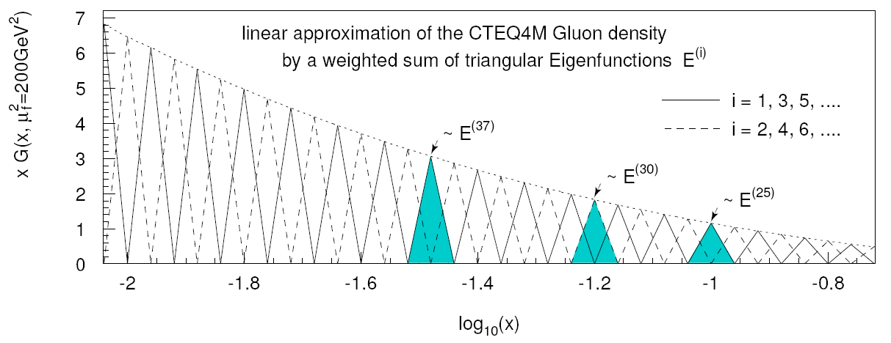


Concept on a Slide
  Introduce set of discrete x^{(i)} with x^{(n)} < ..< x^{(i)} <..<x⁽⁰⁾=1
  Around each x^{(i)} define eigen function E^{(i)}(x) with:
E^{(i)}(x^{(i)}) = 1, E^{(i)}(x^{(j)}) = 0 (i ≠ j), Σi E^{(i)}(x) = 1 for all x
  Express PDF f(x) by lin. combination of eigen functions with coefficients given by PDF values at discrete points:
In detail more complicated: 2-dim. (log) x binning, cubic interpol., weights
=> Integration only over E^{(i)}(x), not f(x)!

Slide 5
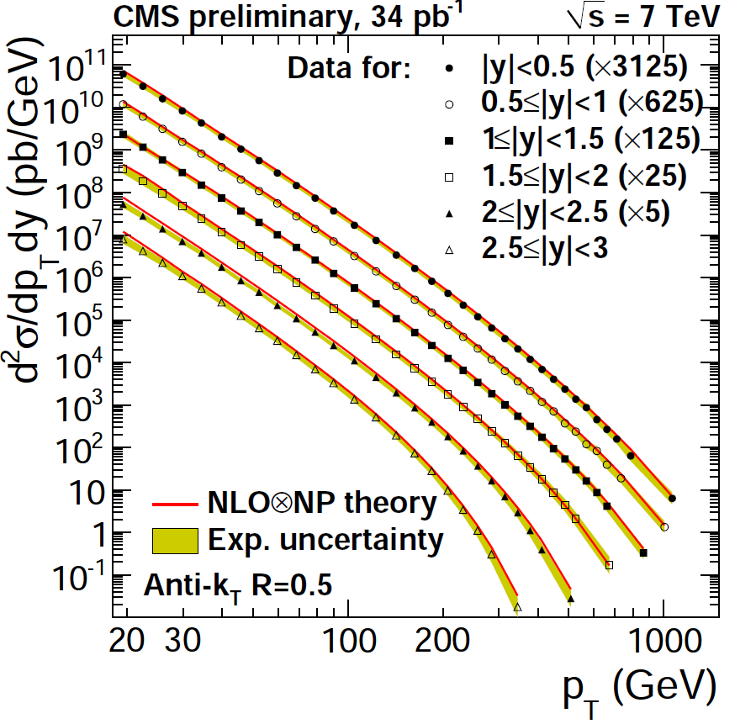

Absolute Measurements
Simplest case:
Inclusive jet pT cross section
For this derive:
  Scale Dependence:
    Mostly: Sim. variation of μ_{r} and μ_{r} by factor of 2
    Better: Indep. variation at 6 points (1/2,1/2), (1/2,1), (1,1/2), (1,2), (2,1), (2,2)
  PDF Uncertainties
    PDF4LHC prescription for 1st compatibility check
    Use of various PDFs (CTEQ, MSTW, NNPDF, HERAPDF, ABKM ...)
  Sensitivity to alpha_s
    Use data set with fit/use of αs(MZ)
CMS-PAPER-QCD-10-011
# NLO = 1

Slide 6
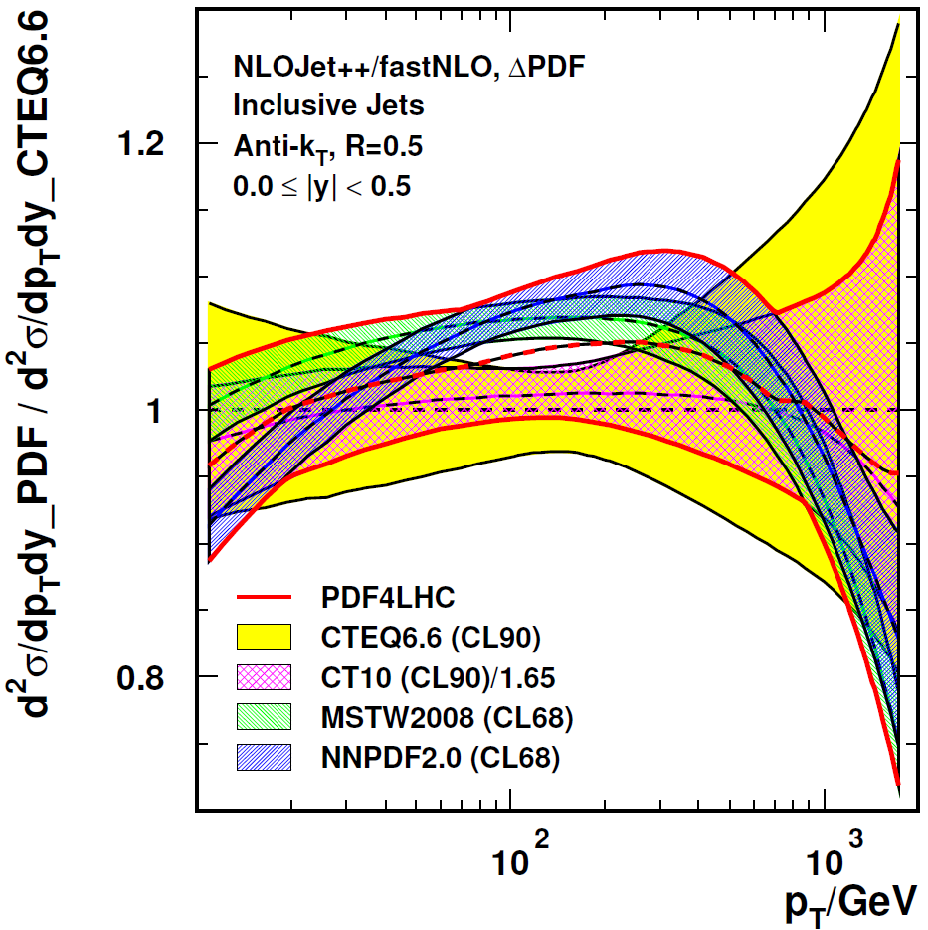
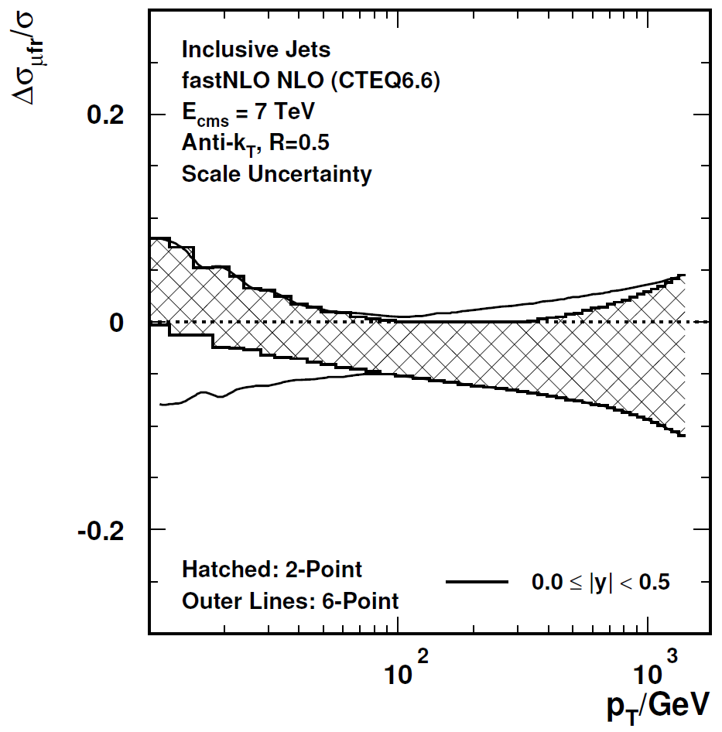
Scale and PDF Uncertainties
Asymmetric scale variations:
Independent variation of μ_{r} and μ_{f}
by factors of ½ and 2 avoiding rel. factors of 4
(6-point: (1/2,1/2), (1/2,1), (1,1/2), (1,2), (2,1), (2,2)
Compared to symmetric variation (2-point)
A la PDF4LHC:
Envelope of predictions of CTEQ,
MSTW and NNPDF at CL68
Compared to CTEQ6.6 (CL90)
PDF4LHC
envelope
x_{µ} = ½, 2
CTEQ6.6
2σ band
x_{µ} = ½,1,2
indep. for µ_{r}, µ_{f}
# NLO = 6
# NLO = 239

Slide 7
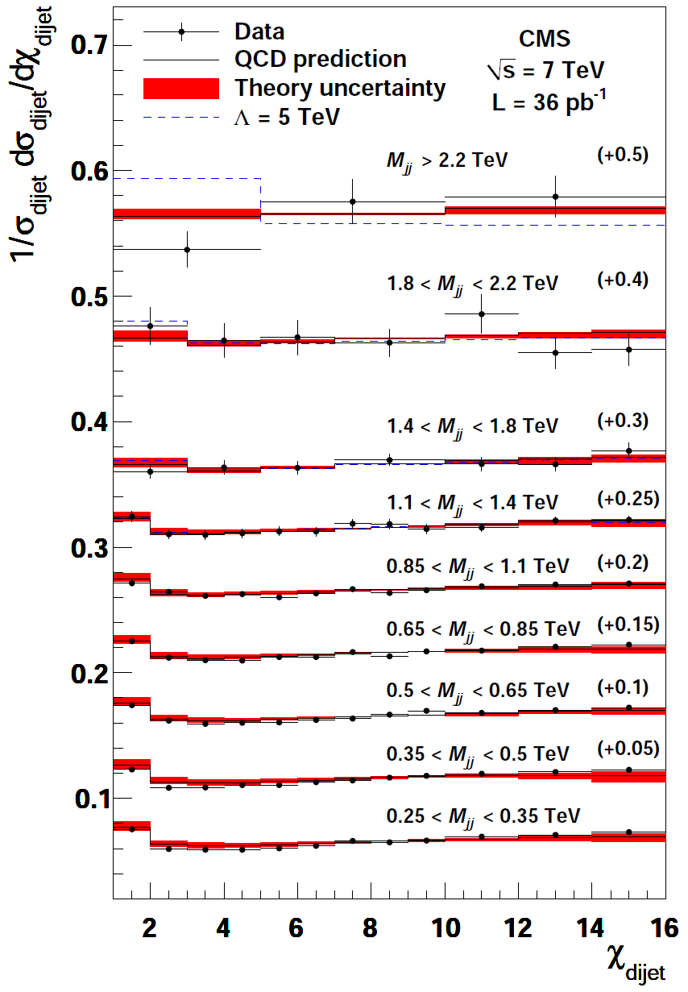


Normalized Cross Section 1
Version 1: Area Normalization
(Not always possible in pQCD!)
Dijet Angular Distribution in Chi_{jj} where
Search for new physics at high mass and
low Chi_{jj} !
Technically:
2-jet cross section well defined at NLO from
minimal Chi_{jj} up to chosen maximum e.g. 16
# NLO = 45
CMS, arXiv:1102:2020

Slide 8
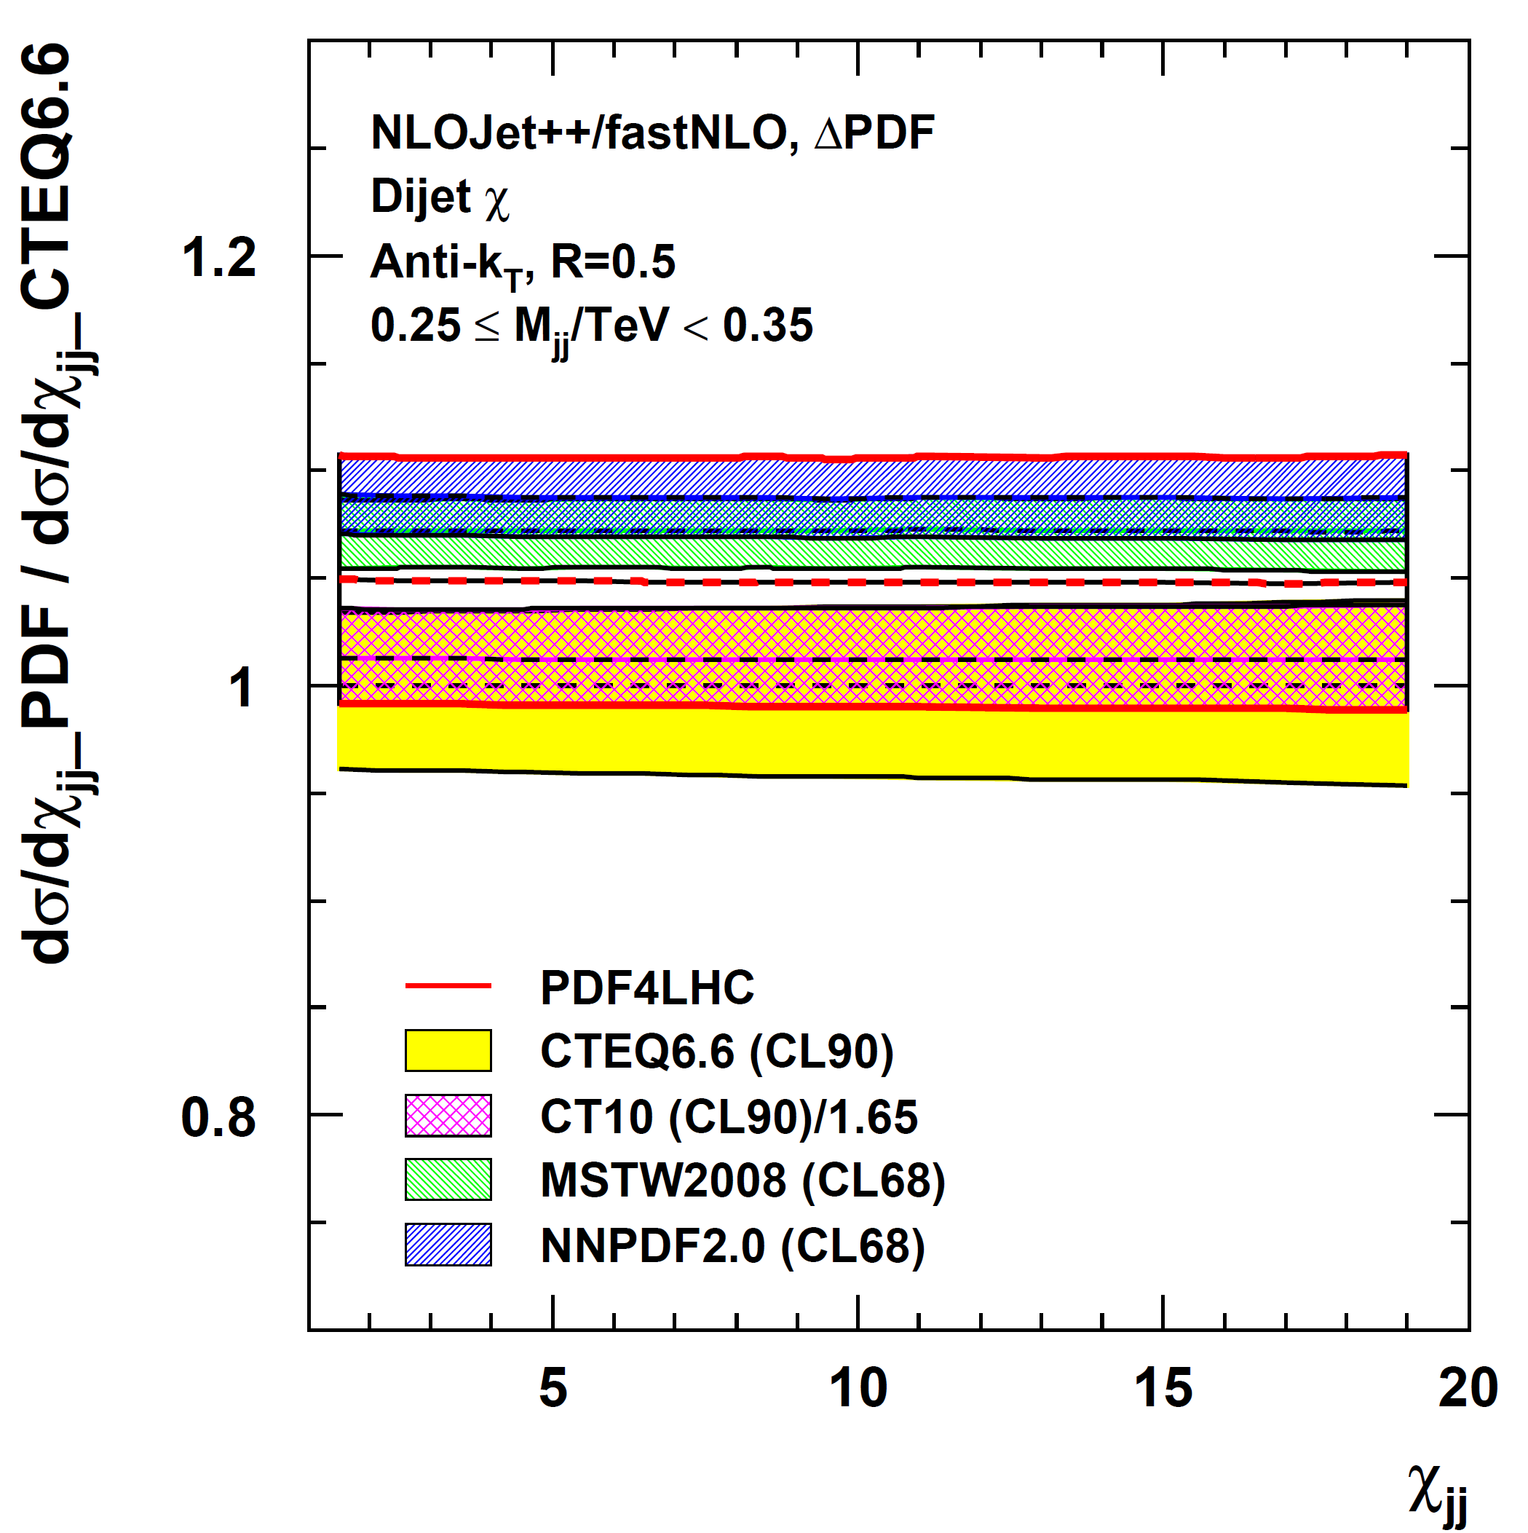
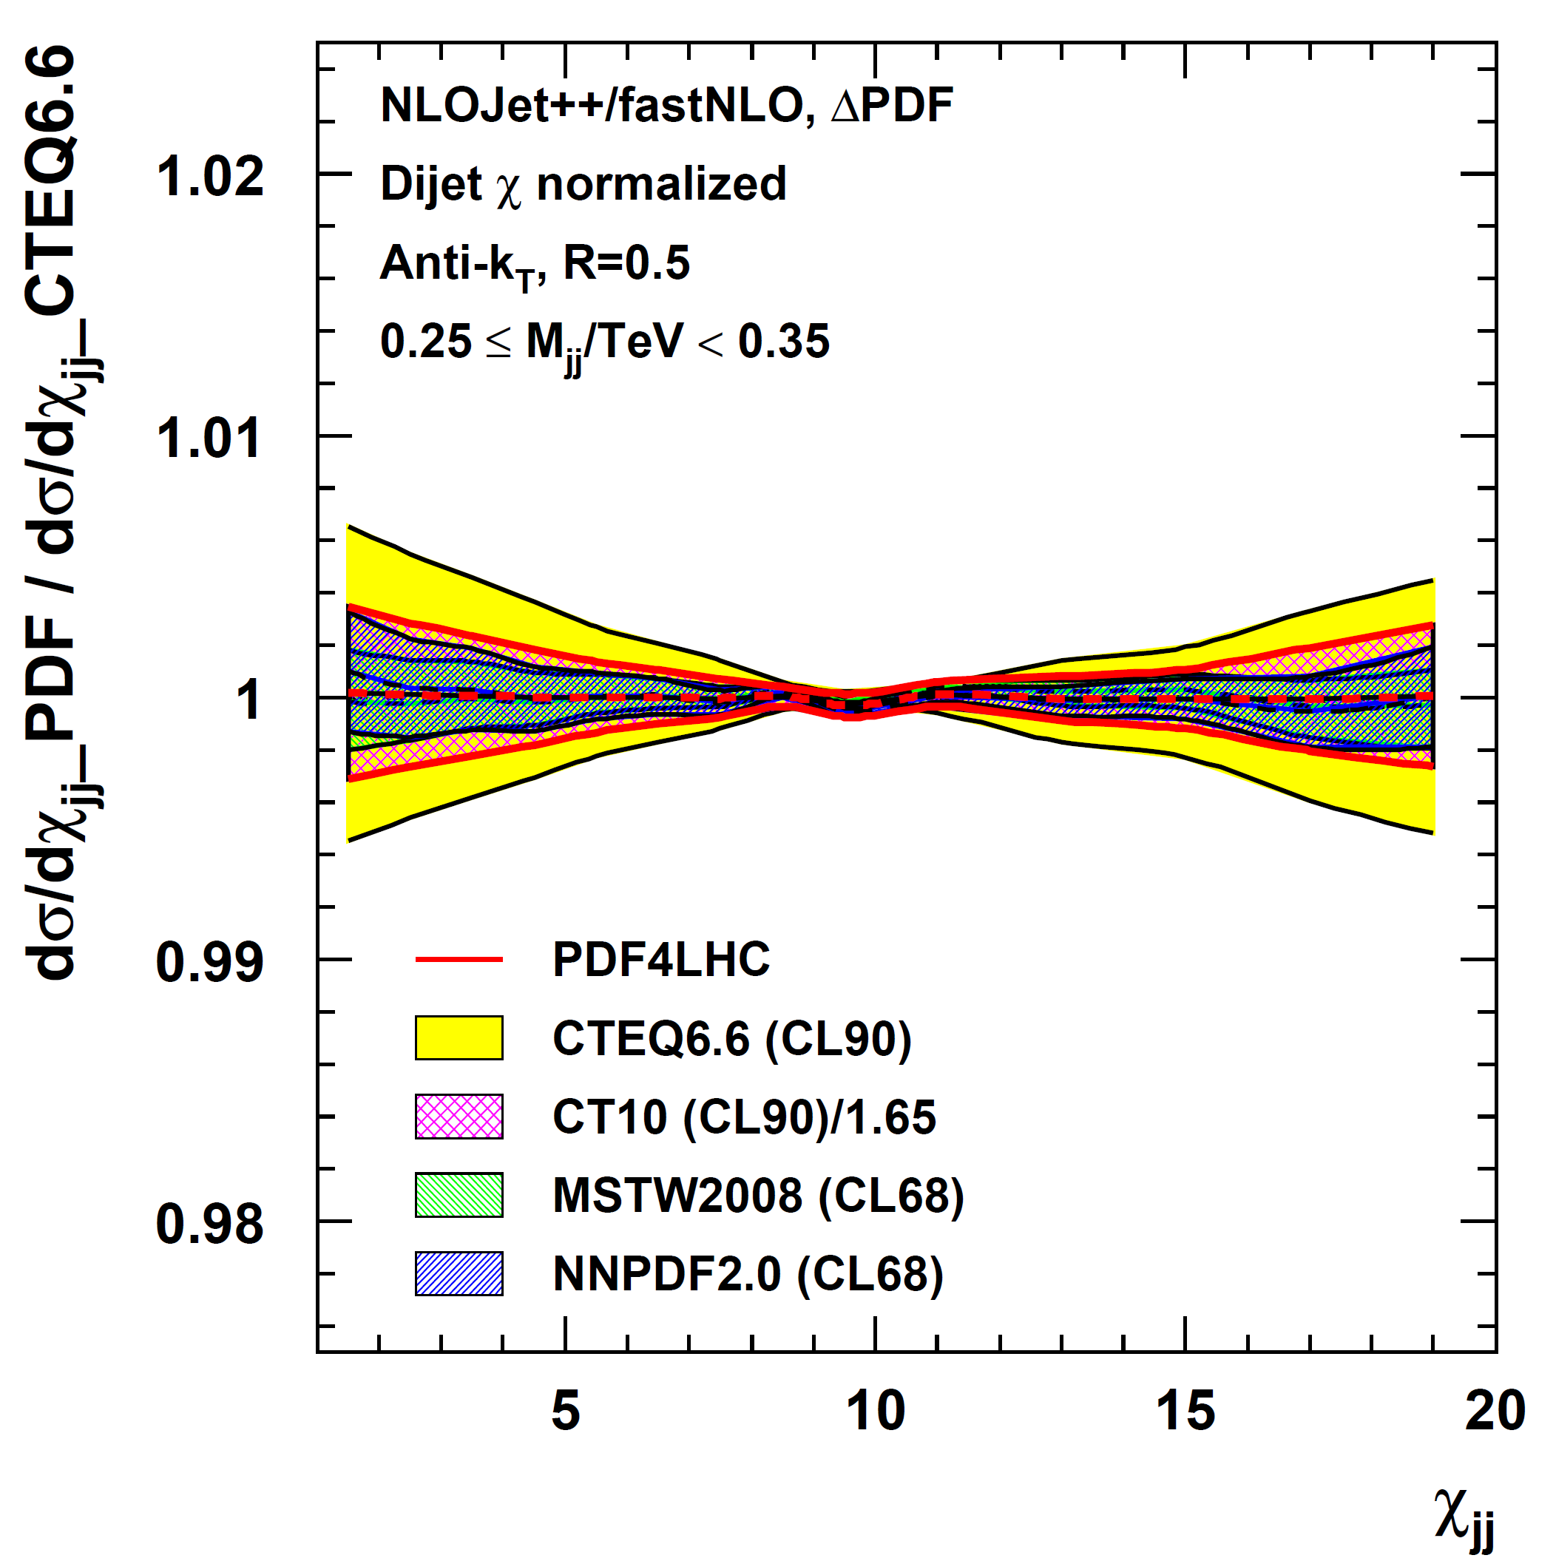
Dijet Angular: ΔPDF
Take proper care of normalization in e.g. PDF uncertainty derivation
Differential cross section
Normalized cross section
# NLO = 239

Slide 9
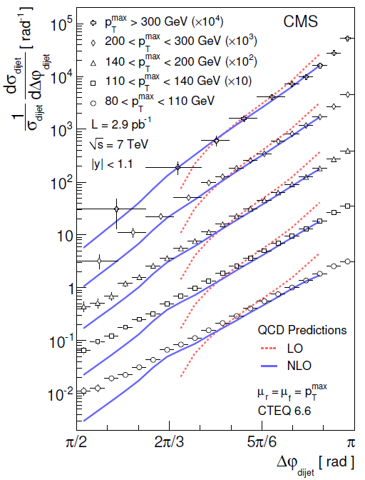
Normalized Cross Section 2
Version 1: Normalize to … ?
Dijet azimuthal decorrelation:
Depending on Δφ_{jj} different orders
(# of partons) contribute!
Some parts of histogram would be NNLO
(at π) or are NLO (down to ~2π/3) or
LO (below ~2π/3)
# NLO = 1
Nevertheless:
Normalization can be done at NLO
==> Numerator and Denominator both at NLO …
but of different order in alpha_s
O(alpha_s³) / O(alpha_s²)
Also possible: Numerator and denominator of
same order in alpha_s e.g. Dijet Centrality Ratio
CMS, arXiv:1101:5029

Slide 10
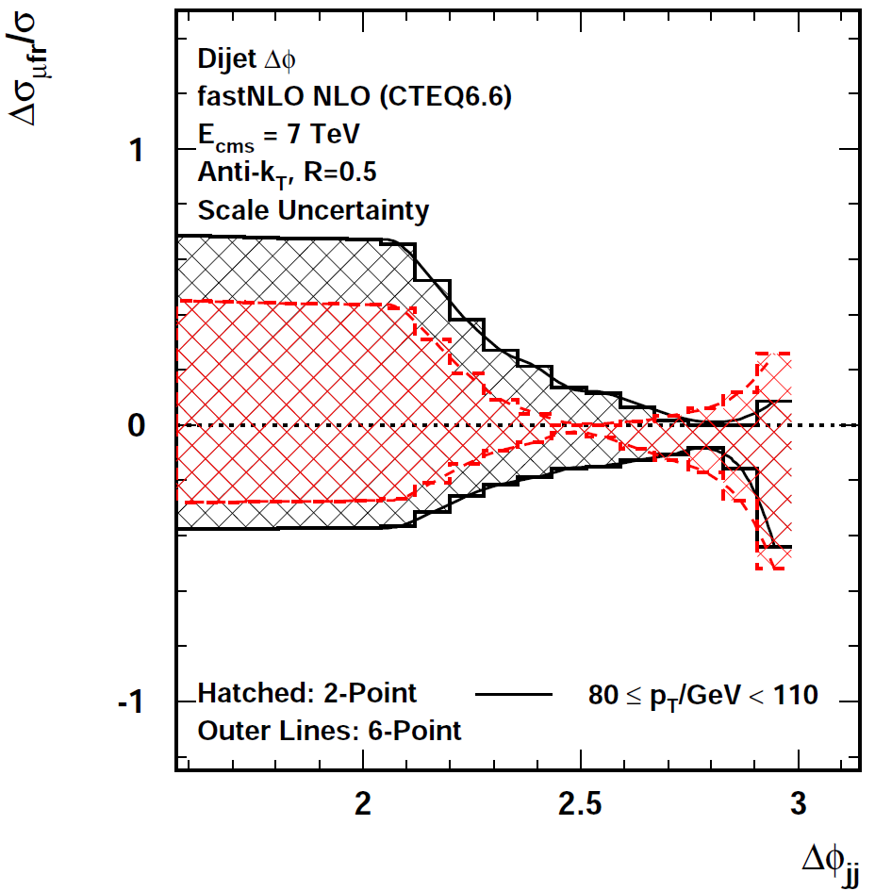
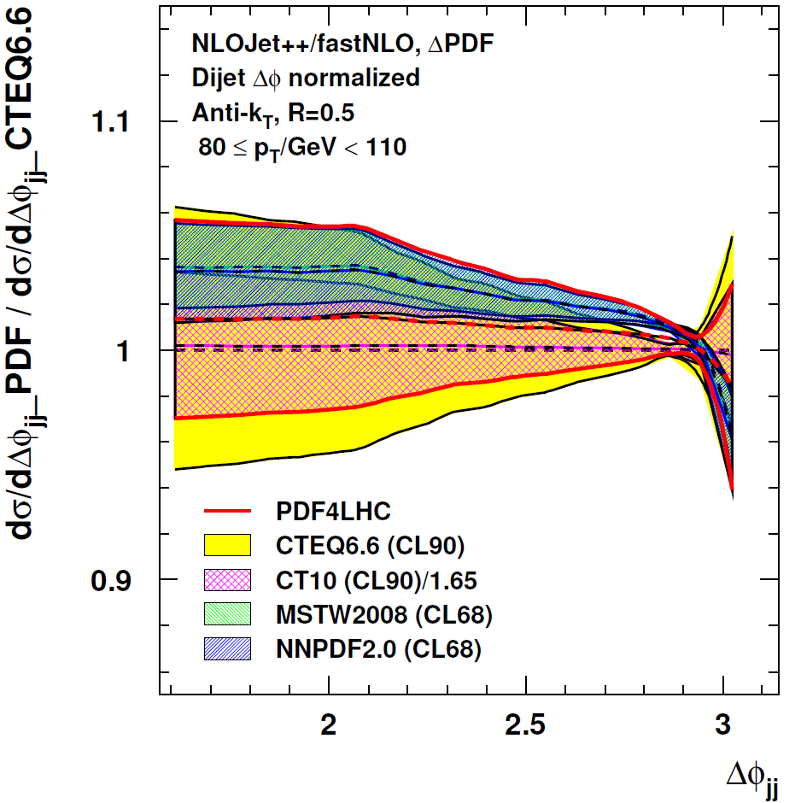
ΔΦ: Scale and ΔPDF
Reevaluations for numerator and denominator!
Low pT bin: 80 < pT / GeV < 110
Only in
3-jet part
PDF4LHC
envelope
Normalized ΔΦ
CTEQ66
2σ band
# NLO = 2 x 6
# NLO = 2 x 239

Slide 11
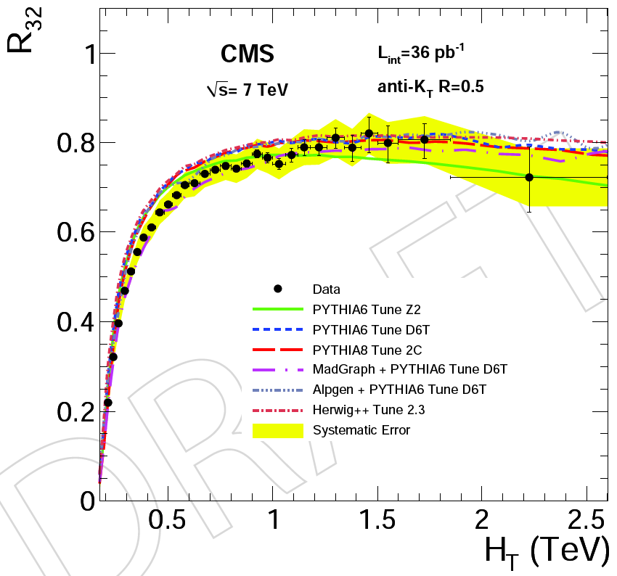
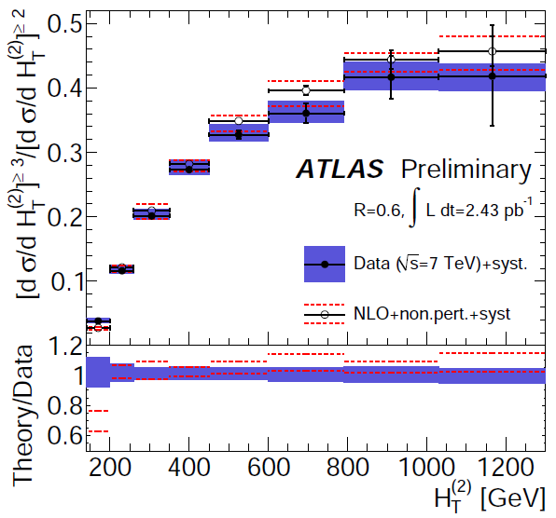
Cross Section Ratios
ATLAS: anti-kT R=0.6, |y| < 2.8
p_{Ti} > 30 GeV, p_{T1} > 60 GeV
H_{T} = Σ |p_{Ti}|
exp. Uncertainty < ~ 10%
CMS: anti-kT R=0.5, |y| < 2.5
p_{Ti} > 50 GeV, p_{T1} > 60 GeV
H_{T} = Σ |p_{Ti}|
exp. Uncertainty < ~ 10%
ATLAS: Also consider differential
2-jet Rate (~> event shape ...)
ATLAS CONF-2011-043
CMS-QCD-10-012

Slide 12
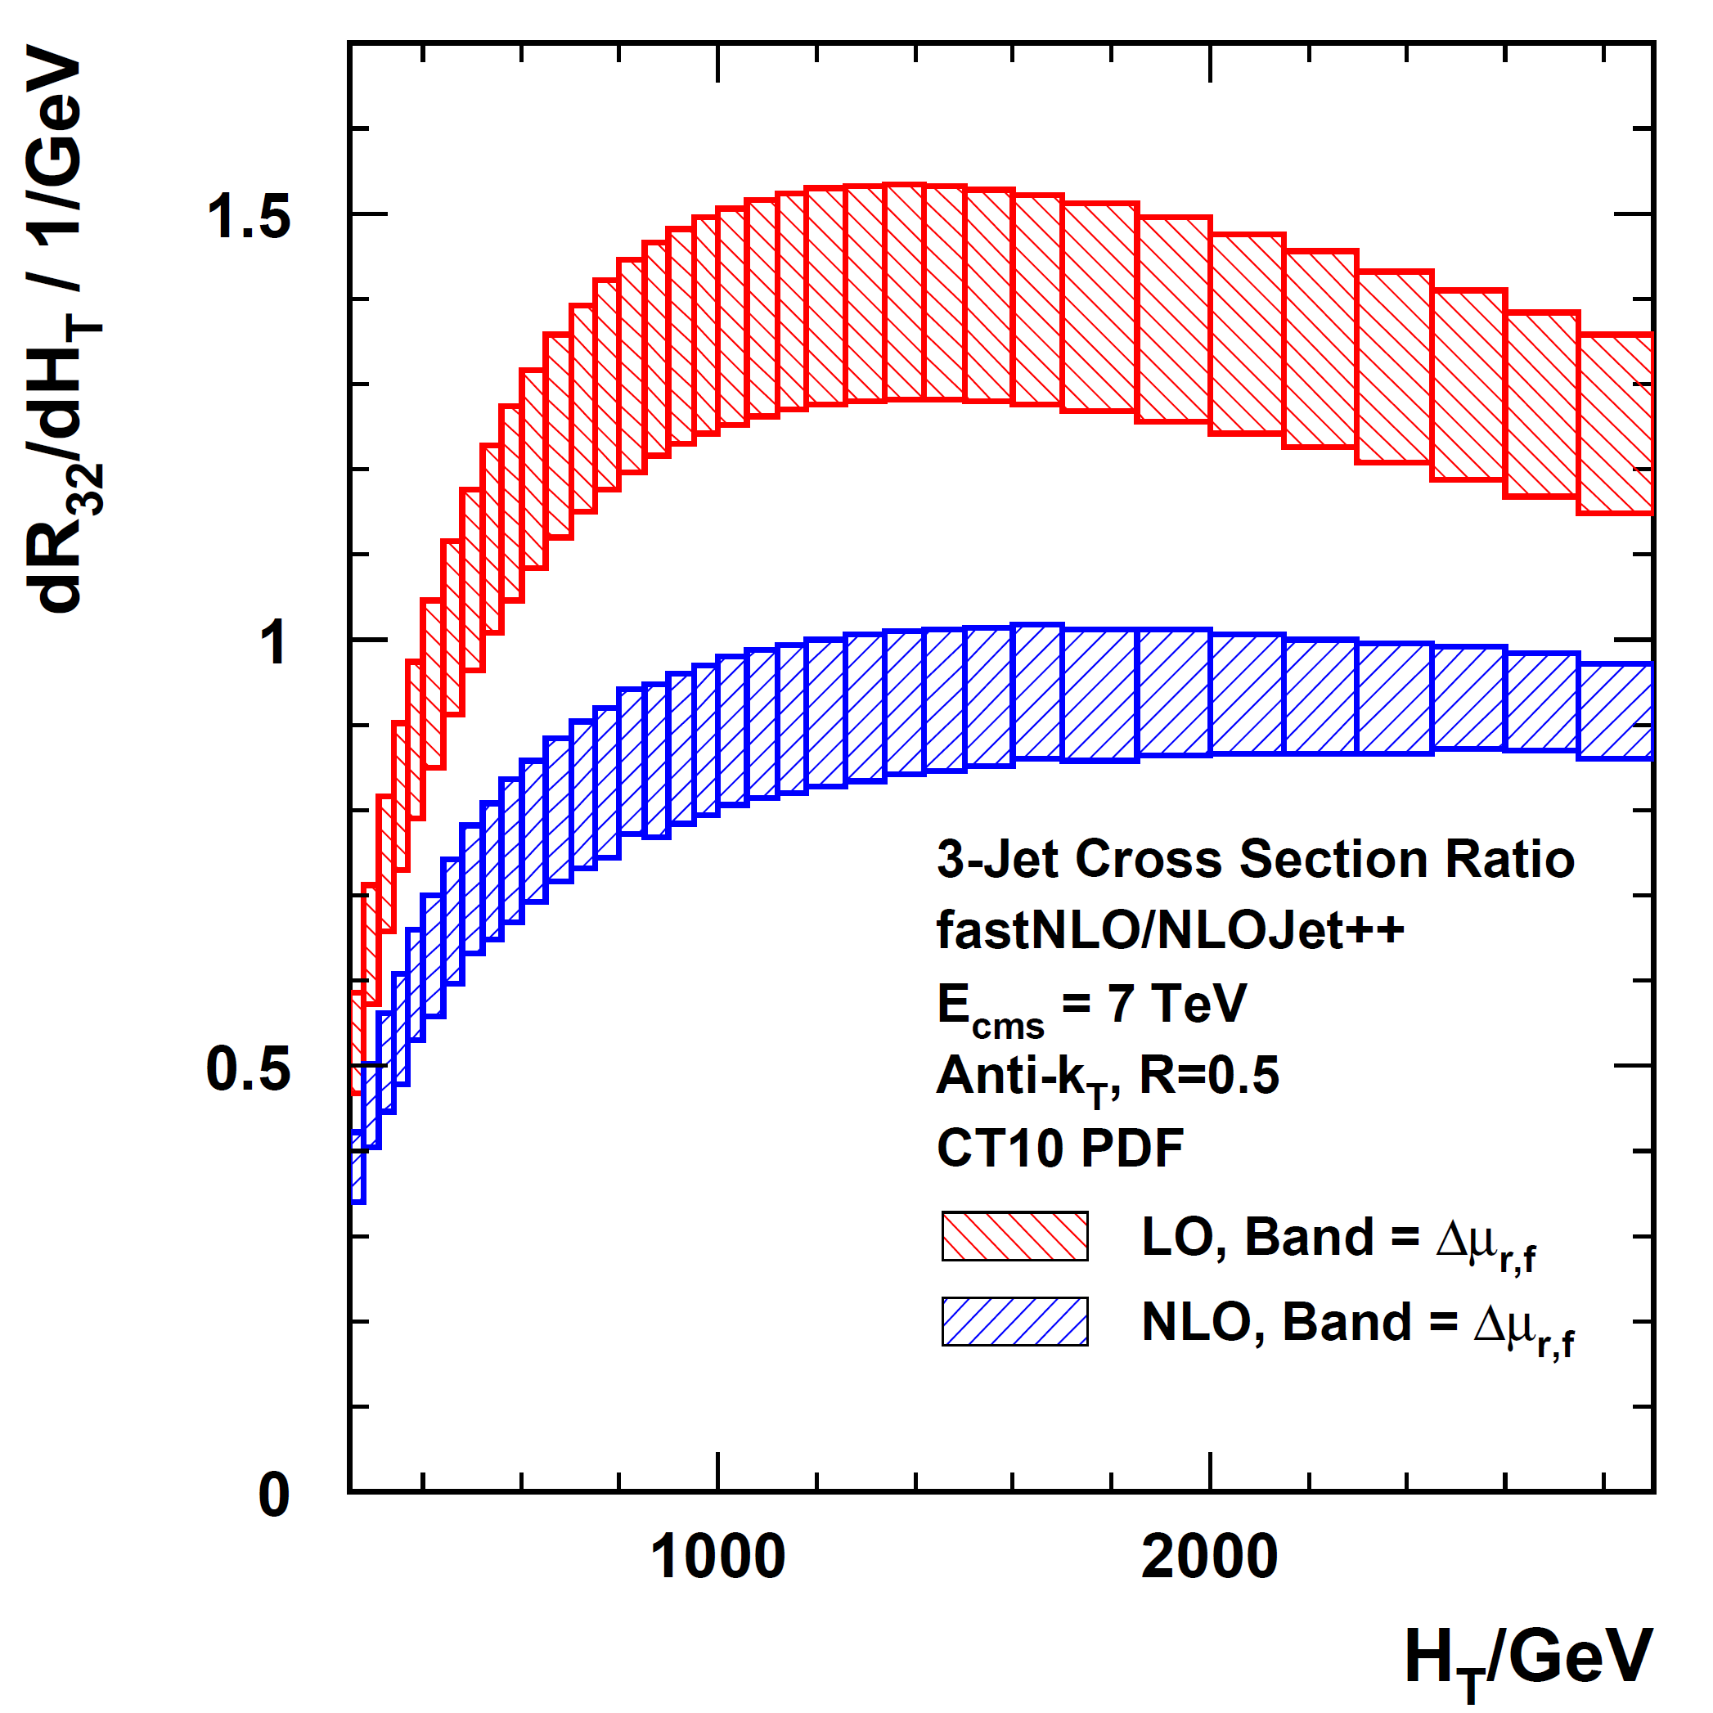
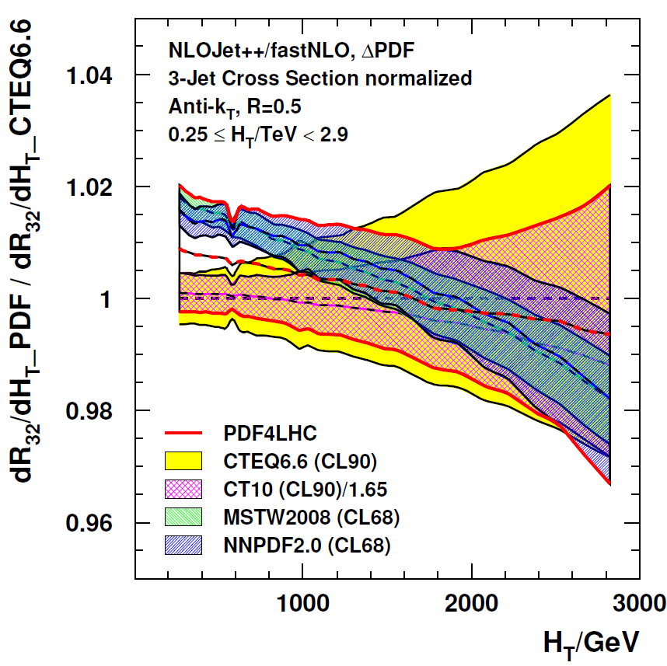
3+/2+: NLO Prediction & ΔPDF
CMS like selection
(ATLAS not very different)
LO > 1 ?!
K factors ~ 0.67
PDF uncertainty reduced
by a factor ~ 10 in ratio
# NLO = 2x7
# NLO = 2x239
Cross section ratios: Outer/inner rapidity, 3+jets/2+jets, jet R=0.7/jet R=0.5, ...
new physics, ~ α_{s}, QCD shower
Largest systematic uncertainties cancel: Lumi (completely), JES, JER (partially)
But also the α_{s} sensitivity except for:

Slide 13
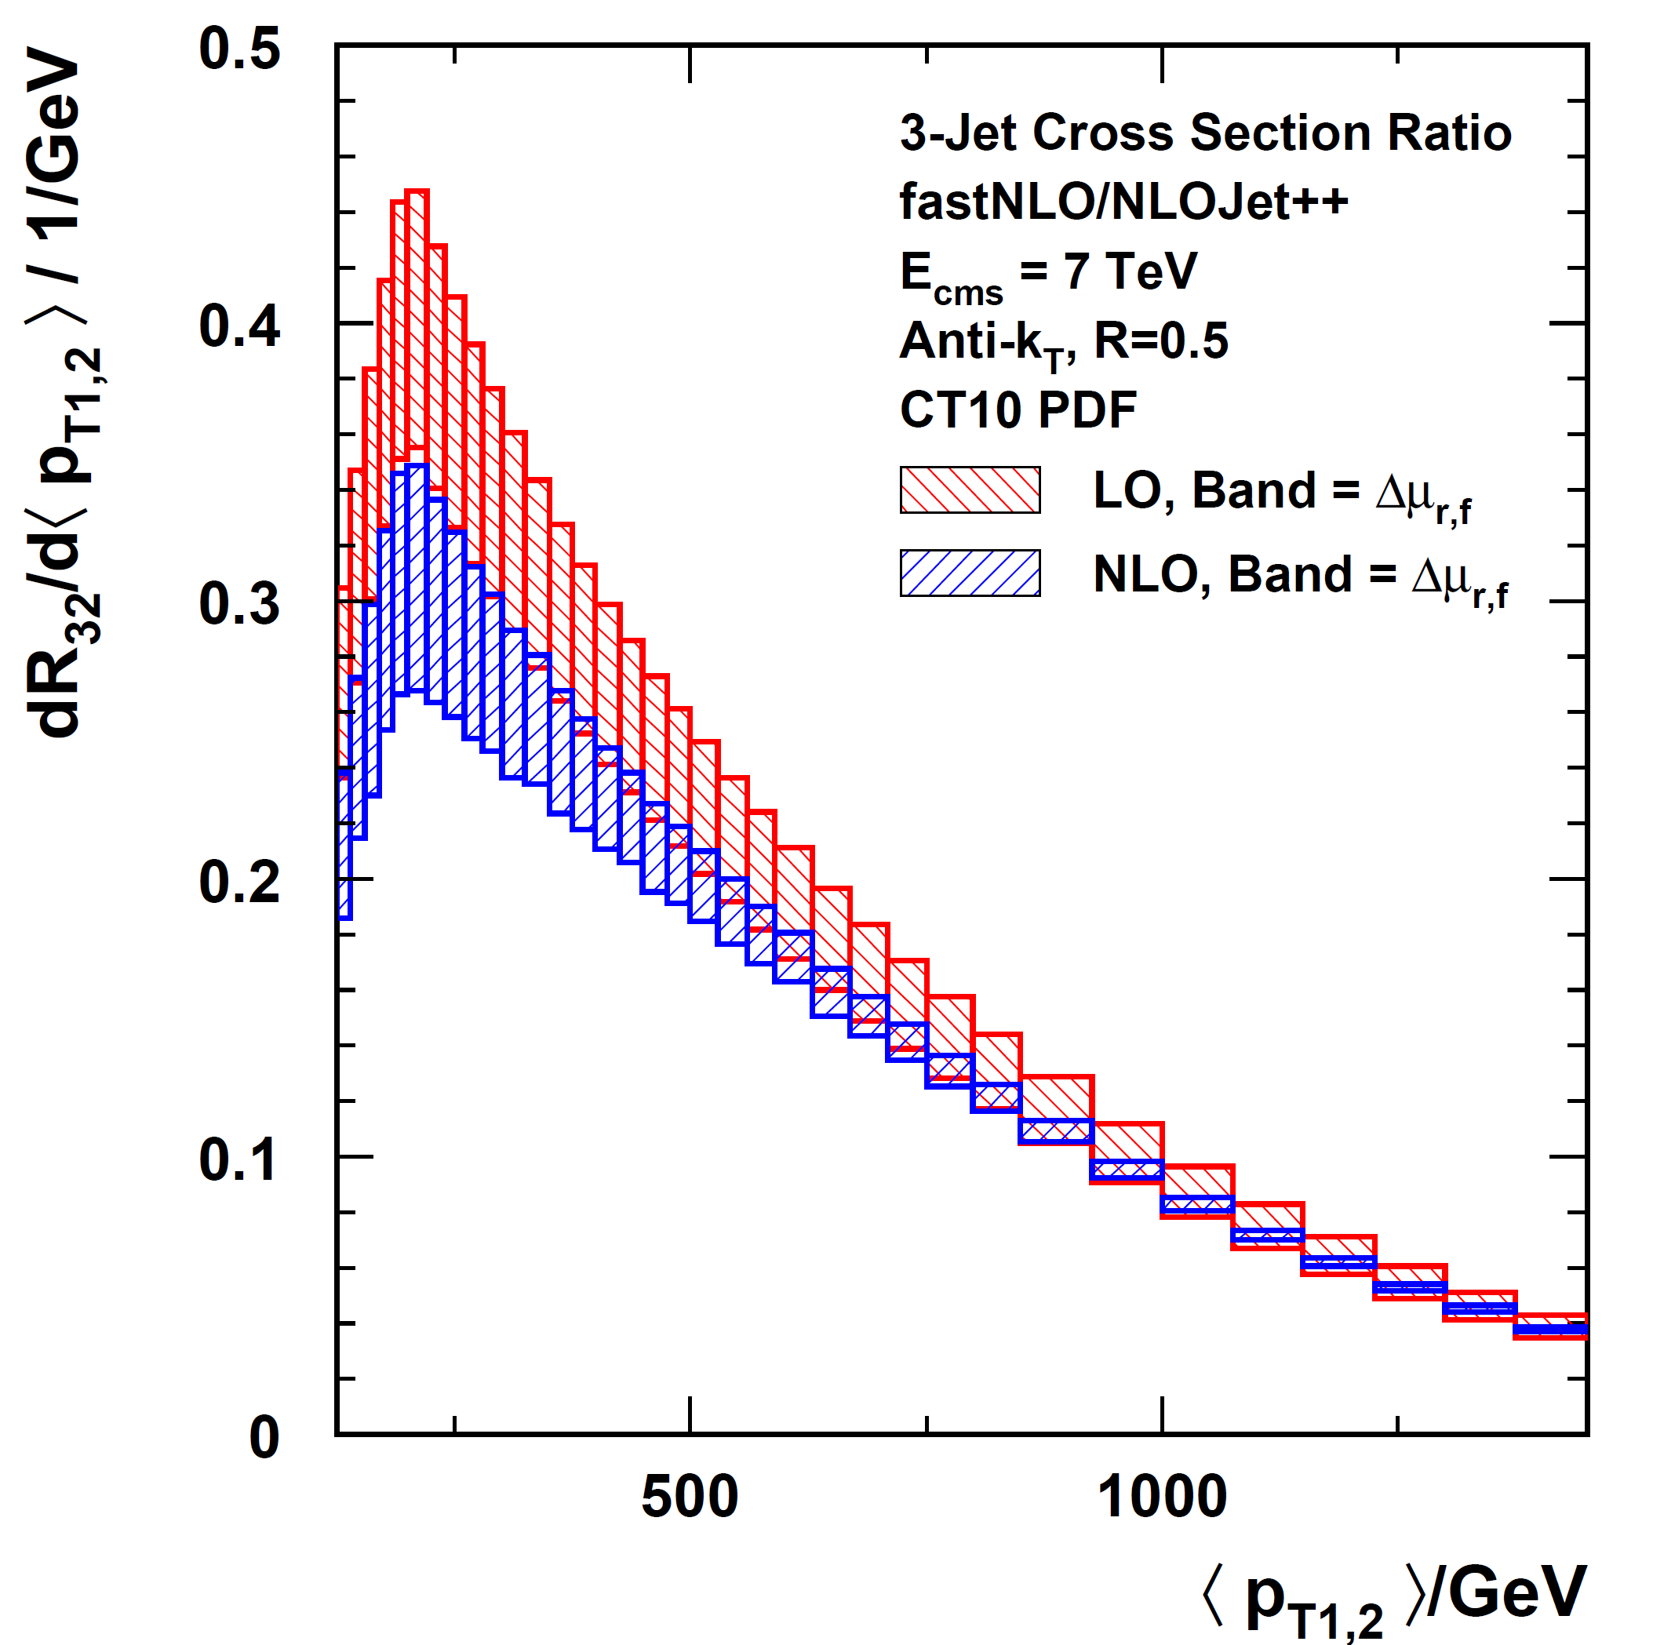
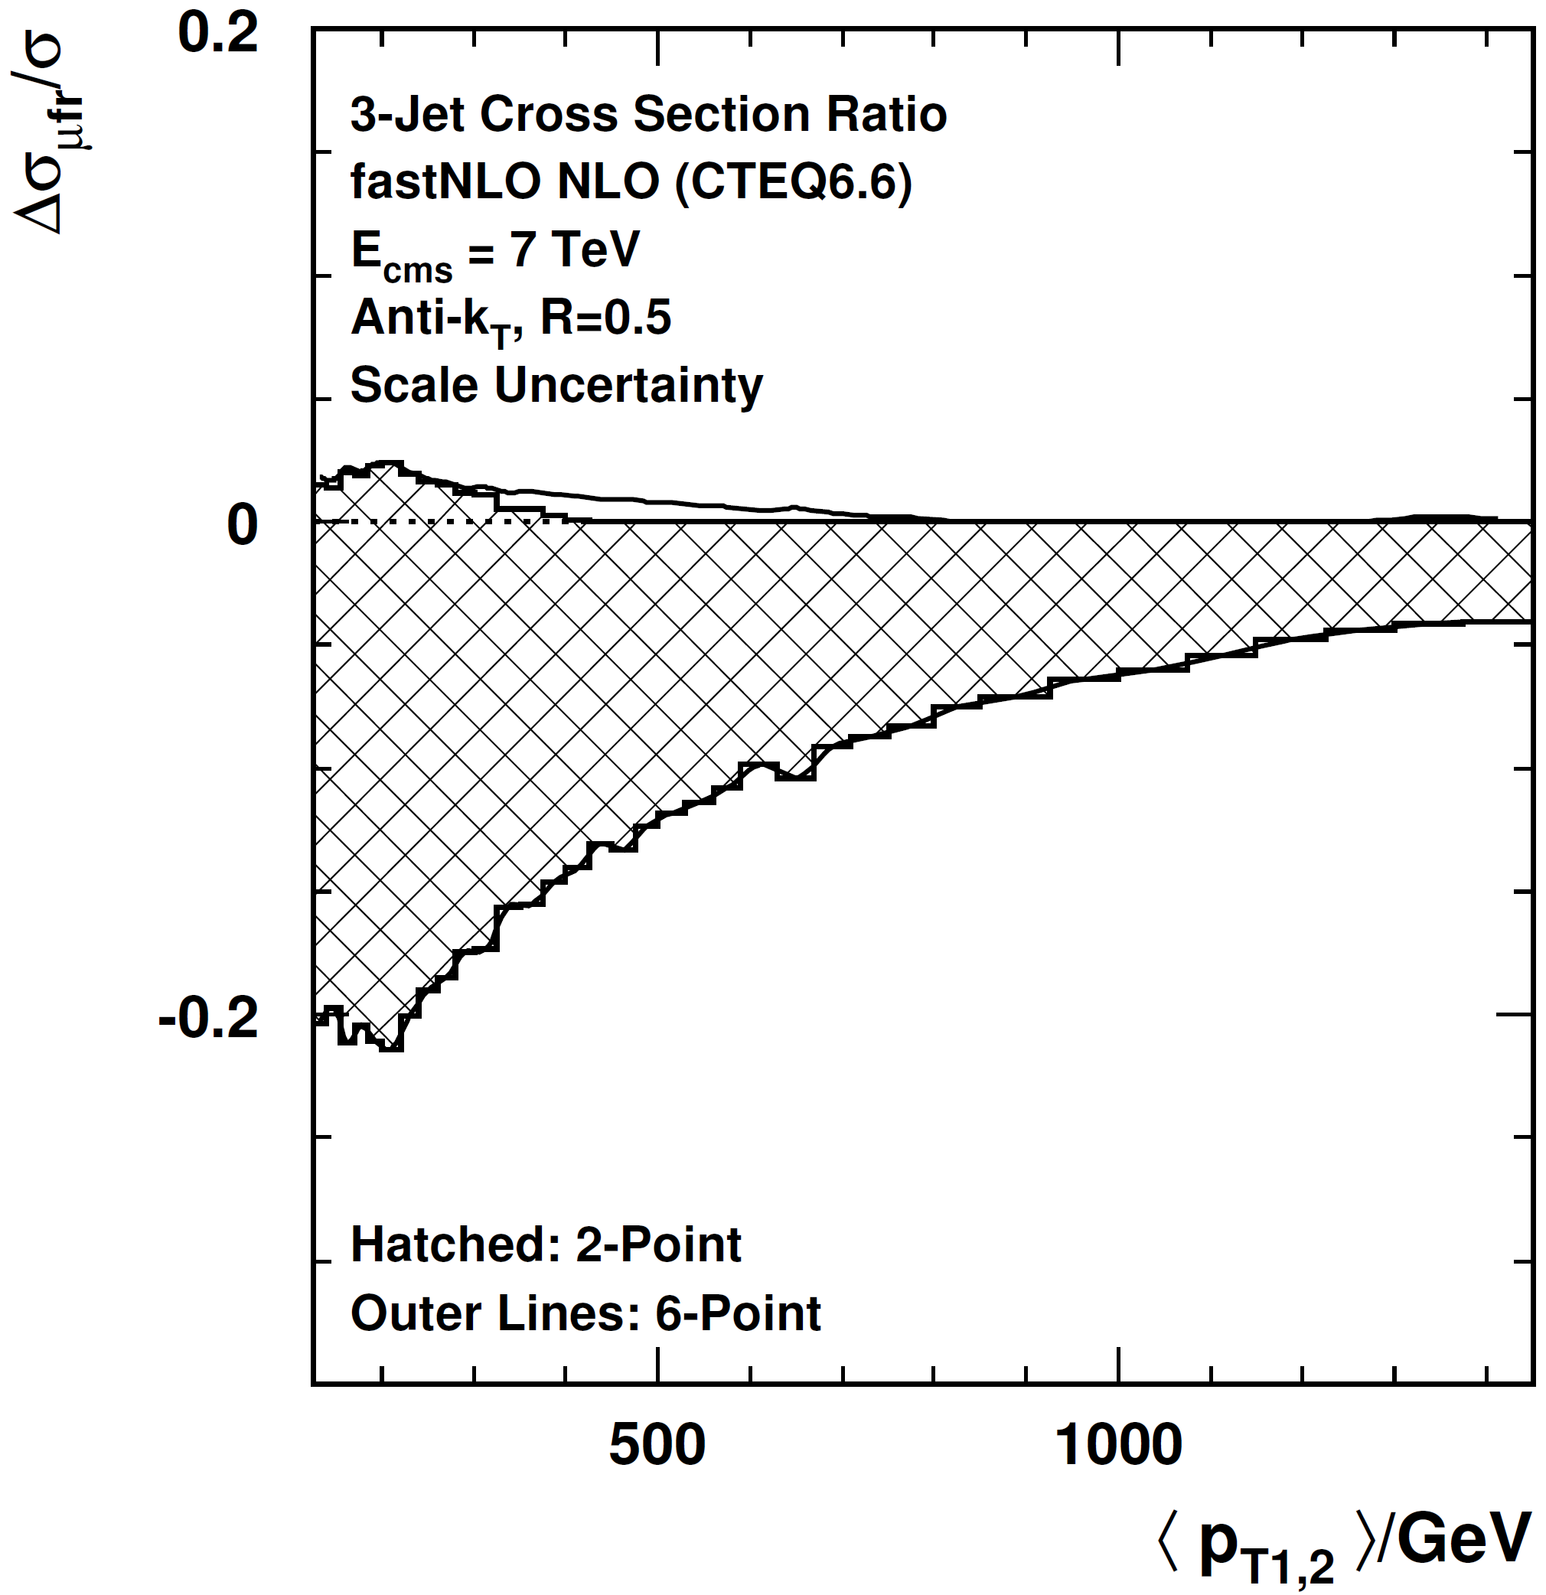
3+/2+ Revisited
Made some adaptations after chat with Gavin Salam, also see D0 or HERA!
- changed scale from H_{T} to average dijet p_{T}: <p_{T1,2}>
- require hard third jet: p_{T3} > 0.25 times <p_{T1,2}>
Not optimal yet,
but clearly better
NLO
~ +3/-8 %
p_{T} > 50 GeV cut
# NLO = 2x7

Slide 14
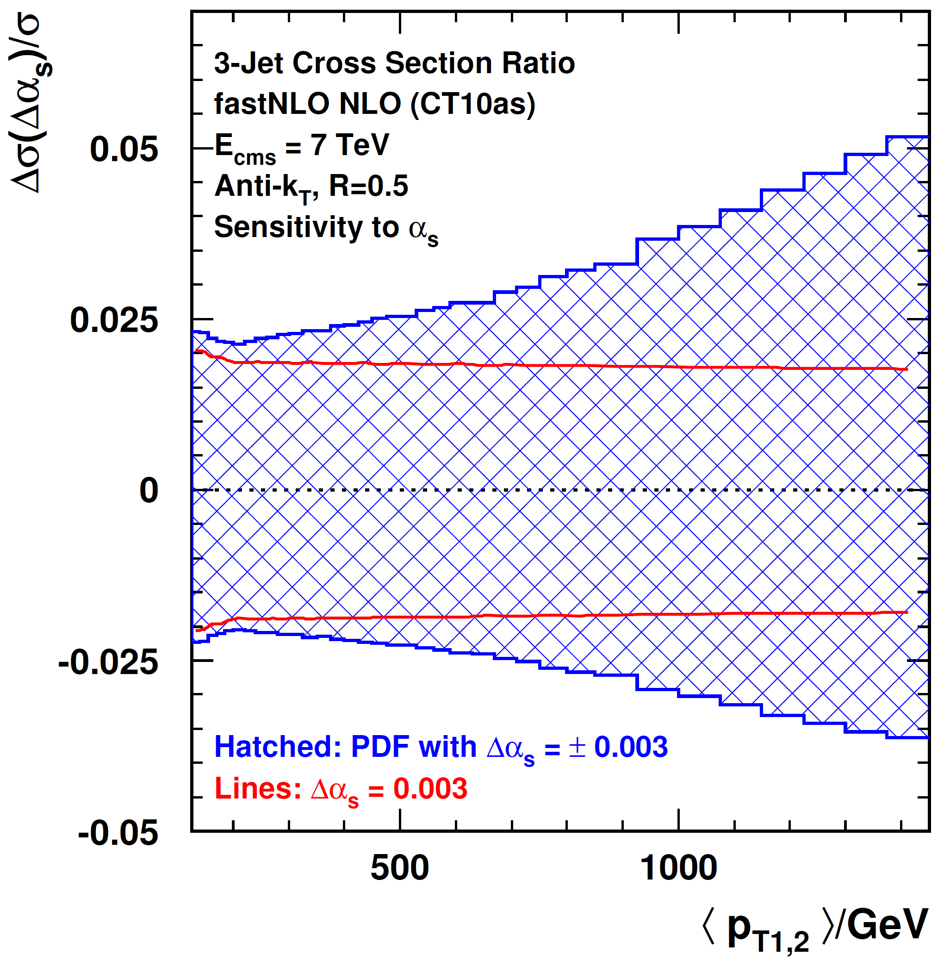
3+/2+: Sensitivity to α_{s}
α_{s} Sensitivity
CT10as members with
α_{s} = 0.118 ± 0.003
α_{s}(M_{Z}) only changed
α_{s} = 0.118 ± 0.003
To be further investigated ...
# NLO = 2x4

Slide 15
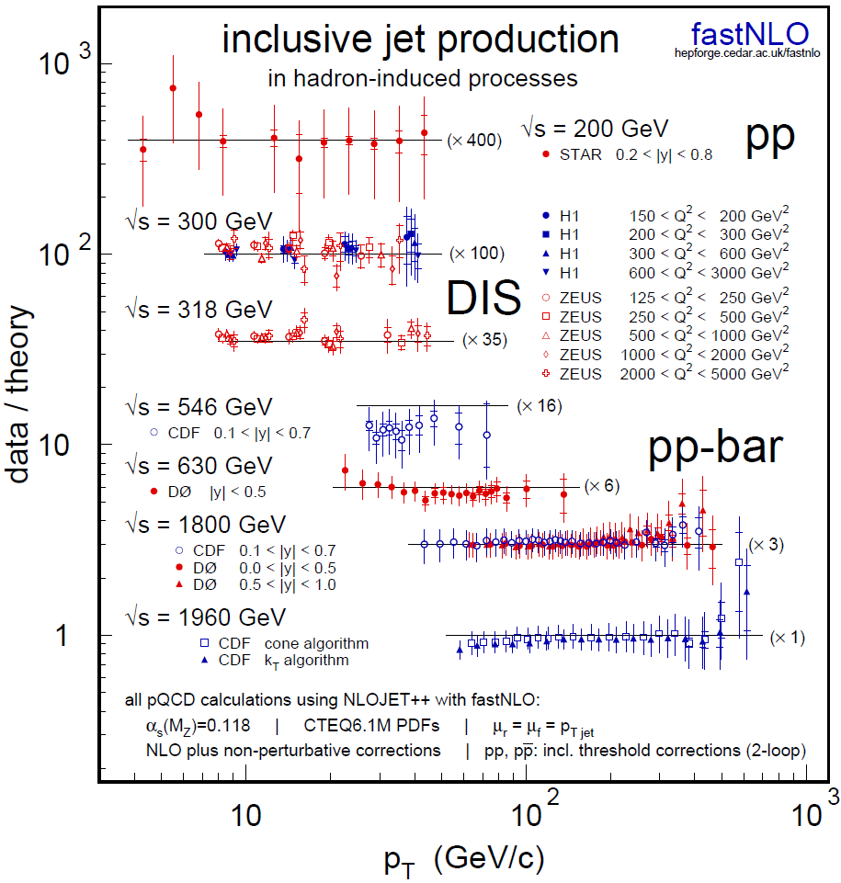


Previous Jets Data / Theory
Comparison of jet data from
  STAR at RHIC
  H1 and ZEUS at HERA
  CDF and D0 at Tevatron
Compatible with NLO pQCD
To be updated with soon to be published LHC measurements

Slide 16

Outlook
NLOJet++
Z.Nagy,
PRD68 2003
PRL88 2002
Examples shown were with NLOJet++ but concept is general!
New version to be released soon (next months) and comes with autotools installation (configure, make, make install)
Better treatment of scale variations if scale is not binning variable
Much more flexible table format, allows inclusion of:
  Corrections factors, e.g. from non-perturbative effects
  Data points with uncertainties
  Normalization
  Additional contributions like threshold corrections (already in previous version) or contact interactions

Slide 17


Fin
# NLO ~ 1600, i.e. 1600 NLO cross section reevaluations were required to prepare this talk!
No computers were harmed in the making of this presentation!
Thank you for your attention!

Slide 18
Backup Slides

Slide 19
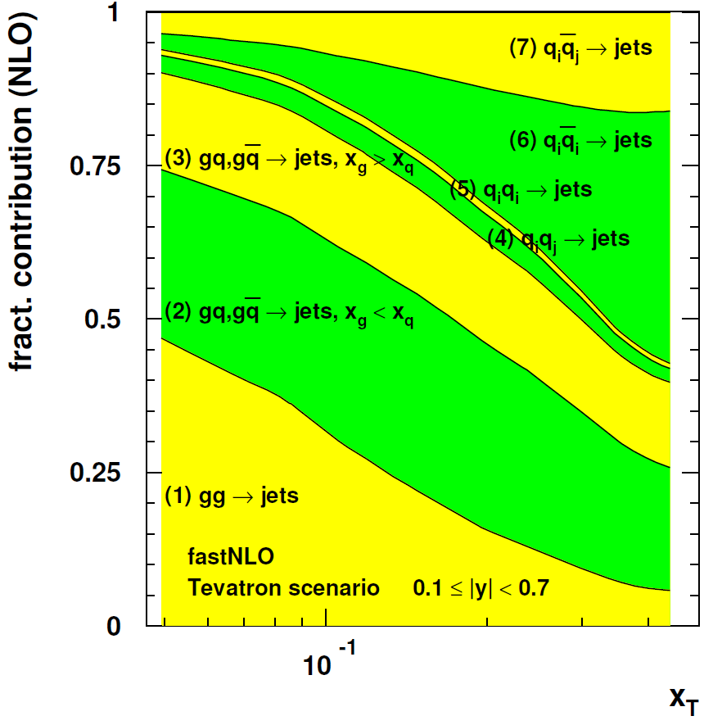
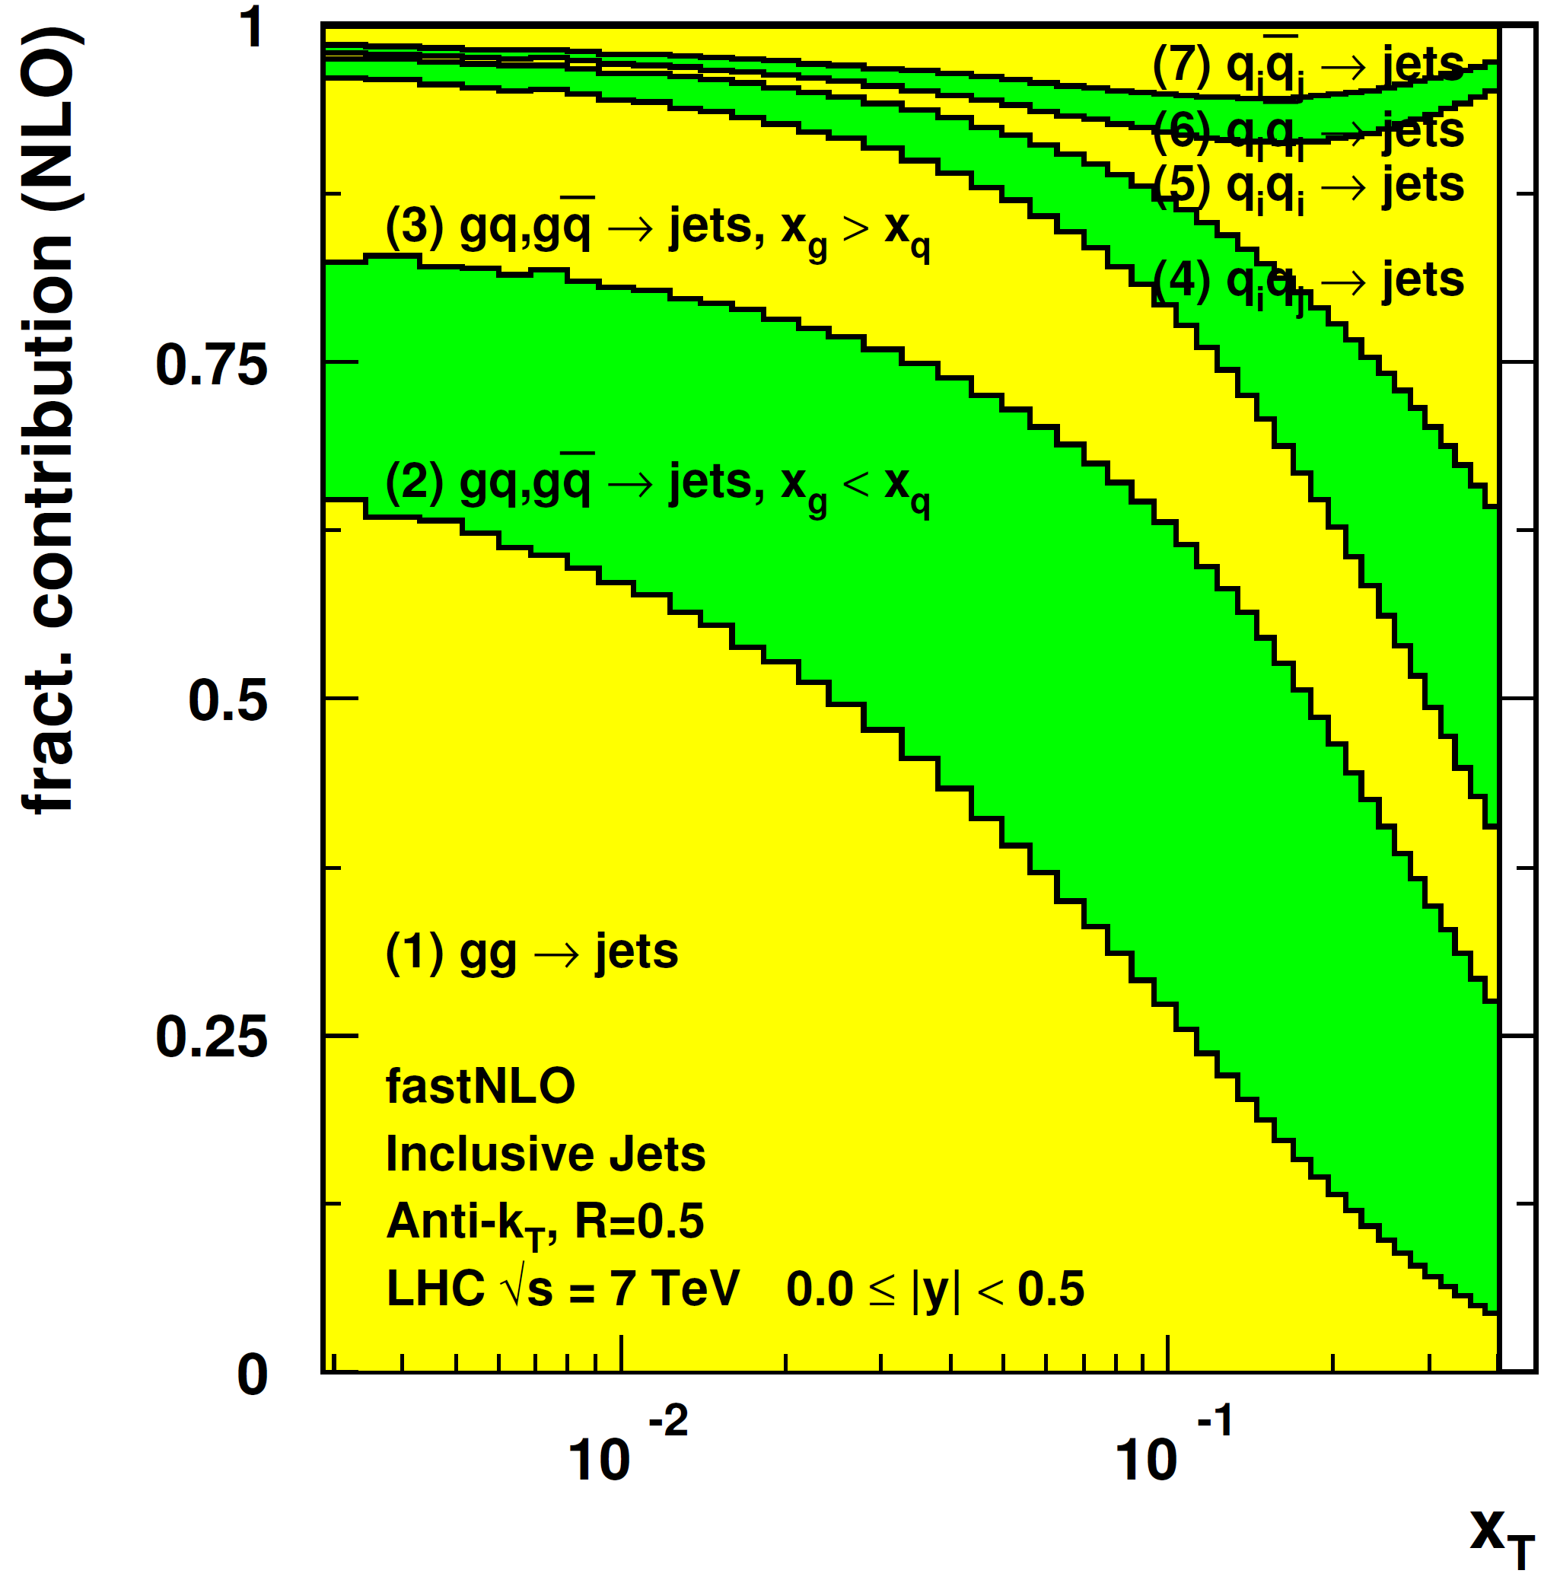
Jet Cross Section Decomposition
Tevatron, 1.96 TeV
LHC, 7 TeV

Slide 20
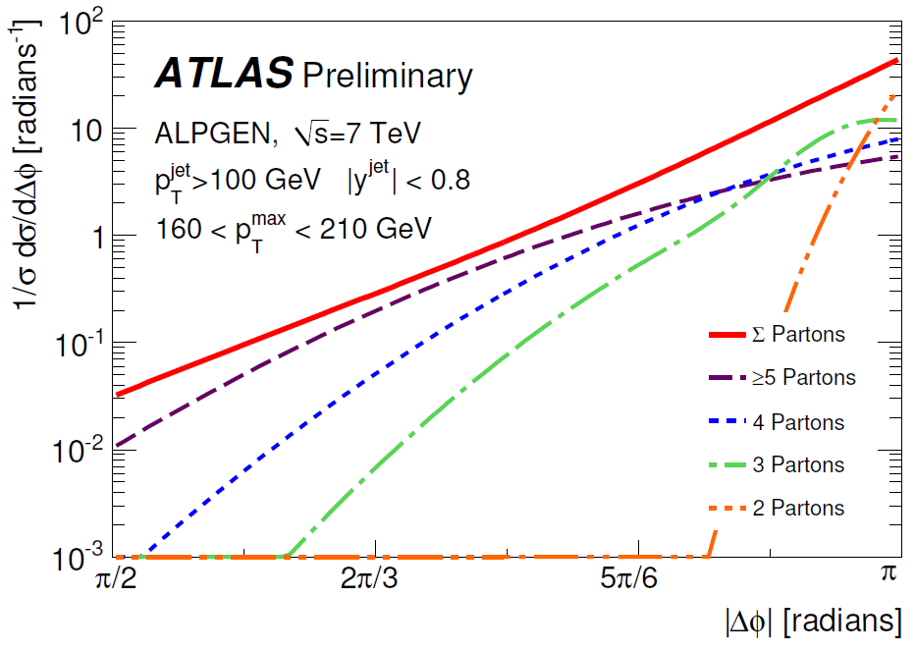
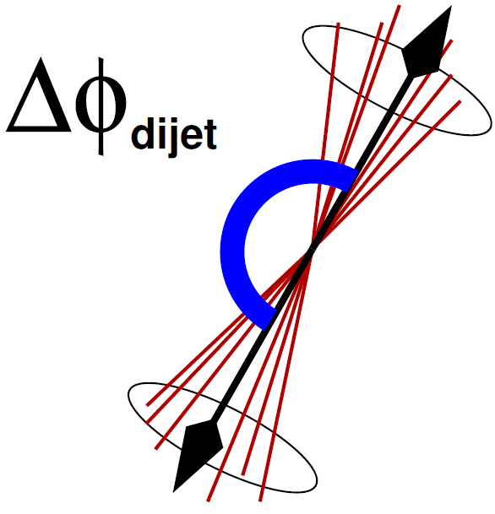
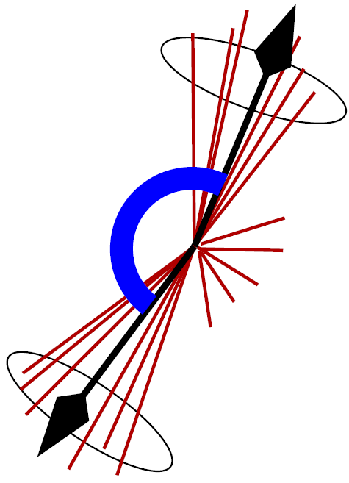
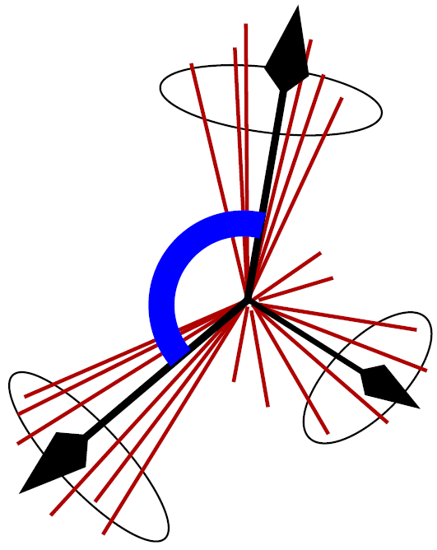
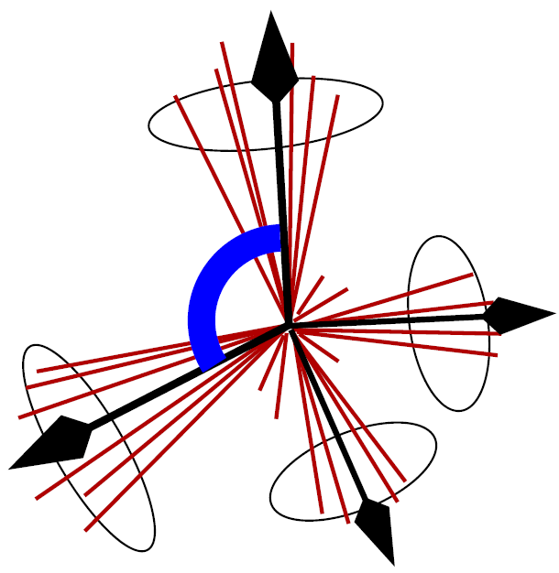
Azimuthal Decorrelation
Born limit has dijets with |ΔΦ| = π
With increasing number of partons smaller separation angles become possible
Depends on α_{s} ...
ATLAS-CONF-2010-083

Slide 21
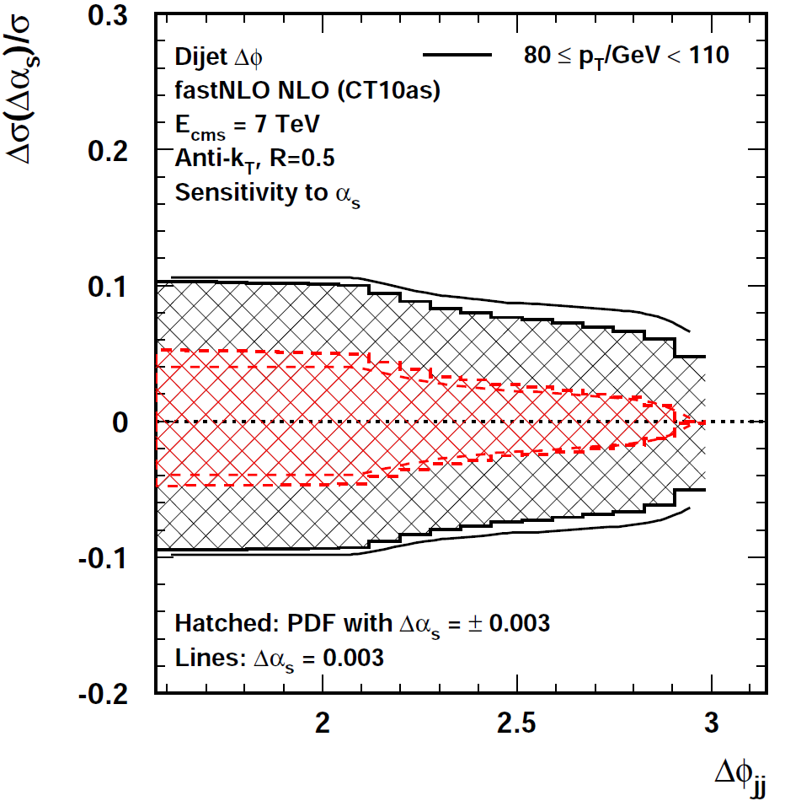
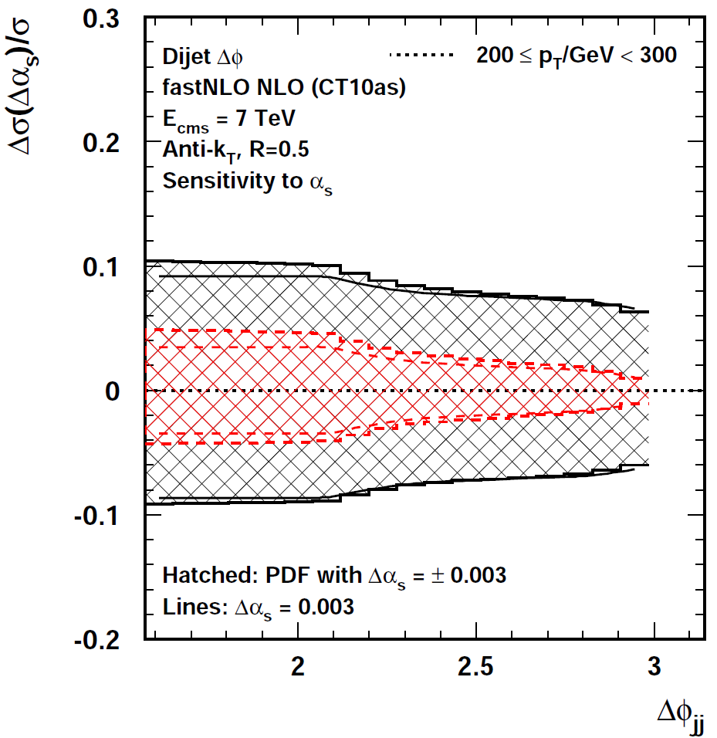
ΔΦ: Sensitivity to α_{s}
Low pT bin: 80 < pT / GeV < 110
High pT bin: 200 < pT / GeV < 300
Only in
3-jet part
Normalized ΔΦ
# NLO = 8
# NLO = 8

Slide 22
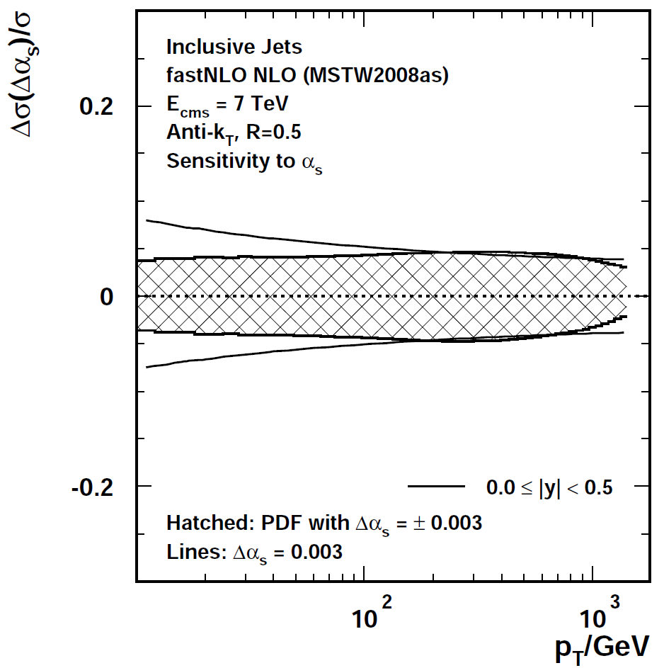
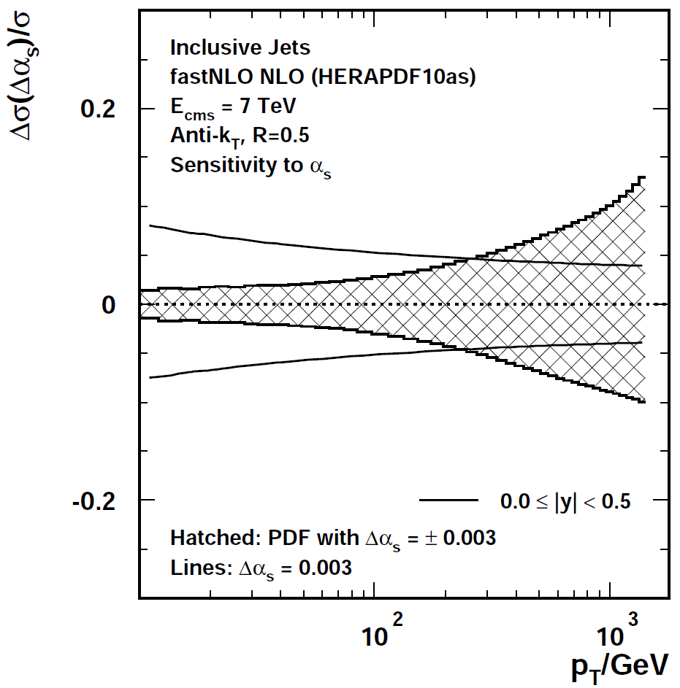
Sensitivity to alpha_s
Inclusive Jet pT

