Slide 1


5. Physics at the Terascale Workshop, Bonn, 2011
v2
The fastNLO Collaboration:
Daniel Britzger, Thomas Kluge, Klaus Rabbertz, Fred Stober,Markus Wobisch
(DESY, Liverpool, KIT, KIT, Louisiana Tech University)

Slide 2
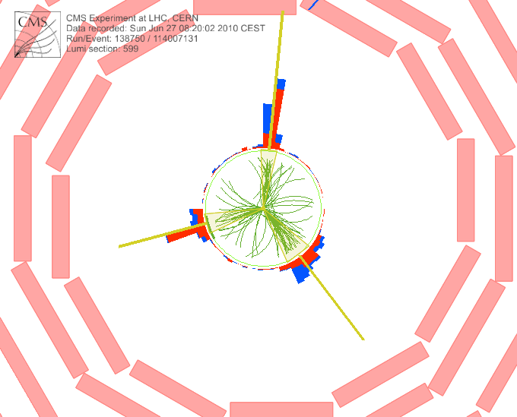
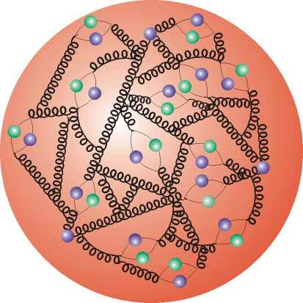

Outline
Quick Reminder: Motivation & Concept
Up to now: Application of v14
News on v2
Outlook

Slide 3




Motivation
  Interpretation of experiment data relies on:
    Availability of reasonably fast theory calculations
    Often needed: Repeated computation of (almost) same cross sections
  Examples for a specific analysis:
    Use of various PDFs (CTEQ, MSTW, NNPDF, HERAPDF, ABKM ...)
    Determine PDF uncertainties (PDF error sets)
    Use data set in fit of PDFs and/or αs(MZ)
  Sometimes NLO predictions can be computed fast
  But some are very slow, esp. for jets
  Need procedure for fast repeated computations of NLO cross sections
  Use fastNLO (in use by most PDF fitting groups) (ATLAS mostly uses another project: APPLGrid)

Slide 4
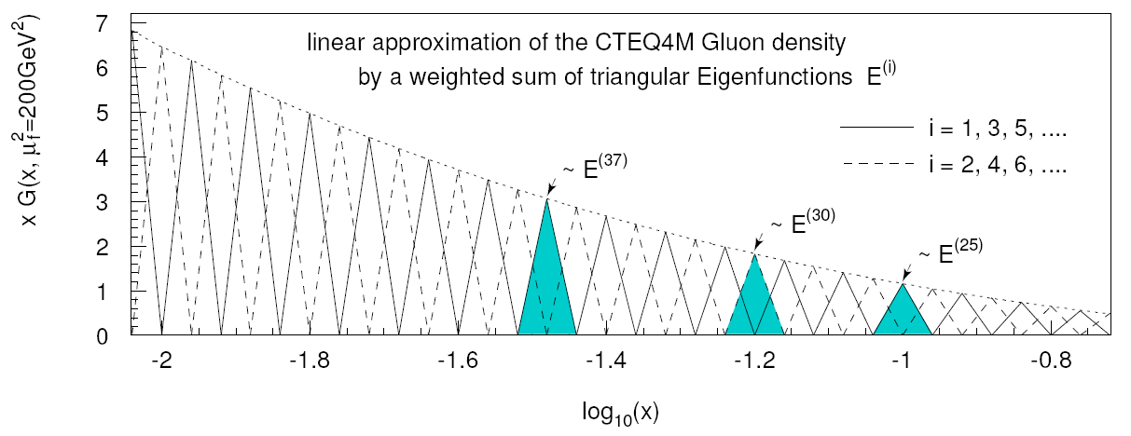


Concept on a Slide
  Introduce set of discrete x^{(i)} with x^{(n)} < ..< x^{(i)} <..<x⁽⁰⁾=1
  Around each x^{(i)} define eigen function E^{(i)}(x) with:
E^{(i)}(x^{(i)}) = 1, E^{(i)}(x^{(j)}) = 0 (i ≠ j), Σi E^{(i)}(x) = 1 for all x
  Express PDF f(x) by lin. combination of eigen functions with coefficients given by PDF values at discrete points:
In detail more complicated: 2-dim. (log) x binning, cubic interpol., weights
=> Integration only over E^{(i)}(x), not f(x)!

Slide 5
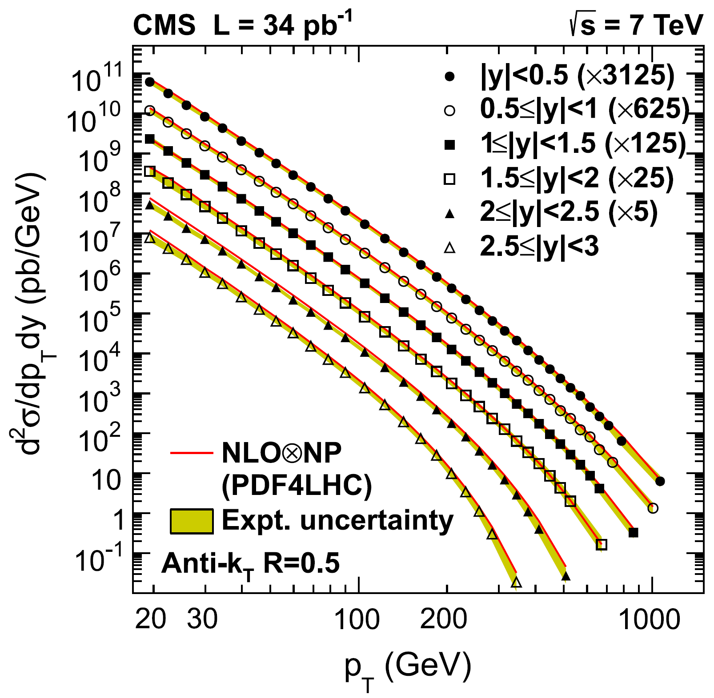

Example: Inclusive Jets
All possible with v1.4:
Inclusive jet pT cross section
For this derive:
  Scale Dependence:
    Mostly: Sim. variation of μ_{r} and μ_{r} by factor of 2
    Better: Indep. variation at 6 points (1/2,1/2), (1/2,1), (1,1/2), (1,2), (2,1), (2,2)
  PDF Uncertainties
    PDF4LHC prescription for 1st compatibility check
    Use of various PDFs (CTEQ, MSTW, NNPDF, HERAPDF, ABKM ...)
  Sensitivity to alpha_s
    Use data set with fit/use of αs(MZ)
CMS, PRL 107, 132001, 2011

Slide 6
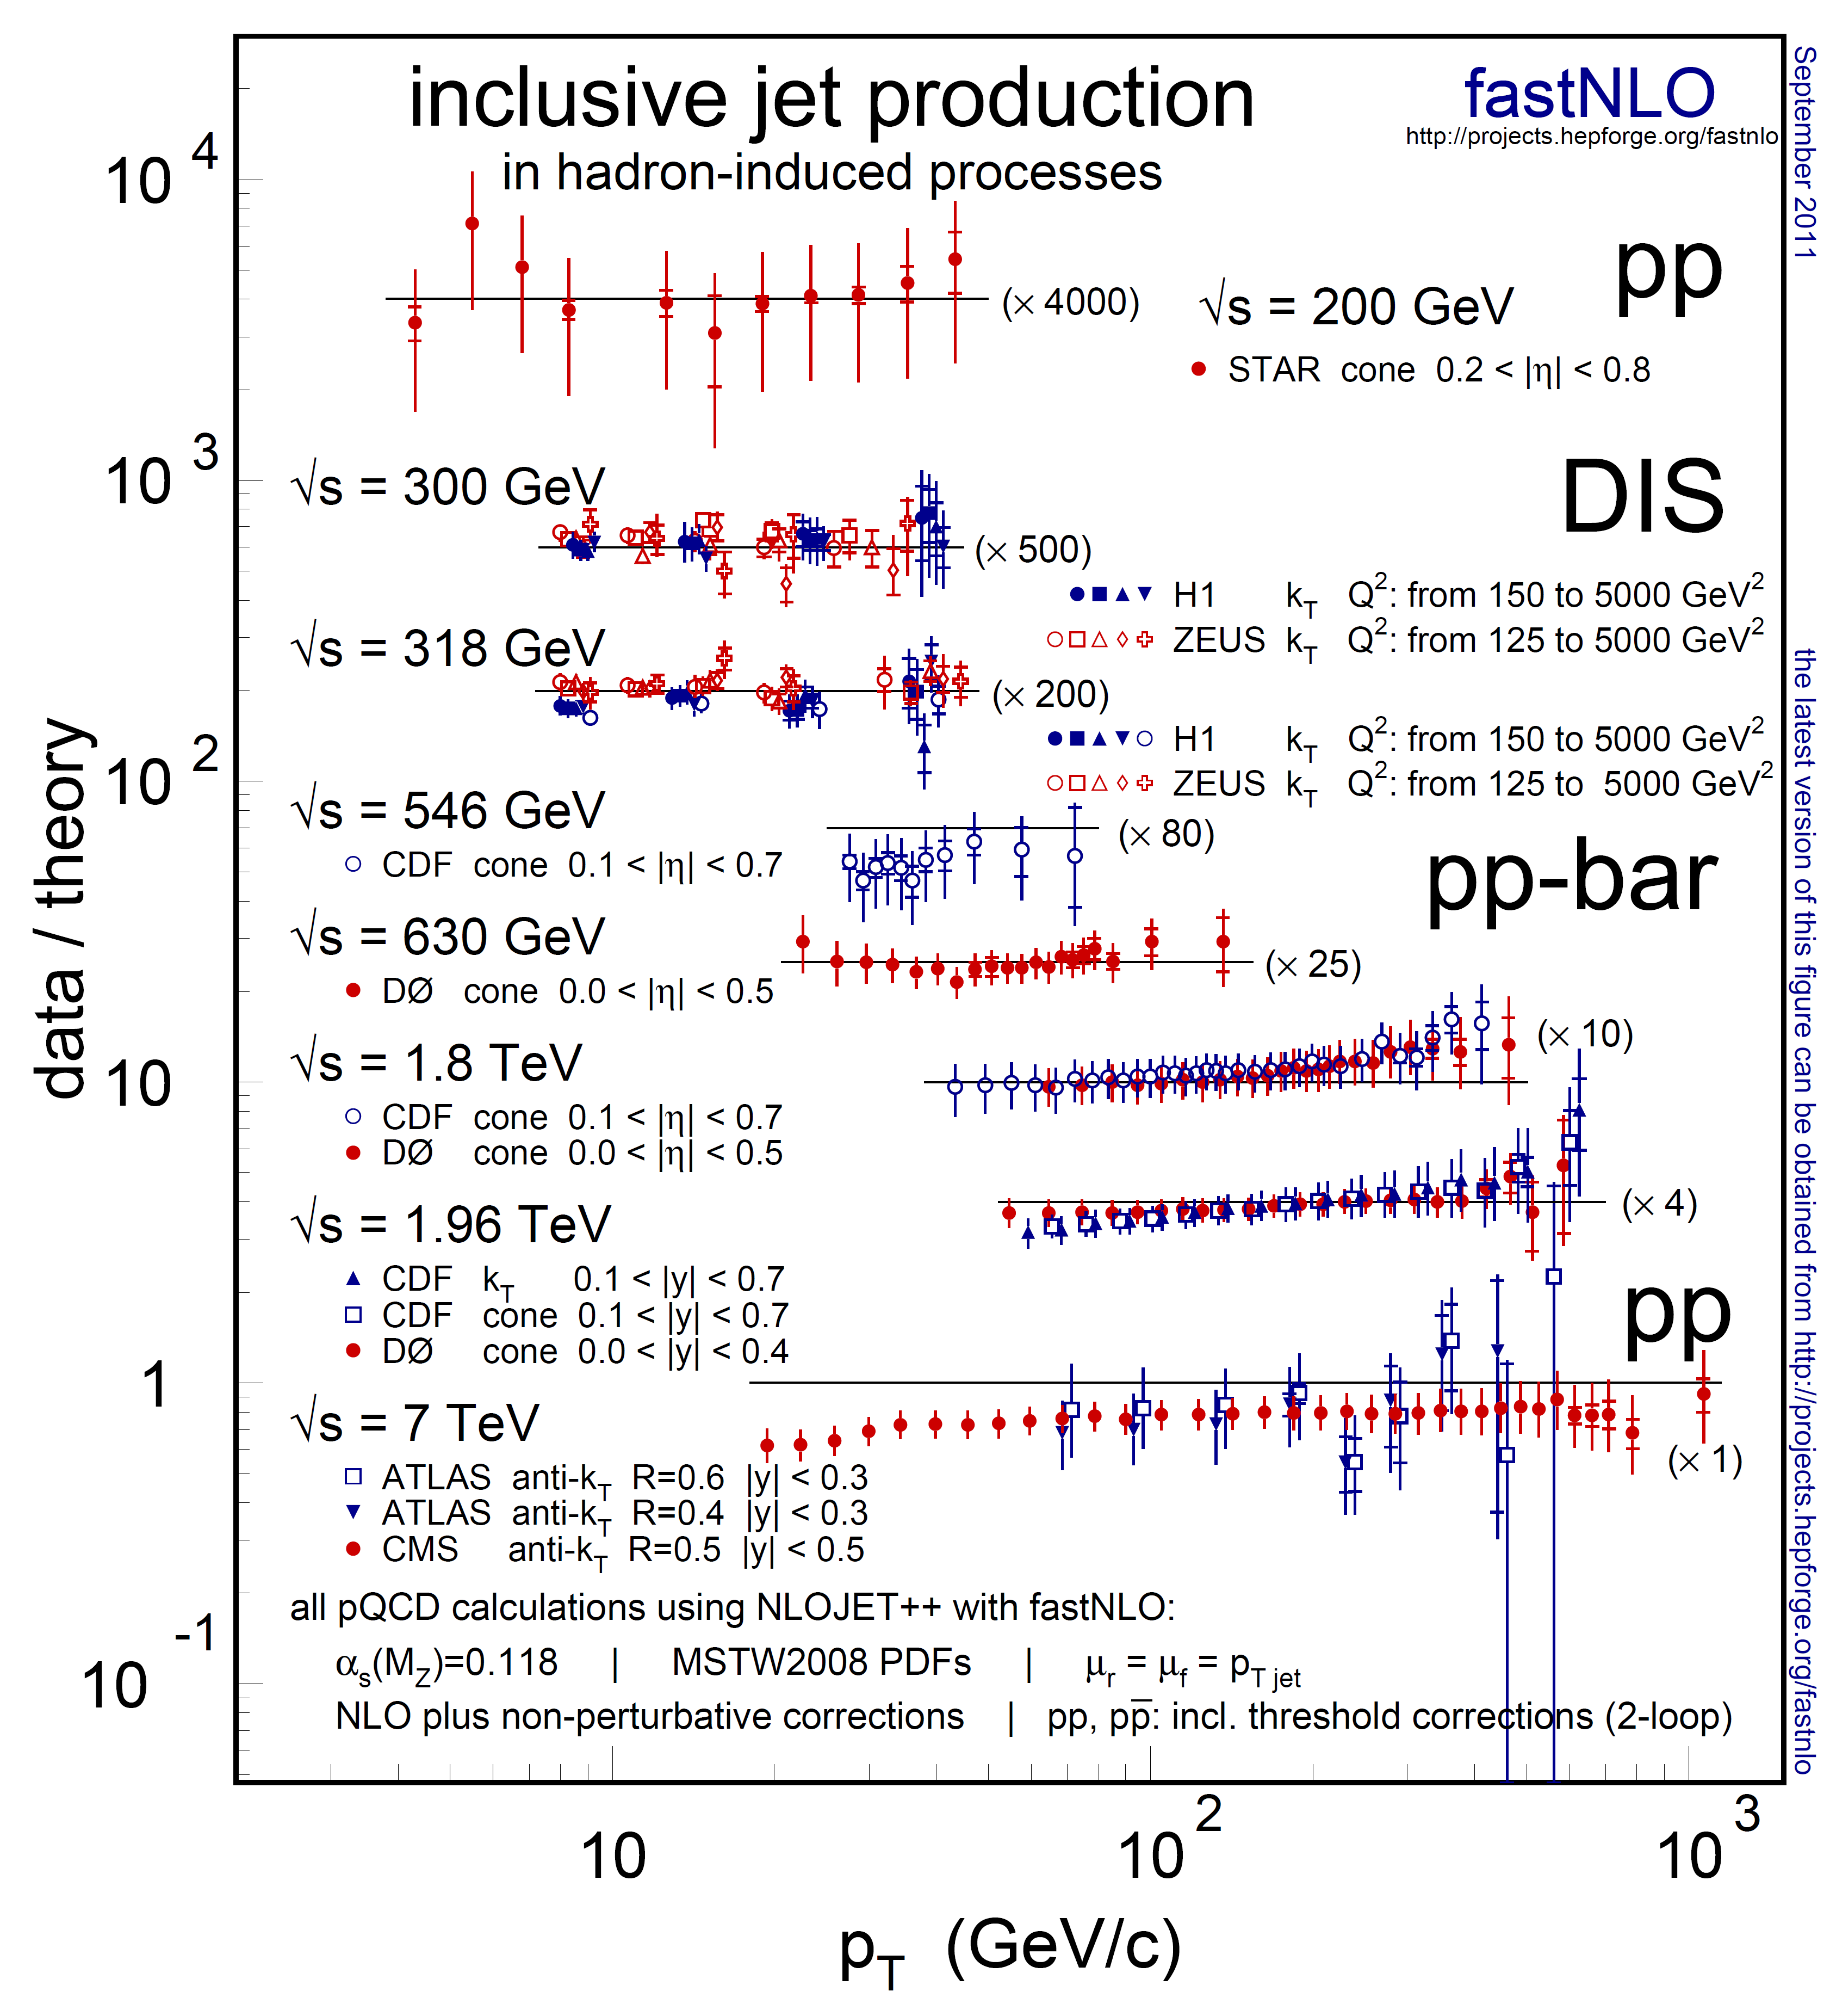


Previous Jets Data / Theory
Comparison of jet data from
  STAR at RHIC
  H1 and ZEUS at HERA
  CDF and D0 at Tevatron
Compatible with NLO pQCD
Includes first measurements from LHC
fastNLO, arXiv:1109:1310v1, 2011

Slide 7
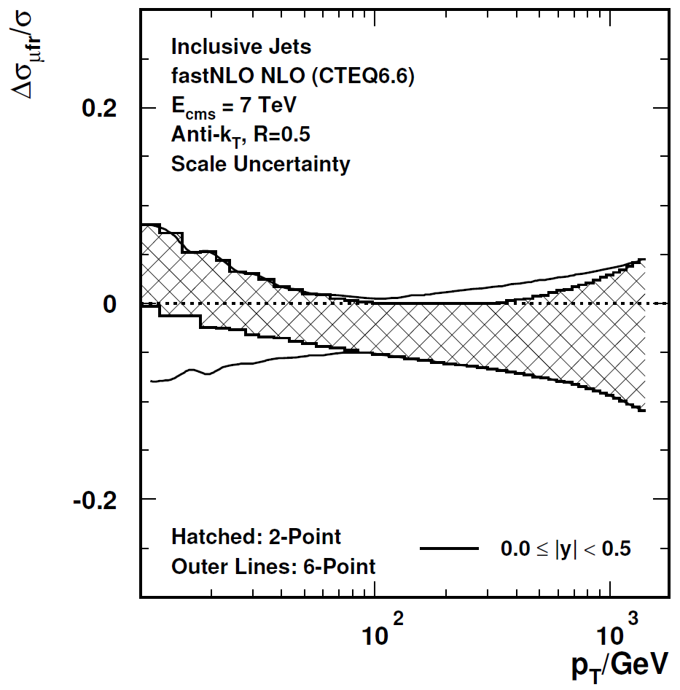

Scales in v2
In v14:
New in v2:
Asymmetric scale variations:
Independent variation of μ_{r} and μ_{f}
by factors of ½ and 2 avoiding rel. factors of 4
(6-point: (1/2,1/2), (1/2,1), (1,1/2), (1,2), (2,1), (2,2)
Compared to symmetric variation (2-point)
  Two new possibilities:
  Scales always get own dimension
    Much improved scale interpolation
    Examples exist for pp/ppbar scattering (CMS incl. Jets, D0 3-Jet Mass)
    Table size moderately larger, sufficient for most purposes
  Even better: Scale factors and functional form freely choosable a posteriori
    Can e.g. choose p_{T}² for μ_{r} and Q² for μ_{f}
    Calculations so far for H1 and ZEUS
    Table size significantly larger, but no problem for DIS
x_{µ} = ½, 2
x_{µ} = ½,1,2
indep. for µ_{r}, µ_{f}

Slide 8
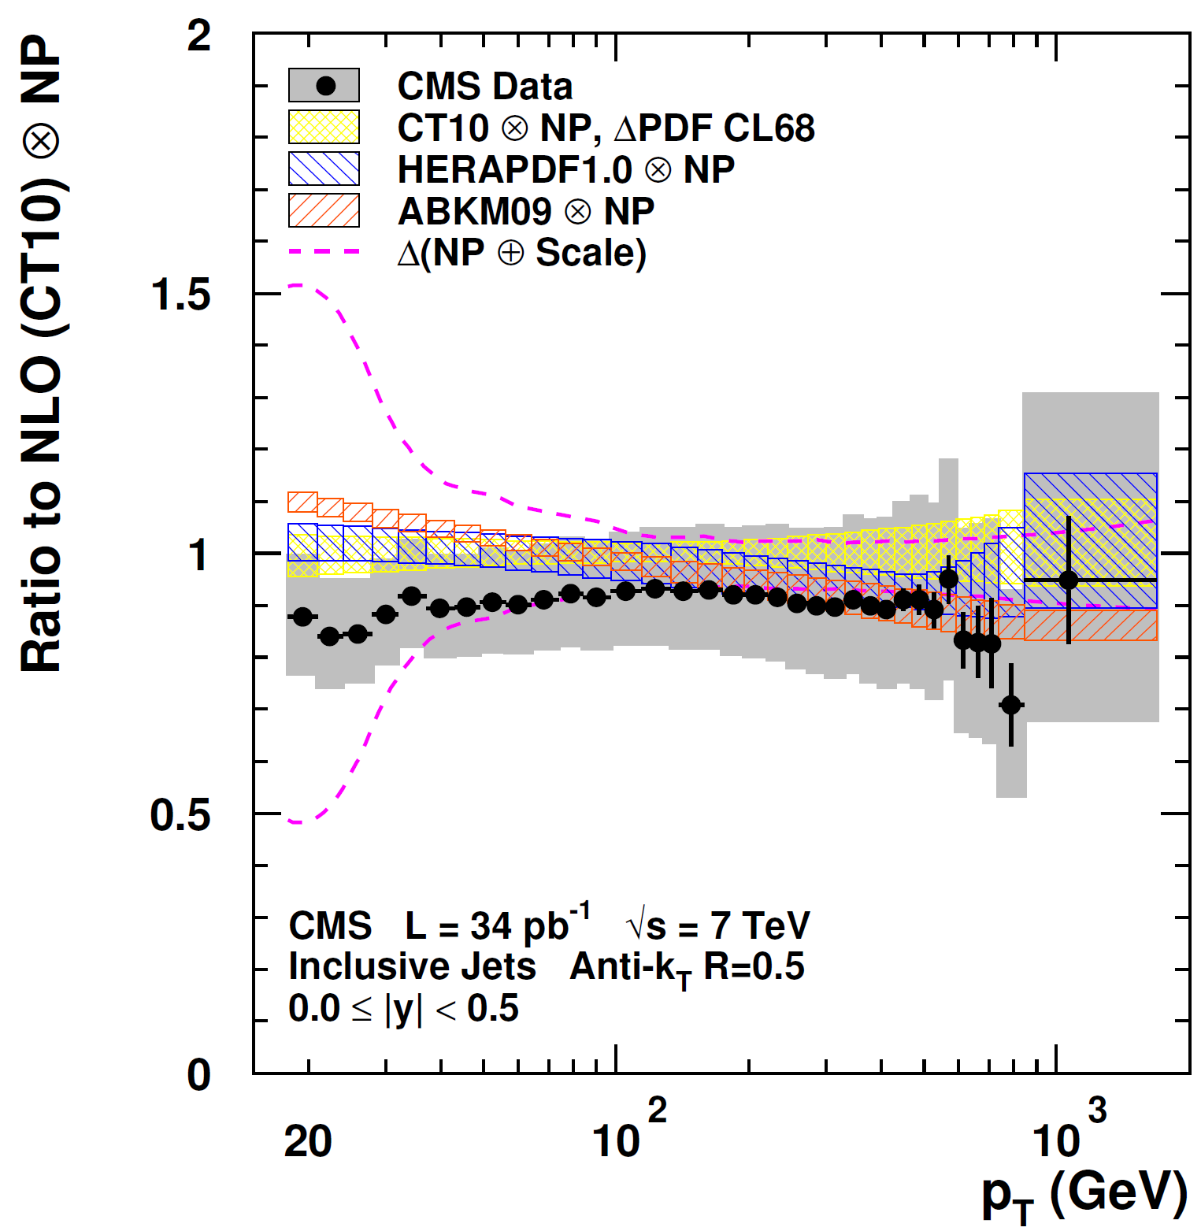
More Features in v2
In v14:
New in v2:
Detailed comparisons to individual
PDF sets:
Here: CT10, HERAPDF1.0 and ABKM09
  Much more flexible table format allows inclusion of:
    Correction factors, e.g. non-perturbative ones incl. uncertainty (Example exists: CMS incl. Jets)
    Data points with uncertainties (Example exists: CMS incl. Jets)
    Electroweak corrections (calculated?)
    Threshold corrections (already in v14 for incl. jets)
    New physics contributions
    Normalization options
  Arbitrary no. of dimensions for binning of observable (in addition to scale bins)
CMS Note-2011-004

Slide 9
Further Features in v2
  Automated determination of optimal limits for x binning in warm-up run
  No. of interpolation bins in x per observable bin is flexible
  Tables in v14 format can be converted to new format v2
  Reader code to evaluate tables in Fortran and C++
  Install packages produced with standard autotools, just run
    ./configure - -prefix=your_local-directory
    make; make install
    Missing features, e.g. LHAPDF will be asked for
  Use of NLOJet++ 4.1.3 (previously: 2.0.1)

Slide 10



Outlook
New version will be released in two steps:
  1. Basic code to read and evaluate the tables will be released together with sample tables still THIS month: fastNLO-Reader-2.1.0-nnn (Some tests were made already in H1Fitter and NNPDF Groups)
  2. Table creation code for use with NLOJet++ will follow in ~ first half of next year
All examples shown were with NLOJet++ from Z. Nagy, but fastNLO concept is more general!
NLOJet++
Z.Nagy,
PRD68 2003
PRL88 2002
Thank you for your attention!

Slide 11
Backup Slides

Slide 12
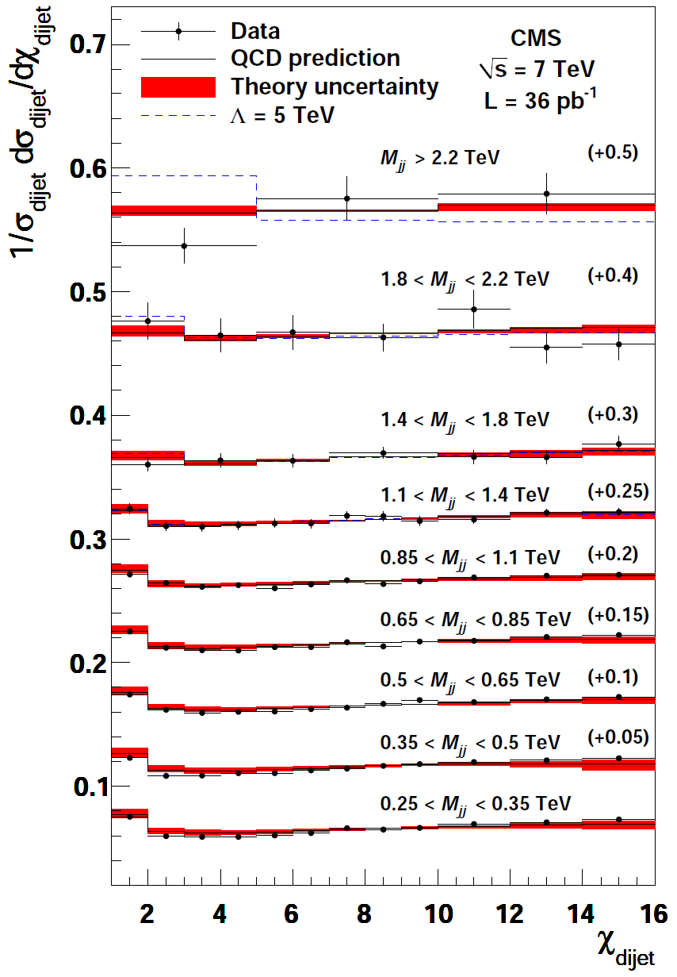


Normalized Cross Section 1
Version 1: Area Normalization
(Not always possible in pQCD!)
Dijet Angular Distribution in Chi_{jj} where
Search for new physics at high mass and
low Chi_{jj} !
Technically:
2-jet cross section well defined at NLO from
minimal Chi_{jj} up to chosen maximum e.g. 16
# NLO = 45
CMS, arXiv:1102:2020

Slide 13
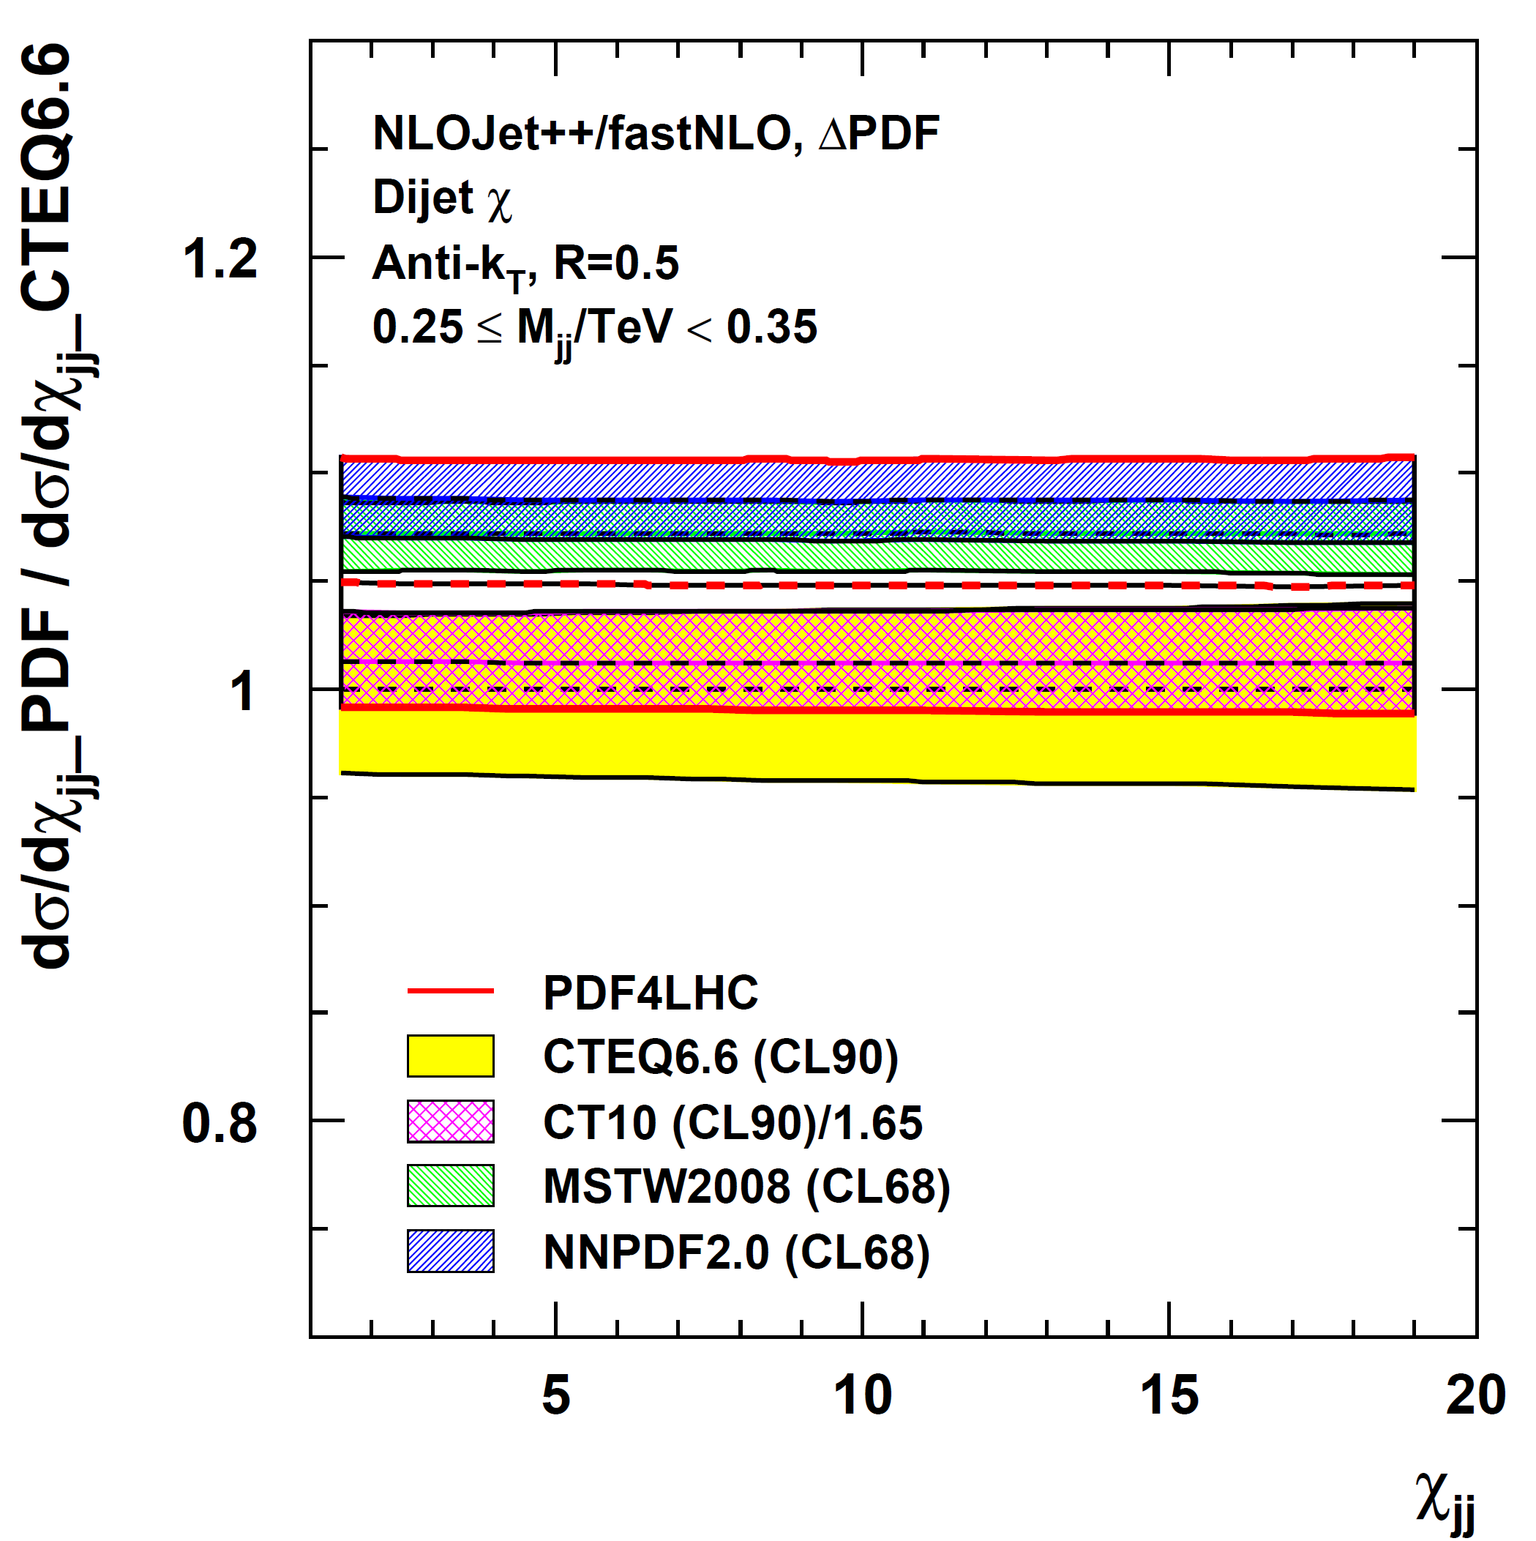
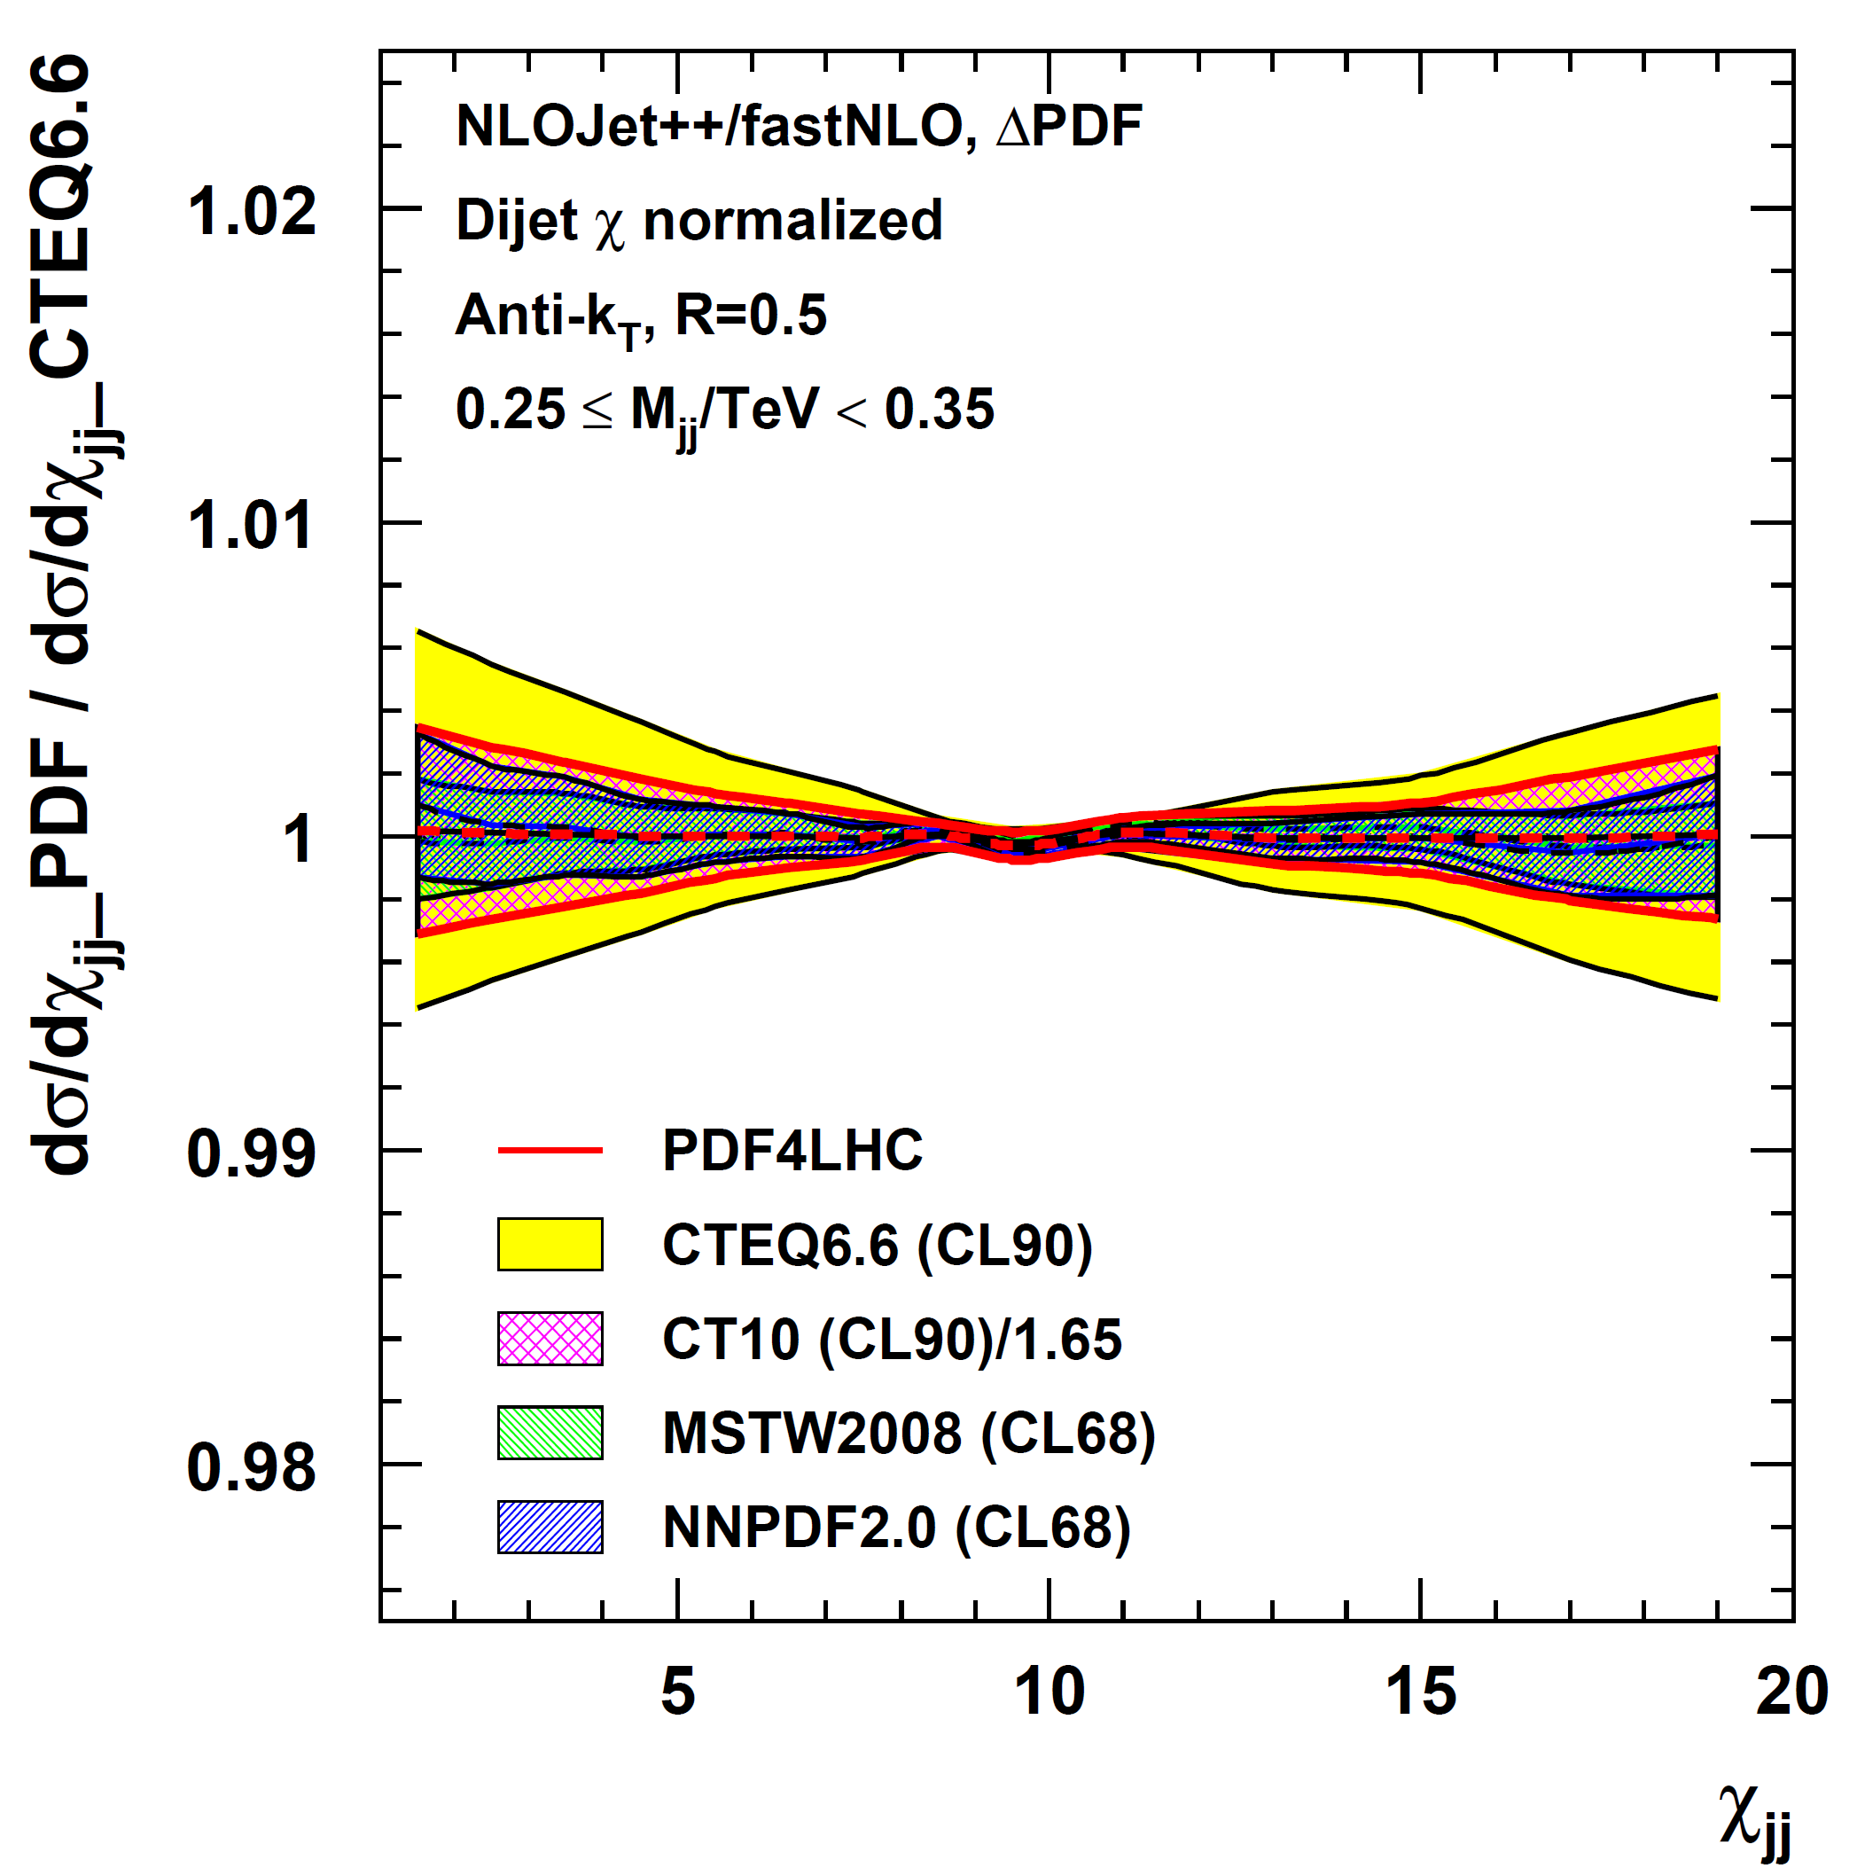
Dijet Angular: ΔPDF
Take proper care of normalization in e.g. PDF uncertainty derivation
Differential cross section
Normalized cross section
# NLO = 239

Slide 14
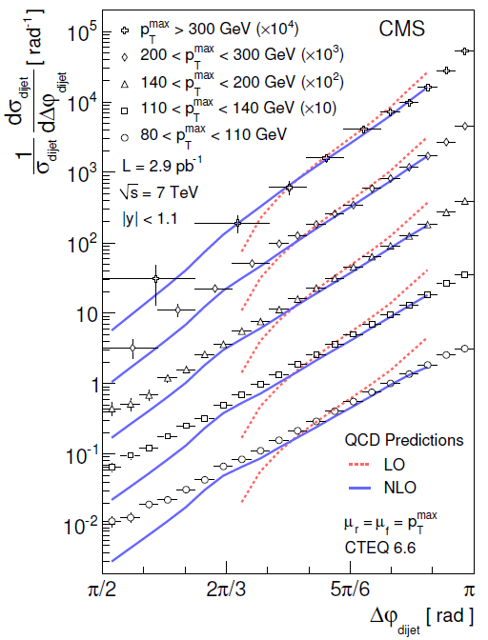
Normalized Cross Section 2
Version 1: Normalize to … ?
Dijet azimuthal decorrelation:
Depending on Δφ_{jj} different orders
(# of partons) contribute!
Some parts of histogram would be NNLO
(at π) or are NLO (down to ~2π/3) or
LO (below ~2π/3)
# NLO = 1
Nevertheless:
Normalization can be done at NLO
==> Numerator and Denominator both at NLO …
but of different order in alpha_s
O(alpha_s³) / O(alpha_s²)
Also possible: Numerator and denominator of
same order in alpha_s e.g. Dijet Centrality Ratio
CMS, arXiv:1101:5029

Slide 15
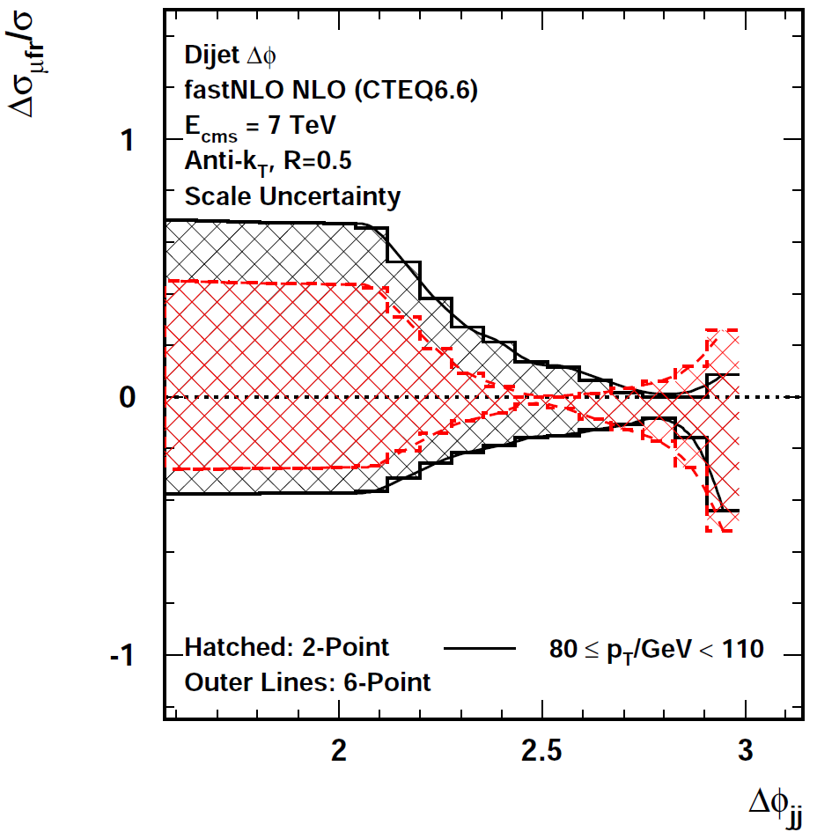
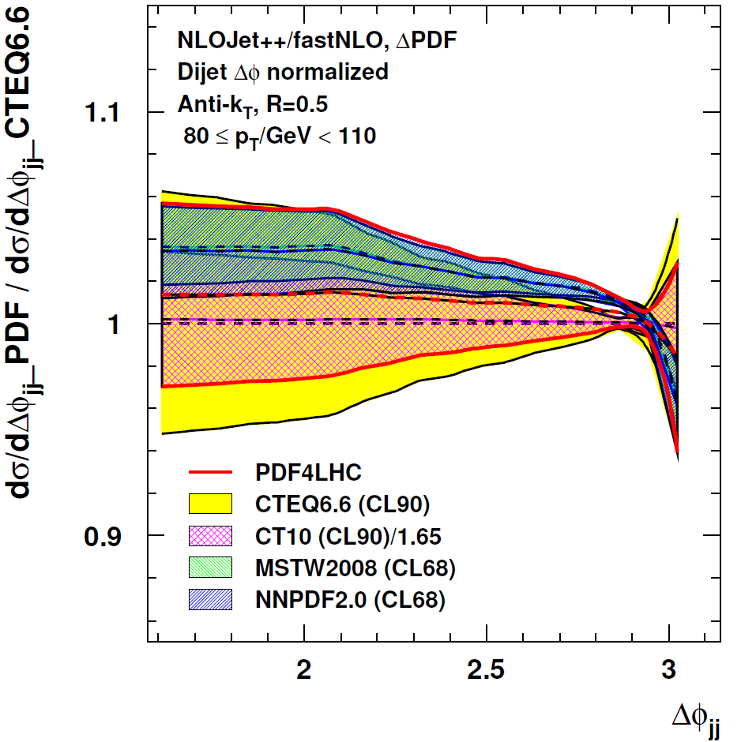
ΔΦ: Scale and ΔPDF
Reevaluations for numerator and denominator!
Low pT bin: 80 < pT / GeV < 110
Only in
3-jet part
PDF4LHC
envelope
Normalized ΔΦ
CTEQ66
2σ band
# NLO = 2 x 6
# NLO = 2 x 239

Slide 16
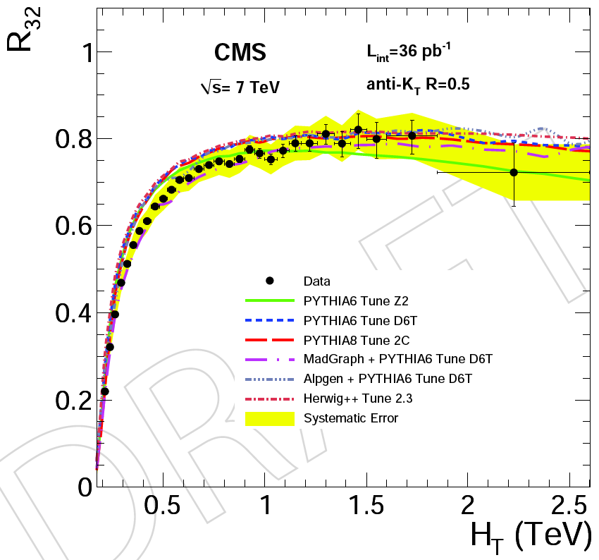
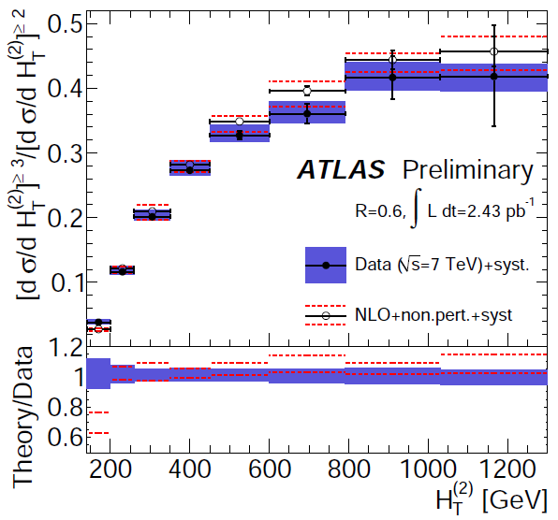
Cross Section Ratios
ATLAS: anti-kT R=0.6, |y| < 2.8
p_{Ti} > 30 GeV, p_{T1} > 60 GeV
H_{T} = Σ |p_{Ti}|
exp. Uncertainty < ~ 10%
CMS: anti-kT R=0.5, |y| < 2.5
p_{Ti} > 50 GeV, p_{T1} > 60 GeV
H_{T} = Σ |p_{Ti}|
exp. Uncertainty < ~ 10%
ATLAS: Also consider differential
2-jet Rate (~> event shape ...)
ATLAS CONF-2011-043
CMS-QCD-10-012

Slide 17
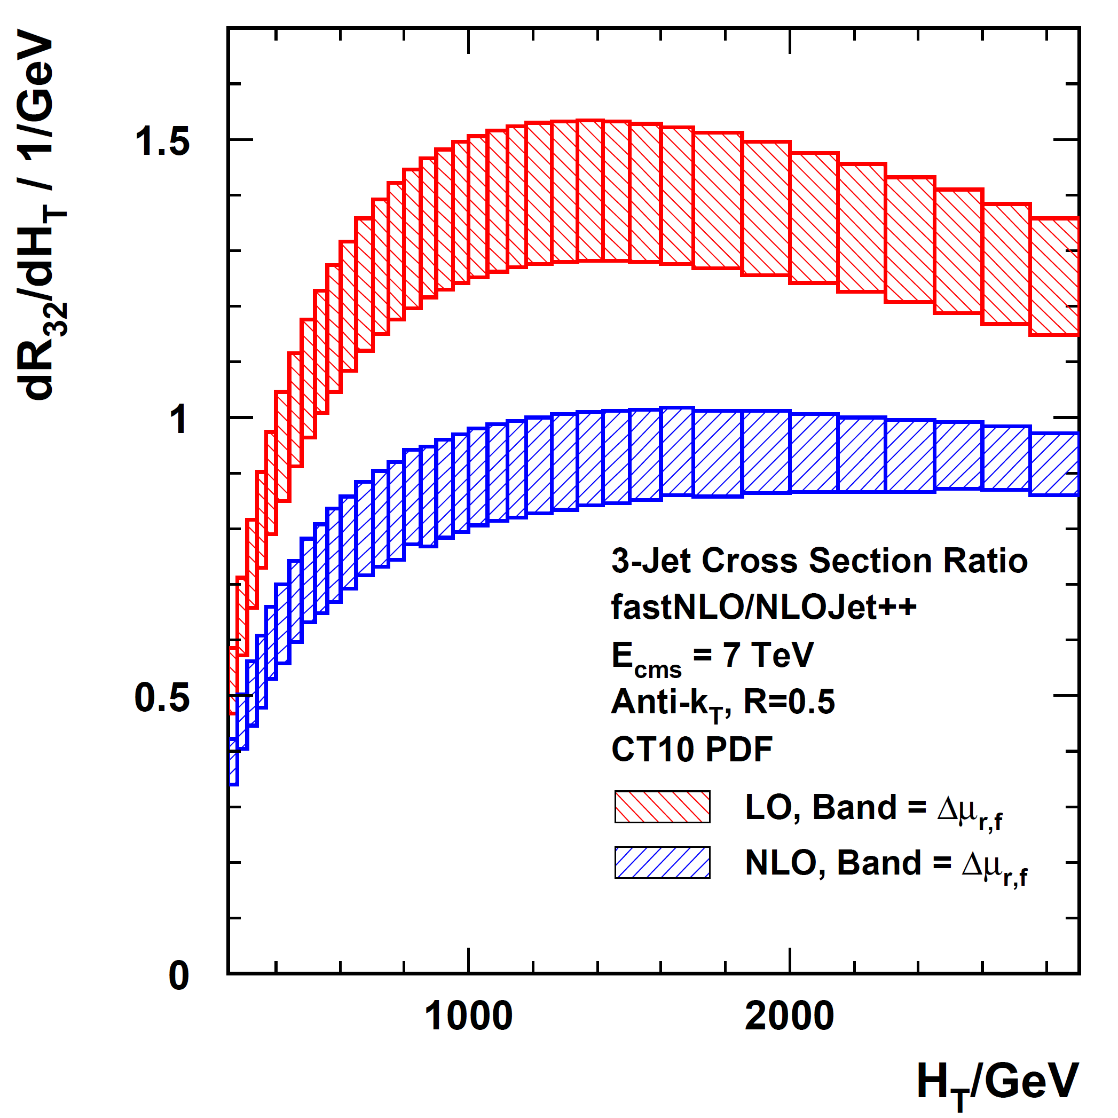
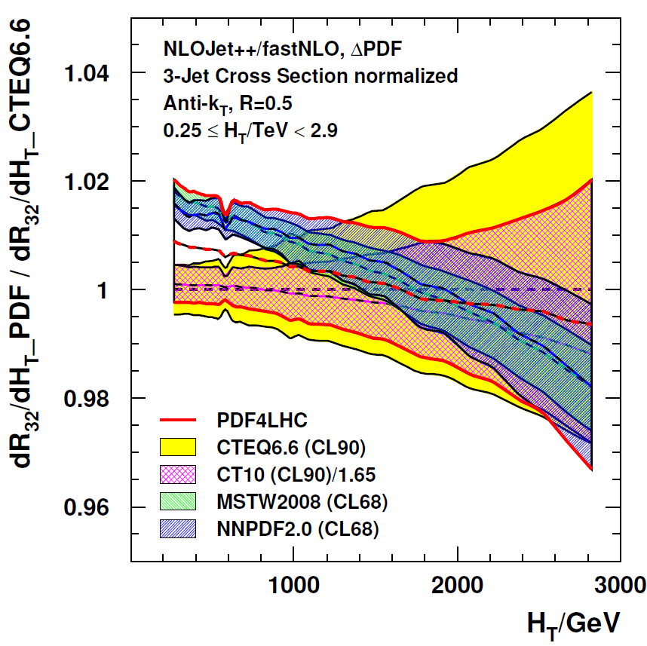
3+/2+: NLO Prediction & ΔPDF
CMS like selection
(ATLAS not very different)
LO > 1 ?!
K factors ~ 0.67
PDF uncertainty reduced
by a factor ~ 10 in ratio
# NLO = 2x7
# NLO = 2x239
Cross section ratios: Outer/inner rapidity, 3+jets/2+jets, jet R=0.7/jet R=0.5, ...
new physics, ~ α_{s}, QCD shower
Largest systematic uncertainties cancel: Lumi (completely), JES, JER (partially)
But also the α_{s} sensitivity except for:

Slide 18
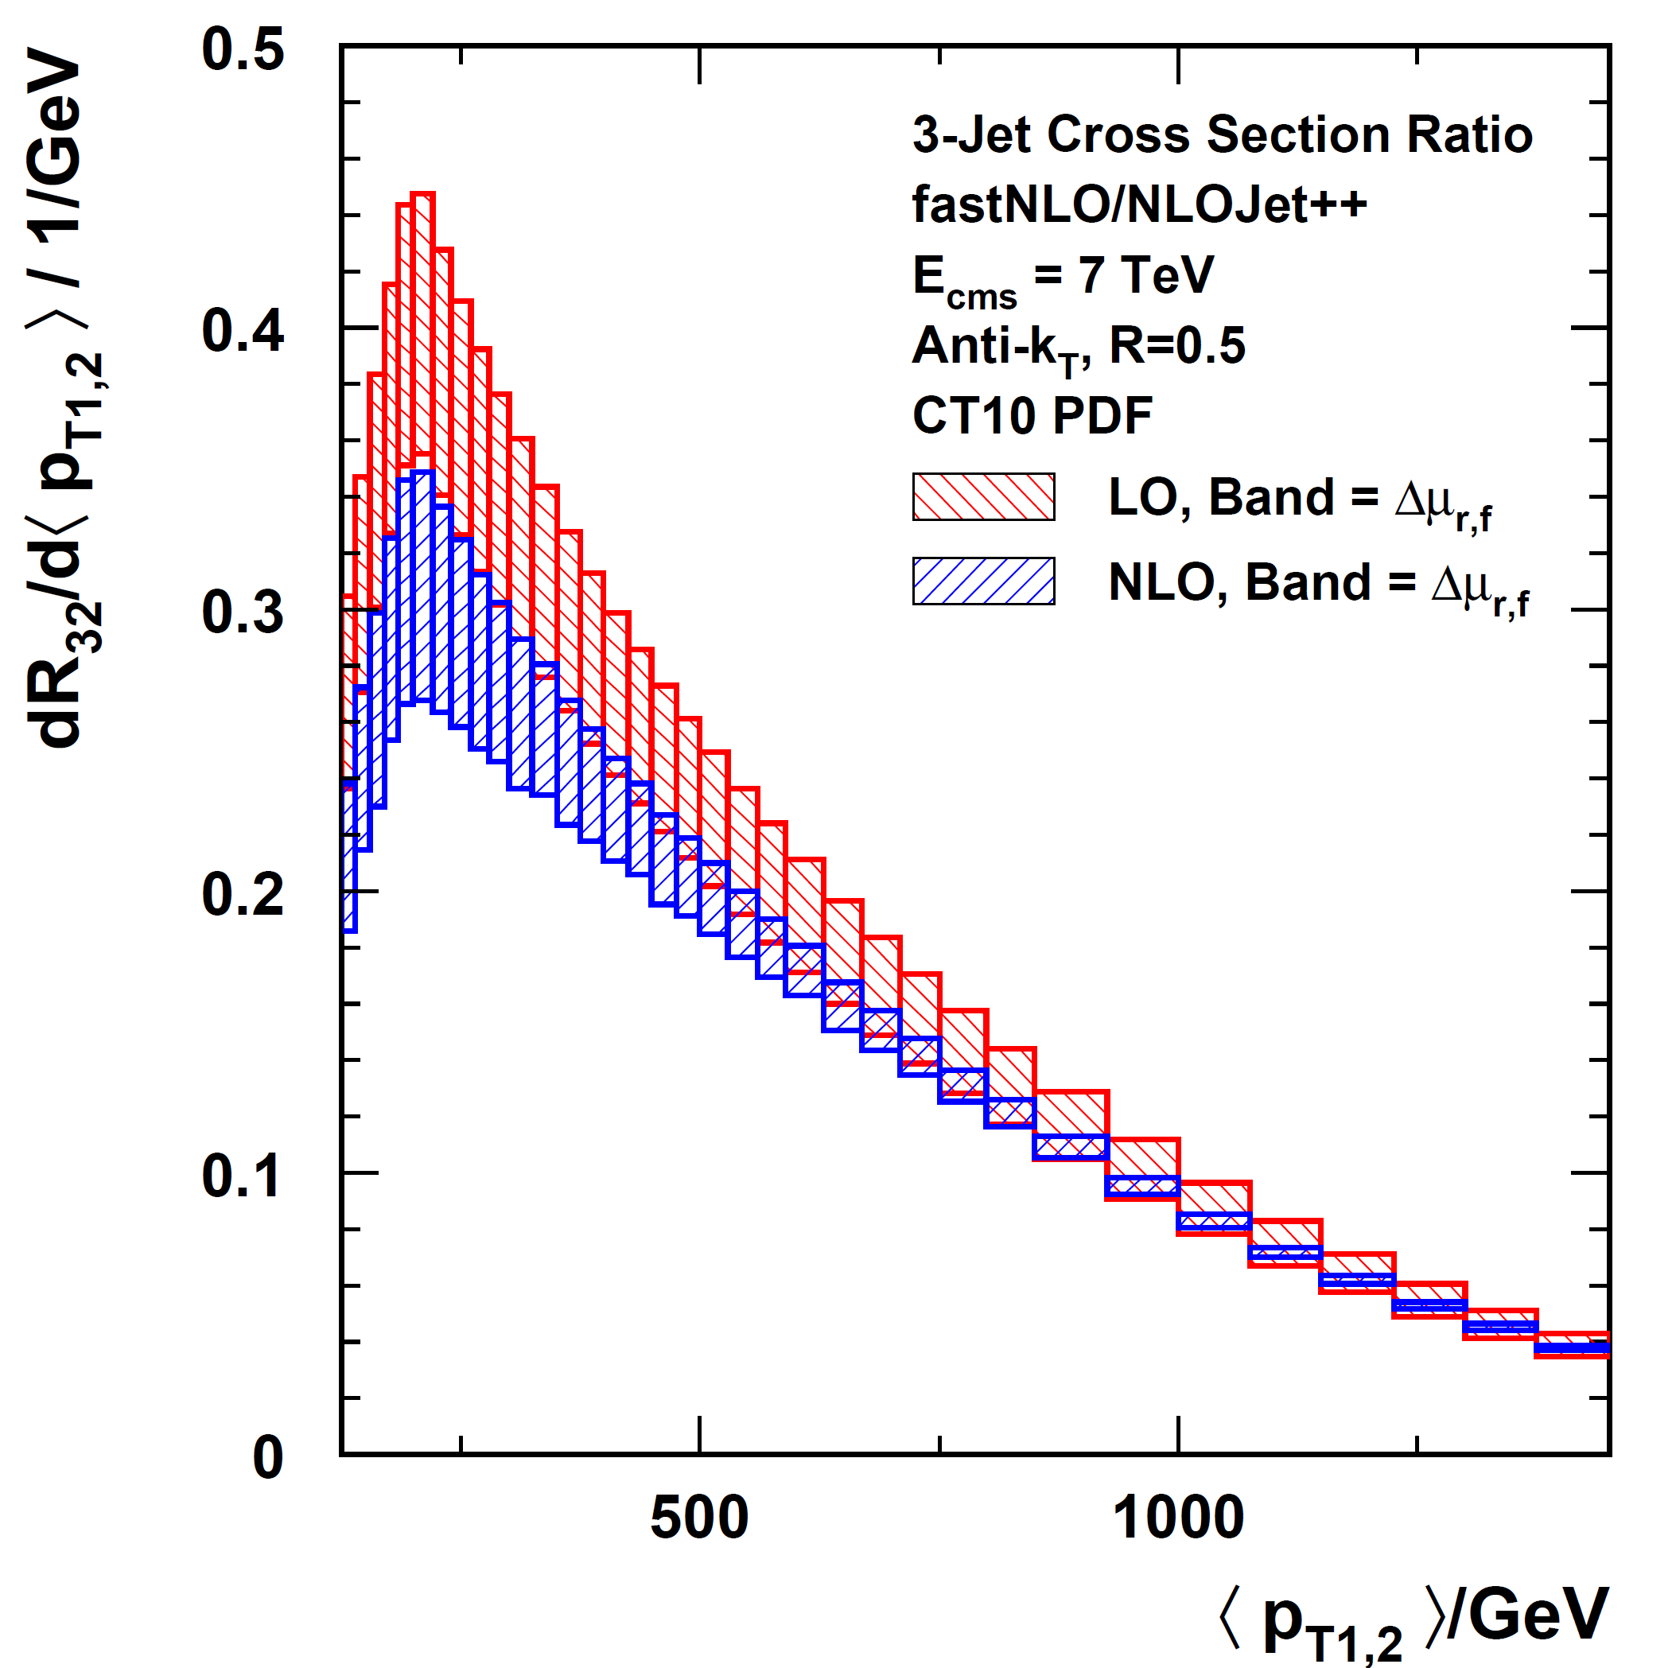
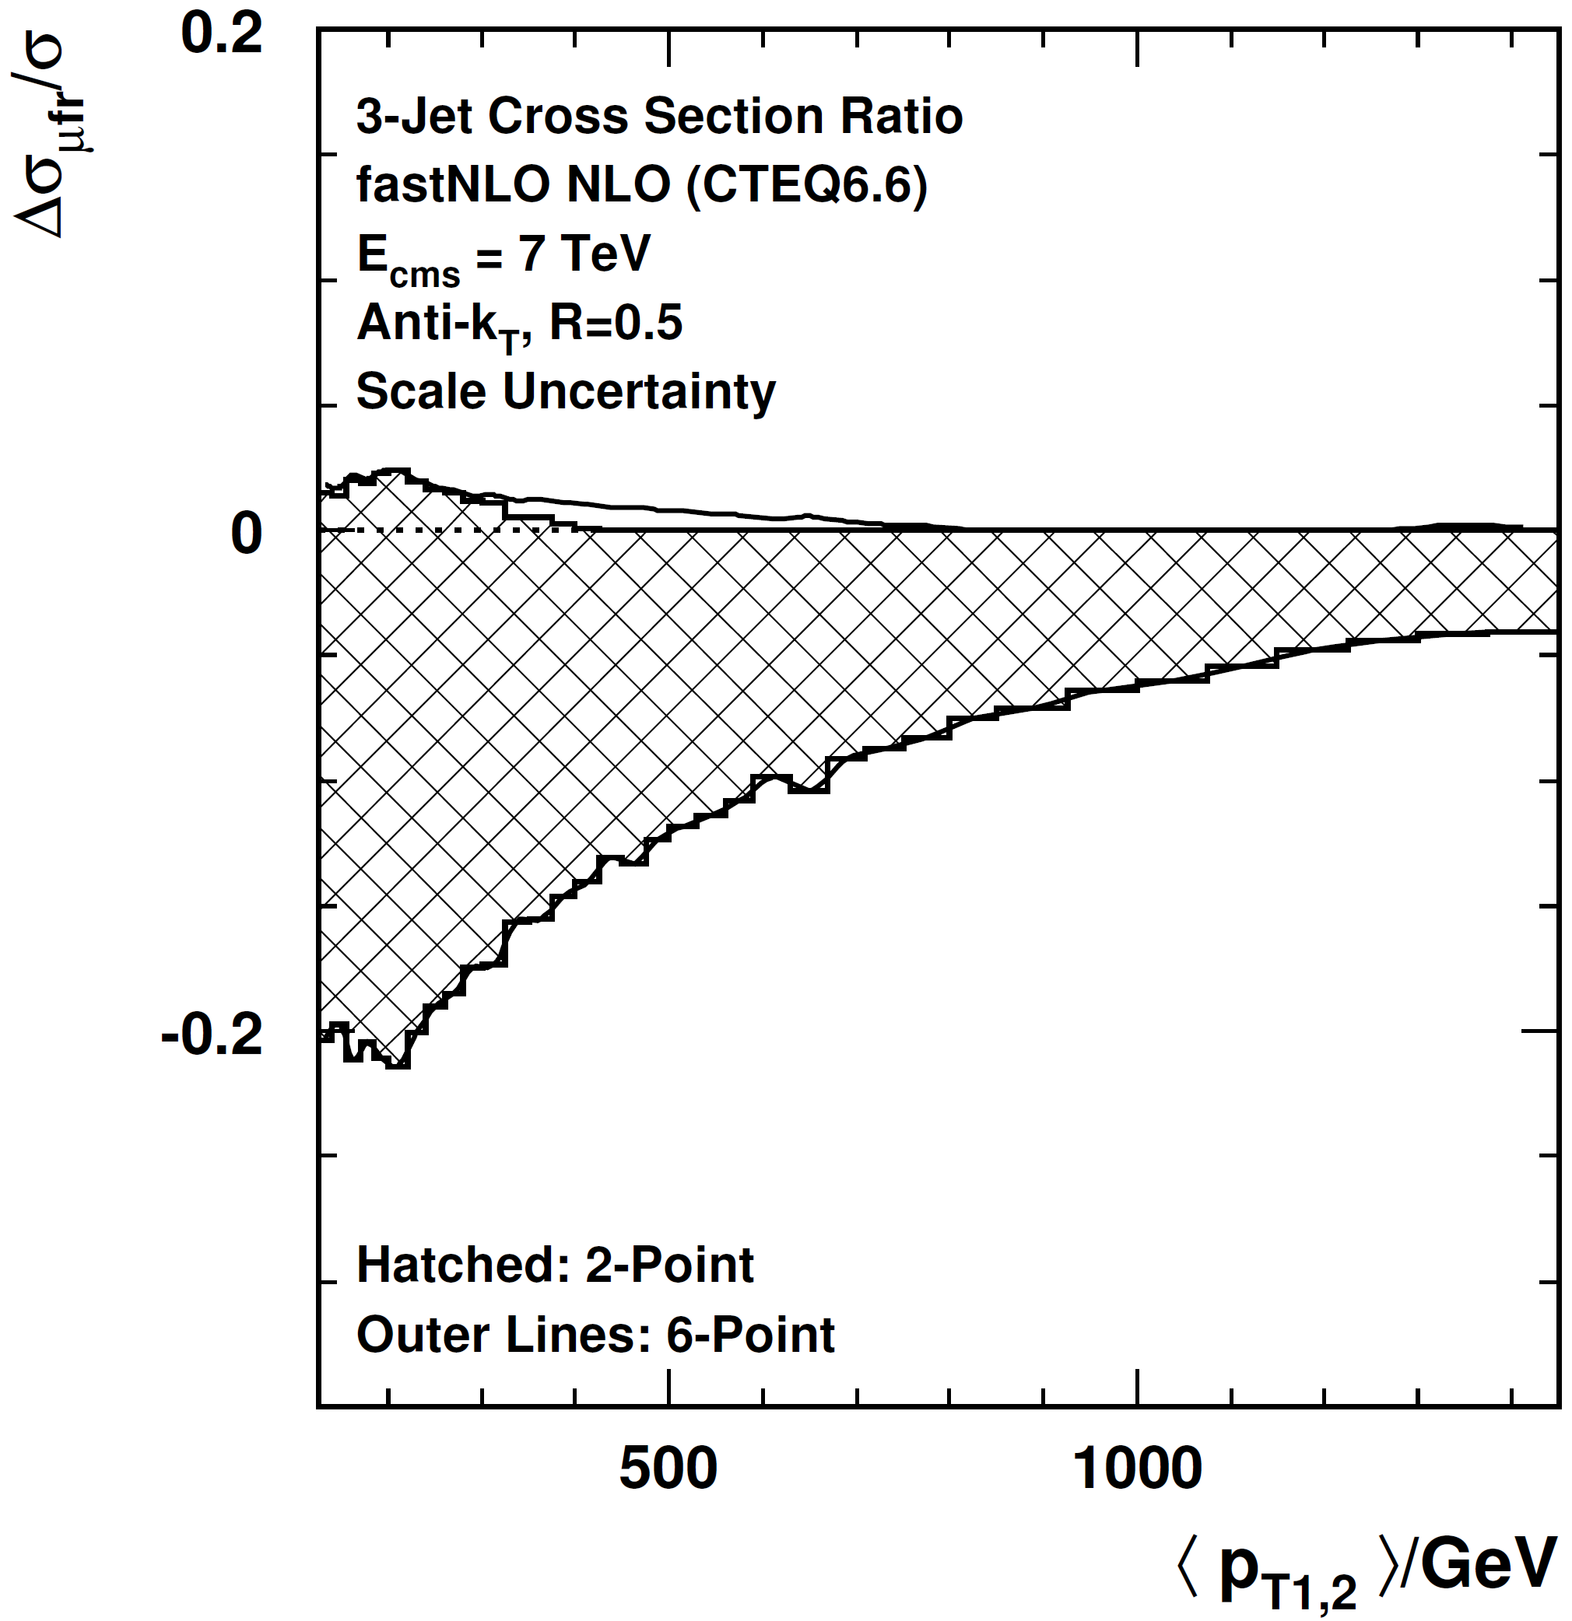
3+/2+ Revisited
Made some adaptations after chat with Gavin Salam, also see D0 or HERA!
- changed scale from H_{T} to average dijet p_{T}: <p_{T1,2}>
- require hard third jet: p_{T3} > 0.25 times <p_{T1,2}>
Not optimal yet,
but clearly better
NLO
~ +3/-8 %
p_{T} > 50 GeV cut
# NLO = 2x7

Slide 19
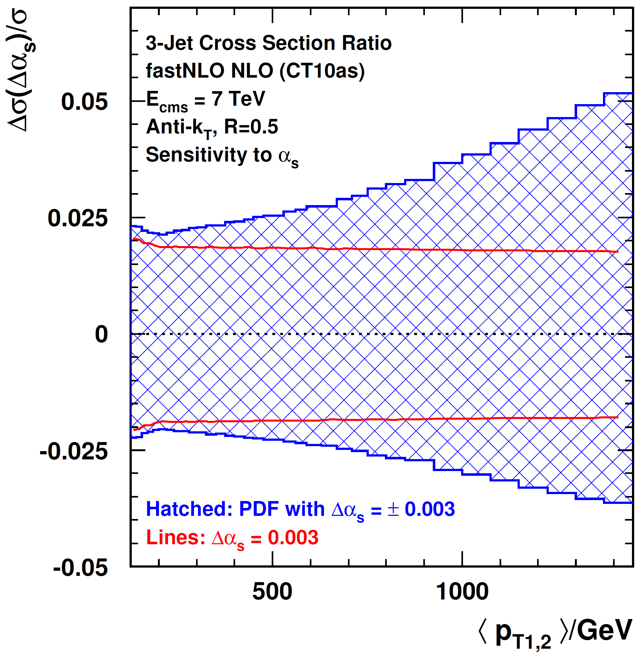
3+/2+: Sensitivity to α_{s}
α_{s} Sensitivity
CT10as members with
α_{s} = 0.118 ± 0.003
α_{s}(M_{Z}) only changed
α_{s} = 0.118 ± 0.003
To be further investigated ...
# NLO = 2x4

Slide 20
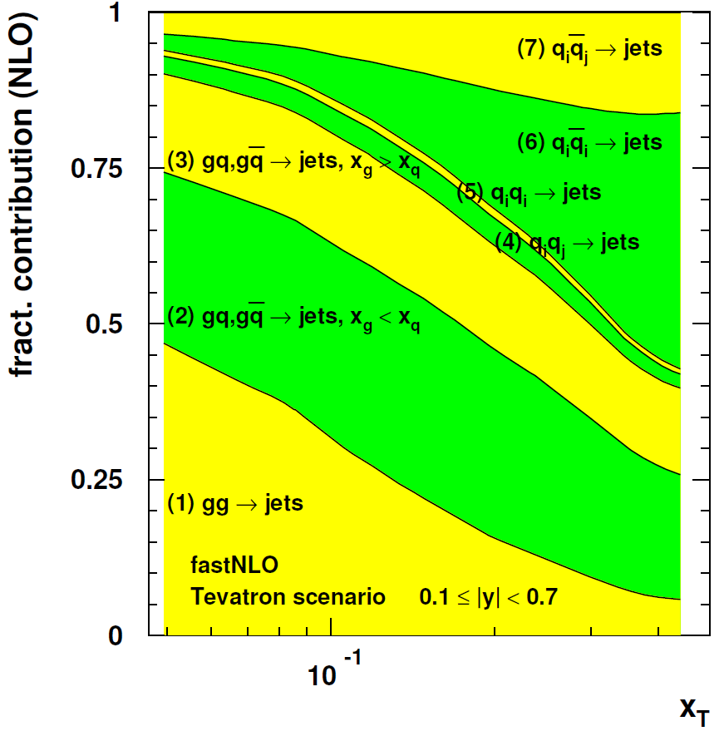
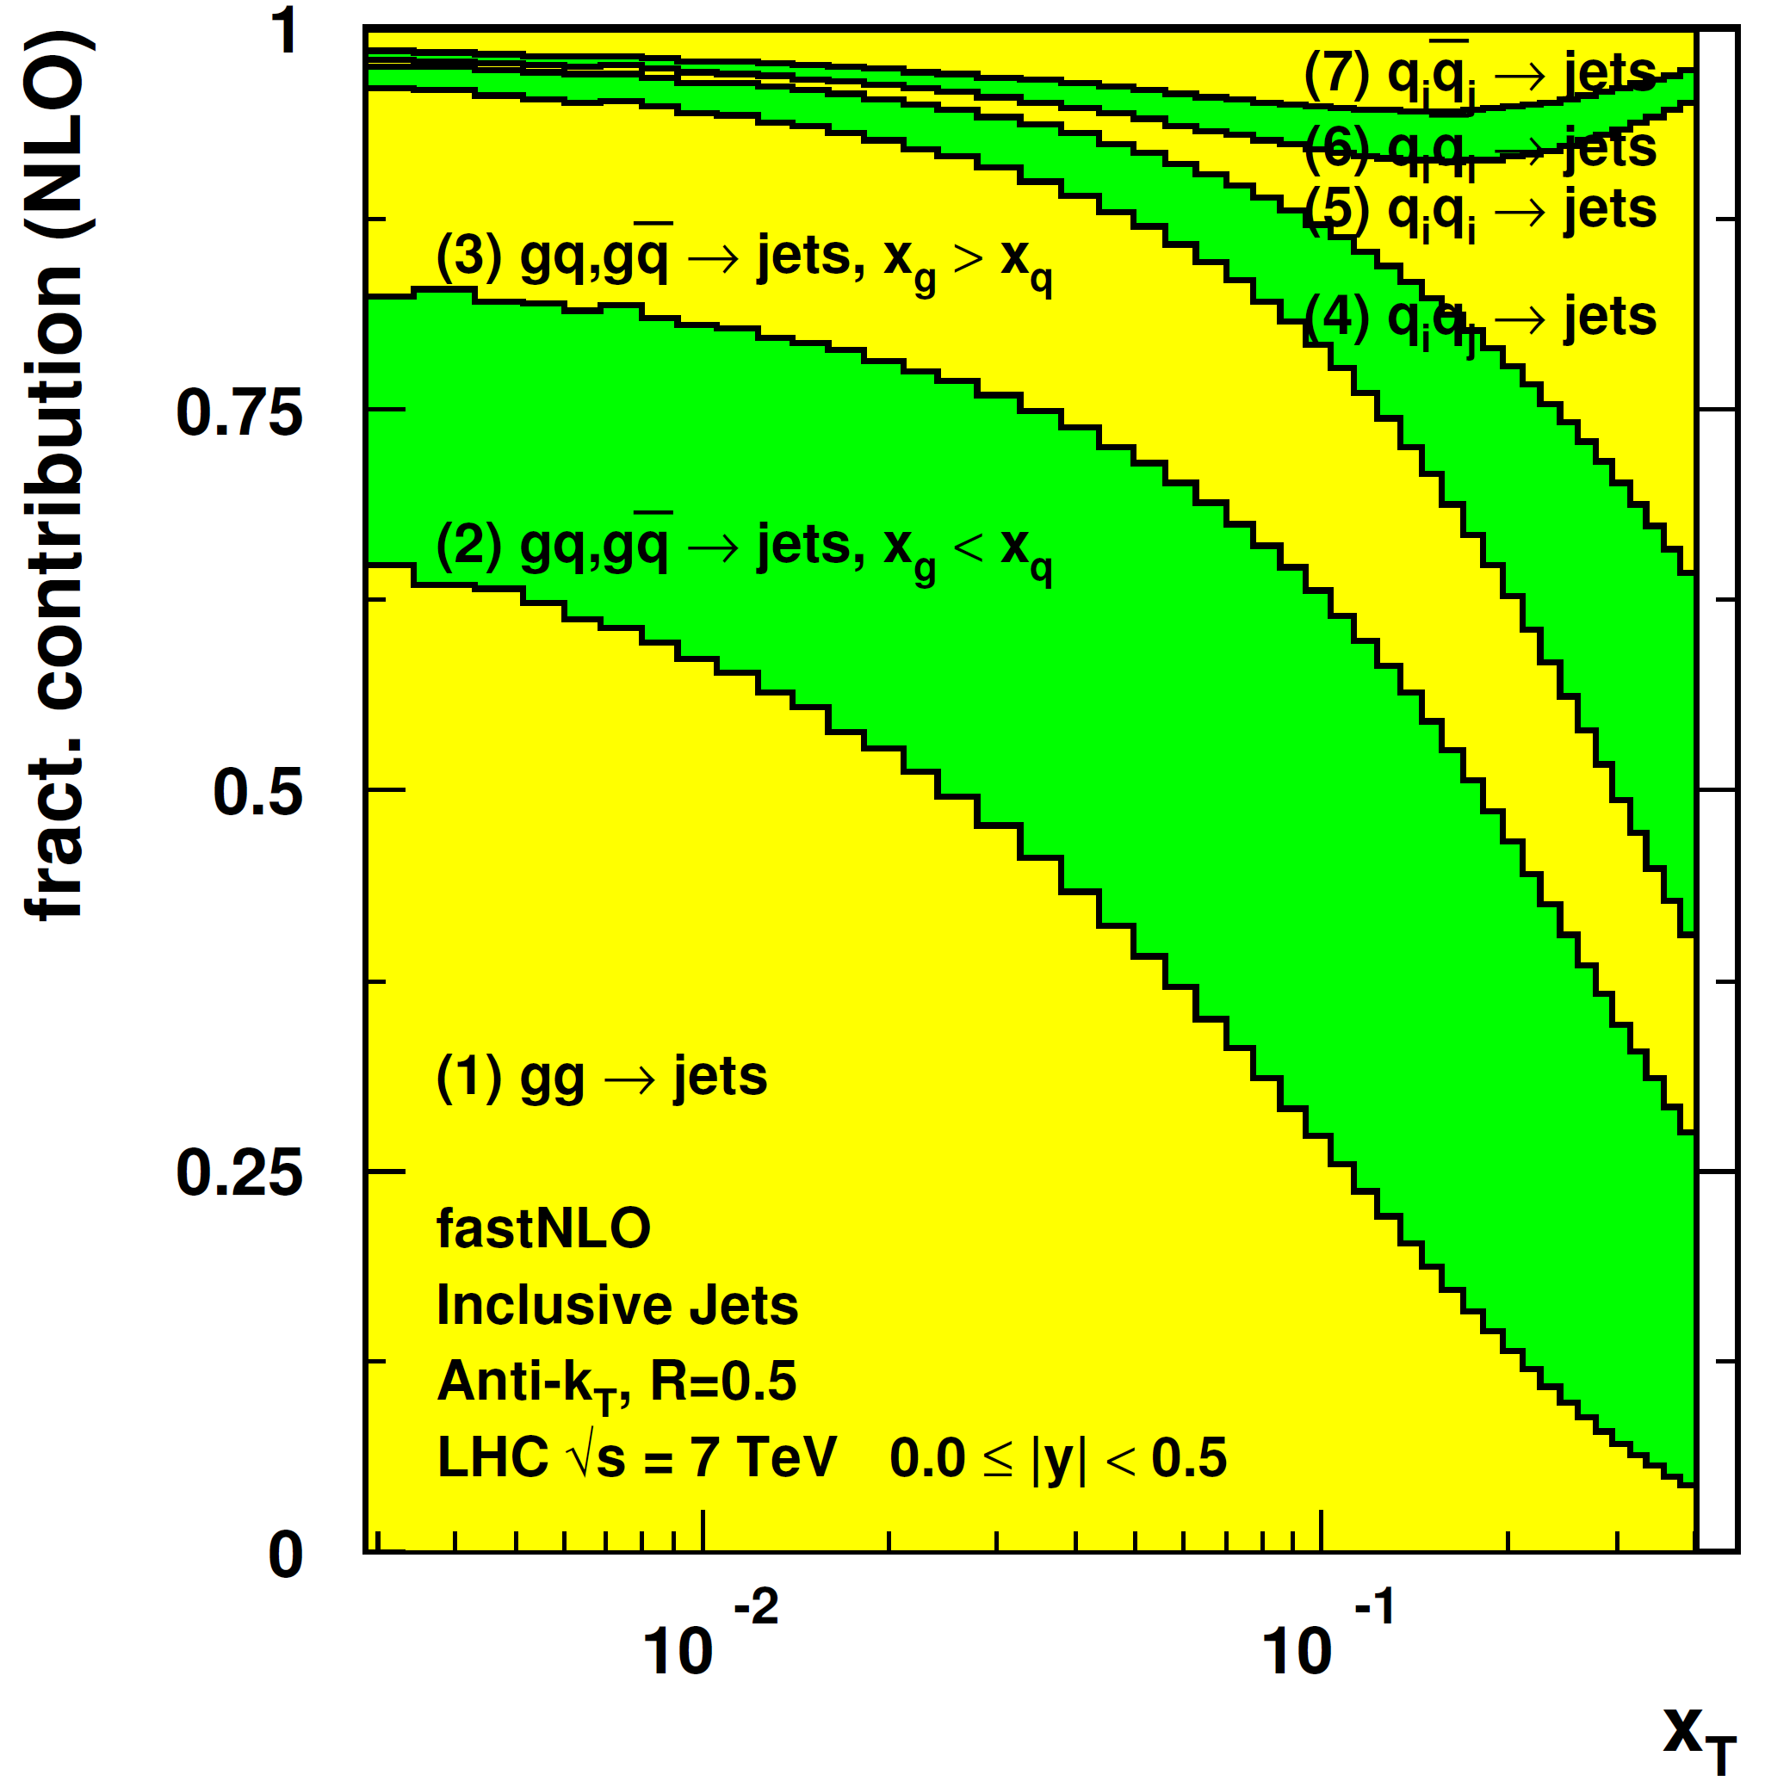
Jet Cross Section Decomposition
Tevatron, 1.96 TeV
LHC, 7 TeV

