Slide 1

DPG Frühjahrstagung 2006
High pT Cross Sections with
Thomas Kluge, DESY, H1
Andreas Oehler, University of Karlsruhe, CMS
Klaus Rabbertz, University of Karlsruhe, CMS
Markus Wobisch, FERMILAB, D0

Slide 2
Outline
Motivation
Concept
PDF Approximation
Optimizations
Some Results
Outlook

Slide 3



Motivation
  Interpretation of experiment data relies on:
    Availability of reasonably fast theory calculations
    Often needed: Repeated computation of same cross section
  Examples for a specific analysis:
    Use of various PDFs (CTEQ, MRST, ...)
    Determine PDF uncertainties (PDF error sets)
    Use data set in fit of PDFs and/or αs(MZ)
  Sometimes NLO predictions can be computed fast
  But some are very slow, esp. for Drell-Yan and jets
  Need new procedure for fast repeated computations of NLO cross sections

Slide 4
New Concept
Can be used for any observable in hadron-induced processes (hh / DIS / Photoproduction)
  Does not include theor. calculation itself (leave this to theorists!), but requires flexible computer code:
    Here: NLOJET++ (Zoltan Nagy)
  During first computation no time saved:
    Needs hours, days, weeks ... for high statistical precision
  Any further computation takes fractions of a second
  Involves one single approximation with quantifiable precision

Slide 5


Jet cross sections in hadron-hadron collisions
General cross section formula:
which depends on:
    Strong coupling constant αs to the power of n
    Perturbative coefficients ci,j,n
    Parton density functions (PDFs) of the hadrons fi(x), fj(x)
    Renormalization scale μr, factorization scale μf
    Momentum fractions x
  Standard procedure: Integration over phase space in (x1,x2) (usually MC method) => Dependency on PDFs!
  New: Interpolation between fixed support points in x for PDFs => Evaluation a posteriori possible

Slide 6
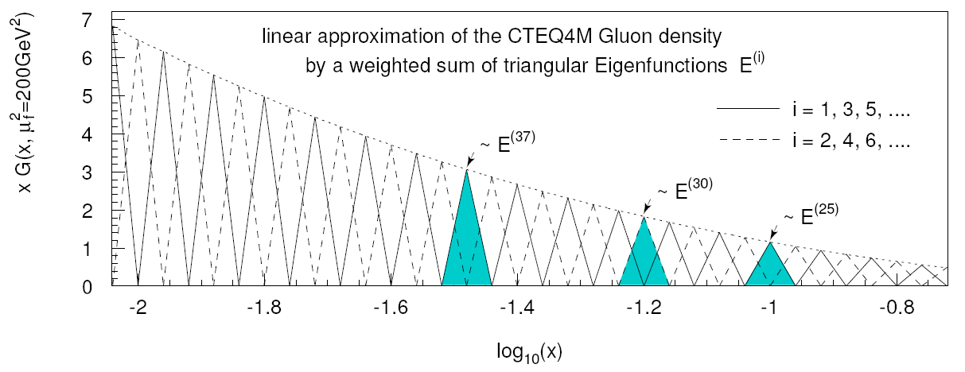

PDF Approximation
  Introduce set of discrete x^{(i)} with x^{(n)} < ..< x^{(i)} <..<x⁽⁰⁾=1
  Around each x^{(i)} define eigen function E^{(i)}(x) with:
    Ε^{(i)}(x^{(i)}) = 1, Ε^{(i)}(x^{(j)}) = 0 (i ≠ j), Σi E^{(i)}(x) = 1 for all x
  Express PDF f(x) by lin. combination of eigen functions with coefficients given by PDF values at discrete points:
=> Integration only over E^{(i)}(x), not f(x)!

Slide 7
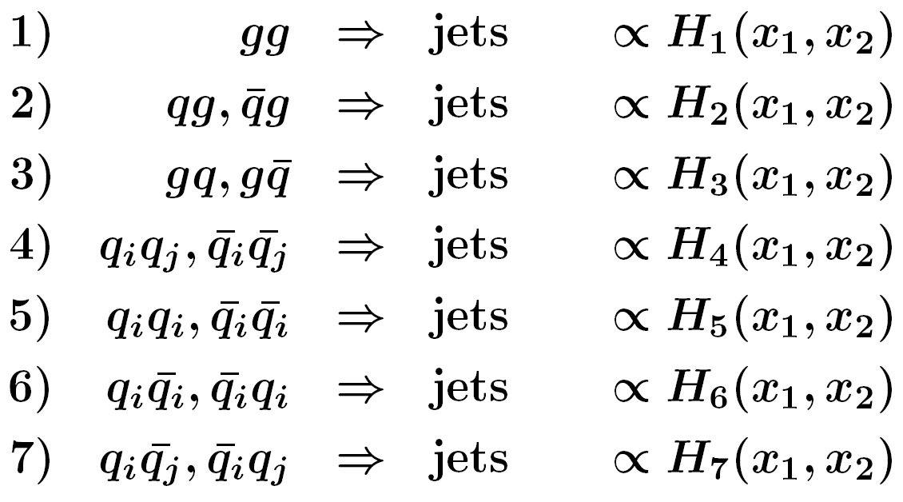
Partonic Subprocesses
  Don't want to deal with 13 X 13 PDFs
  For hh → jets seven relevant partonic subprocesses
  Need only seven linear combinations Hi of PDFs

Slide 8
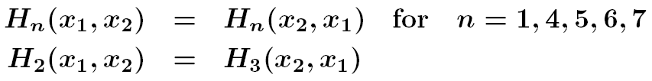
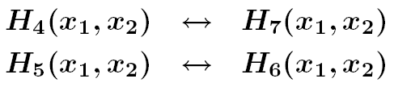
Symmetries
  In addition, symmetries can be exploited:
  For hadron anti-hadron collisions, replace:
  Minimize required table size and computing time!

Slide 9
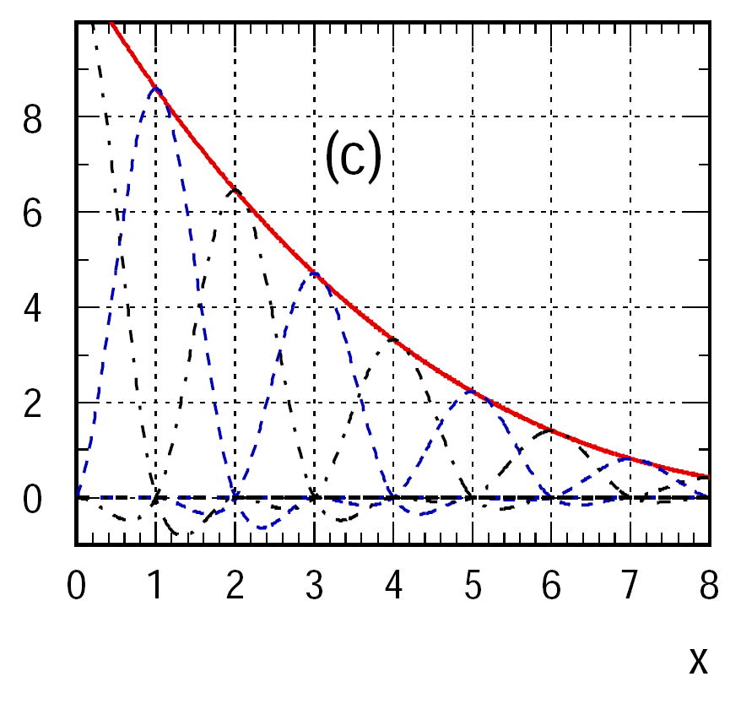

Actual Usage
Our actual interpolation is:
  Two-dimensional (x1,x2)
  Bicubic, linear at the edges
  Spaced in x with points ~
Bicubic interpolation functions
Example use case:
D0 incl. jets (hep-ex/0011036)
No. of bins in rap. y: 5
No. of bins in pT: 24 – 8
Total no. of bins: 90
No. of events (NLO): 49G
CPU time for first run: > 4000h
Table size (10 x bins, 4 scal.): 5.5MB
Reading of table: O(1s)
Execution time/PDF set: < O(0.1s)
Stat. precision, y bins 1-3: 0.1 - 0.3%
y bins 4,5: 0.2 - 1.0%
(Depending on used PC!)

Slide 10
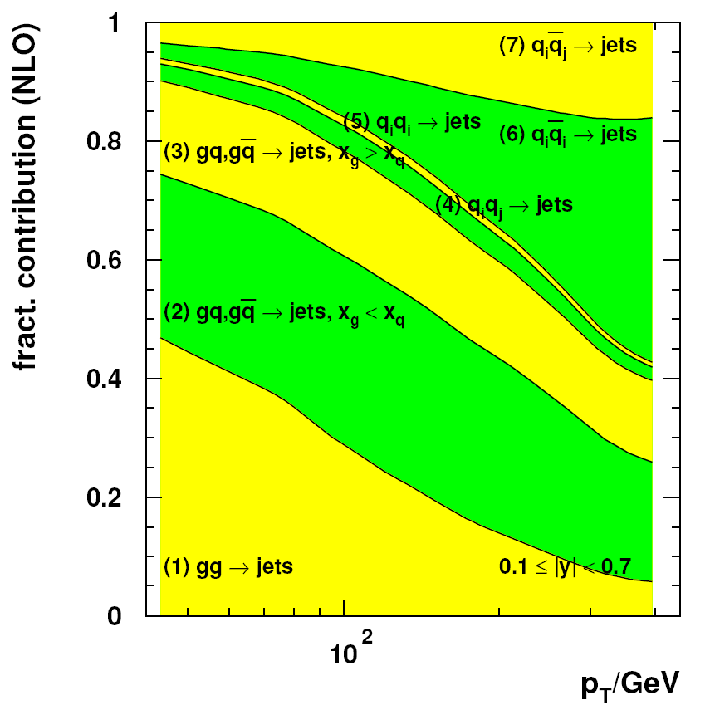
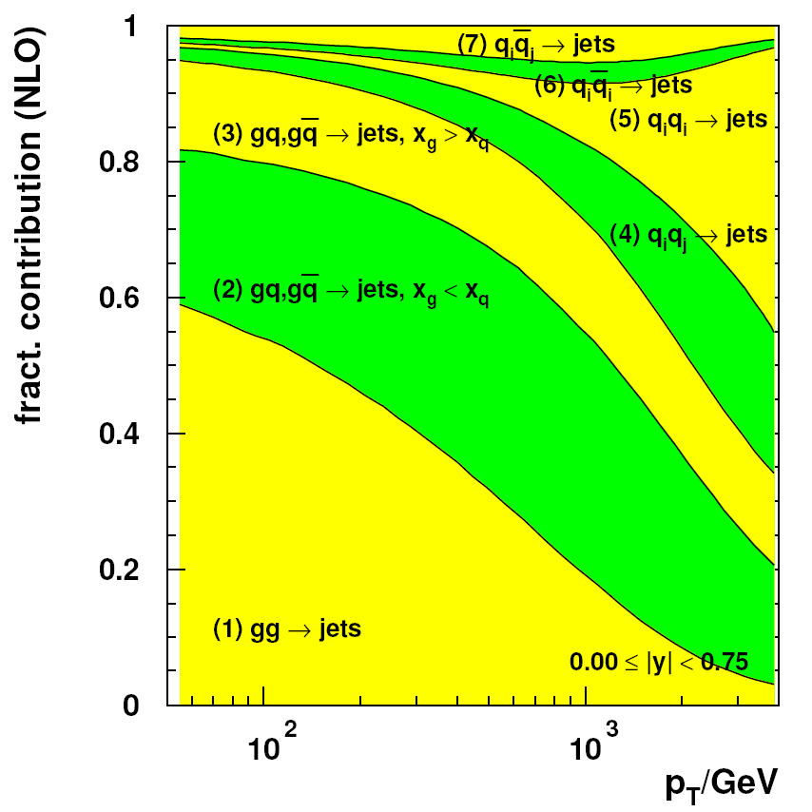
Example Decompositions
Tevatron (left) and LHC (right) subprocess contributions in central rapity region

Slide 11
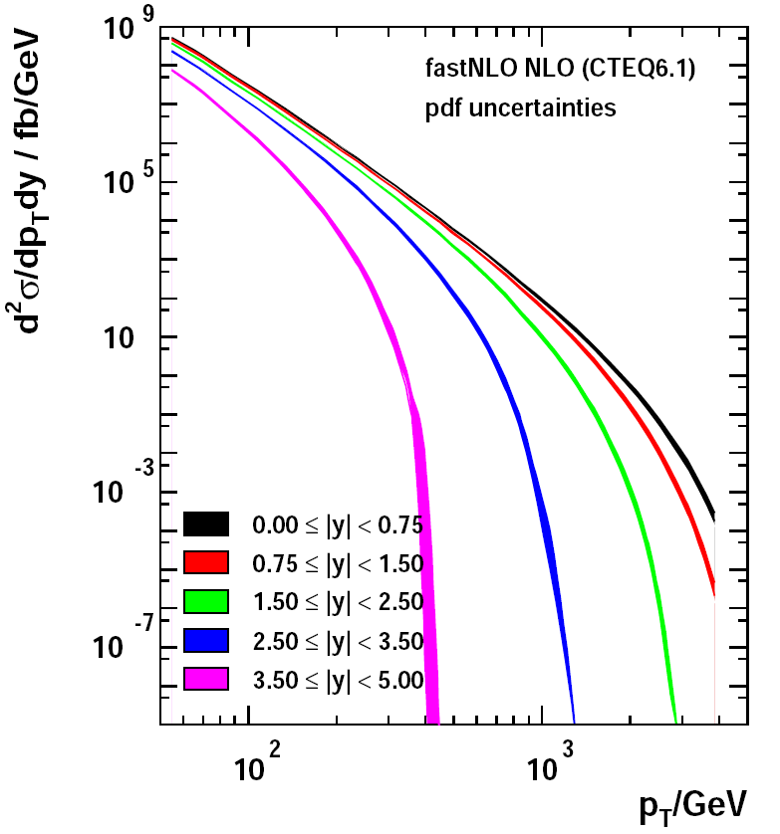
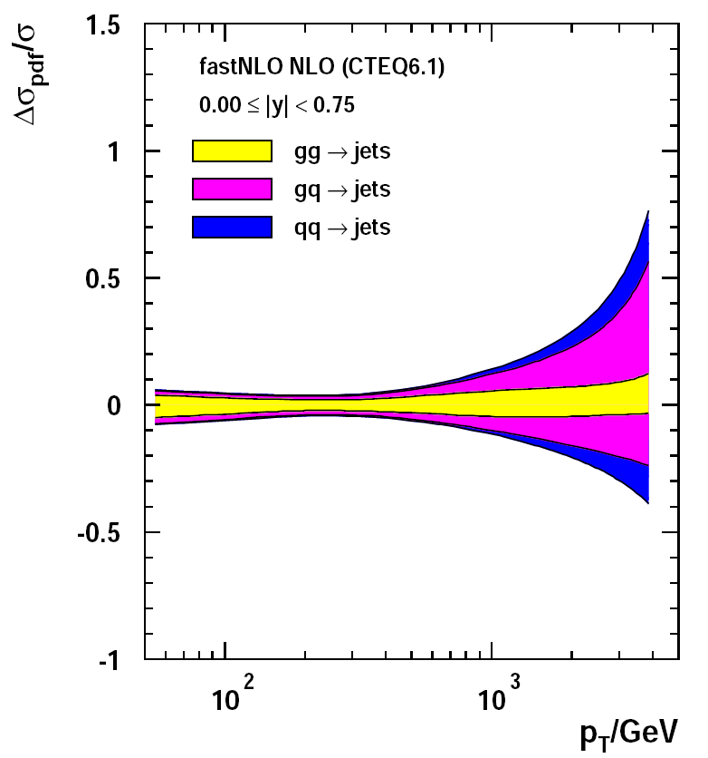
Diff. Jet Cross Section and PDF Uncertainty
LHC scenario for kT Algorithm with D = 1.0, see also A. Oehlers talk T 706.9
The bands correspond to the PDF uncertainty (adding deviations in quadrature)

Slide 12
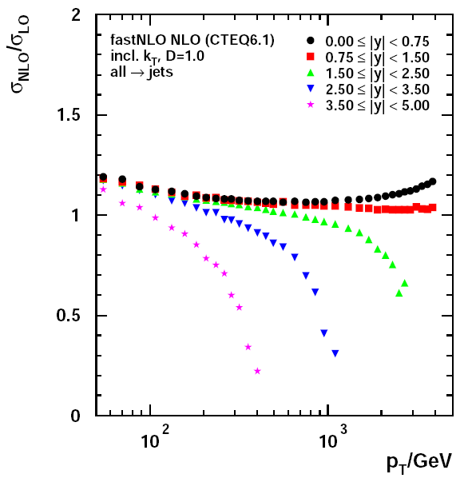
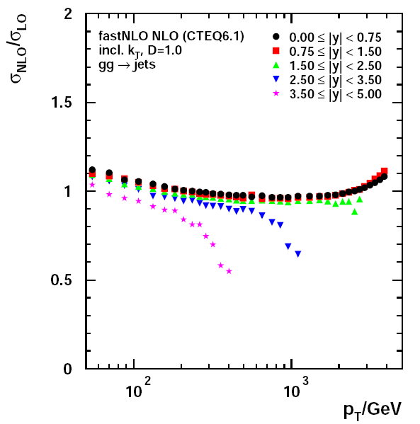
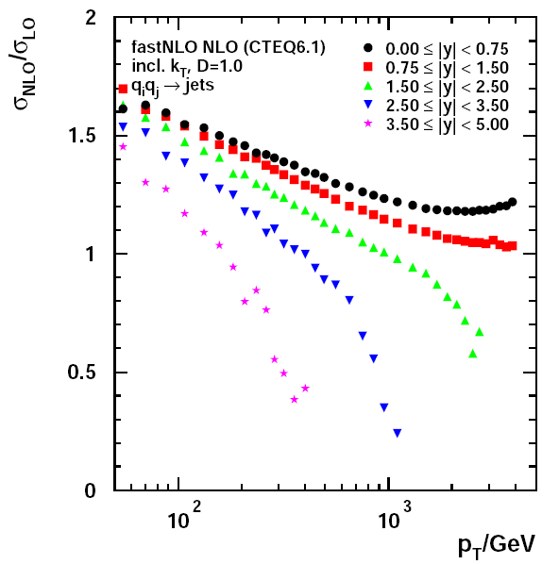
K Factors
gg subprocess
dominant at low pT
all
qiqj subprocess
dominant at high pT

Slide 13
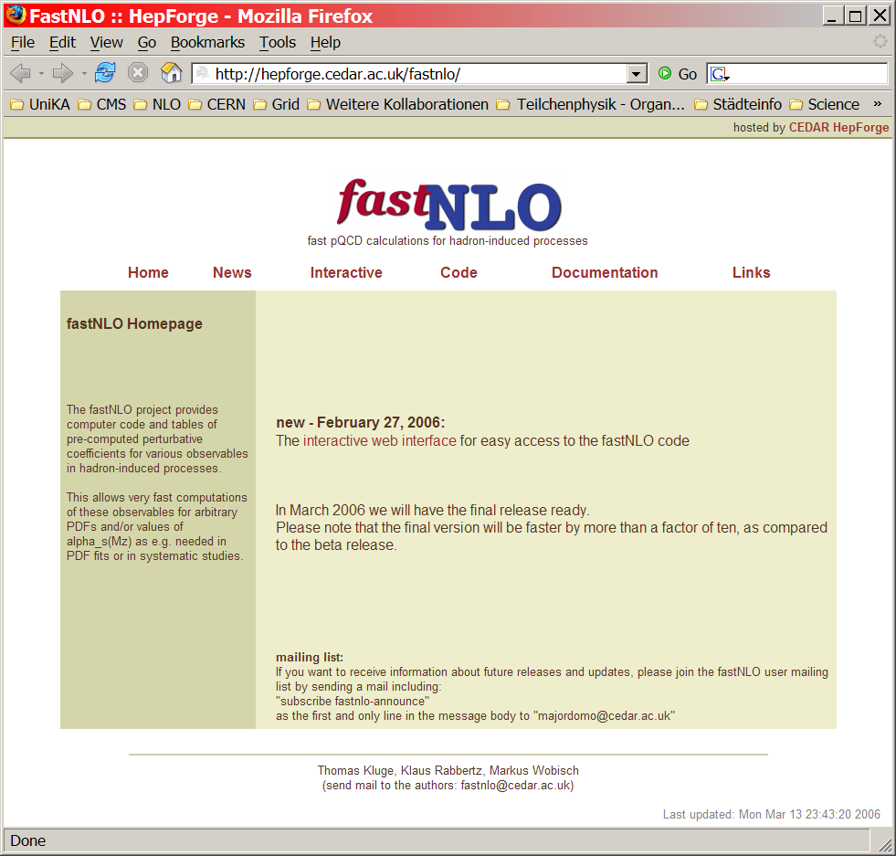
More Information
On our CEDAR web page:
  Application of fastNLO to
  6 Tevatron publications
  3 HERA publications
  1 RHIC scenario
Interface for interactive recomputation
Result tables + user code
Talks from TeV4LHC Workshop
Documentation
  http://hepforge.cedar.ac.uk/fastnlo

Slide 14
Outlook
First plan of implementation almost completed!
  LHC scenarios i.a. for CMS nearly done
  Publication in preparation
  Application to PDF fitting with LHC (simulated) data
  Clean up of code
  Implement a posteriori scale changes of μf (prop. by G. Salam)

