Slide 1


HERAFitter Meeting
v2
The fastNLO Collaboration:
Daniel Britzger, Thomas Kluge, Klaus Rabbertz, Fred Stober,Markus Wobisch
(DESY, Liverpool, KIT, KIT, Louisiana Tech University)

Slide 2
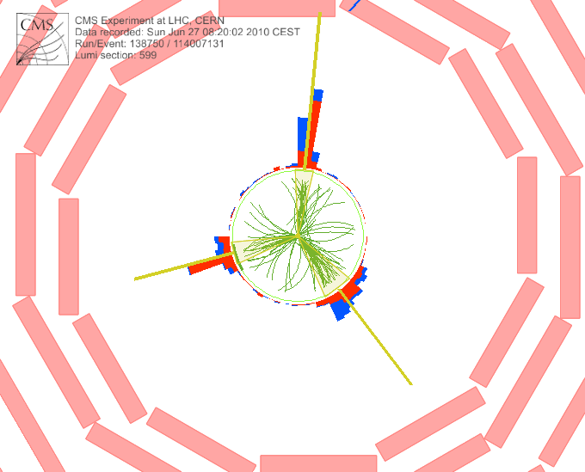
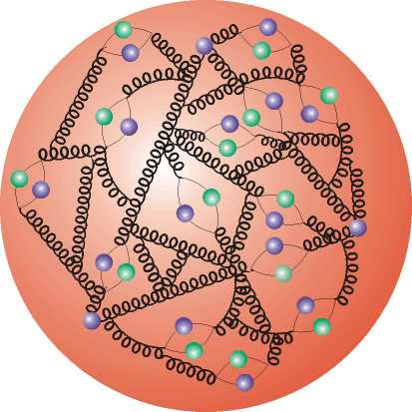

Outline
Quick Reminder: Motivation
Release of fastNLO_reader_2.1.0
Some use of v2
Outlook

Slide 3




Motivation
  Interpretation of experiment data relies on:
    Availability of reasonably fast theory calculations
    Often needed: Repeated computation of (almost) same cross sections
  Examples for a specific analysis:
    Use of various PDFs (CTEQ, MSTW, NNPDF, HERAPDF, ABKM ...)
    Determine PDF uncertainties (PDF error sets)
    Use data set in fit of PDFs and/or αs(MZ)
  Sometimes NLO predictions can be computed fast
  But some are very slow, esp. for jets
  Need procedure for fast repeated computations of NLO cross sections
  Use fastNLO (in use by most PDF fitting groups) (ATLAS mostly uses another project: APPLGrid)

Slide 4
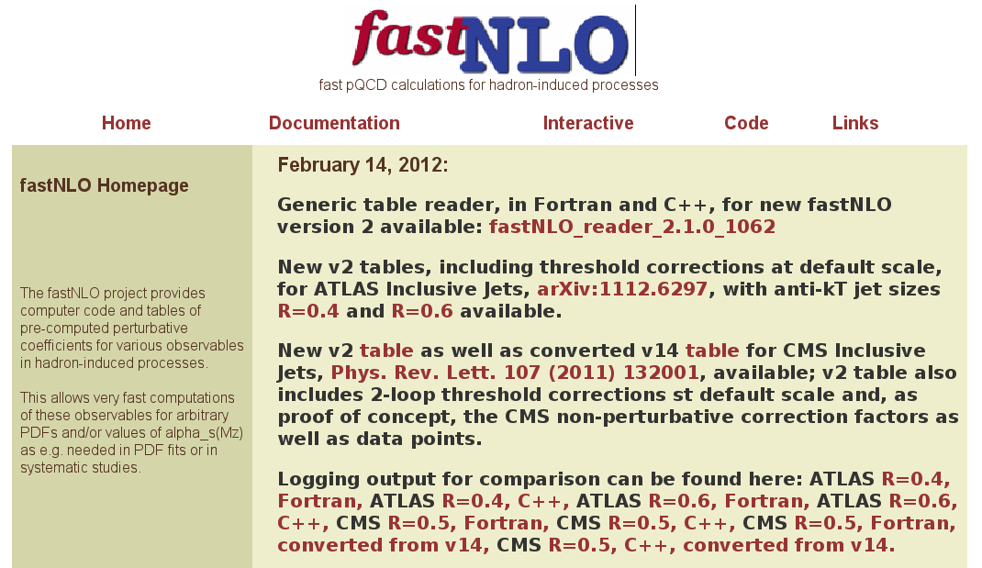
fastNLO_reader_2.1.0
First public release TODAY, 14.02.2012
See: http://projects.hepforge.org/fastnlo/

Slide 5


Scope of Release
  Generic code to read fastNLO v2 tables: fastNLO_reader
    Installable from autotools distribution tarball
    Only dependency: LHAPDF
    Comes in two flavors, Fortran and C++
    Different code base, same results at O(10⁻¹⁰)
    Fortran does not yet deal with flexible scale DIS tables
  New tables:
    ATLAS Inclusive Jets, http://arxiv.org/abs/1112.6297, including 2-loop threshold corrections at default scale (pT_{jet}), R=0.4 and 0.6
    CMS Inclusive Jets, Phys. Rev. Lett. 107 (2011) 132001, including 2-loop threshold corrections at default scale, R=0.5, and as proof of concept the CMS non-perturbative correction factors and data points
    CMS: Table converted from v14 for comparison

Slide 6
Installation
  Install packages produced with standard autotools, just run
    ./configure - -prefix=your/local/dir
    make; make install
  In case of different location of LHAPDF use
    ./configure –prefix=your/local/dir --with-lhapdf=path/to/lhapdf
    Error message with hints if still not found
  For more options check
    ./configure -help
  And also look into the README file
  Executables: fnlo-fread and fnlo-cppread, type
    fnlo-fread -h (or fnlo-cppread -h)
  for command line arguments (table file, PDF file)

Slide 7
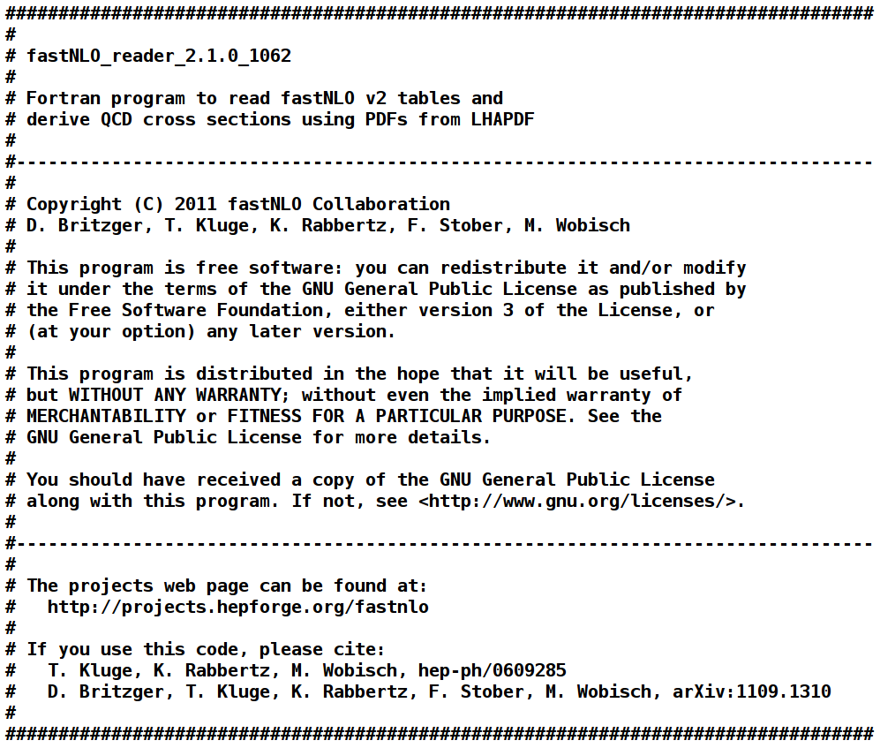
Initial Output
Version and svn
revision number
People
GPLv3 License
Web Page
References
(will be updated)

Slide 8
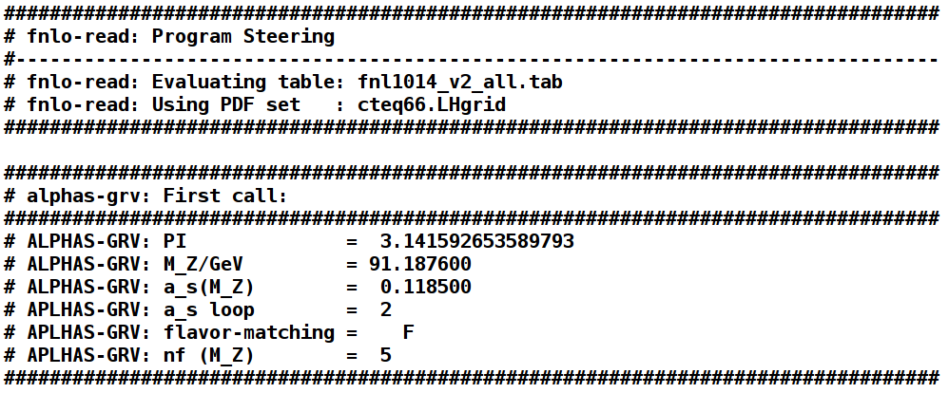
Program Start
Start parameters
of default internal
alpha_s code for
comparison
Basic evaluation code ...
Other evolution code can be used/interfaced e.g. from LHAPDF
→ edit, recompile
Default output: List of LO and NLO x sections for selected PDF
Loop over scale variations, PDF members, alpha_s variations …
→ edit, recompile

Slide 9
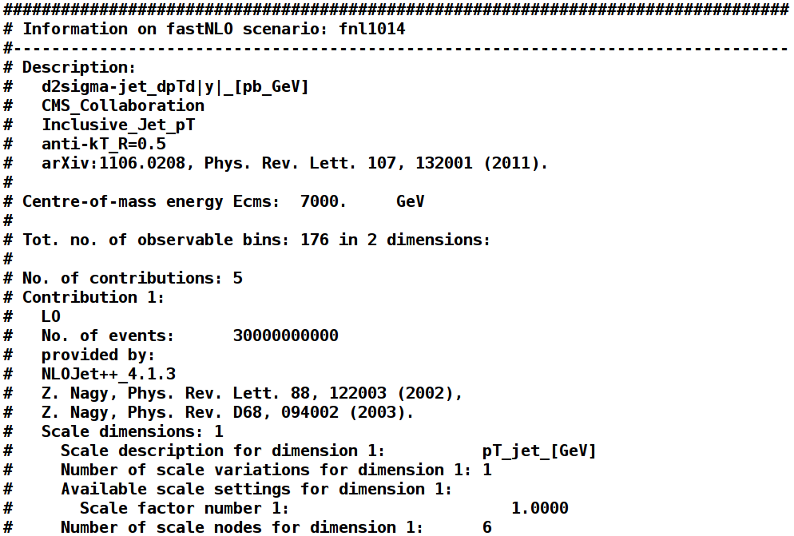
Scenario Information 1
Measurement
Total no. of bins
Exceptional!
Normally 2 or 3.
No. of table contributions
Info for 1st contribution:
LO from NLOJet++
Referenz for used code is
included in table where it
belongs!

Slide 10
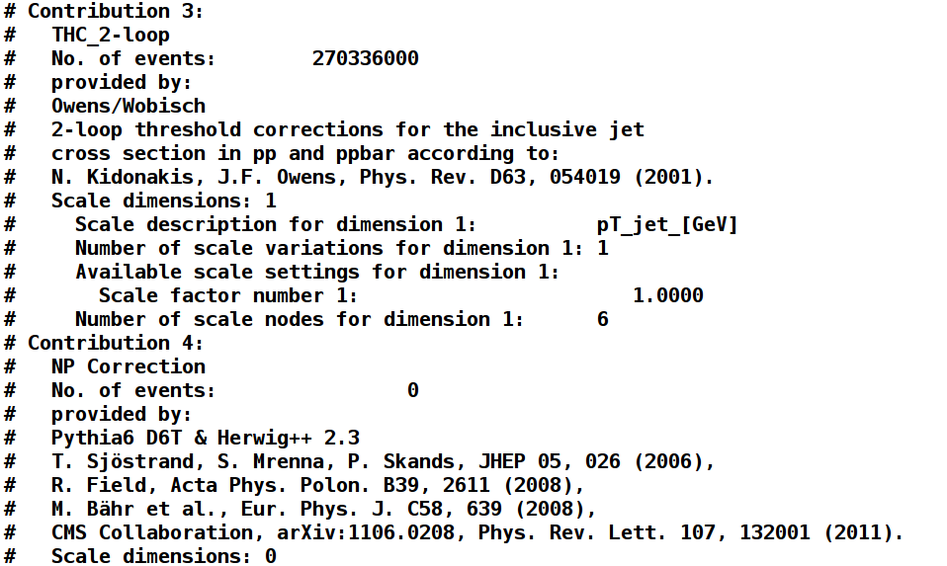
Scenario Information 2
Threshold Corrections
Non-perturbative
Corrections

Slide 11
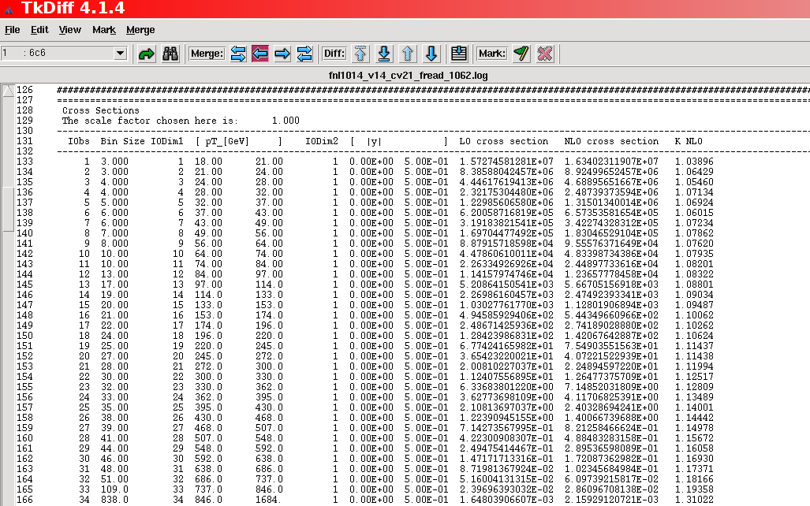
Technical Cross-check
tkdiff between Fortran and C++, ALL differences in color ...!
Identical at O(10⁻¹⁰)

Slide 12
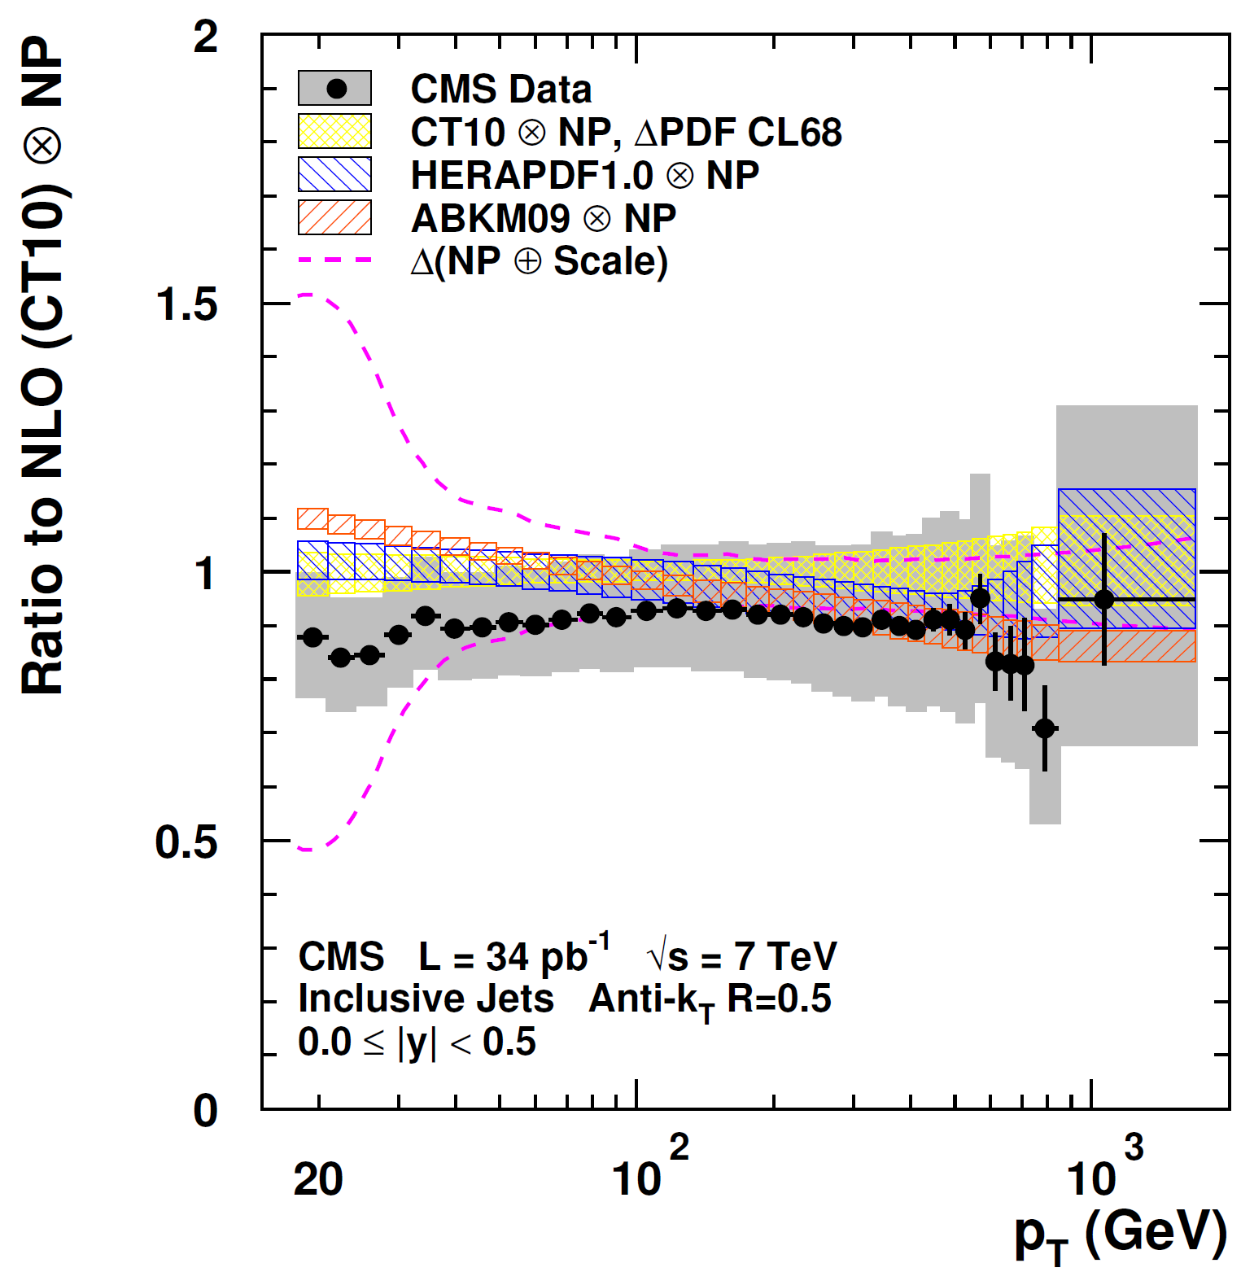


CMS Inclusive Jets 2010
Theory derived with v1.4:
For given syst. experimental uncertainty
stat. precision of NLO of 1% (low pT) or
less sufficient
Highest pT bins are XXL in addition with
large exp. stat. uncertainties
Investigate
  Scale Dependence
  PDF Uncertainties
  Sensitivity to alpha_s
CMS Note-2011-004

Slide 13
Cross-check v2 vs. v14
Feature known from discussion with CTEQ:
Small scale offset in highest pT XXL bin → resolved in v2!
LO
NLO
O(1-2%)
Expected due to:
Stat. independent calculations, NLOJet++_2.0.1 → NLOJet++_4.1.3, improved
x limits/binning, …

Slide 14
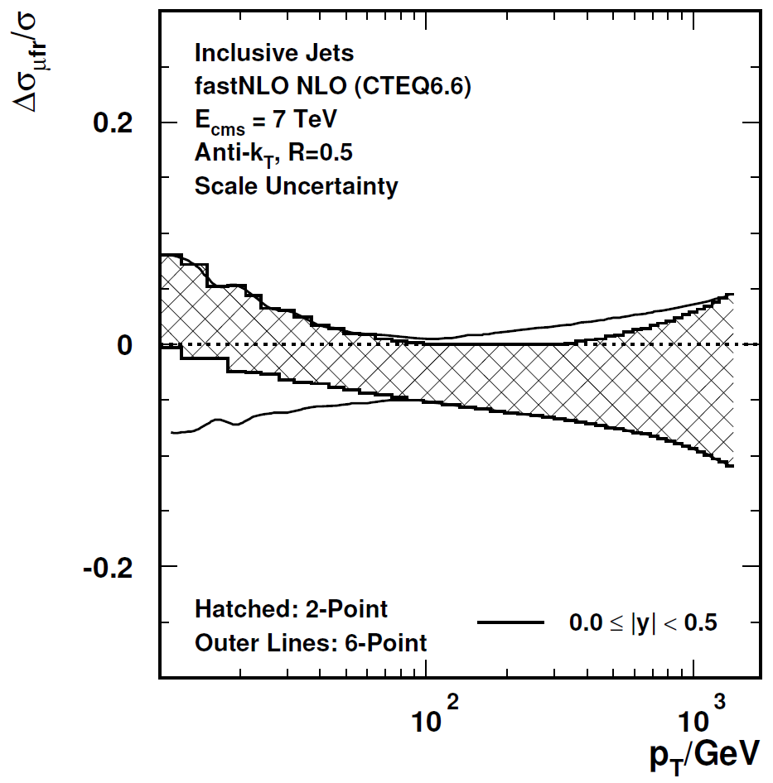

Scales in v2
In v14:
New in v2:
Asymmetric scale variations:
Independent variation of μ_{r} and μ_{f}
by factors of ½ and 2 avoiding rel. factors of 4
(6-point: (1/2,1/2), (1/2,1), (1,1/2), (1,2), (2,1), (2,2)
Compared to symmetric variation (2-point)
  Two new possibilities:
  Improved interpolation for pre-defined scale
    Examples exist for pp/ppbar scattering (CMS incl. Jets, D0 3-Jet Mass)
    Table size moderately larger, sufficient for many purposes
  Even better: Save μ_{r} and μ_{f} dependent contributions separately → full flexibility to compute results for arbitrary combinations of these two scales
    Can e.g. choose p_{T}² for μ_{r} and Q² for μ_{f}
    Calculations for H1 and ZEUS
    Works now also for ppbar, testing with ATLAS dijet mass
x_{µ} = ½, 2
x_{µ} = ½,1,2
indep. for µ_{r}, µ_{f}

Slide 15



Jets Data / Theory
Comparison of jet data from
  STAR at RHIC
  H1 and ZEUS at HERA
  CDF and D0 at Tevatron
Compatible with QCD
Includes measurements from LHC
New: Updated with ATLAS inclusive jets
fastNLO, to be uploaded, arXiv:1109:1310v2, 2012

Slide 16
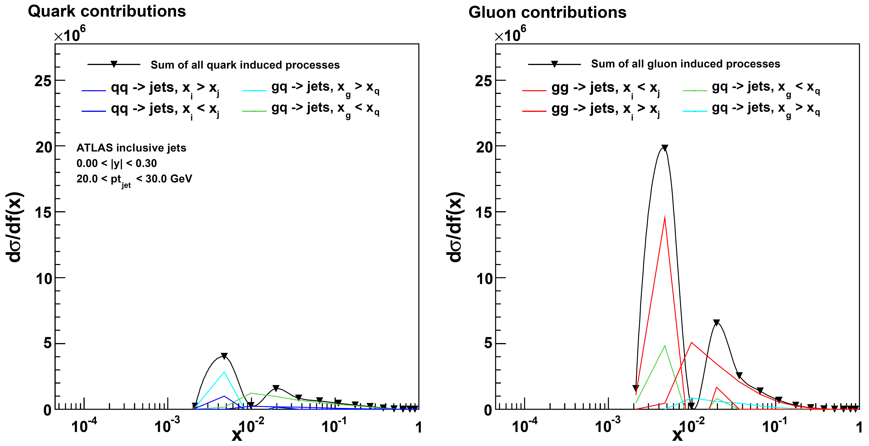
x Ranges
New plots from Daniel: x₁, x₂ ranges in inclusive jets

Slide 17
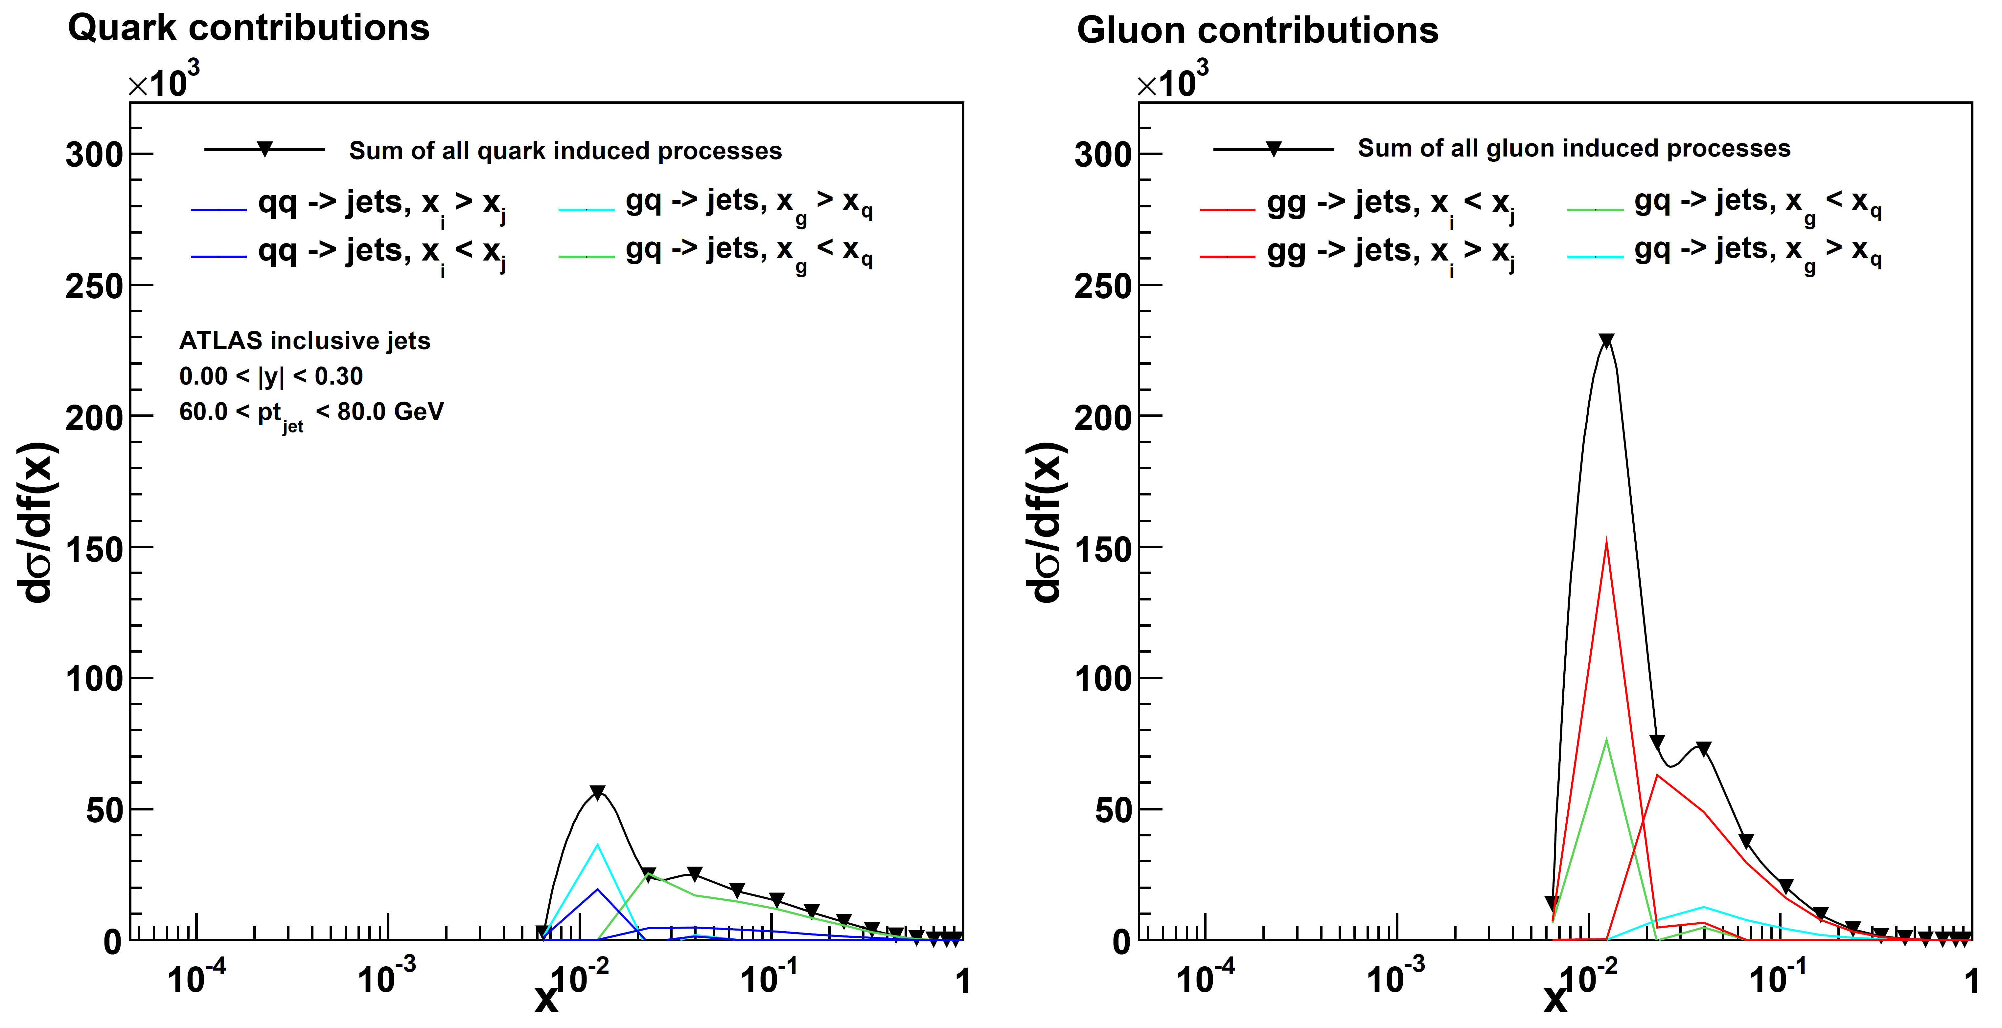
x Ranges

Slide 18
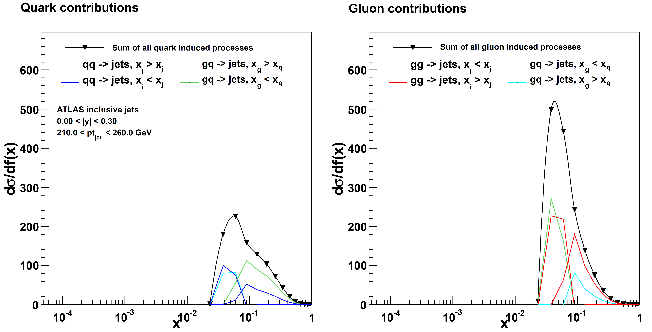
x Ranges

Slide 19
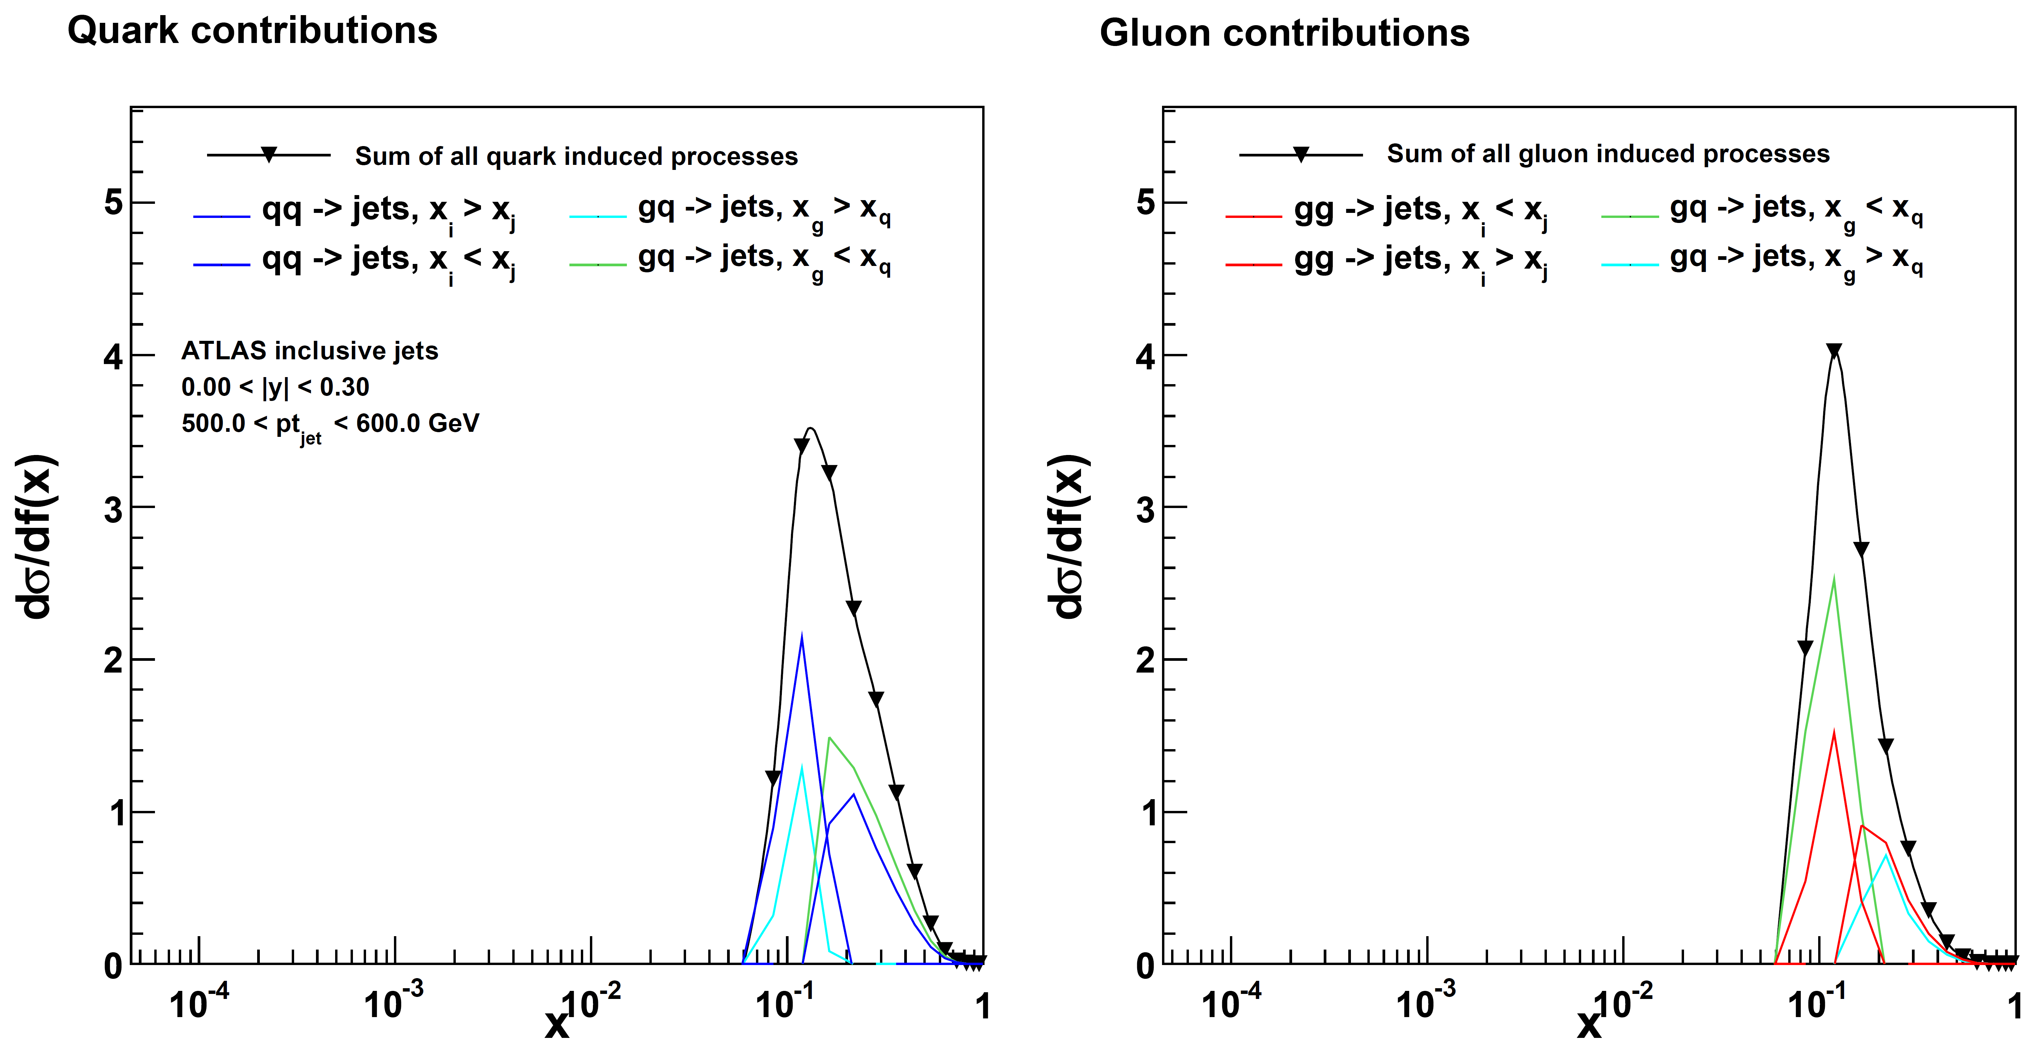
x Ranges

Slide 20
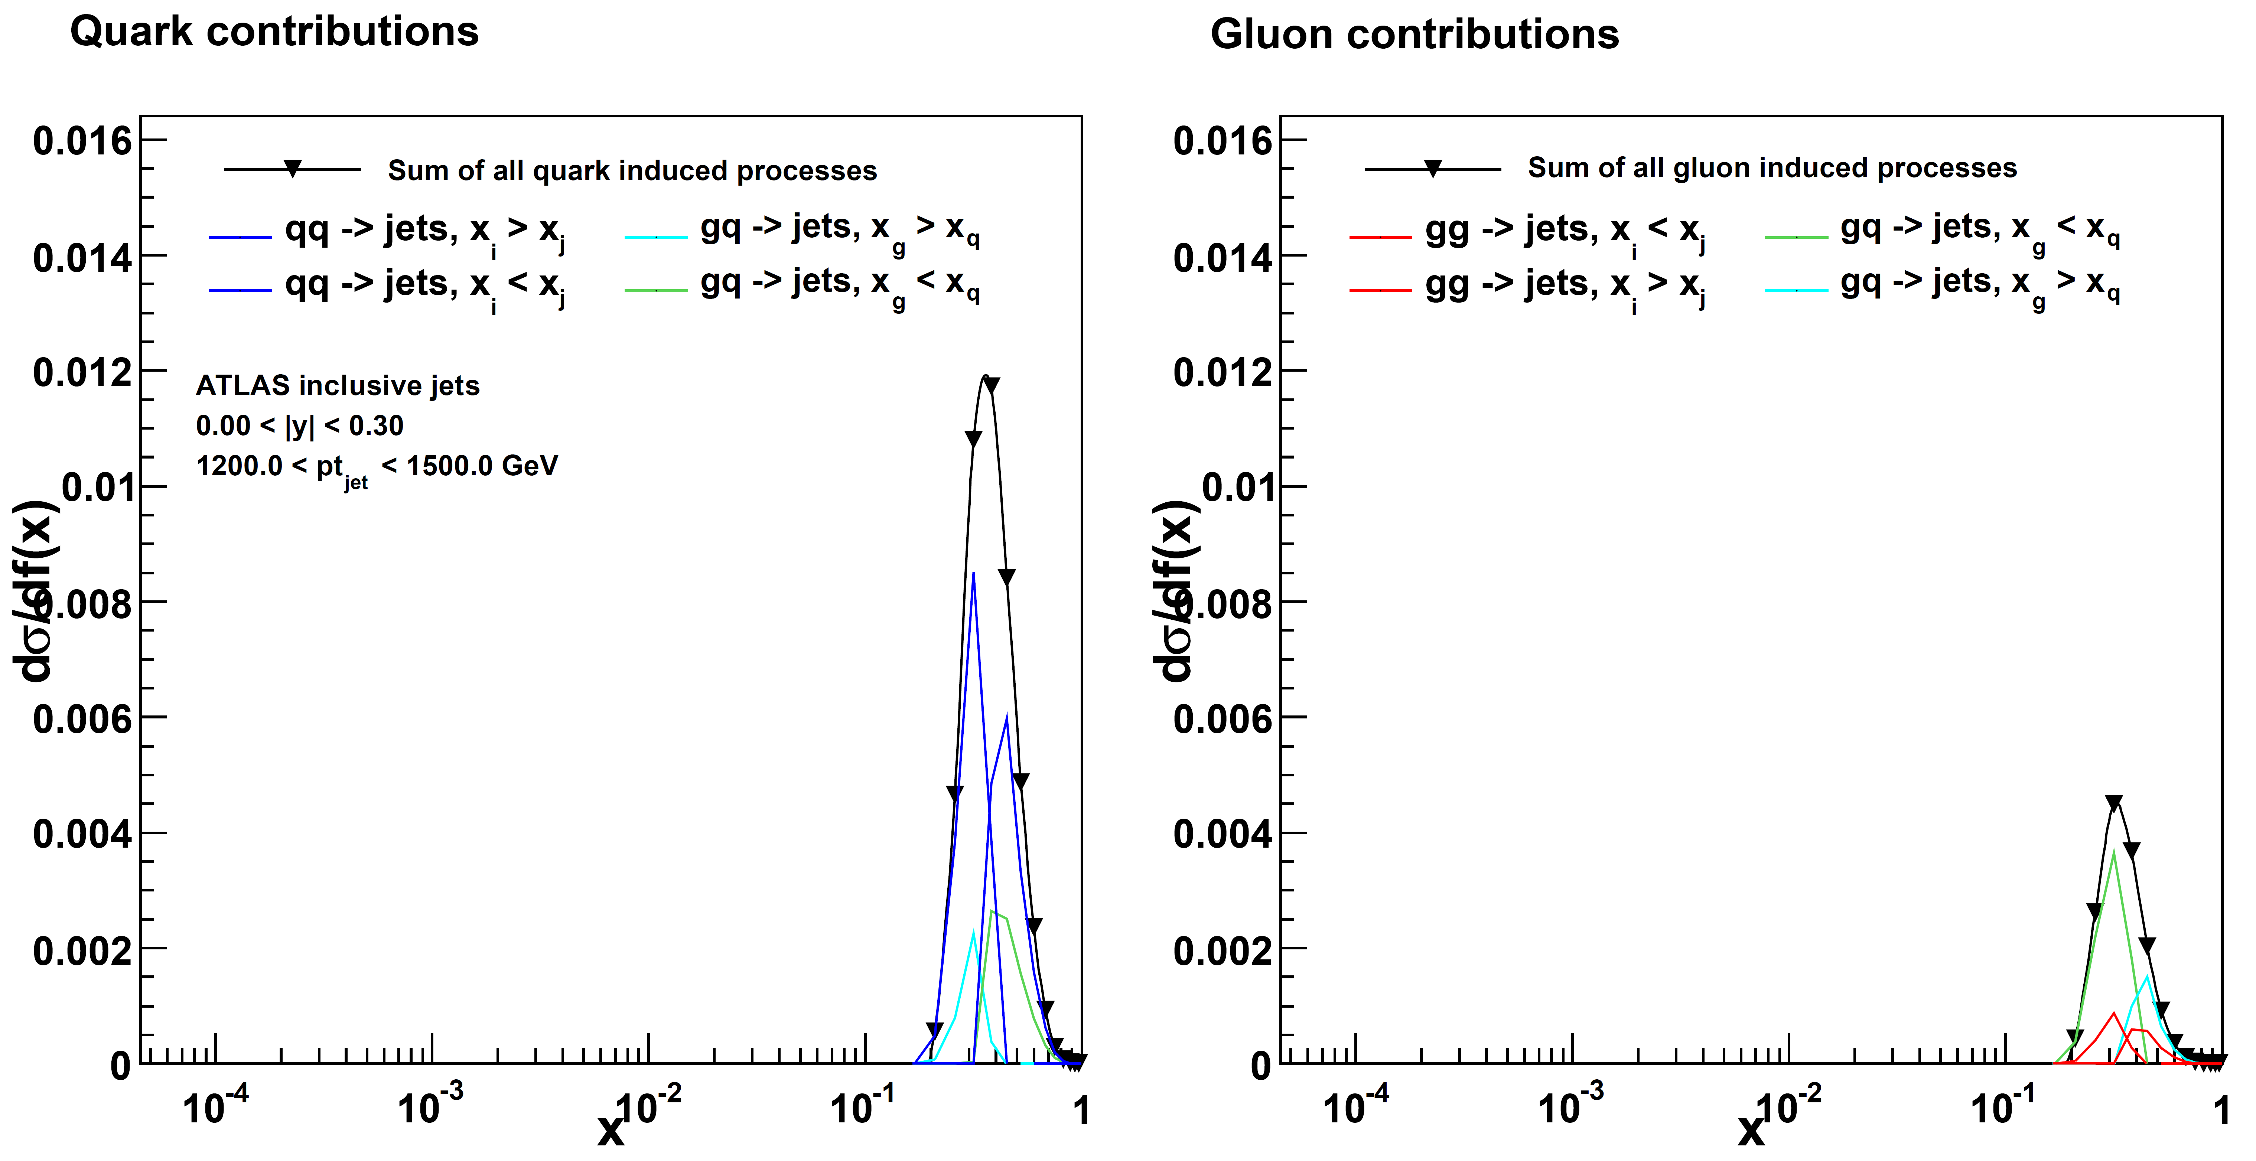
x Ranges

Slide 21
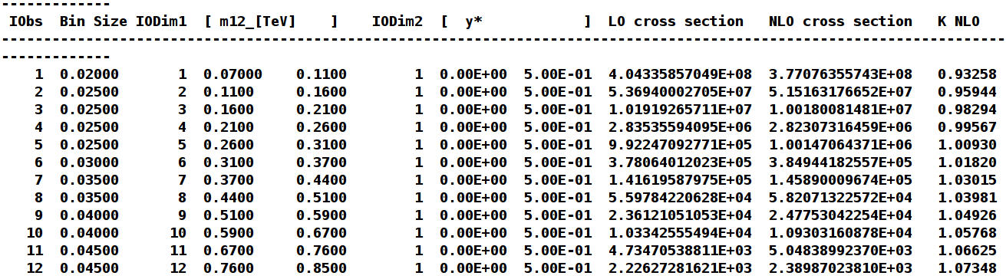
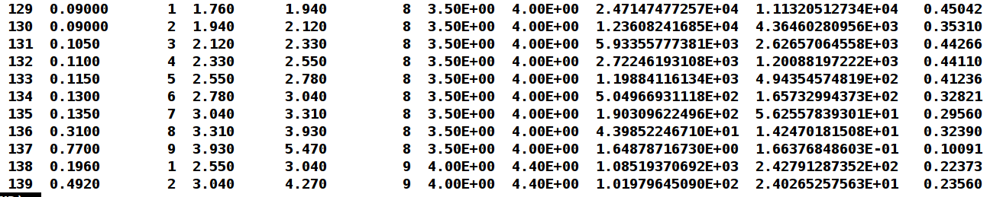
ATLAS Dijet Mass
Here using scale pT₁₂average, not pT_{max}
No negative x sections
But small K factors at high y*

Slide 22
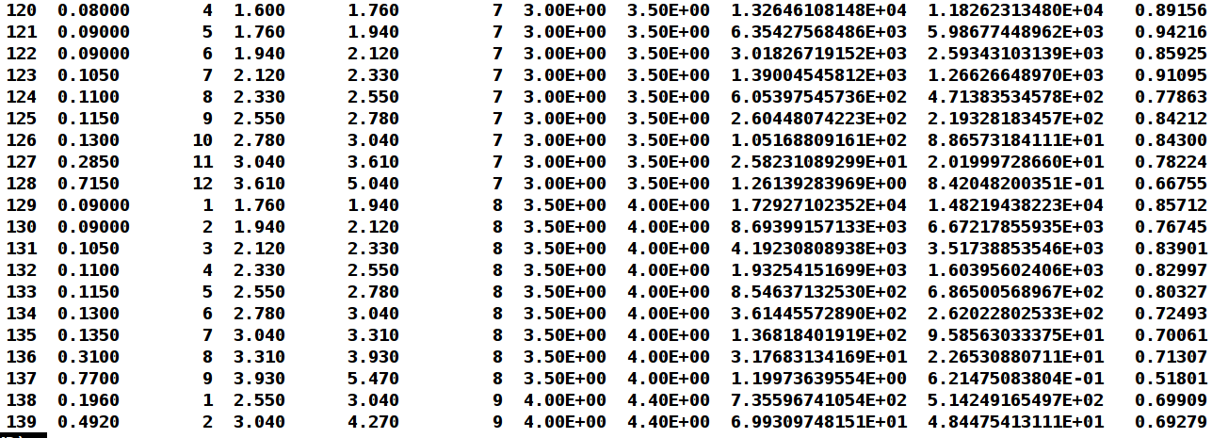
ATLAS Dijet Mass
Within same flexible-scale table using now additional exp. of y* factor
First application of flexible-scale table in pp x sections
K factors improved as suggested in ATLAS publication

Slide 23
Outlook
  Public release of generic code to read fastNLO v2 tables available: fastNLO_reader_2.1.0
  Released simultaneously: ATLAS and CMS inclusive jet tables
  More tables to come, in particular DIS
  Please try it out, we are happy to receive feedback and answer questions

Slide 24
Backup Slides

