Slide 1




Semi-inclusive QCD processes
Extension of
to arbitrary processes
Daniel Britzger, Klaus Rabbertz, Georg Sieber, Fred Stober,Markus Wobisch
(DESY, KIT * 3, Louisiana Tech University)

Slide 2
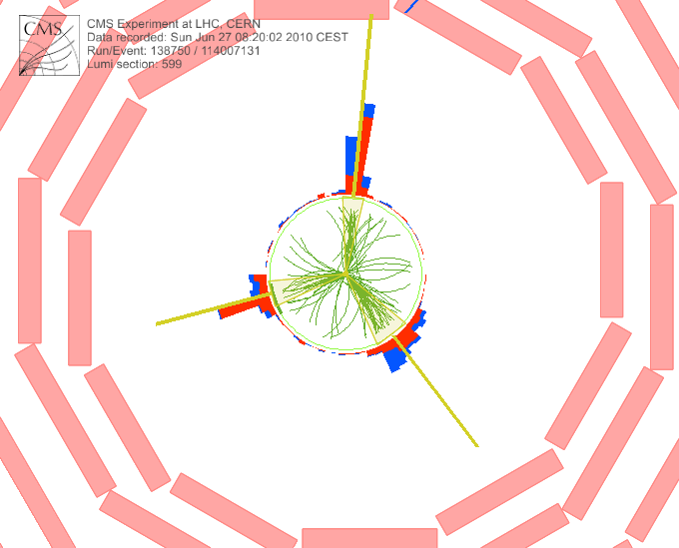
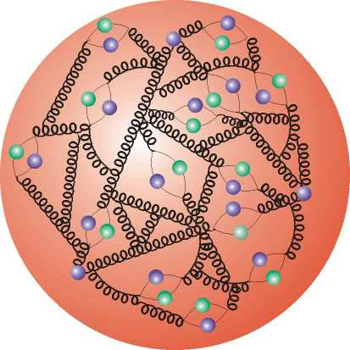

Outline
Introduction & History
Application & Latest Status
Current Developments
Outlook

Slide 3




Motivation
  Interpretation of experiment data relies on:
    Availability of reasonably fast theory calculations
    Often needed: Repeated computation of same cross section
  Examples for a specific analysis:
    Estimate accuracy of perturbative QCD (scale uncertainties)
    Use of various PDFs (AB(K)M, HERAPDF, CTEQ, MSTW, NNPDF, …)
    Determine PDF uncertainties (PDF error sets)
    Use data set in fit of PDFs and/or αs(MZ)
  Sometimes NLO predictions can be computed fast
  But some are very slow, esp. jets, O(1000s CPU h)
  Need procedure for fast repeated computations of NLO cross sections
  Even more so at NNLO when available!
See previous talk from Nigel!

Slide 4

Jet Cross-Sections
Jet production in hadron-hadron collisions depends on
  strong coupling α_{s} to order n
  PDFs of two hadrons f₁, f₂
  Parton flavors a, b
  perturbative coefficients c_{a,b,n}
  renormalization and factorization scales
  Parton momentum fractions x
PDF and α_{s} are external input
Perturbative coefficients are independent from PDF and α_{s}
Idea: Avoid folding integrals and factorize the PDFs and α_{s}

Slide 5
The fastNLO concept
Use interpolation kernel
  - Introduce set of n discrete x-nodes, x_{i}'s being equidistant in a function f(x)
  - Take set of Eigenfunctions E_{i}(x) around nodes x_{i}
  → Interpolation kernels
  - Actually a rather old idea, see e.g.
C. Pascaud, F. Zomer (Orsay, LAL), LAL-94-42
→ Single PDF is replaced by a linear combination of interpolation kernels
  → Then the integrals are done only once
  → Afterwards only summation required to change PDF
Store a table with the convolution of the pert. coefficients with the interpolation kernel

Slide 6
Conceptual Overview
Standard
Method
Table
Generation
fastNLO
Evaluation
Or use it within a fitting framework

Slide 7
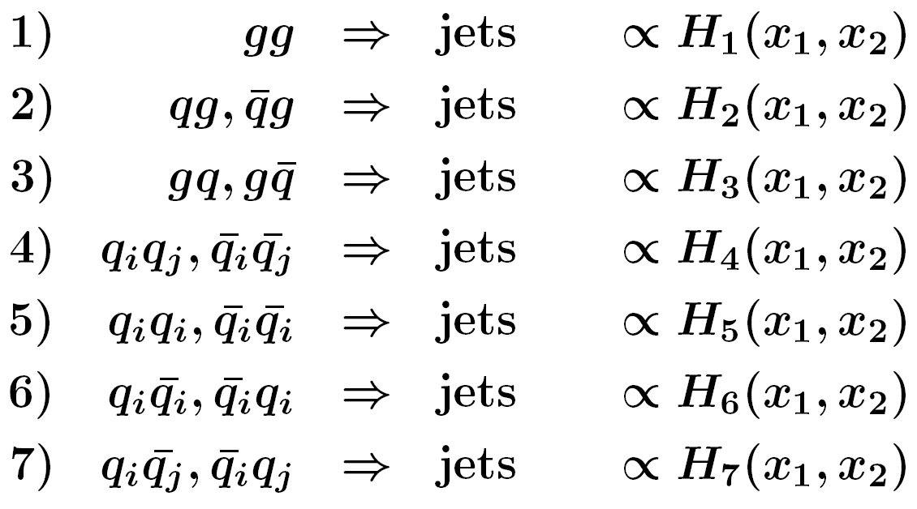


Partonic Subprocesses
  Our test case in 2005/6: Jets @ NLO with NLOJet++
  Don't want to deal with 13 X 13 PDFs
  For hh → jets seven relevant partonic subprocesses
  Need only seven linear combinations Hi of PDFs
NLOJet++, Z.Nagy,
PRD68 2003, PRL88 2002

Slide 8



Remarks
  Strategy applicable in general, NOT restricted to NLO or jets or ...
  In detail a bit more complicated. For each observable bin:
    Cubic interpolation in x (also used in digital imaging)
    2-dimensional binning in (log) x for hh collisions
    Use reasonable number of x nodes and lower x limit
    Interpolate reweighted PDFs for improved approximation
    Scale bins also need interpolation
    Exploit symmetries between different QCD subprocesses
    Many optimizations done to keep table small and programs fast

Slide 9
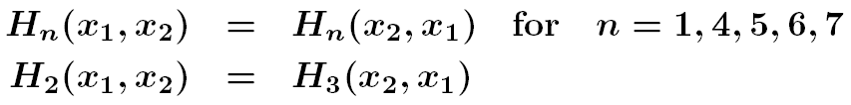
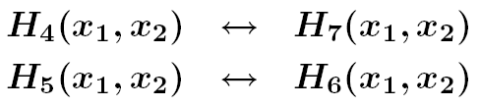
Symmetries
  In addition, symmetries can be exploited:
  For hadron anti-hadron collisions, replace:
  Minimize table size, otherwise number of bins in observable times x₁-, x₂-, μ-nodes, … can quickly get huge!
  Very relevant in 2005/6 because of limited disk space in mass production of tables, problem to fit table into memory, Fortran limitations
  Cumbersome: Adaptation to be done for each new process
  Today: Partially solved using C++ and memory/disk nowadays
  Could even try using 13x13 in a first step for new processes

Slide 10

Table Production
  The general scheme:
    Program the C++ code for your process, selection and observable (easy when it can be almost copied from existing scenarios)
    Run a number of NLO jobs to determine lower x and scale limits for each observable bin → to be used in future jobs
    Do some comparison jobs between original N?LO and rederived fastNLO x sections to make sure the approximation is fine (deviations below permille level or even less); if not start again optimizing settings :-(
    Start large scale production, i.e. submit O(some 100 to 1000) jobs on the grid or a batch system in parallel → order of n 1000 CPU hours to harvest
    Possible to get all NLO tables within a day, fastNLO is set up to combine all the statistically independent calculations into one table
    As a bonus one gets an estimate of the statistical precision

Slide 11

Example Applications
CMS inclusive jets
    Study of PDF dependence
    Determination of PDF envelopes
    PDF-error prediction à la PDF4LHC
D0 three-jet invariant mass
    Study of PDF dependence
    Study of scale dependence
    μ_{r}= μ_{f} = (p_{T1}+ p_{T1} +p_{T1})/3
    μ = 2.0 × μ_{o}
    μ = 0.5 × μ_{o}
    Study of α_{s} dependence using
    α_{s} dependent PDF sets
PLB 704 (2011) 434-441
239 repeated NLO calculations
3138 repeated NLO calculations
Each rederivation takes fractions of a second!

Slide 12
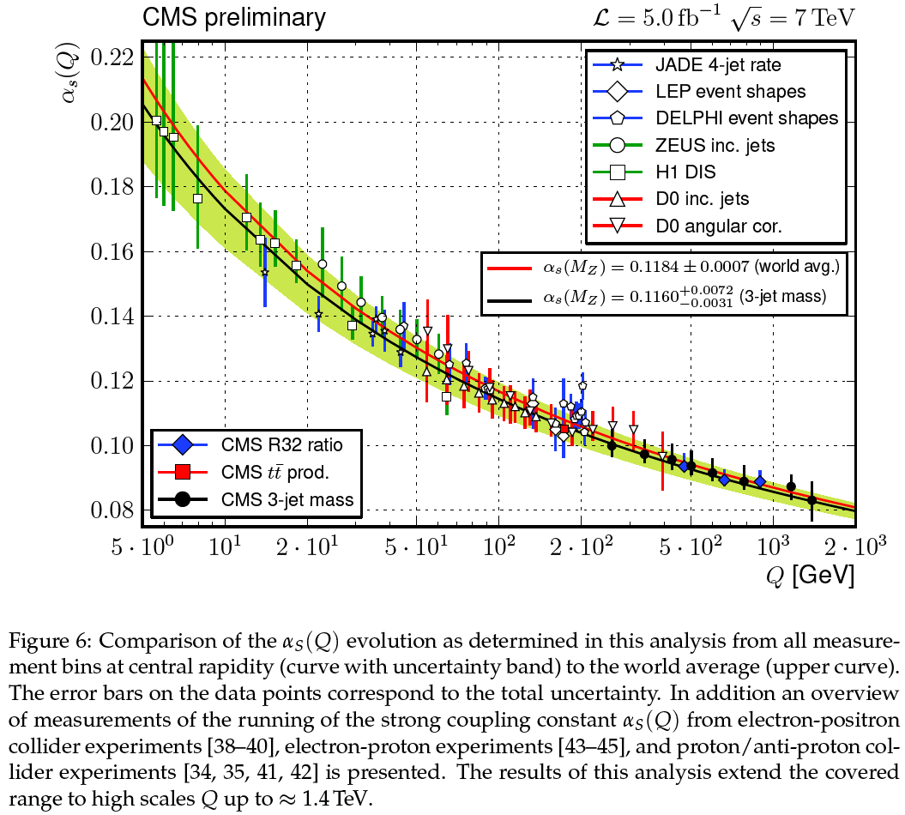
Determination of the strong coupling
R32 results accepted by
EPJC, publication imminent.
Data submitted to HEPDATA,
fastNLO tables prepared for
upload to HepForge.
Error bars change with
respect to arXiv; theory
uncertainties have been
symmetrized after exchange
with journal referees and
G. Salam. Also T. Gehrmann
contacted.
3-jet mass cross section:
CMS-PAS-SMP-12-027 (2013).

Slide 13
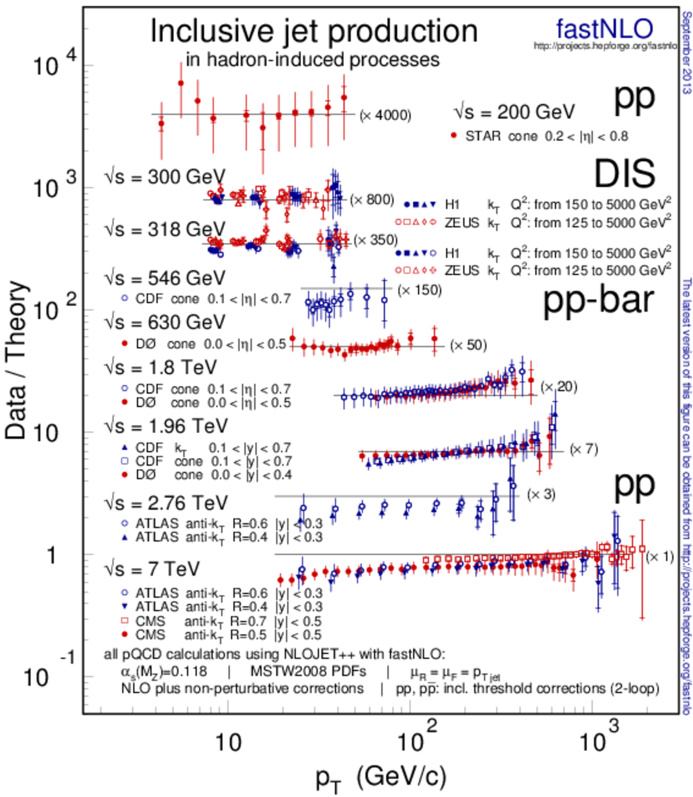



Jets Compilation Plot in PDG Book
Comparison of jet data from
  STAR at RHIC
  H1 and ZEUS at HERA
  CDF and D0 at Tevatron
Compatible with NLO pQCD
Updated last month with ATLAS 2010 and CMS 2010 & 2011 published LHC measurements

Slide 14
New in fastNLO Version 2.1
Features of pre-computed fastNLO tables:
  Automatic adjustment of phase space boundaries
  Flexible # x-nodes for analysis bins
  Improved interpolation in ren./fact. scales
  Arbitrary number of dimensions for binning of observable
  Support for diffractive PDFs
Features of fastNLO reading tools:
  Easy to install (autotools)
  Comes as a library linkable from other programs + one example executable
  α_{s} evolutions provided via
    2-,3-,4-loop iterative solution
    Interface to external α_{s} evolutions, e.g. LHAPDF, QCDNUM, …
    Interface to CRunDec (B. Schmitt, M. Steinhauser, KIT)
  Interface to PDFs/evolution from LHAPDF and QCDNUM
  Easy implementation of new interfaces
  Easy to implement in fitting codes and to interface PDFs
  Independent C++ and Fortran versions
    agreement at double precision O(10⁻¹⁰)
Latest release fastnlo_reader_2.1.0_1488 including some fixes for threshold corrections in C++
One further release planned with Python interface to C++ lib
FastNLO Table
FastNLO
Reader
Reader_f
Reader_cc
No further dependencies (No ROOT, No CERNLIB, etc…)

Slide 15
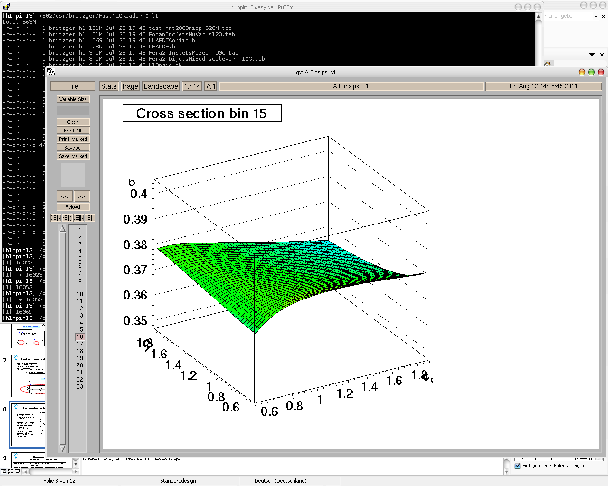

New in v2: Scales
Scales can be functions of multiple observables
  e.g. for DIS jets
  Scale observables are p_{T} and Q²
Functional form of combination can be changed
  Scales can be
  μ_{r}² = (Q² + p_{T}²) / 2
  μ_{r}² = Q²
  μ_{r}² = p_{T}²
  μ_{r}² = 0.8 Q² + 0.3 p_{T}² + Q·p_{T}
Independent scale variations with arbitrary factors of μ_{r} and μ_{f} are possible
  μ_{R}² = c²_{R} × (Q² + p_{T}²) / 2
  μ_{F}² = c²_{F} × Q²
Extensively tested and used in new HERA results to come, not yet exploited for hh tables
σ [pb]
Scale factor c_{F}
Scale factor c_{R}
More flexibility for studies of scale dependencies

Slide 16
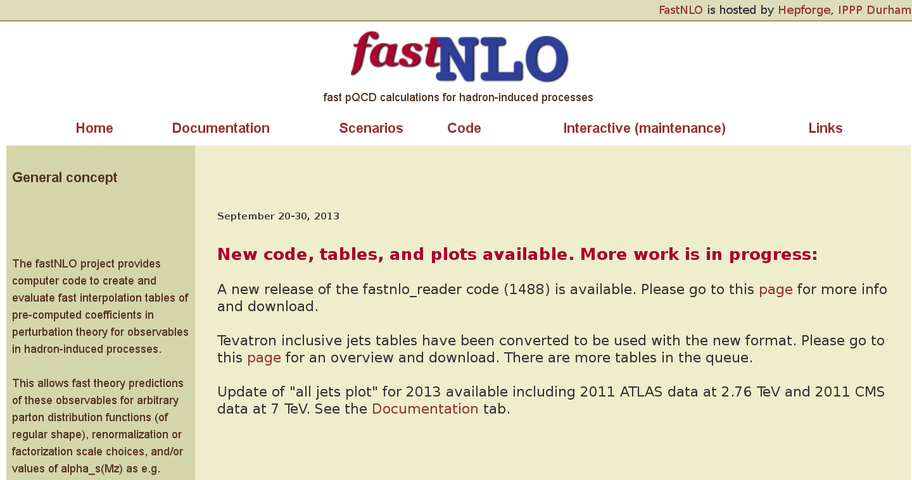
fastNLO page at HepForge
New version with plotting tool exists (G. Sieber), needs some optimization

Slide 17
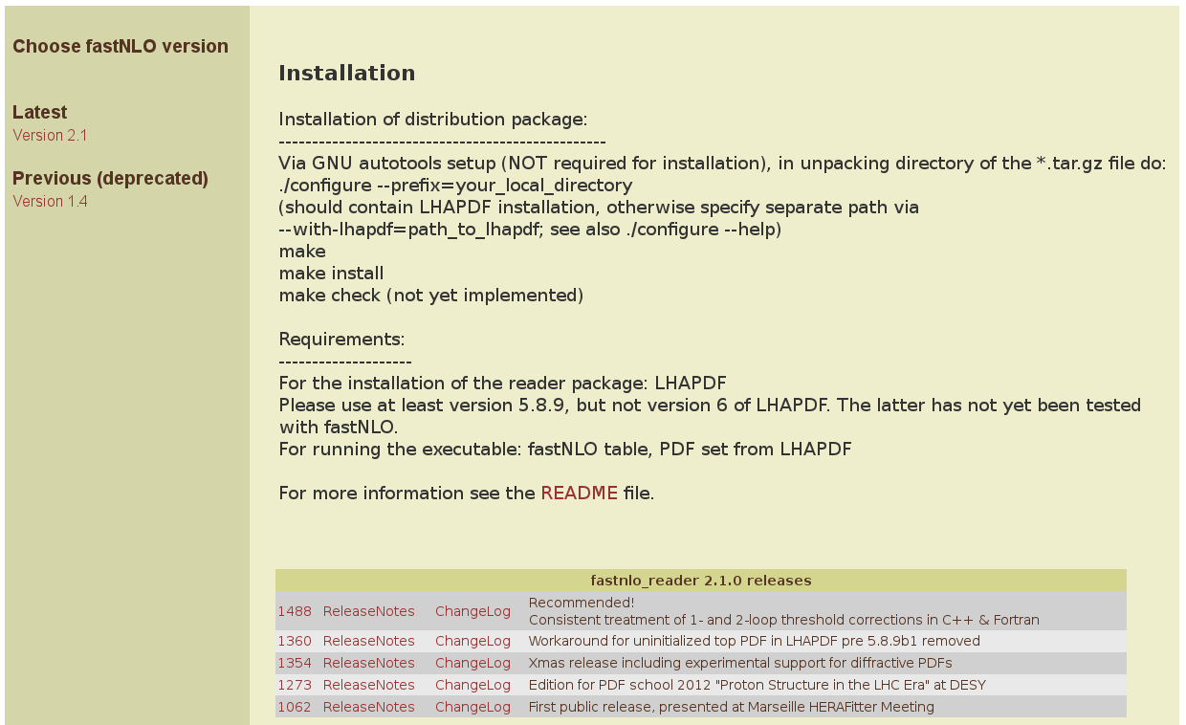
Reader Code Download

Slide 18
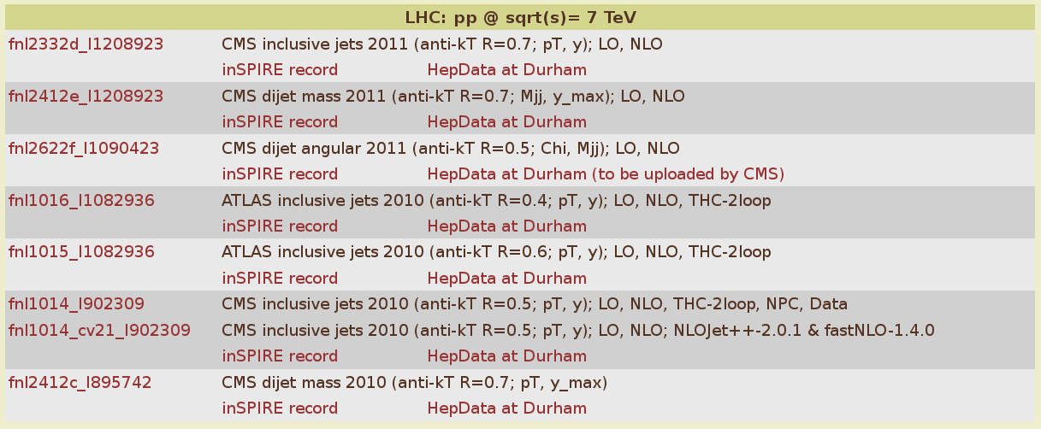
Available Tables in v2.1: LHC
Changed table numbering scheme, now contains two parts:
- our internal development number fnlxxxx
- the reference number of the publication in inSPIRE, similar as in RIVET
- makes it easy to connect with relevant publication and HepData files

Slide 19
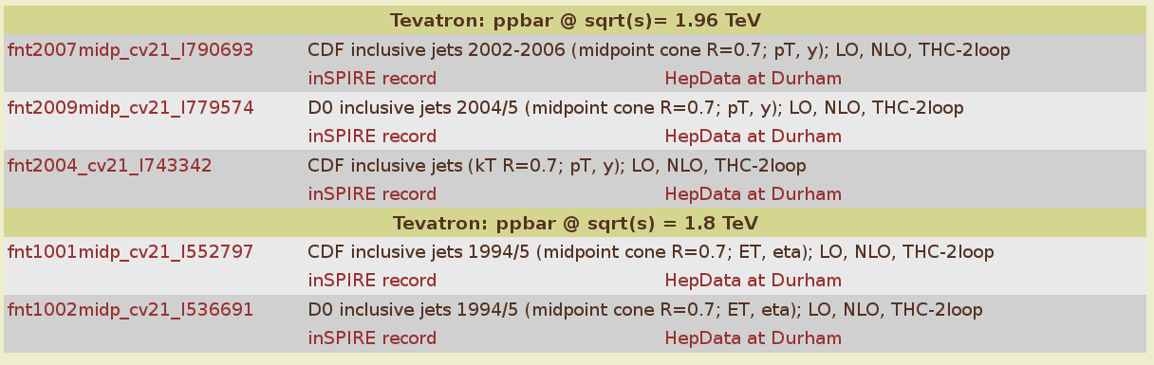
Available Tables in v2.1: Tevatron
Tables with “cv21” refers to tables produced with the old versions
of NLOJet++ 2.0.1 and fastNLO v1.4 that have been converted to the
new format. More tables to come. Will be replaced at some point
by newer tables from scratch.
Waiting for new tables for HERA in new flexible scale format.

Slide 20

FastNLOCreator v2.2
  1. Cross check old v1.4 versus new v2.1 tables … Done!
  2. Cross check new reader code in C++ vs. Fortran … Done!
  3. Public release of reader code as autotools tarball … Done!
  4. Transform C++ reader code into linkable library … Done!
  5. Transform table creation code into linkable library as independent as possible from NLOJet++!
  In progress, first test version exists.
  Make interface available for other N?LO codes.

Slide 21

Basic Code Structure
One fastNLOTable class
    Without functionality for evaluating or creating tables
fastNLO table class holds list of Coefficient tables (formerly called ‘BlockB’)
    Different classes for different purposes
        Data table
        Additive contributions
        Multiplicative contributions
Data-containers without major functionality
fastNLOBase
fastNLOTable
vector < fastNLOCoeffBase* > fCoeff
fastNLOCoeffMult
fastNLOCoeffFlex
fastNLOCoeffBase
basic functionality (Read, Write, Compare)
fastNLOCoeffAddBase
fastNLOCoeffPert
fastNLOCoeffData

Slide 22
Basic Interface to other Codes
Generator | Interface | fastNLO
Executable Calculation of coefficients (weights) Calculation of observables and scales Phase space definition Event count Must provide: x-values weights process IDs Observable and scale values | Weight(s) x-values Process-ID Observable(s) Scale(s) Optional: pass executable specific information to fastNLO during initialization | Binning Bingrid Interpolation Warmup handling Steerfile must provide correct Process dependent information Generator dependent information
fastNLO library can always be compiled without generator specific code !!
Interface knows about generator specific issues and holds fastNLOCreate instance
Generator has not to be modified !
If generator code is complicated: modify code to pass information to interface

Slide 23
Logic of Table Creation
Initialization step
Event loop
End of program
fastNLOCreate
fastNLOCreate(steerfile)
fnloEvent
fnloScenario
fastNLOCreate
WriteTable()
Initialize fastNLOCreate
All (ALL) information is read from steer-file.
Only quantities, which are given by user to ‘program-steering’ (e.g. LO or NLO run) are passed to the fastNLOCreate class.
fastNLOCreate may also pass steering values to program!
fastNLOCreate
Fill(event,scen)
Write table
(pass number of events to table [event count is left to generator])
Pass information to fastNLOCreate
For every subprocess/event

Slide 24


Outlook
Several releases of fastNLO table reading library done. One more to come with Python interface to C++ lib.
Work on generalized library and interface for table reading AND creation in progress; expect first stable version beginning of next year.
In particular working on integration of
  Threshold correction code with Kumar and Sven
  ttbar with M. Guzzi
  Electroweak corrections, in contact with S. Dittmaier & A. Huss
  Contact Interaction @ NLO code from J. Gao
  MCFM
Your feedback is welcome

Slide 25
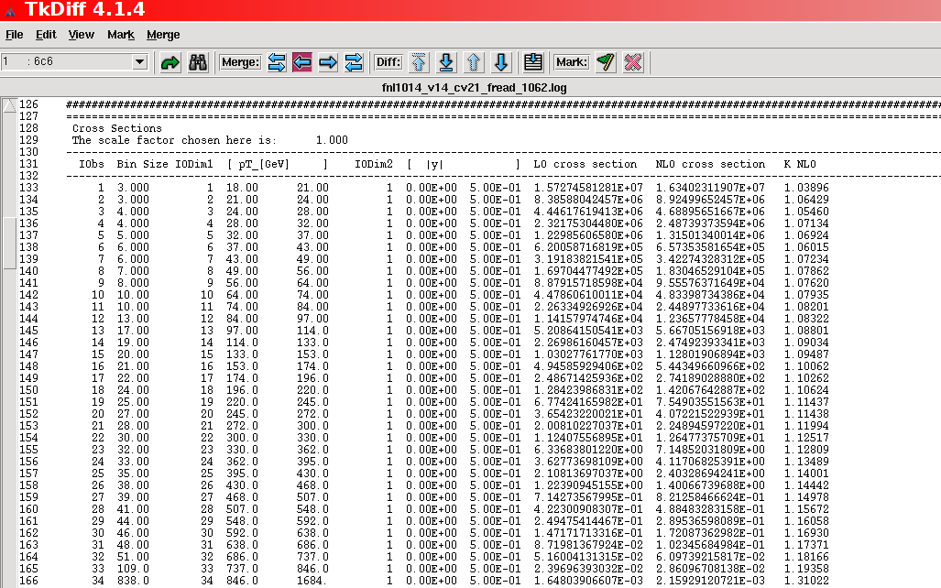
Technical Cross-check
tkdiff between Fortran and C++, ALL differences in color ...!
Identical at O(10⁻¹⁰)

Slide 26
Cross-check v2 vs. v14
Feature known from discussion with CTEQ:
Small scale offset in highest pT XXL bin → resolved in v2!
LO
NLO
O(1-2%)
Expected due to:
Stat. independent calculations, NLOJet++_2.0.1 → NLOJet++_4.1.3, improved
x limits/binning, …

