Slide 1
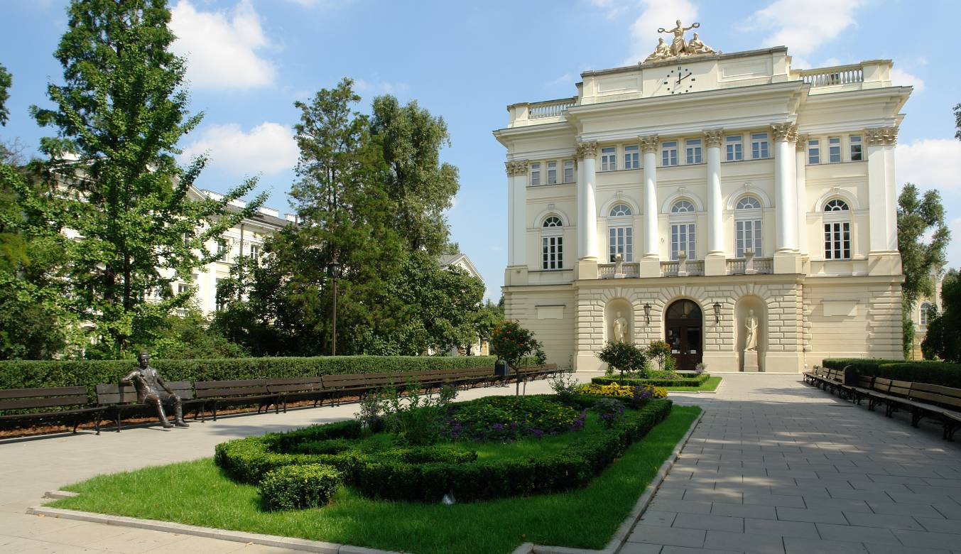

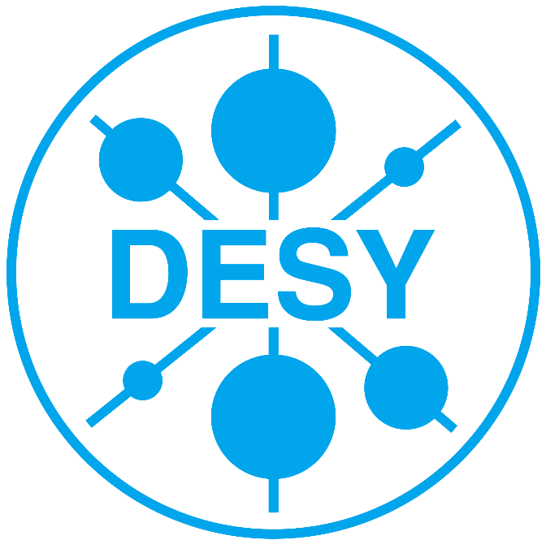
Application of fastNLO to NNLO calculations
Daniel Britzger, Marco Guzzi, Klaus Rabbertz, Georg Sieber, Fred Stober,Markus Wobisch
(DESY, DESY, KIT , KIT, KIT, Louisiana Tech)
DIS 2014
XXII. International Workshop on Deep-Inelastic Scattering and Related Subjects
April 30, 2014

Slide 2
Motivation
Interpretation of experimental data relies on
    Availability of reasonably fast theory calculations
    Often needed: Repeated computation of (almost) same cross sections
        Observables, binning, phase space given by experimental data
Examples for a specific analysis:
    Use of various PDFs (CT, MSTW, NNPDF, …) for data/theory comparison
    Determine PDF uncertainties
    Derivation of scale uncertainties
    Use data set in fit of PDFs and/or α_{s}(M_{Z})
Sometimes NLO predictions can be computed fast
But some are very slow
      e.g. jet cross sections, VB+jets, Drell-Yan, …
Need procedure for fast repeated computations of NLO cross sections
    Use fastNLO (in use by most PDF fitting groups)

Slide 3
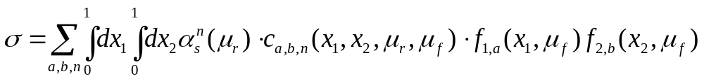
Basic working principle
Cross section in hadron-hadron collisions in pQCD
    Many cross section calculations are time consuming (e.g. jets)
    strong coupling α_{s} in order n
    PDFs of two hadrons f₁, f₂
    Parton flavors a, b
    perturbative coefficent c_{a,b,n}
    renormalization and factorization scales μ_{r,} μ_{f}
    momentum fractions x₁, x₂
f₂(x₂)
c
ˆ
f₁(x₁)
PDF and α_{s} are external input
Perturbative coefficients are independent from PDF and α_{s}
Idea: factorize PDF, α_{s} and scale dependence

Slide 4
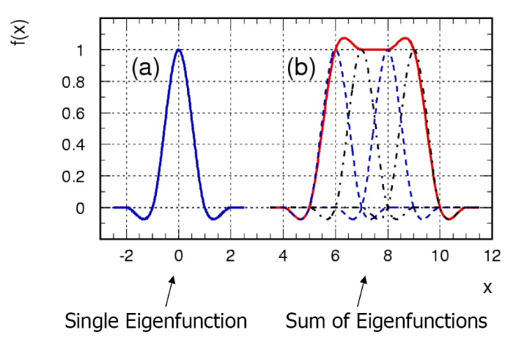
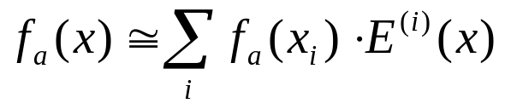
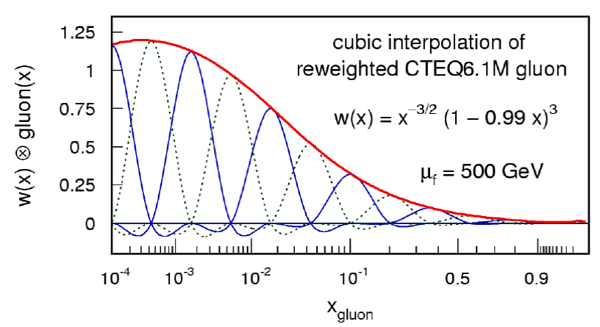
The fastNLO concept
Introduce interpolation kernel
    Set of n discrete x-nodes x_{i}'s being equidistant in a function f(x)
    Take set of Eigenfunctions E_{i}(x) around nodes x_{i}
    -> interpolation kernels
Single PDF is replaced by a linear combination of interpolation kernels
  Improve interpolation by reweighting PDF
Scale dependence
    Similar interpolation procedure also for scales
    Interpolation nodes in x and scales are stored together in look-up table
    Two different observables can be chosen as scale in one table
Convolution integrals become discrete sums
=> Values of perturbative coefficents can be stored in a table

Slide 5
Calculations with fastNLO in NNLO
Problem
    Scale variations become more difficult in NNLO than in NLO
Current available implementations for NLO calculations
Renormalization scale variations
    Scale variations applying RGE
        Use LO matrix elements times nβ₀ln(c_{r}) [fastNLO, APPLgrid (EPJ C (2010) 66: 503)]
    Flexible-scale implementation
        Store scale-independent weights: [fastNLO]
Factorization scale variations
    Calculate LO DGLAP splitting functions using HOPPET [APPLgrid]
    Store coefficients for desired scale factors [fastNLO]
    Flexible-scale implementation [fastNLO]
Scale variations for NNLO calculations
    a-posteriori renormalization scale variations become more complicated
    NLO splitting functions are needed for factorization scale variations
        Calculations become slow again => Not desired for fast repeated calculations

Slide 6
Flexible-scale implementation in NNLO
Storage of scale-independent weights enable full scale flexibility also in NNLO
    Additional logs in NNLO
    Store weights: w₀, w_{R}, w_{F}, w_{RR}, w_{FF}, w_{RF} for order α_{s}^{n+2} contributions
Advantages
    Renormalization and factorization scale can be varied independently and by any factor
        No time-consuming ‘re-calculation’ of splitting functions in NLO necessary
    Only small increase in amount of stored coefficients
fastNLO implementation
    Two different observables can be used for the scales
        e.g.: H_{T} and p_{T,max}
        or e.g.: p_{T} and |y|
        …
    Any function of those two observables can be used for calculating scales
log’s for NLO
additional log’s in NNLO
‘Flexible-scale concept‘: Best choice for performant NNLO calculations

Slide 7
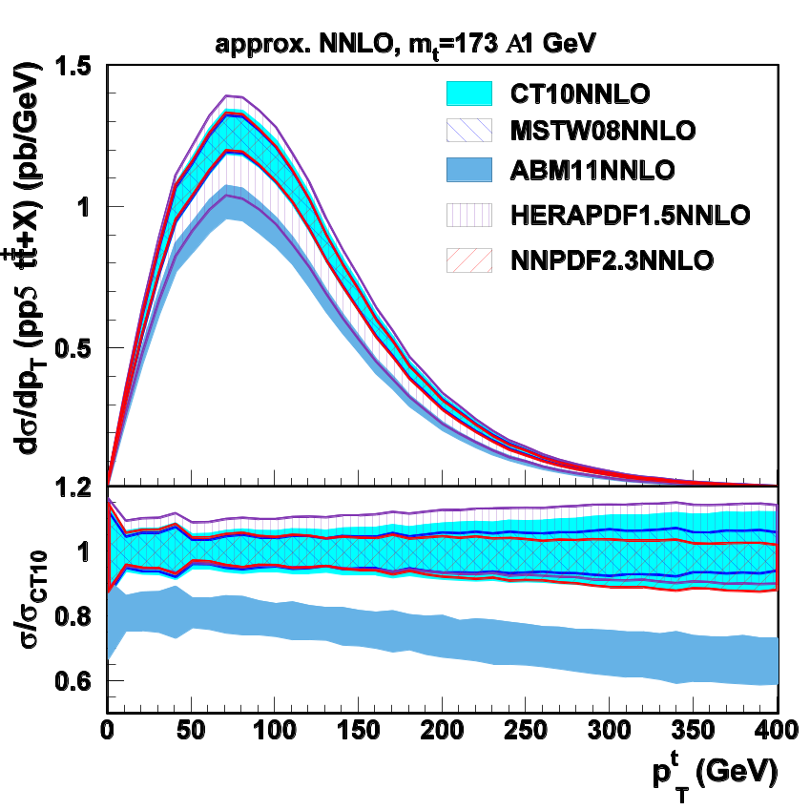
Application to differential ttbar cross sections in approx. NNLO
Application of flexible-scale concept to NNLO calculations
Interface to DiffTop code
    DiffTop
        Code for calculation of heavy quark production within threshold resummation formalism in Mellin space
        See talk by M.Guzzi
    Differential ttbar cross sections in approx. NNLO
        dσ/dp_{T}
        dσ/dy
Benefit in speed
    NNLO calculation O(days-weeks)
    fastNLO calculation O(<1s)
fastNLO facilitates study of PDF dependence
  Particularly including PDF uncertainties
        262 re-calculations are required
preliminary
see talk by M. Guzzi
786 repeated calculations needed including variation of m_{t}

Slide 8
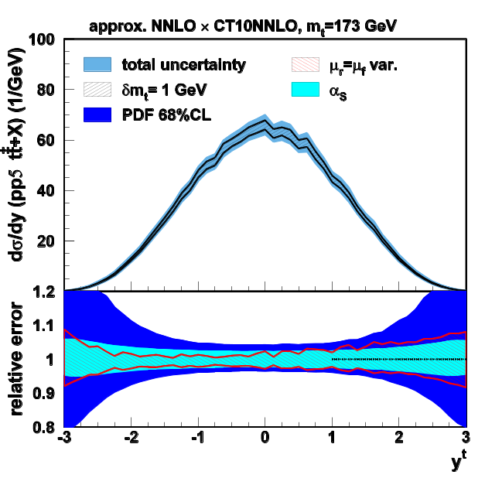
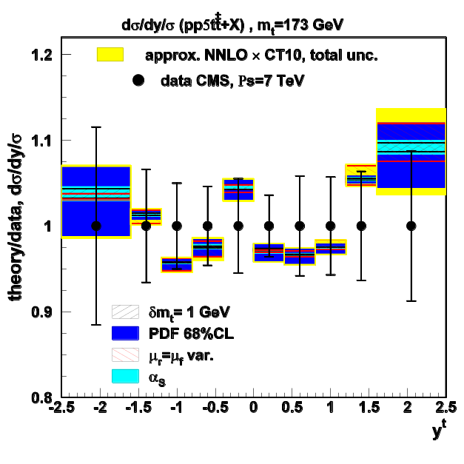
Application to differential ttbar cross sections in approx. NNLO
Without recalculating the coefficients
    Variation of the scales within milliseconds
    Variation of α_{s}
    Determination of PDF uncertainties
    Also choice of the scales possible
    here: μ_{r/f} = f(p_{T},y,m_{t})
Variation of m_{t}
    m_{t} is a third hard scale in this process
    m_{t} is not factorized in the current approach
        Separate fastNLO tables have been computed for different values of m_{t}
Fast recomputation of cross sections for a given measurement enables application of time-consuming (N)NLO calculations to PDF and/or α_{s}-fits
    Large gluon uncertainties at high-x can be reduced using ttbar cross sections

Slide 9
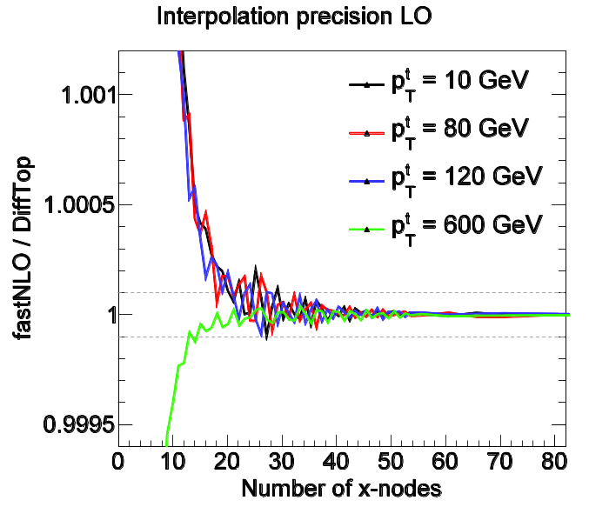
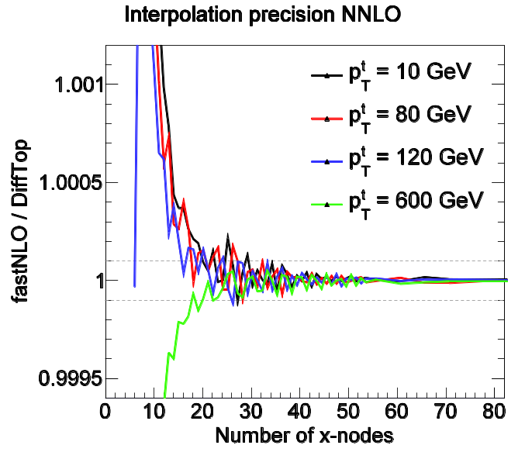
Accuracy of fastNLO interpolation in NNLO
Compare cross sections calcuated with DiffTop standalone compared to fastNLO
    Interpolation accuracy depends on number of nodes and on chosen interpolation kernel
    Bicubic interpolation kernels used
    Compare contribution order by order separately
    Data probe x-range of 2 ∙10⁻³ < x < 1
        High x-range has more distinct PDF shapes
fastNLO/DiffTop
    Perfect agreement within numerical precision reachable (O(10⁻⁶))
    NNLO has same accuracy as LO
    With 18 nodes agreement better than 2∙10⁻⁴
    Accidental ‘interference effects’ with PDF grid may cause small fluctuations O(2∙10⁻⁴)
      -> Numerical uncertainty of PDF grids
MSTW2008nnlo
fastNLO interpolation does not introduce numerical biases
MSTW2008nnlo

Slide 10

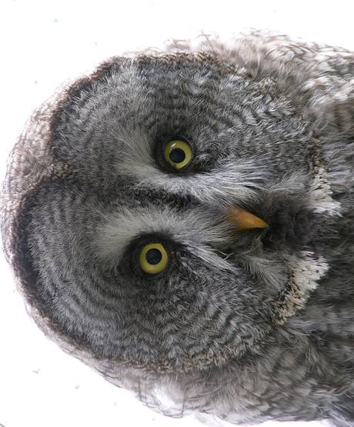
New tool: fastNLO toolkit
What about application of fastNLO to other processes/programs ?
  Hardly any theoretical limitation of fastNLO concept to pQCD or EW calculations
Why not used more frequently?
Interface of fastNLO to theory programs often very complicated…
    Theory codes are not optimized (at all) for fastNLO
    Technical difficulties are mostly limiting factor in usage
Goal:
Provide simple and flexible code to interface fastNLO to any kind of (N)NLO program
Newly developed tool: fastNLO Toolkit

Slide 11
Application procedure of new ‘fastNLO Toolkit’
fastNLO needs access to
    Matrix elements before convolution with PDFs
    x-values where PDFs are evaluated
    Observables
    Scale definitions
Various NLO and NNLO programs have very different software architecture
Reasons
    Optimized for efficient calculation
    Straight implementation of math. formulae
    Historically grown codes
    Usage of well established algorithms (e.g. vegas)
(N)NLO programs often look to non-authors like different kind of pasta

Slide 12
Application procedure of new ‘fastNLO Toolkit’
fastNLO needs access to
    Matrix elements before convolution with PDFs
    x-values where PDFs are evaluated
    Observables
    Scale definitions
Various NLO and NNLO programs have very different software architecture
Reasons
    Optimized for efficient calculation
    Straight implementation of math. formulae
    Historically grown codes
    Usage of well established algorithms (e.g. vegas)
(N)NLO programs often look to non-authors like different kind of pasta
NLO program A
Obs₁
C_{LO}
C_{NLO}
PDF
µ_{r}

Slide 13
Application procedure of new ‘fastNLO Toolkit’
fastNLO needs access to
    Matrix elements before convolution with PDFs
    x-values where PDFs are evaluated
    Observables
    Scale definitions
Various NLO and NNLO programs have very different software architecture
Reasons
    Optimized for efficient calculation
    Straight implementation of math. formulae
    Historically grown codes
    Usage of well established algorithms (e.g. vegas)
(N)NLO programs often look to non-authors like different kind of pasta
NLO program A
Obs₁
C_{LO}
C_{NLO}
PDF
µ_{r}
NLO program B
PDF
C_{LO}
Obs₁
C_{NLO}
µ_{r}

Slide 14
Application procedure of new ‘fastNLO Toolkit’
fastNLO needs access to
    Matrix elements before convolution with PDFs
    x-values where PDFs are evaluated
    Observables
    Scale definitions
Various NLO and NNLO programs have very different software architecture
Reasons
    Optimized for efficient calculation
    Straight implementation of math. formulae
    Historically grown codes
    Usage of well established algorithms (e.g. vegas)
(N)NLO programs often look to non-authors like different kind of pasta
NLO program A
Obs₁
C_{LO}
C_{NLO}
PDF
µ_{r}
NLO program B
PDF
C_{LO}
Obs₁
C_{NLO}
µ_{r}
Think about a general interface to any kind of theoretical program

Slide 15
Application procedure of new ‘fastNLO Toolkit’
Program Start
(N)NLO Program
MC Integration
Program End
(N)NLO Result

Slide 16
Application procedure of new ‘fastNLO Toolkit’
Program Start
fastNLOCreate fnlo(„steering.str“);
fnlo.SetOrderOfCalculation(int order);
Initialize fastNLO class(es)
(N)NLO Program
MC Integration
Program End
(N)NLO Result

Slide 17
Application procedure of new ‘fastNLO Toolkit’
Program Start
fastNLOCreate fnlo(„steering.str“);
fnlo.SetOrderOfCalculation(int order);
Initialize fastNLO class(es)
(N)NLO Program
fnlo.fEvent.SetProcessID(int id);
Pass the process specific variables during the ‘event loop’ to fastNLO
    Order does not matter
    Many other convenient implementations possible
fnlo.fEvent.SetX1(double x1);
fnlo.fEvent.SetX2(double x2);
fnlo.fEvent.SetWeight(double w);
MC Integration
fnlo.fScenario.SetObservable0(double pt);
fnlo.fScenario.SetObsScale1(double s1);
fnlo.Fill();
Pass all information to fastNLO
Program End
(N)NLO Result

Slide 18
Application procedure of new ‘fastNLO Toolkit’
Program Start
fastNLOCreate fnlo(„steering.str“);
fnlo.SetOrderOfCalculation(int order);
Initialize fastNLO class(es)
(N)NLO Program
fnlo.fEvent.SetProcessID(int id);
Pass the process specific variables during the ‘event loop’ to fastNLO
    Order does not matter
    Many other convenient implementations possible
fnlo.fEvent.SetX1(double x1);
fnlo.fEvent.SetX2(double x2);
fnlo.fEvent.SetWeight(double w);
MC Integration
fnlo.fScenario.SetObservable0(double pt);
fnlo.fScenario.SetObsScale1(double s1);
fnlo.Fill();
Pass all information to fastNLO
fnlo.SetNumberOfEvents(double nevents);
fnlo.WriteTable();
Set normalization of the MC integration and write table
Program End
Minimum implementation:
11 lines of code
(N)NLO Result
fastNLO Table
Convenient implementation of fastNLO into any (N)NLO program possible

Slide 19
New developments for fastNLO toolkit
1) Creation of fastNLO tables
    One stand-alone c++ library
        No third party packages needed
        Optimally: Only 11 lines of code necessary
        Depending on (N)NLO program:
        many implementations possible
    Parameters are specified in steering card
        Binning (also double- or triple- differentially)
    Performance optimized
        Caching of interpolation values
        Automatic optimization of grids to phase space
    PDF parton combinations for different subprocesses
        Specified in steering
        Stored in table
2) fastNLO table format
    Further contributions are forseen
        EW corrections, etc…
    PDF combinations are stored in table
    Storage of uncertainties soon available
    QEDPDFs or p-Pb collisions also forseen
3) Evaluating fastNLO tables
    New interface in PYTHON
    Many interfaces to PDF and α_{s} routines
        LHAPDF5, LHAPDF6, Hoppet, QCDNUM, ALPHAS, CRunDec, …
    Improved speed for flexible-scale tables
    Caching of PDFs and α_{s} values for (even) faster re-evaluation
// FastNLO example code in c++ for reading CMS incl.
// jets (PRL 107 (2011) 132001) with CT10 PDF set
fastNLOLHAPDF fnlo("fnl1014.tab","CT10.LHgrid",0);
fnlo.PrintCrossSections();

Slide 20

Summary and Outlook
fastNLO enables fast re-evalution of perturbative calculations
    Convenient for scale or PDF studies (e.g. uncertainties)
    Mandatory tool for phenomenological analysis (e.g. α_{s} or PDF fits)
Scale-independent concept successfully applied in NNLO
fastNLO is applicable to a wide range of processes and corrections
New tool: ‘fastNLO toolkit’
    Facilitates creation of tables and interface to other (N)NLO programs
    Very flexible code:
    Only few modifications in (N)NLO programs are needed (O(11) lines of code)
Code and manual is released soon after conference
    Python interface available for reading tables
    pre-release version of ‘fastNLO toolkit’ is available on request
    more information: http://fastnlo.hepforge.org

Slide 22
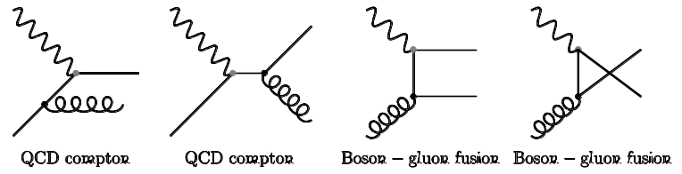
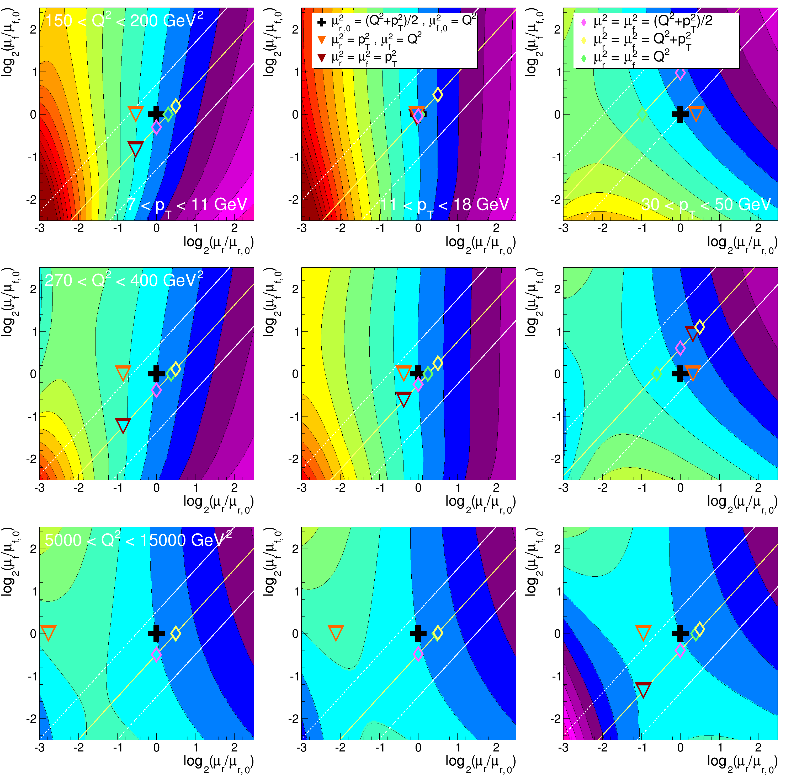
Application of flexible scale concept
Inclusive jet production in DIS
Two scales are stored in table
    Q²
    p_{T} of the jet
Any function of the two can be used as scale
Renormalization and factorization scale can be varied seperately
Choose for scale study
    μ_{r}² = Q²+p_{T}
    μ_{f}² = Q²
    Color code shows 5% change in cross section w.r.t. to scale factor of 1
Other scale choices also shown without scale factors

