Slide 1

New features in version 2 of the fastNLO project
The fastNLO Collaboration
Daniel Britzger, Thomas Kluge, Klaus Rabbertz, Fred Stober,Markus Wobisch
(DESY, Liverpool, KIT, KIT, Louisiana Tech)
v2
DIS 2012
29. March 2012

Slide 2

Outline
Motivation
FastNLO concept
Applications
New features of FastNLO v2
Generalized Concept in FastNLO v2
FastNLO Precision and Examples
Outlook

Slide 3
Motivation
Interpretation of experimental data relies on
  Availability of reasonably fast theory calculations
  Often needed: Repeated computation of (almost) same cross sections
Examples for a specific analysis:
  Use of various PDFs (CTEQ, MSTW, NNPDF, …) for data/theory comparison
  Determine PDF uncertainties
  Derivation of scale uncertainties
  Use data set in fit of PDFs and/or α_{s}(M_{Z})
Sometimes NLO predictions can be computed fast
But some are very slow
  e.g. jet cross sections, Drell-Yan, …
Need procedure for fast repeated computations of NLO cross sections
  Use fastNLO (in use by most PDF fitting groups)

Slide 4
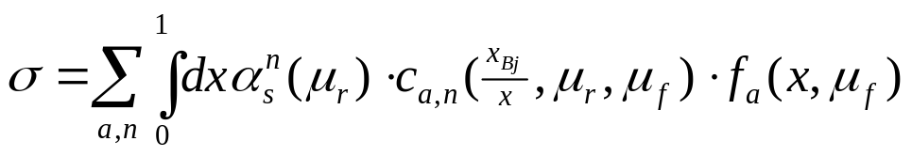
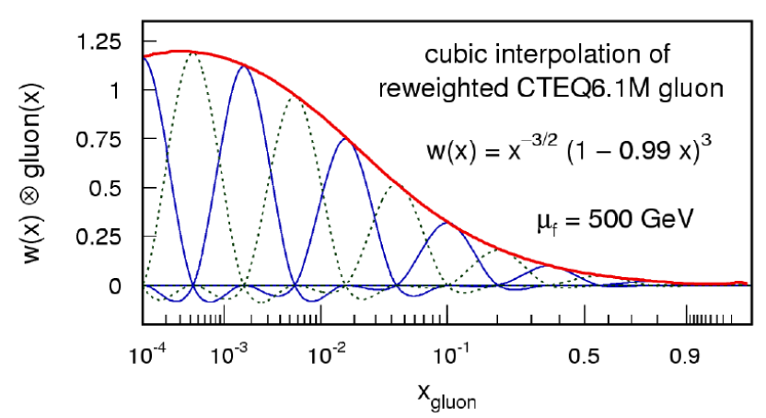
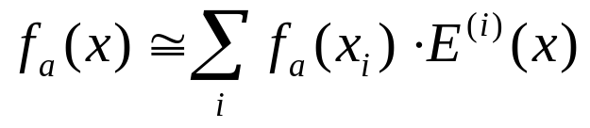
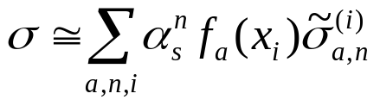
The fastNLO concept
Jetproduction in DIS
  Jet cross sections are very slow to calculate
Idea
Remove PDF from convolution integral
fastNLO Concept
  Introduce set of n discrete x-nodes x_{i}'s
      with x_{n} < ..< x_{i} <..<x₀ =1
  Around each x_{i} define Eigenfunction E_{i}(x)
      E_{i}(x_{i}) = 1, E_{i}(x_{j}) = 0 (i ≠ j), Σ_{i} E_{i}(x) = 1 for all x
Single PDF is replaced by a linear combination of eigenfunctions
Convolution of perturbative coefficients with PDFs and α_{s} is now replaced by a sum
-> More technical details: TeV4LHC Workshop 2005 (Talk: M. Wobisch)
and Pascaud, Zomer: LAL 94-42
-> We only have to store a table of the convolution of the pert. coefficients with the interpolation kernel

Slide 5
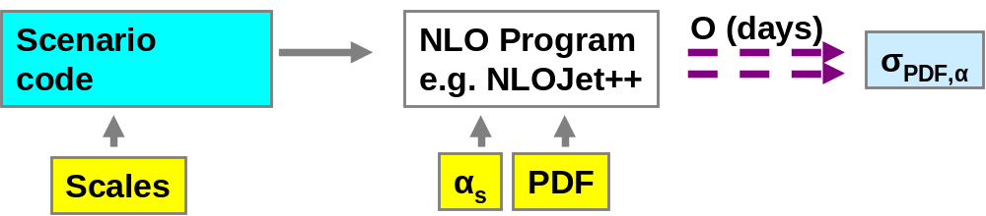
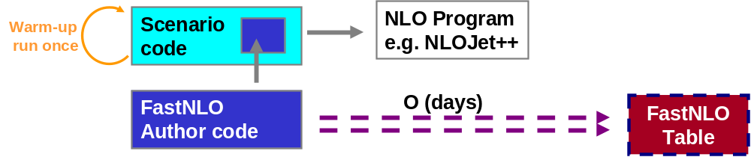
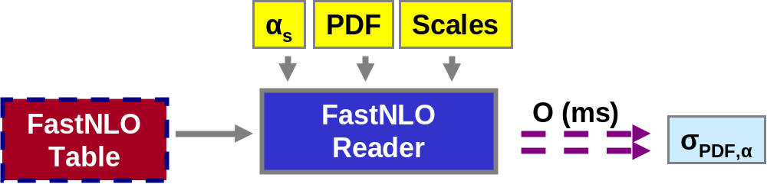
The fastNLO concept
Standard
Method
Table
Generation
fastNLO
Evaluation
Or use it within a fitting framework

Slide 6
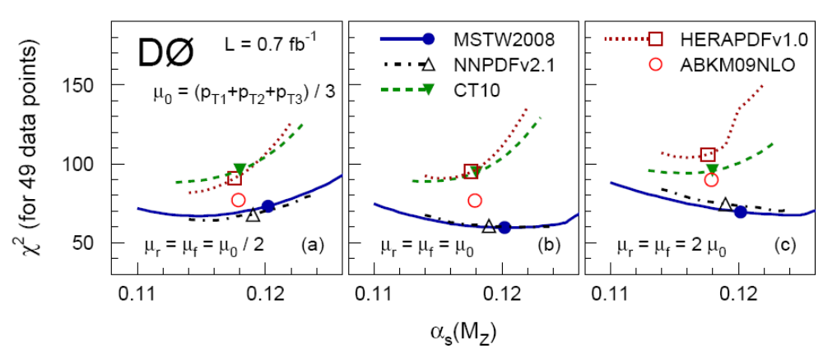
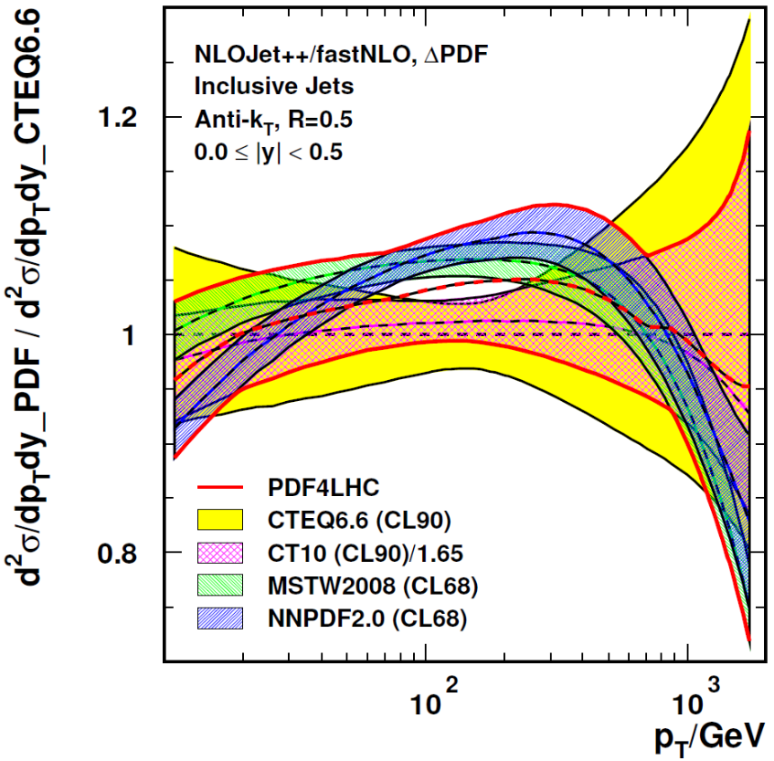
Applications
Example: PDF-Error predictions à la PDF4LHC recommendation
Envelope of predictions of
CT10, MSTW and NNPDF at CL68.
Compared to CTEQ6.6 (CL90)
Application area
  Can be used for any observable in hadron-induced processes
    Hadron-hadron, DIS, Photoproduction, Fragmentation functions
Theory prediction
  Concept does not include the theoretical calculation itself
  Requires flexible computer code, e.g.:
    NLOJET++ (Z. Nagy PRD68 2003, PRL88 2002)
    Threshold corrections (Kidonakis, Owens, PRD 63, 054019 (2001))
  Although labeled “fastNLO” method can be used at any order
Application procedure
  During the first computation no time is saved
  Any further recalculation takes only O(ms)
Typical Applications
  PDF or α_{s} fits
  PDF uncertainties: e.g. PDF4LHC recommendation needs 239 calculations
PLB 704 (2011) 434-441
3138 repeated NLO calculations

Slide 7
New Features in FastNLO v2.0
Technical Features of pre-computed fastNLO tables
  Automatic scan of smallest x-value
  Flexible # x-nodes for analysis bins
  Improved interpolation in ren./fact. scales
  Arbitrary number of dimensions for binning of observable
Features of fastNLO Reading Tools
  Comprehensive α_{s} evolution provided
    2-,3-,4-loop iterative solution, flavor matching ON/OFF, etc…
    Interface to external α_{s} evolutions
    e.g. LHAPDF, QCDNUM, etc…
  Interface to PDF from LHAPDF and QCDNUM
  Easy to install (autotools)
  C++ and Fortran version !
    agreement at double precision O(10⁻¹⁰)
No further dependencies (No ROOT, No CERNLIB, etc…)
FastNLO Table
FastNLO
Reader
Reader_f
Reader_cc

Slide 8
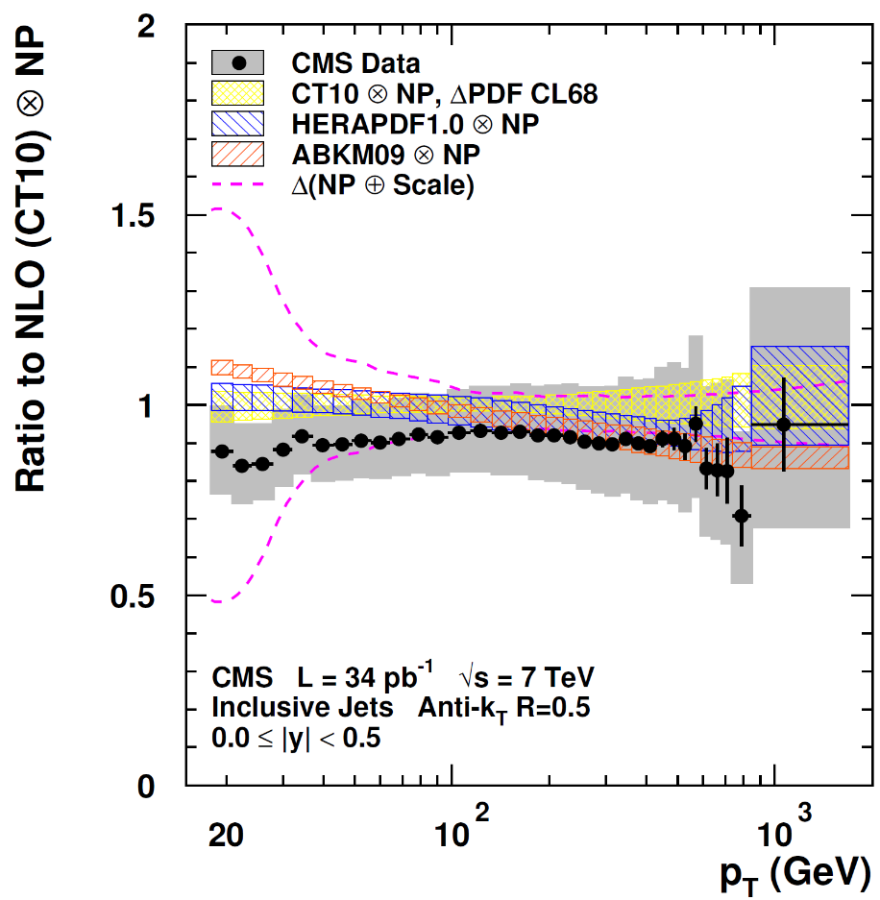
Additional contributions in FastNLO v2.0
Much more flexible Table format
Release on February 14
Format foresees
  Threshold corrections (2-loop)
    Tables are available
  New physics contributions
  Correction factors
    Non-perturbative corrections
    With uncertainties
  Data
    Including arb. number of correlated and uncorrelated uncertainties
    Correlation matrix
  Electroweak corrections
Conversion tool for v1.4 tables
CMS Note-2011-004

Slide 9
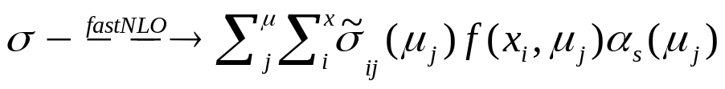
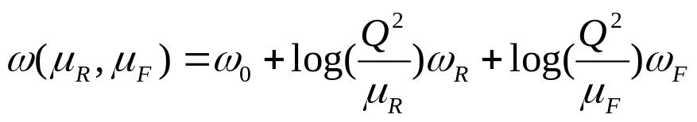
Generalized fastNLO concept in v2.0
We know
  We can use variables from look-up tables for 'any' further calculation (like α_{s}(μ))
σ_{ij}
2-dim Weights
μ_{j}
x_{i}
1-dim look-up table
α(μ_{j})
f(x_{i},μ_{j})
arb. ext. functions
Scale independent weights
  'log(Q²/μ)' can be done at evaluation time
  We assume μ's are 'freely' choosable functions
  μ -> μ(Q²,p_{T})
We store scale independent contribution
  Three tables holding the weights
  Further scale-variables -> σ_{ijk…}need more dimensions
new in v2.0
σ⁰_{ijk}
σ^{R}_{ijk}
σ^{F}_{ijk}
3-dim Weights
p_{T}
Q²
x_{i}
1-dim look-up table
α(μ_{R})
f(x_{i},μ_{F})
arb. ext. functions
μ_{F}(Q²,p_{T})
μ_{R}(Q²,p_{T})
arb. ext. functions
1) We can choose μ_{R} independently from μ_{F}
2) We can choose the functional form of μ_{R/F} as functions of look-up-variables

Slide 10
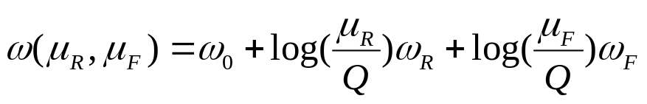
Generalized fastNLO concept in v2.0
We know
  We can use variables from look-up tables for 'any' further calculation (like α_{s}(μ))
σ_{ij}
2-dim Weights
μ_{j}
x_{i}
1-dim look-up table
α(μ_{j})
f(x_{i},μ_{j})
arb. ext. functions
Scale independent weights
  - 'log(μ/Q)' can be done at evaluation time
  μ's are 'freely' choosable functions
  - μ -> μ(Q,p_{T})
We store scale independent contribution
  Three tables holding the weights
  Further scale-variables -> σ_{ijk…}need more dimensions
new in v2.0
σ⁰_{ijk}
σ^{R}_{ijk}
σ^{F}_{ijk}
3-dim Weights
p_{T}
Q²
x_{i}
1-dim look-up table
α(μ_{R})
f(x_{i},μ_{F})
arb. ext. functions
μ_{F}(Q²,p_{T})
μ_{R}(Q²,p_{T})
arb. ext. functions
1) We can choose μ_{R} independently from μ_{F}
2) We can choose the functional form of μ_{R/F} as functions of look-up-variables

Slide 11
Generalized fastNLO concept in v2.0
We know
  We can use variables from look-up tables for 'any' further calculation (like α_{s}(μ))
σ_{ij}
2-dim Weights
μ_{j}
x_{i}
1-dim look-up table
α(μ_{j})
f(x_{i},μ_{j})
arb. ext. functions
Scale independent weights
  - 'log(μ/Q)' can be done at evaluation time
  μ's are 'freely' choosable functions
  - μ -> μ(Q,p_{T})
We store scale independent contribution
  Three tables holding the weights
  Further scale-variables -> σ_{ijk…}need more dimensions
new in v2.0
σ⁰_{ijk}
σ^{R}_{ijk}
σ^{F}_{ijk}
3-dim Weights
p_{T}
Q²
x_{i}
1-dim look-up table
α(μ_{R})
f(x_{i},μ_{F})
arb. ext. functions
μ_{F}(Q,p_{T})
μ_{R}(Q,p_{T})
arb. ext. functions
1) We can choose μ_{R} independently from μ_{F}
2) We can choose the functional form of μ_{R/F} as functions of look-up-variables

Slide 12
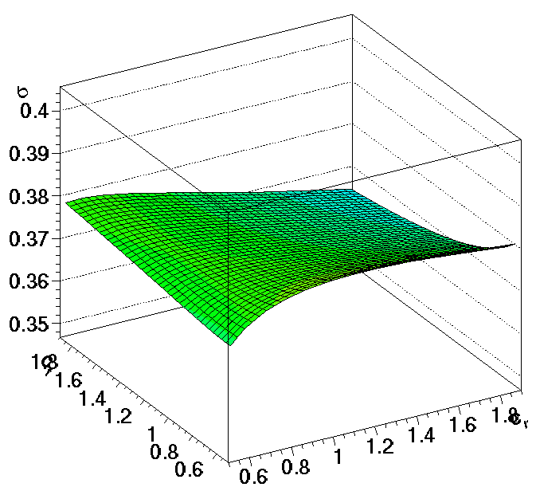
New Features for Scales
When evaluating fastNLO cross section
  Choose scale composition from previously stored scales
  e.g. μ_{r}² = (Q² + p_{T}²) / 2
  μ_{r}² = Q²
  μ_{r}² = p_{T}²
  …
Also scale variation for μ_{r} and μ_{f} are thus independently possible through
  μ_{R}² = c²_{R}× (Q² + p_{T}²) / 2
  μ_{F}² = c²_{F} × Q²
New options for scans of scale dependence
Concept also implemented for pp and ppbar
Zeus Dijets @ High Q²
σ [pb]
Scale factor c_{F}
Scale factor c_{R}

Slide 13
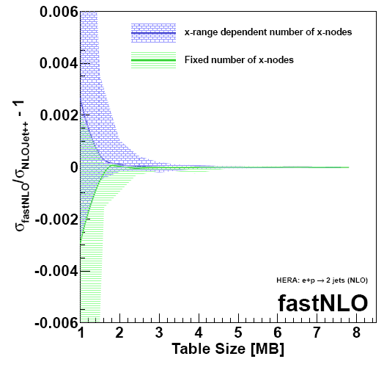
fastNLO Precision
H1 Incl. Jets @ High Q² (24 bins)
Free Parameters
  # x-nodes
  # scale nodes
  -> Affect the interpolation precision
New feature in v2.0
  Flexible # x-nodes
  Number of x-nodes chosen depending on x-range
Comparison vs. 'plain' NLOJet++
  Arbitrary precision possible
  For O(MB) tables, reach better than 1 per mille
O(10⁻⁶)
Filled area shows maximum deviation of all bins
Solid line shows mean deviation of all bins

Slide 14
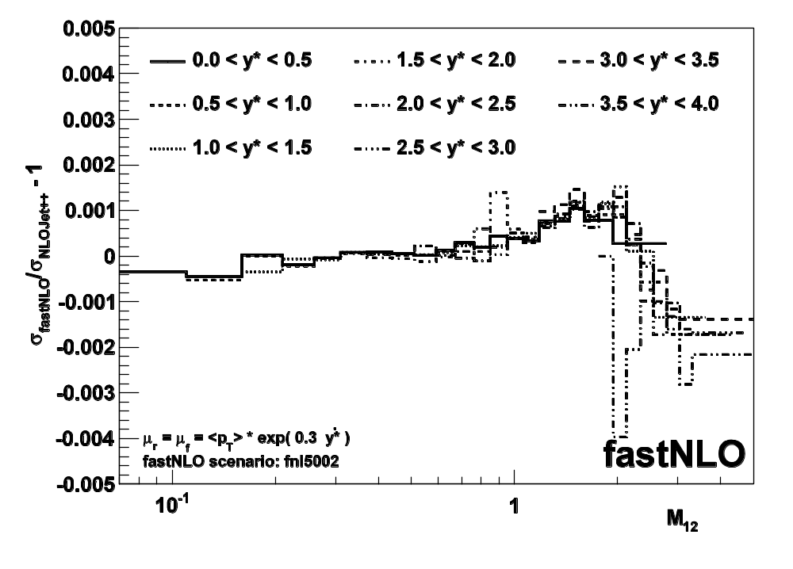
Example: Scale studies with ATLAS Dijet M₁₂
  pp and ppbar Scenarios
  'flexible scale concept' works as well
  ATLAS Dijet Invariant Mass, r=0.6
  p_{T} and y* are stored in table
  Ren./fact. scale can be any function of (p_{T},y*)
  Can study variations of ATLAS dijet scale choice p_{T}·exp(0.3·y*)
  -> We can vary parameter '0.3'
  -> We can use different functions (e.g. cosh)
  -> We can e.g. find optimal scale (FAC,PMS)
  fastNLO vs. plain NLOJet++ calculation with free choice of ren./fac. scale
  Precision ~ 10⁻³

Slide 15
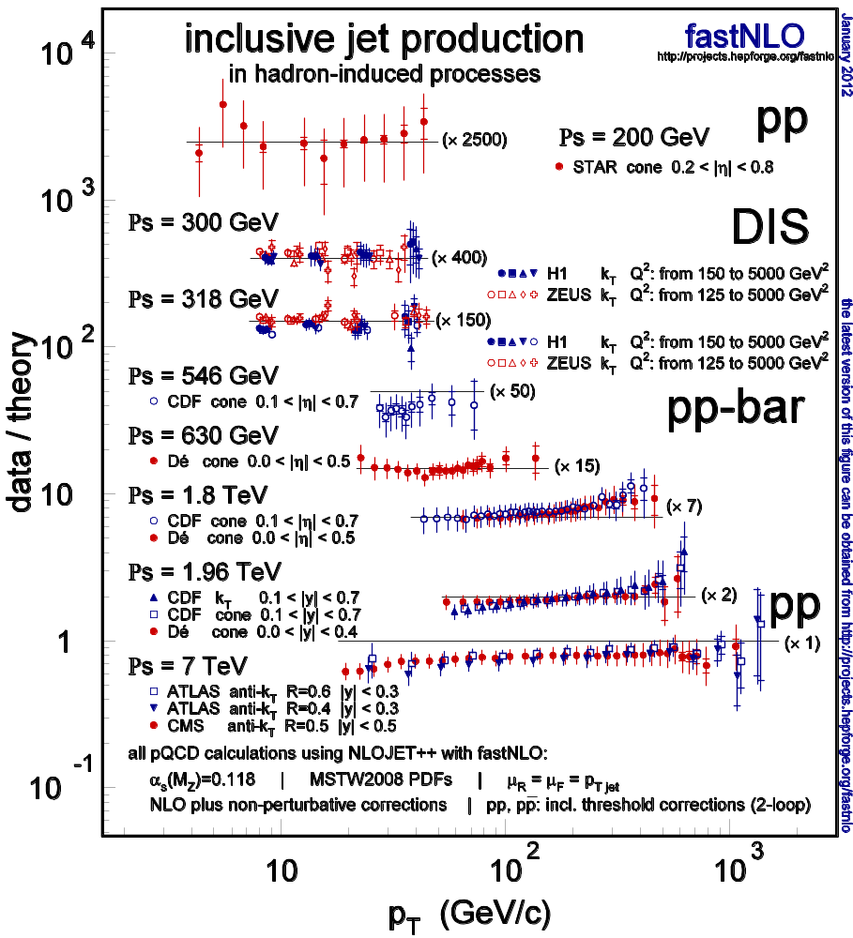
Data/Theory Comparision of Jet Cross Sections
Comparision of inclusive jet data
  STAR @ RHIC
  H1 and ZEUS @ HERA
  CDF and D0 @ TeVatron
  CMS and ATLAS @ LHC
Data/theory comparision
Compatible with NLO pQCD
hadron-hadron including 'threshold corrections' O(2-loop)
fastNLO, arXiv:1109:1310v1, 2011
here: updated plot!
See data references there.

Slide 16
Summary
Release
  User code released
  C++ and Fortran code (No further dependencies)
  Lots of calculations available for all experiments
  ATLAS, CMS, D0, CDF, ZEUS, H1, STAR
New features
  Multiplicative and additive contributions
    threshold corrections, non-perturbative corrections, data, EW contribtions, new physics, etc…
  Technicalities
    Automated x-scan, flexible number of x-nodes, Scale gets own dimension, improved interpolation, etc…
'Flexible scale' tables
  Choose composition of μ_{R} and μ_{F}
  Vary ren./fact. scales independently
  Scale varyations also for higher orders without any recalculations or integrations (which might be slow again!)
-> Visit our website: http://fastnlo.hepforge.org

Slide 17
Summary
Release
  User code released
  C++ and Fortran code (No further dependencies)
  Lots of calculations available for all experiments
  ATLAS, CMS, D0, CDF, ZEUS, H1, STAR
New features
  Multiplicative and additive contributions
    threshold corrections, non-perturbative corrections, data, EW contribtions, new physics, etc…
  Technicalities
    Automated x-scan, flexible number of x-nodes, Scale gets own dimension, improved interpolation, etc…
'Flexible scale' tables
  Choose composition of μ_{R} and μ_{F}
  Vary ren./fact. scales independently
  Scale varyations also for higher orders without any recalculations or integrations (which might be slow again!)
-> Visit our website: http://fastnlo.hepforge.org
… after the hepforge transition

Slide 18
Backup

Slide 19
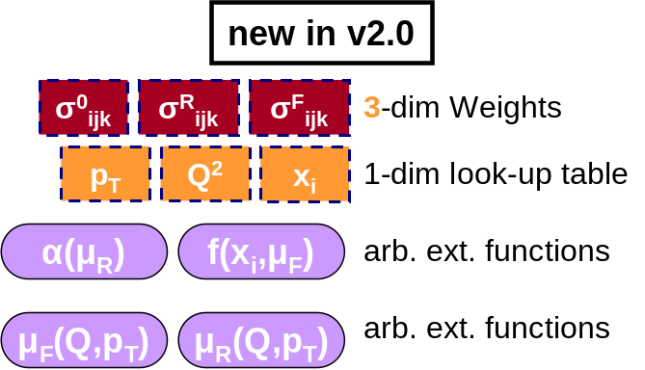
FastNLO v2
FastNLO v2
  Method for fast repeated theory cross sections allowing to change α_{s}, PDF and scales
  More flexible table format for various multiplicative and additive contributions
  C++ and fortran versions with lots of interfaces
  Many calculations available
'Flexible scale' format
  Potential to vary ren. and fact. scale independently
  Scales composition can be choosen as function of pre-defined variables
  -> New options for scans of scale dependence (e.g. à la FAC, PMS)

Slide 20
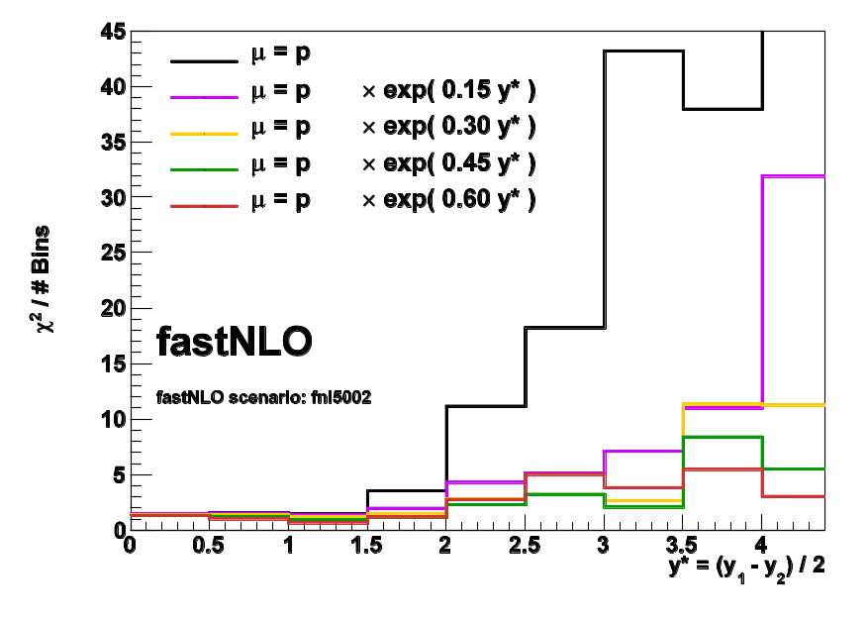
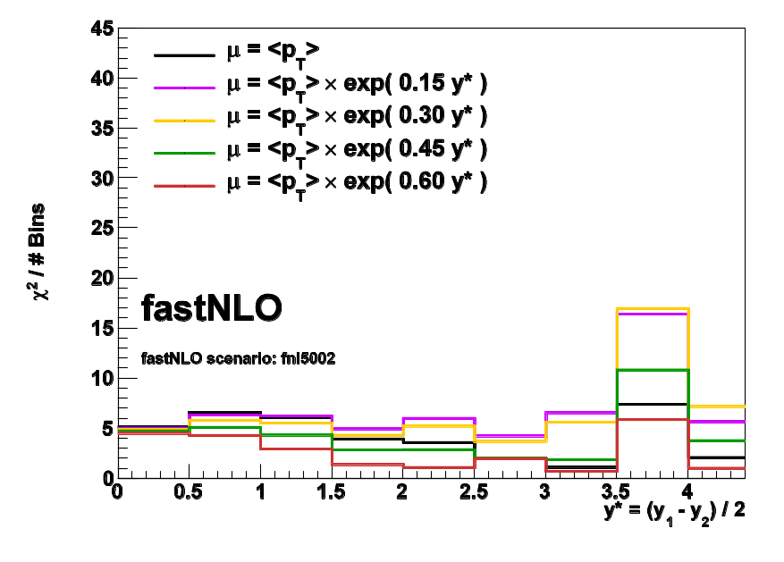
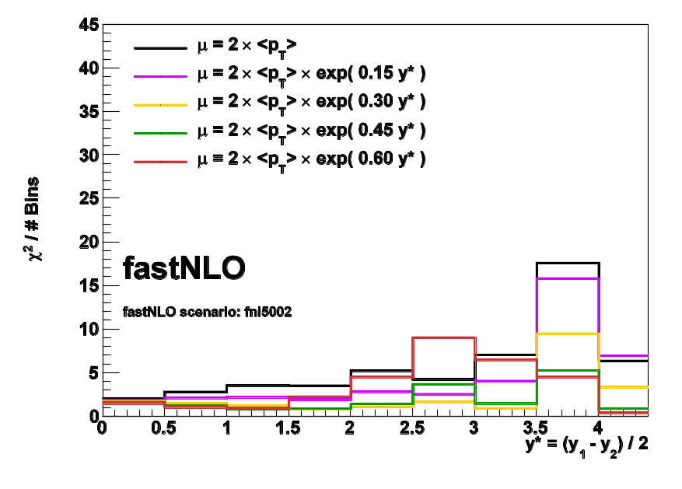
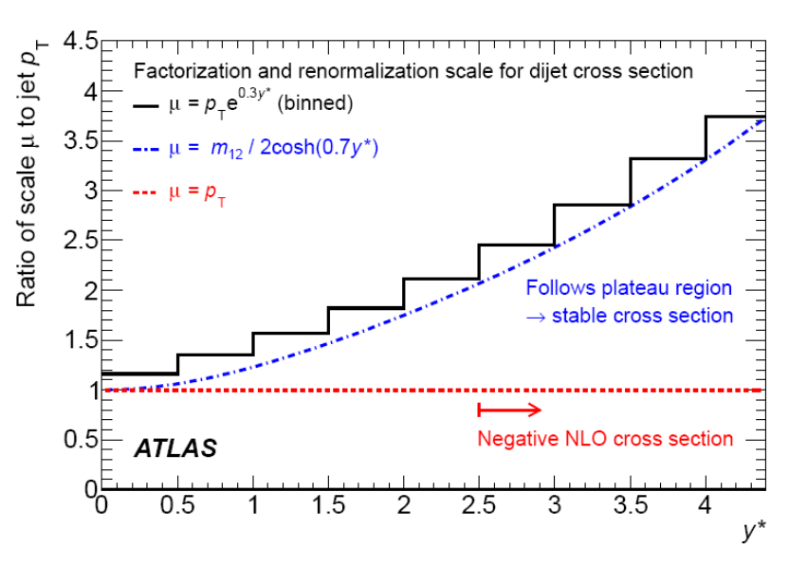
Stuying the scale choice of ATLAS
arXiv:1112.6297 [hep-ex]

Slide 21
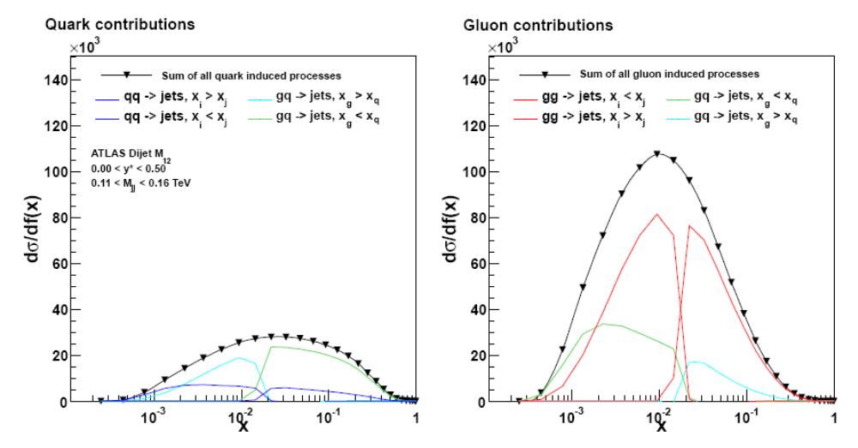
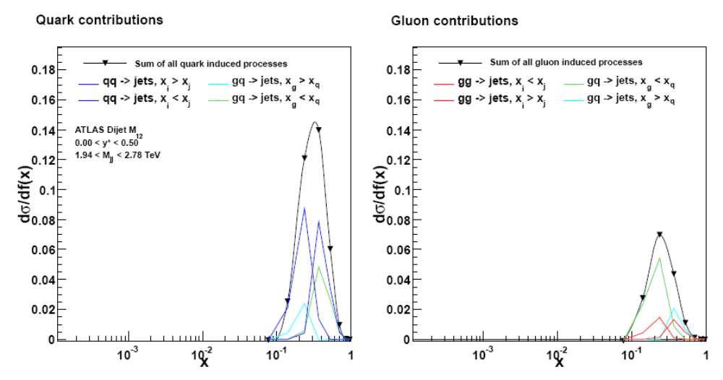

Slide 22
Applications
Example: PDF-Error predictions à la PDF4LHC recommendation
Envelope of predictions of
CT10, MSTW and NNPDF at CL68.
Compared to CTEQ6.6 (CL90)
Application area
  Can be used for any observable in hadron-induced processes
    Hadron-hadron
    DIS
    Photoproduction
    Fragmentation functions
Theory prediction
  Although labeled “fastNLO” method can be used at any order
  Concept does not include the theoretical calculation itself
  Requires flexible computer code, e.g.:
    NLOJET++ (Z. Nagy PRD68 2003, PRL88 2002)
    Threshold corrections (Kidonakis, Owens, PRD 63, 054019 (2001))
Application procedure
  During the first computation no time is saved
  Any further recalculation takes only O(ms)
239 NLO repeated calculations

Slide 23
The fastNLO concept
Standard
Method
Scenario
code
NLO Program
e.g. NLOJet++
O (days)
σ_{PDF,α}
Scales
α_{s}
PDF
Scenario
code
NLO Program
e.g. NLOJet++
Warm-up
run once
Table
Generation
FastNLO
Author code
O (days)
FastNLO Table
fastNLO
Evaluation
α_{s}
PDF
Scales
Or use it within a fitting framework
FastNLO Table
FastNLO
Reader
O (ms)
σ_{PDF,α}

Slide 24
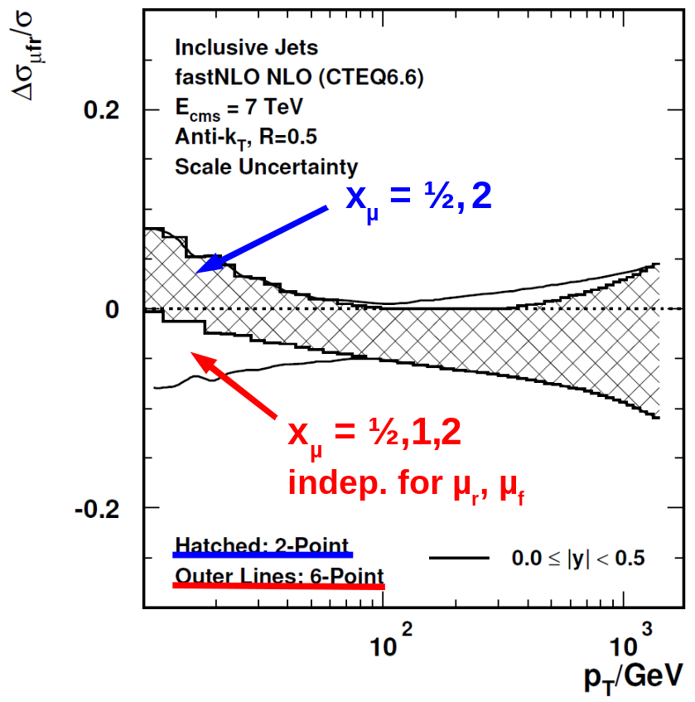
Scales in FastNLO
FastNLO tables come with 3 (4) simultaneous scale variations tables
  e.g. 0.5, 1.0, 2.0 times the nominal scale
A posteriori scale variation of the renormalizatoin scale allows study of asymetric scale variations
  e.g. 6-points: (1/2,1/2), (1/2,1), (1,1/2), (1,2), (2,1), (2,2)
  avoiding of rel. 'factor' 4.
Improvements in v 2.0
  scales get own dimension
  bicubic interpolation of scale-value to scale nodes
  typically 6 scale nodes
  examples already for
    CMS incl. jets
    D0 3-jet mass
    …

Slide 25
Standard methods for higher-order pQCD calculations of cross sections in hadron-induced collisions are time-consuming. The fastNLO project uses multi-dimensional interpolation techniques to convert the convolutions of perturbative coefficients with parton distribution functions and the strong coupling into simple products. By integrating the perturbative coefficients for a given observable with interpolation kernels, fastNLO can store the results of the time-consuming calculation in tables which can subsequently be used for very fast calculations of the same observable for arbitrary PDFs, alpha_s, and different scales. These tables and corresponding user codes are currently available for a large number of jet measurements at the LHC, the Fermilab Tevatron, and HERA. fastNLO is currently used in publications of experimental results by the ATLAS, CMS, CDF, D0, and H1 collaborations, and in all recent global PDF analyses by MSTW, CTEQ, and NNPDF. This talk will focus on new developments, implemented in the new version 2 of fastNLO, which enhance and broaden the functionality.

Slide 27
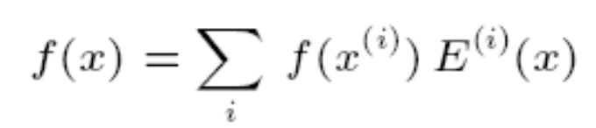
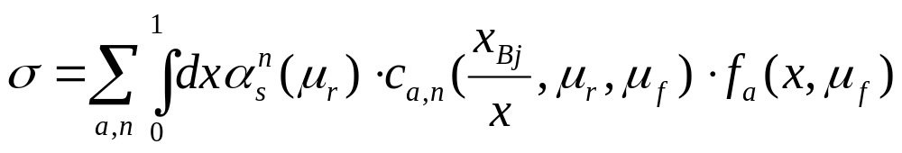
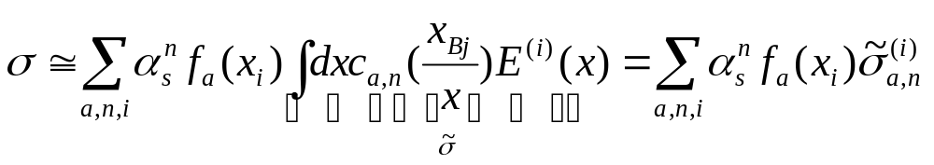
The fastNLO concept
Jet cross sections are very slow to calculate
-> Need of method for very fast repeated calculation of cross sections
FastNLO factorizes the cross section calculation for an a-posteriori inclusion of pdf's and alpha_s for e.g. jet-production
Introduce set of n discrete x_{(i)}'s
with x_{n} < ..< x_{i} <..<x₀ =1
Around each x_{(i)} define eigen function E^{(i)}(x) with:
E^{(i)}(x_{i}) = 1, E^{(i)}(x_{j}) = 0 (i ≠ j), Σ_{i} E^{(i)}(x) = 1 for all x
single pdf is replaced by a linear combination of eigenfunctions
integrals are replaced by sums
Better: Usage of bi-cubic interpolation and pdf reweighting
hadron-hadron -> everything just more complicated, but same concept

Slide 28
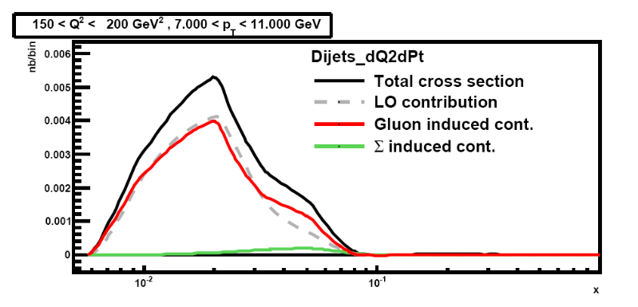
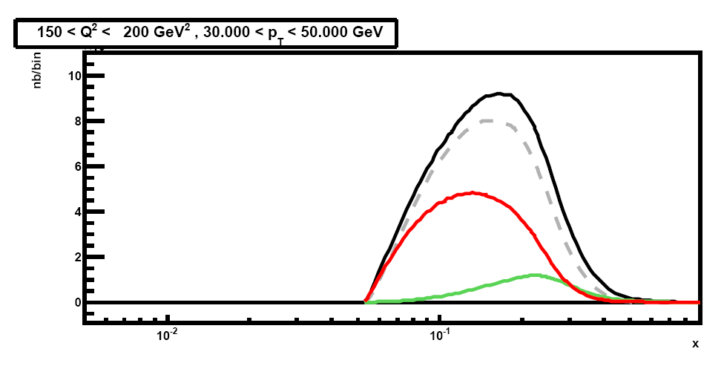
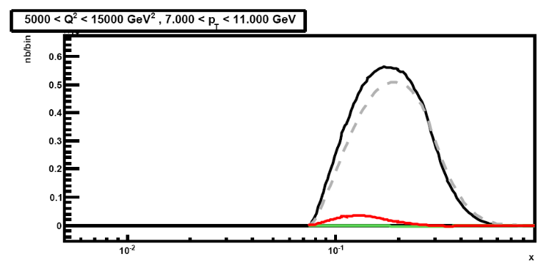
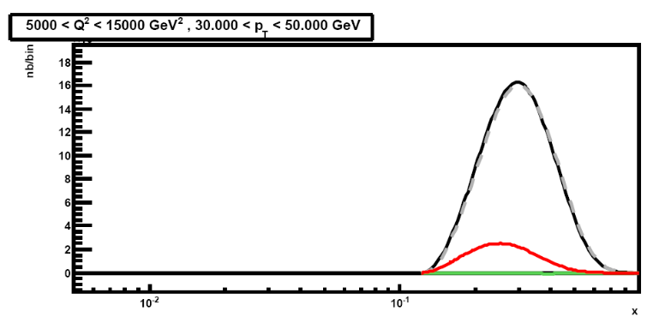
Which x-region do we test with jet data?
E.g. H1 dijets @ high Q²
  four bins:
    low and high Q²
    low and high <pt>
Only three contributions in DIS
Gluon, Delta, Sigma induced processes
low Q² is mostly gluon induced
High Q² is mostly Delta induced
'low' x-region only at low <pt> and low Q²
10⁻²
10⁻¹
x
10⁻²
10⁻¹
x
10⁻²
10⁻¹
x
10⁻²
10⁻¹
x

Slide 29
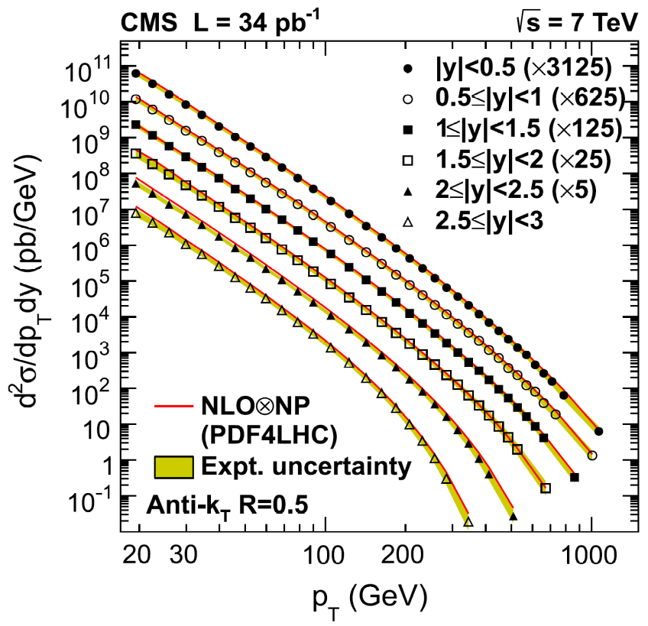
Can we do the same for CMS incl. jets?
CMS inclusive jets
176 bins
6 rapidity regions
To which 'x'-regions and to which pdfs are we sensitive to???
CMS, PRL 107, 132001, 2011

