Slide 1





Recent Developments of the fastNLO Toolkit
Daniel Britzger, Klaus Rabbertz, Georg Sieber, Fred Stober, Markus Wobisch

Slide 2
Motivation
Calculation of hadron-hadron collisions at higher orders of perturbative QCD require large amounts of processing power
Calculations are repeated many times for different parameters.
  Multiple PDF sets (CT, MSTW, NNPDF, …)
  Single PDF set: PDF uncertainties
  Scale uncertainties
  Used in fitting procedures
The fastNLO framework allows to quickly evaluate the cross section for different PDFs, values of αs and scale choices

Slide 3
Introduction
Cross section in hadron-hadron collisions in pQCD
Perturbative coefficients are independent from PDF and αs
Factorize PDF, αs and scale dependence
Interpolation
  Single PDF is decomposed into interpolation kernels
  Similar interpolation procedure also used for scales
Convolution integrals become discrete sums
  Values of perturbative coefficients can be
  stored in a table
  Interpolation nodes in x and scales are stored
  together in look-up table
f₂(x₂)
c
ˆ
f₁(x₁)

Slide 4
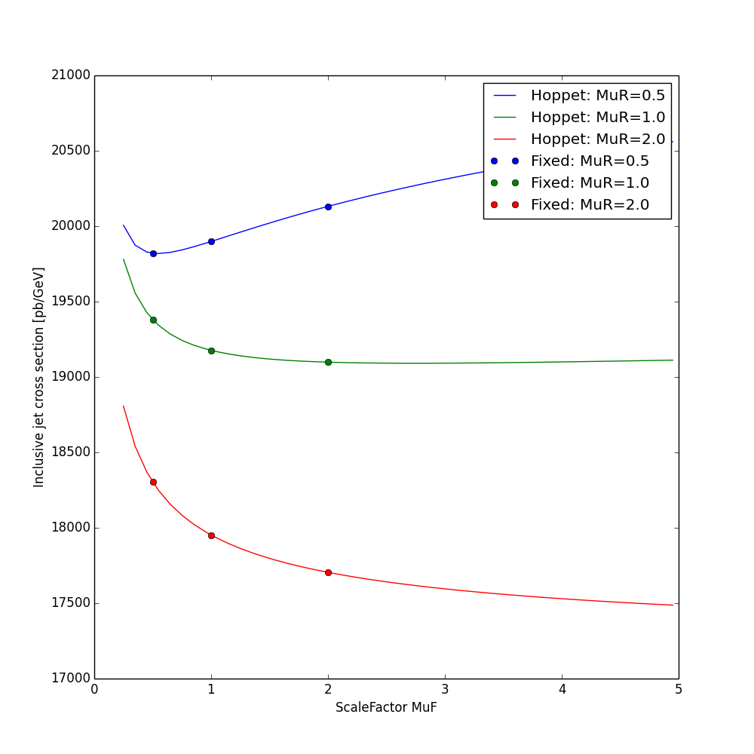
Scale variations for NLO
Renormalization scale variations at NLO
  Standard method:
  RGE → LO matrix element times nβ0ln(cr)
  Flexible-scale:
  using scale-independent weights
  ω(μR,μF) = ω0 + log(μR) ωR + log(μF) ωF
Factorization scale variations at NLO
  Store coefficient for given set of
  scale factors
  Flexible-scale
  Calculate LO DGLAP splitting functions
  with HOPPET
Cross section [pb/GeV]
Scale factor

Slide 5
Scale variations for NNLO
In General: NLO splitting functions are needed for
factorization scale variations → slow
Flexible scale: analogous to NLO + NNLO terms
using scale-independent weights → additional weights
ω(μR,μF) = ω0 + log(μR) ωR + log(μF) ωF
+ log²(μR²) ωRR + log²(μF²) ωFF + log(μR²) log(μF²) ωRF
Advantages
  Vary mR, mF independently and by any factor
  NLO splitting functions are not needed
fastNLO implementation:
  Two different observables can be used for the scales
  Any function of these two observables can be used
  for calculating scales

Slide 6
fastNLO Toolkit
Easy integration into NLO / NNLO Programs
fastNLOCreate fnlo(“steering.str“);
fnlo.SetOrderOfCalculation(int order)
fnlo.fEvent.SetProcessID(int id);
fnlo.fEvent.SetWeight(double w);
fnlo.fEvent.SetX1(double x1);
fnlo.fEvent.SetX2(double x2);
fnlo.fScenario.SetObservable0(double pt);
fnlo.fScenario.SetObsScale1(double s1);
fnlo.Fill();
fnlo.SetNumberOfEvents(double nevents);
fnlo.WriteTable();
Init
Monte-Carlo
Event loop
End

Slide 7
Analysis Workflow
Tomorrow in WG4: Fast evaluation of theoretical
uncertainties with Sherpa and Mcgrid → E. Bothmann
NLO / NNLO Monte Carlo
Event Generator
Event Analysis
Table
Generation
fastNLO
table
NJet
Sherpa
Rivet
+
MCgrid
fastNLO
toolkit
Blackhat
...
fastNLO
toolkit
nloJet++
fastNLO
Native
Analysis
DiffTop
User
Analysis
...
...
...

Slide 8
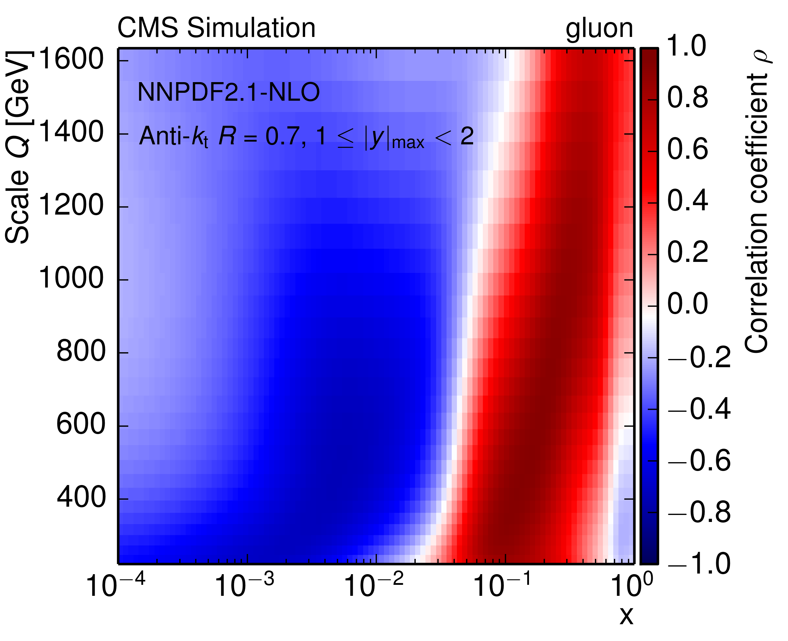
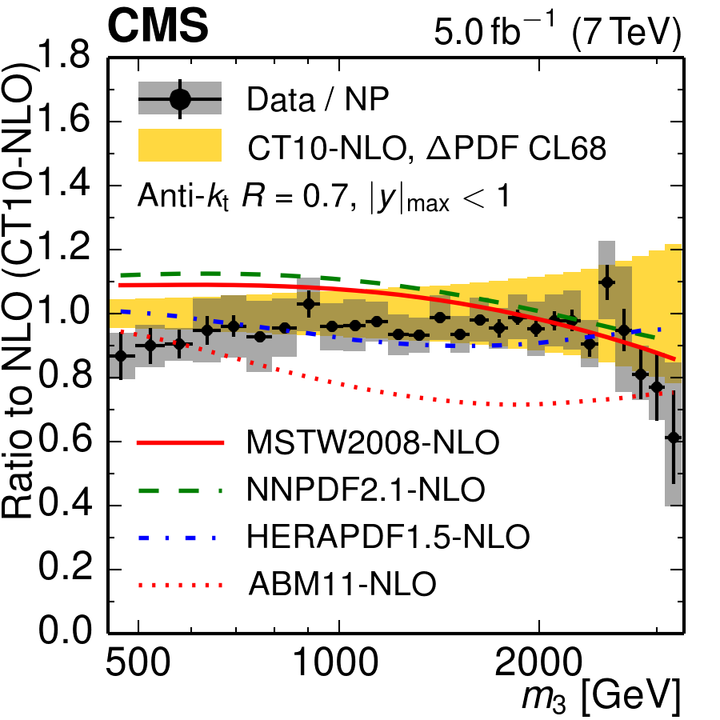
Reading tables
from fastnlo import fastNLOLHAPDF
import numpy
fnlo = fastNLOLHAPDF('fnlotable.tab')
fnlo.SetLHAPDFFilename('CT10nlo.LHgrid')
fnlo.SetLHAPDFMember(0)
mufs = np.arange(0.1, 1.5, 0.10)
murs = np.arange(0.1, 1.5, 0.10)
xs = np.zeros((mufs.size, murs.size))
for i, muf in enumerate(mufs):
for j, mur in enumerate(murs):
fnlo.SetScaleFactorsMuRMuF(mur, muf)
fnlo.CalcCrossSection()
xs[i][j] = np.array(fnlo.GetCrossSection())[0]
Access Tables with
Python or C++
Generate yoda output
with fnlo-tk-yodaout
(with contributions by Stefanos Tyros)
Foreseen to be used in MCplots.
LHAPDF 5 / 6
Different αs Evolution codes available

Slide 9
Example – DiffTop analysis:
NNLO Accuracy with fastNLO
Differential ttbar in approx.
NNLO: dσ/dpT , dσ/dy
Uncertainties:
  PDF, scale, αs, mt
  786 variations needed
Precision study of
fastNLO tables over
standalone DiffTop
vs. no. of x nodes
Perfect agreement for probed x-range
of 2 ·10-3 < x < 1

Slide 10
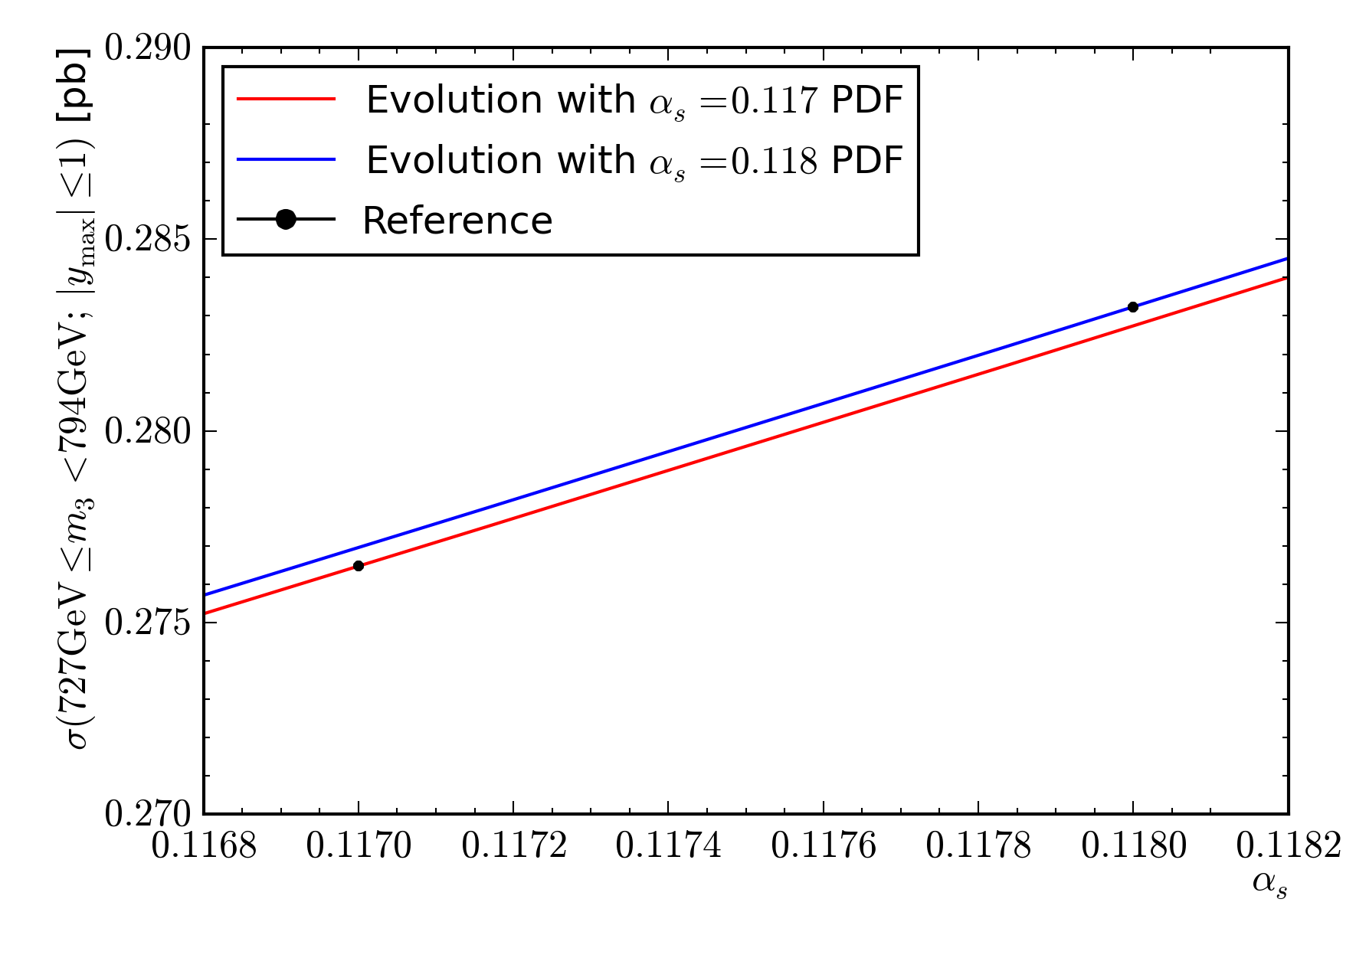
Precision measurement of αS(MZ):
Three-Jet Mass Cross Section - Interpolation
fastNLO allows to use user defined αS evolution codes during the evaluation of the coefficient tables
Not limited to the αS values supplied by the PDF set anymore
  This enables the use of proper minimizer libraries like Minuit2 when fitting αS
Two common :
  Interpolation:
    Interpolate between
    two adjacent αS points
  Extrapolation:
    Some observables with
    large scale uncertainties
    can reach the edge of
    the αS series of the PDF.

Slide 11
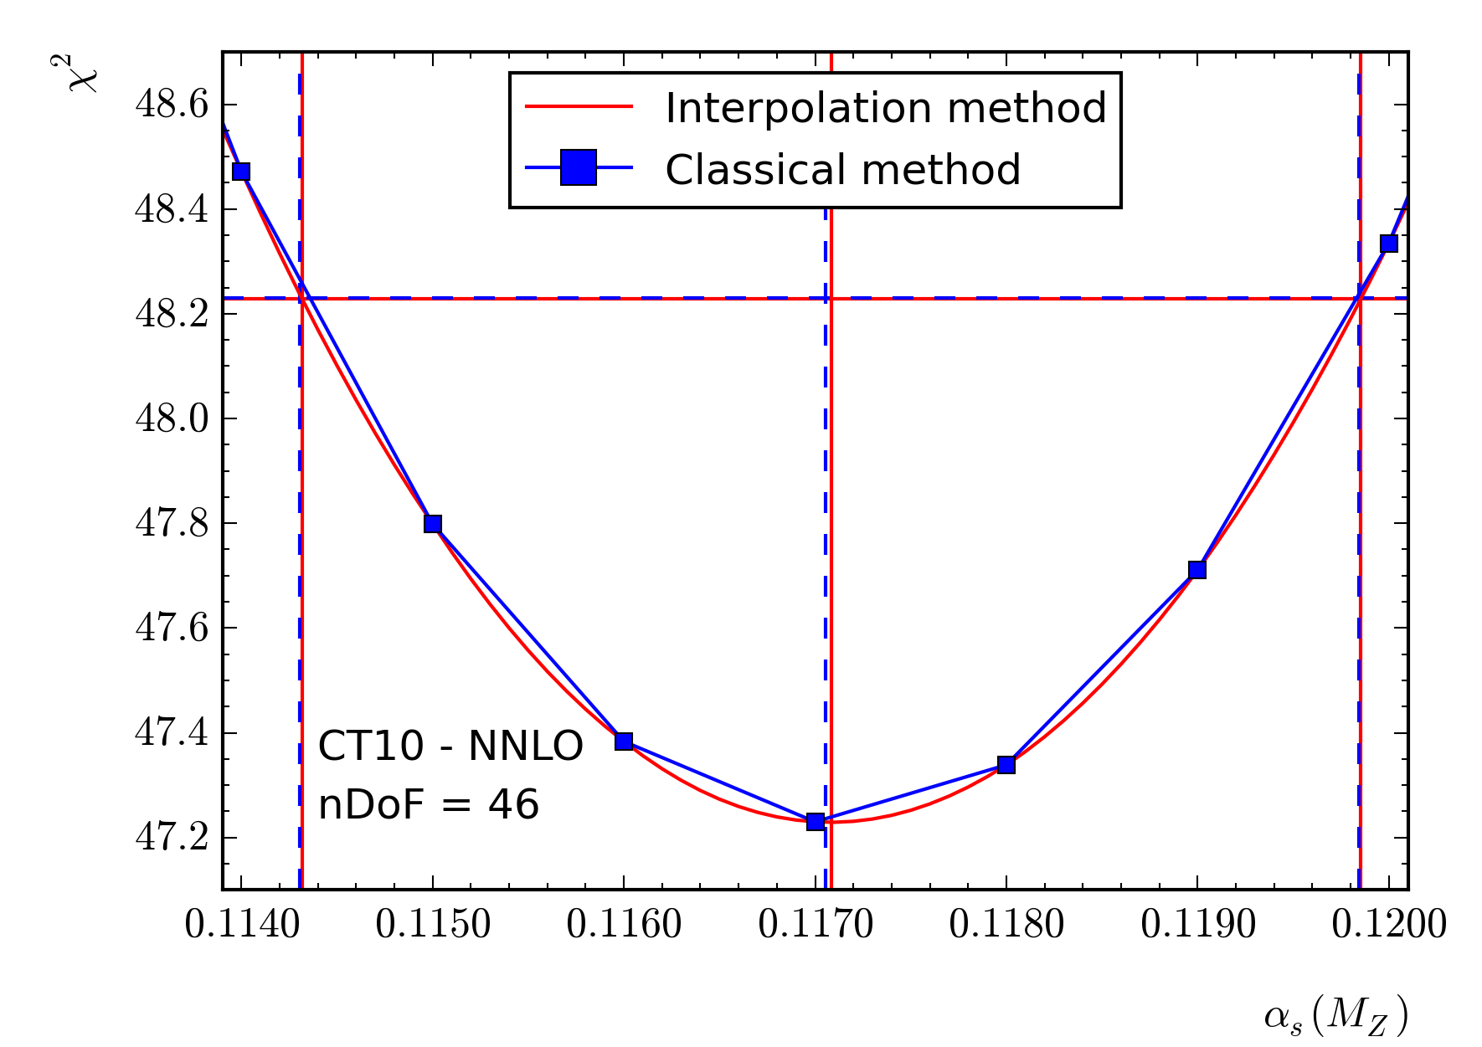
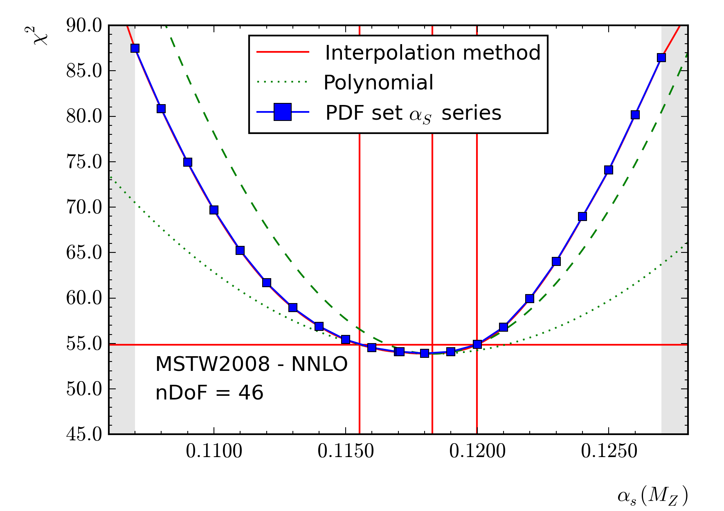
Precision measurement of αS(MZ):
Three-Jet Mass Cross Section - Interpolation
For simple cases, there is good agreement between the interpolation method and the classical parameterization method
For more complicated situations, in particular with very asymmetric PDF uncertainties, the interpolation method avoids all parameterization related issues

Slide 12
New public release
fastNLO toolkit
  Support for MCgrid (> v1.2) and Sherpa (including all NLO processes available via this chain)
  fnlo-tk-yodaout (with contributions by Stefanos Tyros) for YODA-formatted output
  Triple differential observable Binnings are supported
  Convenience functions to derive scale uncertainties
  fnlo-tk-config executable is provided for easier compiling/linking
  Doxygen documentation
fastNLO interface to NLOJet++
  Updated to work with new toolkit prerelease
  Major simplification in NLOJet++ usage – many use cases possible without code changes
    InclusiveNJets - one entry per jet of an event
    InlusiveNJetsEvent - one entry per event.
  Steering files to reproduce calculations for numerous published cross sections
fastNLO reader (compatibility update)
  Adapted to new fastNLO_toolkit
  Up to 3-dimensional binnings are supported
  7 subprocesses for LO hh->jets as used in toolkit is supported
  Internally used cross section units are rescaled to published units

Slide 13
Summary and Outlook
New public release of the fastNLO toolkit this week
Toolkit provides all necessary functions to create and evaluate fast interpolation tables in the fastNLO format
Number of interfaced NLO / NNLO theory programs steadily increasing (via MCgrid or direct interface)
Fast and accurate evaluation of NLO / NNLO calculations with flexible scales / different as evolutions open up new possibilities for analysis
Large scale production effort underway to produce
tables for published results – will be available on
fastnlo.hepforge.org

