Slide 1


CMS PDF Forum
Toolkit
Daniel Britzger, Klaus Rabbertz, Georg Sieber, Fred Stober, Markus Wobisch
(DESY, KIT * 3, Louisiana Tech University)

Slide 2
The fastNLO concept
Use interpolation kernel
  - Introduce set of n discrete x-nodes, x_{i}'s being equidistant in a function f(x)
  - Take set of Eigenfunctions E_{i}(x) around nodes x_{i}
  → Interpolation kernels
  - Actually a rather old idea, see e.g.
C. Pascaud, F. Zomer (Orsay, LAL), LAL-94-42
→ Single PDF is replaced by a linear combination of interpolation kernels
  → Then the integrals are done only once
  → Afterwards only summation required to change PDF
Store a table with the convolution of the pert. coefficients with the interpolation kernel

Slide 3
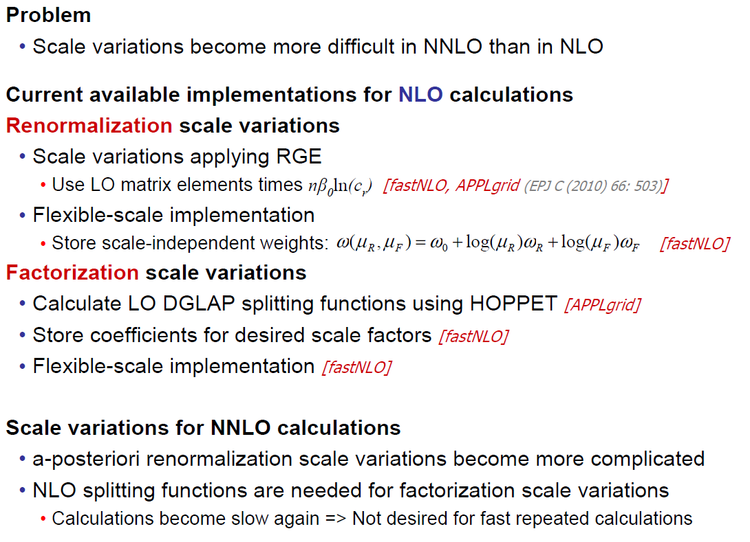
Calculations with fastNLO in NNLO
Georg:
[new: also fastNLO]

Slide 4
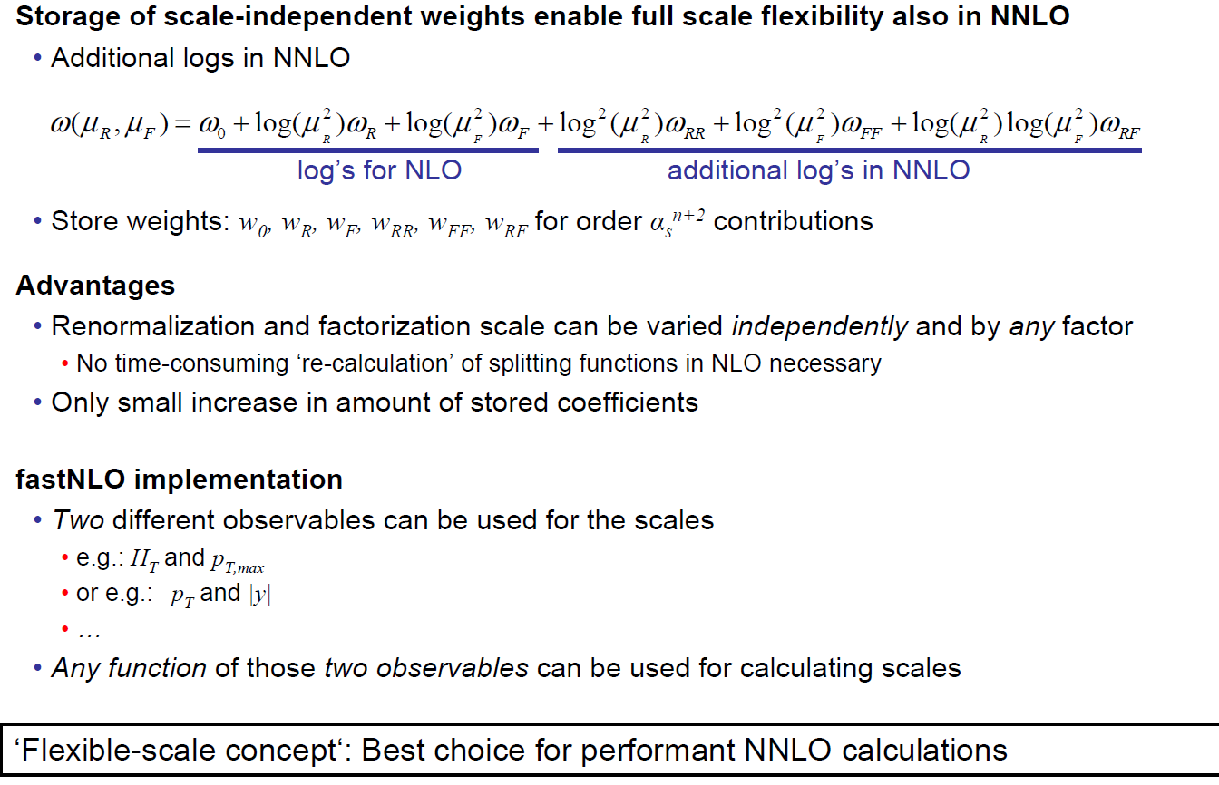
Flexible-scale implementation in NNLO

Slide 5
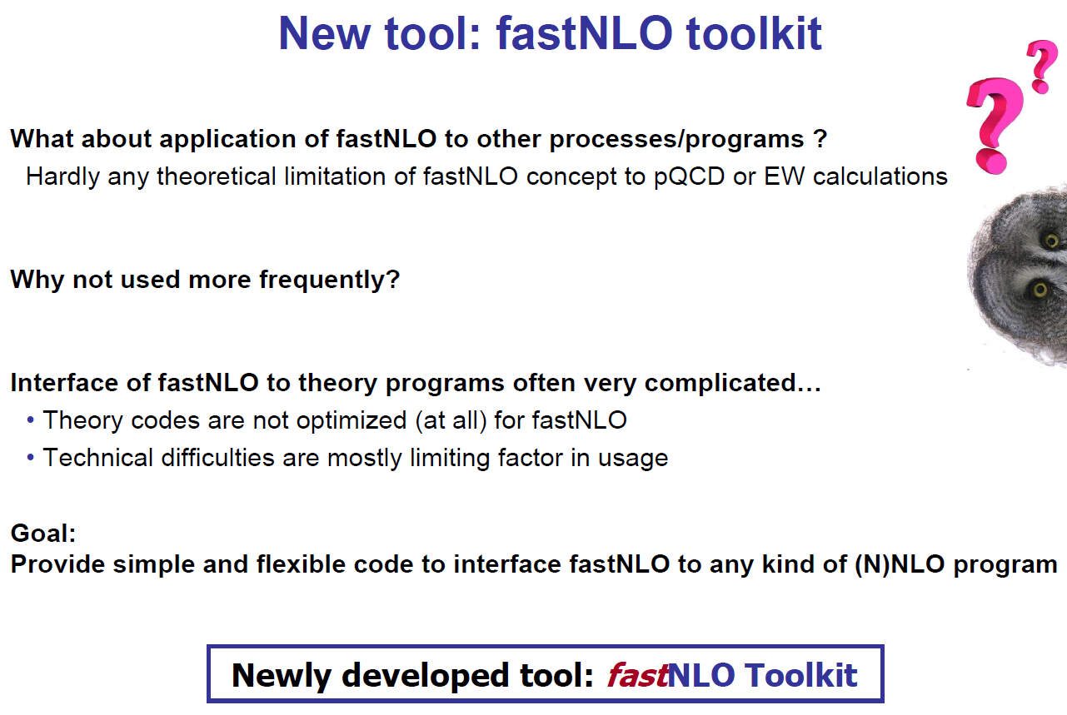
How to use elsewhere ?

Slide 6
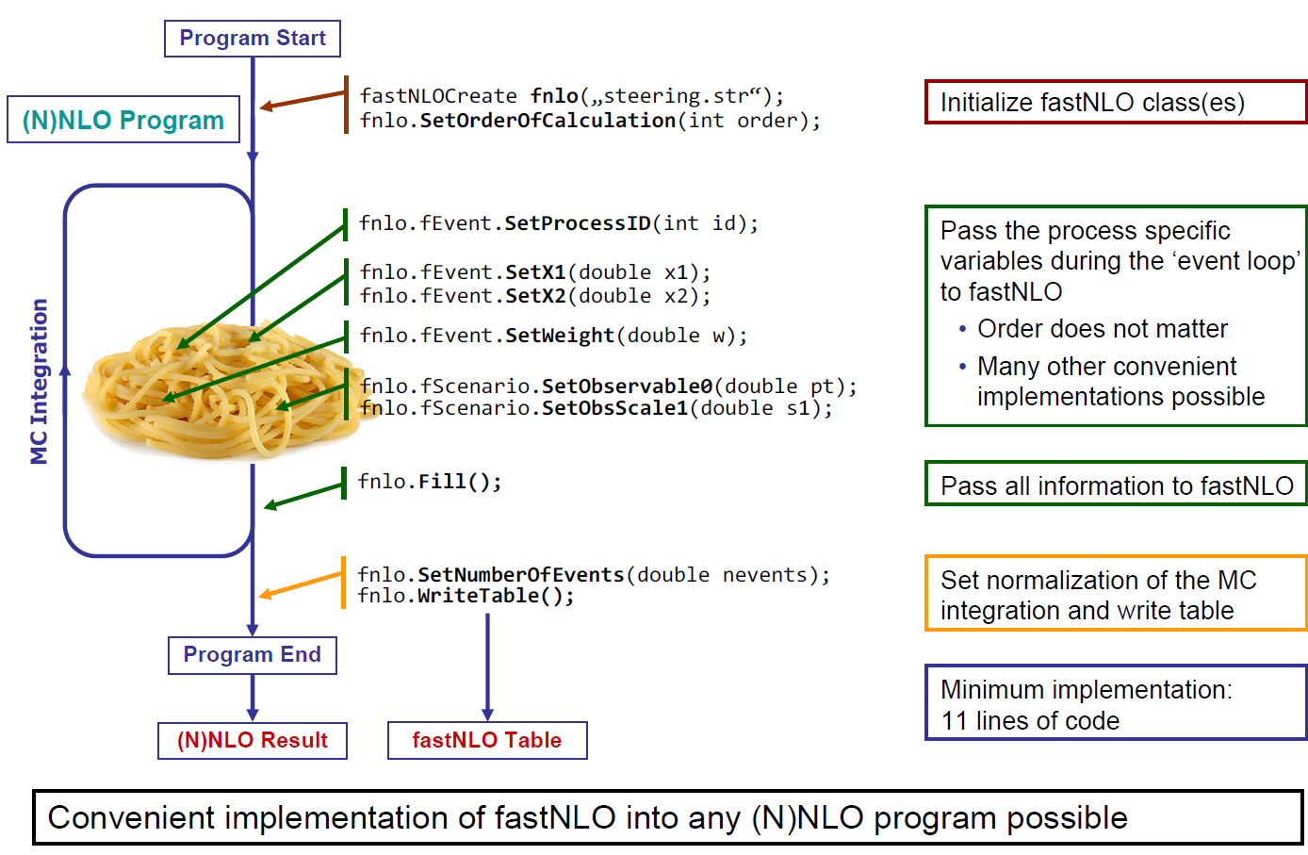
Toolkit working concept

Slide 7


Plans from last October
  1. Cross check old v1.4 versus new v2.1 tables … Done!
  2. Cross check new reader code in C++ vs. Fortran … Done!
  3. Public release of reader code as autotools tarball … Done!
  4. Transform C++ reader code into linkable library … Done!
  5. Transform table creation code into linkable library as independent as possible from NLOJet++!
  In progress, first test version exists.
  Make interface available for other N?LO codes.
All done by now!

Slide 8
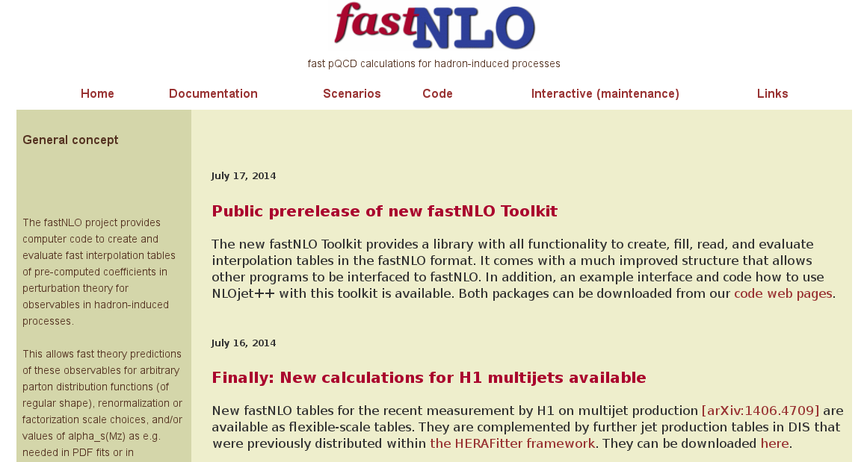
Public prerelease of fastNLO Toolkit

Slide 9
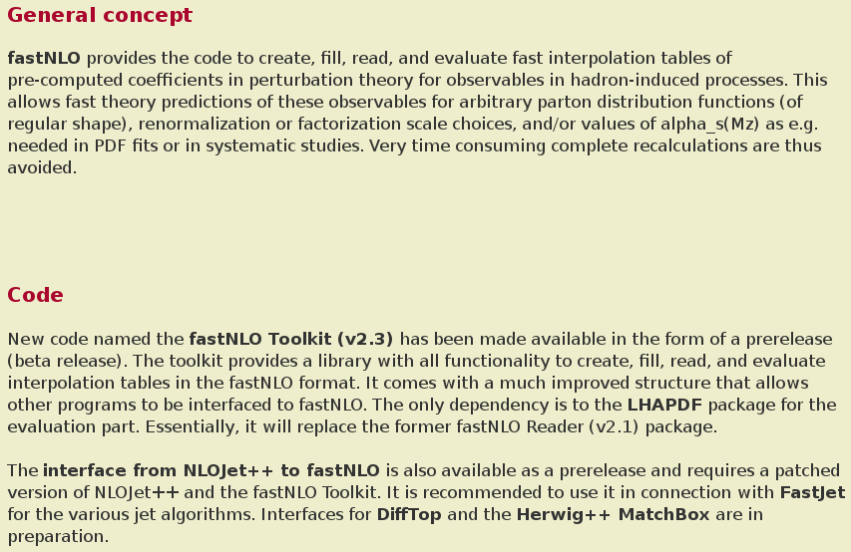
fastNLO code page

Slide 10
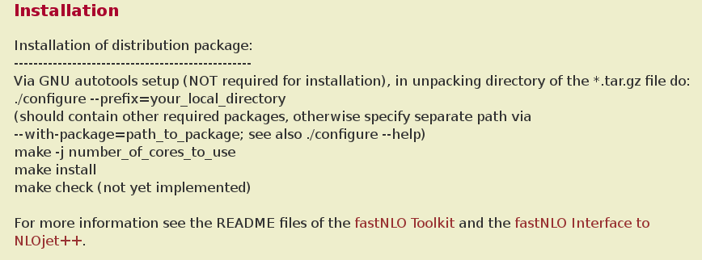
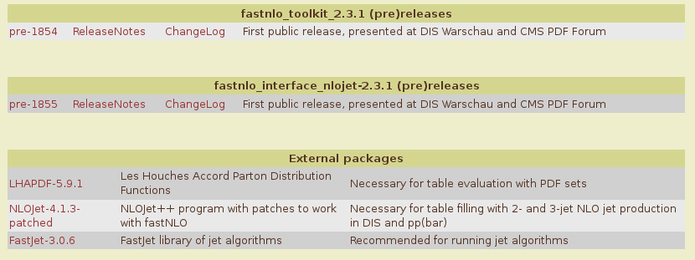
fastNLO code v23 pages

Slide 11
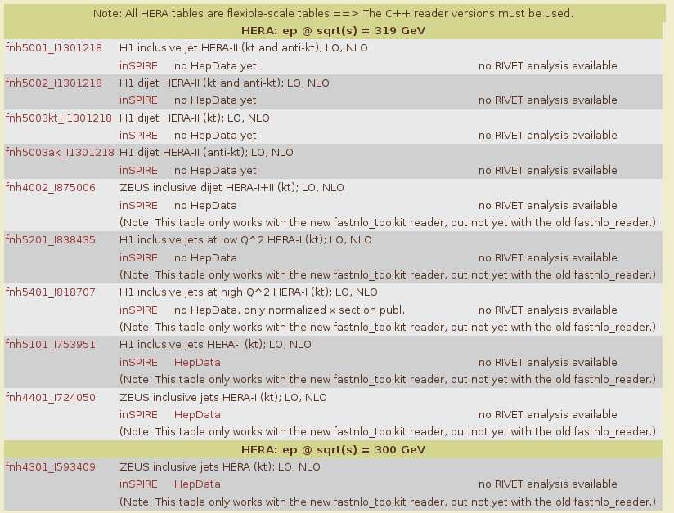
Toolkit in use
New tables from
Daniel for recent
H1 multi-jet study!

Slide 12
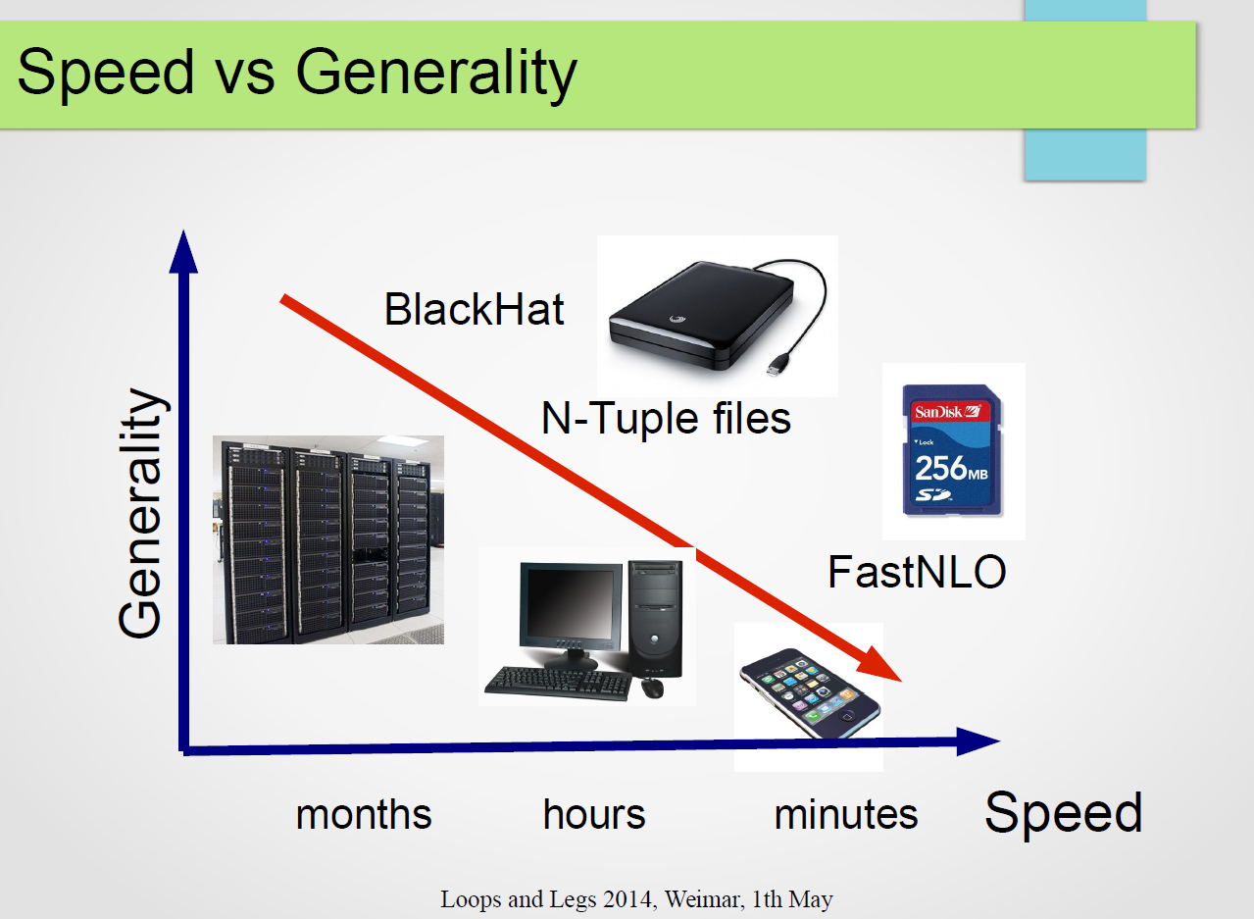
Toolkit in use
Fill BlackHat
parton events
(N-tuple files)
into fastNLO
table
Slide from Daniel Maitre

Slide 13
Toolkit in use
Toolkit interfaces:
  1. Prerelease for NLOJet++ public since TODAY!
  2. Interface to DiffTop exists, see next talk by Marco Guzzi
  3. Interface to the Herwig++ MatchBox with many additional processes, e.g. via MadGraph, Njet, ... is in progress
  4. Would be interesting to test usage in aMCfast, which is possible according to Juan

Slide 14
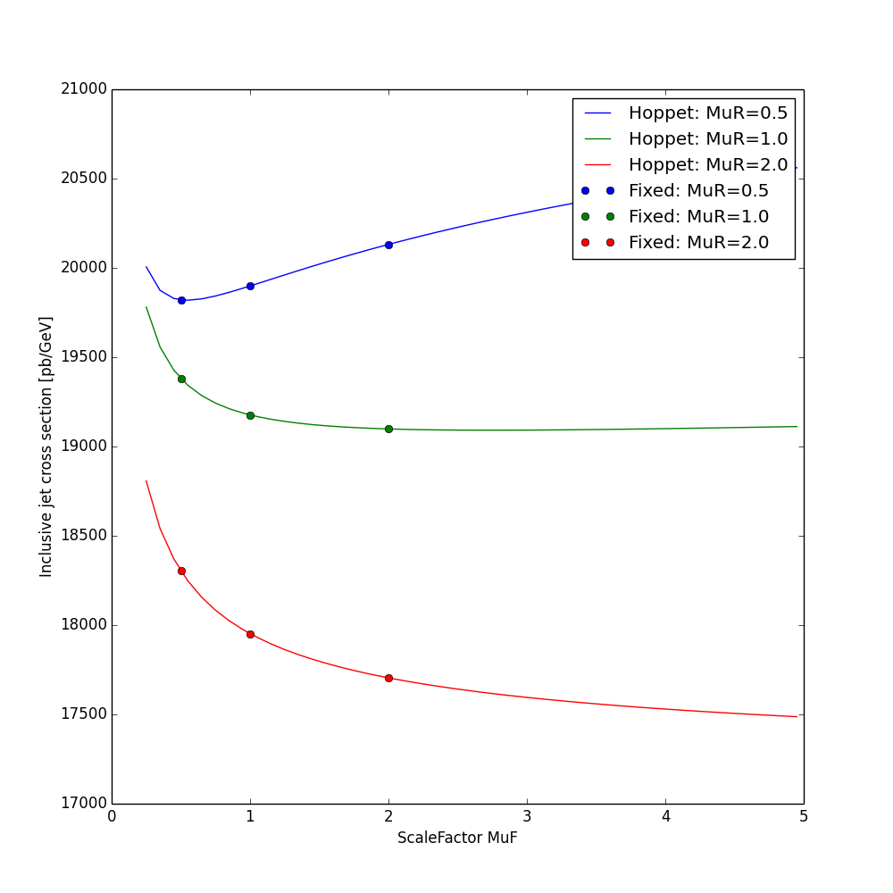
Other work in progress
Use of HOPPET for mu_f variation
Not used in fastNLO
up to now, but in
APPLGRID.
Needs a bit less
storage space but
requires additional
CPU time for each
Table evaluation.
More difficult at NNLO.
Lines derived
with HOPPET
Points from
fastNLO
fixed-scale
tables

Slide 15
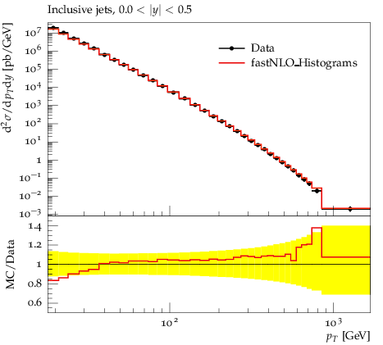
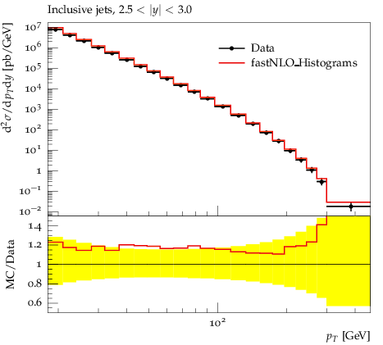


Other work in progress
Summer student project (Stefanos Tyros) with Peter Skands:
  1. Provide YODA formatted output for fastNLO tables Works!
  2. Compare histograms with data using Rivet analyses … OK!
  3. Implement fastNLO tab into development version of MCPlots page … in progress

Slide 16


Outlook
A prerelease of the fastNLO Toolkit is publicly available since TODAY!
The toolkit provides full capability to create, fill, read, and evaluate fast interpolation tables in the fastNLO format
Other theory programs can be interfaced
Works at NNLO ==> well prepared for jets at NNLO
An interface to NLOJet++ is publically available as well ==> Do your own NLO tables!
In case of question, problems, or requests don't hesitate to contact us!
Much more additional integration work and ideas are in progress ...
Your feedback is welcome

