Slide 1

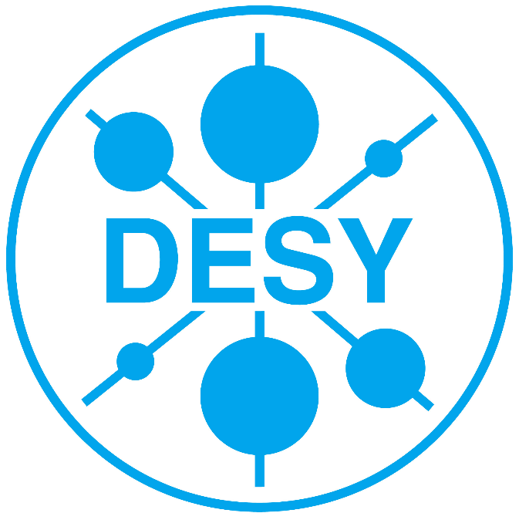
The fastNLO Collaboration
Daniel Britzger, Thomas Kluge, Klaus Rabbertz,
Fred Stober, Markus Wobisch
(DESY, Liverpool, KIT, KIT, Louisiana Tech)
v2
QCD@LHC 2012
August 23 2012

Slide 2
Outline
Motivation
FastNLO concept
New features of fastNLO v2
Generalized concept in fastNLO v2
Example application of flexible scale format
Jet production in diffractive DIS
Outlook

Slide 3
Motivation
Interpretation of experimental data relies on
  Availability of reasonably fast theory calculations
  Often needed: Repeated computation of same quantitites
Examples for a specific analysis
  Use of various PDFs (CTEQ, MSTW, NNPDF, HERAPDF, ABM,…) for data/theory comparison
  Determine PDF uncertainties
  Use data set in fit of PDFs or α_{s}
  Derivation of scale uncertainties
  Comparision to different scale choices
Sometimes NLO or even NNLO predictions can be computed fast
But some are very slow
  e.g. Jet cross sections, Drell-Yan, …
Need procedure for fast repeated computations of higher order cross sections

Slide 4
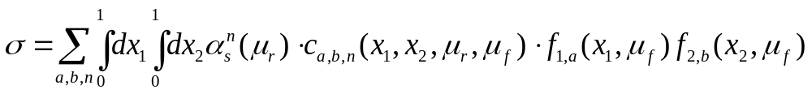
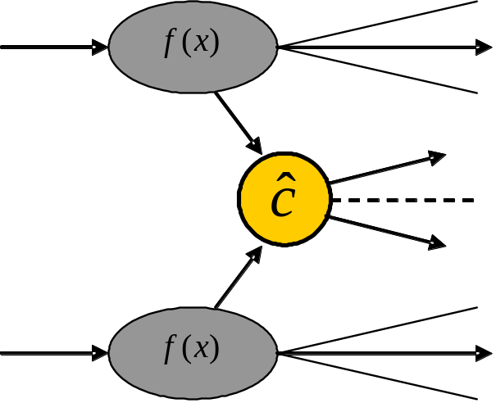
NLO QCD cross section
Jet production in hadron-hadron collisions
  Jet cross section calculations are time consuming
  strong coupling α_{s} in order n
  PDFs of two hadrons f₁, f₂
  Parton flavors a, b
  perturbative coefficent c_{a,b,n}
  renormalization and factorization scales
  momentum fractions x
PDF and α_{s} are external input
Perturbative coefficients are independent from PDF and α_{s}
Idea: Factorize the PDFs and α_{s}

Slide 5
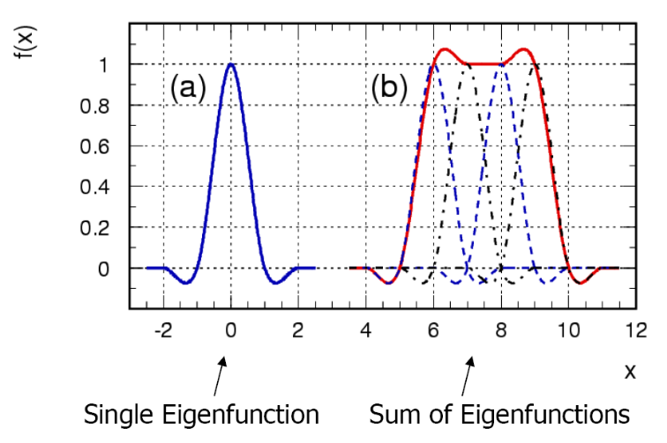
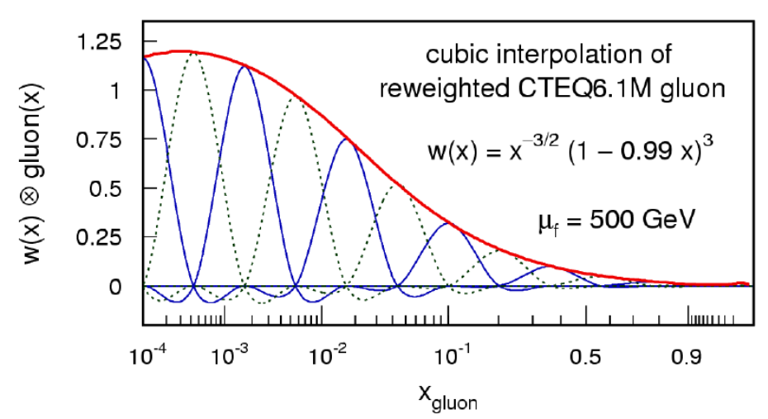
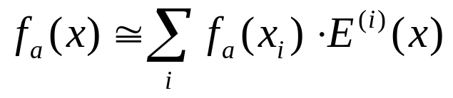
The fastNLO concept
Introduce interpolation kernel
  Introduce set of n discrete x-nodes x_{i}'s being equidistant in a function f(x)
  Take set of Eigenfunctions E_{i}(x) around nodes x_{i}
  -> interpolation kernels
Single PDF is replaced by a linear combination of interpolation kernels
  Improve interpolation by reweighting PDF
LAL 94-42
Scale dependence
  Introduce interpolation procedure also for scales
  Scale gets own dimension and look-up table
Store a table with the convolution of the pert. coefficients with the interpolation kernel

Slide 6

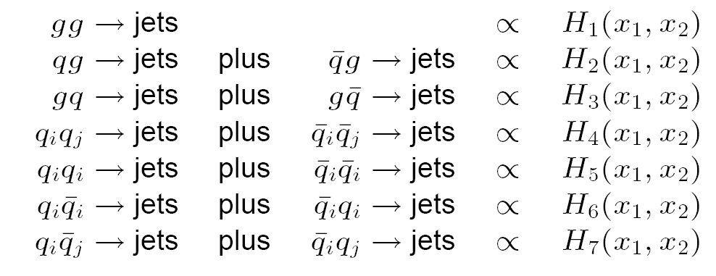
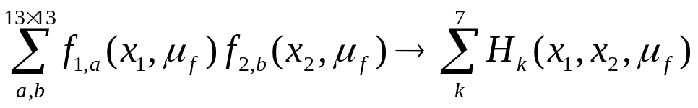
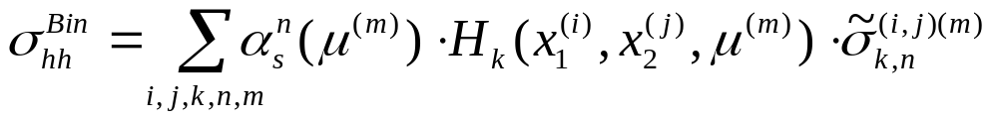
fastNLO for hadron-hadron collisions
Hadron-hadron collisions
  2D interpolation kernels
  Symmetries of matrix elements
  13×13 partonic subprocesses reduce to 7
Final fastNLO cross sections
    Compute σ-table in each bin and store it in fastNLO table
    Contains all information on the observable
Final cross section formula

Slide 7
Application procedure
Theory prediction
  Concept does not include the theoretical calculation itself
  Requires existing computer code, e.g.
    NLOJET++ (Z. Nagy PRD68 2003, PRL88 2002)
    Threshold corrections (Kidonakis, Owens, PRD 63, 054019 (2001))
Application procedure
  During the first computation no time is saved
  Perform calculations with very high statistics
  10¹⁰ – 10¹¹ NLO events -> up to several years of CPU time
  Any further recalculations take only O(ms)
Can be used for any observable in hadron-induced processes
  Hadron-hadron, DIS, photoproduction, fragmentation functions …
// FastNLO example code in c++ for reading CMS incl.
// jets (PRL 107 (2011) 132001) with CT10 PDF set
FastNLOLHAPDF fnlo("fnl1014.tab","CT10.LHgrid",0);
fnlo.PrintCrossSections();
==================================================================================================================================
Cross Sections
The scale chosen here are: mu_f = 1.000 * pT_jet_[GeV], and mu_r = 1.000 * pT_jet_[GeV]
----------------------------------------------------------------------------------------------------------------------------------
IObs Bin Size IODim1 [ pT_[GeV] ] IODim2 [ |y| ] LO cross section NLO cross section K NLO K NPC
----------------------------------------------------------------------------------------------------------------------------------
1 3.000 1 18.00 21.00 1 0.00E+00 5.00E-01 1.55277802824E+07 1.63811325684E+07 1.05496 1.40000
2 3.000 2 21.00 24.00 1 0.00E+00 5.00E-01 8.30682860853E+06 8.77287665130E+06 1.05610 1.38000
3 4.000 3 24.00 28.00 1 0.00E+00 5.00E-01 4.41134160762E+06 4.62463577873E+06 1.04835 1.32000
4 4.000 4 28.00 32.00 1 0.00E+00 5.00E-01 2.30882413125E+06 2.47472392075E+06 1.07185 1.23000
5 5.000 5 32.00 37.00 1 0.00E+00 5.00E-01 1.22487109201E+06 1.30677111896E+06 1.06686 1.16000
6 6.000 6 37.00 43.00 1 0.00E+00 5.00E-01 6.18412283065E+05 6.58015663350E+05 1.06404 1.12000
7 6.000 7 43.00 49.00 1 0.00E+00 5.00E-01 3.18610165168E+05 3.42097336205E+05 1.07372 1.10000
8 7.000 8 49.00 56.00 1 0.00E+00 5.00E-01 1.69694938829E+05 1.82786902463E+05 1.07715 1.09000
9 8.000 9 56.00 64.00 1 0.00E+00 5.00E-01 8.88506455202E+04 9.52323847828E+04 1.07183 1.07000
10 10.00 10 64.00 74.00 1 0.00E+00 5.00E-01 4.48760868947E+04 4.82703440385E+04 1.07564 1.06000
11 10.00 11 74.00 84.00 1 0.00E+00 5.00E-01 2.26829562240E+04 2.43722369908E+04 1.07447 1.05000
12 13.00 12 84.00 97.00 1 0.00E+00 5.00E-01 1.14507422191E+04 1.24049331317E+04 1.08333 1.04000
13 17.00 13 97.00 114.0 1 0.00E+00 5.00E-01 5.23097360990E+03 5.67721041625E+03 1.08531 1.03000
14 19.00 14 114.0 133.0 1 0.00E+00 5.00E-01 2.28063559003E+03 2.48513079140E+03 1.08967 1.03000
15 20.00 15 133.0 153.0 1 0.00E+00 5.00E-01 1.03505174962E+03 1.13314049111E+03 1.09477 1.03000
16 21.00 16 153.0 174.0 1 0.00E+00 5.00E-01 4.96802383700E+02 5.46247174813E+02 1.09953 1.03000
17 22.00 17 174.0 196.0 1 0.00E+00 5.00E-01 2.49815289171E+02 2.75364800692E+02 1.10227 1.03000
18 24.00 18 196.0 220.0 1 0.00E+00 5.00E-01 1.29012893548E+02 1.42599549941E+02 1.10531 1.03000
19 25.00 19 220.0 245.0 1 0.00E+00 5.00E-01 6.80355225457E+01 7.55493261942E+01 1.11044 1.03000
20 27.00 20 245.0 272.0 1 0.00E+00 5.00E-01 3.67048355857E+01 4.09487347532E+01 1.11562 1.03000
21 28.00 21 272.0 300.0 1 0.00E+00 5.00E-01 2.01613029168E+01 2.25604162288E+01 1.11900 1.02000
22 30.00 22 300.0 330.0 1 0.00E+00 5.00E-01 1.12824854482E+01 1.26866111428E+01 1.12445 1.02000
23 32.00 23 330.0 362.0 1 0.00E+00 5.00E-01 6.35845842969E+00 7.17233587864E+00 1.12800 1.02000
24 33.00 24 362.0 395.0 1 0.00E+00 5.00E-01 3.63706128628E+00 4.12851783408E+00 1.13512 1.02000
25 35.00 25 395.0 430.0 1 0.00E+00 5.00E-01 2.11227877473E+00 2.40602532981E+00 1.13907 1.02000
26 38.00 26 430.0 468.0 1 0.00E+00 5.00E-01 1.22524458697E+00 1.40203526441E+00 1.14429 1.01000
27 39.00 27 468.0 507.0 1 0.00E+00 5.00E-01 7.14187420152E-01 8.19893199048E-01 1.14801 1.01000
28 41.00 28 507.0 548.0 1 0.00E+00 5.00E-01 4.21748162421E-01 4.88300824898E-01 1.15780 1.01000
29 44.00 29 548.0 592.0 1 0.00E+00 5.00E-01 2.48791400377E-01 2.88852906110E-01 1.16102 1.01000
30 46.00 30 592.0 638.0 1 0.00E+00 5.00E-01 1.46515601054E-01 1.71074985050E-01 1.16762 1.01000
31 48.00 31 638.0 686.0 1 0.00E+00 5.00E-01 8.66490094287E-02 1.01902201541E-01 1.17603 1.01000
32 51.00 32 686.0 737.0 1 0.00E+00 5.00E-01 5.11700908830E-02 6.04966189129E-02 1.18227 1.01000
33 109.0 33 737.0 846.0 1 0.00E+00 5.00E-01 2.37402790440E-02 2.83054753812E-02 1.19230 1.01000
34 838.0 34 846.0 1684. 1 0.00E+00 5.00E-01 1.78674955347E-03 2.17513026527E-03 1.21737 1.01000
35 3.000 1 18.00 21.00 2 5.00E-01 1.00E+00 1.50754366012E+07 1.60609009301E+07 1.06537 1.40000
36 3.000 2 21.00 24.00 2 5.00E-01 1.00E+00 8.05442518090E+06 8.54078421141E+06 1.06038 1.32000
37 4.000 3 24.00 28.00 2 5.00E-01 1.00E+00 4.26021653062E+06 4.54082512372E+06 1.06587 1.22000
Although labeled “fastNLO” method can be used at any order

Slide 8
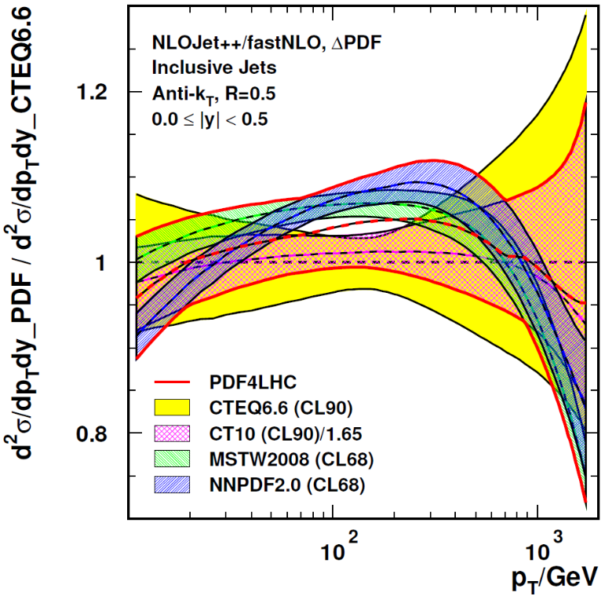
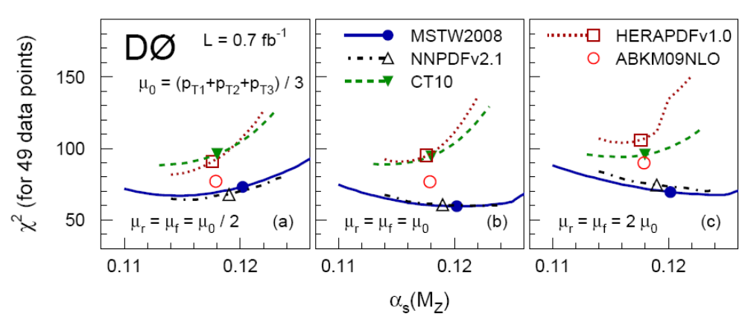
Example Applications
CMS inclusive jets
    Study of PDF dependence
    Determination of PDF envelopes
    PDF-error prediction à la PDF4LHC
D0 three-jet invariant mass
    Study of PDF dependence
    Study of scale dependence
    μ_{r}= μ_{f} = (p_{T1}+ p_{T1} +p_{T1})/3
    μ = 2.0 × μ_{o}
    μ = 0.5 × μ_{o}
    Study of α_{s} dependence using
    α_{s} dependent PDF sets
PLB 704 (2011) 434-441
239 repeated NLO calculations
3138 repeated NLO calculations

Slide 9
New in version 2.0
Features of pre-computed fastNLO tables
  Automatic adjustment of phase space boundaries
  Flexible # x-nodes for analysis bins
  Improved interpolation in ren./fact. scales
  Arbitrary number of dimensions for binning of observable
Features of fastNLO reading tools
  Comprehensive α_{s} evolutions provided
    2-,3-,4-loop iterative solution, flavor matching ON/OFF, etc…
    Interface to external α_{s} evolutions
    e.g. LHAPDF, QCDNUM, etc…
    Interface to CRunDec (arXiv:1201.6149v1, arXiv:hep-ph/0004189v1)
  Interface to PDFs from LHAPDF and QCDNUM
    easy implementation of new interfaces
  Easy to install (autotools)
  Easy to implement in fitting codes and to interface PDFs
  Independent C++ and Fortran versions
    agreement at double precision O(10⁻¹⁰)
FastNLO Table
FastNLO
Reader
Reader_f
Reader_cc
No further dependencies (No ROOT, No CERNLIB, etc…)

Slide 10
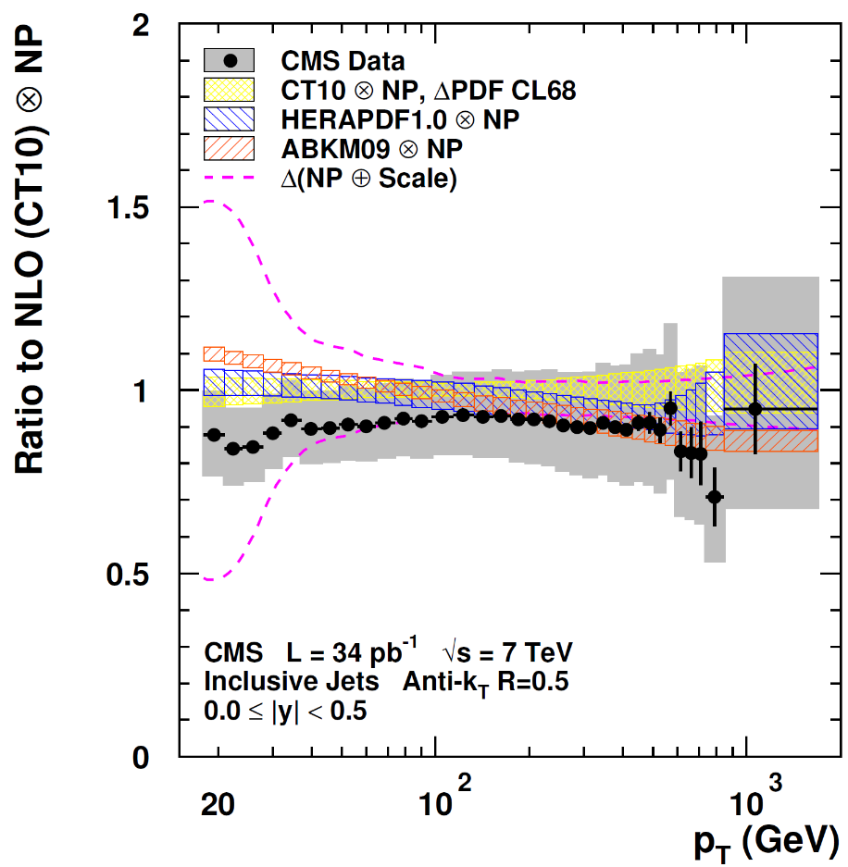
Flexible table format in fastNLO 2.0
CMS Note-2011-004
Format foresees
  Fixed orders (LO, NLO, NNLO,…)
  Threshold corrections
    2-loop for inclusive jets available
  Electroweak corrections
  New physics contributions
  Correction factors
    Non-perturbative corrections
    With uncertainties
  Data
    Including correlated and uncorrelated uncertainties
    Correlation matrix
Conversion tool for v1.4 tables

Slide 11
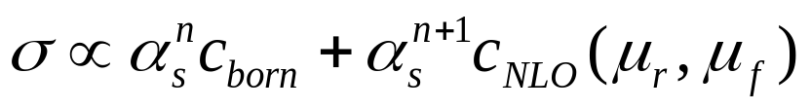

Scale flexibility in fastNLO v2.0
Perturbative coefficients beyond LO have scale dependence
Scale dependence can be factorized
Store individual scale independent coefficients
Scales can be arbitrary values - or functions of observables
  Scales can be functions of multiple variables e.g. p_{T} and y*
  Final scale can be chosen to be any function of both
Scales can be functions of multiple observables

Slide 12
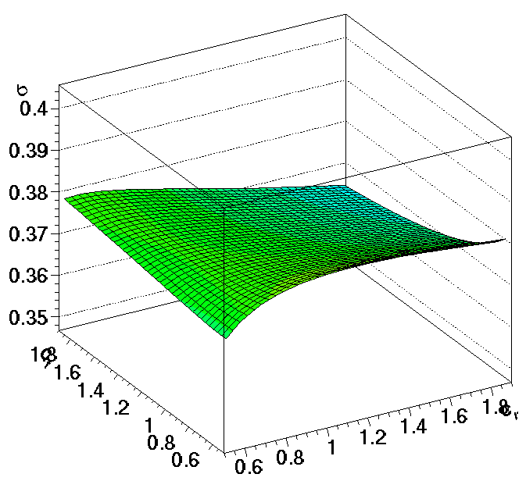
New Features for Scales
Scales can be functions of multiple observables
  e.g. for DIS jets
  Scale observables are p_{T} and Q²
  Scales can be
  μ_{r}² = (Q² + p_{T}²) / 2
  μ_{r}² = Q²
  μ_{r}² = p_{T}²
  μ_{r}² = 0.8 Q² + 0.3 p_{T}² + Q·p_{T}
Independent scale variations
of μ_{r} and μ_{f} are possible
  μ_{R}² = c²_{R} × (Q² + p_{T}²) / 2
  μ_{F}² = c²_{F} × Q²
σ [pb]
Scale factor c_{F}
Scale factor c_{R}
More flexibility for studies of scale dependencies

Slide 13
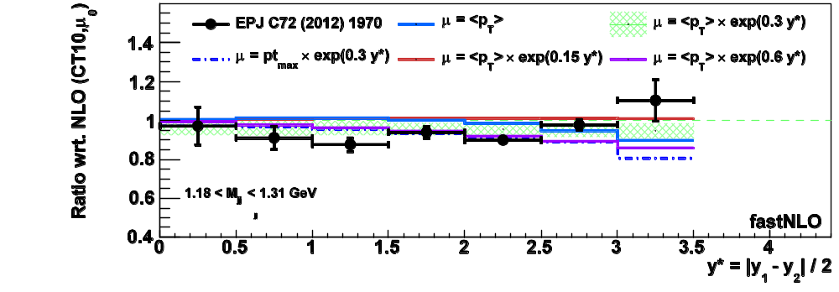

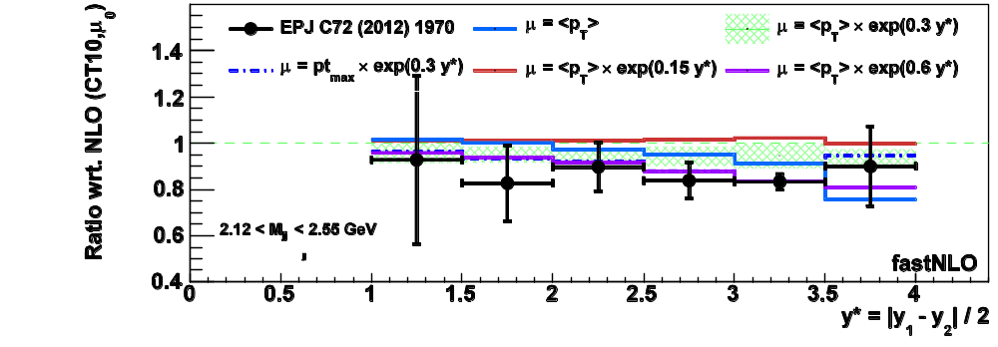

Example Study: Scale studies for ATLAS Dijets M_{jj}
ATLAS dijet invariant mass measurement, R=0.6 PRD86 (2012) 014022
  <p_{T}> and y* (or p_{T,max} and y*) are stored as scale variables in table
  Renormalization and factorization scales can be any function f = f(p_{T},y*)
Possiblity to study variations of ATLAS dijet scale choice
  Atlas choice
  where y* is a fixed factor per y*-bin
  Differentialy in y*
  Possiblity to vary parameter '0.3'
  We could any functions (e.g. cosh)
  We can e.g. find optimal scale
  e.g. á la FAC or PMS
Here
New possiblites to study the best inclusion of y* into the scales

Slide 14
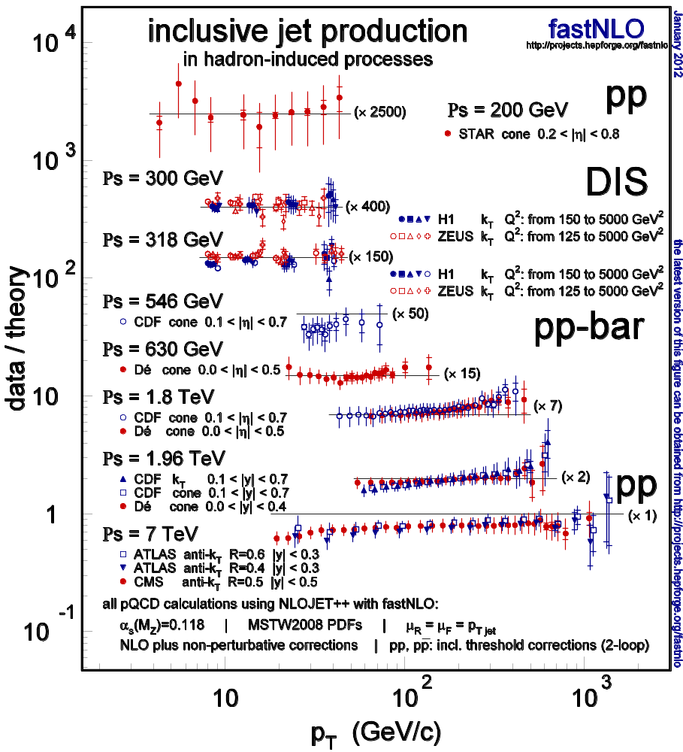
Data/Theory Comparision of Jet Cross Sections
Large number of calculations are available at
fastnlo.hepforge.org
Overview of inclusive jet data
  STAR @ RHIC
  H1 and ZEUS @ HERA
  CDF and D0 @ Tevatron
  CMS and ATLAS @ LHC
Data/theory comparision
Hadron-hadron including threshold corrections
O(2-loop)
fastNLO, arXiv:1109:1310

Slide 15
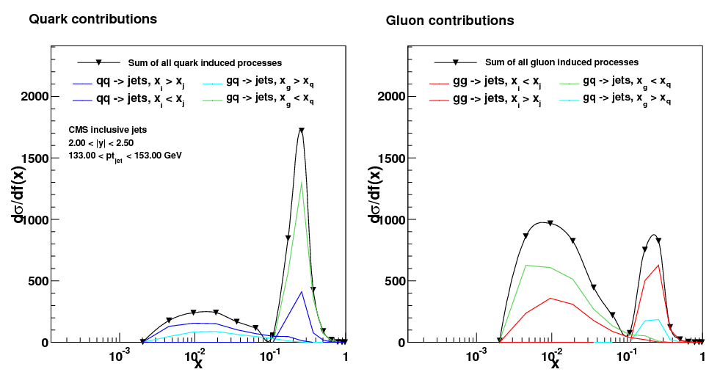
PDF sensitivity
x-dependence of cross sections
  Jet production does not distinguish between quark flavors
  We identify four subprocesses (qq, gg, gq, qg)
  Two x-values: We study x_{min} and x_{max}
  Each event contributes to x_{min} and x_{max}
CMS inclusive jets
PhysRevLett. 107.132001
  μ_{f} = p_{T}
  2.0 < |y| < 2.5
  133 < p_{T} < 153 GeV
gg -> jets
qg -> jets (x_{g} < x_{q})
gq -> jets (x_{g} > x_{q})
qq -> jets
qg -> jets (x_{g} < x_{q})
gq -> jets (x_{g} > x_{q})
Particular p_{T} bin in forward region probes two separated x-ranges

Slide 16
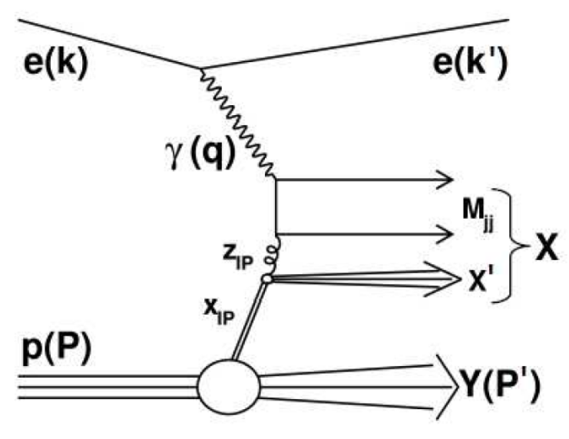
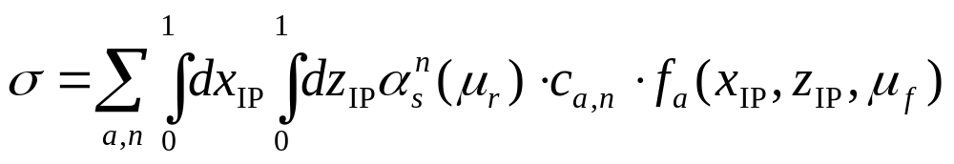
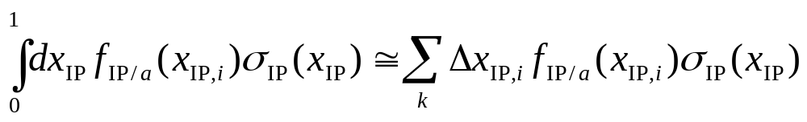
New: Jet production in diffractive DIS
Jet production in diffractive DIS (t=0)
Standard method of calculating NLO cross sections: 'Slicing method' H1-07/07-628
  Riemann-Integration of dx_{IP}
  Discretize the x_{IP} range into k bins (k~10)
  Needs Repeated cross section calculation for each slice of x_{IP}

Slide 17
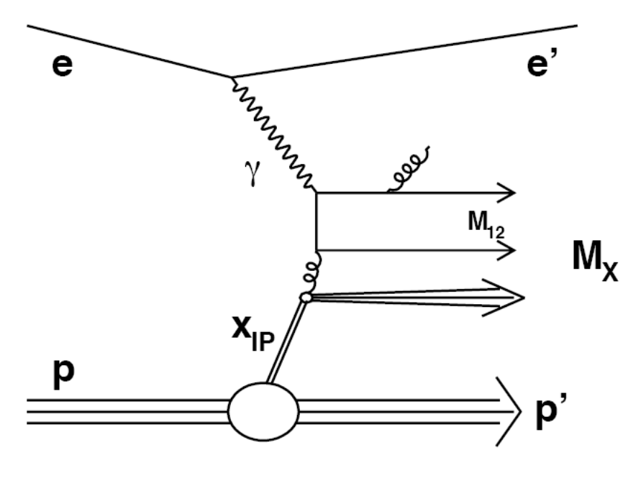
Jet production in diffractive DIS
Perturbative coefficients have only dependence on momentum fraction
  No direct dependence of the two momentum fractions x_{IP} and z_{IP}
  Each slice calculates basically same coefficients c
  Factorization is independent of incoming parton
c
μ_{f}
Perform x_{IP}-Integration a-posteriori
Calculate one fastNLO table with hadron energy = proton energy
Calculation of only a single fastNLO table is needed

Slide 18
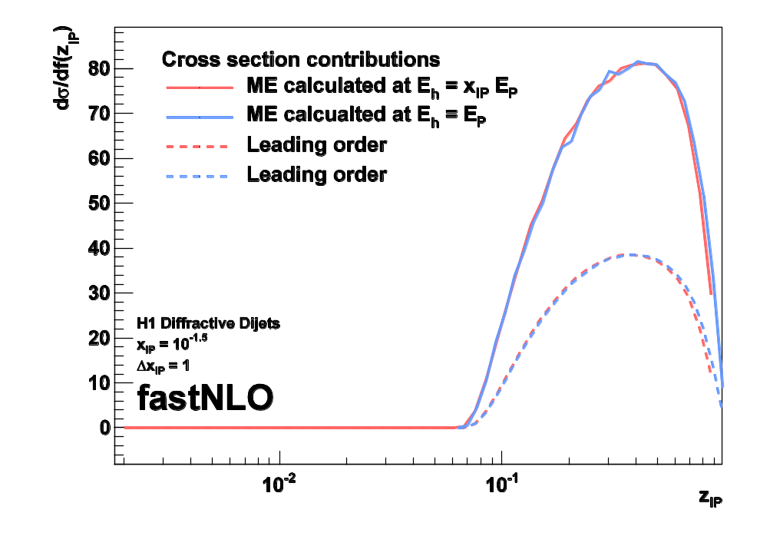
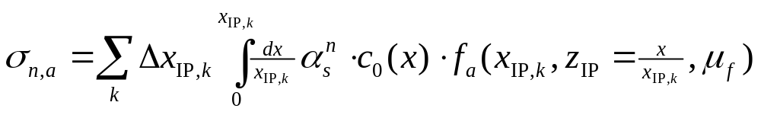
Jets in diffractive DIS with fastNLO
1. Fixed center-of-mass calculation
  Calculate only one fastNLO table at proton energy E_{p}
  Increased number of x-nodes
  in low-x region
2. Adapt the slicing method
  Define arbitrary x_{IP} slicing
  Calculate cross section by Rieman-integrating x_{IP}
  Integrate over x wrt. E_{p}
Integral becomes a standard fastNLO evaluation
  Upper integration interval needs to be respected properly
FastNLO procedure improves previously used approach

Slide 19
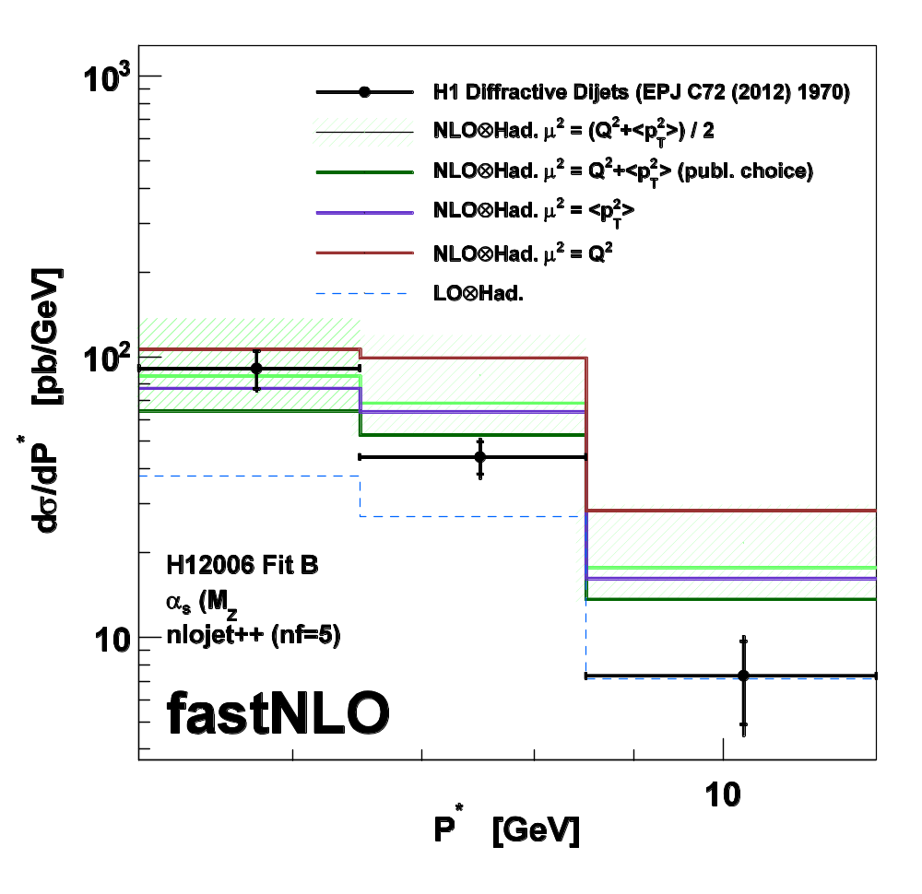
Application: Diffractive PDF fits
Dijet production in diffractive DIS (H1) EPJ C72 (2012) 1970
  Calculations available for
    dσ/dQ²
    dσ/dp*_{T,1}
  Possibility to derive by restricting x_{IP} integration interval
    dσ/dx_{IP}
Full fastNLO features accessible
  Scale studies are easily possible
  Compare various scale choices
  Interface various DPDFs
  Direct access to k-factors
NEW: Facilitate inclusion of diffractive jets in DPDF fits
-> Will help to constrain the gluon in diffractive PDFs

Slide 20
Summary
FastNLO code
    Code downloadable
    C++ and Fortran code (No further dependencies)
    Many calculations available for all experiments
    ATLAS, CMS, CDF, D0, H1, ZEUS, STAR
New features in v2.0
    Many technical improvements
    Table format forsees different physics contributions
'Flexible scale' tables
    Choose composition of μ_{R} and μ_{F}
    Vary ren./fact. scales independently
    Scale variations in any order without recalculations or integrations
Diffractive jet production in DIS
    New concept developed
    Ready to use in DPDF fits

Slide 21

New release soon
fastnlo.hepforge.org
New release of C++ and fortran code within the next weeks
Many new calculations:
LHC, Tevatron, HERA, …
Diffractive DIS code and tables

Slide 22

Backup

Slide 23
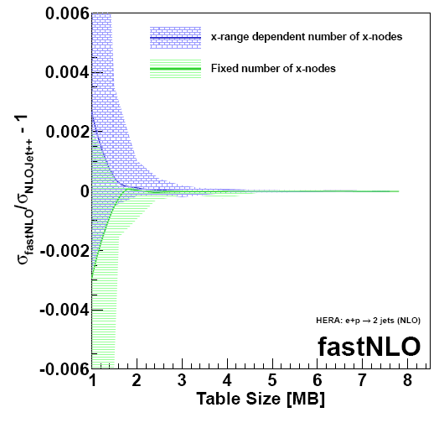
fastNLO Precision
H1 Incl. Jets @ High Q² (24 bins)
Free Parameters
  # x-nodes
  # scale nodes
  -> Affect the interpolation precision
New feature in v2.0
  Flexible # x-nodes
  Number of x-nodes chosen depending on x-range
Comparison vs. 'plain' NLOJet++
  Arbitrary precision possible
  For O(MB) tables, reach better than 1 per mille
O(10⁻⁶)
Filled area shows maximum deviation of all bins
Solid line shows mean deviation of all bins

Slide 24
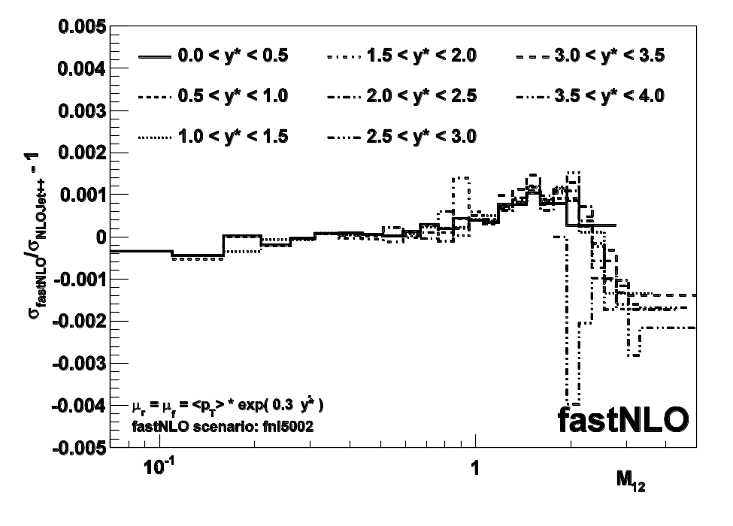

Example: Scale studies with ATLAS Dijet M₁₂
ATLAS Dijet Invariant Mass Measurement, r=0.6 PRD86 (2012) 014022
  pT and y* are stored as scale variables in table
  Renormalization and factorization scale can be any function of (p_{T},y*)
Possiblity to study variations of ATLAS dijet scale choice
  Atlas choice
  We could choose any parameter '0.3'
  We could use different functions (e.g. cosh)
  We can e.g. find optimal scale (FAC,PMS)
Here: fastNLO vs. plain NLOJet++ calculation with free choice of ren./fac. scale
  Precision ~10⁻³

Slide 25
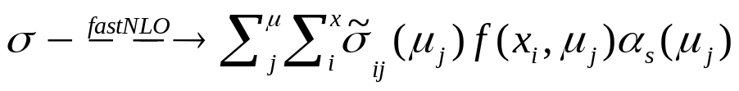
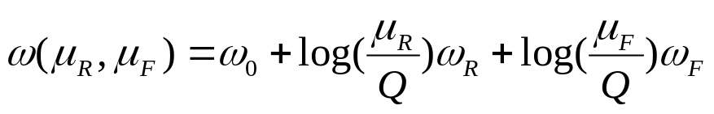
Generalized fastNLO concept in v2.0
We know
  We can use variables from look-up tables for 'any' further calculation (like α_{s}(μ))
σ_{ij}
2-dim Weights
μ_{j}
x_{i}
1-dim look-up table
α(μ_{j})
f(x_{i},μ_{j})
arb. ext. functions
Scale independent weights
  - 'log(μ/Q)' can be done at evaluation time
  μ's are 'freely' choosable functions
  - μ -> μ(Q,p_{T})
We store scale independent contribution
  Three tables holding the weights
  Further scale-variables -> σ_{ijk…}need more dimensions
new in v2.0
σ⁰_{ijk}
σ^{R}_{ijk}
σ^{F}_{ijk}
3-dim Weights
p_{T}
Q²
x_{i}
1-dim look-up table
α(μ_{R})
f(x_{i},μ_{F})
arb. ext. functions
μ_{F}(Q,p_{T})
μ_{R}(Q,p_{T})
arb. ext. functions
1) We can choose μ_{R} independently from μ_{F}
2) We can choose the functional form of μ_{R/F} as functions of look-up-variables

Slide 26
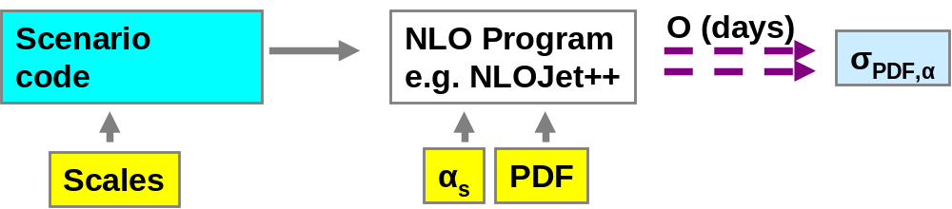
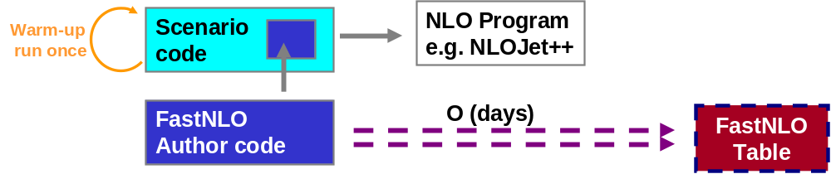
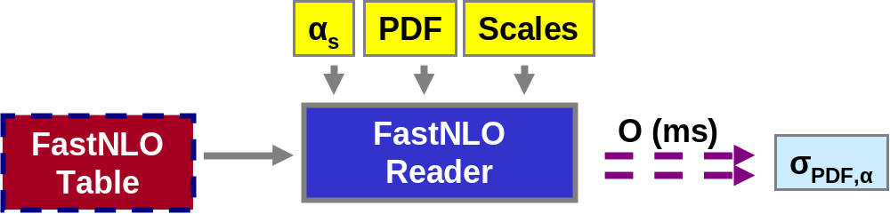
The fastNLO concept
Standard
Method
Table
Generation
fastNLO
Evaluation
Or use it within a fitting framework

Slide 27
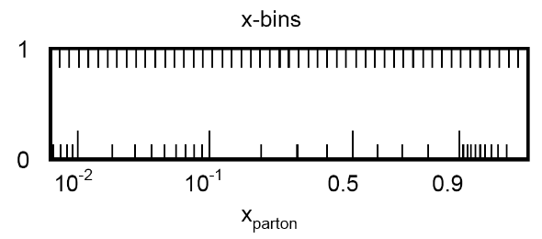

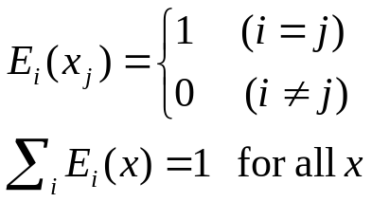
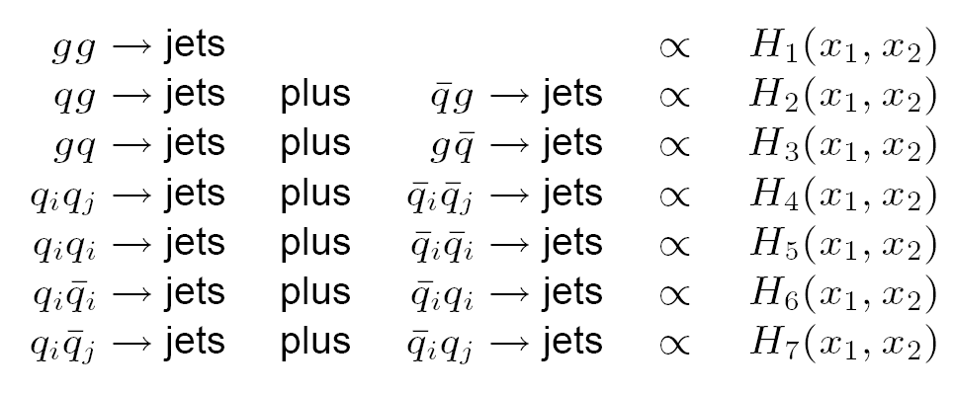
The fastNLO concept
Introduce n discrete x-nodes x_{i}'s
    with x_{n} < ..< x_{i} <..<x₀ =1
    x_{n} is lowest x-value in each bin
    needs reasonable choice of discretization e.g.
Around each x_{i} define n (cubic) Eigenfunction E_{i}(x)
Hadron-hadron collision need two dimensions
  2D-Eigenfunctions
  13×13 partonic subprocesses reduce to 7
-> More technical details: TeV4LHC Workshop 2005 (Talk: M. Wobisch)
and Pascaud, Zomer: LAL 94-42
-> We only have to store a table of the convolution of the pert. coefficients with the interpolation kernel

Slide 28
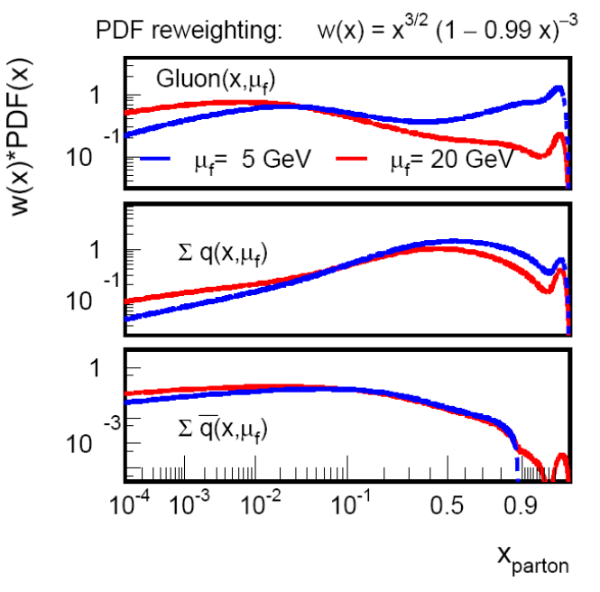

The fastNLO concept
Flatten PDFs by reweighting with simple function w(x)
  We choose
  Improve high-x gluon
  PDF curvatures are reduced for all scales
  independent of μ_{f}
  w(x)⁻¹ is absorbed in E_{i}
Single PDF is replaced by a linear combination of eigenfunctions
-> More technical details: TeV4LHC Workshop 2005 (Talk: M. Wobisch)
and Pascaud, Zomer: LAL 94-42
-> We only have to store a table of the convolution of the pert. coefficients with the interpolation kernel

Slide 29
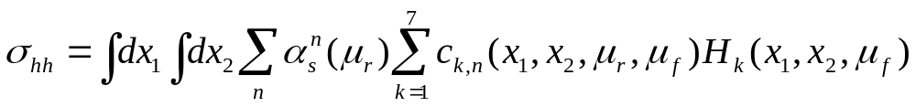
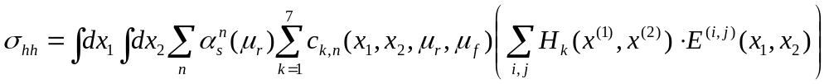
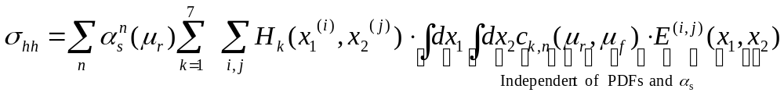
The fastNLO concept
With these definitions the cross section reads
Now express PDF linear combinations H_{k} by the 2D-eigenfunction
Rewrite the cross section
Important: Integral is independent of PDFs!

Slide 30

Last steps
Scale dependence
    Perturbative coefficients are scale dependent
    PDFs and α_{s} need to be evaluated at certain scale values
Introduce interpolation procedure also for scales
    Assume μ_{r} = μ_{f}
    Introduce m scale nodes with distances
Coefficient table gets one additional dimension for μ
Final fastNLO cross sections
    Define σ-table and store it as fastNLO table
    Contains all information on the observable
Final cross section formula

Slide 31
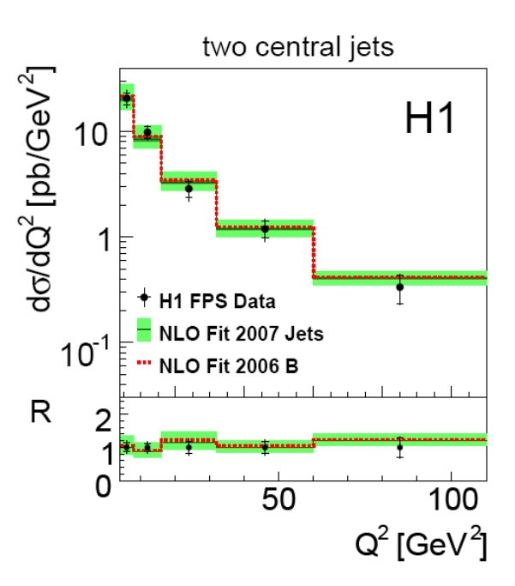
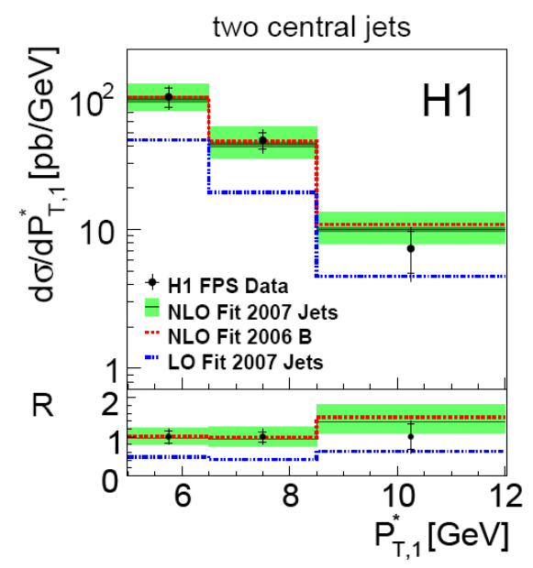
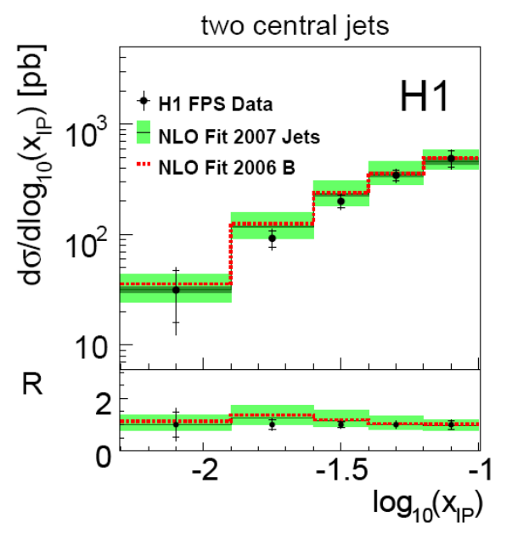
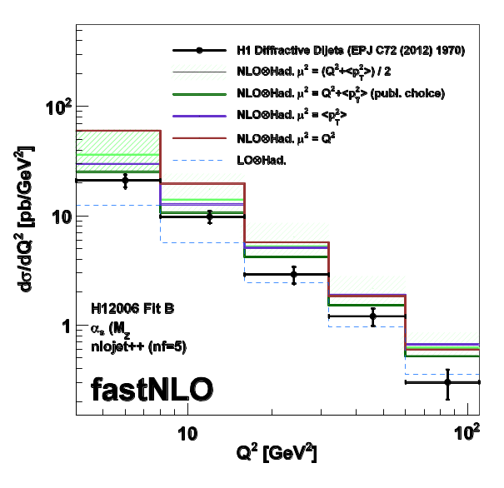
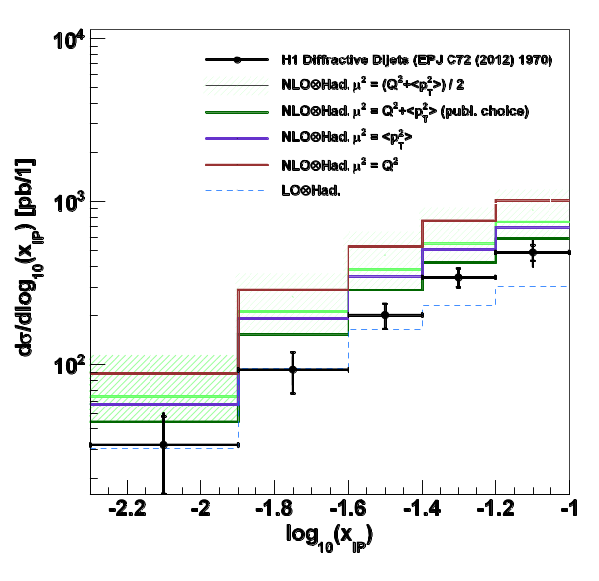
Diffractive dijets

Slide 32
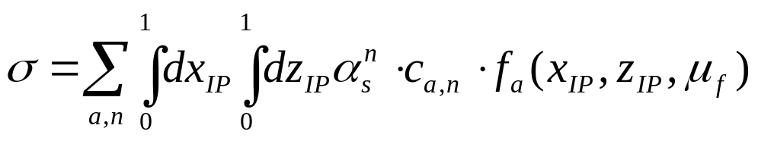
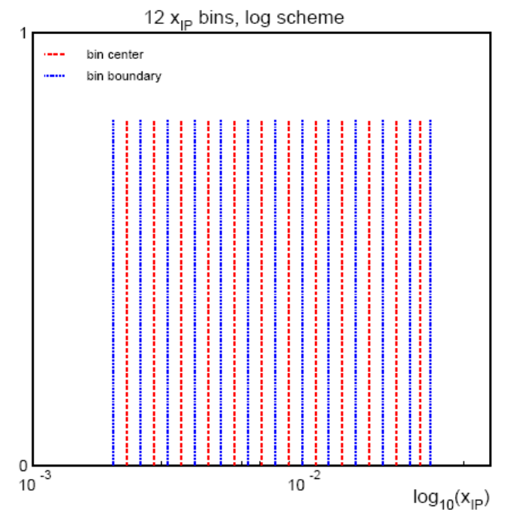
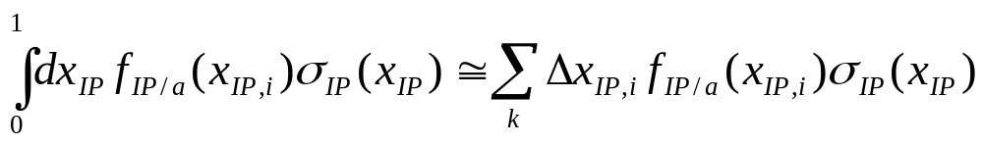
Jetproduction in diffractive DIS
Jetproduction in diffractive DIS (t=0)
Standard method of calculating NLO cross sections: 'Slicing method'
  Riemann-Integration of dx_{IP}
  Discretize the x_{IP} range into k bins (k~10)
  Repeated cross section calculation for each slice of x_{IP}
    fixed value of x_{IP,i}
    At reduced center of mass energy of
    sqrt(s) = 4x_{IP}E_{P}E_{e}
    slice-width Δx_{IP}
H1-07/07-628

Slide 33
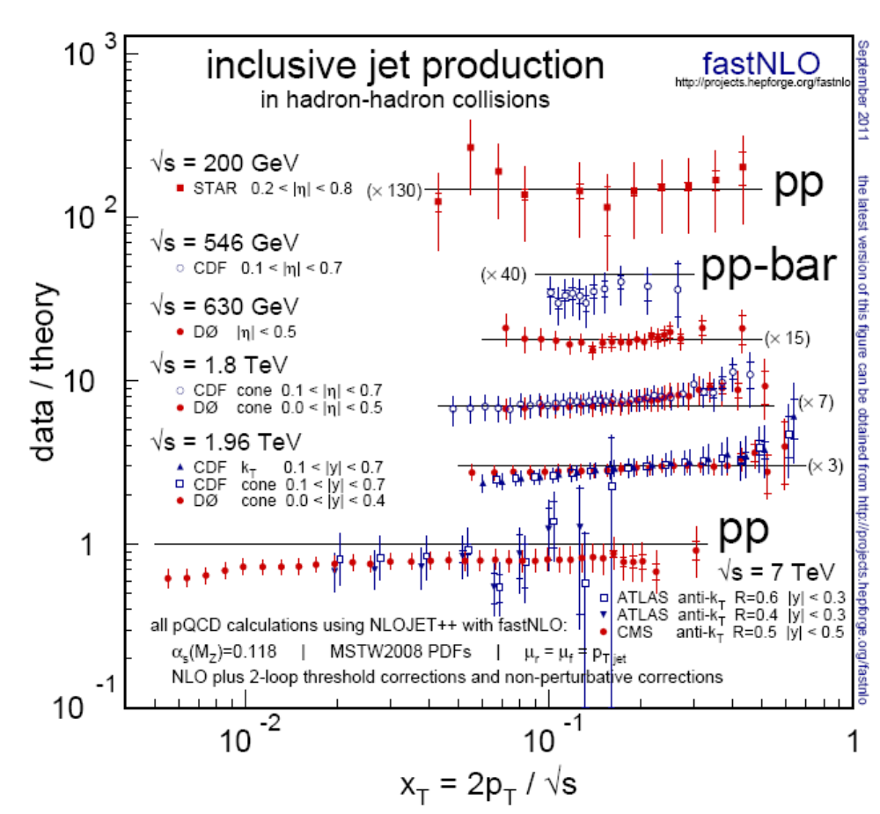
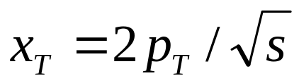
Hadron-hadron collisions only
PDF sensitivity
  compare jet cross section at fixed x_{T}
Tevatron give more constraints on PDFs in high x_{T} region
LHC data with impact for low-x gluon

Slide 34
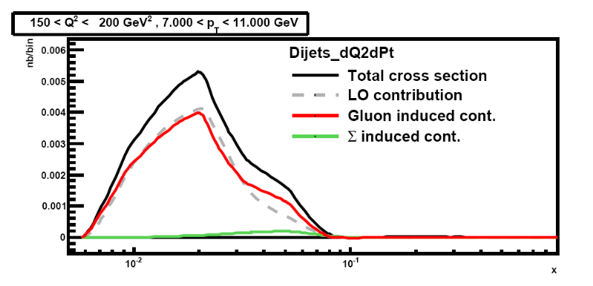



Which x-region do we test with jet data?
E.g. H1 dijets @ high Q²
  four bins:
    low and high Q²
    low and high <pt>
Only three contributions in DIS
Gluon, Delta, Sigma induced processes
low Q² is mostly gluon induced
High Q² is mostly Delta induced
'low' x-region only at low <pt> and low Q²
10⁻²
10⁻¹
x
10⁻²
10⁻¹
x
10⁻²
10⁻¹
x
10⁻²
10⁻¹
x

Slide 35

x-dependence of jet cross sections

Slide 36

FastNLO v2
FastNLO v2
  Method for fast repeated theory cross sections allowing to change α_{s}, PDF and scales
  More flexible table format for various multiplicative and additive contributions
  C++ and fortran versions with lots of interfaces
  Many calculations available
'Flexible scale' format
  Potential to vary ren. and fact. scale independently
  Scales composition can be choosen as function of pre-defined variables
  -> New options for scans of scale dependence (e.g. à la FAC, PMS)

Slide 37




Stuying the scale choice of ATLAS
arXiv:1112.6297 [hep-ex]

Slide 38

Scales in FastNLO
FastNLO tables come with 3 (4) simultaneous scale variations tables
  e.g. 0.5, 1.0, 2.0 times the nominal scale
A posteriori scale variation of the renormalizatoin scale allows study of asymetric scale variations
  e.g. 6-points: (1/2,1/2), (1/2,1), (1,1/2), (1,2), (2,1), (2,2)
  avoiding of rel. 'factor' 4.
Improvements in v 2.0
  scales get own dimension
  bicubic interpolation of scale-value to scale nodes
  typically 6 scale nodes
  examples already for
    CMS incl. jets
    D0 3-jet mass
    …

