Slide 1


fastNLO for
Jetproduction in Diffractive DIS
D. Britzger, F. Ceccopieri
H1 Collaboration Meeting 2012
MPI Munich
September 12 2012

Slide 2

fastNLO
Motivation
  Calculation of jet cross sections in higher orders are time consuming
  Often: Calculations have to be repeated for same measurement but different PDFs or α_{s} (e.g. PDF uncertainties, scale variations, etc…)
  Inclusion of jet-data in a fit (e.g. PDF or α_{s}) requires very fast recomputation of almost the same cross sections
Need procedure for fast repeated computations of NLO cross sections
use:

Slide 3
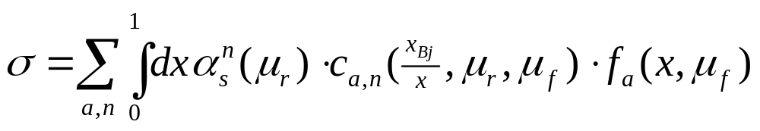
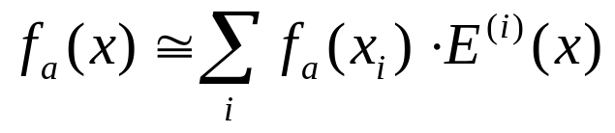
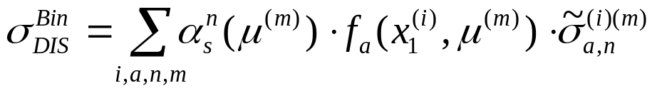
fastNLO
fastNLO concept
  Jet-production cross section in DIS
  Introduce interpolation kernels for 'x' using Eigenfunctions E_{i}(x)
  Single PDF is replaced by a linear combination of interpolation kernels
We can calculate once a table with perturbative coeff. using e.g. nlojet++
Cross section is then just a sum
over all interpolation nodes
More features of fastNLO
e.g.Scale interpolation, PDF reweighting, scale independent contr., etc..

Slide 4
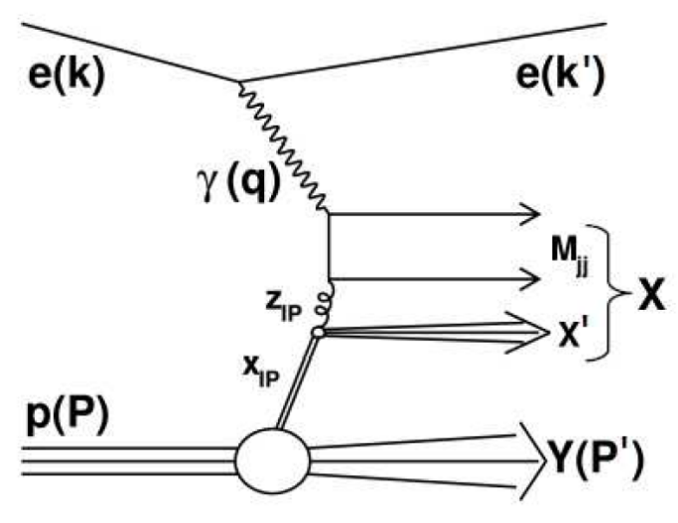
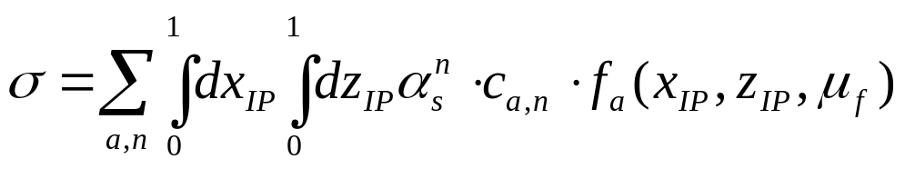
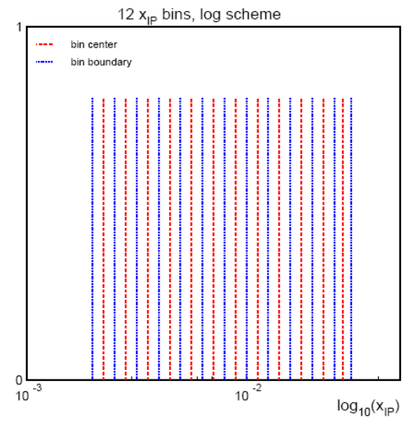
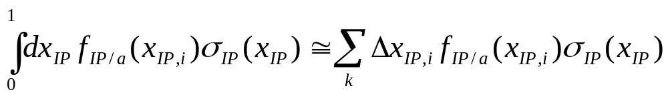
Jet production in diffractive DIS
Jetproduction in diffractive DIS (t=0)
Standard method of calculating NLO cross sections: 'Slicing method'
  Riemann-Integration of dx_{IP}
    Discretize the x_{IP} range into k bins (k~10)
  Repeated cross section calculation with reduced hadron energy for each slice of x_{IP}
    fixed value of x_{IP,i}
    At reduced center of mass energy of
    sqrt(s) = x_{IP}·4E_{P}E_{e}
    slice-width Δx_{IP}
H1-07/07-628

Slide 5
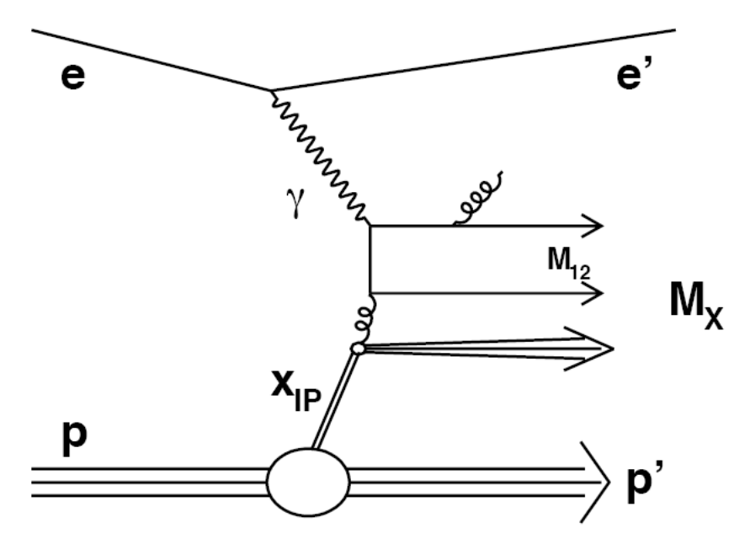
Jet production in diffractive DIS
Perturbative coefficients have only dependence on momentum fraction
  No direct dependence of the two momentum fractions x_{IP} and z_{IP}
  Each slice calculates basically same coefficients c
  Factorization is independent of incoming parton
c
μ_{f}
Perform x_{IP}-Integration a-posteriori
Calculate one fastNLO table with hadron energy = proton energy
Calculation of only one single fastNLO table is needed
  Very high statistical precision
  No limitations in x_{IP} integration

Slide 6
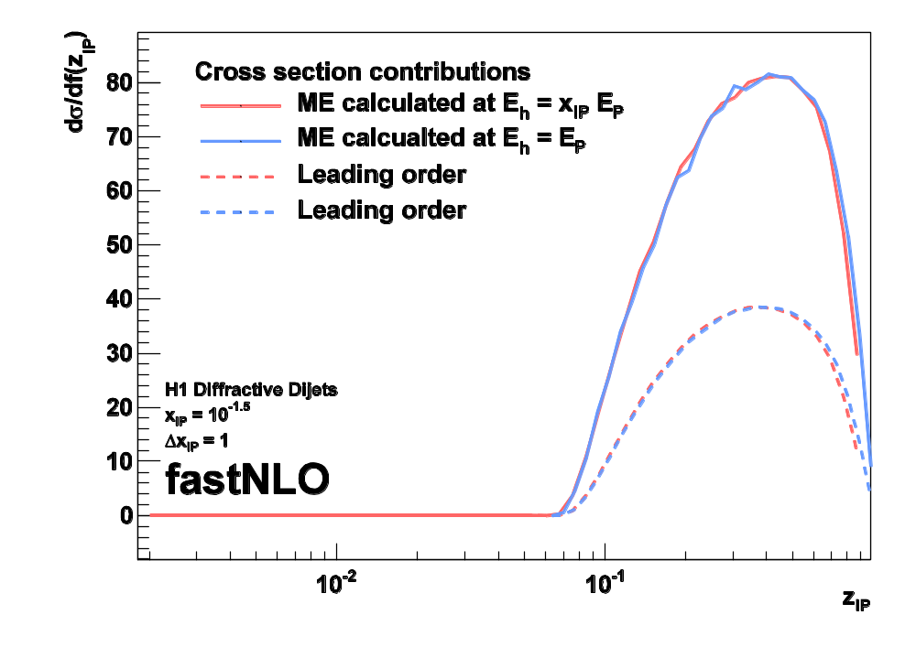
Proof of concept
Compare two cross section calculations for one single fixed x_{IP} slice at
x_{IP} = 10^{-1.5}
Cross section contribution with reduced CME (standard slicing method)
Hadron = Pomeron
E_{h} = x_{IP}·E_{P}
Calculate matrix elements using proton energy (new method)
Hadron = Proton
E_{h} = E_{P}
Compare z_{IP} dependent cross section contribution
z_{IP} = x_{hadron}
z_{IP} = x_{hadron}/x_{IP} < 1
x_{hadron} being the momentum fraction of the parton wrt. to the incoming hadron (Pomeron) momentum
Perfect agreement
  Perturbative coefficients are identical for each x_{IP} slice

Slide 7
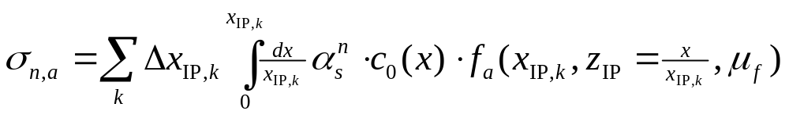
Jets in diffractive DIS with fastNLO
1. Fixed center-of-mass calculation
  Calculate only one fastNLO table at proton energy E_{p}
  Increased number of x-nodes in low-x region
2. Adapt the slicing method
  Define arbitrary x_{IP} slicing
  Calculate cross section by Rieman-integrating x_{IP}
  Integrate x wrt. E_{p}
  Formulae calculated properly by Federico !!!
Integral becomes a standard fastNLO evaluation
  Upper integration interval needs to be respected properly
    x-integration runs over discrete x-nodes
    Uppermost x-node is weighted according to its range inside/outside of the integration interval
FastNLO procedure improves previously used approach

Slide 8
Code example for pre-calculated fastNLO table
// FastNLO example code in C++ for reading
// H1 diffractive dijets dP*_T,1
// Eur.Phys.J. C70 (2010) 15
FastNLODiffH12006FitB fnlodiff( "fnhd1012.tab" );
fnlodiff.SetXPomLinSlicing( 30, 0.0, 0.1 );
vector<double> xs = fnlodiff.GetDiffCrossSection();
// optional printout
fnlodiff.PrintCrossSections();
// output
* This is a single-differential table in p*_T,1.
*
* --- p*_T,1 --- - Bin - -- XS-FNLO --
* 4.000 - 6.500 0 9.4173e+01
* 6.500 - 8.500 1 6.6364e+01
* 8.500 - 12.000 2 1.6610e+01
Pretty easy to use (if fastNLO table is already calculated)

Slide 9
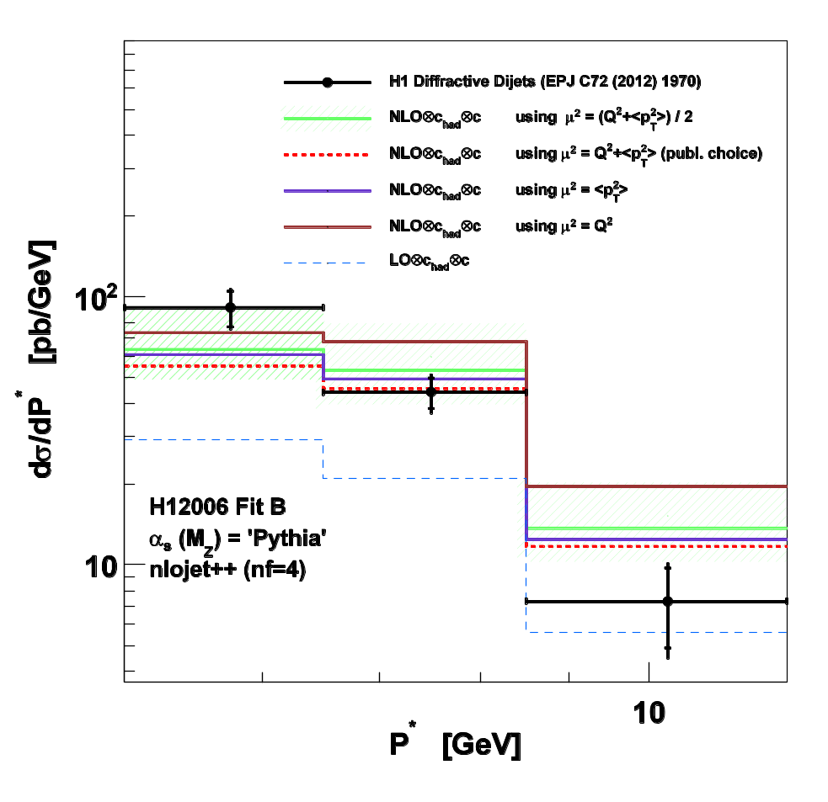
Application: Scale study
Dijet production in diffractive DIS (H1) EPJ C72 (2012) 1970
  Calculations available for
    dσ/dQ²
    dσ/dp*_{T,1}
  Possibility to derive by restricting x_{IP} integration interval
    dσ/dx_{IP}
Full fastNLO features accessible
  Scale studies are easily possible
  Compare various scale choices
  Interface various DPDFs
  Direct access to k-factors
NEW: Facilitate inclusion of diffractive jets in DPDF fits
-> Will help to constrain the gluon in diffractive PDFs

Slide 10
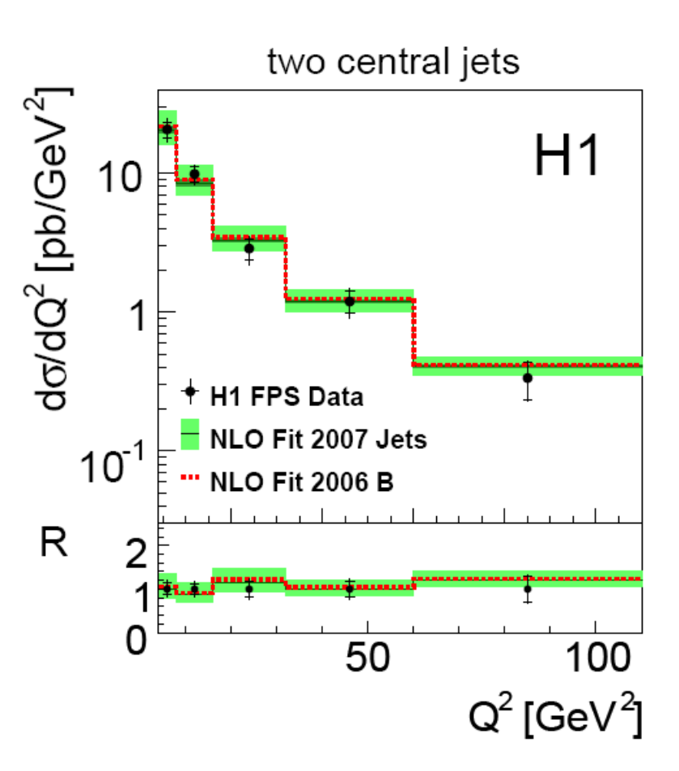
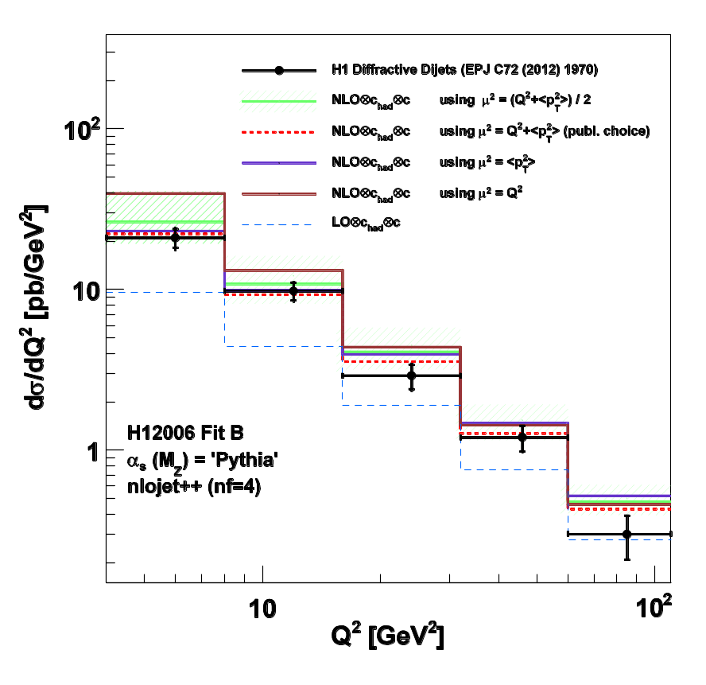
Test scenario: Diffractive Dijets dQ²
Data is identical
Red dashed lines should be identical
Small differences
  Automatic (but wrong) nlojet++ interpolation of NLO subtraction terms
  Jet-finder recombination scheme (~1%)
  Different (but very fine) xIP (and dxIP) slicing (~0-2%)
  Limited statistic (26×6·106) vs. very high statistic (2·1010) (<1%)

Slide 11
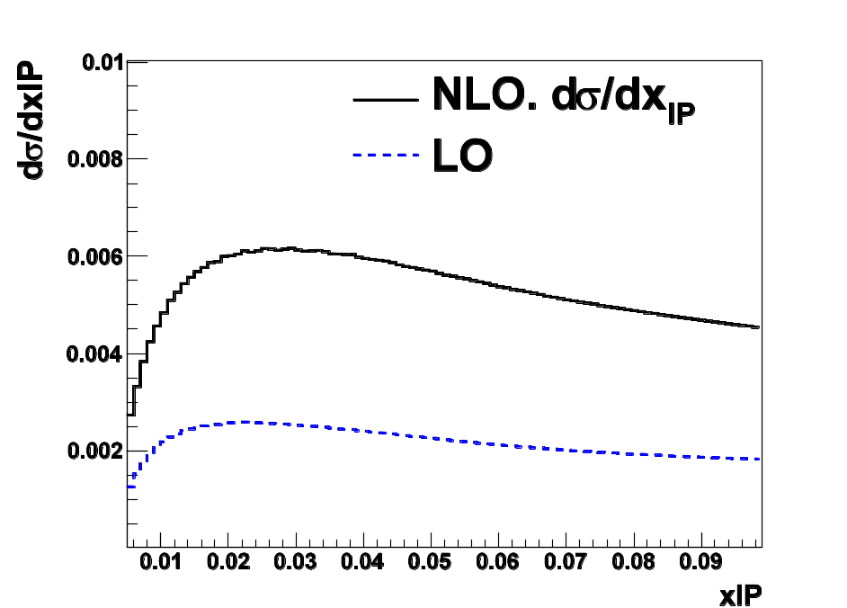
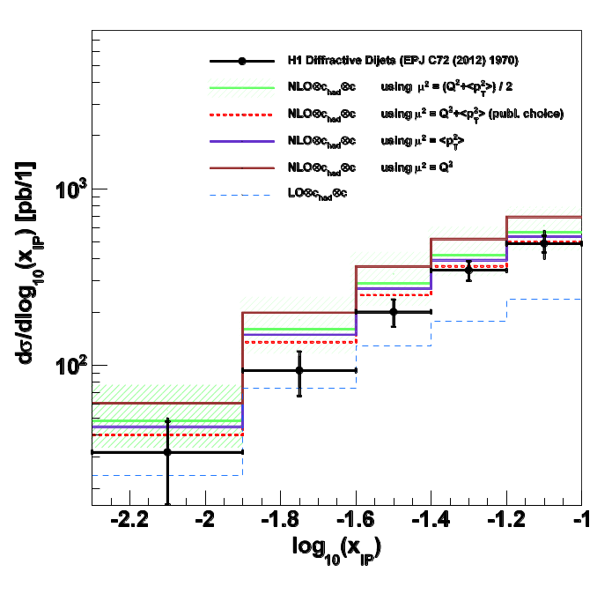
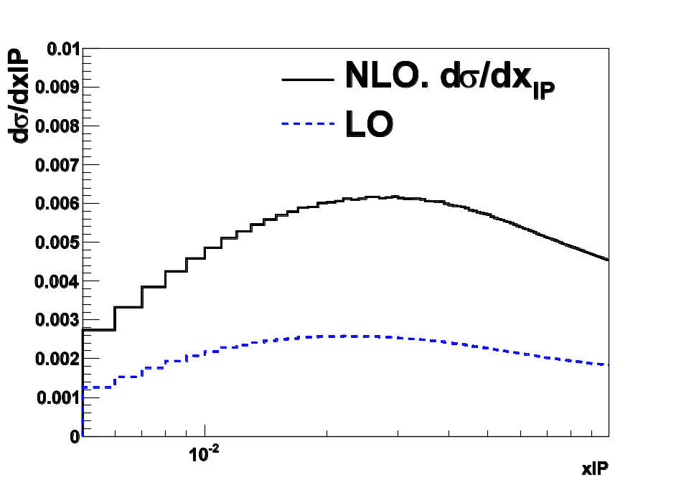
Which slicing is preferred?
dσ/dlog₁₀(x_{IP})
dσ/dx_{IP}
Linear or logarithmic slicing of xIP ?
Both are available
fnlodiff.SetXPomLinSlicing( 30, 0.0, 0.1 );
fnlodiff.SetXPomLogSlicing( 30, 0.0, 0.1 );
Or any other
double xp[] = {…};
double dxp[] = {…};
fnlodiff.SetXPomSlicing( 30, xp, dxp );
dσ/dx_{IP}

Slide 12
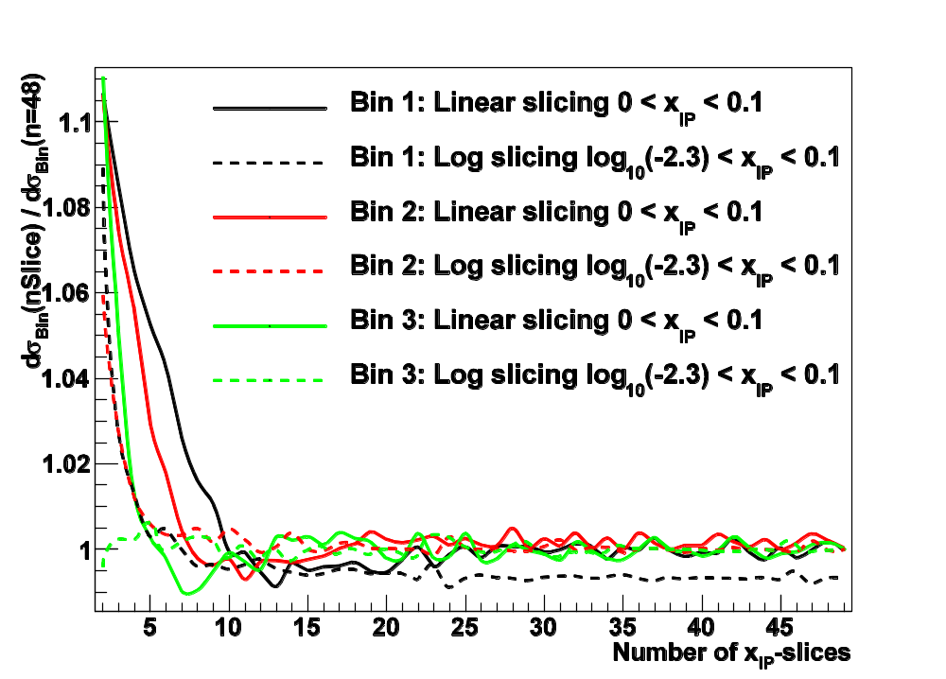
Convergence of slicing method
Study cross section dependence on number of x_{IP} slices
  Compare:
  linear and logarithmic slicing
Convergence after 10 slices
Logarithmic slicing seems to converge faster
  But one must know lowest x_{IP}
  -> Otherwise bias!
Fluctuations
  arise from discrete x_{hadron} interpolation within fastNLO
  despite (simple) 'smoothing' at upper integration interval at
  x_{hadron} ~ x_{IP,k}
Very fast convergence of cross section
FastNLO accuracy (for this table) could be estimated to < 0.25 %
  Accuracy smaller than cut on log(x_{IP,min}) for log slicing

Slide 13
What about dσ/dz_{IP} ??
Warning!
No dσ/dz_{IP} available through restricting z_{IP} integration interval
z_{IP} ≠ ξ_{IP} in higher orders
z_{IP} = Parton momentum fraction compared to Hadron (Pomeron)
ξ_{IP} = β_{Bj} · (1+M_{jj}/Q²)

Slide 14
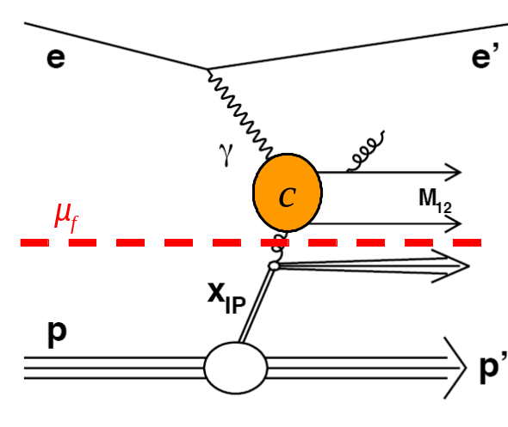
Summary
New method of calculating diffractive jet-cross sections was developed
FastNLO code was developed and intensively tested
FastNLO for jet production in diffractive DIS is ready to use
Use it for your analysis or for fits of diffractive PDFs

Slide 15
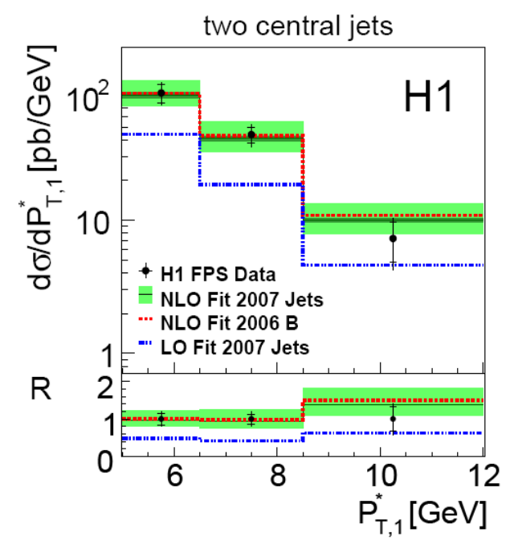
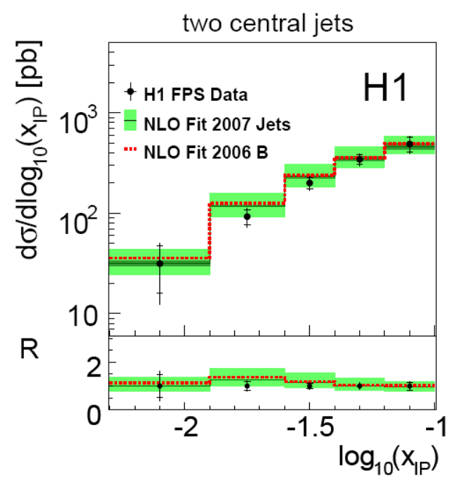
Diffractive dijets

Slide 17
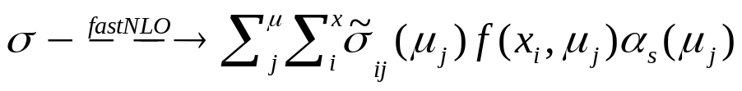
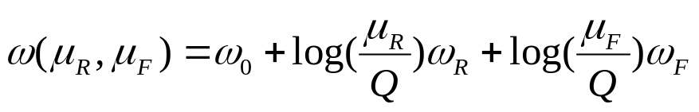
Generalized fastNLO concept in v2.0
We know
  We can use variables from look-up tables for 'any' further calculation (like α_{s}(μ))
σ_{ij}
2-dim Weights
μ_{j}
x_{i}
1-dim look-up table
α(μ_{j})
f(x_{i},μ_{j})
arb. ext. functions
Scale independent weights
  - 'log(μ/Q)' can be done at evaluation time
  μ's are 'freely' choosable functions
  - μ -> μ(Q,p_{T})
We store scale independent contribution
  Three tables holding the weights
  Further scale-variables -> σ_{ijk…}need more dimensions
new in v2.0
σ⁰_{ijk}
σ^{R}_{ijk}
σ^{F}_{ijk}
3-dim Weights
p_{T}
Q²
x_{i}
1-dim look-up table
α(μ_{R})
f(x_{i},μ_{F})
arb. ext. functions
μ_{F}(Q,p_{T})
μ_{R}(Q,p_{T})
arb. ext. functions
1) We can choose μ_{R} independently from μ_{F}
2) We can choose the functional form of μ_{R/F} as functions of look-up-variables

Slide 18
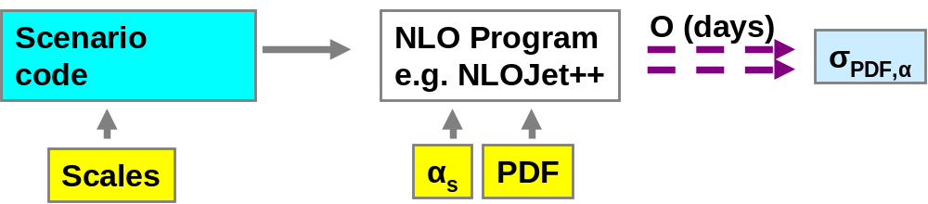
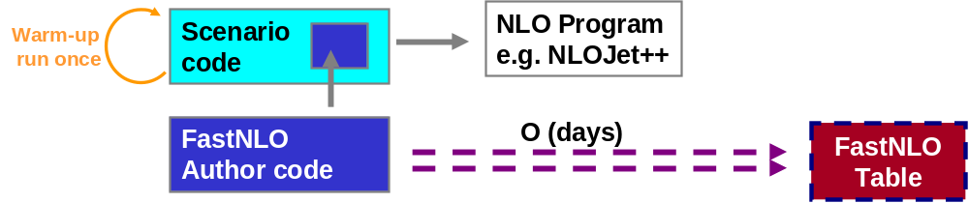
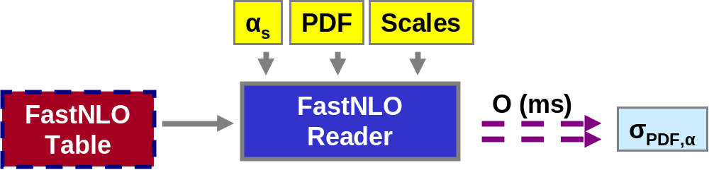
The fastNLO concept
Standard
Method
Table
Generation
fastNLO
Evaluation
Or use it within a fitting framework

Slide 19
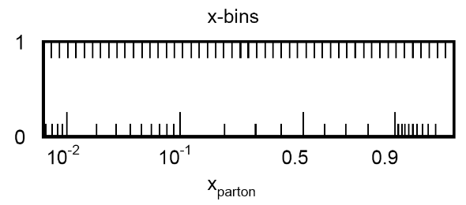

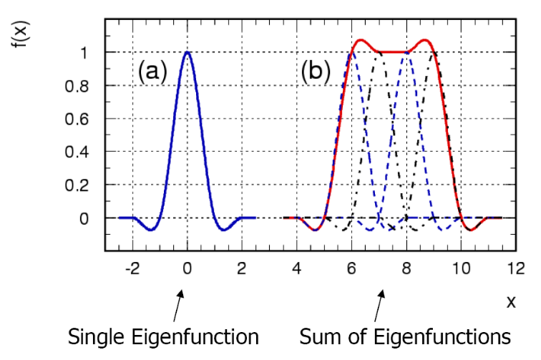
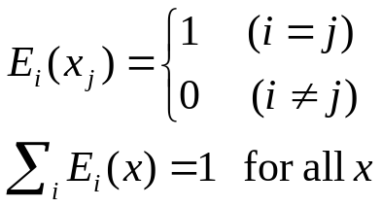

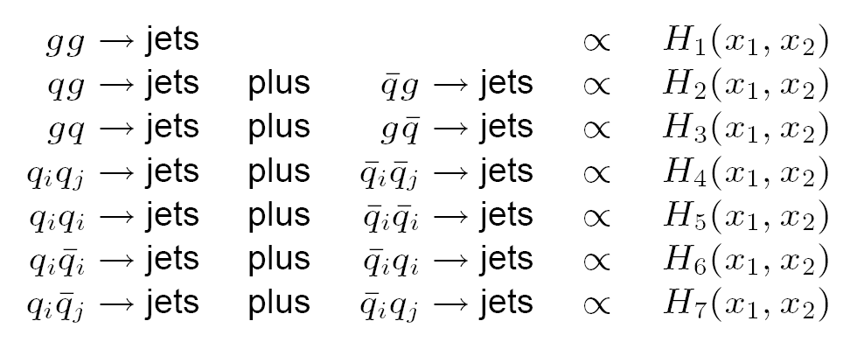
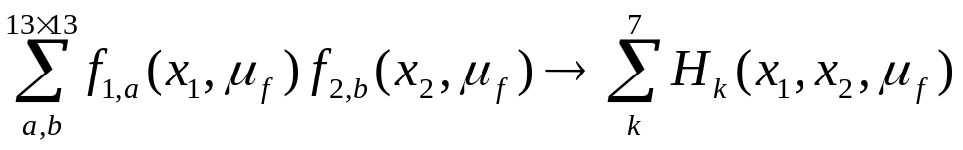
The fastNLO concept
Introduce n discrete x-nodes x_{i}'s
    with x_{n} < ..< x_{i} <..<x₀ =1
    x_{n} is lowest x-value in each bin
    needs reasonable choice of discretization e.g.
Around each x_{i} define n (cubic) Eigenfunction E_{i}(x)
Hadron-hadron collision need two dimensions
  2D-Eigenfunctions
  13×13 partonic subprocesses reduce to 7
-> More technical details: TeV4LHC Workshop 2005 (Talk: M. Wobisch)
and Pascaud, Zomer: LAL 94-42
-> We only have to store a table of the convolution of the pert. coefficients with the interpolation kernel

Slide 20
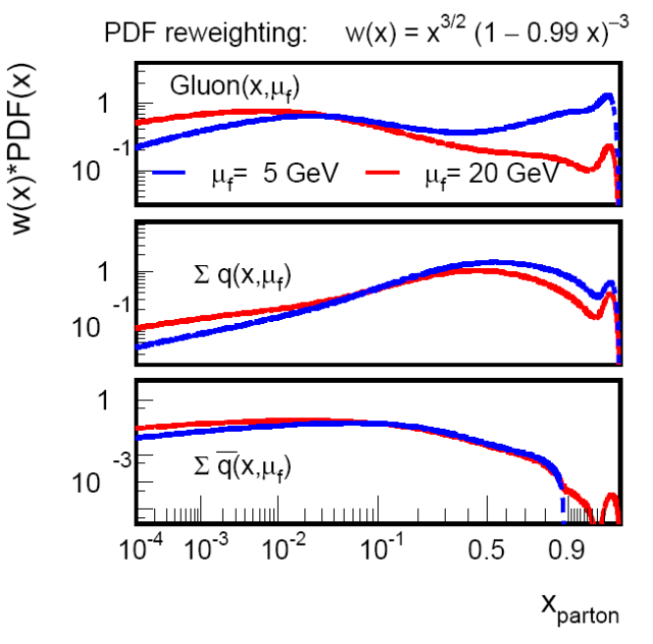

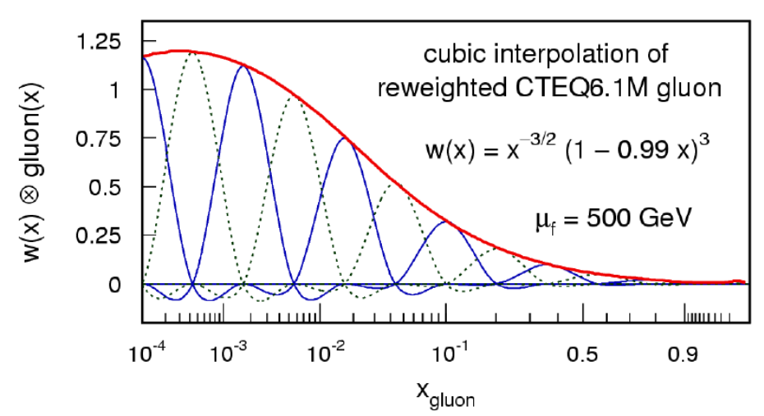
The fastNLO concept
Flatten PDFs by reweighting with simple function w(x)
  We choose
  Improve high-x gluon
  PDF curvatures are reduced for all scales
  independent of μ_{f}
  w(x)⁻¹ is absorbed in E_{i}
Single PDF is replaced by a linear combination of eigenfunctions
-> More technical details: TeV4LHC Workshop 2005 (Talk: M. Wobisch)
and Pascaud, Zomer: LAL 94-42
-> We only have to store a table of the convolution of the pert. coefficients with the interpolation kernel

Slide 21
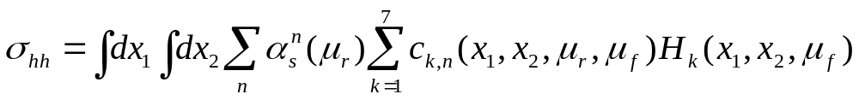
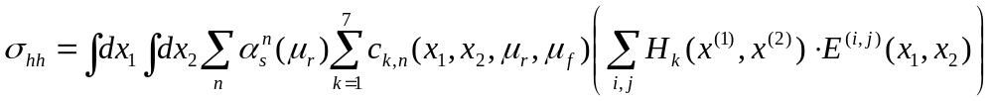
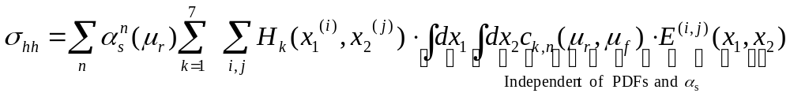
The fastNLO concept
With these definitions the cross section reads
Now express PDF linear combinations H_{k} by the 2D-eigenfunction
Rewrite the cross section
Important: Integral is independent of PDFs!

Slide 22

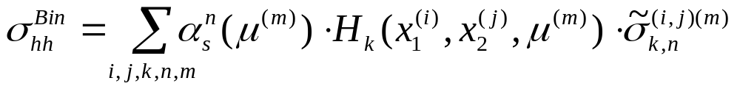
Last steps
Scale dependence
    Perturbative coefficients are scale dependent
    PDFs and α_{s} need to be evaluated at certain scale values
Introduce interpolation procedure also for scales
    Assume μ_{r} = μ_{f}
    Introduce m scale nodes with distances
Coefficient table gets one additional dimension for μ
Final fastNLO cross sections
    Define σ-table and store it as fastNLO table
    Contains all information on the observable
Final cross section formula

