Slide 1
RESEARCH PROJECT • INTELLIGENT SYSTEMS
Brain MRI Segmentation
and Classification
A deep learning pipeline combining U-Net and VGG16 for tumor
localization and four-class diagnosis on the BRISC 2025 dataset.
Department of Electrical and Computer Engineering
Toronto Metropolitan University • Toronto, ON, Canada
Notes:
Welcome everyone. Today we'll be presenting our project on brain MRI segmentation and classification using a UNet and VGG16 pipeline.

Slide 2
MEET THE TEAM
Who We Are
Wasay Aamer
Muzammil Hussain Memon
Mahad Khokhar
BACHELORS
BACHELORS
BACHELORS
B.Eng. Mechatronics Engineering
B.Eng. Electrical Engineering
B.Eng. Software Engineering
CURRENTLY
CURRENTLY
CURRENTLY
M.Eng. Computer Engineering
M.Eng. Computer Engineering
M.Eng. Computer Engineering
Brain MRI Segmentation & Classification | Toronto Metropolitan University
2
Notes:
Our group consists of me Muzammil, Mahad and Wasay.

Slide 3
OVERVIEW
Agenda
01
Introduction
02
Literature Review
The clinical motivation and problem
Prior work in segmentation & classification
03
Dataset
04
Methodology
BRISC 2025 — structure and distribution
U-Net and VGG16 model architectures
05
Results & Discussion
Quantitative metrics, visuals, comparison
Brain MRI Segmentation & Classification | Toronto Metropolitan University
3
Notes:
We will go over introduction, Literature review, dataset, methodology, results and discussion.
—---------------—---------------—---------------—---------------—---------------—---------------—---------------—---------------—---------------—---------------—---------------—---------------—---------------—---------------—---------------—---------------—---------------

Slide 4
01 • INTRODUCTION
Why Automate Brain Tumor Diagnosis?
The Clinical Challenge
OUR GOAL
MRI is the standard imaging modality for diagnosing brain tumors due to its detailed soft-tissue contrast.
However, manual analysis by neuroradiologists is slow, subjective, expensive, and difficult to scale across large patient volumes.
Tumor boundaries are often ambiguous due to low contrast, intensity inhomogeneity, and heterogeneous appearance — increasing inter-observer variability.
Build an automated pipeline that both localizes tumors and classifies them.
✓ Pixel-wise tumor segmentation with U-Net
✓ Four-class classification with VGG16
✓ Glioma, meningioma, pituitary, no tumor
✓ Evaluated using Dice, IoU, F1, accuracy
Brain MRI Segmentation & Classification | Toronto Metropolitan University
4
Notes:
Brain tumors are one of the most life-threatening forms of cancer, and accurate diagnosis from MRI is critical for effective treatment planning. MRI is the standard imaging modality because of its detailed soft-tissue contrast — but the analysis side is still mostly manual. A neuroradiologist has to look at the scans, mark out the tumor, and decide what type it is. That's slow, expensive, and subjective — two experts can disagree on where the tumor boundary actually is, especially when contrast is low. Our goal was to build an automated pipeline that does both jobs: it localizes the tumor pixel-by-pixel using U-Net, and then classifies the tumor type using VGG16, across four categories — glioma, meningioma, pituitary, and no tumor.

Slide 5
02 • LITERATURE REVIEW
Four Papers That Shaped Our Approach
PAPER 1 • FOUNDATION
PAPER 2 • REFERENCE WORK
U-Net (Ronneberger et al., 2015)
Arafat et al. (2023)
The original U-Net paper. Introduced the encoder-decoder architecture with skip connections for biomedical image segmentation. Achieved an IoU of 0.92 on the ISBI 2015 cell-tracking challenge using very few annotated images — proving the architecture works even with limited data. This is the foundation our segmentation model is built on.
Brain Tumor MRI Segmentation and Classification using Deep Learning. Combined U-Net with a 16-layer CNN classifier on 3,064 images, applying skull-stripping for preprocessing. Reported a Dice coefficient of 0.94 and ~99% classification accuracy. This is the paper we benchmark our results against throughout the talk.
PAPER 3 • CLASSIFICATION
PAPER 4 • COMBINED PIPELINE
Fine-Tuned VGG16 (Multi-Class)
Multi-Scale SAM + VGG16
A transfer-learning approach that fine-tuned VGG16 with global average pooling, batch normalization, and dropout. Trained on a Kaggle dataset of 7,023 MRI scans across the same four classes we use. Reported 95% overall accuracy with strong per-class F1 scores — directly motivating our choice of VGG16 as the classifier.
A two-stage pipeline that first uses a Multi-Scale Detail-Enhanced Segment Anything Model (SAM) for tumor segmentation, then feeds the result into a VGG16 classifier. Achieved ~97% segmentation accuracy and 98% classification accuracy on 3,929 MRI scans — strong evidence that combining segmentation and classification in one pipeline is the right strategy.
Brain MRI Segmentation & Classification | Toronto Metropolitan University
5
Notes:
Out of the ten papers we reviewed in our report, four really stand out as the ones that directly shaped our approach. Paper 1 is the original U-Net by Ronneberger from 2015 — this is the foundation of pretty much all modern biomedical segmentation. The encoder-decoder shape with skip connections is exactly what we use. Paper 2 is Arafat et al. — this is our reference paper. They combined U-Net segmentation with a CNN classifier on brain MRI and reported very strong numbers, Dice of 0.94 and around 99% classification accuracy. We benchmark ourselves against them throughout the talk. Paper 3 is the fine-tuned VGG16 paper — they showed transfer learning from ImageNet works really well for the same four-class brain tumor problem we're tackling, hitting 95% accuracy. That's why we picked VGG16 for our classifier. And paper 4 — the SAM plus VGG16 pipeline — is interesting because it validates the broader idea of combining segmentation and classification in a single pipeline, which is exactly the architecture we built.

Slide 6
03 • DATASET
BRISC 2025 — Overview
Repository Structure
DATA SOURCE
Kaggle — BRISC 2025
brisc2025/
classification_task/
train/
glioma/ (1,147 images)
meningioma/ (1,329 images)
no_tumor/ (1,067 images)
pituitary/ (1,457 images)
test/
glioma/ (254 images)
meningioma/ (306 images)
no_tumor/ (140 images)
pituitary/ (300 images)
segmentation_task/
train/
images/ (3,933 files)
masks/ (3,933 files)
test/
images/ (860 files)
masks/ (860 files)
Brain Tumor Reference Image Set for Classification — a curated, publicly available MRI dataset hosted on Kaggle. It ships pre-split into train and test folders for both tasks, with paired image–mask annotations for segmentation and class-labeled folders for classification.
Two parallel tasks:
✓ Classification — 4 tumor types
✓ Segmentation — pixel-wise tumor masks
Brain MRI Segmentation & Classification | Toronto Metropolitan University
6
Notes:
Let’s talk about the data.
To train our deep learning models, we used a dataset sourced from Kaggle.
The dataset is called BRISC 2025, which stands for Brain Tumor Reference Image Set for Classification.
We chose this dataset because it is publicly available and well-curated, making it reliable for research and model training.
It really convenient because it comes pre-split for both classification and segmentation tasks. Additionally, the data is subdivided into training and validation sets.
On the right, you can see the full file directory structure.
In total, the dataset contains over 10,000 MRI images.

Slide 7
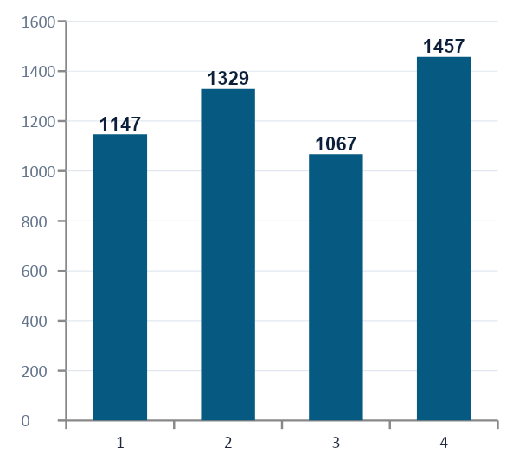
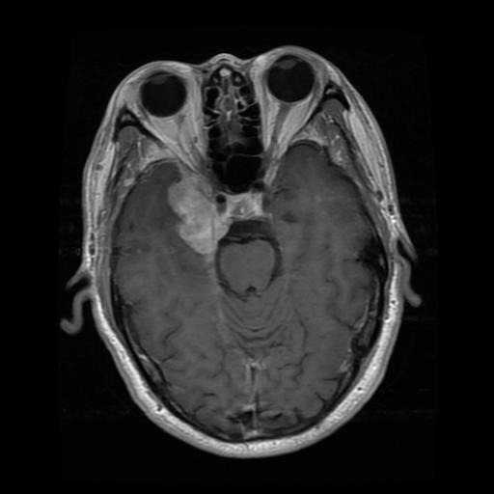
03 • DATASET
Classification Task
6,000
5,000 / 1,000
4
Total Images
Train / Test Split
Tumor Classes
Class Distribution
Train Distribution
Sample MRI Scan
Class | Train | Test | Total
Glioma | 1,147 | 254 | 1,401
Meningioma | 1,329 | 306 | 1,635
No Tumor | 1,067 | 140 | 1,207
Pituitary | 1,457 | 300 | 1,757
Total | 5,000 | 1,000 | 6,000
e.g. one glioma scan
Brain MRI Segmentation & Classification | Toronto Metropolitan University
7
Notes:
Looking at the classification position of our dataset, There are 6,000 images.
Split 5,000 for training and 1,000 for testing, across 4 tumor classes.
glioma/
meningioma/
no_tumor/
pituitary/
Looking at the table on the left, you can see the per-class breakdown.

Slide 8
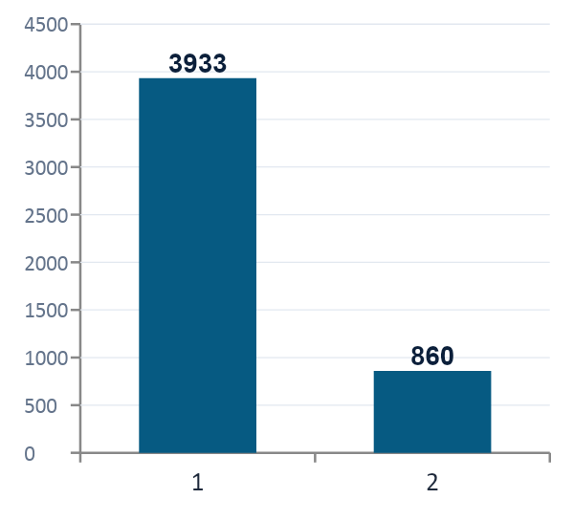
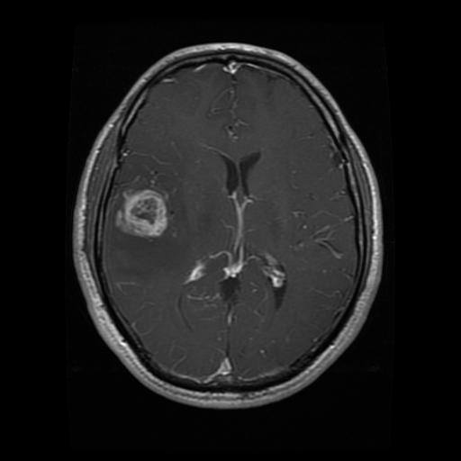
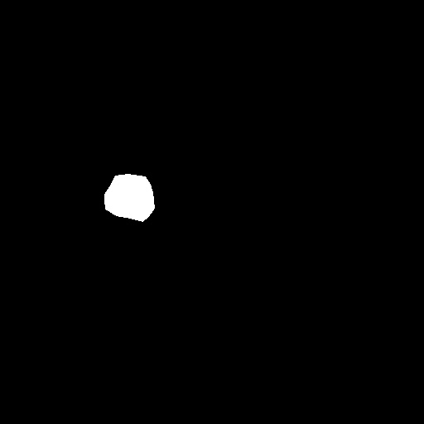
03 • DATASET
Segmentation Task
4,793
3,933 / 860
1 : 1
Total Image–Mask Pairs
Train / Test Split
Image to Mask Ratio
Paired Sample — MRI Scan + Ground-Truth Mask
Train vs. Test
Each MRI scan is paired with a binary mask annotating the tumor region pixel-by-pixel.
Brain MRI Segmentation & Classification | Toronto Metropolitan University
8
Notes:
Now, let’s focus on the segmentation data.
This portion of the dataset contains 4,793 samples in total.
Out of these, 3,933 are used for training and 860 for testing.
The key distinction in this dataset is that each MRI image is paired with a binary mask.
This mask serves as the ground truth, indicating exactly where the tumor is located. In other words, it tells the model which pixels belong to the tumor and which belong to the surrounding brain tissue.
After data processing, we will have 1:1 image to mask ratio
On the left, you can see an example: the original MRI scan, the corresponding ground-truth mask in the middle.

Slide 9
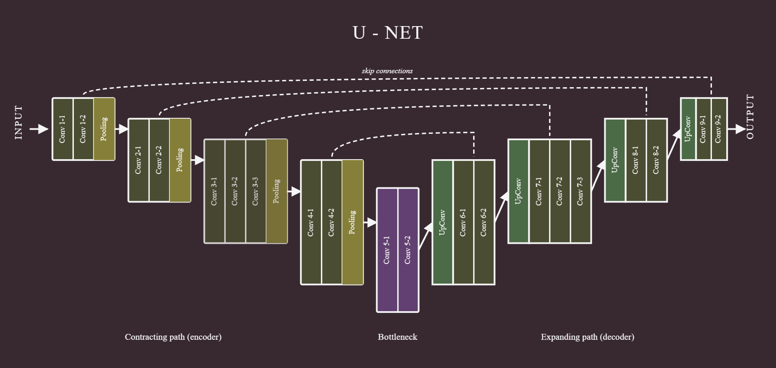
05 • METHODOLOGY
Model 1 — U-Net for Segmentation
Encoder–Decoder with Skip Connections
Contracting path compresses the image through repeated 3×3 convolutions, ReLU, and 2×2 max-pooling — capturing increasingly abstract features.
Expansive path uses up-convolutions to restore spatial resolution and produce a full segmentation map.
Skip connections copy high-resolution features from early layers into the decoder, preserving spatial context for precise localization.
Output is a binary mask highlighting the tumor region for each input MRI slice.
U-Net architecture
Brain MRI Segmentation & Classification | Toronto Metropolitan University
10
Notes:
Our deep learning model to capture image segmentation is called is U-Net.
The same one mentioned previously from the foundational 2015 paper.
It works in two main stages:
encoder, extract features (such as shapes and patterns) and compress the images
decoder, expands it back to the original size of the image to produce a pixel-by-pixel mask of the tumour.
What makes U-Net especially effective is its use of skip connections, which pass detailed information from the encoding stage directly to the decoding stage,
helping the model retain fine details like edges. In simple terms, it learns the big picture and the small details at the same time, allowing it to accurately outline structures like tumors in medical images.

Slide 10
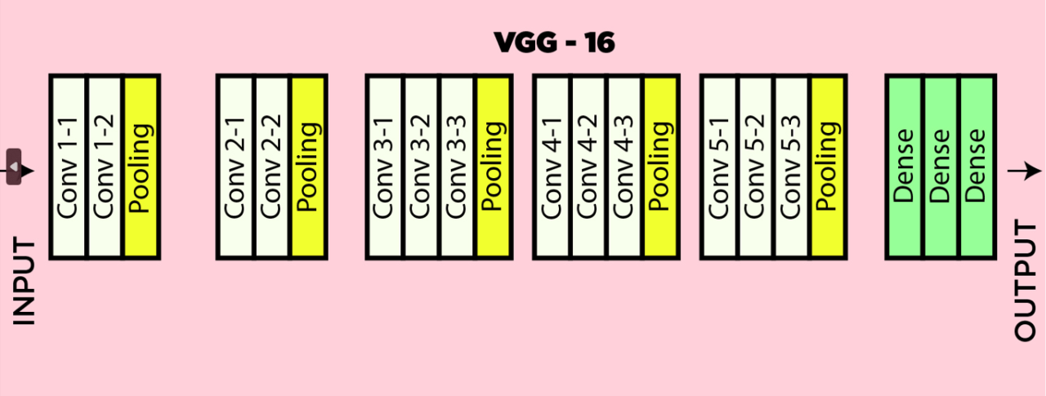
05 • METHODOLOGY
Model 2 — VGG16 for Classification
Transfer Learning from ImageNet
Architecture 13 convolutional layers in 5 blocks with max-pooling, followed by 3 fully connected layers at the classifier head.
Pretrained weights loaded from PyTorch torchvision (ImageNet). The convolutional base was frozen during training.
Replaced head the final fully connected layer was swapped for a new linear layer mapping to 4 output classes.
Preprocessing 224×224 resize, BGR→RGB, ImageNet mean subtraction via Keras preprocess_input().
VGG16 architecture
Brain MRI Segmentation & Classification | Toronto Metropolitan University
11
Notes:
For classification, we used VGG16, a 16-layer convolutional neural network developed by the Visual Geometry Group at Oxford.
The architecture consists of 13 convolutional layers organized into 5 blocks, with max-pooling between each block, followed by 3 fully connected layers at the end.
Instead of training the model from scratch, we used transfer learning, which would be computationally cheaper.(less prone to overfitting)
Specifically, we loaded pretrained weights from PyTorch’s torchvision library and In our implementation, we had frozen the entire convolutional base
The only part we modified was the final fully connected layer, which we replaced with a new linear layer that outputs the four tumor classes
This approach works well because first few convolutional layers have already learned to detect general visual patterns such as edges, textures, and shapes —
These are features that transfer effectively to our medical images.
For preprocessing, we resized all MRI images to 224×224, converted them from BGR to RGB, and applied ImageNet normalization so the inputs match what the pretrained model expects.

Slide 11
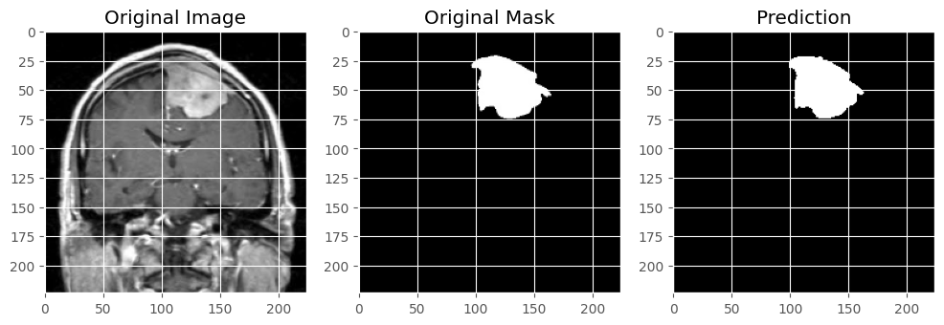
06 • RESULTS
U-Net Segmentation Performance
0.824
0.750
0.998
0.019
Dice Coefficient
IoU (Jaccard)
Binary Accuracy
Final Loss
KEY TAKEAWAY
The model captures the main tumor shape and follows the ground-truth structure well — but has room to improve near edges and low-contrast regions at the pixel level.
Brain MRI Segmentation & Classification | Toronto Metropolitan University
12
Notes:
Here are the U-Net segmentation results. Starting on the left: a Dice coefficient of 0.824 — that means on average our predicted masks have about 82% overlap with the ground truth. The IoU is 0.750, which as we said earlier is always slightly lower than Dice for the same prediction. Binary accuracy is 0.998, but I want to flag that this metric is misleading on its own for segmentation — most pixels in any MRI are background, so even a model that predicts zero tumor everywhere would score very high on pixel accuracy. The Dice and IoU are the numbers that actually matter. Final loss came in at 0.019. On the right you can see one of our prediction examples — the original MRI on the left, the ground-truth mask in the middle, and our prediction on the right. The model captures the overall shape and location of the tumor really well. Where it struggles is at the edges and in low-contrast regions — that's why we land at 0.82 Dice and not 0.95. We think more aggressive preprocessing like skull stripping would close some of that gap.
_____________________________________________________________________________________________________________
We trained the model on the BRISC 2025 dataset, using around 3,500 images for training and about 400 for validation.
In terms of performance, the model achieved a Dice coefficient of 0.824 and an IoU of 0.750, which indicates strong overlap between the predicted tumor regions and the ground truth masks. It also reached a very high binary accuracy of 0.998 (Binary accuracy is 0.998, but I want to flag that this metric is misleading on its own for segmentation — most pixels in any MRI are background, so even a model that predicts zero tumor everywhere would score very high on pixel accuracy.) with a low final loss of 0.019, showing stable and effective learning.
Looking at the examples below, we can see that the model is able to capture the overall shape and location of the tumor quite accurately, closely matching the ground truth masks.
This strong performance is mainly due to the U-Net architecture, which uses skip connections to preserve both spatial and contextual information.
However, the Dice and IoU scores suggest that there is still room for improvement, especially around tumor boundaries and low-contrast regions, where pixel-level precision becomes more challenging.

Slide 12
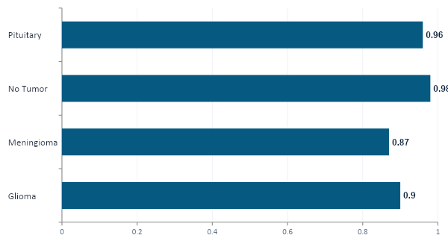
06 • RESULTS
VGG16 Classification Performance
Per-Class F1 Scores
OVERALL ACCURACY
93%
on the held-out evaluation split across all 4 classes
Training: 0.70 → 0.97 accuracy
Loss: 1.64 → 0.10 over 10 epochs
Brain MRI Segmentation & Classification | Toronto Metropolitan University
13
Notes:
On the classification side, our overall accuracy on the held-out test set was 93% across all four classes, training for 10 epoch with a final loss of 0.10. According to the bar graph on the right the model performs well interms of F1 score with the no-tumor and pituitary classes. the model slightly struggles with the Glioma and meningioma classes as visually they are very similar in MRI images.
—---------------------—---------------------—---------------------—---------------------—---------------------—---------------------—---------------------—---------------------—---------------------—---------------------—---------------------—---------------------—---------------------
On the classification side, our overall accuracy on the held-out test set was 93% across all four classes. To give you the training story: over 10 epochs the training accuracy went from 70% in the first epoch up to 97% by the last, and the loss dropped from 1.64 down to 0.10. So the model converged smoothly — it actually learned the difference between the four tumor types rather than just memorizing. Looking at the per-class F1 scores on the right, the model did best on no_tumor at 0.98 and pituitary at 0.96 — those two classes are visually quite distinct. Glioma came in at 0.90 with precision around 0.89 and recall around 0.92, which is solid. The hardest class was meningioma at 0.87, with recall around 0.83 — that means about 17% of the actual meningioma cases got confused with other tumor types. This is consistent with what other papers report: meningiomas can look structurally similar to gliomas in some scans. Both the macro-average and weighted-average F1 were 0.93, which tells us the classifier is balanced and not just doing well on one easy class.

Slide 13
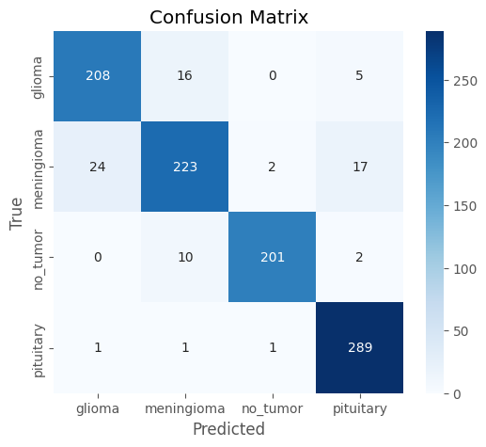
04 • RESULTS
VGG16 Classification Performance (Confusion Matrix)
Key Takeaway
Strong diagonal values: high correct predictions across all classes
pituitary tumors: 289 correct
glioma: 208 correct
meningioma: 223 correct
no_tumors: 201 correct
Observation
Most Confusion: between glioma and meningioma
Minor misclassification: meningioma → pituitary cases
Least eros in: pituitary and no_tumor classes
Brain MRI Segmentation & Classification | Toronto Metropolitan University
9
Notes:
Here we can see the confusion matrix of our classification model. We can see that most of the values are concentrated along the diagonal, which indicates that the model is correctly classifying the majority of the samples, with only minor confusion between closely related classes.
—----------—----------—----------—----------—----------—----------—----------—----------—----------—----------—----------—----------—----------—----------—----------—----------—----------—----------—----------—----------—----------—----------—----------
Continuing with out classification models performance by looking into the confusion matrix.
We can see that most of the values are concentrated along the diagonal, which indicates that the model is correctly classifying the majority of the samples.
In particular, the model performs very well on pituitary tumors with 289 correct predictions, and also shows strong performance for glioma, meningioma, and no tumor classes.
However, there are some misclassifications, mainly between glioma and meningioma, which is expected since these tumor types can appear visually similar in MRI images.
Overall, the results demonstrate that the model achieves high classification accuracy, with only minor confusion between closely related classes.

Slide 14
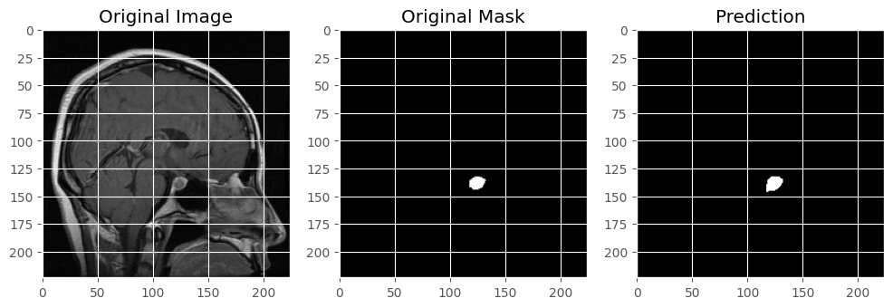
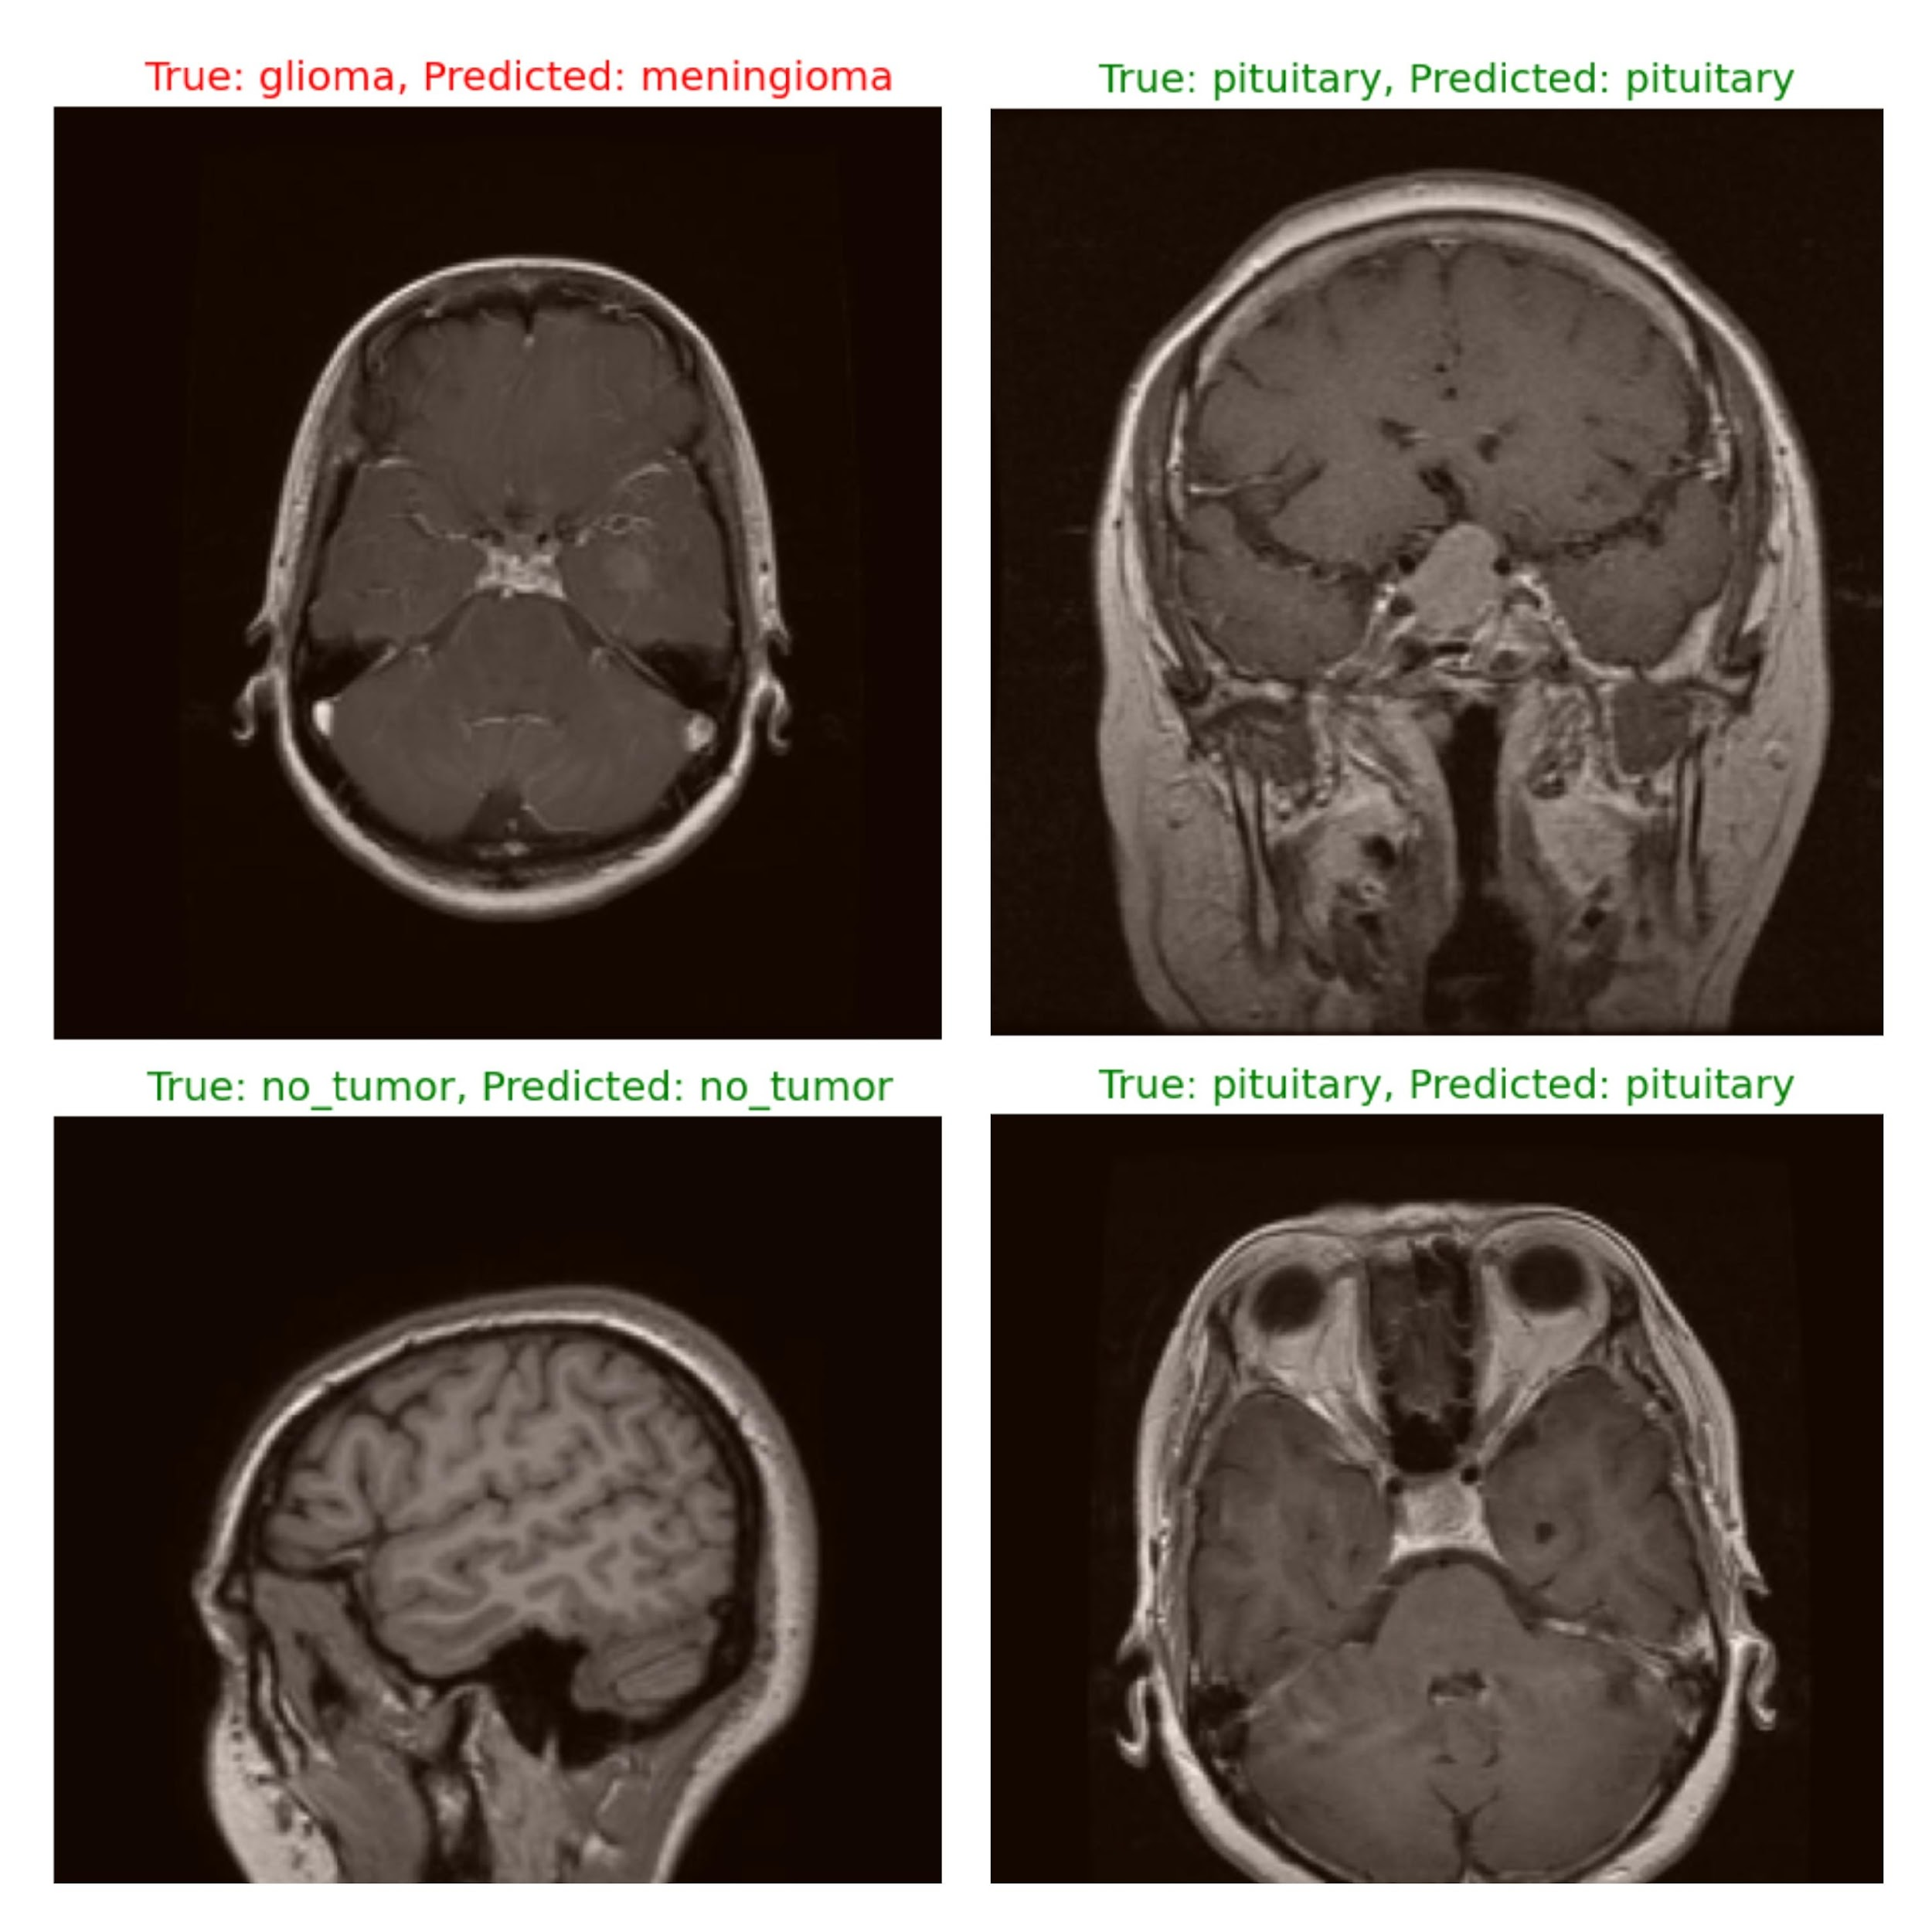
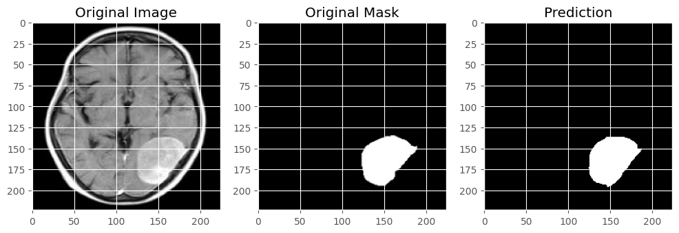
06 • RESULTS
Visual Outputs
U-Net Predicted Masks vs. Ground Truth
VGG16 Predicted Labels vs. Ground Truth
Best class: no_tumor (F1 = 0.98) • Hardest: meningioma (F1 = 0.87)
Brain MRI Segmentation & Classification | Toronto Metropolitan University
14
Notes:
These are some qualitative outputs from both models. On the left, two more U-Net segmentation examples. You can see the predictions follow the rough shape of the ground truth — the top one captures a small lesion well, and the bottom one follows the boundary of a larger tumor. Where you can spot the model's weaknesses is in the fine details right at the edges. On the right are four VGG16 classification examples. Three of them are correct — the model gets the no_tumor scan, the two pituitary scans — and one is a misclassification: a glioma case that got predicted as meningioma. As I mentioned on the previous slide, meningioma vs. glioma is the hardest distinction for our classifier, and that's exactly the kind of error you see here.

Slide 15
05 • DISCUSSION
How We Compare to Arafat et al.
Metric | Our Project | Reference Paper | Gap
Dice Coefficient | 0.824 | 0.94 | −0.116
IoU / Jaccard | 0.750 | 0.68 | +0.070
Classification Accuracy | 93% | ~99% | −6 pts
Glioma (F1 Score) | 0.90 | 0.98 | -0.08
No Tumor (F1 Score) | 0.98 | 0.97 | +0.01
Meningioma (F1 Score) | 0.87 | 0.98 | -0.11
Pituitary (F1 Score) | 0.96 | 0.99 | -0.03
Brain MRI Segmentation & Classification | Toronto Metropolitan University
11
Notes:
in terms of comparison with our reference paper the pipeline fell below the reference pipeline in Dice, classification accurcays and F1 of 3 out of 4 classes. Our pipeline did exceed the reference in Iou and no_tumor F1 score.
—---------------------------------------------
Starting with segmentation, our model achieved a Dice coefficient of 0.824, which is slightly lower than the reference value of 0.94. However, we actually achieved a higher IoU of 0.75 compared to 0.68, indicating strong overlap with the ground truth.
For classification, our model reached an overall accuracy of 93%, compared to about 99% in the reference paper, showing a small performance gap.
Looking at the class-wise F1 scores, our model performs very well on no tumor, slightly outperforming the reference. It also shows strong performance on pituitary tumors.
However, the largest gap appears in the meningioma class, where classification is more challenging due to similarities with other tumor types. We also see a small drop in glioma performance.
Overall, our model remains competitive, with strong segmentation overlap and balanced classification performance, while highlighting areas for improvement in more difficult tumor classes.

Slide 16
05 • DISCUSSION
How We Compare to Arafat et al.
Why the Gap?
Preprocessing depth
Training duration
Model architecture
Reference applied skull stripping and ROI extraction; we used resize + normalization only.
Likely fewer epochs and lighter hyperparameter tuning in our pipeline.
Reference used a custom CNN trained on segmented tumor regions; we used a frozen pretrained VGG16.
Brain MRI Segmentation & Classification | Toronto Metropolitan University
11
Notes:
In terms of reasons why we fell short of the reference paper: first, preprocessing — they applied skull stripping, where you remove the non-brain tissue from the MRI before training, plus region-of-interest extraction. We just did resize and normalization. That extra preprocessing reduces noise and class imbalance and is probably the biggest single factor. Second, training duration — we trained for a limited number of epochs and didn't do extensive hyperparameter tuning. Third, model choice — they used a custom CNN trained directly on segmented tumor regions, while we used a frozen pretrained VGG16. Unfreezing more layers and fine-tuning would likely close some of the classification gap.

Slide 17
06 • DISCUSSION
Conclusion & Future Work
Key Findings
FUTURE WORK
✓ U-Net successfully detected tumor regions with Dice 0.82 and IoU 0.75 — strong overlap with ground truth.
✓ VGG16 reached 93% accuracy across four tumor classes, showing solid discrimination.
✓ The combined pipeline confirms that joint segmentation + classification is a powerful approach for automated brain tumor analysis.
✓ Our IoU actually exceeded the reference paper's Jaccard score by 0.07.
Closing the Gap to State of the Art
→ Add skull stripping and ROI extraction preprocessing
→ Apply data augmentation (rotation, flips, elastic)
→ Fine-tune deeper layers of VGG16 instead of freezing
→ Test attention-augmented U-Net variants (CBAM)
→ Train for more epochs with hyperparameter tuning
Brain MRI Segmentation & Classification | Toronto Metropolitan University
16
Notes:
To wrap up the findings: U-Net successfully segmented the tumor regions with a Dice of 0.82 and an IoU of 0.75. The VGG16 reached 93% accuracy across the four tumor classes, showing the classifier can reliably distinguish between them. The combined pipeline confirms our main hypothesis — that joint segmentation plus classification is a powerful approach for automated brain tumor analysis. For future work, the obvious next steps are the ones we just talked about on the comparison slide. First, add skull stripping and ROI extraction to the preprocessing pipeline — that's the single biggest improvement we could make. Second, apply data augmentation like rotation, flips, and elastic deformations to increase robustness. Third, fine-tune the deeper layers of VGG16 instead of freezing the entire base — that gives the model more capacity to specialize on MRI features. Fourth, try attention-augmented U-Net variants like CBAM that we saw in the literature review. And finally, train for more epochs with proper hyperparameter tuning.

Slide 18
THANK YOU
Questions & Discussion
Toronto Metropolitan University • Department of Electrical and Computer Engineering
Notes:
That brings us to the end. Thanks for listening — happy to take any questions about the dataset, the model architectures, the metrics, or how we'd improve on this in a follow-up project.

