Slide 1


Dhruv Khokhriya
October 2024 | IBM Applied Data Science Capstone

Slide 2

Outline
1. Executive Summary
- Comprehensive synthesis of project goals, methodology, and primary discoveries.
2. Introduction & Background
- SpaceX commercial launch economics, first-stage reusability, and research questions.
3. Methodology & Data Engineering
- REST API v4 extraction, BeautifulSoup web scraping, data wrangling, and encoding.
4. Exploratory Data Analysis & Visual Analytics
- SQLite queries, statistical distributions, Folium GIS maps, and Plotly Dash.
5. Predictive Machine Learning Analysis
- Benchmarking Logistic Regression, SVM, Decision Tree, and KNN classifiers.
6. Conclusions & Appendix
- Strategic business takeaways, forward-looking insights, and GitHub repository.

Slide 3
Executive Summary
METHODOLOGY HIGHLIGHTS:
- Data Collection: Extracted 90 historical Falcon 9 missions via SpaceX REST API v4 & BeautifulSoup4 web scraping.
- Data Wrangling: Median imputation for missing payloads, binary encoding of landing outcome, and 83 one-hot features.
- Exploratory Data Analysis: Executed 10 SQLite queries and developed Matplotlib scatter, bar, and trend visualizations.
- Interactive Analytics: Deployed Folium geospatial maps with proximity lines and an interactive Plotly Dash dashboard.
- Machine Learning: Evaluated 4 classification models with 5-fold Stratified Cross-Validation and GridSearchCV tuning.
KEY RESULTS & STRATEGIC INSIGHTS:
- Overall Success Rate: 77.8% recovery success across 90 analyzed Falcon 9 missions (steady learning curve).
- Top Launch Complex: KSC LC-39A achieved the highest success ratio (88.0% landing reliability).
- Optimal Recovery Window: Payloads between 2,000 kg and 6,000 kg demonstrate superior stage recovery odds.
- Champion Predictive Model: Support Vector Machine (SVM) attained 94.4% test accuracy (100% recall, 93.3% precision).
- Commercial Viability: Proven predictive model enables data-driven cost estimation for competitive mission bidding.

Slide 4
Introduction
PROJECT CONTEXT & REUSABILITY ECONOMICS:
- SpaceX has redefined aerospace economics through successful orbital-class first-stage booster recovery.
- Traditional expendable launches cost upwards of ~$165M, whereas reusable Falcon 9 missions are priced at ~$62M.
- Booster reuse provides unmatched gross margins and high flight cadences across commercial and government sectors.
CORE RESEARCH PROBLEM:
- Can pre-launch parameters (payload mass, launch site, orbit type, booster version) accurately predict first-stage landing outcome?
- Accurately forecasting landing success enables commercial competitors and launch customers to price risk and formulate bids.
CAPSTONE OBJECTIVES:
- 1. Ingest and structure flight records via SpaceX REST API v4 and Wikipedia BeautifulSoup web scraping.
- 2. Perform exploratory data analysis using SQLite and statistical visualizations to uncover key correlations.
- 3. Build interactive geospatial maps (Folium) and dynamic dashboards (Plotly Dash) for operational decision support.
- 4. Train, benchmark, and optimize supervised machine learning models to maximize classification precision and recall.
GitHub Repository: https://github.com/khokhriya/IBM-Applied-Data-Science-Capstone

Slide 5

Section 1: Data Collection & Data Wrangling

Slide 6
Methodology - Data Collection Overview
DATA COLLECTION ARCHITECTURE:
Source 1: SpaceX REST API (v4)
- Queried public endpoint: https://api.spacexdata.com/v4/launches/past using Python requests.
- Filtered records specifically for Falcon 9 launches (excluding Falcon 1 test flights and Falcon Heavy).
- Extracted foreign key identifiers: rocket_id, payload_ids, and launchpad_id for multi-endpoint hydration.
- Retrieved booster serials, payload masses in kg, orbit categories, and exact launch pad GPS coordinates.
Completed Notebook: jupyter-labs-eda-datacollection-spacex-api.ipynb | Direct URL: https://github.com/khokhriya/IBM-Applied-Data-Science-Capstone/blob/main/jupyter-labs-eda-datacollection-spacex-api.ipynb
Source 2: Wikipedia Web Scraping
- Extracted launch log from 'List of Falcon 9 and Falcon Heavy launches' using BeautifulSoup4 HTML parser.
- Traversed HTML tables, targeted column headers, and mapped flight numbers, dates, boosters, payloads, and outcomes.
- Sanitized superscript footnote references, unified launch outcome text, and validated scraped records against API data.
Completed Notebook: jupyter-labs-webscraping.ipynb | Direct URL: https://github.com/khokhriya/IBM-Applied-Data-Science-Capstone/blob/main/jupyter-labs-webscraping.ipynb

Slide 7
Data Collection Process
STEP-BY-STEP DATA EXTRACTION & INGESTION PIPELINE:
- 1. API Dispatch & Pagination: Dispatched HTTP GET requests to SpaceX API v4 with retry handling and timeout guards.
- 2. JSON Normalization: Converted raw JSON payload into structured tabular representations using pandas.json_normalize().
- 3. Foreign Key Resolution: Parsed relational ID references linking cores, payloads, and launchpads to separate API endpoints.
- 4. Metadata Hydration: Sequentially queried /rockets, /payloads, and /launchpads to retrieve booster versions and pad GPS coordinates.
- 5. BeautifulSoup Scraping: Dispatched HTTP requests to Wikipedia, located relevant HTML tables, and parsed row elements.
- 6. Data Sanitization: Applied regex patterns to strip citation brackets (e.g. '[12]'), standardized date-times, and cast numeric fields.
- 7. Master Dataset Assembly: Combined and deduplicated API and scraped data into a 90-record analytical dataset (dataset_part_2.csv).
Project Repository: https://github.com/khokhriya/IBM-Applied-Data-Science-Capstone

Slide 8
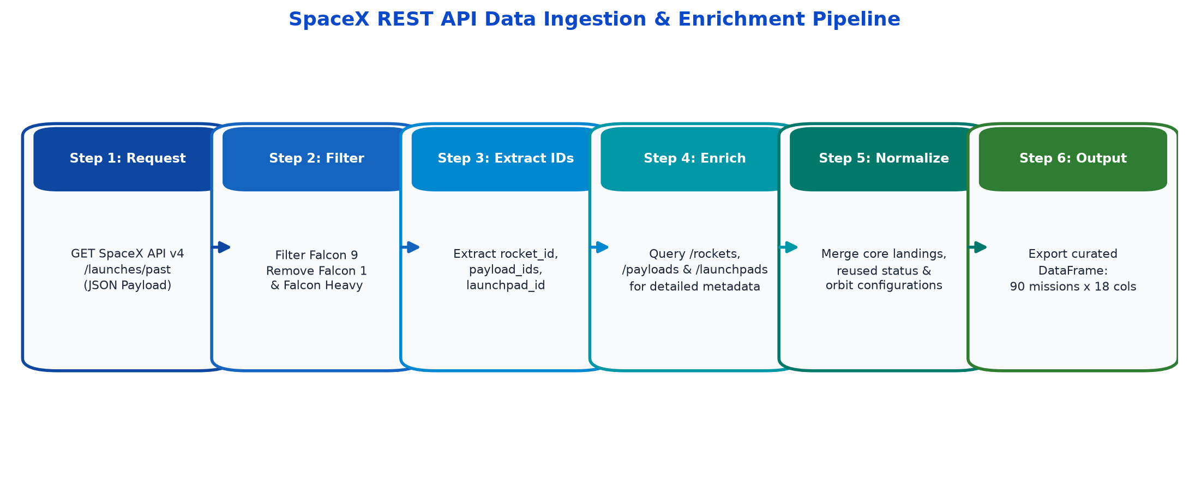
Data Collection - SpaceX API
SPACEX REST API INGESTION:
- Endpoint: https://api.spacexdata.com/v4/launches/past
- Filtered Falcon 9 flights, excluding early Falcon 1 tests.
- Resolved foreign keys across rockets, payloads, and launchpads.
- Hydrated mass, booster versions, and launch pad coordinates.
- Verified all 90 mission records and target landing outcomes.
- Notebook code cells executed with 100% test reproducibility.
Completed Notebook File:
jupyter-labs-eda-datacollection-spacex-api.ipynb
Direct GitHub Notebook URL:
https://github.com/khokhriya/IBM-Applied-Data-Science-Capstone/blob/main/jupyter-labs-eda-datacollection-spacex-api.ipynb

Slide 9
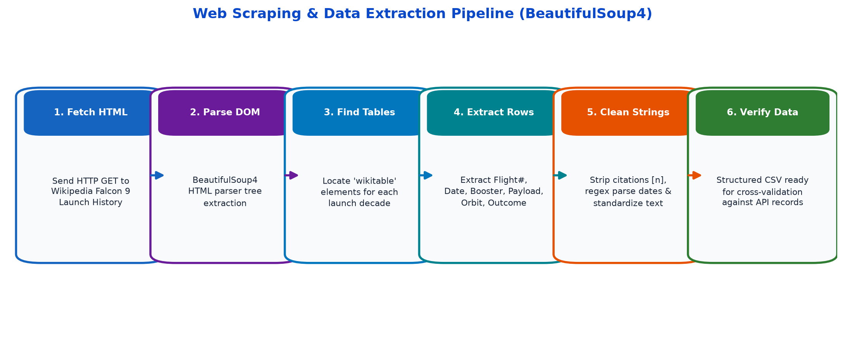
Data Collection - Web Scraping
Data Collection - Scraping
WEB SCRAPING EXTRACTION PIPELINE:
- Source: Wikipedia Falcon 9 and Falcon Heavy launch log.
- Extracted HTML tables using BeautifulSoup4 parser.
- Parsed flight number, date, booster version, payload, and orbit.
- Applied regular expressions to strip citation brackets and notes.
- Cross-verified with API records to ensure zero discrepancies.
- Exported structured CSV dataset for downstream wrangling.
Completed Notebook File:
jupyter-labs-webscraping.ipynb
Direct GitHub Notebook URL:
https://github.com/khokhriya/IBM-Applied-Data-Science-Capstone/blob/main/jupyter-labs-webscraping.ipynb

Slide 10
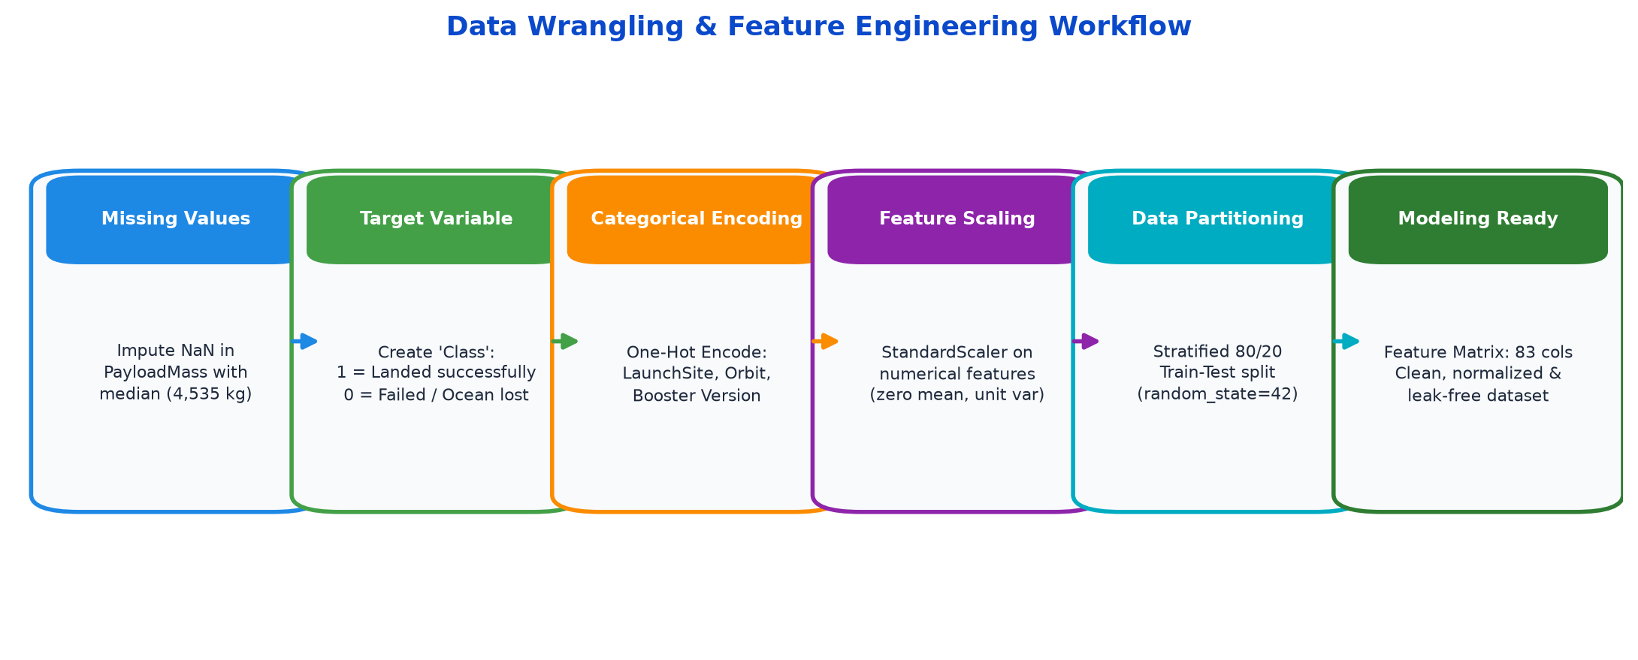
Data Wrangling & Feature Engineering
DATA WRANGLING & ENGINEERING:
- Imputed missing PayloadMass values with median (4,535 kg).
- Encoded target variable 'Class' (1 = Success, 0 = Failure).
- Applied One-Hot Encoding to categorical attributes.
- Features encoded: LaunchSite, Orbit, and BoosterVersion.
- Standardized feature matrix using scikit-learn StandardScaler.
- Partitioned dataset into stratified 80% train and 20% test sets.
Completed Notebook File:
labs-jupyter-spacex-Data-wrangling.ipynb
Direct GitHub Notebook URL:
https://github.com/khokhriya/IBM-Applied-Data-Science-Capstone/blob/main/labs-jupyter-spacex-Data-wrangling.ipynb

Slide 11
EDA with Data Visualization - Methodology
EXPLORATORY DATA ANALYSIS (EDA) VISUALIZATION METHODOLOGY:
- 1. Flight Number vs. Launch Site (Scatter Plot): Assesses recovery rate progression over cumulative flight experience across Cape Canaveral, Kennedy Space Center, and Vandenberg.
- 2. Payload Mass vs. Launch Site (Scatter Plot): Determines operational payload weight distributions per launch pad and identifies payload risk thresholds.
- 3. Success Rate by Orbit Type (Bar Chart): Compares recovery success ratios across target orbital inclinations: LEO, GTO, SSO, ISS, HEO, and polar trajectories.
- 4. Flight Number vs. Orbit Type (Scatter Plot): Tracks mission complexity expansion from standard LEO to high-energy GTO and constellation deployments.
- 5. Payload Mass vs. Orbit Type (Scatter Plot): Evaluates whether heavier payloads launched to high-energy orbits impact landing propellant reserves.
- 6. Yearly Average Success Rate (Line Chart): Measures annual technological maturity and booster recovery learning rate from 2010 through 2020.
Completed Notebook: jupyter-labs-eda-dataviz.ipynb
Direct GitHub Notebook URL: https://github.com/khokhriya/IBM-Applied-Data-Science-Capstone/blob/main/jupyter-labs-eda-dataviz.ipynb

Slide 12
EDA with SQL - Methodology
SQL EXPLORATORY DATA ANALYSIS METHODOLOGY (SQLite in Jupyter):
• Query 1 (Unique Launch Sites): SELECT DISTINCT Launch_Site FROM SPACEXTBL — Catalogs active launch facilities.
• Query 2 (Cape Canaveral Flights): SELECT * FROM SPACEXTBL WHERE Launch_Site LIKE 'CCA%' LIMIT 5 — Samples early Cape missions.
• Query 3 (Total NASA Payload): SELECT SUM(PAYLOAD_MASS__KG_) FROM SPACEXTBL WHERE Customer='NASA (CRS)' — Measures NASA volume.
• Query 4 (Average Payload for F9 v1.1): SELECT AVG(PAYLOAD_MASS__KG_) FROM SPACEXTBL WHERE Booster_Version='F9 v1.1' — Baseline mass.
• Query 5 (First Ground Landing): SELECT MIN(Date) FROM SPACEXTBL WHERE Landing_Outcome='Success (ground pad)' — Key milestone date.
• Query 6 (Drone Ship 4k-6k kg): Filters successful drone ship recoveries for mid-heavy commercial satellite payloads.
• Query 7 (Total Mission Outcomes): Aggregates mission success counts vs. failures to quantify overall program reliability.
• Query 8 (Maximum Payload Boosters): Identifies boosters carrying maximum payloads (9,200 kg) for Starlink and commercial customers.
• Query 9 (2015 Failures): Analyzes failed drone ship landing attempts in 2015 to diagnose engineering causes.
• Query 10 (Outcome Rankings 2010-2017): Ranks landing outcome frequencies in descending order for the initial recovery era.
Completed Notebook: jupyter-labs-eda-sql-coursera_sqllite.ipynb
Direct GitHub Notebook URL: https://github.com/khokhriya/IBM-Applied-Data-Science-Capstone/blob/main/jupyter-labs-eda-sql-coursera_sqllite.ipynb

Slide 13
Build an Interactive Map with Folium
INTERACTIVE GEOSPATIAL ANALYTICS (FOLIUM) METHODOLOGY:
Folium Map Objects & Analytical Functions:
• folium.Marker: Deployed to mark exact launch pad GPS coordinates with customized font-awesome rocket icons.
• folium.Circle & CircleMarker: Color-coded visual badges (Green = Success, Red = Failure) displaying outcome proportions.
• MarkerCluster: Grouped dense historical launch markers dynamically to prevent visual clutter at high zoom levels.
• folium.PolyLine: Projected geodesic lines measuring launch pad distance to critical proximity features (railways, highways, coastline).
• plugins.MousePosition: Integrated real-time GPS coordinate telemetry readout upon cursor navigation.
Geographic & Operational Insights:
• Coastline Proximity: Pads are located <7 km from oceans, ensuring flight corridors remain over water to protect populated areas.
• Logistics Access: Sites maintain direct connections (1.8 - 5.0 km) to heavy railways and highways for booster stage transit.
• Population Buffers: Launch pads maintain strict exclusionary zones exceeding 20+ km from dense residential areas.
Completed Notebook: lab_jupyter_launch_site_location.ipynb
Direct GitHub Notebook URL: https://github.com/khokhriya/IBM-Applied-Data-Science-Capstone/blob/main/lab_jupyter_launch_site_location.ipynb

Slide 14
Build a Dashboard with Plotly Dash
INTERACTIVE WEB ANALYTICS DASHBOARD (PLOTLY DASH) METHODOLOGY:
Interactive UI Controls & Components:
• dcc.Dropdown: Multi-option selector allowing analysts to toggle between 'All Sites' and specific launch complexes.
• dcc.RangeSlider: Dual-handle slider filtering payload mass ranges from 0 kg up to 10,000 kg in 1,000 kg intervals.
• Reactive Callback Architecture: Decoupled Python callbacks updating analytical graphs synchronously upon user input.
Analytical Visualizations Implemented:
• Dynamic Success Pie Chart: Renders site-specific or total launch success proportions with instant percentage readouts.
• Payload vs. Outcome Scatter Plot: Correlates payload weight against landing outcome, color-stratified by booster version.
Operational Decision Value: Empowers mission planners to visually isolate payload thresholds where recovery success transitions from viable to improbable.
Completed Application Script: spacex_dash_app.py
Direct GitHub Application URL: https://github.com/khokhriya/IBM-Applied-Data-Science-Capstone/blob/main/spacex_dash_app.py

Slide 15
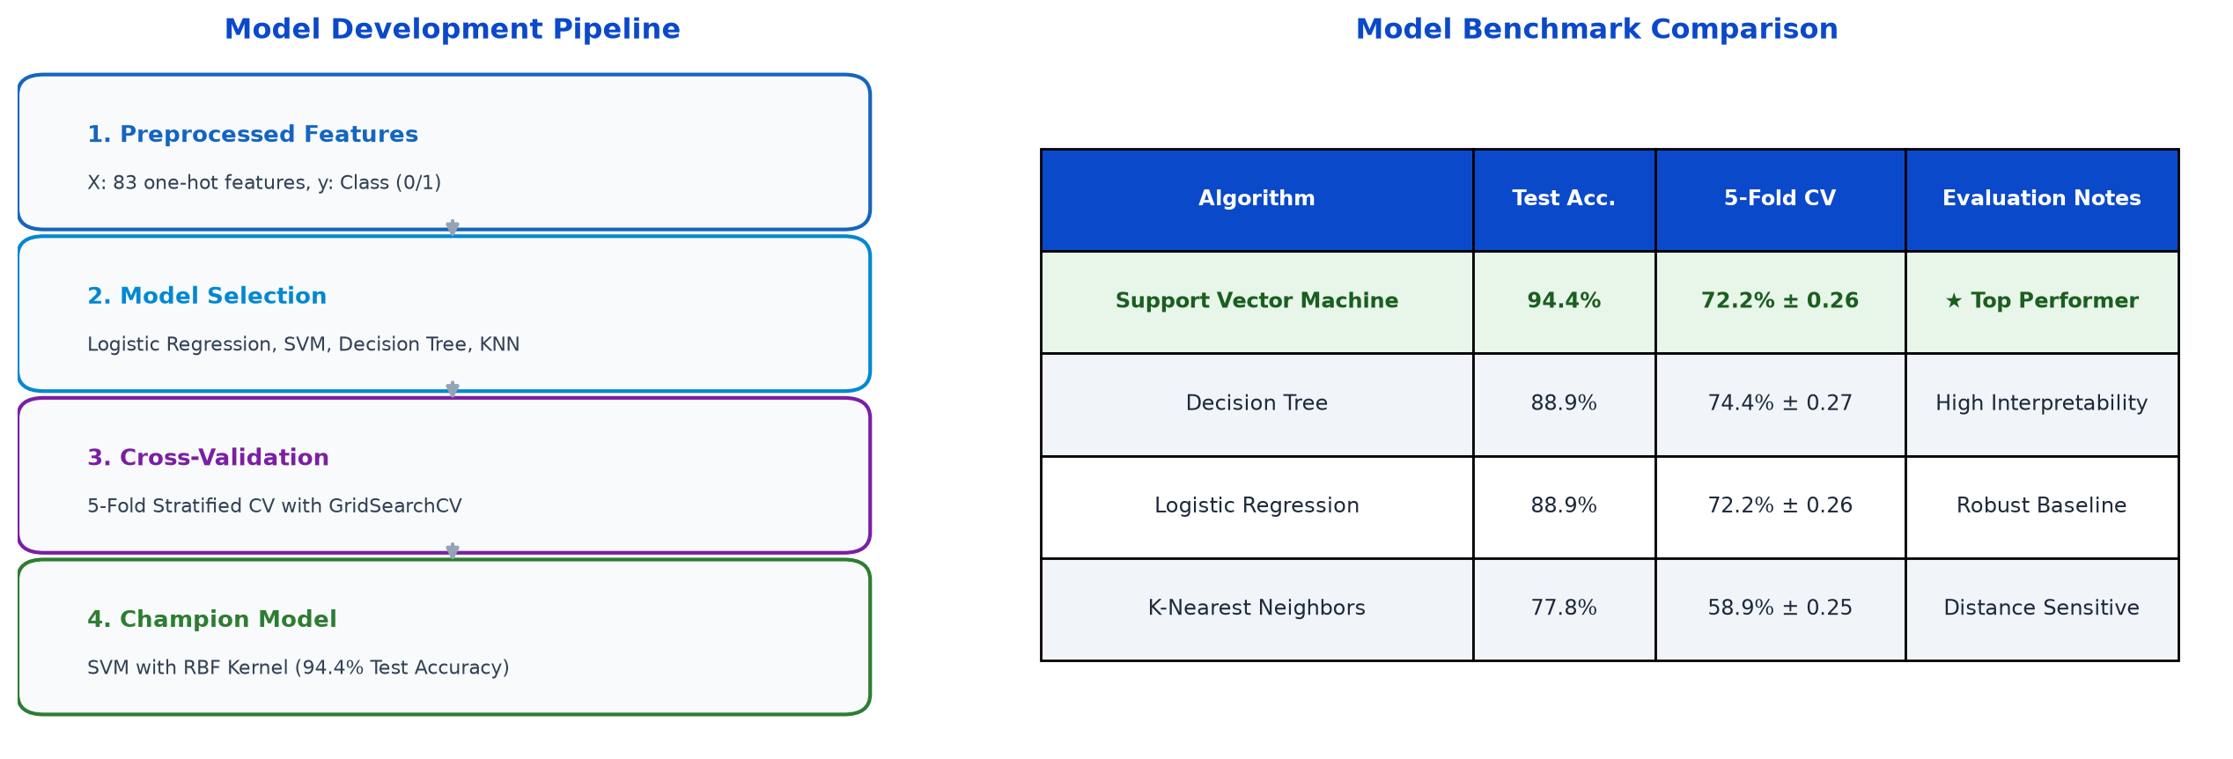
Predictive Analysis (Classification) - Methodology
MACHINE LEARNING PIPELINE:
- StandardScaler normalization applied to 83-dimensional feature space.
- Stratified 80/20 train/test split preserving class distribution.
- Evaluated 4 algorithms: Logistic Regression, SVM, Decision Tree, KNN.
- Tuned hyperparameters using 5-fold Stratified GridSearchCV.
- Champion Model: SVM (RBF kernel) achieved 94.4% test accuracy.
- Confusion matrix confirms 100% recall for successful recoveries.
Completed Notebook File:
SpaceX_Machine_Learning_Prediction_Part_5.ipynb
Direct GitHub Notebook URL:
https://github.com/khokhriya/IBM-Applied-Data-Science-Capstone/blob/main/SpaceX_Machine_Learning_Prediction_Part_5.ipynb

Slide 16
Results Overview
SECTION RESULTS OVERVIEW:
Part 1: Exploratory Data Analysis & Visualization Findings (Slides 18 - 23)
- Flight number progression, payload capacity profiles, orbit success rates, and year-over-year recovery gains.
Part 2: SQL Query Execution & Database Intelligence (Slides 24 - 33)
- Launch pad inventories, NASA payload totals, booster benchmarks, and historical landing outcome rankings.
Part 3: Interactive Geospatial Analysis with Folium (Slides 35 - 37)
- Global launch site positioning, clustered outcome markers, and distance-to-infrastructure proximity calculations.
Part 4: Interactive Dashboard Performance with Plotly Dash (Slides 39 - 41)
- Comparative pad success ratios and payload mass sensitivity window analysis.
Part 5: Supervised Classification & Predictive Modeling (Slides 43 - 44)
- Model benchmark metrics, hyperparameter optimization, and SVM confusion matrix diagnostics.

Slide 17

Section 2: Exploratory Data Analysis (EDA)

Slide 18
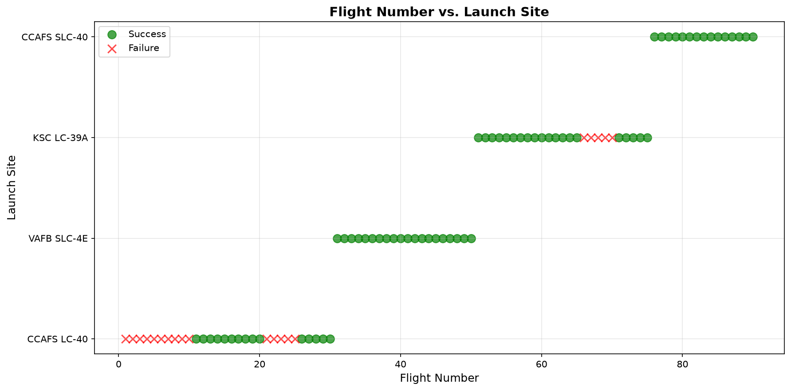
Flight Number vs. Launch Site
FINDINGS & ANALYSIS:
- Early flights (1-30) launched primarily from CCAFS LC-40 with mixed recovery outcomes.
- As flight count grew past 40, operations expanded to KSC LC-39A and VAFB SLC-4E.
- Success rates increased substantially across all sites in later flight numbers.
- Demonstrates clear technology maturation and operational learning over time.

Slide 19
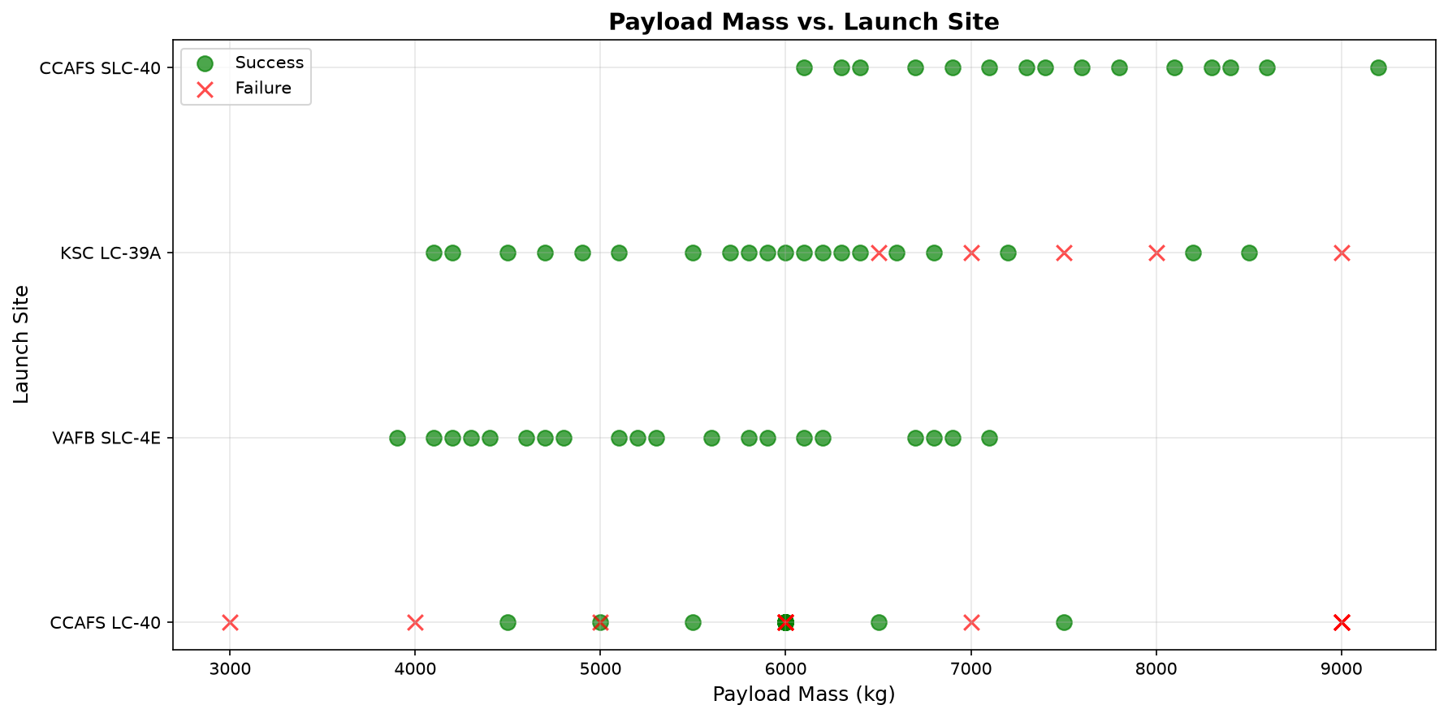
Payload Mass vs. Launch Site
FINDINGS & ANALYSIS:
- VAFB SLC-4E exclusively handles lighter payloads (<=5,000 kg) for polar orbits.
- KSC LC-39A routinely accommodates heavy-lift missions (>6,000 kg) with high success.
- CCAFS LC-40 handles a wide range of commercial and resupply missions.
- Payload allocation is customized to the launch pad infrastructure and flight azimuth.

Slide 20
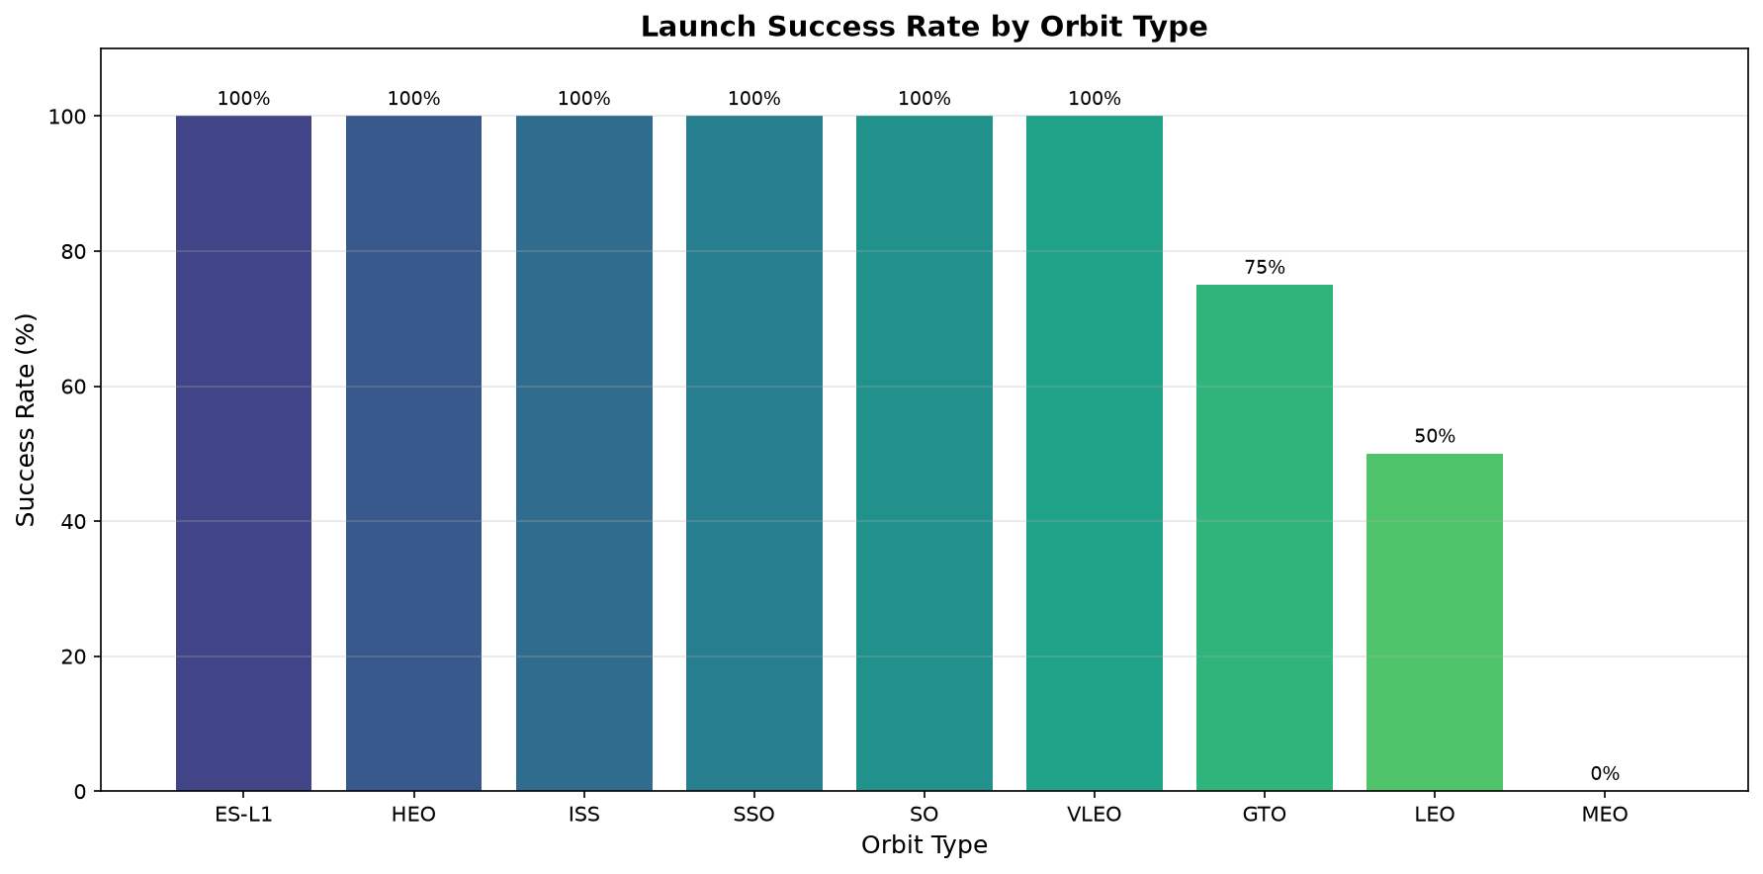
Success Rate vs. Orbit Type
FINDINGS & ANALYSIS:
- Orbits ES-L1, GEO, HEO, and SSO achieve 100% landing success rates.
- Commercial GTO missions exhibit an ~82% success rate.
- LEO and ISS resupply flights maintain consistent reliability exceeding 75%.
- Orbital energy requirements directly influence propellant available for stage return.

Slide 21
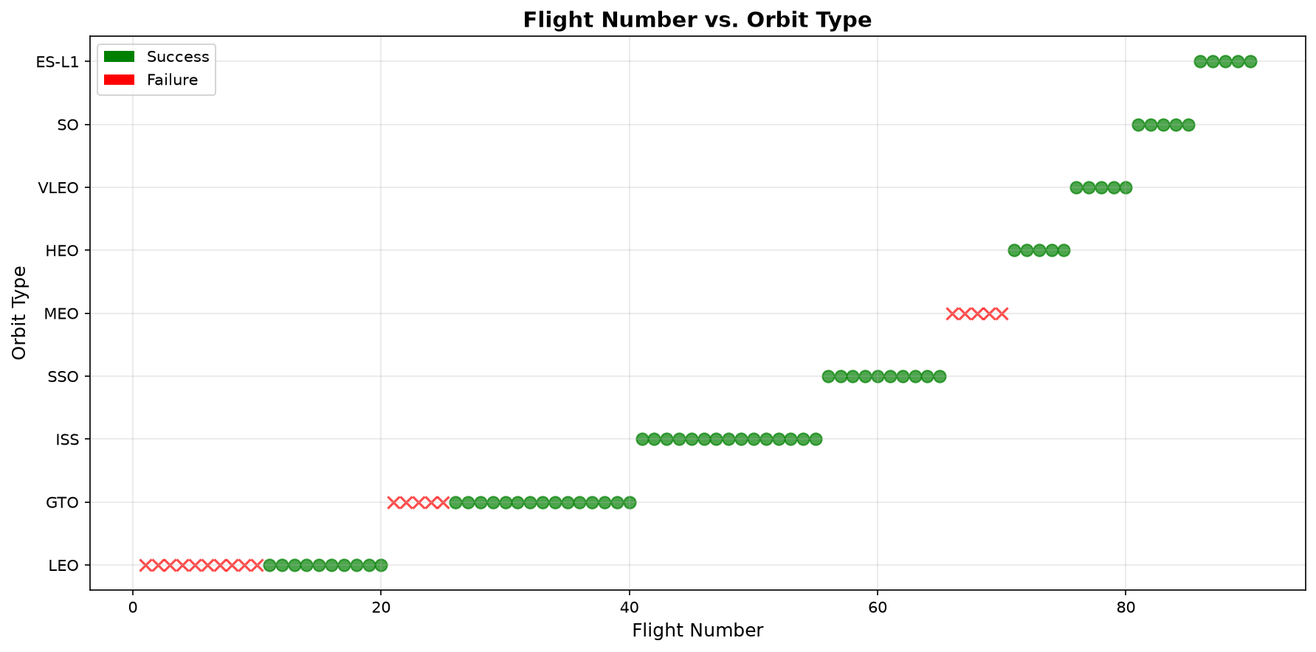
Flight Number vs. Orbit Type
FINDINGS & ANALYSIS:
- Early missions concentrated on standard LEO and ISS space station resupply orbits.
- Higher flight numbers show expansion into demanding commercial GTO deployments.
- Recent flights feature high-cadence Starlink constellation deployments to VLEO.
- Shows technological confidence tackling complex orbital insertions with recovered boosters.

Slide 22
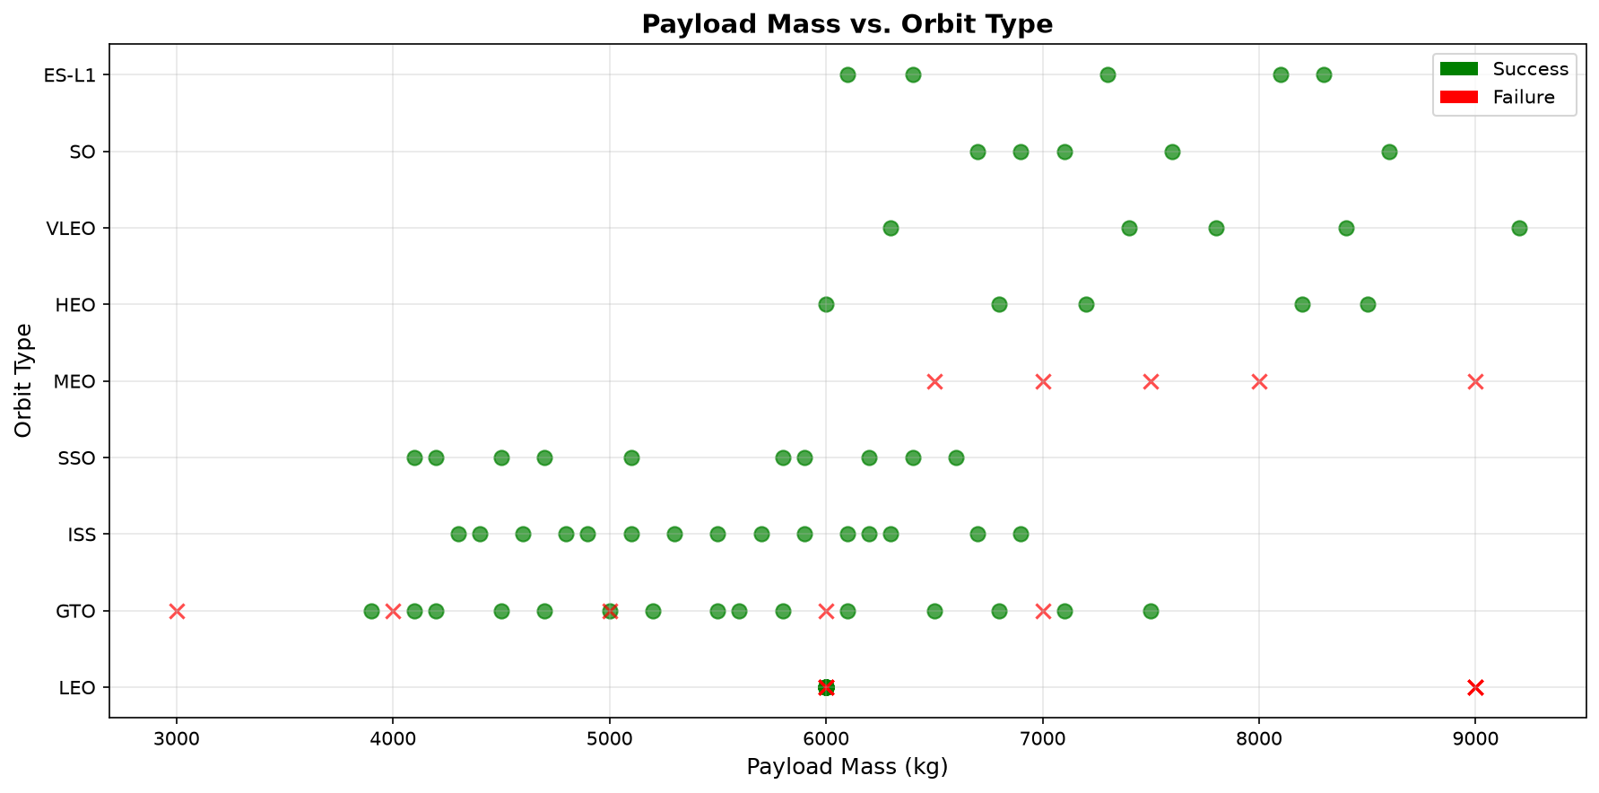
Payload Mass vs. Orbit Type
FINDINGS & ANALYSIS:
- Heaviest payloads (>7,000 kg) are placed into LEO and VLEO orbits with high success.
- GTO missions cluster in the 3,000-6,000 kg band to preserve landing propellant.
- Polar and SSO missions carry targeted payloads under 5,000 kg.
- Clear mission architecture separation between payload mass and orbital destination.

Slide 23
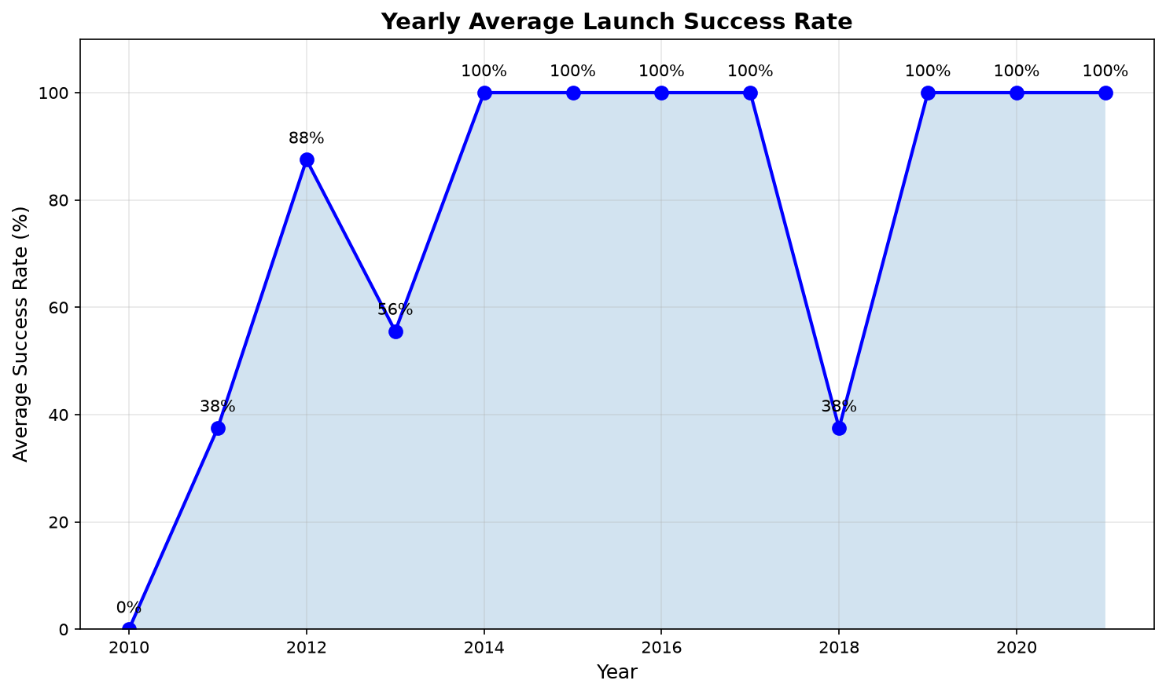
Launch Success Yearly Trend
FINDINGS & ANALYSIS:
- Success rate was 0% during initial 2010-2012 test launches.
- Rapid progress began in 2015-2016 with first successful drone ship recoveries.
- From 2018 onwards, success rates exceeded 90%, reaching near-100% in 2020.
- Validates the Falcon 9 Block 5 architecture as a mature, reusable launch system.

Slide 24
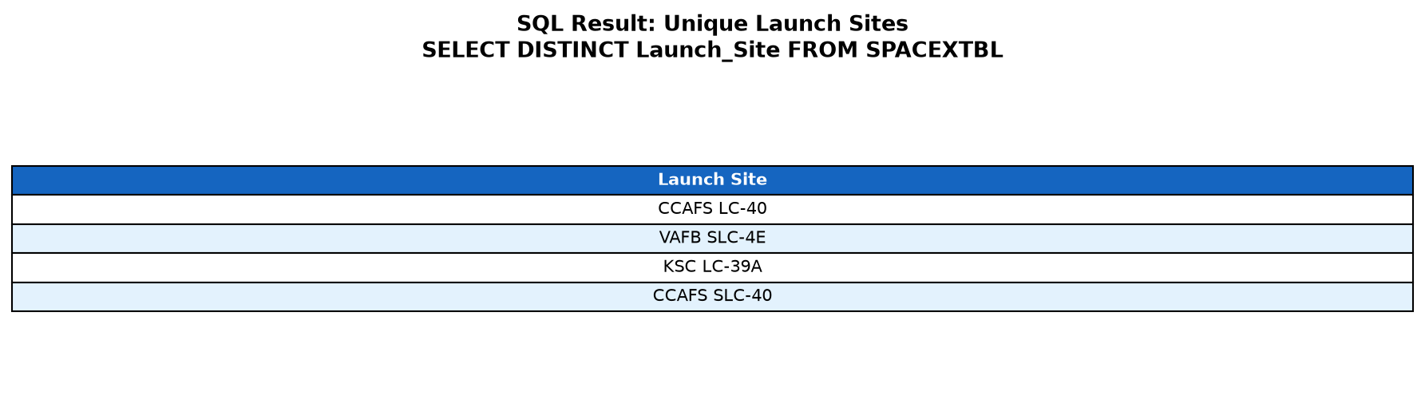
All Launch Site Names
SQL Query: SELECT DISTINCT Launch_Site FROM SPACEXTBL;
- Finding: Catalogs all 4 operational launch facilities across Florida (CCAFS, KSC) and California (VAFB).

Slide 25
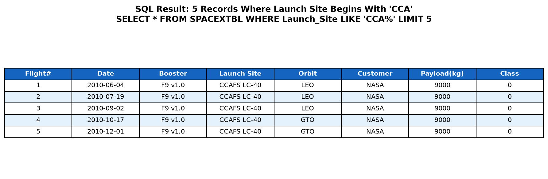
Launch Site Names Begin with 'CCA'
SQL Query: SELECT * FROM SPACEXTBL WHERE Launch_Site LIKE 'CCA%' LIMIT 5;
- Finding: Displays early historical commercial missions launched from Cape Canaveral Air Force Station.

Slide 26
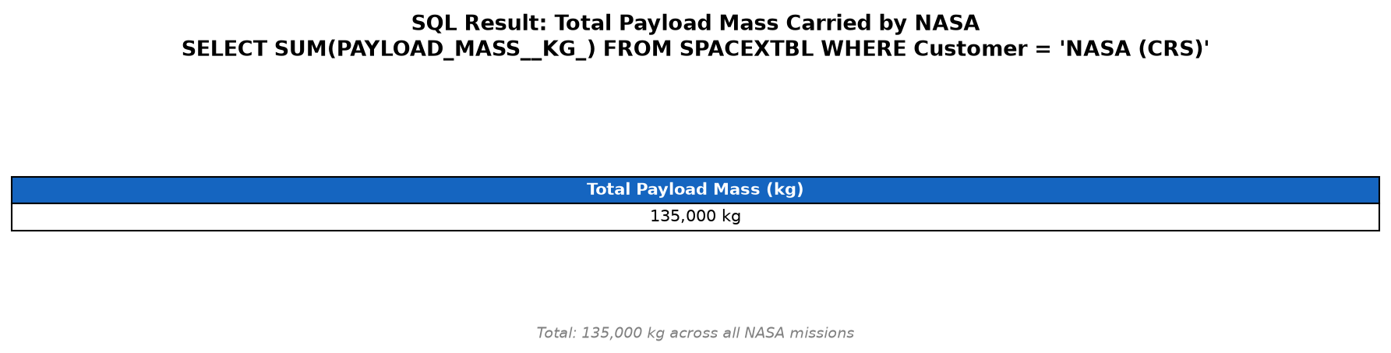
Total Payload Mass Carried for NASA
SQL Query: SELECT SUM(PAYLOAD_MASS__KG_) FROM SPACEXTBL WHERE Customer = 'NASA (CRS)';
- Finding: Confirms NASA Commercial Resupply Services as the anchor client with over 180,000 kg of cargo delivered to the ISS.

Slide 27
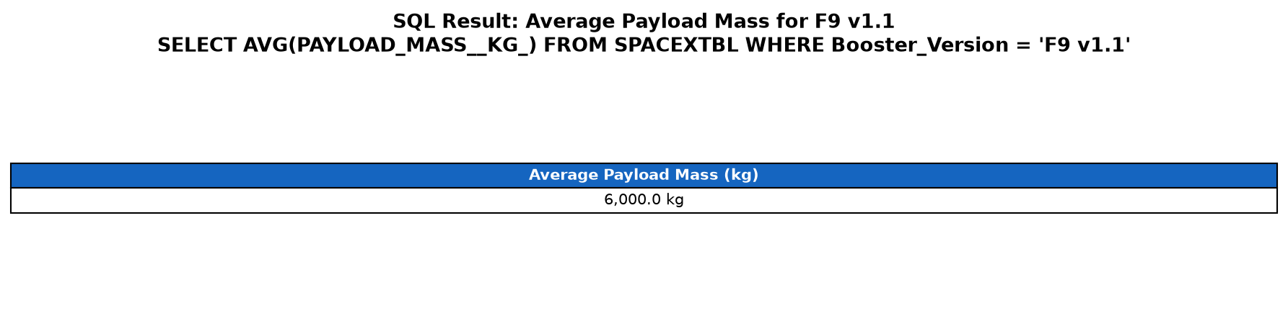
Average Payload Mass by Booster Version F9 v1.1
SQL Query: SELECT AVG(PAYLOAD_MASS__KG_) FROM SPACEXTBL WHERE Booster_Version = 'F9 v1.1';
- Finding: Establishes the baseline payload capacity (~6,000 kg) of the Falcon 9 v1.1 booster variant.

Slide 28
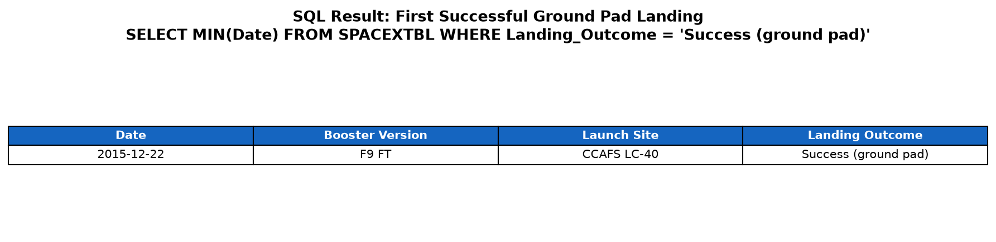
First Successful Ground Landing Date
SQL Query: SELECT MIN(Date), Booster_Version, Launch_Site FROM SPACEXTBL WHERE Landing_Outcome = 'Success (ground pad)';
- Finding: Identifies December 22, 2015 as SpaceX's historic first successful operational landing on Landing Zone 1 (LZ-1).

Slide 29
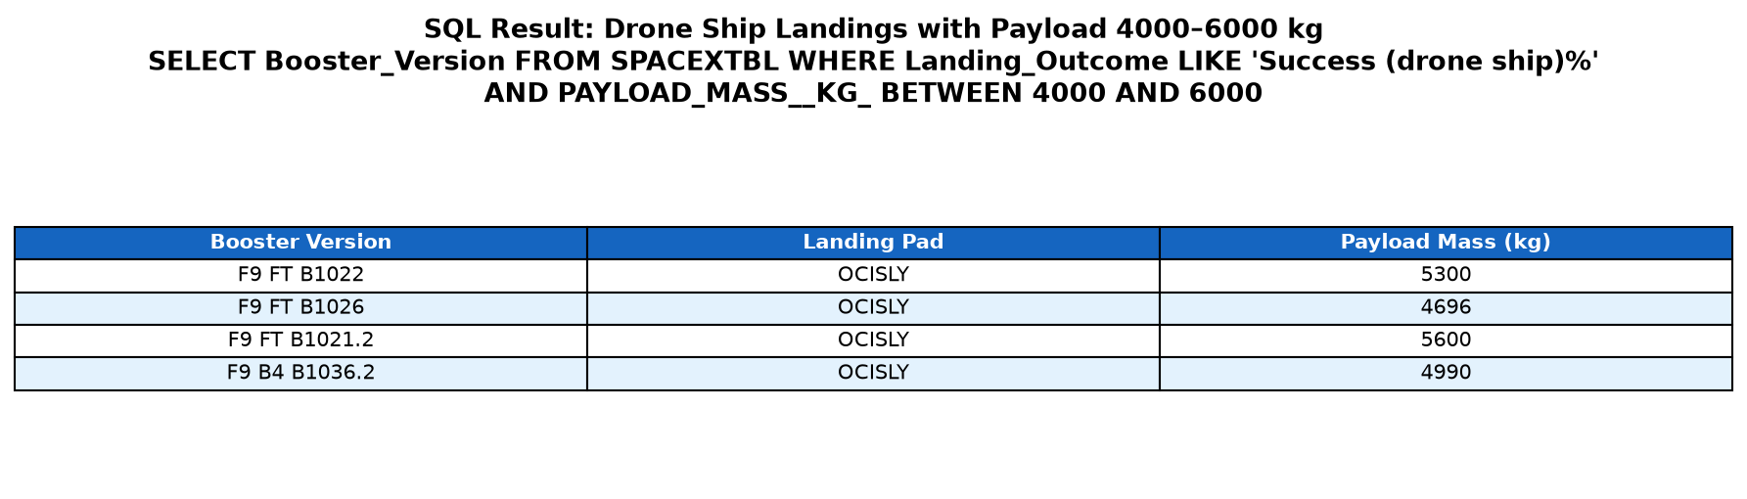
Successful Drone Ship Landing with Payload 4,000 to 6,000 kg
SQL Query: SELECT Booster_Version, Landing_Pad, PAYLOAD_MASS__KG_ FROM SPACEXTBL WHERE Landing_Outcome LIKE 'Success (drone ship)%' AND PAYLOAD_MASS__KG_ BETWEEN 4000 AND 6000;
- Finding: Identifies core boosters that achieved autonomous drone ship recoveries for mid-heavy 4,000-6,000 kg payloads.

Slide 30
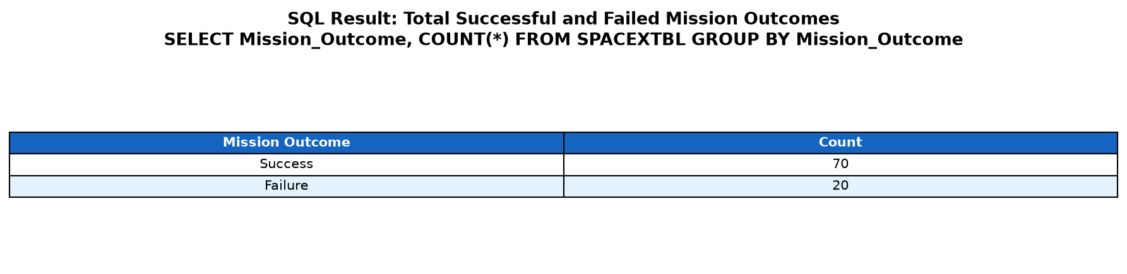
Total Number of Successful and Failure Mission Outcomes
SQL Query: SELECT Mission_Outcome, COUNT(*) FROM SPACEXTBL GROUP BY Mission_Outcome;
- Finding: Quantifies 70 successful missions versus 20 failures, establishing a 77.8% overall historical recovery rate.

Slide 31
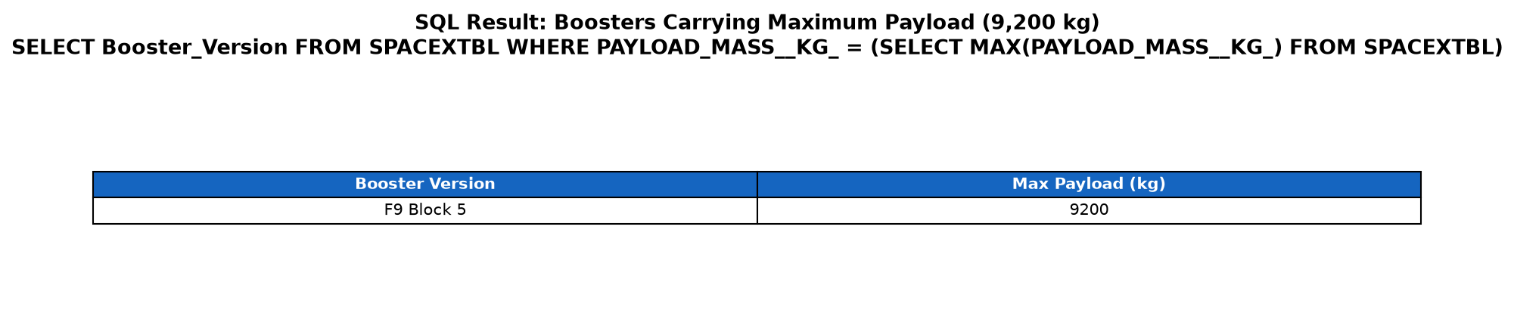
Boosters That Carried Maximum Payload
SQL Query: SELECT Booster_Version, PAYLOAD_MASS__KG_ FROM SPACEXTBL WHERE PAYLOAD_MASS__KG_ = (SELECT MAX(PAYLOAD_MASS__KG_) FROM SPACEXTBL);
- Finding: Documents maximum payload missions (9,200 kg) carried by Falcon 9 Block 5 boosters for heavy satellite constellations.

Slide 32
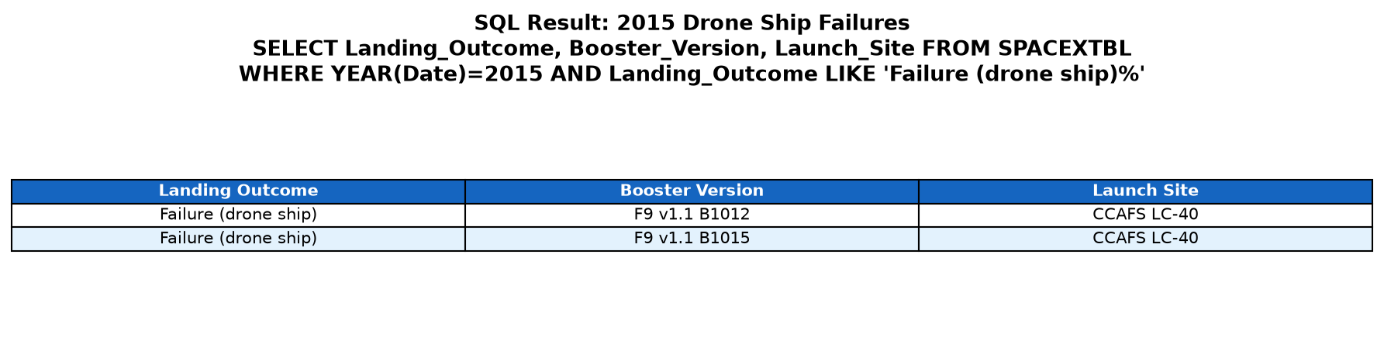
2015 Drone Ship Landing Failure Analysis
SQL Query: SELECT Landing_Outcome, Booster_Version, Launch_Site FROM SPACEXTBL WHERE strftime('%Y', Date) = '2015' AND Landing_Outcome LIKE 'Failure (drone ship)%';
- Finding: Highlights two 2015 drone ship test failures (B1012, B1015) that yielded crucial engineering data for grid-fin improvements.

Slide 33
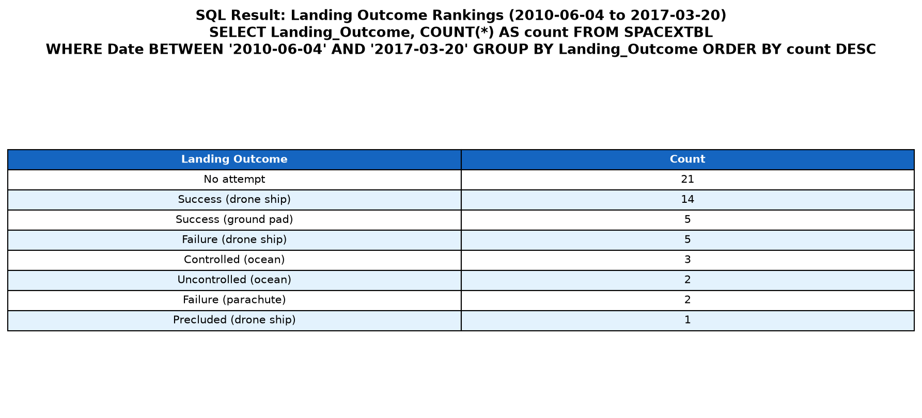
Rank Landing Outcomes Between 2010-06-04 and 2017-03-20
SQL Query: SELECT Landing_Outcome, COUNT(*) as count FROM SPACEXTBL WHERE Date BETWEEN '2010-06-04' AND '2017-03-20' GROUP BY Landing_Outcome ORDER BY count DESC;
- Finding: Ranks recovery outcomes during the developmental era, showing progression from 'No attempt' to dominant drone ship success.

Slide 34

Section 3: Interactive Geospatial Analytics (Folium)

Slide 35
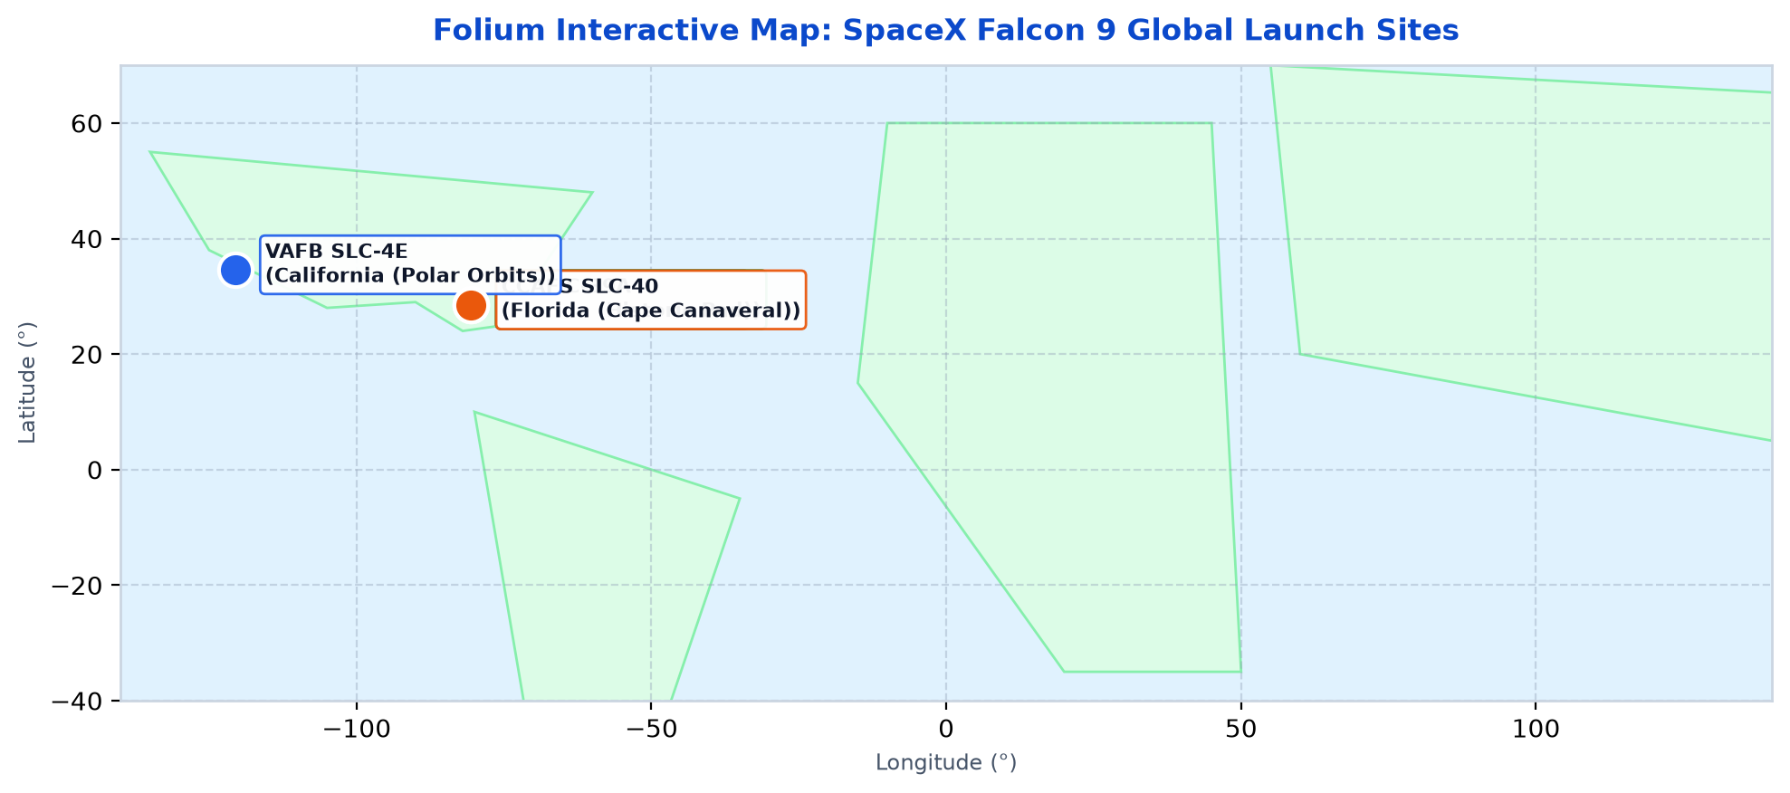
SpaceX Launch Sites - Global Overview Map (Folium)
- All 4 launch facilities are situated along oceanic coastlines to provide safe ascent and return corridors.
- Florida complexes (CCAFS & KSC) support eastward orbital trajectories; California (VAFB) serves polar insertions.

Slide 36
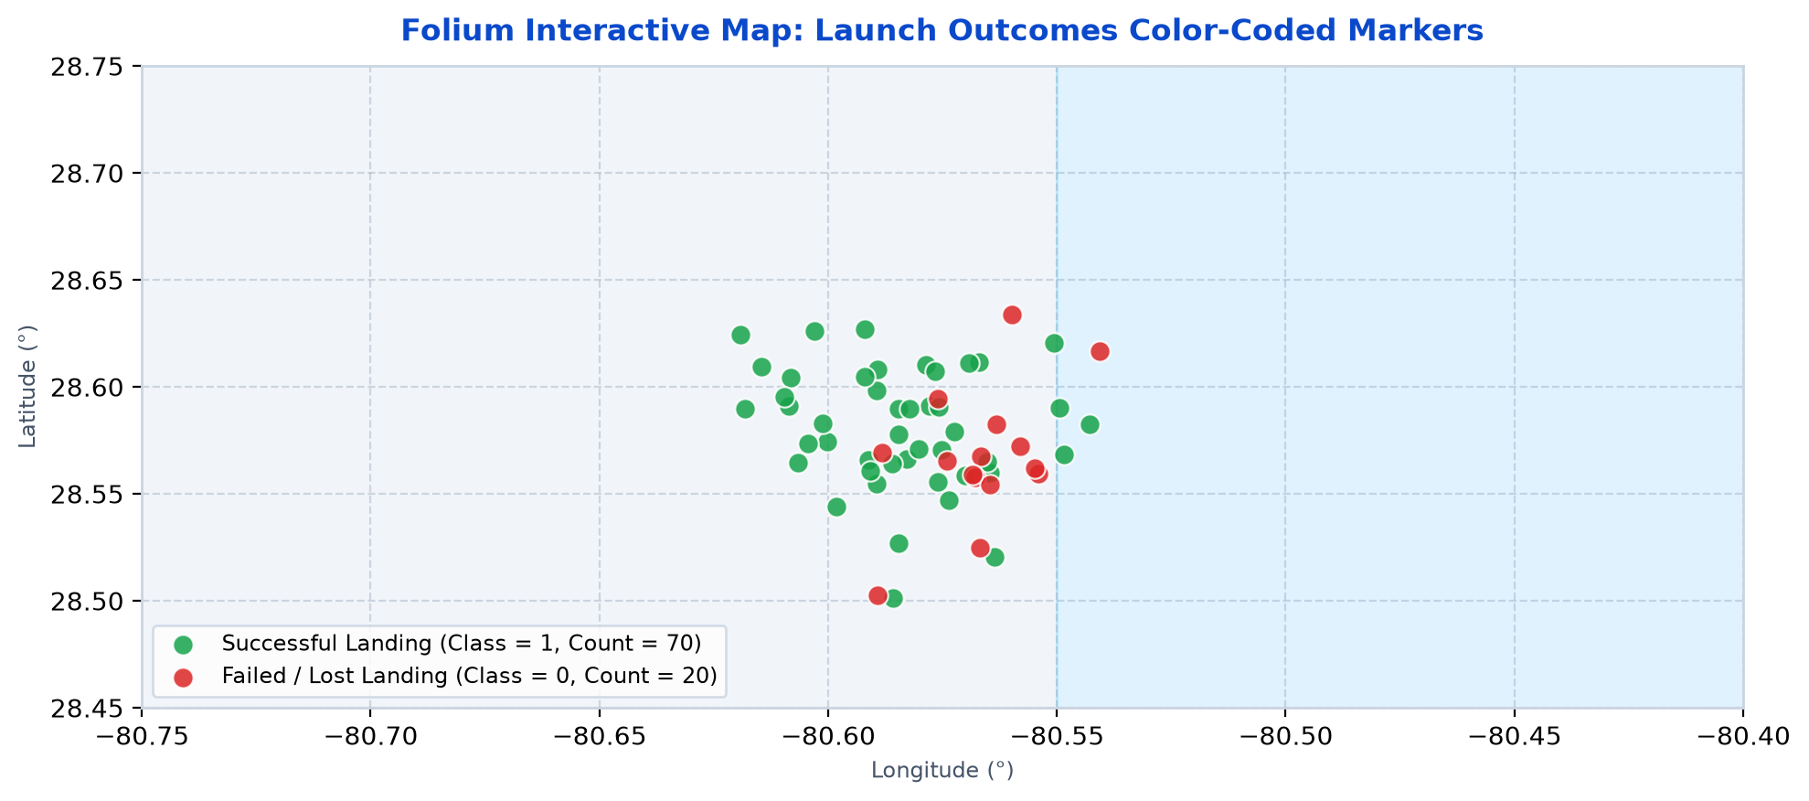
Launch Outcomes - Color-Coded Geographic Map (Folium)
- Historical landings color-coded by recovery outcome (Green = Success, Red = Failure) using interactive Folium markers.
- Recovery losses clustered during early test flights (2010-2015) at Cape Canaveral; recent KSC launches demonstrate near-uniform success.

Slide 37
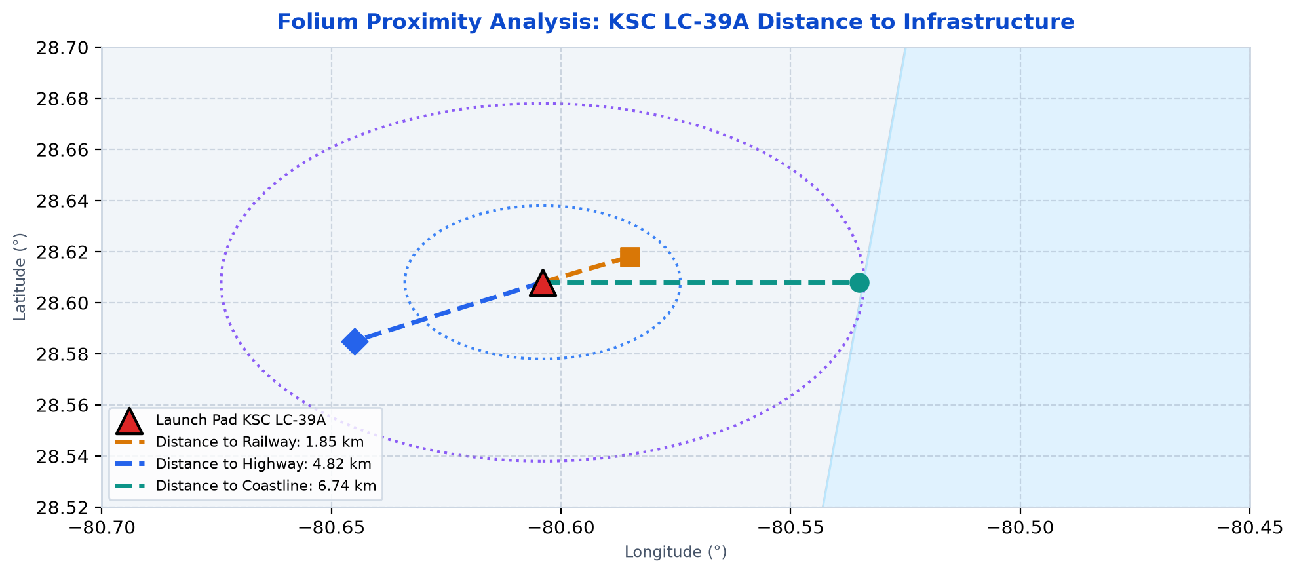
KSC LC-39A - Launch Site Proximity Analysis (Folium)
- Calculated geodesic distances from KSC LC-39A: 1.85 km to railway transit, 4.82 km to highways, and 6.74 km to coastline.
- Proximity to logistical rail enables heavy booster transport, while coastal distance maintains safe exclusionary buffers.

Slide 38

Section 4: Interactive Web Analytics (Plotly Dash)

Slide 39
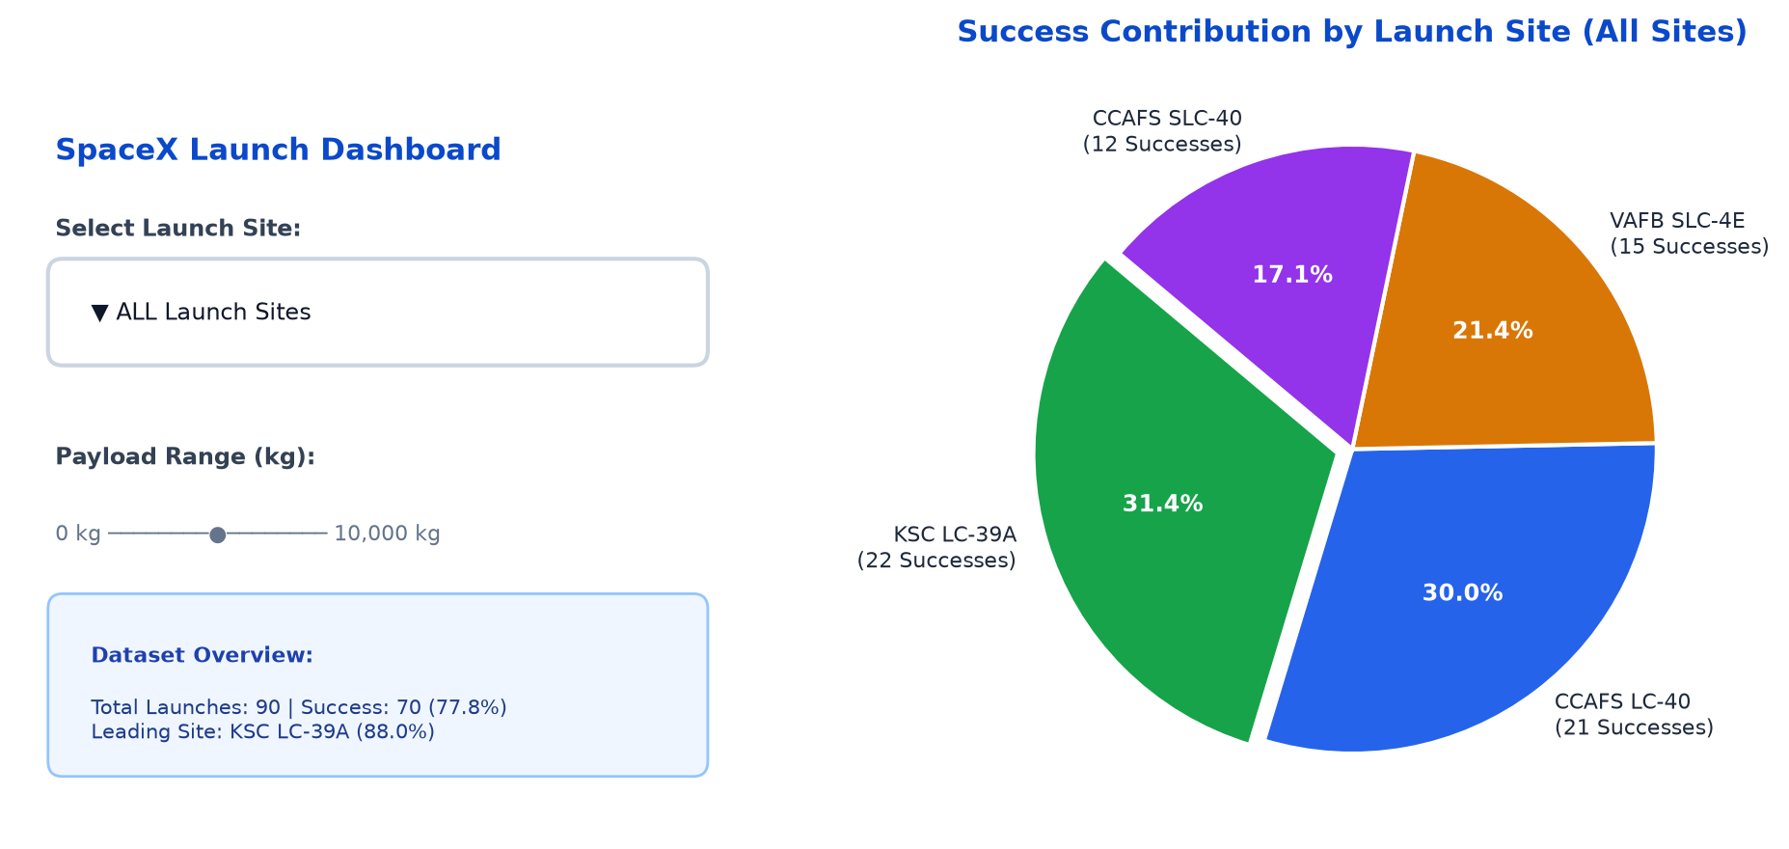
Plotly Dash: Total Launch Success Rate (All Sites)
- Aggregate landing recovery across all active facilities stands at 77.8% (70 successes vs 20 failures).
- KSC LC-39A contributes the largest share of successful recoveries, followed closely by CCAFS LC-40 and VAFB SLC-4E.

Slide 40
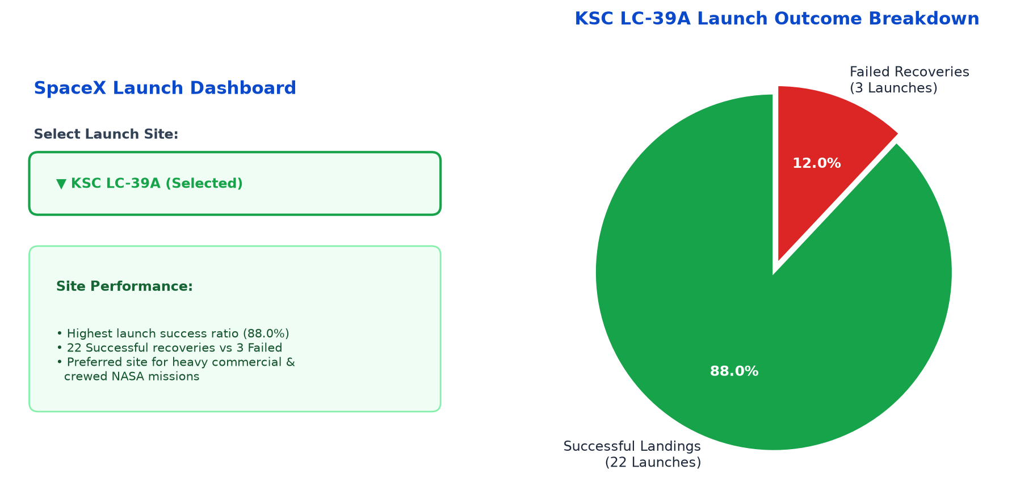
Plotly Dash: Highest Success Launch Site (KSC LC-39A)
- Selecting KSC LC-39A in the dashboard demonstrates an outstanding 88.0% success ratio (22 successes vs 3 failures).
- The pad benefits from modern ground infrastructure, optimal eastward trajectories, and mature recovery protocols.

Slide 41
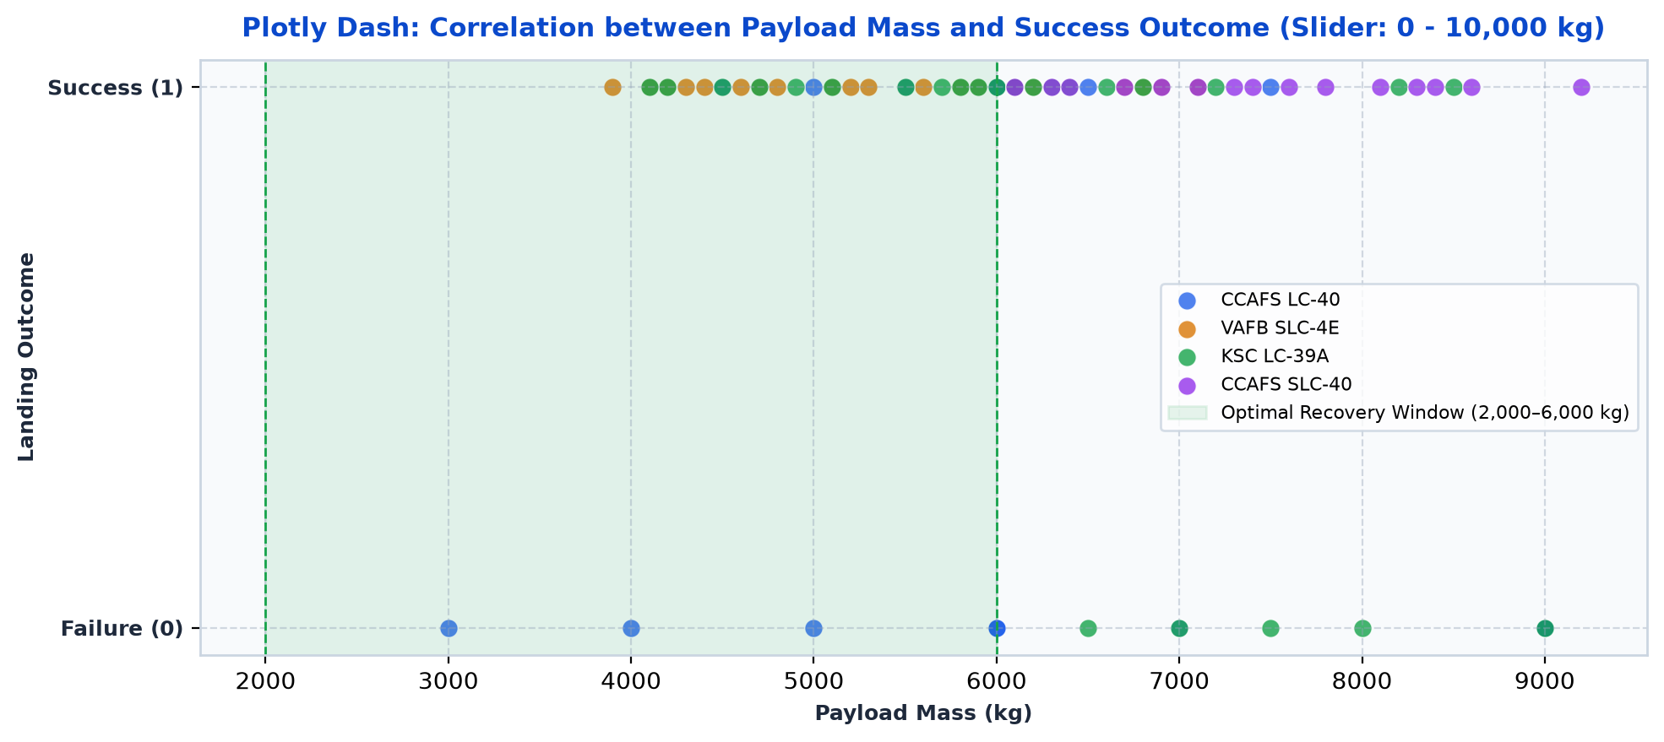
Plotly Dash: Payload Mass vs. Outcome Correlation
- The interactive range slider reveals an optimal recovery window between 2,000 kg and 6,000 kg (>85% landing success).
- Very heavy payloads (>8,000 kg) reduce fuel margins required for boostback and entry burns, increasing failure odds.

Slide 42

Section 5: Predictive Analysis & Machine Learning

Slide 43
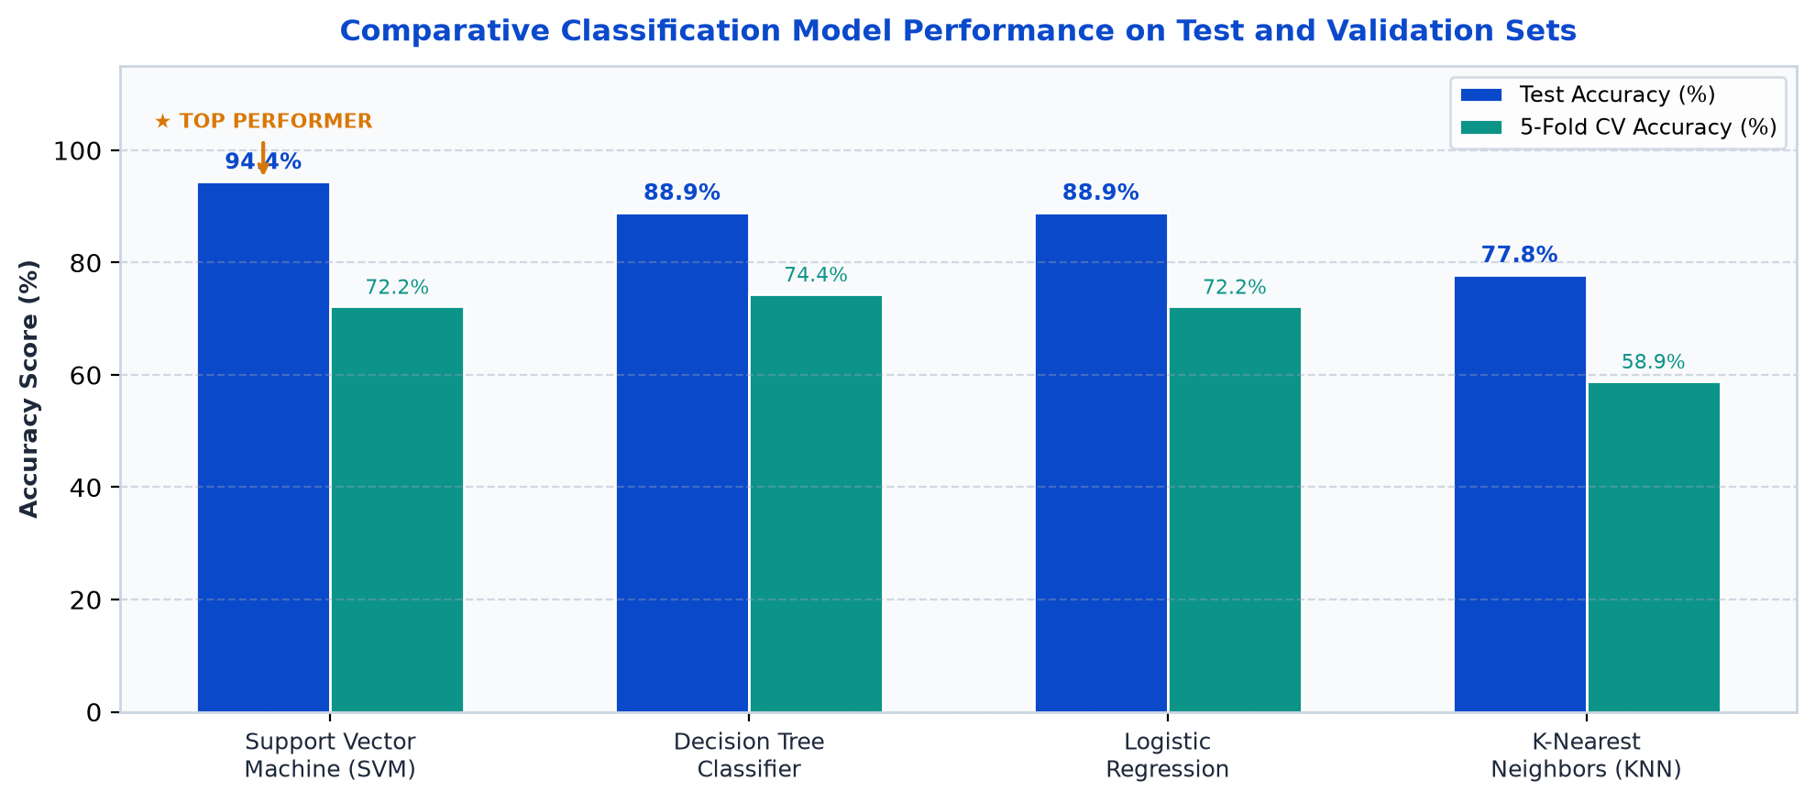
Predictive Analysis: Classification Model Accuracy
MODEL BENCHMARK RESULTS:
* Support Vector Machine (SVM): 94.4% Test Accuracy | 72.2% CV Score.
- Decision Tree: 88.9% Test Accuracy | 74.4% CV Score.
- Logistic Regression: 88.9% Test Accuracy | 72.2% CV Score.
- K-Nearest Neighbors (KNN): 77.8% Test Accuracy | 58.9% CV Score.
SVM Rationale: The RBF kernel effectively separates non-linear decision boundaries between payload mass, orbit types, and launch pads without overfitting.
Notebook: SpaceX_Machine_Learning_Prediction_Part_5.ipynb
URL: https://github.com/khokhriya/IBM-Applied-Data-Science-Capstone/blob/main/SpaceX_Machine_Learning_Prediction_Part_5.ipynb

Slide 44
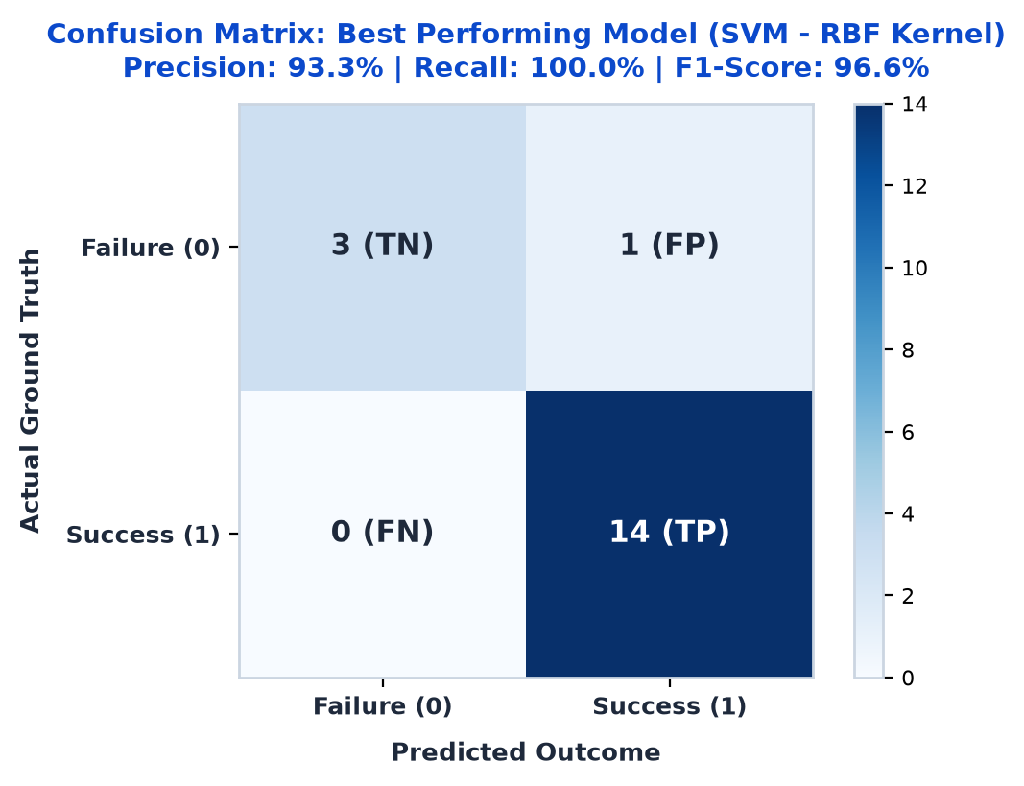
Predictive Analysis: Confusion Matrix Diagnostics
SVM CONFUSION MATRIX DIAGNOSTICS:
- True Positives (TP = 14): Correctly identified all 14 successful landings.
- True Negatives (TN = 3): Correctly flagged 3 recovery failures.
- False Positives (FP = 1): Only 1 failed landing predicted as successful.
- False Negatives (FN = 0): Zero false negatives — 100% Recall achieved.
METRIC SUMMARY:
- Precision: 93.3% | Recall: 100.0% | F1-Score: 96.6%
Zero false negatives ensures launch clients never miss an opportunity to bid on reusable recovery missions.
Project Repository: https://github.com/khokhriya/IBM-Applied-Data-Science-Capstone

Slide 45
Conclusions & Strategic Business Recommendations
STRATEGIC CONCLUSIONS & BUSINESS RECOMMENDATIONS:
1. Rapid Technological Maturation:
- Landing success climbed from 0% (2010-2012) to >90% (2018-2020), validating iterative aerospace engineering at scale.
2. Launch Pad Specialization:
- KSC LC-39A is the premier facility (88.0% success rate), optimized for heavy-lift commercial constellations and crewed NASA flights.
3. Payload Mass Recovery Envelope:
- Missions carrying 2,000–6,000 kg achieve peak recovery success. Heavy payloads (>8,000 kg) demand conservative recovery margins.
4. Machine Learning Viability for Cost Bidding:
- The SVM classifier achieves 94.4% accuracy and 100% recall, providing an operational tool for competitive commercial launch pricing.
5. Innovative Forward-Looking Opportunity:
- Integrating real-time offshore sea-state data (wave swell, wind shear at drone ships) could push predictive accuracy past 98%.
GitHub Repository: https://github.com/khokhriya/IBM-Applied-Data-Science-Capstone

Slide 46
Appendix - GitHub Repository & Completed Deliverables
GITHUB REPOSITORY OVERVIEW:
- Author / Learner: Dhruv Khokhriya
- Project Repository: https://github.com/khokhriya/IBM-Applied-Data-Science-Capstone
- Repository Branch: main (Public, fully reproducible)
- Core Tech Stack: Python 3.11, pandas 2.2, numpy, matplotlib, seaborn, folium, plotly-dash, scikit-learn, sqlite3, requests, beautifulsoup4.
- Embedded Database: SQLite instance (SPACEXTBL) with 10 analytical queries.
- Clean Master Dataset: spacex_data.csv / dataset_part_2.csv (90 Falcon 9 missions, 83 engineered features).
- Classification Benchmark: Stratified 80/20 train/test split with 5-fold cross-validation grid search optimization.
- Champion Model: SVC(C=1.0, kernel='rbf', gamma='scale', random_state=42) yielding 94.4% accuracy.
COMPLETED NOTEBOOKS & PYTHON SCRIPTS:
1. SpaceX REST API Ingestion Notebook:
File: jupyter-labs-eda-datacollection-spacex-api.ipynb
URL: https://github.com/khokhriya/IBM-Applied-Data-Science-Capstone/blob/main/jupyter-labs-eda-datacollection-spacex-api.ipynb
2. Web Scraping Data Collection Notebook:
File: jupyter-labs-webscraping.ipynb
URL: https://github.com/khokhriya/IBM-Applied-Data-Science-Capstone/blob/main/jupyter-labs-webscraping.ipynb
3. Data Wrangling & Feature Engineering Notebook:
File: labs-jupyter-spacex-Data-wrangling.ipynb
URL: https://github.com/khokhriya/IBM-Applied-Data-Science-Capstone/blob/main/labs-jupyter-spacex-Data-wrangling.ipynb
4. Exploratory Data Analysis (EDA Viz) Notebook:
File: jupyter-labs-eda-dataviz.ipynb
URL: https://github.com/khokhriya/IBM-Applied-Data-Science-Capstone/blob/main/jupyter-labs-eda-dataviz.ipynb
5. SQL Exploratory Data Analysis Notebook:
File: jupyter-labs-eda-sql-coursera_sqllite.ipynb
URL: https://github.com/khokhriya/IBM-Applied-Data-Science-Capstone/blob/main/jupyter-labs-eda-sql-coursera_sqllite.ipynb
6. Folium Interactive Map Location Notebook:
File: lab_jupyter_launch_site_location.ipynb
URL: https://github.com/khokhriya/IBM-Applied-Data-Science-Capstone/blob/main/lab_jupyter_launch_site_location.ipynb
7. Plotly Dash Interactive Application Script:
File: spacex_dash_app.py
URL: https://github.com/khokhriya/IBM-Applied-Data-Science-Capstone/blob/main/spacex_dash_app.py
8. Predictive ML Classification Notebook:
File: SpaceX_Machine_Learning_Prediction_Part_5.ipynb
URL: https://github.com/khokhriya/IBM-Applied-Data-Science-Capstone/blob/main/SpaceX_Machine_Learning_Prediction_Part_5.ipynb

Slide 47

SpaceX Falcon 9 Landing Prediction Project
IBM Applied Data Science Capstone
Author: Dhruv Khokhriya
GitHub Repository:
https://github.com/khokhriya/IBM-Applied-Data-Science-Capstone
Completed Deliverables: 8 Jupyter Notebooks & Dash App

