Slide 1

Data Mining
&
Data Warehousing
Presented
By:
Group 4
Kirk Bishop Joe Draskovich Amber Hottenroth
Brandon Lee Stephen Pesavento

Slide 2

Introduction
What is Data Mining?
Data Mining is the process of collecting large amounts of raw data and transforming that data into useful information.
Data Warehousing?
A Data Warehouse is a computerized collection of mined data.

Slide 3
Objectives
Explore the business applications of data mining & warehousing
Explain the advantages & disadvantages
Uncover software used in data mining.
Find what data mining is used for.
Discover current trends, regulation, and future uses of the technology.

Slide 4
What is Data Mining?
Data mining is the practice of searching through large amounts of computerized data to find useful patterns or trends (American Heritage Dictionary, 2008).

Slide 5
Data Mining Applications
Banking
  Detect Fraudulent Activity
Insurance
  Risk Assessment
Medicine/Healthcare
  Enhance Research
Retail
  Track consumer buying trends

Slide 6
Data Mining Software Applications
-SPSS/ SPSS Clementine is a data mining toolkit with a wide variety of mining methods to choose from. This package is designed to be used by the normal person with the desire to do their own data mining projects
-Previously known as yale, RapidMiner is a data mining suite which makes a wide range of techniques available. . Its easy to use interface makes it accessible for general use, while its flexibility and extensibility make it suitable for academic use and adds a number of useful visualization methods.
-‘SAS Enterprise Miner,’ a tool provided in the package suite, has an easy to use data-flow GUI. A wide variety of data mining techniques are supported including: Decision Trees; Neural Networks; Market Basket Analysis; Clustering; Web Log Analysis; Regression; and Rule Induction.

Slide 7

CRISP-DM
Cross-Industry Standard Process for Data Mining
Understanding the business
Understanding the data
Data preparation
Modeling
Evaluation
Deployment

Slide 8
Data Warehousing
Advantages
  Access to information
  Data Inconsistency
  Decrease Computing Cost
  Productivity Increase
  Increase company profits

Slide 9
Data Warehousing
Disadvantages
  Data must be cleaned, loaded, and extracted
    80% of the overall process
  User Variability
    Proper Training
  Difficult to Maintain
    Incongruence among systems

Slide 10
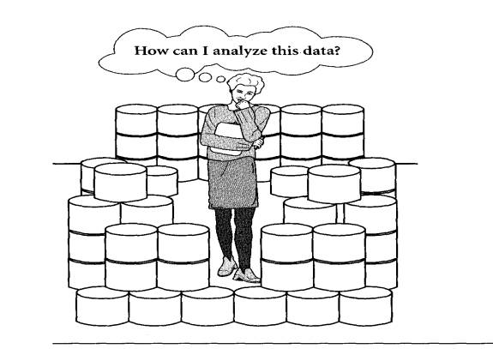
Data Mining
Advantages
Improves Customer Satisfaction/service
Saves Time and Money
Increases Sales Effectiveness
Increases profitability

Slide 11
Data Mining
Disadvantages
  Require skilled technical users to interpret and analyze data from warehouse
  Validity of the patterns
    Related to real world circumstances
  Unable to Identify Casual Relationships
  Reserved for the few instead of the many

Slide 12
Current Issues
Data Quality
  Duplicated records
  Lack of Data Standards
  Human Error
Inoperability
  Lack of communications among existing systems
Mission Creep

Slide 13
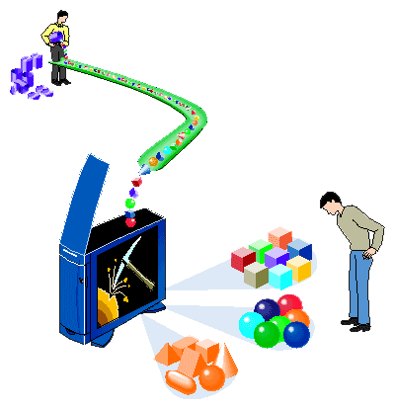
Trends & Current Issues
4 Major Trends
  Data – growing amount collected to be sifted
  Hardware – growing performance & storage
  Scientific Computing – theory, experiment, simulation
  Business – Meet higher standard in order to foresee risks, opportunities, and benefits for the company
Growing quickly due to renewal with new methodology frequently discovered
Applications of uses & methodology to medical, marketing, operations, & others
The government is closely reviewing the uses of data mining, due to the possibilities both good and bad
Counterterrorism data mining has been done, but in some instances has been deemed a violation of privacy

Slide 14
Future Research Possibilities
Government’s uses for data mining.
  National Security
  Terrorism Detection
Identity theft through data mining.

Slide 15
Conclusion/Analysis
Data mining is the extraction of information that can predict future trends & behaviors
Requires a large amount of data to be collected, and then stored in data warehouse
Possible violation of privacy in some circumstances
Government is getting involved with regulation, despite the counterterrorism program being a possible violation

Slide 16
Questions
Questions
Questions
Questions
Questions
Questions
Questions
Questions

