Slide 1


Technical Take-Home Exercise
Core Exercise
Keith Hollman
December 2023

Slide 2
CockroachDB
A distributed SQL datatabase
designed for speed, scale,
and survival

Slide 3
Agenda
Launch and Initialize CRDB
Generate a load against the cluster
Scaling and Failing
Executing a Code Example
Next Steps

Slide 4
Launch and Initialize CRDB
What’s your favourite?
Let’s take a look at:
- A Kubernetes install with CockroachDB Operator
vs
- A standard configuration

Slide 5
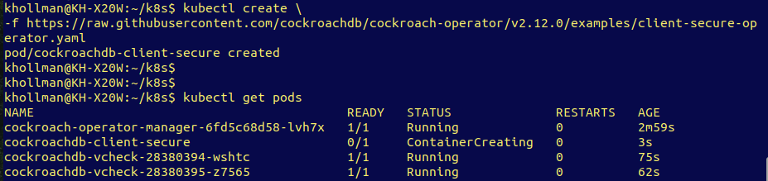
Creating a kubernetes cluster
An easy way to get up started with cockroachdb and distributed SQL is via Cockroach Operator.

Slide 6
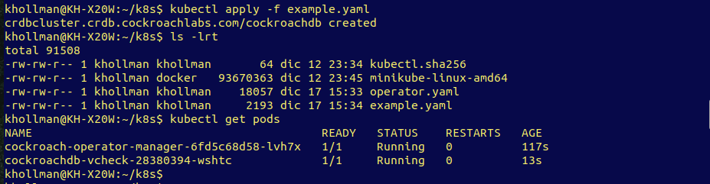
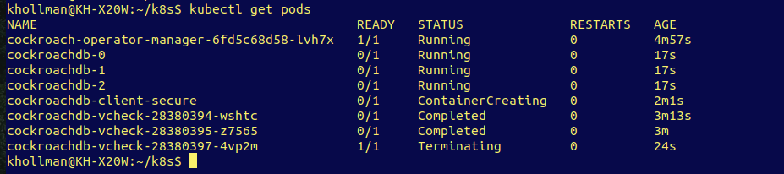

Slide 7
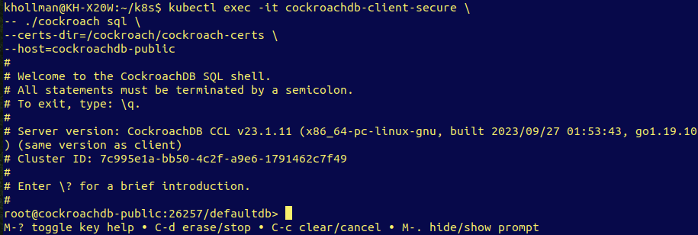
Connecting in
Via the secure pod, we can use the CockroachDB SQL client:
kubectl exec -it cockroachdb-client-secure -- ./cockroach sql --certs-dir=/cockroach/cockroach-certs --host=cockroachdb-public

Slide 8
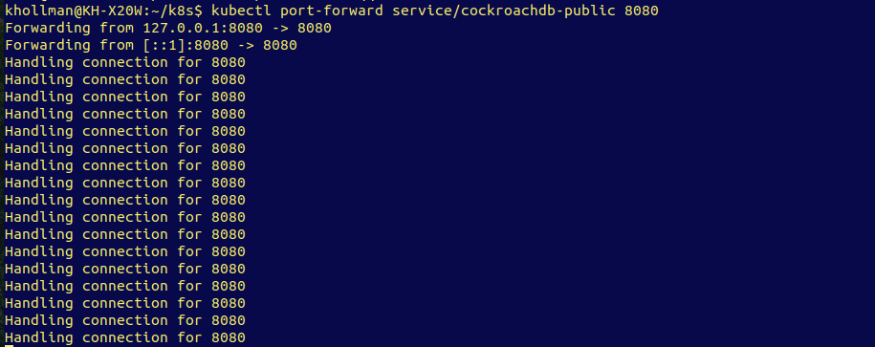
Console access
As with all CockroachDB installs, we want to be able to see the UI, so we map the K8s port using “kubectl port-forward”

Slide 9
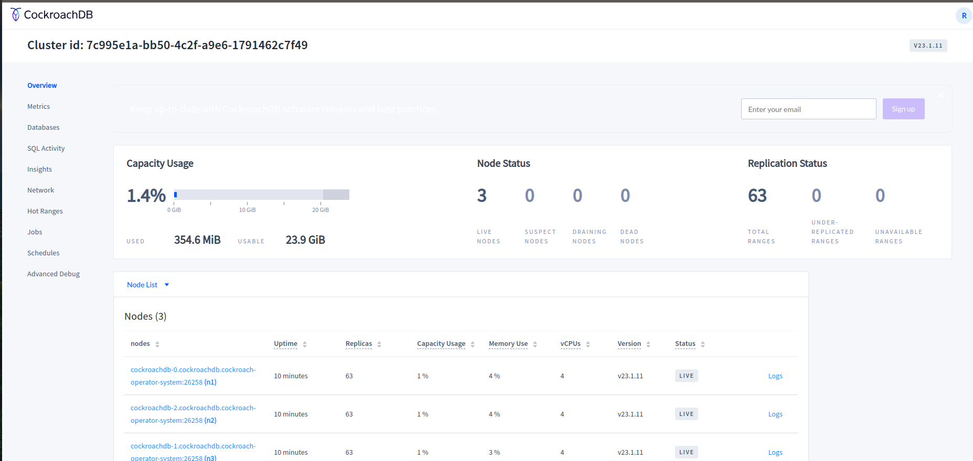

Slide 10
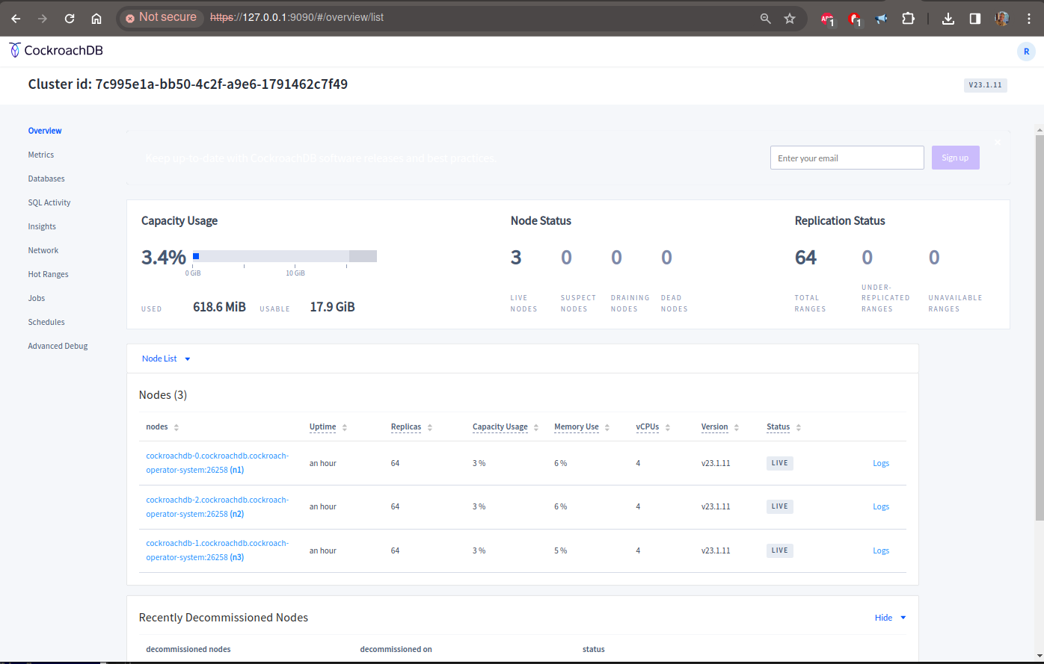
kubectl port-forward service/cockroachdb-public 9090:8080
Can you spot the difference?

Slide 11
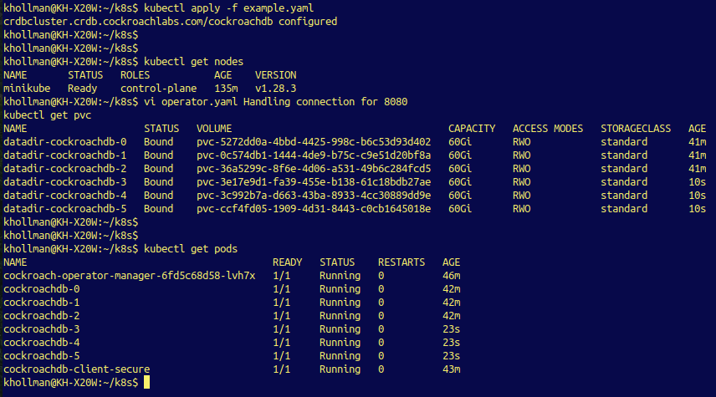
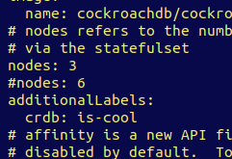
Scaling with K8s & Operator
Via the using example.yaml, via just changing a 3 to a 6 we’re looking at a 6 node cockroachdb cluster:

Slide 12
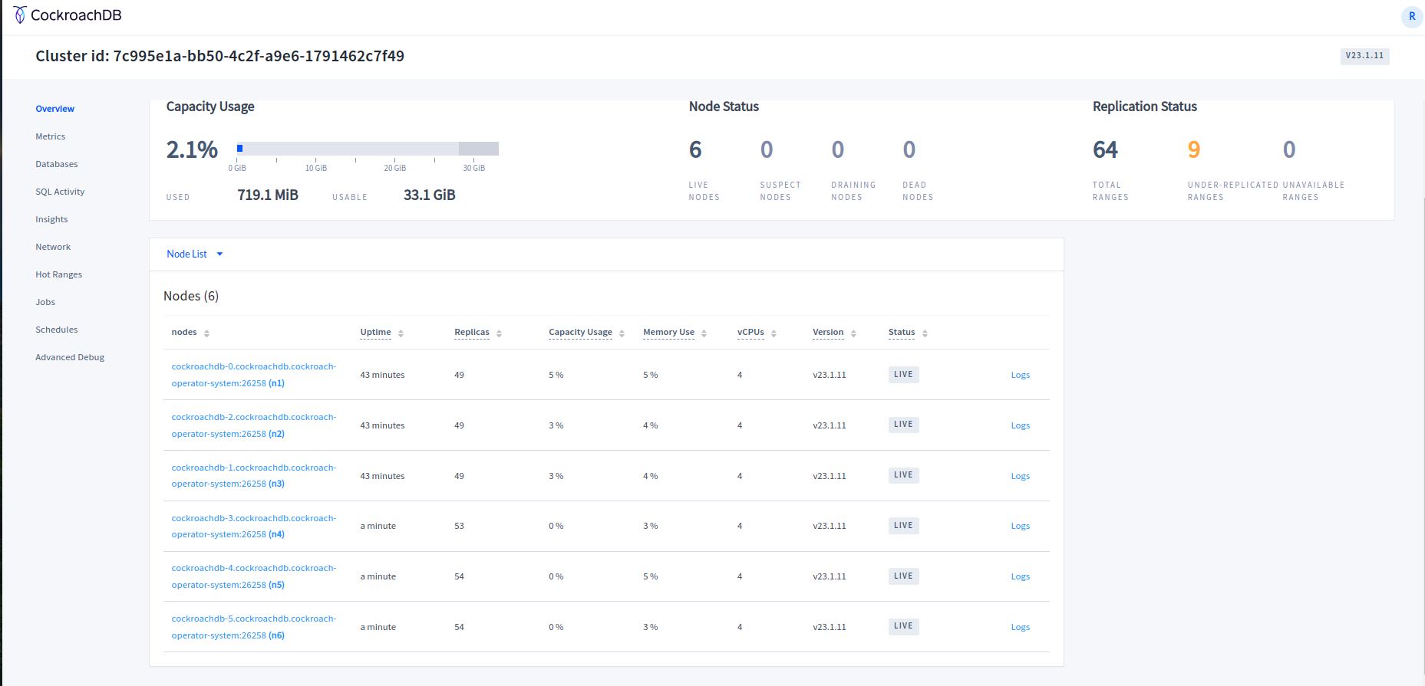

Slide 13
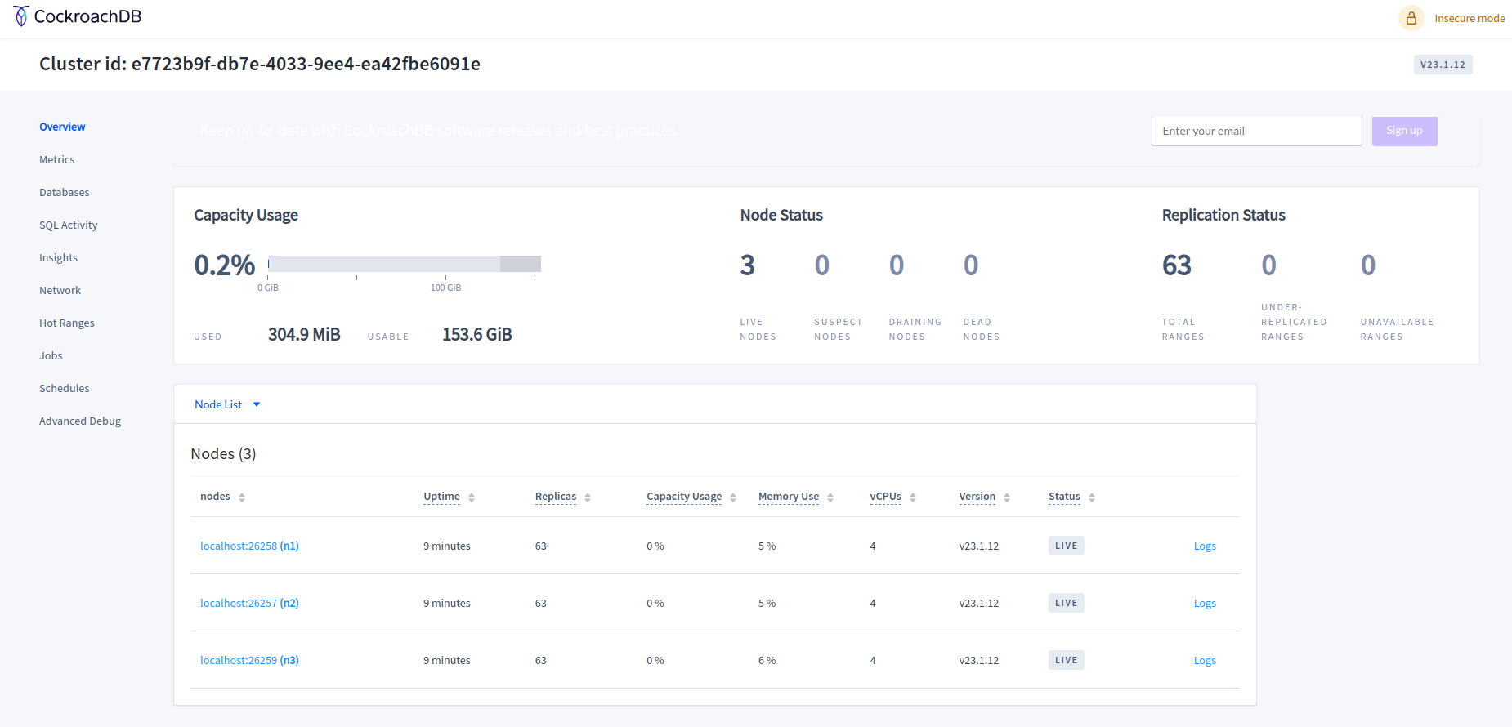
A standard configuration
Using virtualbox & vagrant we can also quickly generate CockroachDB cluster.

Slide 15
The console

Slide 16
Configure your HAProxy
cockroach gen haproxy --insecure --host=192.168.1.160:26257
scp haproxy.cfg 192.168.1.161:/home/vagrant/
@192.168.1.161
sudo apt-get install haproxy
haproxy -f haproxy.cfg > haproxy.log &
Test it, from 192.168.1.160:
cockroach sql --insecure --host=192.168.1.161:26257

Slide 17
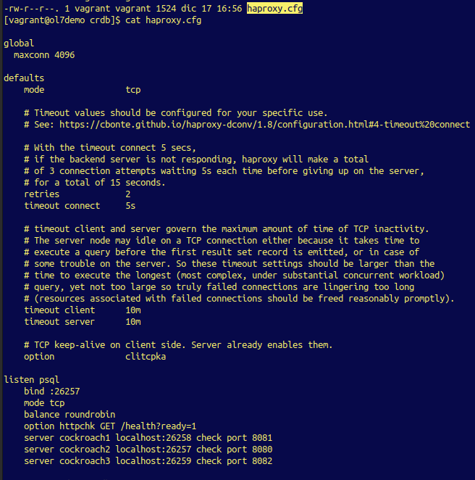

Slide 18
Generate a load against the cluster
Now to stress the cluster. A number of ways are possible:
- cockroach workload init movr
- sysbench
- hammerDB
- tpcc
Etc.

Slide 19
tpcc
Quickest way to freeze something:
So let’s adjust. First import the dataset:
cockroach workload fixtures import tpcc --warehouses=10 \ 'postgresql://root@192.168.1.161:26257?sslmode=disable'
Then run it:
cockroach workload run tpcc --warehouses=10 --ramp=3m --duration=10m \
'postgresql://root@192.168.1.161:26257?sslmode=disable'
https://www.cockroachlabs.com/docs/v23.1/performance-benchmarking-with-tpcc-small

Slide 21
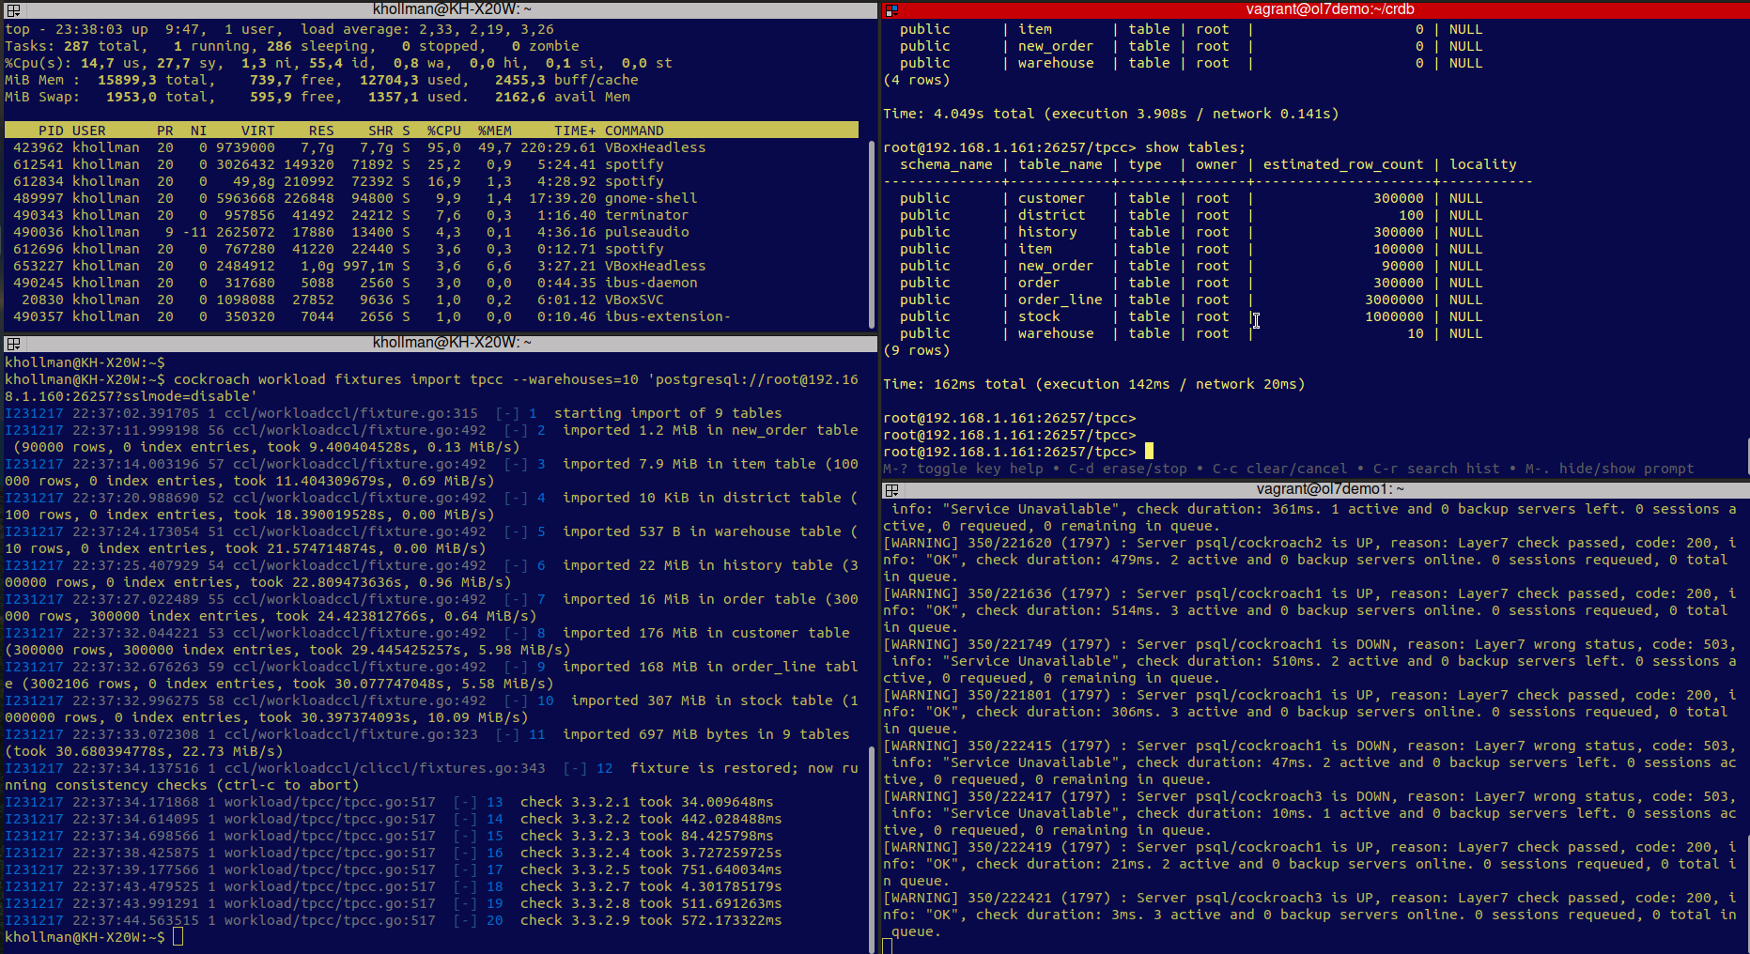

Slide 22
Scaling and Failing
Now let’s have a look at:
adding
remove
& loosing
a node.

Slide 23
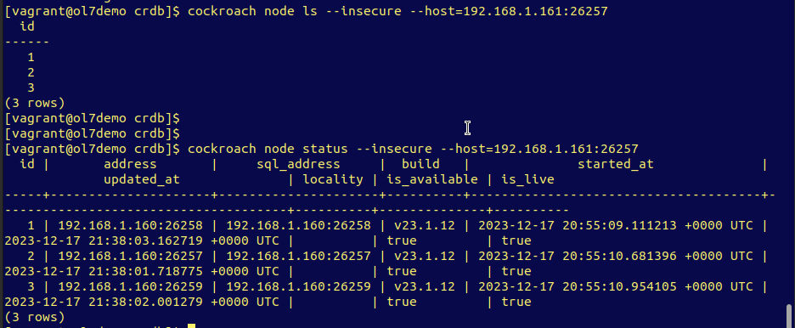
What do we have?

Slide 24
Add a new node
cockroach start --insecure --store=node4 –listen-addr=192.168.1.160:26260 \
--http-addr=192.168.1.160:8083 \
--join=192.168.1.160:26257,192.168.1.160:26258,192.168.1.160:26259,\
192.168.1.160:26260 --background –pid-file=node4_pid
Let’s see what the console shows:

Slide 26
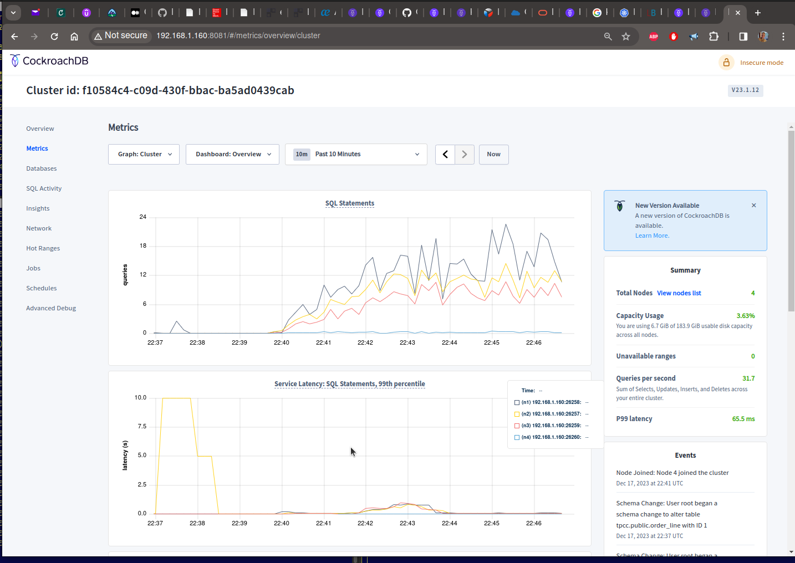
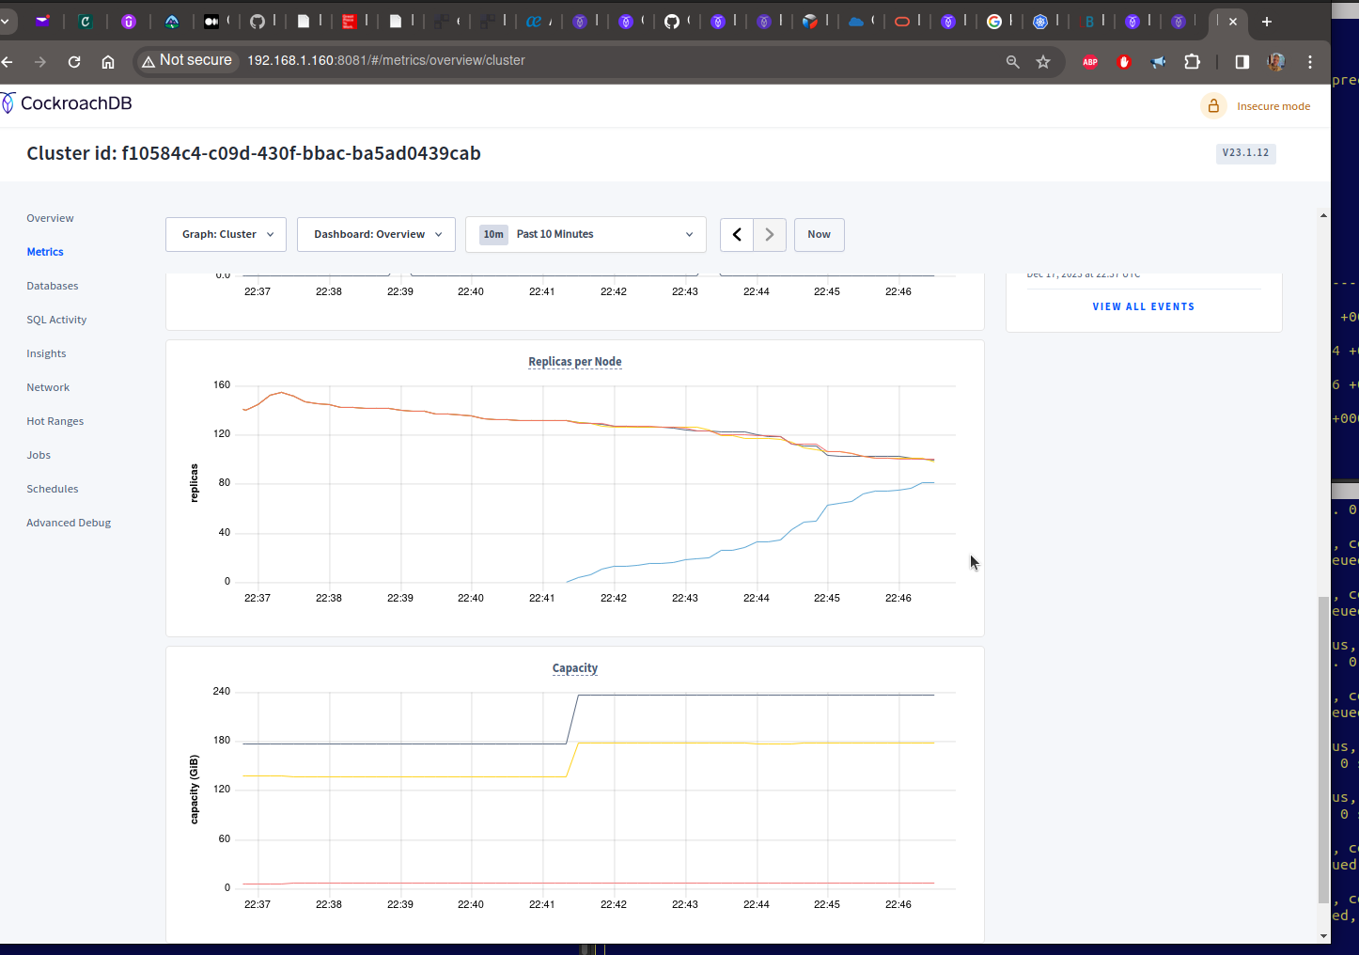
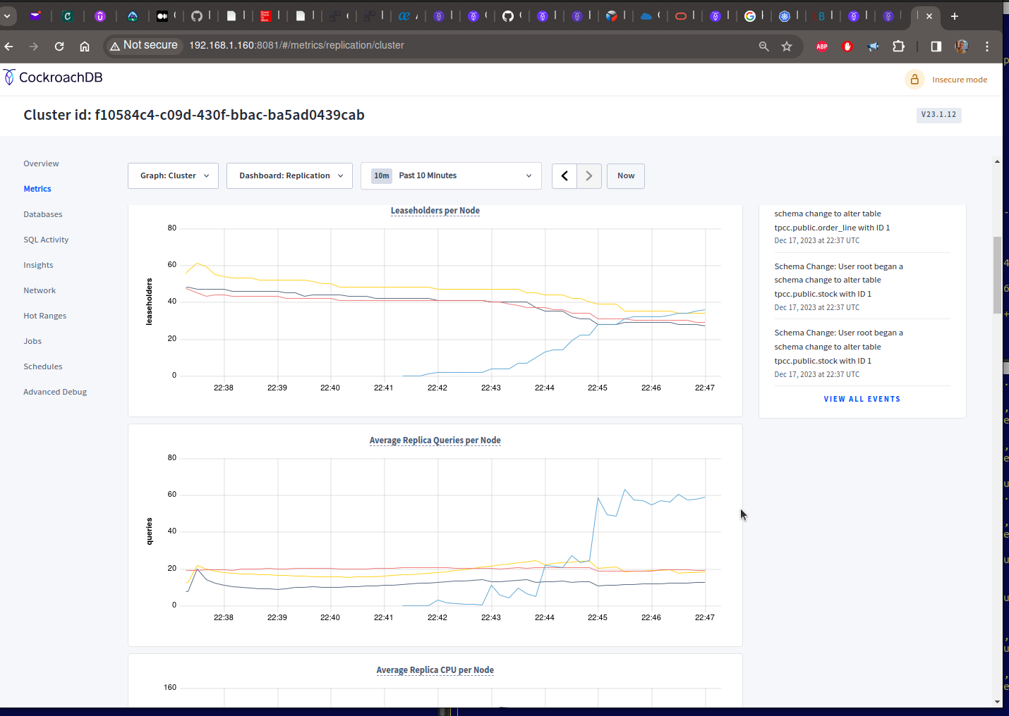


Slide 27
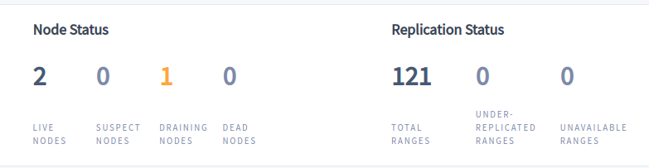
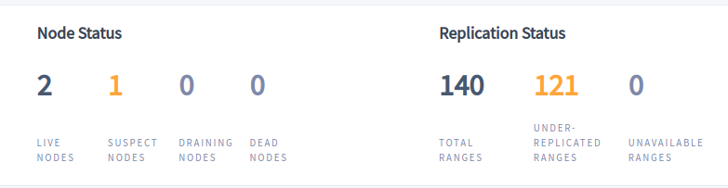
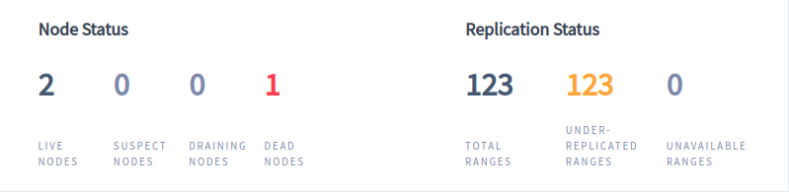
Removing a node ...
… gracefully:
kill -TERM 9371 (cat node1_pid)
  Or
cockroach --insecure --host=192.168.1.161:26257 node decommission 4
… forcibly:
kill -9 9331 (cat node3_pid)

Slide 28
A suspect node appears:

Slide 29
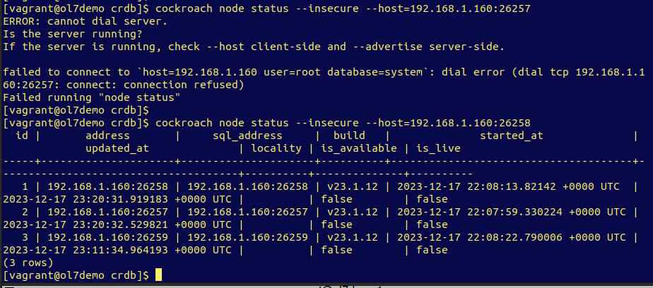
Leaving a single node in the cluster

Slide 30
Questions to answer
As you were adding and removing nodes from the cluster, how did that impact performance? What kinds of metrics were you tracking to identify that impact?
- Lots of IO started due to occur due to replication, snapshot and range activity. Also CPU was affected due to increase in activity and leader reassignment.
What other kinds of behaviour did you witness as you were changing the cluster topology? How did the system handle the hard node failure differently than the graceful shutdown?
- Graceful shutdown caused a temporary drain and then the node became suspect of being unavailable but a hard kill caused it to become “dead” after the suspect period.
When you killed all of the nodes but one, what happened to the database?
- The database froze and didn’t allow any connections and the log on the remaining node declared “probably not enough nodes in the cluster”.
Did the platform behave differently than you would expect in any of the above scenarios? If so please describe.
- When the database froze, I was expected some sort of attempt for the system to restart a decomissioned node. But I understand that any previous action upon a node for a given reason doesn’t imply that any attempt is valid.

Slide 31
Executing a Code Example
Choosing amongst one of the available sample apps from:
Advanced Example Applications Overview
Let’s look at one that gave a couple of errors: Psycopg3

Slide 32


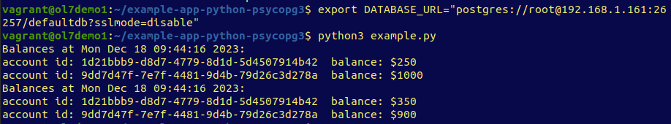
Build a Python App with CockroachDB and Psycopg 3
The database connection
After trying different schemas, IP’s, install locations:
The database connection string
It should read a little different, as per v23.1 documentation:
postgres://<username>:<password>@<host>:<port>/<database>?<parameters>
ticket: [Cockroach Labs - #19758] & DOC-9413 Documentation error when trying to deploy a sample app

Slide 33
Next Steps?
We’ve arrived this far but is that it?
By no means!
Have a look at the marketplace and other cloud vendors to see what they’re doing with CockroachDB.
Or look at the true native cloud solutions offered for CockroachDB, such as Dedicated or Serverless.

Slide 34
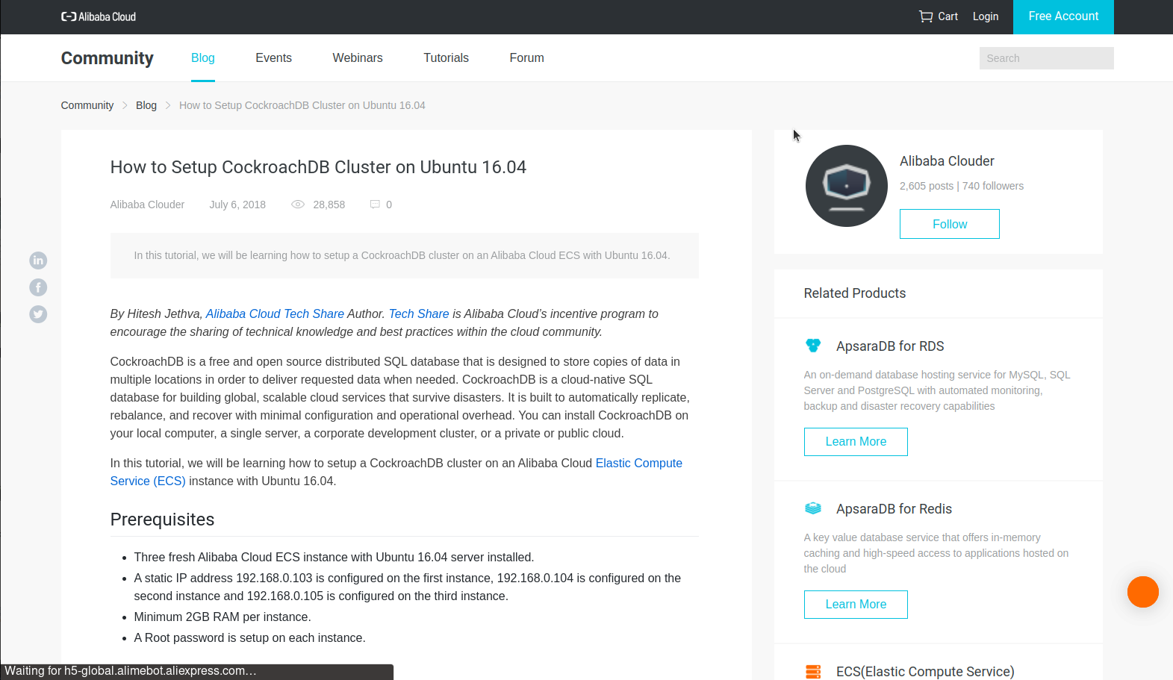
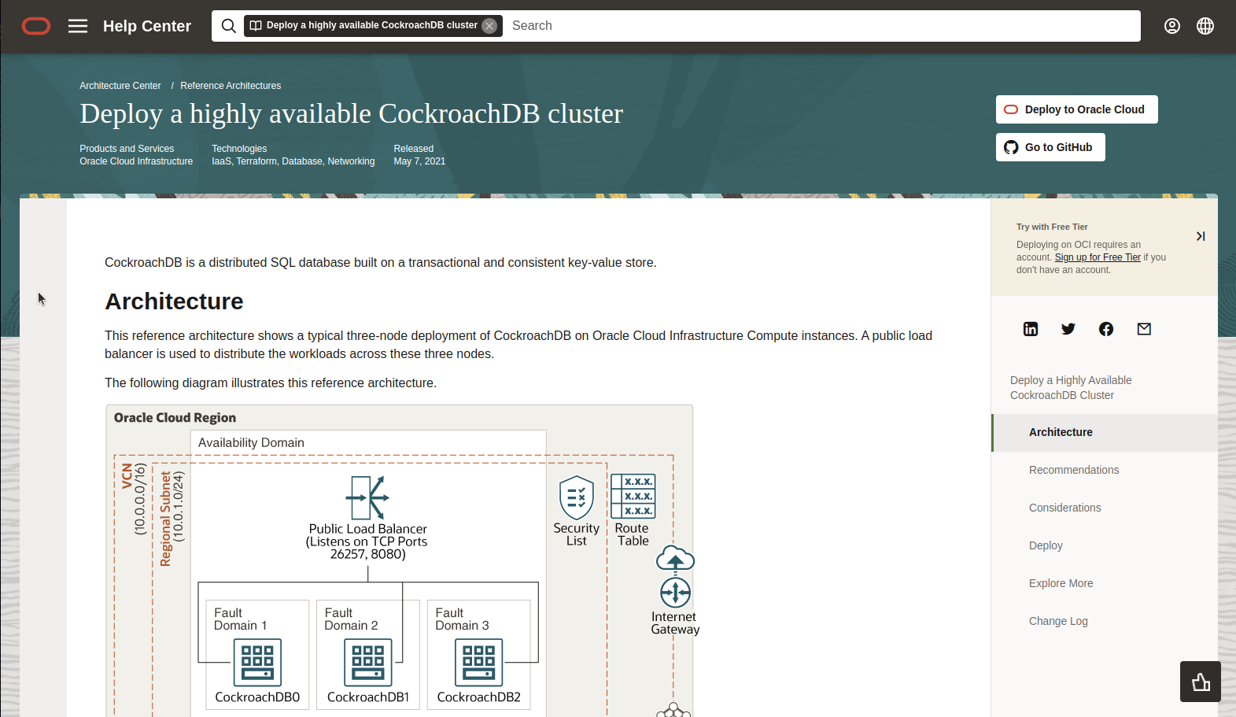

Slide 35
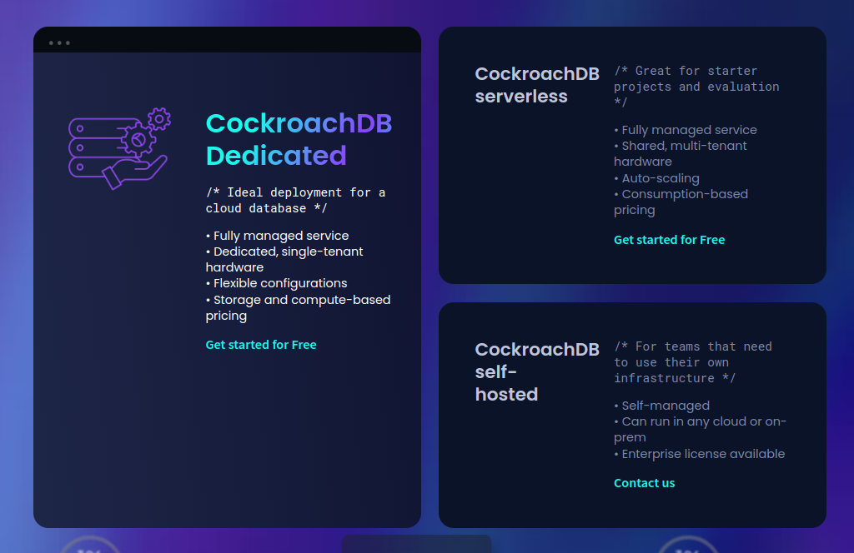
Cloud native solutions

Slide 36
Learn more
Performance Benchmarking with TPC-C
Cockroach Labs - Kubernetes Overview
Oracle Cloud - Deploy a highly available CockroachDB cluster
Alibaba Cloud - How to Setup CockroachDB Cluster on Ubuntu 16.04
Cockroach Labs - Monitoring and Alerting
Github: K8s cockroachdb/cockroach-operator
Client Connection Parameters

Slide 37

Thank you for this opportunity!
I would like to thank you all for the openness in the interview process and the huge amoung of information readily available.
Keith Hollman
Candidate for Principal Sales Engineer
khollman@yahoo.com or
keithh@cockroachlabs.com?

