Slide 1
FINAL PROJECT · MLOPS
MLOps Credit
Scoring Pipeline
End-to-End ML Engineering: Data → DVC → Train → Docker → SageMaker → Monitor
Margo Kholostova · April 2026
github.com/kholostovamk/mlops-credit-scoring
Notes:
Hi, I'm Margo, and today I'm going to walk you through my final project — a full end-to-end machine learning system for credit scoring. And when I say end-to-end, I mean it — I didn't just train a model, I built the entire production pipeline around it: how data flows in, how the model gets trained and deployed, how it stays healthy once it's live, and how the whole thing runs automatically without me touching anything. Let me take you through it.

Slide 2
01 Introduction & Problem Statement
The Problem
30,000
Financial institutions must predict credit card default risk before extending credit. Late or missed payments cost billions annually in write-offs and provisioning costs.
Customer Records
23
Dataset
UCI Default of Credit Card Clients
Taiwan bank, 2005 · Target: will this customer default next month?
Features: payment history, bill amounts, demographics (23 total)
Input Features
22.1%
Default Rate (imbalanced)
Notes:
The problem we're solving is credit card default prediction. A bank wants to know — before extending credit — whether a customer is likely to miss their next payment. Miss too many of these calls and you're writing off billions in losses. I used a real dataset from a Taiwanese bank: 30,000 customers, each described by 23 features — payment history, outstanding balances, credit limit, demographic info. The target variable is binary: did this person default the following month, yes or no. About 22% of customers did, which creates a class imbalance — the model sees far more non-defaults than defaults during training, which actually makes prediction harder and means we have to be careful about which metrics we optimize for.

Slide 3
02 System Architecture
Data
Ingestion
Validate
& Version
Train &
Tune
Evaluate
& Track
Docker
Container
SageMaker
Endpoint
UCI API
DVC Cache
Schema Checks
DVC Stage
XGBoost
Optuna HPO
MLflow
Fairness Audit
ECR
Flask Server
AWS
Inference
CI/CD Pipeline
Monitoring
Governance
GitHub Actions
Prometheus + Grafana + PSI
Audit Log + Incident Playbook
Cross-cutting: Git version control · AWS S3 artifact store · us-east-1
Notes:
Here's the full system architecture. The core pipeline runs top-to-bottom: ingest the raw data, validate it, train and tune the model, then evaluate it. Those four stages are wired together using a tool called DVC — think of it like a Makefile for machine learning, where each stage declares its inputs and outputs, and only reruns when something actually changed. Wrapping around that pipeline are three cross-cutting layers: CI/CD on GitHub Actions handles automated testing and deployment; Prometheus and Grafana handle real-time monitoring once the model is live; and a governance layer maintains an audit trail and incident runbooks. Everything runs on AWS in the us-east-1 region.

Slide 4
03 Data Versioning & Pipeline
01
02
03
04
Ingest
Validate
Train
Evaluate
Downloads UCI ZIP from URL, extracts XLS, cleans columns → data/staged/data.csv
Schema, nulls, value ranges, class balance. Exits code 1 on critical failures.
XGBoost + Optuna HPO (20 trials, 5-fold CV). MLflow tracking. Saves model.joblib.
Accuracy, AUC-ROC, confusion matrix, feature importances, fairness audit (3 groups).
HTTP → data.csv
data.csv → validation_report.json
data.csv + params.yaml → model
model → metrics/*.json
Notes:
Let me walk through the four pipeline stages. Stage one — data ingestion — downloads the UCI dataset from a public URL, extracts it from an Excel file, cleans the column names, and writes it out as a CSV. Stage two — data validation — runs a set of programmatic checks: are any values out of expected range? Are there null values? Is the class balance consistent with what we trained on? If any critical check fails, the stage exits with a non-zero code and the entire pipeline stops — nothing proceeds downstream. Stage three trains the model. Stage four evaluates it and writes metrics to disk. The key thing DVC adds here is reproducibility — every artifact, every dataset version, every model file is tracked by its content hash, so you can always reconstruct exactly what produced a given result.

Slide 5
04 Model Training & Baseline Results
Training Setup
0.778
82.0%
Algorithm
XGBoost Classifier
Pre-processing
StandardScaler (sklearn Pipeline)
AUC-ROC
Accuracy
HPO Framework
Optuna TPE Sampler
Trials / CV
20 trials · 5-fold cross-validation
0.642
67.5%
Tracking
MLflow → registered as credit-scoring-xgb
Train/Test
80% / 20% stratified split
F1 Score
Precision
All runs logged in MLflow · Best model registered to Model Registry
Notes:
For the model I used XGBoost — a gradient-boosted decision tree algorithm that consistently performs well on structured tabular data. But rather than manually tuning hyperparameters, I used Optuna, a framework for automated hyperparameter optimization. It runs 20 trials, each with a different configuration — things like tree depth, learning rate, number of estimators — and evaluates each one using 5-fold cross-validation on the training set. It uses a smart search strategy called TPE — Tree-structured Parzen Estimator — which learns from previous trials to focus on the most promising regions of the search space. Every trial is automatically logged to MLflow — an experiment tracking tool that stores parameters, metrics, and artifacts so you can compare runs later. The best model hit an AUC-ROC of 0.778, which is a solid result for this dataset. I also ran a fairness audit — checking that model performance doesn't degrade significantly for specific demographic groups.

Slide 6
05 Containerized Inference Demo
Dockerfile — Multi-Stage Build
Flask Inference Server (port 8080)
# ── Stage 1: Builder ──────────────────
FROM python:3.11-slim AS builder
GET
/ping
RUN apt-get install build-essential
Health check · returns 200 OK
SageMaker polls this to verify container is alive
COPY requirements.txt .
RUN pip install -r requirements.txt
# ── Stage 2: Runtime ──────────────────
FROM python:3.11-slim
POST
/invocations
COPY --from=builder /deps .
COPY src/ inference/ models/ .
Accepts JSON {"instances":[...]} or CSV
Returns {"probabilities":[], "predictions":[]}
ENV SM_MODEL_DIR /opt/program/models
CMD ["python", "serve.py"]
Model baked into image — no S3 dependency at runtime
Notes:
Once the model is trained, it needs to be packaged for deployment. I used Docker for this. The idea is that you describe your entire runtime environment — the OS layer, the Python dependencies, your code, your model file — in a Dockerfile, and Docker builds it into a self-contained image that runs identically anywhere. I used a two-stage build: a builder stage that compiles heavy dependencies like XGBoost, and a slim runtime stage that only includes what's actually needed at inference time, keeping the image small and fast. The model is baked directly into the image. The container exposes a Flask server on port 8080 with two endpoints — GET /ping for health checks and POST /invocations for inference.

Slide 7
06 AWS SageMaker Deployment Demo
Train
Model
Docker
Build
Push to
ECR
SM
Model
Live
Endpoint
DVC repro
GitHub Actions
Multi-stage
local smoke test
197479160475
.dkr.ecr.us-east-1
Custom container
no ModelDataUrl
InService ✓
HTTPS inference
Key Engineering Decisions:
Model baked into Docker image — IAM user lacked s3:PutObject — no DVC push, no ModelDataUrl needed
Local /ping smoke test before ECR push — Validates container starts and Flask loads before any cloud deploy
Failed→Delete→Recreate endpoint logic — CD handles stale endpoints gracefully on every redeploy to main
Notes:
For deployment I used Amazon SageMaker, which is AWS's managed machine learning serving platform. You give it a Docker image, tell it what instance type to run on, and it handles everything else — provisioning, scaling, health monitoring. The CD pipeline automates the whole flow: build the image, push it to Amazon ECR — their container registry — then create a SageMaker model resource, an endpoint configuration, and finally the endpoint itself. One interesting constraint: the course IAM account didn't have S3 write permissions, so I couldn't use SageMaker's standard model-from-S3 approach. The workaround was baking the model into the Docker image, which actually makes the deployment simpler. There's also error handling for stale endpoints — if a previous deployment left the endpoint in a Failed state, the pipeline detects it, deletes it, and starts fresh.

Slide 8
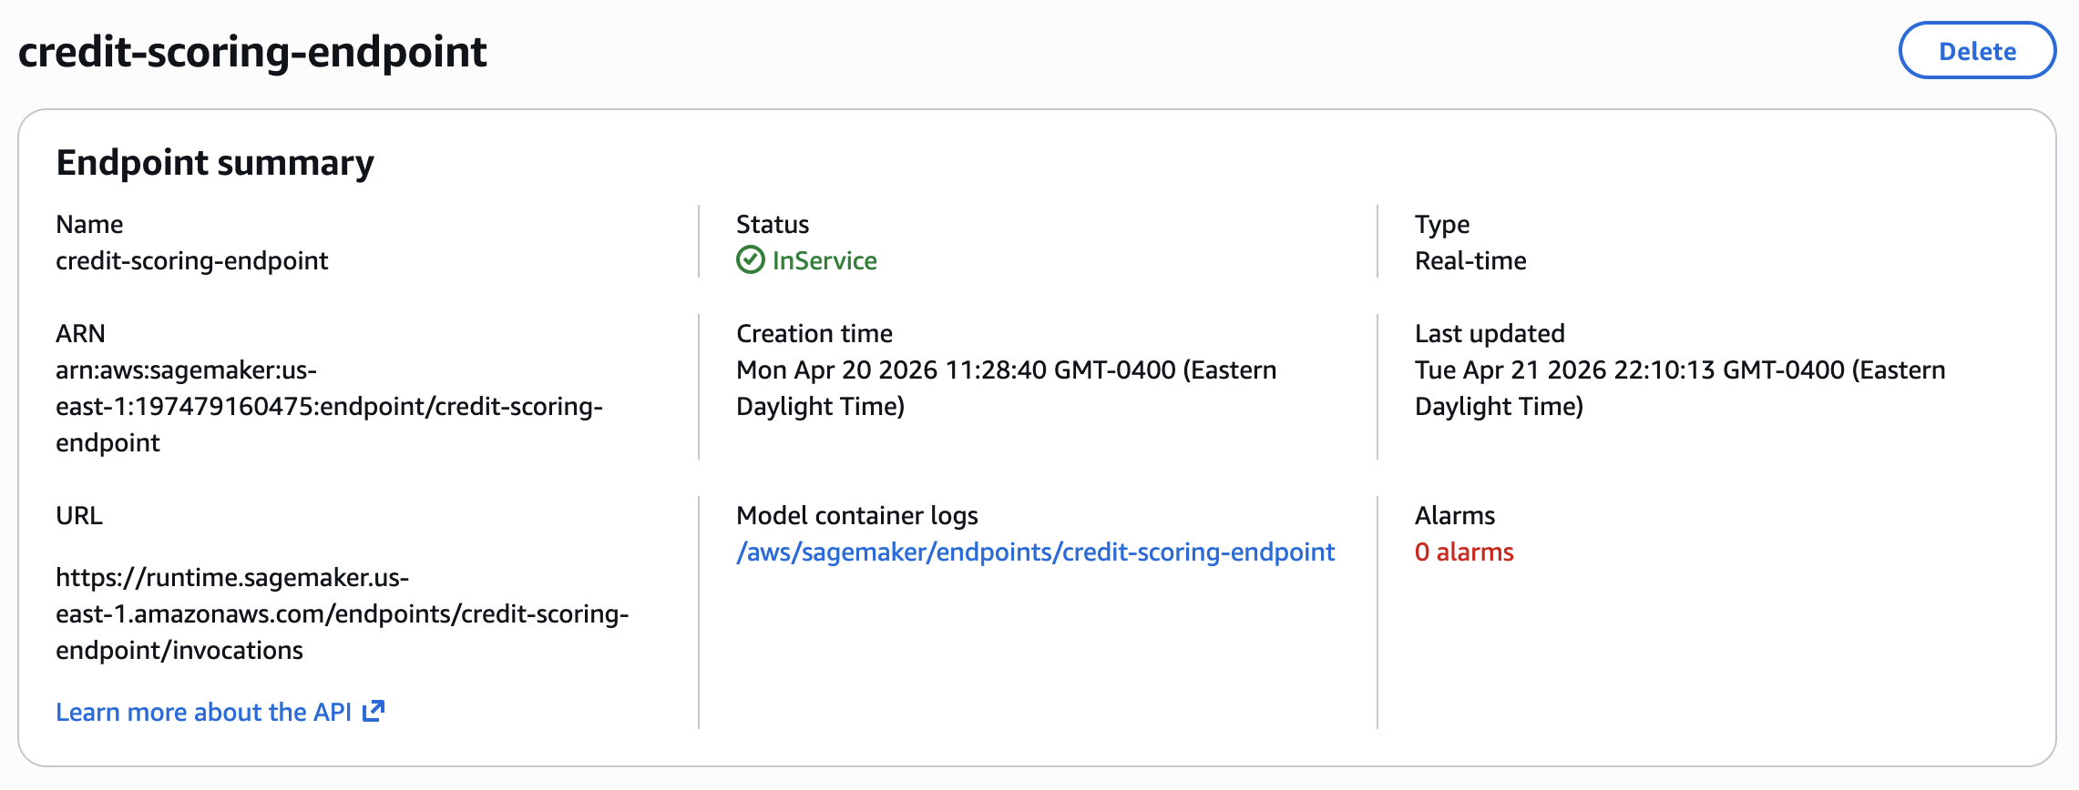
06b
SageMaker Endpoint — Live Demo
Evidence: AWS Console showing endpoint reaching InService status
[ INSERT SCREENSHOT HERE ]
Go to AWS Console → SageMaker → Endpoints → mlops-credit-scoring-endpoint Take a screenshot showing Status: InService and the endpoint URL
MLOps Credit Scoring Pipeline · April 2026 · github.com/kholostovamk/mlops-credit-scoring
Notes:
And here it is in the AWS console — the endpoint is InService, meaning it's live and accepting requests. This was deployed fully automatically by the CD pipeline on merge to main.

Slide 9
07 CI/CD Flow Overview
CI · Continuous Integration
CD · Continuous Deployment
Trigger: push to feature branch or PR to main
Trigger: push to main branch
1. Lint
1. DVC Pipeline
flake8 src/ inference/ tests/ — PEP8, unused imports, style
dvc repro — ingest, validate, train, evaluate. Artifacts via GH Actions
2. Unit Tests
2. Docker Build
pytest — 13 tests: data validation, inference hooks, metrics
Multi-stage build, local /ping smoke test, push image to ECR
3. Sanity Train
3. SageMaker Deploy
200-row smoke, 5 Optuna trials — confirms end-to-end pipeline
Create/update Model + EndpointConfig. Wait InService. Final smoke test.
Notes:
CI/CD stands for Continuous Integration and Continuous Deployment — it's the practice of automating your testing and release process so that every code change is validated and deployed without manual intervention. On the CI side, which runs on every push or pull request: first, flake8 checks the code for style issues and unused imports. Then pytest runs 13 unit tests covering data validation logic, inference hooks, and metrics computation. Finally, a sanity training job runs the full four-stage pipeline on just 200 rows with 5 Optuna trials — enough to confirm nothing is broken end-to-end, in under two minutes. On the CD side, which triggers only on merges to main: the full pipeline reruns on all the data, the Docker image is built and pushed to ECR, and SageMaker deploys the new endpoint. Total runtime is about 10 minutes. Zero manual steps.

Slide 10
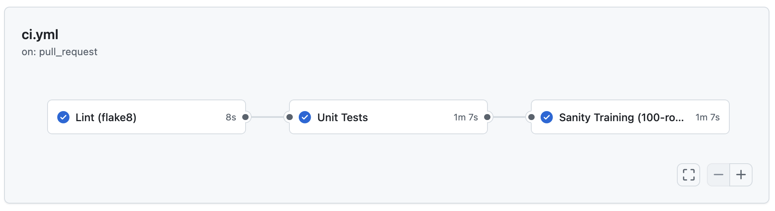
07b
GitHub Actions — CI Pipeline Green
Evidence: All three CI checks passing on the ci/smoke-test branch
[ INSERT SCREENSHOT HERE ]
Go to github.com/kholostovamk/mlops-credit-scoring → Actions tab Open the latest CI run and take a screenshot showing: Lint ✓ Unit Tests ✓ Sanity Training ✓
MLOps Credit Scoring Pipeline · April 2026 · github.com/kholostovamk/mlops-credit-scoring
Notes:
Here's the actual CI run from the pull request — all three jobs passed in 2 minutes 31 seconds. Lint, unit tests, sanity training — all green. This triggered automatically the moment I opened the PR.

Slide 11
09 Governance & Incident Playbook
★ BONUS
Model Audit Log
Incident Playbook — 5 Runbooks
Model version, training date, dataset hash
INC-001
Endpoint Down
Hyperparameters from best Optuna trial
INC-002
Feature Drift Detected
Performance metrics: AUC-ROC, F1, accuracy
INC-003
Concept Drift / Decay
Fairness audit across SEX, EDUCATION, MARRIAGE groups
INC-004
Fairness Violation
Drift baseline — PSI reference scores
Deployment target & approver sign-off
INC-005
CI/CD Pipeline Failure
Notes:
These are the two bonus components. The first is governance — which in a production ML context means maintaining accountability for every model version that gets deployed. Every deployment automatically writes a structured audit log entry: which model version, what training date, what dataset hash, what hyperparameters, what performance metrics, how it did on the fairness audit, and who approved it. This is the kind of documentation a bank's risk or compliance team would actually require. The second bonus is an incident playbook — five runbooks, one for each failure mode: endpoint down, feature drift detected, concept drift or model decay, fairness violation, and CI/CD pipeline failure. Each runbook defines the detection signal, the immediate response steps, the escalation path, and the remediation procedure.

Slide 12
10 Optional Enhancements Showcase
★ BONUS
MLflow Experiment Tracking
Prometheus + Grafana Monitoring
Experiment Runs
Prometheus Metrics
Every Optuna trial logged: params, CV score, duration
Request count, latency (p50/p95), error rate — scraped every 15s
Best Run Promotion
Grafana Dashboard
Top trial's artifacts logged to parent MLflow run
4 panels: throughput, latency, errors, drift score
Model Registry
PSI Drift Detector
Registered as 'credit-scoring-xgb' with version tracking
Rolling 1,000-sample buffer · alerts when PSI > 0.2
Auto-logging
Alert Rules
mlflow.sklearn autolog captures feature importances & signature
High error rate, latency spikes, drift threshold breaches
Metrics Dashboard
Sidecar Pattern
Compare AUC-ROC across runs; filter by hyperparameter range
drift_detector.py runs alongside inference on port 8081
Notes:
The two optional enhancements are experiment tracking and monitoring. On the left — MLflow. Every Optuna trial is logged as a child run under a parent experiment, so you can see the full history of what was tried and what worked. The best trial's artifacts get promoted to the parent run, and the final model is registered in the MLflow Model Registry with a version number — so you have a clean history of what's been deployed and when. On the right — the monitoring stack. Prometheus scrapes metrics from the inference server every 10 seconds. Those metrics include request throughput, p95 latency, error rate, and prediction probability. Grafana visualizes all of this in a live dashboard. There's also a drift detection sidecar — a separate process running alongside the inference server that maintains a rolling buffer of recent predictions and computes PSI, Population Stability Index, against the training baseline. PSI is a statistical measure of how much a distribution has shifted — if it goes above 0.2, an alert fires.

Slide 13
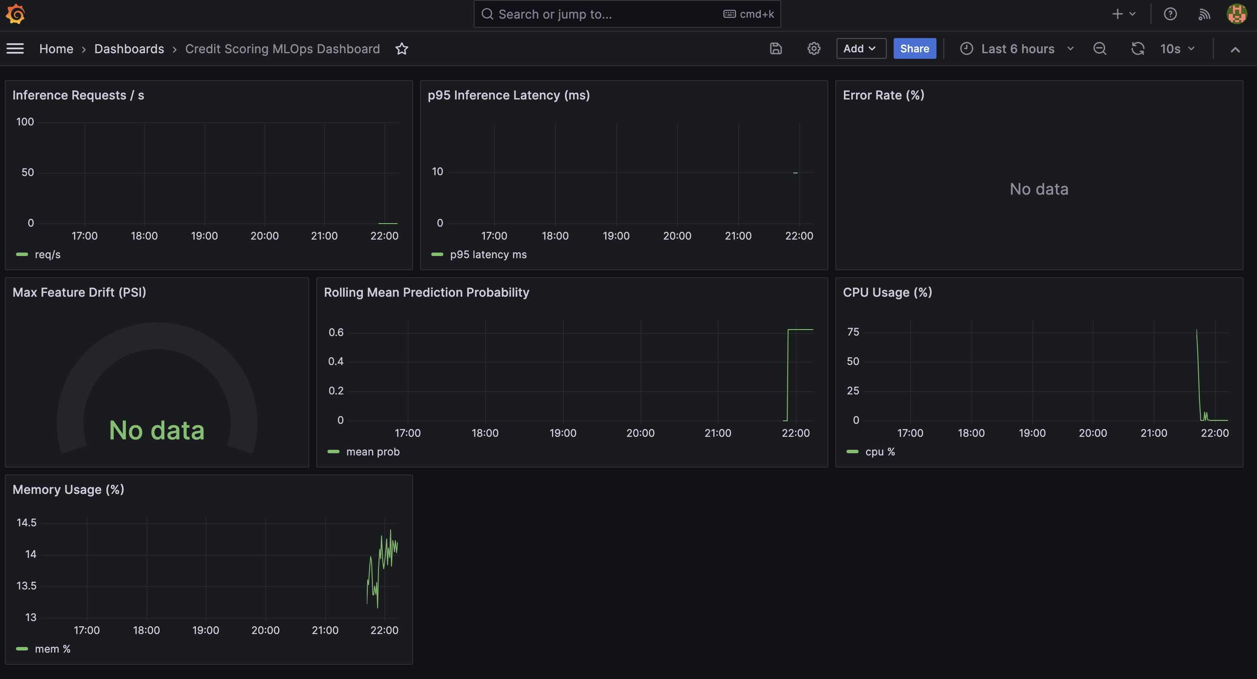
10b
Grafana Dashboard — Live Monitoring Metrics
Evidence: Prometheus + Grafana monitoring stack running via docker compose
[ INSERT SCREENSHOT HERE ]
Run: docker compose up --build → open http://localhost:3000 → login admin/admin Screenshot should show: Inference Requests/s · p95 Latency (ms) · Rolling Prediction Probability · CPU & Memory Usage
MLOps Credit Scoring Pipeline · April 2026 · github.com/kholostovamk/mlops-credit-scoring
Notes:
And here's the live dashboard during a test traffic burst. You can see requests per second spiking, p95 latency around 10 milliseconds, the rolling mean prediction probability, and system CPU and memory from node-exporter — all updating in real time.

Slide 14
11 Lessons Learned & Next Steps
Lessons Learned
Next Steps
IAM permissions shape architecture
A/B Testing
S3 write restrictions forced baking the model into Docker — creative constraint solving
Champion/challenger endpoints with traffic splitting by real-world conversion
Container failures are hard to debug
Auto-Retraining
No CloudWatch access → local smoke tests in CI are an essential safety net
Trigger pipeline when PSI drift score exceeds 0.2 — close the feedback loop
DVC + GitHub Actions work well together
Feature Store
Artifacts API cleanly replaces cloud storage for pipeline hand-offs between jobs
SageMaker Feature Store for real-time serving and cross-team consistency
Fairness is a first-class metric
SageMaker Pipelines
Built directly into evaluate.py — runs on every model version automatically
Replace GitHub Actions CD with native SM Pipelines for step caching + lineage
Notes:
A few things I'd do differently or think about differently next time. First — IAM permission constraints shaped the architecture in ways I didn't anticipate. Not having S3 write access pushed me toward baking the model into Docker, which turned out to be a cleaner solution, but it's the kind of thing you want to understand upfront. Second — without CloudWatch access, I had no visibility into what was happening inside the container once it was deployed. Adding a local /ping smoke test in CI caught real failures before they ever hit production. Third — DVC and GitHub Actions compose really well. Using the Artifacts API to pass pipeline outputs between jobs was simpler than I expected and removed the need for a dedicated artifact store. Fourth — fairness auditing needs to be built into the evaluation script from day one, not retrofitted later. If it's not automated, it won't happen consistently.

Slide 15
Thank You
MLOps Credit Scoring Pipeline — End-to-End
0.778
13
4 Stages
AWS SM
AUC-ROC
Unit Tests
DVC Pipeline
Deployment
github.com/kholostovamk/mlops-credit-scoring
Margo Kholostova · April 2026
Notes:
To wrap up — I built a full production ML pipeline that takes raw financial data and produces a live, monitored, automatically redeploying credit scoring service. The model hits 0.778 AUC-ROC, the system tests itself on every commit, and deploys itself to SageMaker on every merge to main. The full code, DVC pipeline, CI/CD configs, Docker setup, monitoring stack, and governance documents are all on GitHub at the link on screen. Thanks.

