Slide 1
Probability Theory Recap
Discrete variables – only a limited number of specific values
example: a classroom of 100 desks that are uniquely numbered
sample space : the possible values a variable can assume
S = {1, 2, … 100}
Continuous variables – an assume any value within a range
example: temperature
sample space : 0˚K ≤ X ≤ ∞ (sample space defined by the range of limiting values)
The treatment of probability differs depending on whether the variable of interest
is discrete or continuous.
Probability for discrete variables is mathematically simpler to describe.

Slide 2
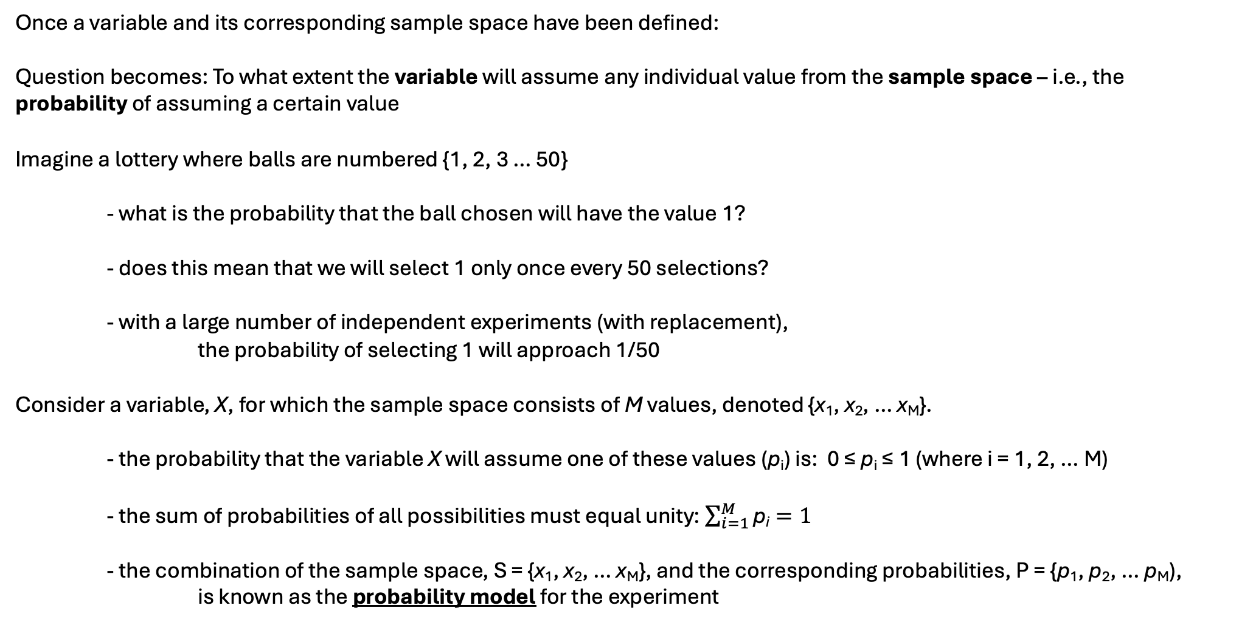
Probability Theory Recap
Once a variable and its corresponding sample space have been defined:
Question becomes: To what extent the variable will assume any individual value from the sample space – i.e., the probability of assuming a certain value
Imagine a lottery where balls are numbered {1, 2, 3 … 50}
- what is the probability that the ball chosen will have the value 1?
- does this mean that we will select 1 only once every 50 selections?
- with a large number of independent experiments (with replacement), the probability of selecting 1 will approach 1/50
Consider a variable, X, for which the sample space consists of M values, denoted {x₁, x₂, … x_{M}}.
- the probability that the variable X will assume one of these values (p_{i}) is: 0 ≤ p_{i} ≤ 1 (where i = 1, 2, … M)
- the sum of probabilities of all possibilities must equal unity: $\sum_{i=1}^{M}{\text{p}\text{i}}=1$
- the combination of the sample space, S = {x₁, x₂, … x_{M}}, and the corresponding probabilities, P = {p₁, p₂, … p_{M}),
is known as the probability model for the experiment

Slide 3
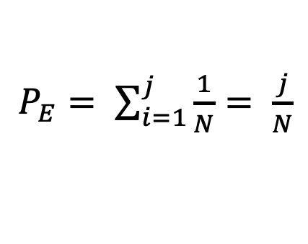
Probability Theory Recap
The Fundamental Counting Principle
Potential outcomes after tossing a coin four times
Event probability – the probability associated with an
outcome of interest from a series of experiments
What is probability of getting at least two H after four tosses?
T
T
T
T
H
T
T
T
T
H
T
T
T
T
H
T
T
T
T
H
H
H
T
T
H
T
H
T
H
T
T
H
T
H
H
T
T
H
T
H
T
T
H
H
H
H
H
T
H
H
T
H
H
t
H
H
T
H
H
H
H
H
H
H
For a sample space, S = {s₁, s₂, … s_{N}}, where the probability of an event, E, occurring is P_{E}.
If there are j values in S corresponding to the outcome of interest with all outcomes of equal probability, then
$P_{E}= \sum_{i=1}^{j}{\frac{1}{N}}= \frac{j}{N}$
j is the number of permutations of the sample space that correspond to the event of interest

Slide 4
Probability Theory Recap
The Fundamental Counting Principle
The probabilities from the preceding examples could be accomplished by counting
But what if we toss a coin 50 times and want to know the probability of the coin landing 20 times out of these 50 tosses?
- writing down every possible outcome would be tedious
Another example: assemble 30 students into a line – how many possible arrangements?
W = (30)(29)(28)…(2)(1) = 30! = 2.65 x 10³²
The fundamental counting principle: For a series of j manipulations {M₁, M₂ .. M_{j}} having n_{i} ways to accomplish M_{i}, the total number of ways to perform the entire series of manipulations (Total_{M}) is the product of the number of ways to perform each manipulation (under the assumption that the ways are independent):
Total_{M} = (n_{i=1})(n_{i=2})…(n_{i=j})
How many five-card arrangements (manipulations) are possible from a standard deck of 52 cards?
(52)(51)(50)(49)(48) = 311,875,200

Slide 5
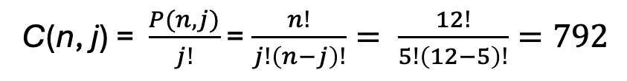
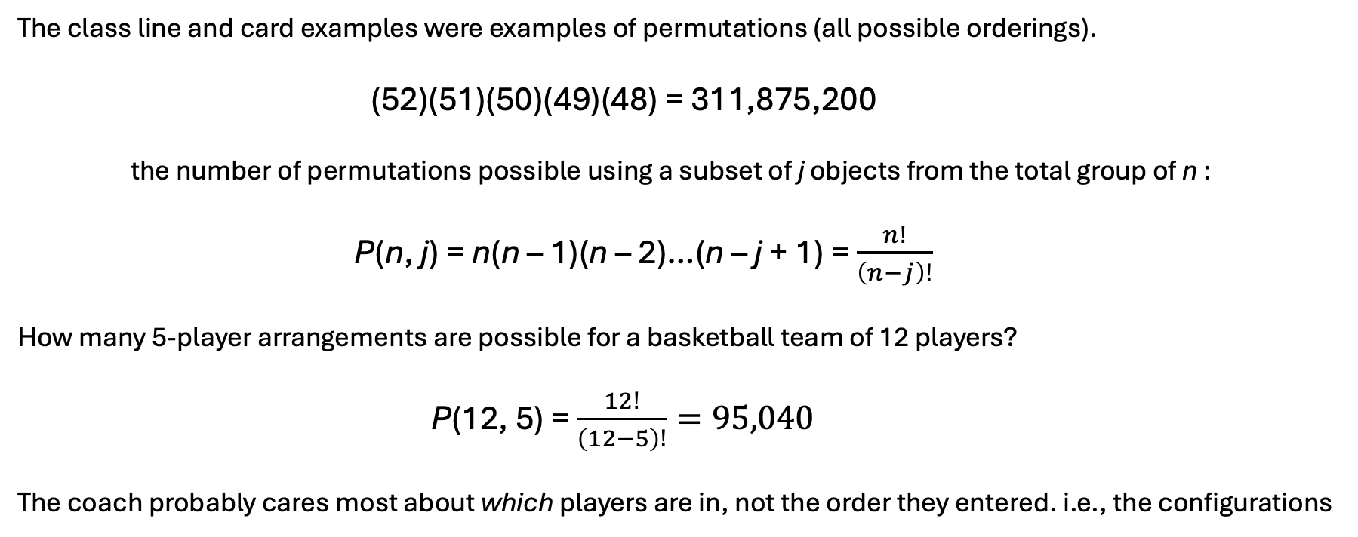
Probability Theory Recap
Permutations and Configurations
The class line and card examples were examples of permutations (all possible orderings).
(52)(51)(50)(49)(48) = 311,875,200
the number of permutations possible using a subset of j objects from the total group of n :
P(n, j) = n(n – 1)(n – 2)…(n – j + 1) = $\frac{n!}{\left(n−j\right)!}$
How many 5-player arrangements are possible for a basketball team of 12 players?
P(12, 5) = $\frac{12!}{\left(12−5\right)!}=95,040$
The coach probably cares most about which players are in, not the order they entered. i.e., the configurations
C(n, j) = $\frac{P(n, j)}{j!}$ = $\frac{n!}{j!\left(n−j\right)!}= \frac{12!}{5!\left(12−5\right)!}=792$

Slide 6
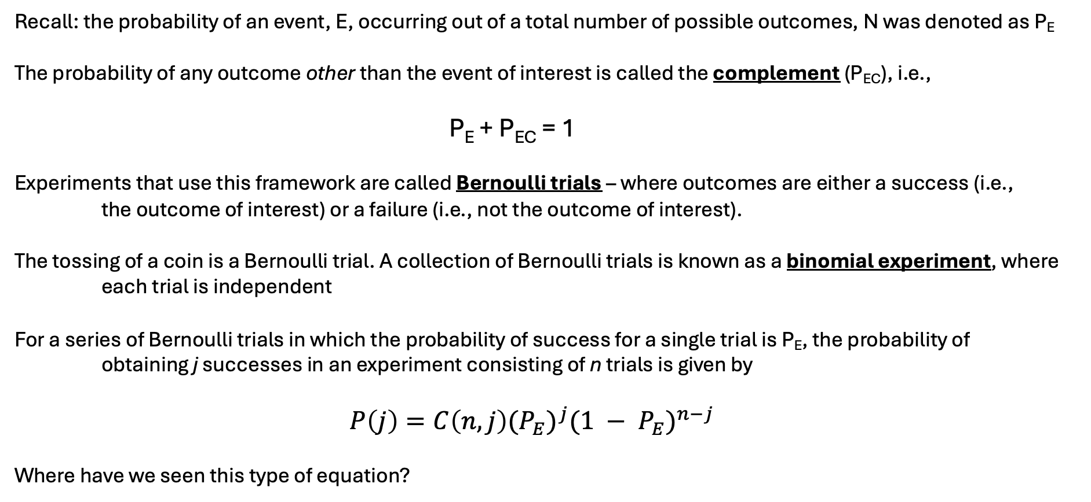
Probability Theory Recap
Binomial probabilities
Recall: the probability of an event, E, occurring out of a total number of possible outcomes, N was denoted as P_{E}
The probability of any outcome other than the event of interest is called the complement (P_{EC}), i.e.,
P_{E} + P_{EC} = 1
Experiments that use this framework are called Bernoulli trials – where outcomes are either a success (i.e.,
the outcome of interest) or a failure (i.e., not the outcome of interest).
The tossing of a coin is a Bernoulli trial. A collection of Bernoulli trials is known as a binomial experiment, where
each trial is independent
For a series of Bernoulli trials in which the probability of success for a single trial is P_{E}, the probability of obtaining j successes in an experiment consisting of n trials is given by
$P\left(j\right)=C\left(n, j\right){{(P}_{E})}^{j}{(1 − P_{E})}^{n−j}$
Where have we seen this type of equation?

Slide 7
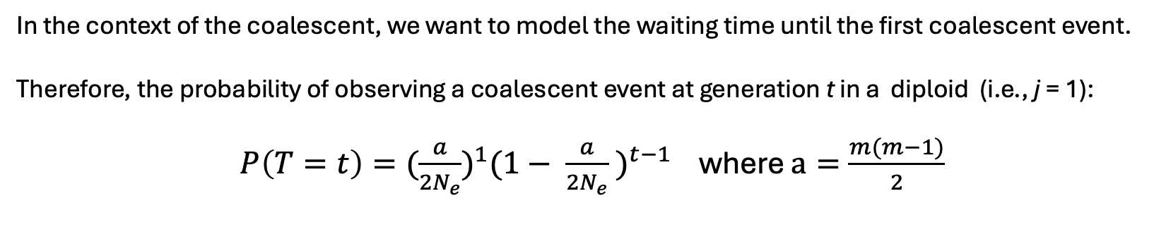
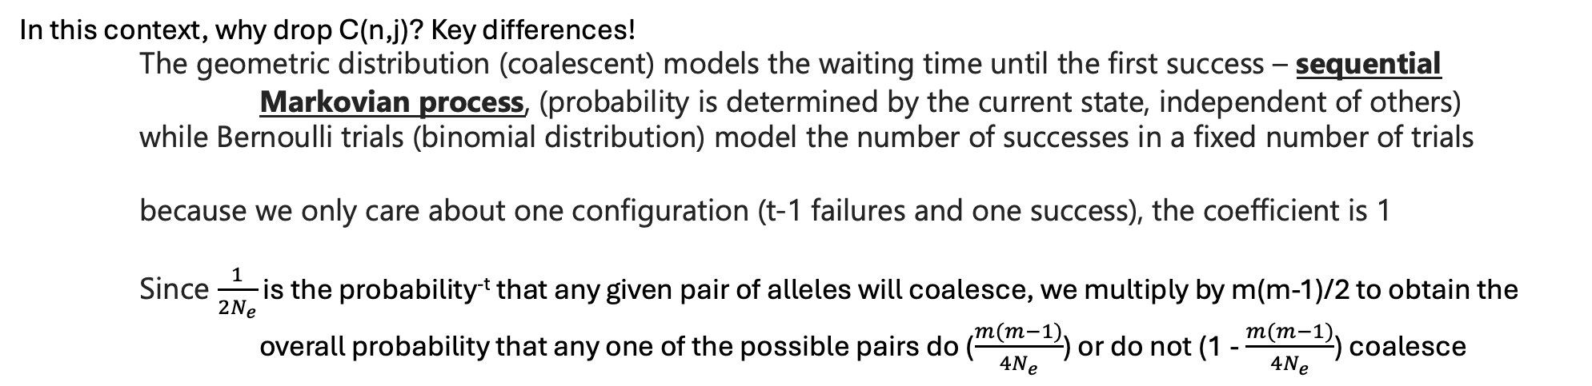
Probability Theory Recap
Relating to the coalescent
the probability of obtaining j successes in an experiment consisting of n trials is given by
$$P\left(j\right)=C\left(n, j\right){{(P}_{E})}^{j}{(1 − P_{E})}^{n−j}$$
In the context of the coalescent, we want to model the waiting time until the first coalescent event.
Therefore, the probability of observing a coalescent event at generation t in a diploid (i.e., j = 1):
$P\left(T=t\right)={(\frac{a}{2N_{e}})}^{1}{(1− \frac{a}{2N_{e}} )}^{t−1}$ where $a=\frac{m(m−1)}{2}$
In this context, why drop C(n,j)? Key differences!
The geometric distribution (coalescent) models the waiting time until the first success – sequential Markovian process, (probability is determined by the current state, independent of others)
while Bernoulli trials (binomial distribution) model the number of successes in a fixed number of trials
because we only care about one configuration (t-1 failures and one success), the coefficient is 1
Since $\frac{1}{2N_{e}}$ is the probability^{-t} that any given pair of alleles will coalesce, we multiply by m(m-1)/2 to obtain the
overall probability that any one of the possible pairs do ($\frac{m(m−1)}{4N_{e}}$) or do not (1 - $\frac{m(m−1)}{4N_{e}}$) coalesce

Slide 8
Assumptions (that can be relaxed)
Diploid
Genotyped 20 gene copies (10 individuals)
Everyone is homozygous
Constant population size
Offspring inherited alleles from previous generations
Non-overlapping generations
The population has Ne=100 individuals
t-1
Now
Let’s pick this one
We know
Gene copies inherited from previous (t-1) generation
Population size of t-1 = Ne = 100 (just showing 20)
There is a 1/200 chance it came from any given t-1 copy
Which gene copy in t-1 was inherited by gene copy in Now?
- could have come from any, but only came from one
When talking about coalescence, we’re asking if any of our now gene copies shared an ancestor, not just the chance of being from any given ancestor.
how many NOW gene copies are related to each other?

Slide 9
Assumptions (that can be relaxed)
Diploid
Genotyped 20 gene copies (10 individuals)
Everyone is homozygous
Constant population size
Offspring inherited alleles from previous generations
Non-overlapping generations
The population has Ne=100 individuals
t-1
Now
Let’s pick this one
There is a 1/200 chance it came from any given t-1 copy
What is the chance of these two coalescing in t-1?
1/200 = (1) * (1/200) = 1/2N

Slide 10
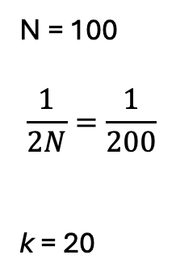
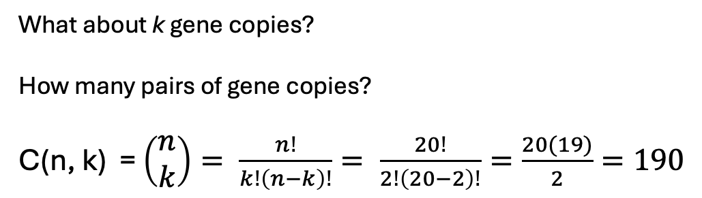
Assumptions (that can be relaxed)
Diploid
Genotyped 20 gene copies (10 individuals)
Everyone is homozygous
Constant population size
Offspring inherited alleles from previous generations
Non-overlapping generations
The population has Ne=100 individuals
t-1
Now
N = 100
$$\frac{1}{2N}=\frac{1}{200}$$
k = 20
What about k gene copies?
How many pairs of gene copies?
C(n, k) = $\left(\begin{matrix}n \\ k\end{matrix}\right)= \frac{n!}{k!\left(n−k\right)!}= \frac{20!}{2!\left(20−2\right)!}=\frac{20(19)}{2}=190$
k(k-1)
------- = 190
2

Slide 11
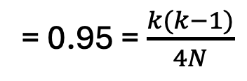
Assumptions (that can be relaxed)
Diploid
Genotyped 20 gene copies (10 individuals)
Everyone is homozygous
Constant population size
Offspring inherited alleles from previous generations
Non-overlapping generations
The population has Ne=100 individuals
t-1
Now
N = 100
$$\frac{1}{2N}=\frac{1}{200}$$
k = 20
What are the chances that any one of our 190 gene copies
will coalesce in t-1? (i.e., the event probability)
k(k-1)
------- = 190
2
190 *
1 / 200
= 0.95 = $\frac{k(k−1)}{4N}$

Slide 12
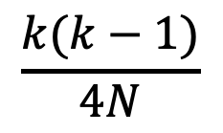
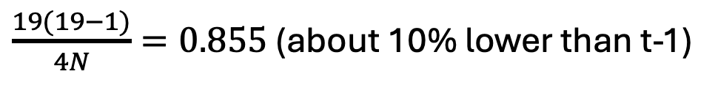
Assumptions (that can be relaxed)
Diploid
Genotyped 20 gene copies (10 individuals)
Everyone is homozygous
Constant population size
Offspring inherited alleles from previous generations
Non-overlapping generations
The population has Ne=100 individuals
t-2
t-1
Now
N = 100
$$\frac{1}{2N}=\frac{1}{200}$$
k = 20
If a pair coalesces, it looks like this – most genes have unique ancestors, but two gene copies in Now share an ancestor in t -1
k(k-1)
------- = 190
2
Once a coalescent event happens, we expect the chances of the next event to be smaller
$$\frac{k(k−1)}{4N}$$
$\frac{19(19−1)}{4N}=0.855$ (about 10% lower than t-1)

Slide 13
Assumptions (that can be relaxed)
Diploid
Genotyped 20 gene copies (10 individuals)
Everyone is homozygous
Constant population size
Offspring inherited alleles from previous generations
Non-overlapping generations
The population has Ne=100 individuals
t-2
t-1
Now
N = 100
$$\frac{1}{2N}=\frac{1}{200}$$
k = 20
Probability gets smaller and smaller
k | Probability
20 | 0.95
19 | 0.855
18 | 0.765
17 | 0.68
… | …
3 | 0.015
2 | 0.005
Should happen almost
Right away
k(k-1)
------- = 190
2
Will take a long time
How long? – use the rate

Slide 14
Assumptions (that can be relaxed)
Diploid
Genotyped 20 gene copies (10 individuals)
Everyone is homozygous
Constant population size
Offspring inherited alleles from previous generations
Non-overlapping generations
The population has Ne=100 individuals
t-2
t-1
Now
N = 100
$$\frac{1}{2N}=\frac{1}{200}$$
k = 20
Probability gets smaller and smaller
k | Probability | Rate
20 | 0.95 | 1.05
19 | 0.855 | 1.17
18 | 0.765 | 1.31
17 | 0.68 | 1.47
… | … | …
3 | 0.015 | 66.67
2 | 0.005 | 200.00
k | Probability
20 | 0.95
19 | 0.855
18 | 0.765
17 | 0.68
… | …
3 | 0.015
2 | 0.005
Should happen almost
Right away
k(k-1)
------- = 190
2
k(k-1)
------- = coal. / generation
4N
4N
------- = generations / coal.
k(k-1)
Will take a long time
How long? – use the rate

Slide 15
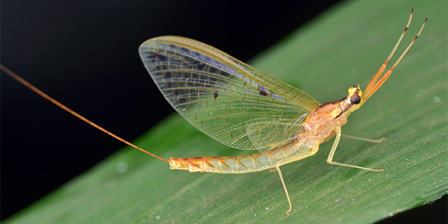
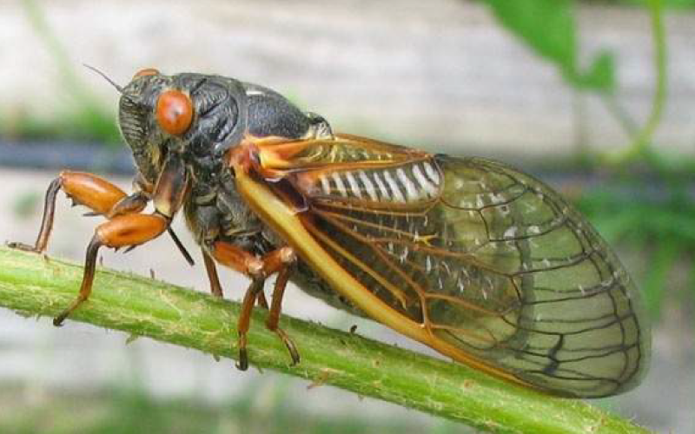
Assumptions (that can be relaxed)
Diploid
Genotyped 20 gene copies (10 individuals)
Everyone is homozygous
Constant population size
Offspring inherited alleles from previous generations
Non-overlapping generations
The population has Ne=100 individuals
t-2
t-1
Now
N = 100
$$\frac{1}{2N}=\frac{1}{200}$$
k = 20
Mayfly generation = 1yr
= 380 years
k | Probability | Rate | Cumulative rate
20 | 0.95 | 1.05 | 1.05
19 | 0.855 | 1.17 | 2.22
18 | 0.765 | 1.31 | 3.53
17 | 0.68 | 1.47 | 5.00
… | … | … | …
3 | 0.015 | 66.67 | 180.00
2 | 0.005 | 200.00 | 380.00
k(k-1)
------- = 190
2
17-year (generation) cicada
Rate x 17 = years
= 6460 years

Slide 16
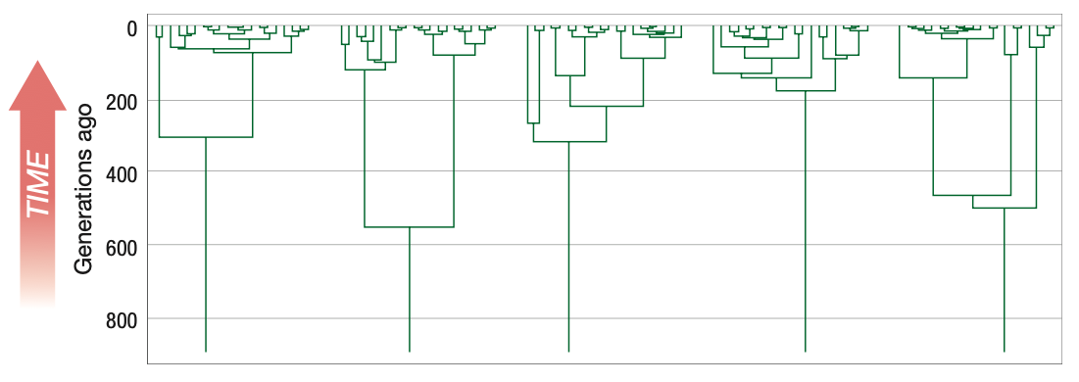
Remember: rates are averages
5 simulated coalescent trees
(same assumptions and probabilities)
k | Probability | Rate | Cumulative rate
20 | 0.95 | 1.05 | 1.05
19 | 0.855 | 1.17 | 2.22
18 | 0.765 | 1.31 | 3.53
17 | 0.68 | 1.47 | 5.00
… | … | … | …
3 | 0.015 | 66.67 | 180.00
2 | 0.005 | 200.00 | 380.00
Chance of first coalescent event NOT happening in five generations
= 0.05 ^ 5 ≈ 1 / 10,000,000
But patterns remain

Slide 17
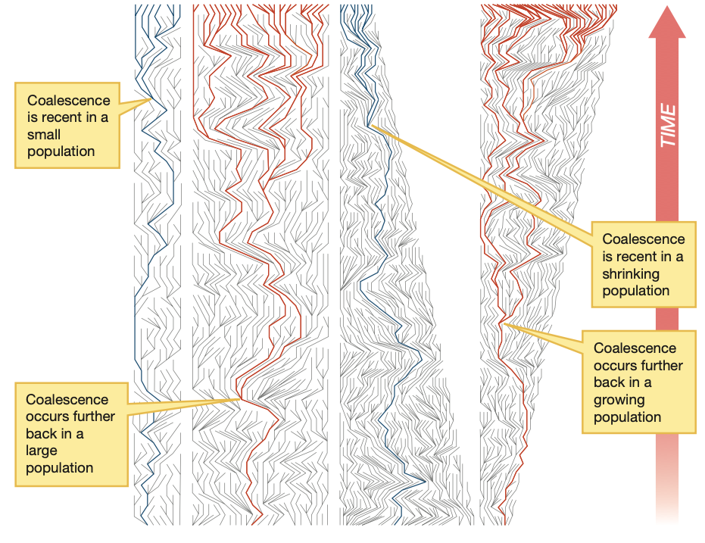

Slide 18
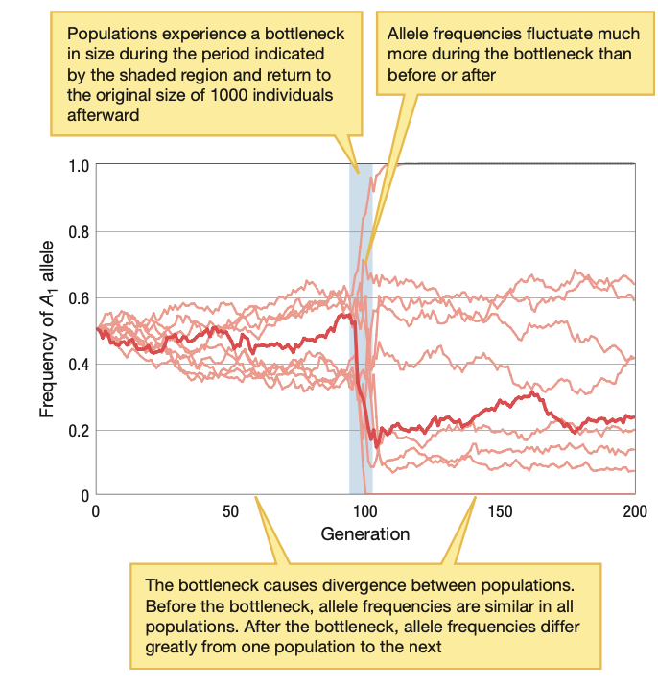
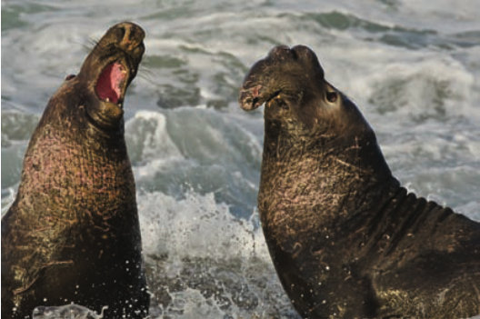
Northern elephant seals
Hunted to edge of extinction in 19th century
In 1892 – 8 individuals thought to be the last were discovered on Guadalupe Island off coast Mexico
– and promptly killed for museum specimens
Fortunately, these were not the last – 10-20 survived

Slide 19

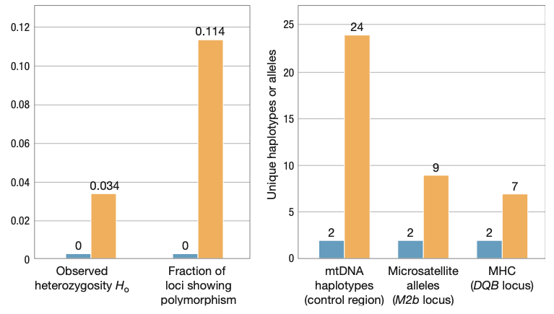
Low variation in northern elephant seals
Enzyme electrophoresis
DNA sequences
Hoelzel (1999) Biol. J. Linn. Soc., Hoelzel et al. (1999) Mol Biol Evol

Slide 20
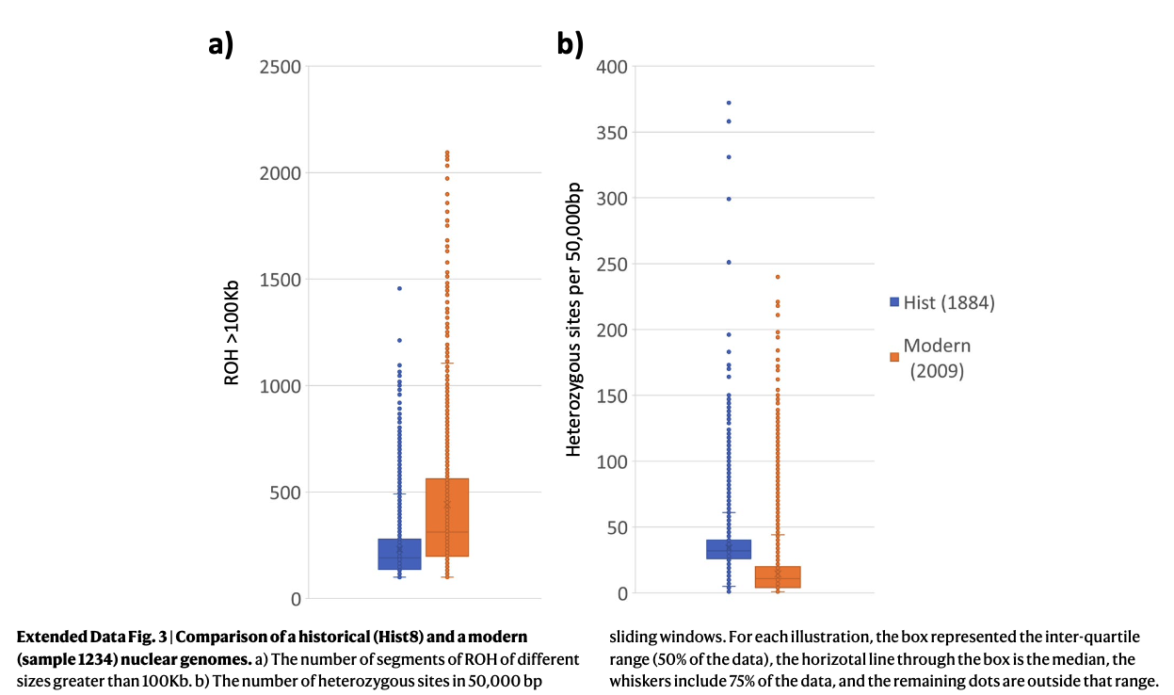
Hoetzel et al. 2024 Nat Ecol Evol

Slide 21
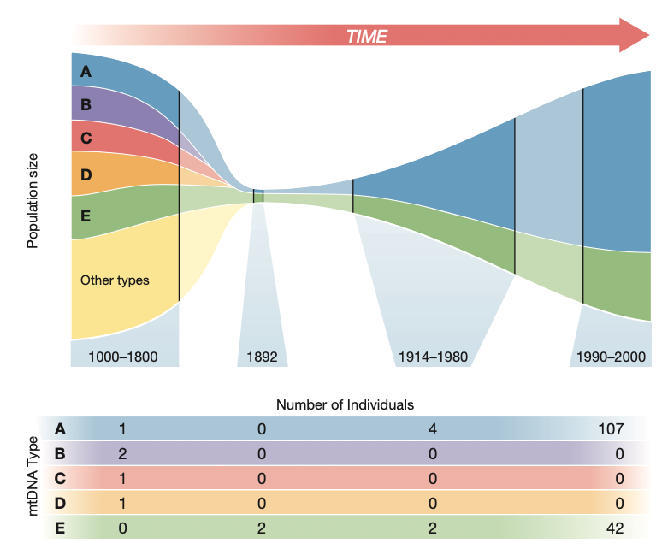
Using historical samples to show low diversity was (likely) caused by bottleneck
Pre-bottleneck sample size = 5
mtDNA
Weber et al. (2000) Curr. Biol.

Slide 22
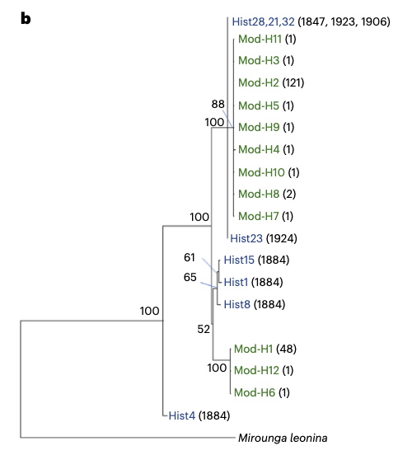
Two major lineages remained after the bottle neck
Hoetzel et al. 2024 Nat Ecol Evol

Slide 23
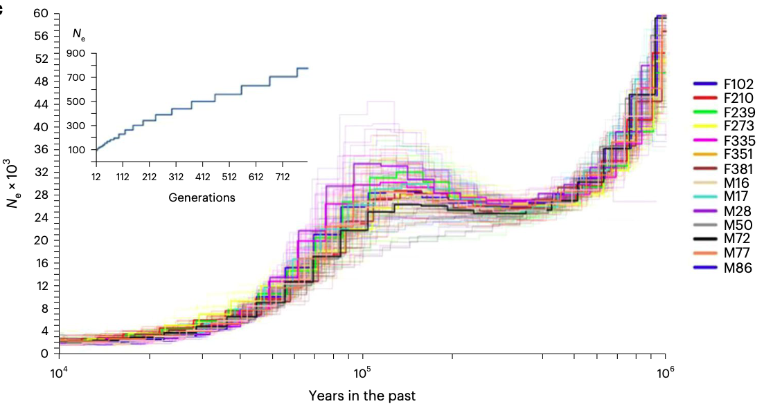
10,000
100,000
1,000,000
Hoetzel et al. 2024 Nat Ecol Evol

Slide 24
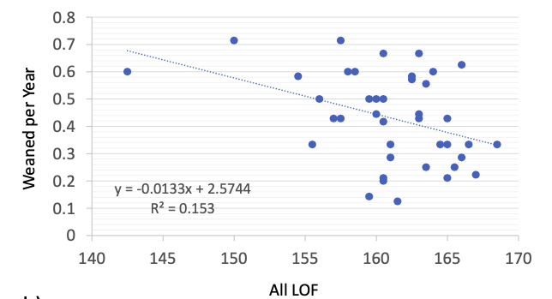
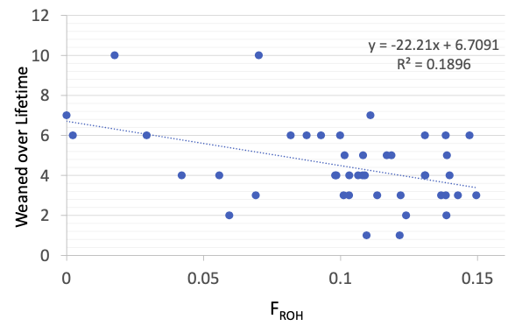
Reproductive Fitness declines with
decreased levels of diversity
But not lifespan or total pups produced “A significant correlation for pups weaned, but not for pups pro-
duced, suggests that the impairment may be more about the fitness
of offspring affected by inbreeding rather than fecundity; however,
more data on the genotypes and phenotypes of the relevant pups
would be needed to test this further.”
(ROH positively correlated with LOF missense mutations)
Hoetzel et al. 2024 Nat Ecol Evol

Slide 25
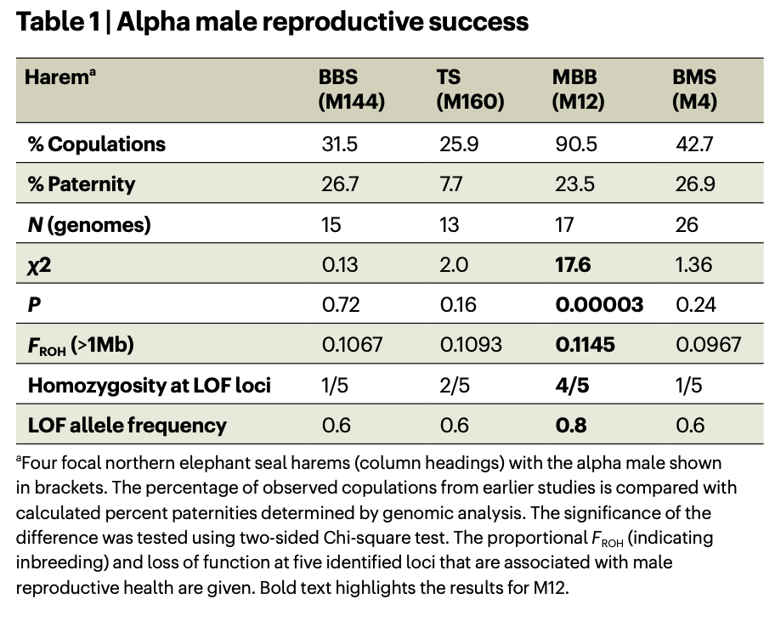
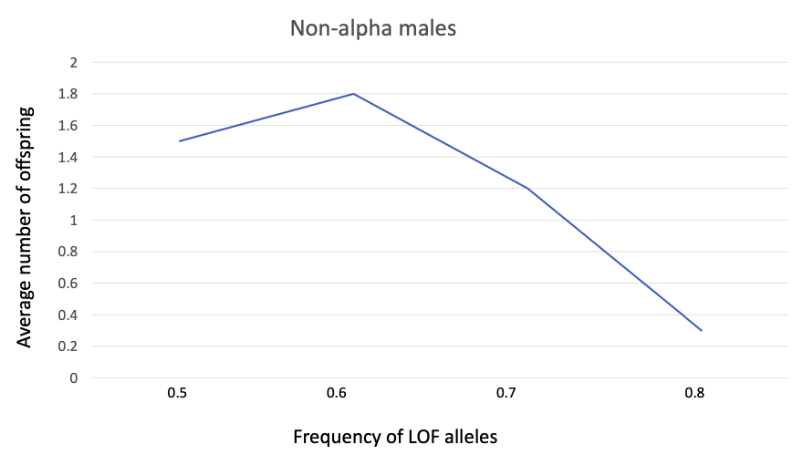
N = 27
But no sig. relationship between paternal success with FROH and LOF

Slide 26
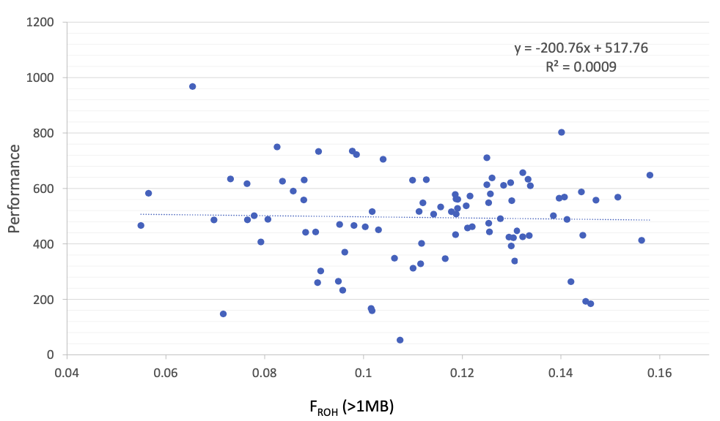
diving
performance
Though MAF was higher in 5 hypoxia genes for individuals with lower diving performance

