Slide 1
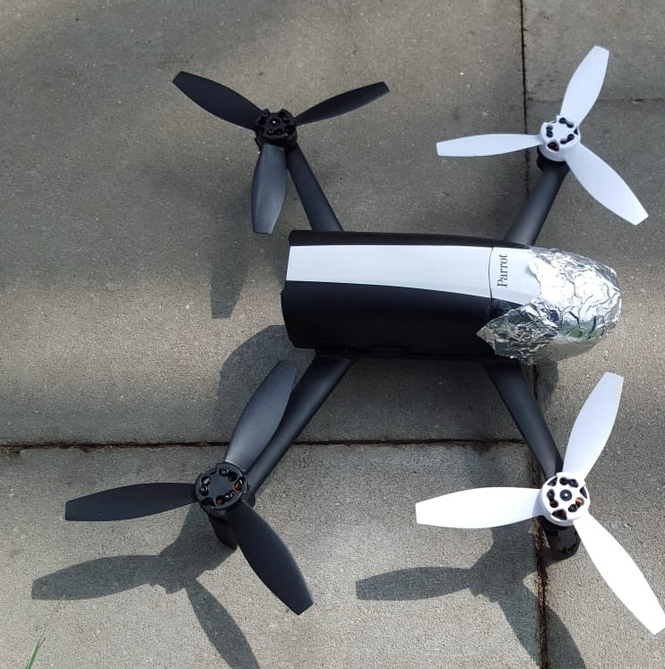


Greenhouse Navigation and Localisation with the Bebop2 Drone

Slide 2
Contents
Problem Introduction
Objective
Materials & Methods
Discussions
Conclusions

Slide 3
Problem Introduction
- Drones are prevalent
- Drones are dope
- Many platforms exist to control drones manually. New field is autonomous drone control
- Even fewer options to navigate and localise in a closed environment
- Navigation Options include using Dronekit (works on the pichawk flight controller) Dronecode (works on Ardupilot flight controller) or PyParrot (works on the Parrot Bebop flight controller)
- Localisation options include UWB "Tim's Masters Work" Or UWB by commercial products OR SLAM

Slide 4
Objective
Localise and navigate inside a closed greenhouse. Size is around 100 m x 20 m. Accuracy must be within XYZ cm

Slide 5
Materials & Method
Parameters/Materials:
- Small quadcopter (40x40 cm max)
- Fast Algorithm ()
- Greenhouse 12 x 6 m
- PyParrot Library

