Slide 1
BASE PROJECT 4:
BUILDING VIRTUAL ASSISTANCE
Student : Nguyen Trong Tam 18IT5
Idstudent :18IT294
Instructor: TS.Nguyen Si Thin

Slide 2

Content
Overview analyzing the topic
Theoretical basis
System design and analysis
Deploy and build
Conclusions and development direction

Slide 3

Overview analyzing the topic
Idea:
Science and technology development
Voice recognition technology
Target:
AI - especially in natural language processing
Operating principle

Slide 4


Slide 5

Theoretical basis
Artificial intelligence
ASR – Automatic Speech Recogntion
Processing sound
Image Matching
Question Answering
NLP application in chatbot

Slide 6

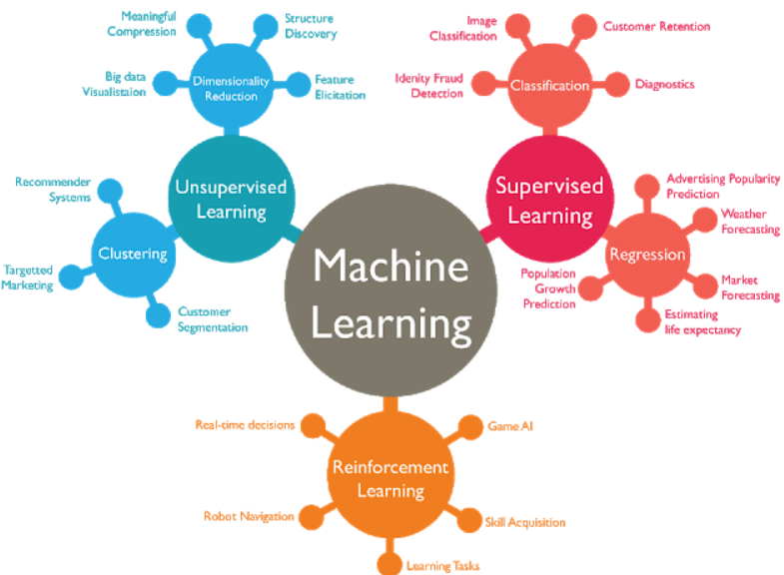
Artificial intelligence
Programmers make up - help computers automate intelligent behaviors
Machine learning and deep learning development
Application
Digital consulting
Health monitoring
Search for customer centers. ...
Target leads and improve sales processes. ...
- The advent of Deep Learning has helped with voice recognition accuracy

Slide 7
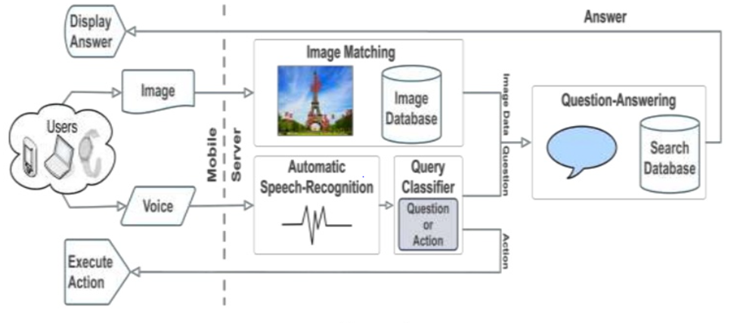
Processing sound

Slide 8
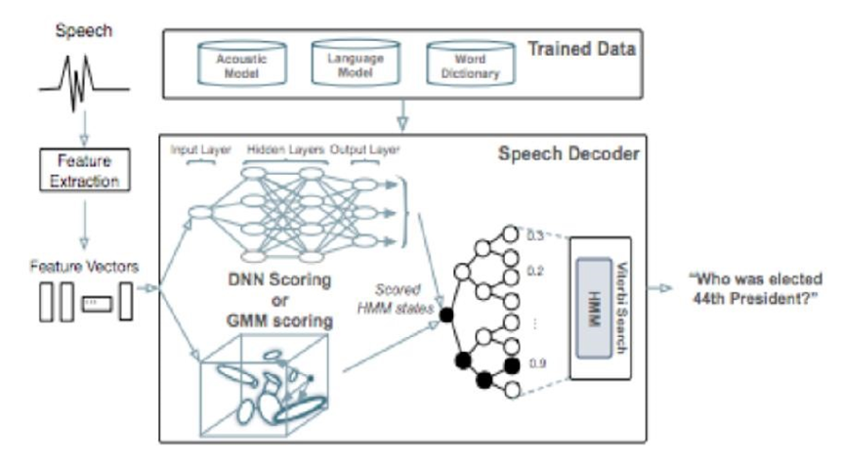
Processing sound

Slide 9
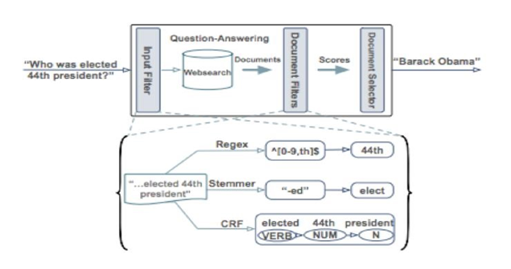
Question Answering

Slide 10
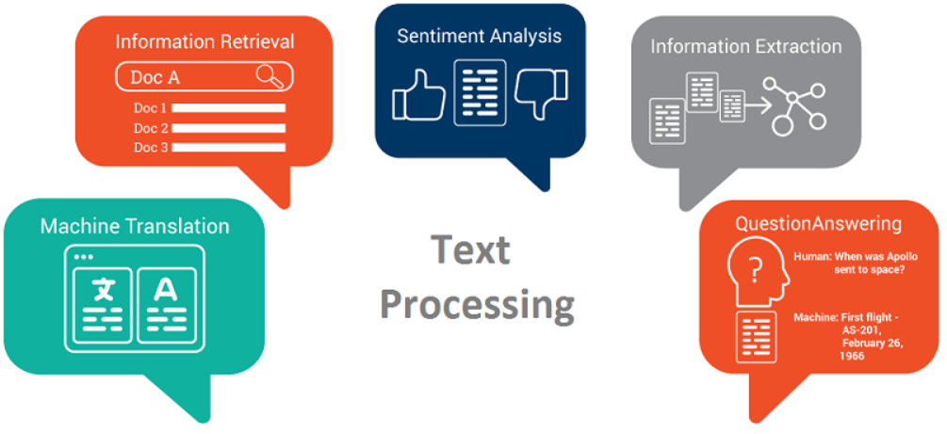
Natural Language Processing
A branch of artificial intelligence that focuses on human language applications
The hardest part as it involves having to understand the perfect tool-language meaning of thinking and communicating
Processing steps
Morphological analysis
Parsing
Semantic analysis
Text integration
Meaning analysis
Natural language processing applications

Slide 11
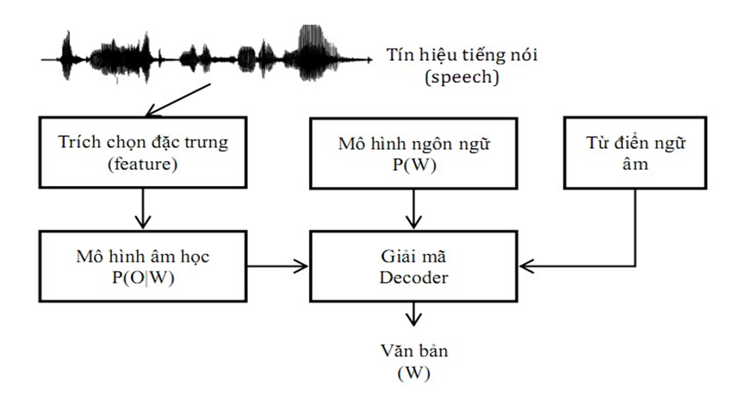
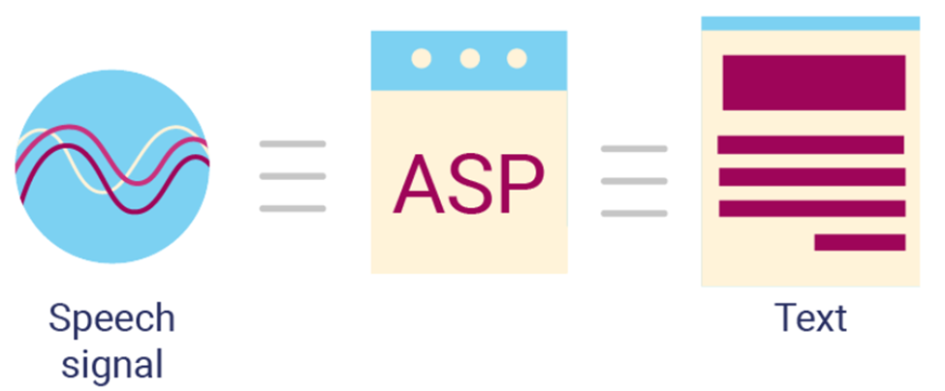
System design and analysis
Virtual assistant structure
Virtual assistant activities

Slide 12
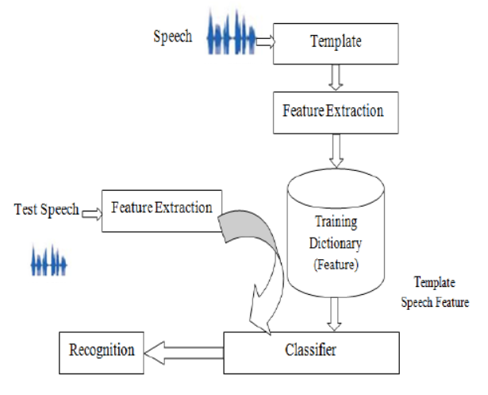
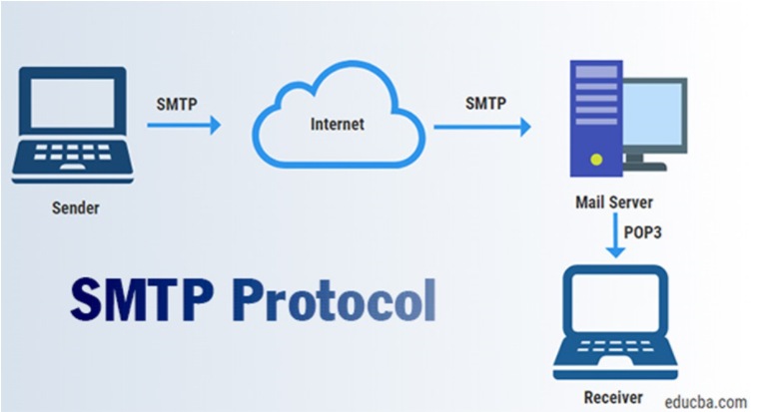
Deploy and build
Function that converts audio to text
Email function

Slide 13

Conclusions and development direction
Conclusions
Learn how virtual assistants work
The process of building virtual assistants
Know the structure of the virtual assistant
What is the virtual assistant's application in life like?
Development direction
Database design
Many functions
The controller has an electronic device

Slide 14
Thanks for watching and listening

