Slide 1
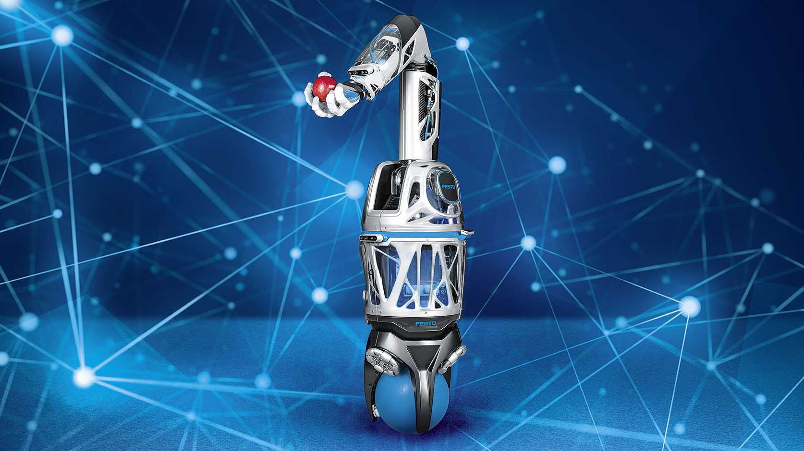
BioX

Slide 2

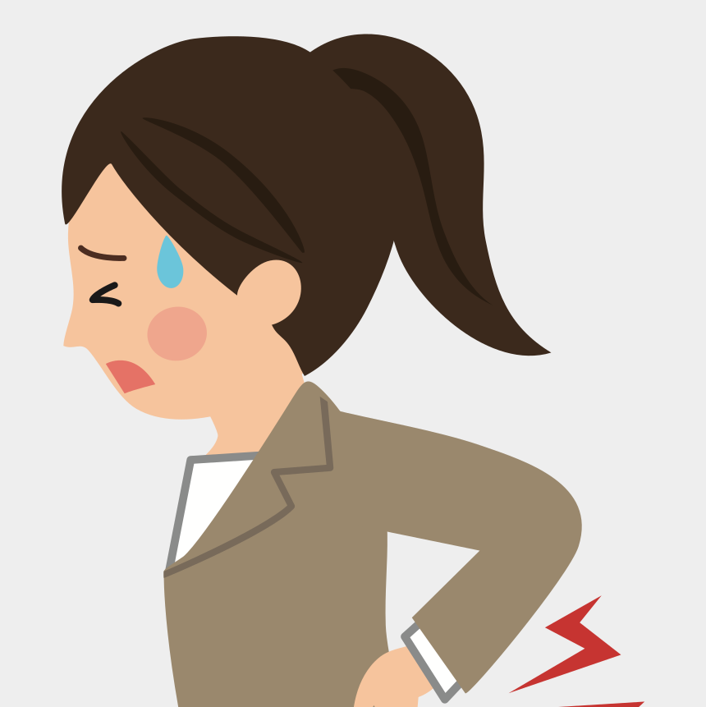
Problem Statement:
Imagine you are working at home on your car, fixing a leak in the bathroom or maybe even in practical labs where it is not practical to keep chairs and where we would need to stand for a long time.
Preventing fatigue and maintaining posture especially at an older age is very important and while there may be many beautiful and comfortable chairs at home, we cannot take them everywhere. This is where a bionic chair comes in very handy as we can take it anywhere and simply have a seat by locking in the mechanism. This can also be useful in occupations where one would need to stand on their feet for a long time.

Slide 3

BioX
This pandemic has taught us a lot on the importance of our physical posture, Almost all of us have suffered from bad posture.
We created the BioX as a bionic chair that allows you to rest anywhere you want with a posture that creates positive impact on your body.
The way the BioX automatically adjusts your sitting posture is based on extensive research to create a natural resting position where the back remains upright while the thighs bend .
The position helps relax the muscles, encourage easy breathing and relieve pressure on the stomach.

Slide 4
SWAT
New Industry So lot of market share and penetration available
Sub industry Of Bionic Market
Low Entry Barrier so we need to patent our design
Lex is a major and only Global Competitor

Slide 5

Engineering Requirements
Attachable to the user’s legs
Hinged properly to be able to turn without pushing too much against the user’s inner side of the knee.
Proper selection of the material used so that each leg of the chair must be able to sustain the weight expected
Appropriate distribution of load ensuring stability
Lightweight for Portability.
Ensuring safety and the sitting angle is recoverable.

Slide 6
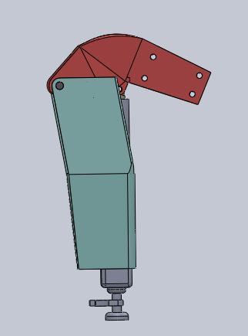
Design and Component Selection
Two main links to support the thigh and the calf muscles.
Further Connected by a hinge like connector with a piston links on the calf link and the connector.
Using of hydraulic we can adjust Centre of mass.
Aluminum Body
The BioX exoskeleton is built from the ground up incorporating many advanced design elements
The grooves and channel cut into the aircraft grade aluminum frame helps reduce weight to a bare minimum but is meticulously calculated to maintain strength and integrity enough to withstand daily use.

Slide 7
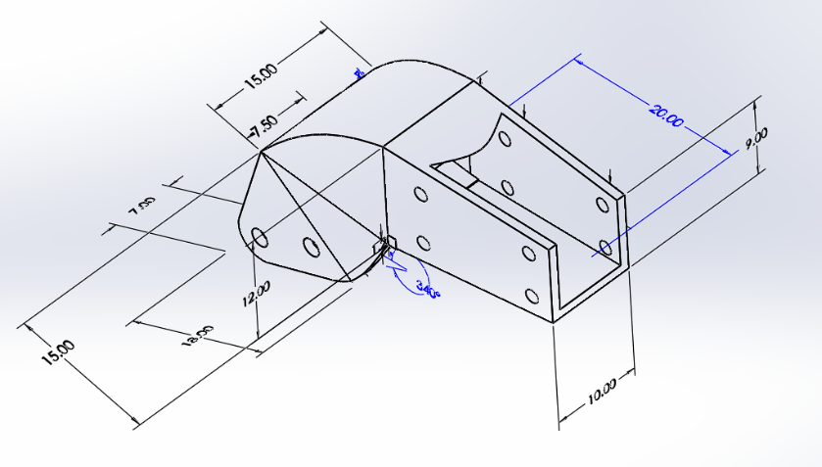
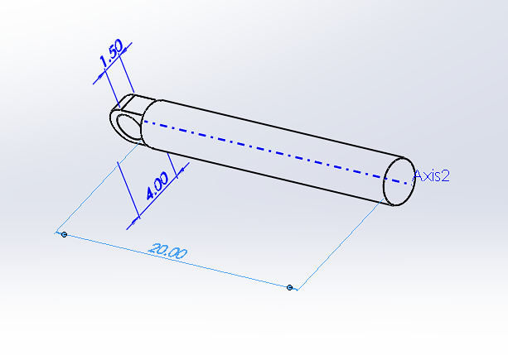
Components
The knee link connector which will connect the calf link and the sheet for the seating area
The piston which will work with the hydraulic links

Slide 8
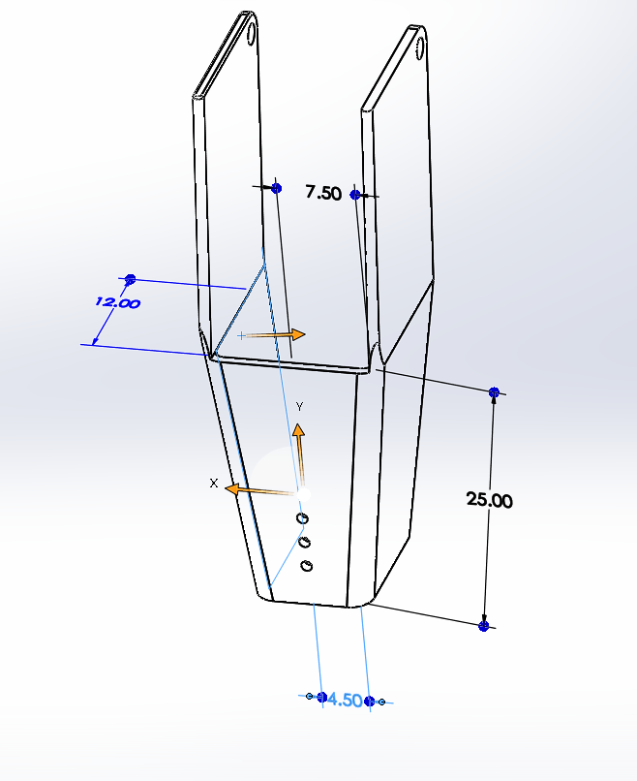
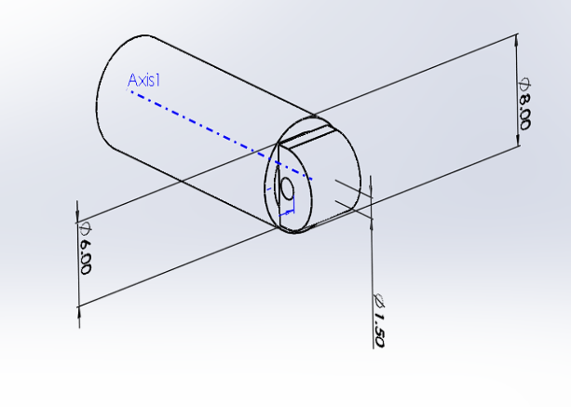
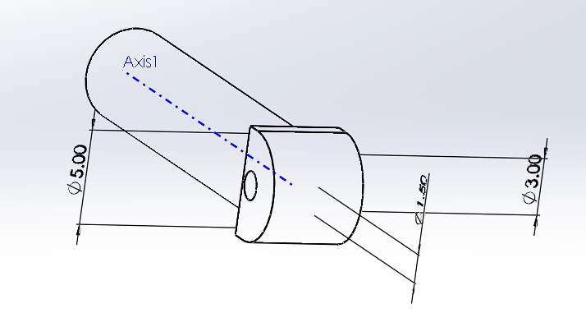
The bottom link for the calf
The two hydraulic parts

Slide 9
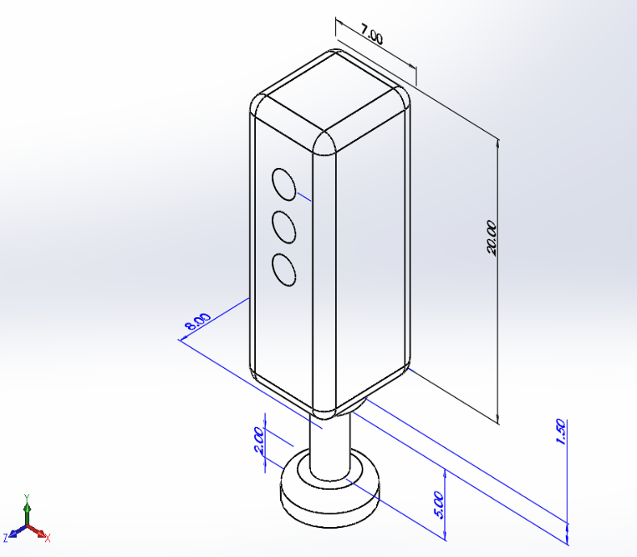
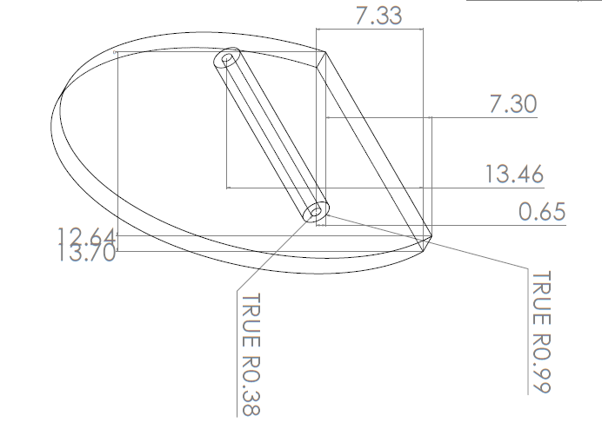
The bottom cylinder which will touch the ground
The seating sheet

Slide 10
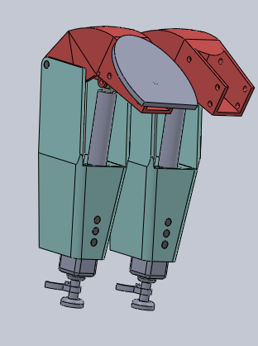
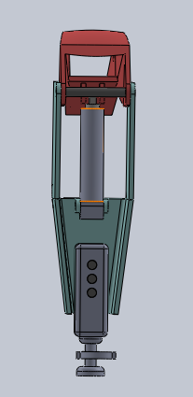
Model

Slide 11
Mechanism with technical issues
In our model, the most important components are hydraulic part and top and bottom parts.
Bottom and top are attached by pin, as well as seat is also attached through pin.
To move from one place to another there is attached at the bottom.
When person sits the load of person is handled by hydraulic part when we try to fold it by hydraulic.
In our next slide we have done FME to understand importance about center of mass

Slide 12
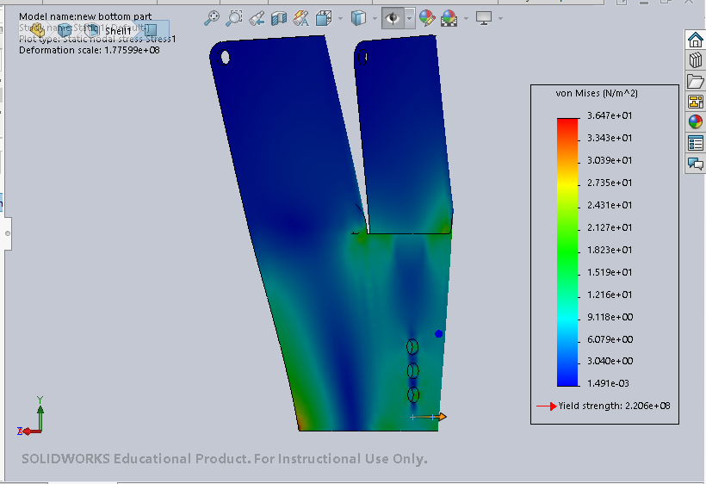
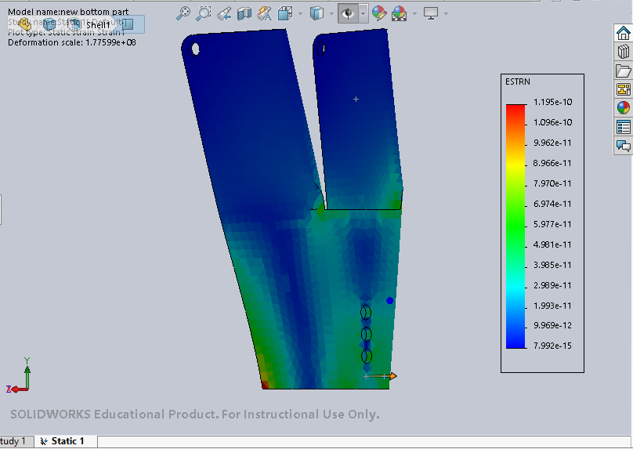
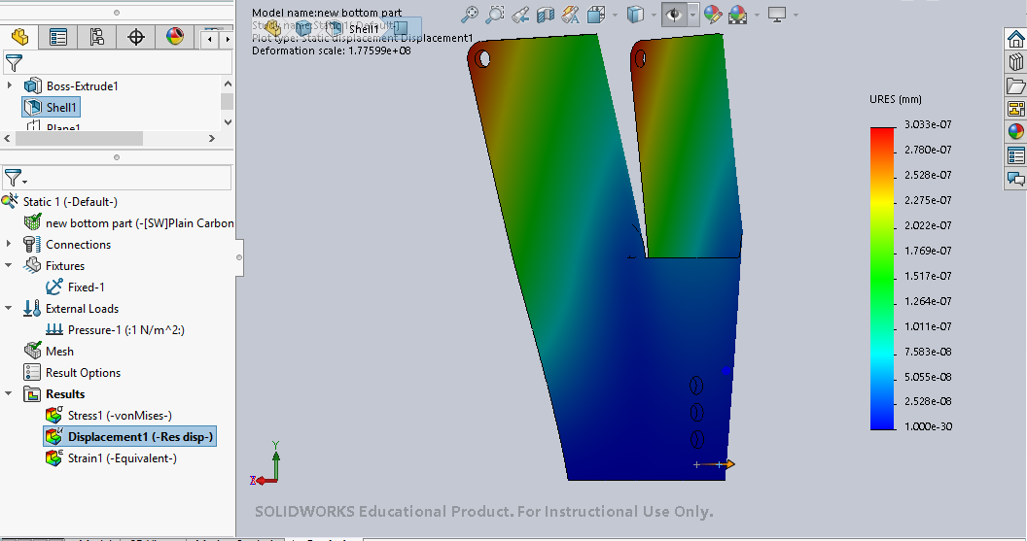
FME Analysis

Slide 13
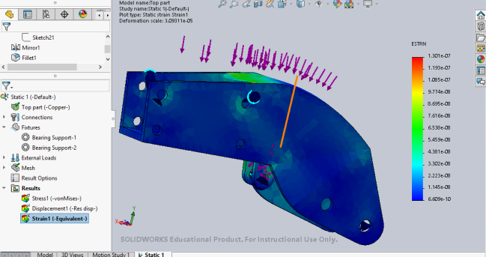
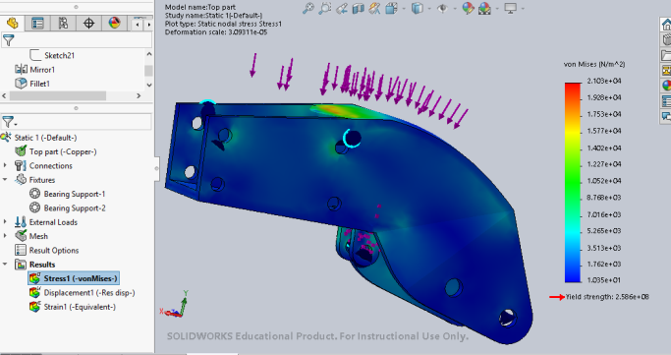
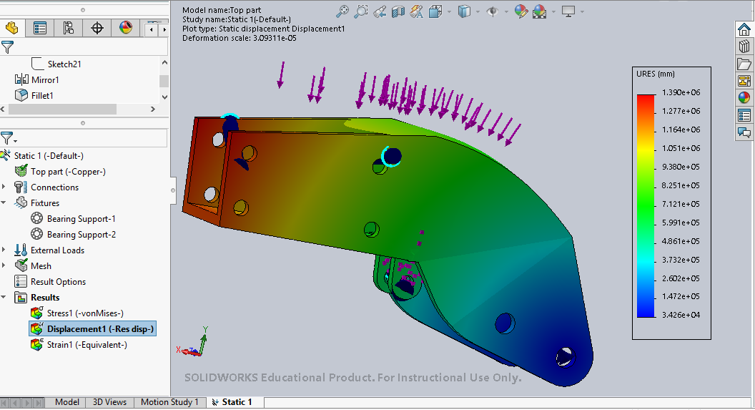

Slide 14
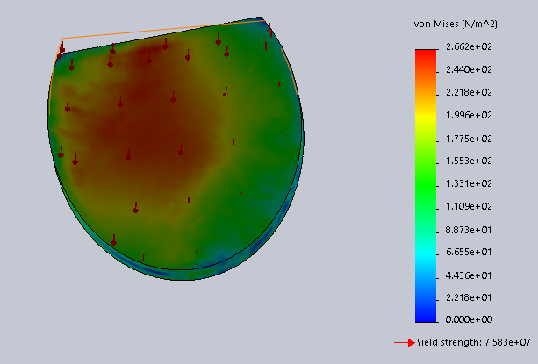
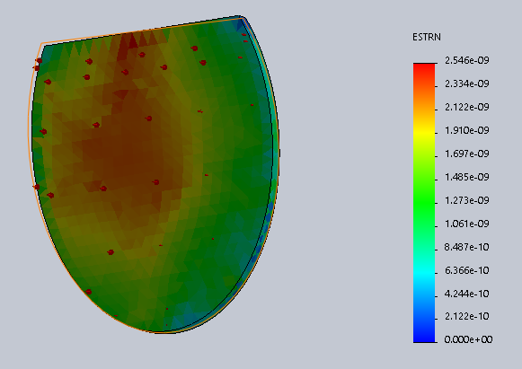
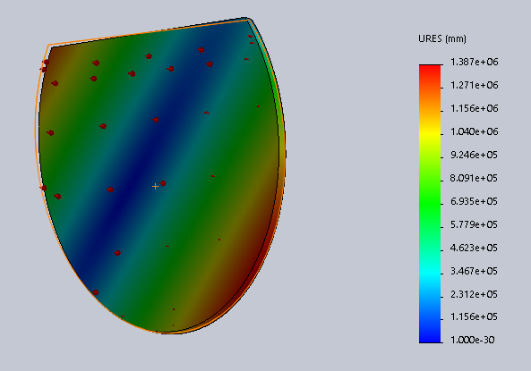

Slide 15
Usage Scenario
The BioX can be used every day in all types of scenarios as it constantly enhances your posture and comfort.
The BioX is your extra pair of legs whenever you want to sit. The only limit is where you want to go.
Relaxing
Commuting
Working
Travelling

Slide 16
Goals and Future
Use of AI to help our Clients
Cost Reduction and affordability
Attractive and Slim Design
As easy as a Laptop to Carry

Slide 17

Social impact and Economics
With our idea we can help many people with their knees problem
Now Sit With a perfect Posture
Comfort anywhere anytime

Slide 18
Risks and challenges
Some parts might fail QC and will need to be fixed, part X and mechanism Y might not fit perfectly with each other, and inspection has to be made.
Something is lacking in our design , doesn't seem Modern we will improve it by 3rd prototype.
We think that we will need a forward test of at least 6 months with customer feedbacks and experiences.
Although We are committed to our deadlines But initial launch could be delayed.

Slide 19

That’s all For Now
We are attaching Simulation at the end Check it out

Slide 20



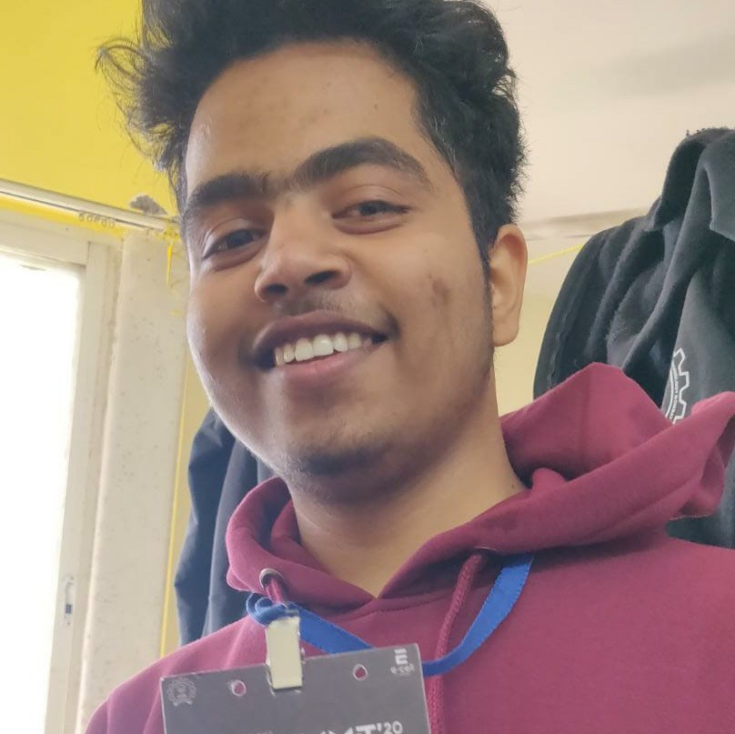
Team BioX
Nashwa
Jatin
Himanshu Kumar
Pratik

