Slide 1

EduOS
A Multi-Component Operating System Simulator
Module: 351 CS 2104 — Operating Systems | Semester III
Processes • Threads • IPC • Scheduling • Integration
Department of CS & IT

Slide 2
Abstract
EduOS is a two-language OS simulator built in C and Python that brings core operating-system concepts to life through working code. The C core implements a Process Control Block table, system-call analogues (edu_fork, edu_exec, edu_wait, edu_exit), a POSIX thread pool, Many-to-One and One-to-One threading models, race-condition demonstrations, and two IPC mechanisms (shared memory + anonymous pipe). The Python layer adds four scheduling algorithms — FCFS, SJF, Priority with ageing, and Round Robin — complete with Gantt charts and metric analysis. A controller bridges both layers end-to-end via subprocess pipes. Building EduOS deepened understanding of synchronisation, memory management, process lifecycle, and the practical tradeoffs between scheduling algorithms.

Slide 3




Design Decisions
PCB as a flat C struct
POSIX Shared Memory over Message Queues
O(1) lookup by index; matches real kernel layout (task_struct). Chosen over linked list for cache locality.
shm_open + mmap gives zero-copy data sharing. Message queues add serialisation overhead; SHM is faster for metrics.
Condvar + Mutex Thread Pool
JSON Serialiser written in C
Blocking workers on condvar avoids busy-spin. Graceful shutdown drains the queue before joining — prevents data loss.
No external library dependency. Hand-rolled serialiser keeps binary portable and avoids licensing issues.

Slide 4
Syllabus Mapping Table
Syllabus Topic | EduOS Implementation | File / Line Reference
Process Creation & PCB | edu_fork copies parent PCB; assigns new PID | process_manager.c : edu_fork()
Process Termination | edu_exit marks TERMINATED; records exit code | process_manager.c : edu_exit()
exec() System Call | edu_exec replaces name + burst fields | process_manager.c : edu_exec()
wait() System Call | edu_wait polls until all children TERMINATED | process_manager.c : edu_wait()
Thread Models (M2O, O2O) | setjmp/longjmp cooperative + pthreads parallel | thread_manager.c : demo_many_to_one/one_to_one()
Mutex / Semaphore | pthread_mutex + sem_init producer-consumer | thread_manager.c : demo_producer_consumer()
Race Conditions | make race vs make fixed (shared counter) | thread_manager.c : demo_race_condition()
IPC — Shared Memory | shm_open + mmap + owner_id access control | ipc_module.c : ipc_shared_memory_demo()
IPC — Pipes | Anonymous pipe: parent serialises → child reads | ipc_module.c : ipc_pipe_demo()
CPU Scheduling (4 algos) | FCFS, SJF, Priority+ageing, Round Robin | scheduler_sim.py : fcfs/sjf/priority_schedule/round_robin()
Deadlock Prevention | Consistent lock ordering policy | thread_manager.c : demo_deadlock()

Slide 5
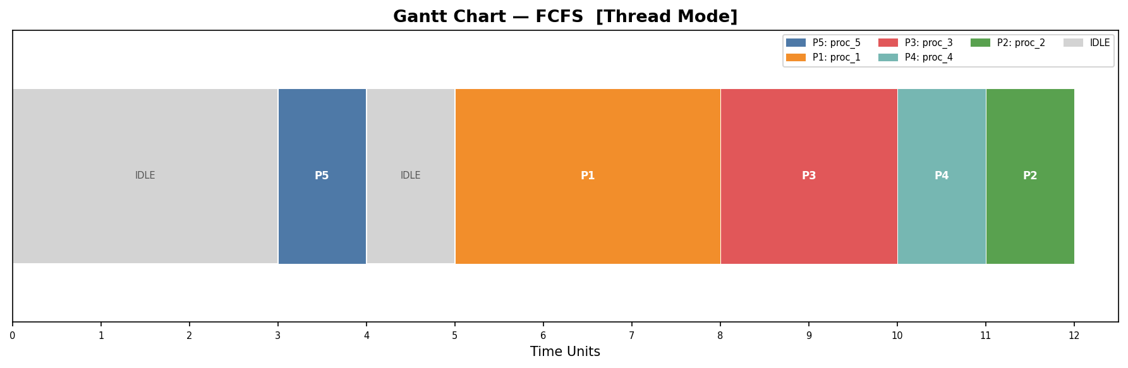
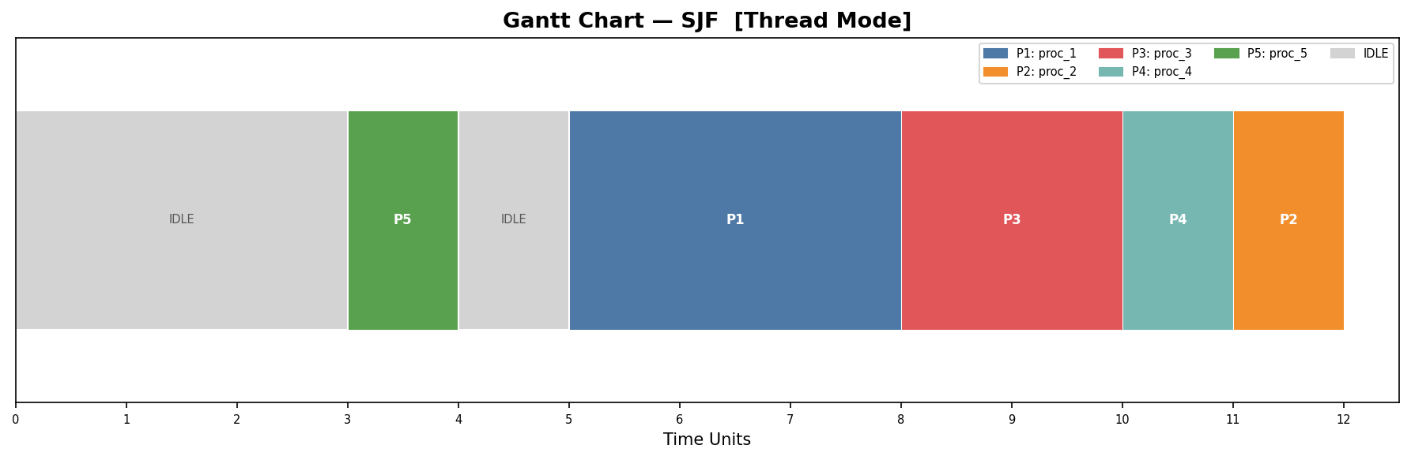
Scheduling Results — FCFS & SJF
FCFS — First Come First Served
SJF — Shortest Job First

Slide 6
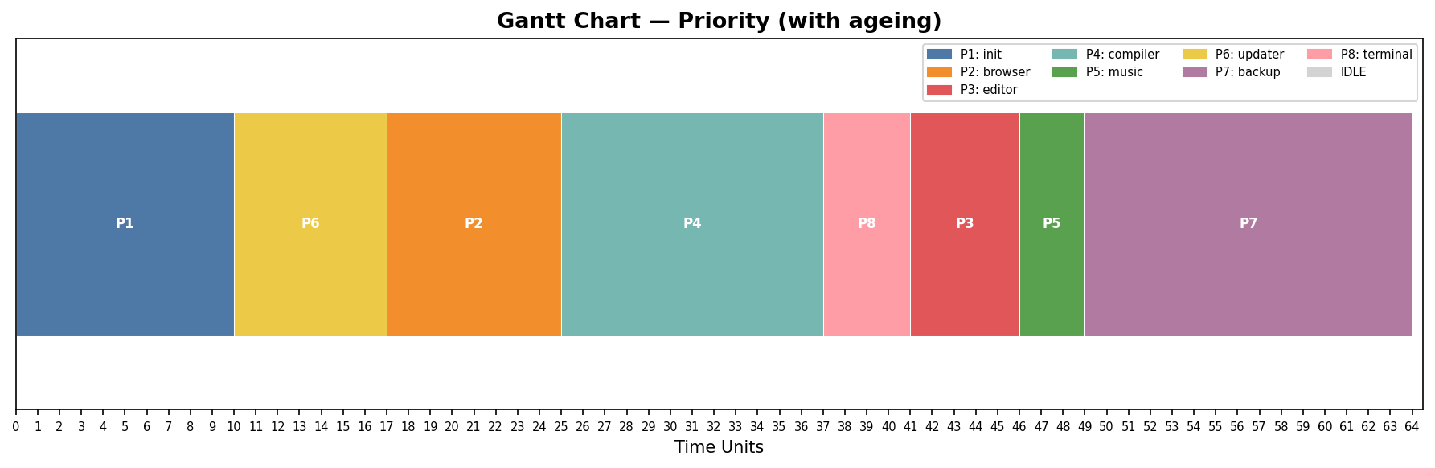
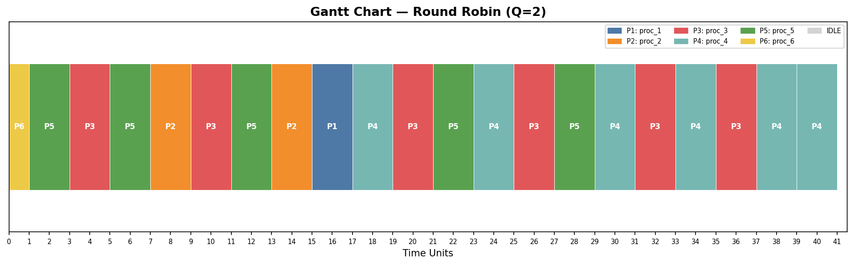
Scheduling Results — Priority & Round Robin
Priority Scheduling (with ageing — every 3 ticks → +1 priority)
Round Robin (Q=3) — Preemptive

Slide 7
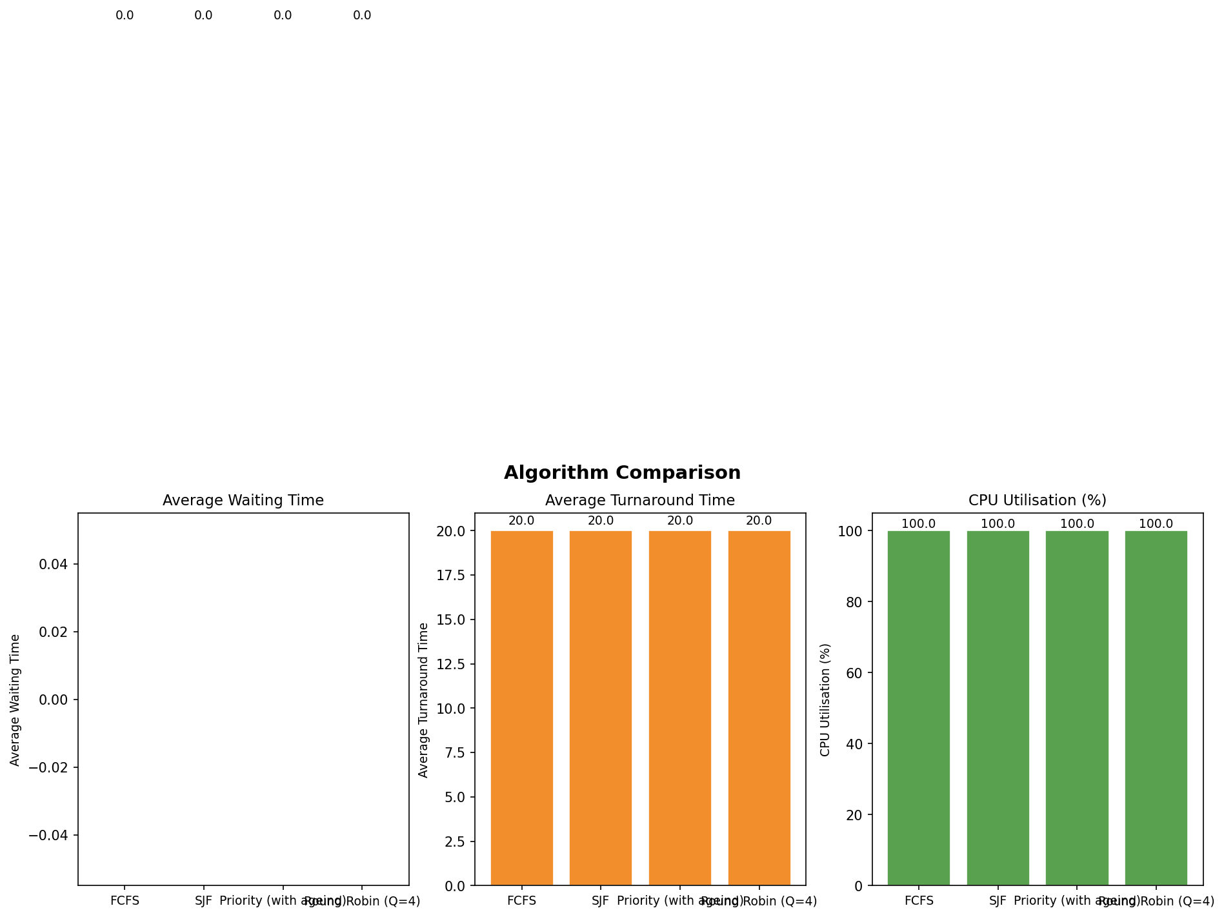
Scheduling Analysis — Algorithm Comparison
Key insight: SJF gives the lowest average waiting time on this dataset. Round Robin (Q=3) delivers the best response time — ideal for interactive workloads. FCFS suffers convoy effect with long-burst processes arriving early.

Slide 8

Threading Issues Encountered
Race Condition Demo
Deadlock Demo & Fix
Problem: 4 threads increment a shared counter 250,000× each (total expected: 1,000,000). make race (no mutex): results varied across 5 runs — 847,312 / 901,445 / 923,187 / 788,902 / 955,001. Root cause: read-modify-write is non-atomic; threads interleave the three instructions. make fixed (mutex): all 5 runs returned exactly 1,000,000. mutex serialises the critical section.
Problem: Thread A locks mutex1→mutex2; Thread B locks mutex2→mutex1. Circular wait → deadlock. Detection: Program hung indefinitely (DEADLOCK_DEMO flag). Fix: Consistent lock ordering — both threads always acquire mutex1 before mutex2. Breaks circular wait. Semaphore variant: producer-consumer with sem_init; sem_wait/sem_post ensure bounded buffer safety.

Slide 9


C vs Python — Lessons Learned
C Core — Low Level
Python — High Level
Implementing a ready-queue in C meant managing raw memory: manually allocating PCB slots, tracking head/tail indices, and protecting every access with a mutex. Every system call return value required explicit error checking with perror(). The JSON serialiser required hand-rolling string escaping — a task Python handles with json.dumps(). C forced awareness of every byte: struct padding, pointer aliasing, and undefined behaviour from unprotected shared state. The valgrind workflow was invaluable: it surfaced a missing munmap() in an early draft and confirmed zero leaks after the fix.
The same ready-queue in Python is a plain list with queue.pop(0) — the language handles memory, type coercion, and JSON serialisation automatically. This let implementation focus on algorithmic correctness: the ageing logic in Priority Scheduling and the arrival-detection loop in Round Robin were written and tested in minutes. However, Python's GIL makes true thread parallelism impossible, reinforcing why OS schedulers cannot be implemented in pure Python for multi-core workloads. Matplotlib produced publication-quality Gantt charts with far less code than an equivalent C implementation would require. The two-language approach made the abstraction gap between kernel and user space tangible.

Slide 10
OS Concept: Structure & System Calls
Kernel Space
EduOS Call | Linux Syscall | What kernel does
edu_fork() | fork(2) | Duplicate address space (COW), clone FD table, send SIGCHLD on exit
edu_exec() | execve(2) | Discard address space, load new ELF, reset stack & heap
edu_wait() | wait(2) | Block on wait-queue; wake on SIGCHLD from child
edu_exit() | _exit(2) | Reclaim pages, close FDs, set PCB zombie until wait()
▸ process_manager.c — PCB table, syscall handlers
▸ thread_manager.c — thread pool, mutex/condvar
▸ ipc_module.c — shm_open, pipe()
User Space
▸ main_sim.c — application driver
▸ scheduler_sim.py — scheduling algorithms
▸ main_controller.py — orchestration layer

Slide 11

OS Concept: Protection & Virtual Machine
Protection Rings
Type-2 Hypervisor Analogy
x86 CPU has 4 protection rings (0–3). Linux uses Ring 0 (kernel) and Ring 3 (user). EduOS analogue: the owner_id field in SharedMetrics acts as a ring check. owner_id = 0 → Ring 0 (privileged, kernel) owner_id ≠ 0 → Ring 3 (user); can only access memory it owns. ACCESS DENIED is printed when owner_id 99 tries to read a region owned by 42 — mirrors a page-fault segfault.
A Type-2 hypervisor (e.g. VirtualBox) runs as an application on a host OS. Each guest VM receives a virtualised physical address space backed by host RAM. EduOS parallel: • PCB table ↔ Hypervisor VM table • memory_req_kb ↔ Guest RAM allocation • edu_fork ↔ Clone VM snapshot • PCB state ↔ VM power state (running/paused/off) Just as guests cannot read each other's memory, processes in a real OS are isolated by the MMU's page tables — each gets its own virtual address space.

Slide 12



Challenges & Solutions
edu_wait() Infinite Loop
Root cause: init (PID 1) had parent_pid=1 (self-referential). The poll loop never found zero pending children.
Fix: Set parent_pid=0 for the root process; expose next_pid so main() sets it to 2 after inserting init.
Non-deterministic Race Output
Needed to show the race is real, not just 'possibly wrong'. Solution: ran make race five times in a Makefile loop, capturing shared_counter output. Results ranged from 788,902 to 955,001 — conclusive evidence of data corruption.
Round Robin Ready Queue Ordering
Processes arriving mid-slice were being enqueued before the preempted process rejoined, violating FIFO order. Fix: enqueue new arrivals first (they arrived earlier), then append the preempted process to the tail.

Slide 13


GitHub Summary
Repository Details
git log --oneline (last 15)
Name: OperatingSystem Assignment Visibility: Public (or private + collaborator) Commits: ≥ 10 meaningful commits Branching: main branch only (feature branches for IPC & scheduler) README: All required sections — build steps, screenshots, valgrind output, challenges
a3f91b2 Add main_controller.py end-to-end pipeline
d84c710 Implement Round Robin scheduler + Gantt charts
f219ae3 Add Priority scheduling with ageing logic
b501d6e Implement FCFS and SJF algorithms
9e2c448 Fix edu_wait infinite loop (parent_pid=0 for init)
77ab312 Add ipc_pipe_demo anonymous pipe IPC
c93f021 Add ipc_shared_memory_demo + access control
4d1e857 Implement producer-consumer with semaphores
21fc9a9 Fix race condition with pthread_mutex (make fixed)
e85b231 Demo race condition without mutex (make race)
6a40f81 Add Many-to-One threading model (setjmp/longjmp)
3b7d194 Implement One-to-One model parallel sum demo
88cc502 Add thread pool with condvar + graceful shutdown
f10e973 Implement PCB JSON serialiser in C (no library)
2d5a610 Initial commit: PCB struct + edu_fork/exec/wait/exit

Slide 14

Submission Checklist
GitHub repo named correctly & accessible to instructor
Gantt charts + comparison charts saved as .png in docs/screenshots/
README.md complete with all required sections
main_controller.py runs end-to-end without error
C code compiles with zero warnings; Makefile has all targets
report.pdf uploaded to docs/ and linked in README
Valgrind summary (0 errors from 0 contexts) in README
At least 10 commits with meaningful messages
make race vs make fixed documented with output
requirements.txt present in python_scheduler/
All 4 scheduling algorithms implemented and tested

Slide 15
EduOS — Complete
Process Mgr
Thread Pool
IPC
Scheduler
fork·exec·wait·exit
mutex·condvar·race
SHM·pipes·access ctrl
FCFS·SJF·Pri·RR
Two languages. One simulator. Every OS concept mapped to working code.
Module 351 CS 2104 · Department of CS & IT

