Slide 1
CS1010X Lecture 4:
Recursion, Iteration & Order of Growth
2 February 2019

Slide 2
Recursion Revisited
Express (divide) a problem into one or more smaller similar problems
Solve the problem for a simple (base) case

Slide 3
Recursion
n
computed with
n - 1
computed with
n - 2
computed with
2
computed with
base
case
1

Slide 4
Recursion
Solve the problem for a simple (base) case
Express (divide) a problem into one or more smaller similar problems
Similar to
Mathematical Induction

Slide 5
Mathematical Induction vs Recursion
Mathematical Induction:
Start with a base case b
Come up with a general procedure to show that if k works, k+1 also works
Therefore, it must always work for all case ≥ b.
Recursion:
Derive a procedure to express a problem of size n as problem(s) of smaller size k ≤ n
Show that there exist a simple base case(s) b for which we can just state the answer (termination)
Procedure can therefore compute problem for all n ≥ b

Slide 6
Sometimes you will need more than one base case
Qn: When? Why?

Slide 7
Other times you may have to express a problem in another form and the other form back in the present form
(mutual recursion)
  E.g. sin and cos

Slide 8


Greatest Common Divisor (GCD)
Euclid’s Algorithm: Given two numbers a and b, denoted by r = a – b .[ ] the remainder of the division. Then we have
  GCD(a,b) = GCD(b, r), for a b > 0
  GCD(a,0) = a

Slide 9
Greatest Common Divisor (GCD)
def gcd(a, b):
if (b == 0):
return a
else:
return gcd(b, a % b)
GCD(206,40) = GCD(40,6)
= GCD(6,4)
= GCD(4,2)
= GCD(2,0)
= 2
  GCD(a,b) = GCD(b, r), for a, b > 0
  GCD(a,0) = a

Slide 10
Towers of Hanoi

Slide 11
Towers of Hanoi

Slide 12
Recursion
What if we have no discs?
Solve the problem for a simple (base) case
Express (divide) a problem into one or more smaller similar problems
Do nothing!

Slide 13
Towers of Hanoi
A
B
C
Suppose we know how to move
3 discs from A to C

Slide 14
Towers of Hanoi
A
B
C
Suppose we know how to move
3 discs from A to C

Slide 15
Towers of Hanoi
A
B
C
Claim: we can move
3 discs from A to B. Why?

Slide 16
Towers of Hanoi
A
B
C
Claim: we can move
3 discs from A to B. Why?

Slide 17
Towers of Hanoi
A
B
C
What do we do for
4 discs?

Slide 18
Towers of Hanoi
def move_tower(size, src, dest, aux):
if size == 0:
return True
else:
move_tower(size-1, src, aux, dest)
print_move(src, dest)
move_tower(size-1, aux, dest, src)
src
aux
dest
Notes:
Cannot use “from” because “from” is a reserved keyword in Python

Slide 19
Towers of Hanoi
def print_move(src, dest):
print("move top disk from ", src, " to ", dest)

Slide 20
Recap: Factorial
factorial(6)
6 * factorial(5)
6 * 5 * factorial(4)
6 * 5 * 4 * factorial(3)
6 * 5 * 4 * 3 * factorial(2)
6 * 5 * 4 * 3 * 2 * factorial(1)
6 * 5 * 4 * 3 * 2 * 1
6 * 5 * 4 * 3 * 2
6 * 5 * 4 * 6
6 * 5 * 24
6 * 120
720
Recursive Process
Time ∝ n
Space ∝ n

Slide 21
Another way for factorial
Start with 1, multiply by 2, multiply by 3, …
Factorial rule:
product ← product * counter
counter ← counter + 1
def factorial(n):
product, counter = 1, 1
while counter <= n:
product = product * counter
counter = counter + 1
return product

Slide 22
Yet another way
Start with 1, multiply by 2, multiply by 3, …
Factorial rule:
product ← product * counter
counter ← counter + 1
def factorial(n):
product = 1
for counter in range(2,n+1):
product = product * counter
return product
Up to n, does
not include n+1

Slide 23
while loop
while <expression>:
<body>
expression
  Predicate to stay within loop
body
  Body that will be evaluated if predicate <expression> is True

Slide 24
for loop
for i in range([start,] stop[, step])
<body>
Body be evaluated once for each of i = start, …, stop-1 incremented in intervals of step
for i in range(10):
print(i)
for i in range(3,10):
print(i)
for i in range(3,10,4):
print(i)

Slide 25
break & continue
0
1
2
3
for j in range(10):
print(j)
if j == 3:
break
Break out
of loop
1
3
5
7
9
for j in range(10):
if j % 2 == 0:
continue
print(j)
Skip current
iteration

Slide 26
Iterative process
Product | Counter
def factorial(n):
product, counter = 1, 1
while counter <= n:
product = (product *
counter)
counter = counter + 1
return product
factorial(6)
1 | 1
1 | 2
2 | 3
6 | 4
24 | 5
120 | 6
720 | 7
counter > n = 6
return product = 720

Slide 27
Iterative process
Number of steps: linearly proportional to n
Space required: constant
No deferred operations.
All relevant information contained in variables.
factorial(6)
Product | Counter
1 | 1
1 | 2
2 | 3
6 | 4
24 | 5
120 | 6
720 | 7
Notes:
I am not sure about the last part

Slide 28
Recursion vs
Iteration

Slide 29
Recursive process occurs when there are deferred operations.
Iterative process does not have deferred operations.

Slide 30
Recursive Process
factorial(6)
6 * factorial(5)
6 * 5 * factorial(4)
6 * 5 * 4 * factorial(3)
6 * 5 * 4 * 3 * factorial(2)
6 * 5 * 4 * 3 * 2 * factorial(1)
6 * 5 * 4 * 3 * 2 * 1
6 * 5 * 4 * 3 * 2
6 * 5 * 4 * 6
6 * 5 * 24
6 * 120
720
deferred operations

Slide 31
In many languages, e.g. Python Java, there are explicit mechanisms for iteration:
while loops, for loops.
But actually, all that is needed is the ability to call a function.
Notes:
To be deleted or rephrased …

Slide 32
Counting Change

Slide 33
Problem
Make change for $1, using coins 50¢, 20¢, 10¢, 5¢, 1¢
  (assume unlimited number of coins available)
  e.g. 50¢ + 50¢,
  50¢ + 20¢ + 20¢ + 10¢,
  20¢ + 20¢ + 20¢ + 20¢ + 20¢,
  etc.

Slide 34
Counting change
How many ways to do it?

Slide 35
Base cases
only 1 way to make change.
If a = 0,
If a < 0,
If n = 0,
there is no way to make change, i.e. 0
then no way to make change.

Slide 36
Recursive step
Observation - can be divided into two groups:
50¢+50¢,
50¢+20¢+20¢+10¢,
…
+
20¢+20¢+20¢+20¢+20¢,
20¢+10¢+ …
Those that use at least
one 50¢ coin.
Those that do not
use any 50¢ coins.

Slide 37
Recursive step
# of ways to change amount a using n kinds of coins =
# of ways to change amount (a – d) using all n kinds of coins
    (where d is the denomination of the first kind of coin)
+
# of ways to change amount a using all but the first kind of coin

Slide 38
Python function
def cc(amount, kinds_of_coins):
if amount == 0:
return 1
elif (amount < 0) or (kinds_of_coins == 0):
return 0
else:
return cc(amount, kinds_of_coins-1)
+ cc(amount – first_denomination(kinds_of_coins), kinds_of_coins)
def first_denomination(kinds_of_coins):
… <left as an exercise>
def count_change(amount)
return cc(amount,5)
Using all but
first kind of coin
Using at least 1
coin of first kind
count_change(100) ➔
343
Notes:
Not done by occ

Slide 39
Recursion vs. Iteration
Counting change is (quite) easily formulated via recursive process.
Can you write an iterative process to count change?
    Can, but not easy!

Slide 40
Moral of the story
In general, an iterative process is (usually) more efficient than a recursive process.
But sometimes it is hard to devise an iterative solution, whereas a recursive one is straightforward (and more elegant).

Slide 41
Don’t hesitate to write recursive processes. Leave the optimization to the interpreter.

Slide 42
Homework
How would you implement iteration without loops?

Slide 43
Orders of Growth

Slide 44
Rough measure of resources used by a computational process

Slide 45
Time: how long it takes to run a program
Space: how much memory do we need to run the program

Slide 46
We want to ask questions like:
factorial(5) → factorial(10) ?
fib(10) → fib(20)?
How much more time?
How much more space?
2x?
Same?
4x?

Slide 47
Orders of Growth
Let n denote size of the problem.
Let R(n) denote the resources needed.
Definition:
  R(n) has order of growth Θ( f(n) ), written
  R(n) = Θ( f(n) )
  If there are positive constants k₁ and k₂ such that
  k₁ f(n) ≤ R(n) ≤ k₂ f(n)
  for any sufficiently large value of n

Slide 48
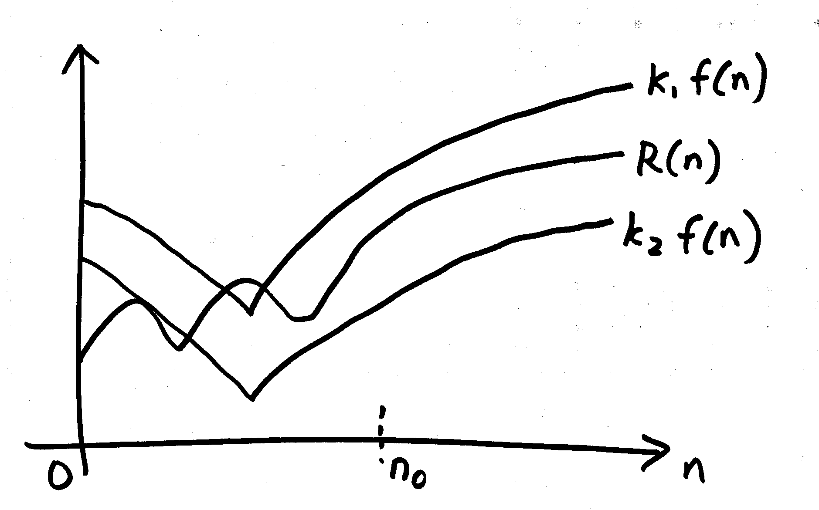
Diagram
O(f(n))
Θ(f(n))
Ω(f(n))
For n>= n₀, R(n) is sandwiched between

Slide 49
Intuitively, it means that if n is doubled (i.e. increased to 2n), then the resource required, R(n), is increased to f(2n)

Slide 50
Some common f(n)
1
n
n²
n³
log n
n log n
2^{n}

Slide 51
Recursive factorial
factorial(6)
6 * factorial(5)
6 * 5 * factorial(4)
6 * 5 * 4 * factorial(3)
6 * 5 * 4 * 3 * factorial(2)
6 * 5 * 4 * 3 * 2 * factorial(1)
6 * 5 * 4 * 3 * 2 * 1
6 * 5 * 4 * 3 * 2
6 * 5 * 4 * 6
6 * 5 * 24
6 * 120
720
Time: O(n)
Linear
Space: O(n)
Linear

Slide 52
Iterative process
Product | Counter
def factorial(n):
product, counter = 1, 1
while counter <= n:
product = (product *
counter)
counter = counter + 1
return product
factorial(6)
1 | 1
1 | 2
2 | 3
6 | 4
24 | 5
120 | 6
720 | 7
Time: O(n)
Linear
Space: O(1)
Constant

Slide 53
Suppose a computation C takes 3n+5 steps to complete, what is the order of growth?
O(3n+5) = O(n)

Slide 54
Take the largest term and drop the constants

Slide 55
Another example
How about 3^{n}+4n²+4?
Order of growth =
O(3^{n}+4n²+4) = O(3^{n})

Slide 56
Tips
Identify dominant terms, ignore smaller terms
Ignore additive or multiplicative constants
  4n² – 1000n + 300000 = O(n²)
  n/7 + 200n log n = O(n log n)
Note: log_{a}b = log_{c}b / log_{c}a
  So base is not important

Slide 57
More tricks in CS1231, CS3230
  Some involve sophisticated proofs

Slide 58
For now
Count the number of “basic computational steps”.
  Identify the basic computation steps
  Try a few small values of n
  Extrapolate for really large n
  Look for “worst case” scenario

Slide 59
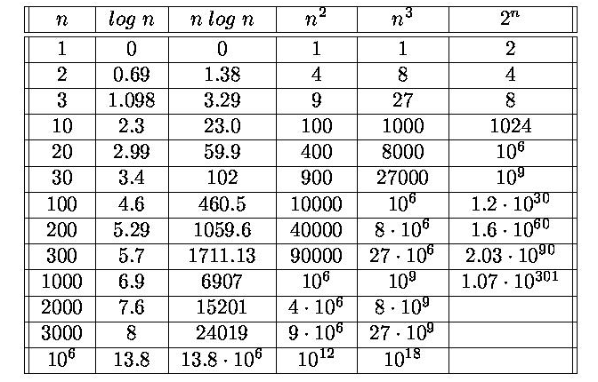
Numeric example
Note: age of universe ≈ 2⁵⁹ seconds

Slide 60
Moral of the story
Different ways of performing a computation (algorithms) can consume dramatically different amounts of resources.

Slide 61
What does this function compute?
def foo(b, e):
def bar(a, b, e):
if (e == 0):
return a
else:
return bar(a*b, b, e-1)
return bar(1, b, e)

Slide 62
Do Not Name Your Function foo!

Slide 63
Exponentiation
def power(b, e):
def power_product(a, b, e):
''' returns a * b^e '''
if (e == 0): return a
else:
return power_product(a*b, b, e-1)
return power_product(1, b, e)
Time requirement?
Space requirement?
Can we do better?
O(n)
O(n)

Slide 64
Another way to express b^{e}
1, e = 0
b^{e} = (b²)^{(e/2)}, e even
b^{e-1.}b, e odd

Slide 65
Fast Exponentiation
def fast_expt(b, e):
if e == 0: return 1
elif e%2 == 0:
return fast_expt(b*b, e/2)
else:
return b * fast_expt(b, e-1)
Time requirement?
Space requirement?
Can we do this iteratively?
O(log n)
O(log n)

Slide 66
Fast Exponentiation (Iterative)
def fast_expt(b, e):
a = 1
while e > 0:
if e%2 == 0:
b = b * b
e = e/2
else:
a = a * b
e = e - 1
return a
Loop Invariant :
a * b^{e}
Notes:
Changesafter this slide not made by occ

Slide 67
Writing the code is the easy part, figuring out WHAT TO DO is the hard part

Slide 68
Summary
Recursion
  Solve the problem for a simple (base) case
  Express (divide) a problem into one or more smaller similar problems
Iteration: while and for loops
Fast Exponential Technique

Slide 69
Summary
Order of growth:
  Time and space requirements for computations
  Different ways of performing a computation (algorithms) can consume dramatically different amounts of resources.
  Pay attention to efficiency!

