Slide 1
CS1010X Lecture 5:
Higher-order Functions
16 Feb 2019

Slide 2
Today’s Agenda
Clarifications
Order of Growth
Higher-order Functions
  Generalizing Common Patterns
  Functions as arguments

Slide 3
Watch Your Syntax

Slide 4

beside(pic1, pic2)
beside(pic)
beside(p1,p2,p3)

Slide 5
Conditional
missing colon ☹
Form 2
if expr:
statement(s)
else:
  statement(s)
if a > 0
print(‘a > 0!’)
else:
print(‘a <= 0’)
no indentation! ☹

Slide 6
What is pass?
Do nothing ☺

Slide 7
Importing Modules
Remember?
from runes import *
Insight: Often convenient to have code in different files for code reuse

Slide 8
Importing Modules
import X imports the module X
  Can use X.name to refer to objects in X
from X import * imports the module X, and creates references to all public objects in X
  Can use a plain name, i.e. something to refer to objects defined in module X. No need X.something
from X import a, b, c imports the module X, and creates references to the specified objects.
  Can now use a and b and c in your program.

Slide 9
Order of Growth
  Identify the basic computation steps
  Try a few small values of n
  Extrapolate for really large n
  Look for “worst case” scenario

Slide 10
Python function
def cc(amount, kinds_of_coins):
if amount == 0:
return 1
elif (amount < 0) or (kinds_of_coins == 0):
return 0
else:
return cc(amount, kinds_of_coins-1)
+ cc(amount – first_denomination(kinds_of_coins), kinds_of_coins)
def first_denomination(kinds_of_coins):
… <left as an exercise>
def count_change(amount)
return cc(amount,5)
Using all but
first kind of coin
Using at least 1
coin of first kind
Notes:
Not done by occ

Slide 11
  Try a few small values of n
cc(11,5)
0
cc(11,4)
cc(-39,5)
0
cc(11,3)
cc(-9,4)
cc(11,2)
cc(1,3)
0
cc(11,2)
...
cc(1,2)
cc(-9,3)
0
cc(6,2)
cc(11,1)
cc(1,1)
cc(-4,2)
cc(6,1)
cc(1,2)
1
1
0
cc(1,1)
1
cc(-4,2)
1

Slide 12
3. Extrapolate for really large n
cc(10000,5)
cc(10000,4)
cc(9950,5)
cc(10000,3)
cc(9980,4)
cc(9950,4)
cc(9900,5)
…
…
…
…
…
…
…
…
4. Two steps:
    (a) Work out the steps in the computation
    (b) Generalize to n

Slide 13
4. Generalize to n
Full binary tree
cc(10000,5)
cc(10000,4)
cc(9950,5)
cc(10000,3)
cc(9980,4)
cc(9950,4)
cc(9900,5)
…
…
…
…
…
…
…
…
Partial tree
Partial tree
Partial tree
Partial tree

Slide 14
Full binary tree
D?
L?
Partial tree
Partial tree
Partial tree
Partial tree
D = a/largest-denomination
L = a + #-coin-types

Slide 15
Order of Growth
For large amounts a,
  Time complexity = leaves in the tree
  = 2^{L} (full tree)
  – (missing leaves)
  = O(2^{L} – …)
  = O(2^{a+n} – …)
  = O(2ª)

Slide 16
Order of Growth in Space
Two main sources:
  Function Calls – Stack
    Look for pending operations & recursive function calls
  Data Structures – Heap
    To be discussed later

Slide 17
Order of Growth
  Space complexity
  = depth of entire tree
  = L
  = a + #-coin-types
  = O(a)

Slide 18
To Think About
What if you only had a finite number of coins?

Slide 19
CS1010FC Road Map
Memoization
C Programming
ADVANCED
Searching & Sorting
Dynamic Programming
Object-Oriented Programming
INTERMEDIATE
Higher-Order Functions
List Processing
Multiple
Representations
BASIC
Functional Abstraction
Data Abstraction
Iteration
Mutation & State
Wishful Thinking
Recursion
Order of Growth
Fundamental concepts of computer programming

Slide 20
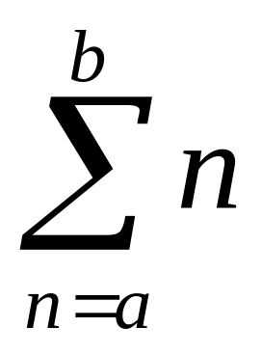
Abstracting common patterns
Consider the following code to sum all integers in the range a to b
def sum_integers(a,b):
if a > b:
return 0
else:
return a + sum_integers(a + 1, b)

Slide 21
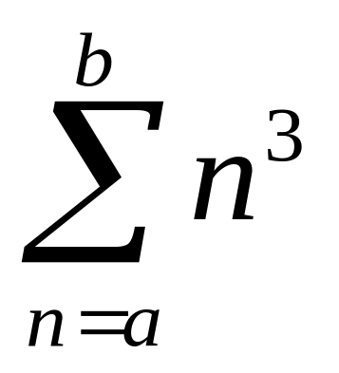
Abstracting common patterns
Now suppose we want to sum the cubes of numbers in the range a to b
def sum_cubes(a, b):
if a > b:
return 0
else:
return cube(a) + sum_cubes(a + 1, b)
def cube(n):
return n * n * n

Slide 22
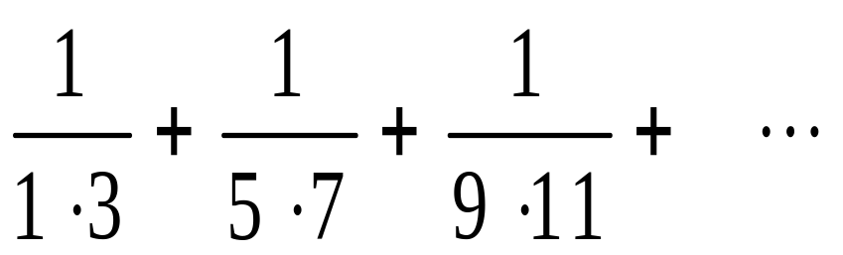
Abstracting common patterns
Finally, we want to sum this series:
which converges very slowly to π/8
def pi_sum(a, b):
if a > b:
return 0
else:
return 1/(a*(a + 2)) + pi_sum(a + 4, b)
b
a

Slide 23
Abstracting common patterns
All three functions are very similar.
Common pattern:
def <name>(a, b):
if a > b:
return 0
else:
return <term>(a) + <name>(<next>(a), b)
Can we abstract this common pattern?

Slide 24
Yes!
def sum(term, a, next, b):
if a > b:
return 0
else:
return term(a) + sum(term, next(a), next, b)
Note that term and next are functions.
Note also that there is a pre-defined function called sum. We are over-writing it.

Slide 25
Higher-order functions
Redefining sum_cubes
def sum_cubes(a,b):
return sum(cube, a, inc, b)
def inc (n):
return n+1
def cube(x):
return x*x*x
sum_cubes(1,10) →
3025

Slide 26
Higher-order functions
Redefining sum_integers
def sum_integers(a,b):
return sum(identity, a, inc, b)
def identity(x):
return x
sum_integers(1,10) →
55

Slide 27
Higher-order functions
Alternatively,
def sum_integers(a,b):
return sum(lambda x: x,
a,
lambda n: n+1,
b)
anonymous functions

Slide 28
Higher-order functions
Redefining pi_sum
def pi_sum(a,b):
return sum(lambda x: 1/(x*(x+2)),
a,
lambda x: x+4,
b)
8 * pi_sum(1,1000)
→
3.139592655589783

Slide 29
Key idea
sum captures a common pattern.
The other functions(sum_integers, sum_cubes, pi_sum) are special cases of sum.

Slide 30
Key idea
sum_integers, sum_cubes, pi_sum can be defined by providing the appropriate term and next arguments to sum
sum is a higher-order function:
takes functions as arguments

Slide 31
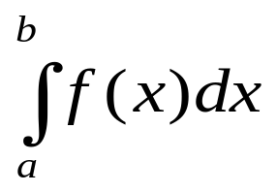
Example: Integration
= area under curve
f(x)
a
b

Slide 32
Example: Integration
≈ sum of areas of rectangles
f(x)
dx
a
b

Slide 33
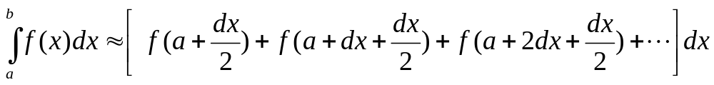
Example: Integration
def integral(f,a,b,dx):
def add_dx(x):
return x+dx
return dx * sum(f,
a + dx / 2,
add_dx,
b)
integral(cube,0,1,0.01)
#0.24998750000000042
# exact value is 1/4

Slide 34
Functions as return values
Functions may be returned as values from other functions.
def make_x(x):
return lambda : x
five = make_x(5)
eight = make_x(8)
x = 10
five →
five() → 5
eight →
eight() → 8
Must understand whether the return value of a function is another function or a number or some other object
<function ..>
<function ..>

Slide 35
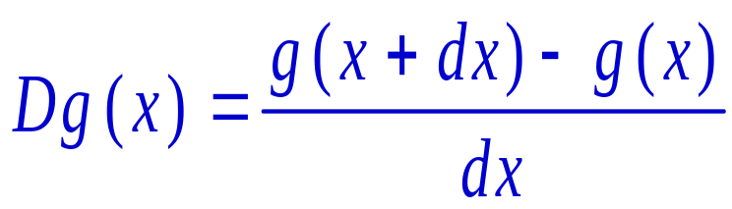
Example: Derivative
In math, the derivative of g(x) is
Derivative transforms a function into another function.
def deriv(g):
dx = 0.00001
return lambda x: (g(x+dx)-g(x))/dx

Slide 36
Derivative
from math import sin, pi
cos = deriv(sin)
cos(pi/4) → 0.7071032456451575
cos(pi/2) → -5.000000413701855e-06
i.e., -5.0000 × 10-6 ≈ 0
cube = lambda x: x*x*x
deriv(cube)(5) → 75.00014999664018
Notes:
We don’t want to do `from math import *` because we want to define our own cos. Explicit is better implicit.

Slide 37
Example: Newton’s method
To compute root of function g(x), i.e. find x such that g(x) = 0
Start with initial guess x₀
x ← x₀
If g(x) ≈ 0 then stop: answer is x
x ← x – g(x)/Dg(x)
Go to step 3
Dg(x) is the derivative of g(x)

Slide 38
Newton’s Method
def newtons_method(g, first_guess):
dg = deriv(g)
def improve(x):
return x-g(x)/dg(x)
def is_close_enough(v):
tolerance = 0.0001
return abs(v)<tolerance
def attempt(guess):
if is_close_enough(g(guess)):
return guess
else:
return attempt(improve(guess))
return attempt(first_guess)
Start with initial guess x₀
x ← x₀
If g(x) ≈ 0 then stop:
answer is x
x ← x – g(x)/Dg(x)
Go to step 3
Notes:
try -> attempt, since try is reserved in python.

Slide 39
Computing square root
Square root of a is the number x such that:
x² = a
Use Newton’s method to solve:
g(x) ≡ x² - a = 0

Slide 40
Newton’s method
square = lambda y: y*y
def sqrt(a):
return newtons_method(lambda x: square(x)-a,
a/2) #initial guess is half of a
sqrt(9) → 3.0000153774963274
sqrt(2) → 1.4142156951657834

Slide 41
Higher Order Functions Manipulate Other Functions

Slide 42

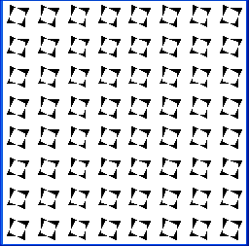
Repeating patterns
def repeat_pattern(n, pat, pic):
if n==0:
return pic
else:
return pat(repeat_pattern(n-1, pat, pic))
Isn’t this a function also?

Slide 43
n
repeat_
pattern
pat
pic
pic
term
a
sum
value
next
b

Slide 44
f
a
integral
value
b
dx
g
deriv
Dg
g
newton
value
guess

Slide 45
n
repeat_
pattern
pat
pic
pic
make them equivalent
Homework:
n
repeat_
pattern
npat
pat
pic
npat
pic
pic
npat
pic

Slide 46
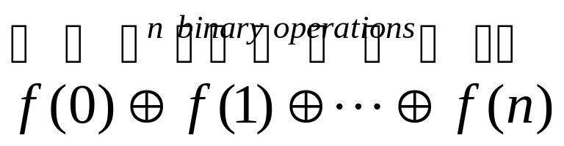
Another Example
Compute , for some function f, by applying binary operator ⊕ n times.
def fold(op, f, n):
if n==0:
return f(0)
else:
return op(f(n), fold(op, f, n-1))

Slide 47
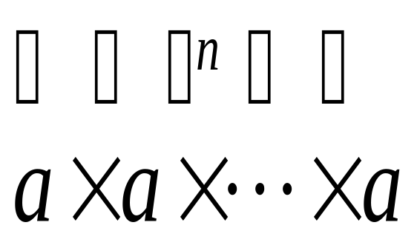
Defining expt with fold
Fold:
expt:
f ⇨ lambda x: a
op ⇨ lambda x,y: x*y
n ⇨ n-1
expt(a,n)≡ fold(lambda x,y: x*y,
lambda x: a, n-1)
fold(op, f, n)

Slide 48
Usage of fold
Suppose sum_of_digits(n) returns the sum of the digits of n. How do we express this as fold?
def sum_of_digits(n):
return fold(lambda x,y: x+y,
lambda k: kth_digit(n,k),
count_digits(n))
Question of the Day:
How do we define kth_digit and count_digits?
Notes:
please check, I think this should be count_digits(n)-1, since fold starts from 0. Either that or redefine kth_digit

Slide 49
Usage of fold
def product_of_digits(n):
return fold(lambda x,y: x * y,
lambda k: kth_digit(n,k),
count_digits(n))
def sum_of_sqrt_of_digits(n):
return fold(lambda x,y: x+y,
lambda k: sqrt(kth_digit(n,k)),
count_digits(n))
Notes:
Same as previous slide.

Slide 50
Recap: Sum of Integers
Consider the following code to sum all integers in the range a to b
def sum_integers(a,b):
if a>b:
return 0
else:
return a + sum_integers(a+1, b)

Slide 51
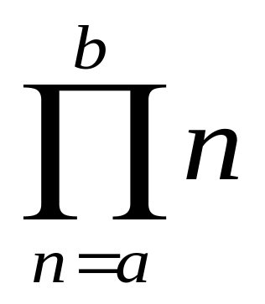
Recap: Product of Integers
Consider the following code to multiply all integers in the range a to b
def product_integers(a,b):
return product(lambda x: x,
a,
lambda n: n+1,
b)
What’s this??

Slide 52
Recall: Definition of sum
Definition of sum:
    def sum(term, a, next, b):
    if a > b:
    return 0
    else:
    return term(a) +
    sum(term, next(a), next, b)
Definition of product:
    def product(term, a, next, b):
    if a > b:
    return 1
    else:
    return term(a) *
    product(term, next(a), next, b)

Slide 53
A More General Version of fold
def fold2(op, term, a, next, b, base):
if a > b:
return base
else:
return op (term(a),
fold2(op, term, next(a), next,
b, base))
def sum(term, a, next, b):
return fold2(lambda x,y: x+y, term, a, next, b, 0)
def product(term, a, next, b):
return fold2(lambda x,y: x*y, term, a, next, b, 1)
abstract as parameters in higher-order function

Slide 54
Please DO NOT memorize the definitions of fold, fold2, sum, product, etc.

Slide 55
Don’t Worry about Definitions
Functions can be inputs to functions
Functions can be return values from functions
Both 1 & 2 can happen at the same time!

Slide 56
CS1010FC is NOT about memory work. It is about UNDERSTANDING.

Slide 57
CS1010FC is NOT about answers. It is about PROCESS.

Slide 58
Summary
Python functions are first-class objects.
  They may be named by variables.
  They may be passed as arguments to functions.
  They may be returned as the results of functions.

Slide 59
Summary
Higher-order functions capture common programming patterns.
Functions can be returned as the result of functions

Slide 60
Required Competencies
Understand how to use higher-order functions to define specific functions
Understand how to define higher-order functions by abstracting patterns

Slide 61
For practice (and to check your understanding…..)
How would you define factorial in terms of product?
How would you define expt in terms of product?

