Slide 1
CS1010X Lecture 7:
Data Abstraction
2 Mar 2019

Slide 2
Today’s Agenda
Data Abstraction
Rational number package
  Constructors, selectors, predicates, printers
  Contract and implementation
  Abstraction barrier
Equality & Identity
Working with Files

Slide 3
Sanity Check:
Key Concepts Covered So Far
Functional Abstraction
  Wishful Thinking
Recursion
Iteration
Order of Growth
Higher-Order Functions
  Functions as Return Values
  Abstracting Common Patterns

Slide 4
So far we have only been dealing with very simple data: numbers
(and some pictures)

Slide 5
Life is complicated.
☺

Slide 6
To doing anything useful, we need to model *REAL* objects

Slide 7
Example
NUS Registrar has a record of every student.
  Contains personal info, modules taken, grades, etc.
  Record may be a paper folder, or electronic document
  Record is a compound data

Slide 8
Recap: Functional Abstraction
Organize computational process as a black box
  Specify inputs
  Specify how function operates on or transforms inputs
  No need to know how computation is implemented to make run computation

Slide 9
Recap: Functional Abstraction
  Abstracts away irrelevant details, exposes what is necessary
  Separates usage from implementation.
  Captures common programming patterns
Serves as a building block for more complex functions

Slide 10
Key Idea
We can organize and reason about data in the same way!!

Slide 11
Data Abstraction
  Abstracts away irrelevant details, exposes what is necessary
  Separates usage from implementation.
  Captures common programming patterns
Serves as a building block for other compound data.

Slide 12
Rational Number Package
Rational number: n/d
  e.g. 3/5, -1/2
  n: numerator, integer
  d: denominator, non-zero integer
Want to provide arithmetic operations:
  Addition
  Subtraction
  Multiplication, etc.

Slide 13
Guidelines for Creating Compound Data
Constructors
  Means to create compound data from primitive data.
Selectors (accessors)
  Means to access individual components of compound data.
Predicates
  Means to ask (true/false) questions about compound data.
Printers
  Means to display compound data in human-readable form.

Slide 14
Wishful Thinking
Let’s wish for the following:
  def make_rat(n, d)
    Returns a rational number with numerator n, denominator d
    Constructor
  def numer(rat_number)
    Returns the numerator of rat-number
    Selector
  def denom(rat_number)
    Returns the denominator of rat-number
    Selector

Slide 15
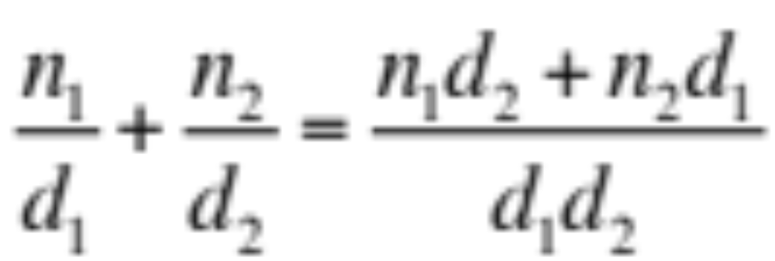
Arithmetic Operations
Addition:
def add_rat (x, y):
nx, dx = numer(x), denom(x)
ny, dy = numer(y), denom(y)
return make_rat(nx * dy + ny * dx,
dx * dy)

Slide 16
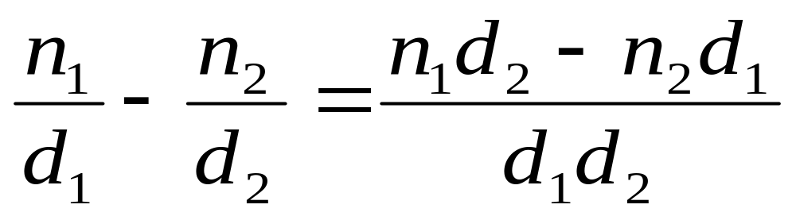
Arithmetic Operations
Subtraction:
def sub_rat (x, y):
nx, dx = numer(x), denom(x)
ny, dy = numer(y), denom(y)
return make_rat(nx * dy - ny * dx,
dx * dy)

Slide 17
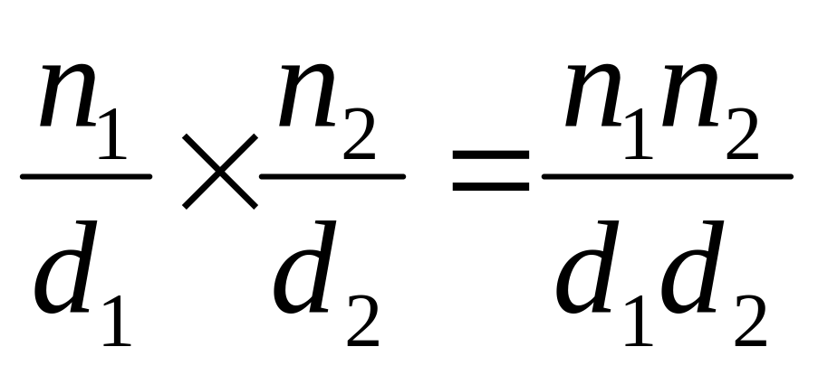
Arithmetic Operations
Multiplication:
def mul_rat (x, y):
return make_rat (numer(x) * numer(y),
denom(x) * denom(y))

Slide 18
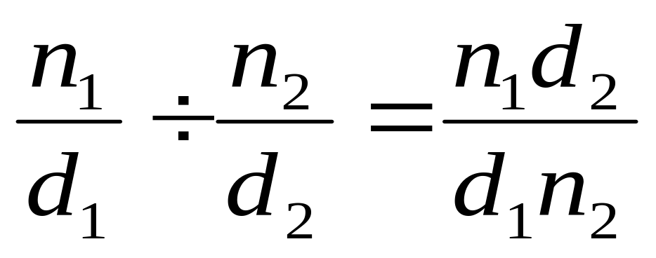
Arithmetic Operations
Division:
def div_rat(x, y):
return make_rat (numer(x) * denom(y),
denom(x) * numer(y))

Slide 19
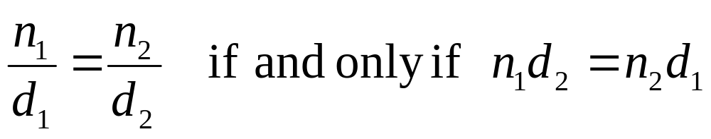
Other Operations
Equality:
def equal_rat(x, y):
return numer(x) * denom(y) ==
numer(y) * denom(x)

Slide 20
Other Operations
Displaying:
def print_rat(rat):
print(str(numer(rat))
+ '/' + str(denom(rat)))
print_rat(make_rat(1, 2)) → 1/2

Slide 21
Recap
We assumed the existence of
  make_rat(n, d)
  numer(rat_number)
  denom(rat_number)
From which we defined new operations
  add_rat, sub_rat, mul_rat, div_rat, equal_rat, print_rat
But what about our assumptions?

Slide 22
Implementing rats
We can use a Python primitive called a tuple to build “glue” data together.
foo = (x, y) #creates a tuple out of x, y
foo[0] #returns 1st component of foo
foo[1] #returns 2nd component of foo

Slide 23
Tuples
x = (1, 2)
x → (1, 2)
x[0] → 1
x[1] → 2
y = (3, 4)
z = (x, y) # A tuple of tuples
z[0][0] → 1
z[1][1] → 4

Slide 24
Box-and-pointer notation
A way to visualize tuples
x = (1, 3) is drawn:
Variable x points to tuple
Left arrow is [0]
Right arrow is [1]
Numbers are outside the
tuple, not inside
x
1
3

Slide 25
Box-and-pointer notation
x = (3, 7)
x → (3, 7)
y = (x, 5)
y → ((3, 7), 5)
y[0][0] → 3
y[0][1] → 7
x
7
3
y
5

Slide 26
More on Tuples
A tuple is a common structure:
bar = (1, 2)
bat = (3, 4)
foo = bar + bat
foo → (1, 2, 3, 4)
foo = (bar, bat)
foo → ((1, 2), (3, 4))
() is the empty tuple.

Slide 27
Remember String Slicing?
s[start:stop:step]
non-inclusive
>>> s = ‘abcdef’
>>> s[0:2]
‘ab’
>>> s[1:2]
‘b’
>>> s[:2]
‘ab’
>>> s[1:5:3]
‘be’
>>> s[::2]
‘ace’
Slicing returns a new string

Slide 28
Selectors
foo :returns all the elements of foo
foo[0] : returns 1st element of foo
foo[1:]: returns tail of foo (rest of foo without 1st element)
foo[a:b]: returns tuple consisting of the (a+1)th to the bth element of foo, i.e. b is not inclusive
foo[a:b:c]: returns tuple consisting of the (a+1)th to the bth element of foo, i.e. b is not inclusive, at intervals of c
foo[-1]: returns last element of foo, i.e. 1st element from the back
len(foo): return number of elements of foo

Slide 29
Examples
x = (1, 2, 3, 4)
x[0]
x[1:]
x[0:]
x[1:3]
x[1:2]
x[-1]
X[:3:2]
len(x)
→ 1
→ (2, 3, 4)
→ (1, 2, 3, 4)
→ (2, 3)
→ (2,)
→ 4
→(1, 3)
→ 4 # Length of the tuple

Slide 30
Iterating over tuples
x = (4, 2, 1, 3)
count = 0
for i in x:
print (i)
count = count + i
print(count)
→ 4
2
1
3
→ 10

Slide 31
Rational Number
We can complete our rational number package by defining:
def make-rat(n, d):
return (n, d)
def numer(rat):
return rat[0]
def denom(rat):
return rat[1]

Slide 32
Using Rational Number
one_half = make_rat(1, 2)
print_rat(one_half)
1/2
one_third = make_rat(1, 3)
print_rat(one_third)
1/3
print_rat(add_rat(one_half, one_third))
5/6
print-rat(mul_rat(one_half, one_third))
1/6
print-rat(add_rat(one_third, one_third))
6/9
Ouch! Prefer: 2/3

Slide 33
Improvement
We can “reduce to lowest terms” by modifying make_rat
from fractions import gcd
def make_rat(n, d): # version 2
g = gcd(n, d)
return (n//g, d//g)

Slide 34
Abstraction Barrier
Programs that use rational numbers
Rational numbers in the problem domain
add_rat sub_rat …
Rational numbers as numerators and denominators
make_rat numer denom
Rational numbers as tuples
tuple
However tuples are implemented
At each level, use only functions available at that interface, not below it.

Slide 35
Summary
Compound data helps us to reason at a higher conceptual level.
Abstraction barriers separate usage of a compound data from its implementation.
Only functions at the interface should be used.
We can choose between different implementations as long as contract is fulfilled.

Slide 36
Question of the Day
Implement a new Abstract Data Type (ADT) set with the following associated functions:
  make_set() – creates a new empty set object
  add_set(set,object) – adds an object to a set
  remove_set(set,object) – removes an object from a set
  contains_set(set,object)- returns True if the set contains the specified object

Slide 37
Equality

Slide 38
What does equality mean?

Slide 39
Two possibilities (usually)
Identity
  This means the SAME object (reference in memory)
  In Python, we use is to test for this.

Slide 40
Two possibilities (usually)
Equivalence
  This means two objects that are equivalent (even if they are not the same object)
  In Python, we use == to test for this.
  Identity != Equivalence

Slide 41
Equality
is returns True if the two objects are the same object
== returns True if the two objects are equivalent
a = 1
b = 2
x = (a, b)
y = (a, b)
x is y → False
x == y → True
z = x
z is x → True
z is y → False
z == y → True
x
b
a
y
b
z
a

Slide 42
Caution with is
is cannot be used to compare numbers reliably.
3 is 3
True
3.000 is 3
False

Slide 43
Equality
The predicate == returns True if the two objects have the same contents
  works for numbers, strings and tuples.
('apple', 1, 2, 3) == ('apple', 1, 2, 3)
→ True
('apple', 1, 2, 3) is ('apple', 1, 2, 3)
→ False
('apple', 1, 2, 3) == ('apple', (1, 2), 3)
→ False

Slide 44
To add to confusion: ==
('apple', 1, 2, 3) == ('apple', (1), 2, 3) → True
('apple', 1, 2, 3) == ('apple', (1,), 2, 3)
→ False
t = (1)
t → 1
s = (1,)
s → (1,)

Slide 45
Moral of the story
Use == and is carefully, so to save yourself grief.

Slide 46
Working with Files
Reading a File:
input = open('inputfilename.txt', 'r’)
some_line = input.readline()
We can check for end of file by checking whether some_line ==''(empty string).
Writing to a File:
output = open('outputfilename.txt', ‘w’)
output.write('HELLO WORLD')

Slide 47
Example
def metrics(dictfile):
dict = open(dictfile, 'r')
longest_word = ''
shortest_word = "Pneumonoultramicro…"
currword = dict.readline()
while currword != '':
if(len(currword) < len(shortest_word)):
shortest_word = currword
if(len(currword) > len(longest_word)):
longest_word = currword
currword = dict.readline()
output = open("output.txt", "w")
output.write("longest word: "+longest_word)
output.write("shortest word: "+shortest_word)
Find longest and shortest word
write to file

Slide 48
Example
dictionary.txt>>
CS1010FC
BEST
MODULE
WORLD
metrics("dictionary.txt")
output.txt>>
longest word: CS1010FC
shortest word: BEST

