Slide 1
Data
group | experiment setup |  | bounds | number of examples | train | test
high | 0.002/1.46pN | 9/5mm | high: above 300 | 83 | 65 | 18
 |  |  | low: below 230
medium | 9.24pN | 3mm | high: above 150 | 16 | 12 | 4
 |  |  | low: below 100
low | 22.6/35.14pN | 2/1.5mm | high: above 50 | 56 | 44 | 11
 |  |  | low: below 30

Slide 2
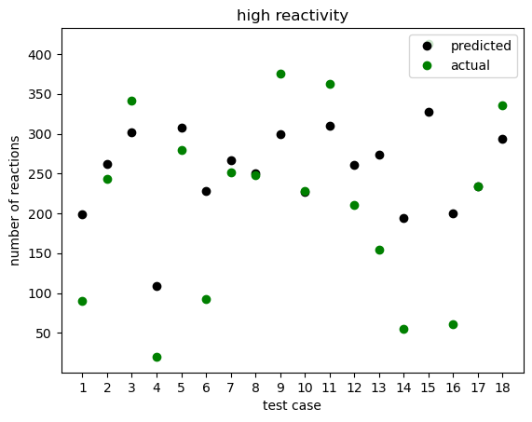
88% within 137 of actual
50% within 52 of actual
high: above 300
low: below 230

Slide 3
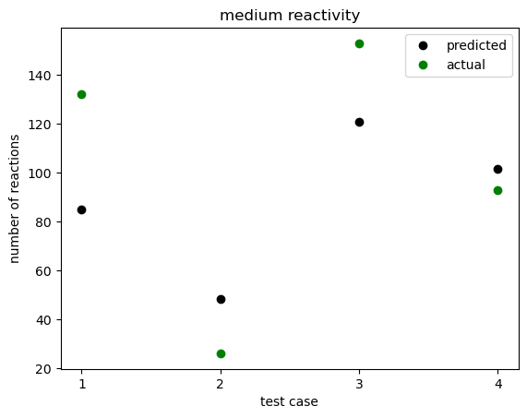
75% within 40 of actual
50% within 30 of actual
high: above 150
low: below 100

Slide 4
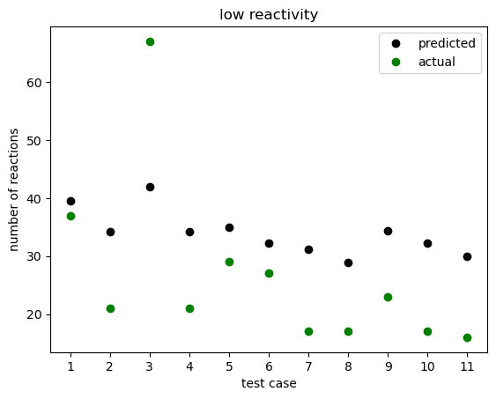
90% within 15 of actual
50% within 12 of actual
high: above 50
low: below 30

Slide 5
Summary
group | experiment setup |  | bounds | number of examples | train | test | within ~90% | within ~50%
high | 0.002/1.46pN | 9/5mm | high: above 300 | 83 | 65 | 18 | 137 | 52
 |  |  | low: below 230
medium | 9.24pN | 3mm | high: above 150 | 16 | 12 | 4 | 40 | 30
 |  |  | low: below 100
low | 22.6/35.14pN | 2/1.5mm | high: above 50 | 56 | 44 | 11 | 15 | 12
 |  |  | low: below 30

