Slide 1
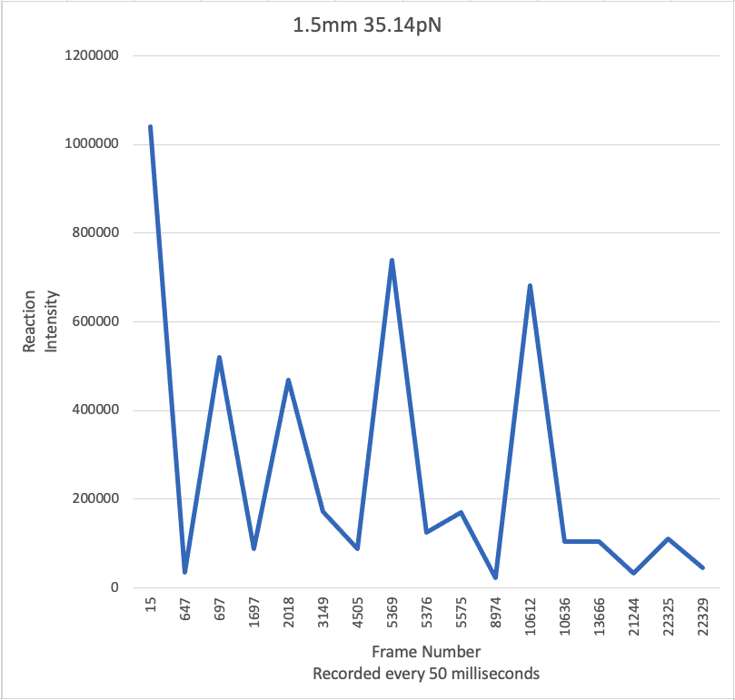
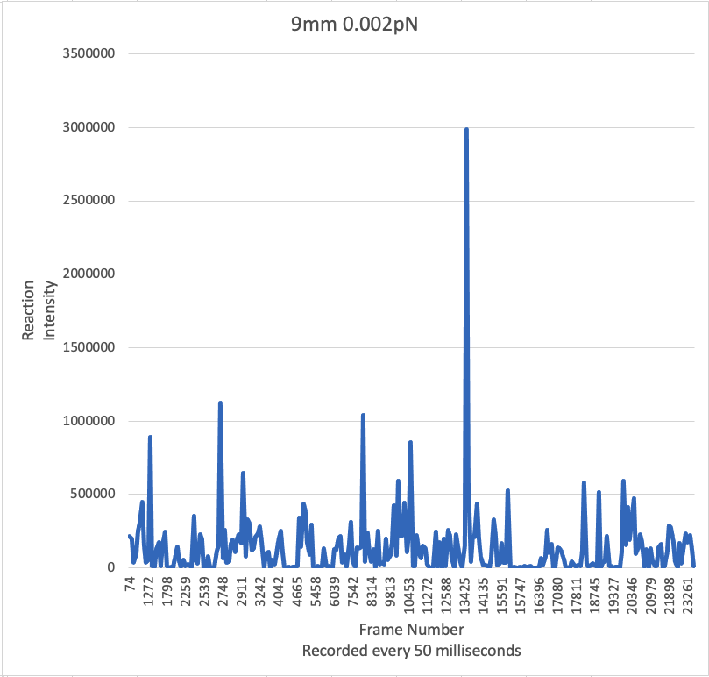
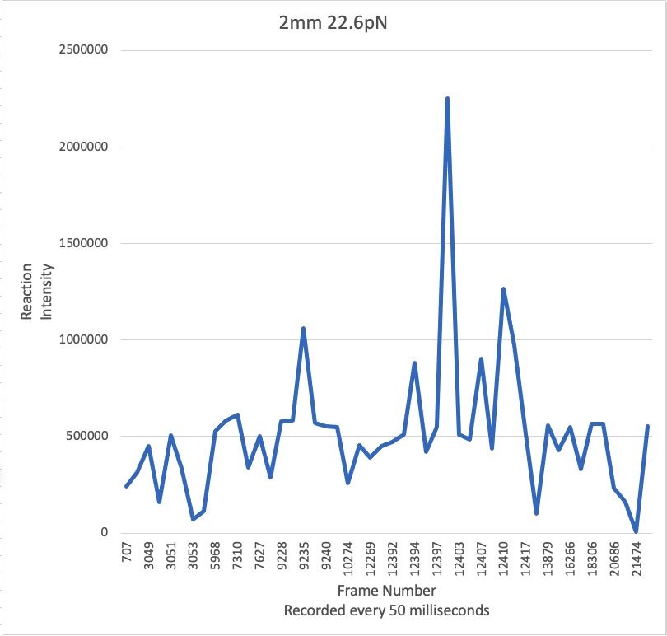
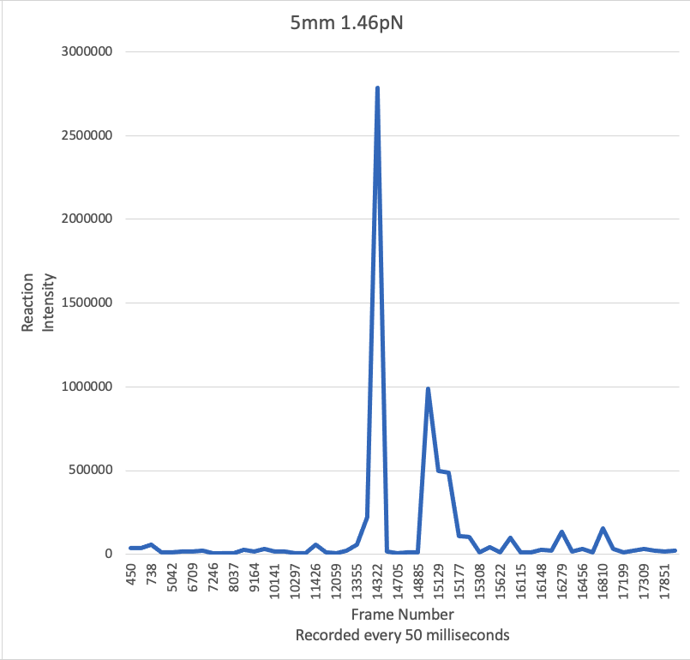
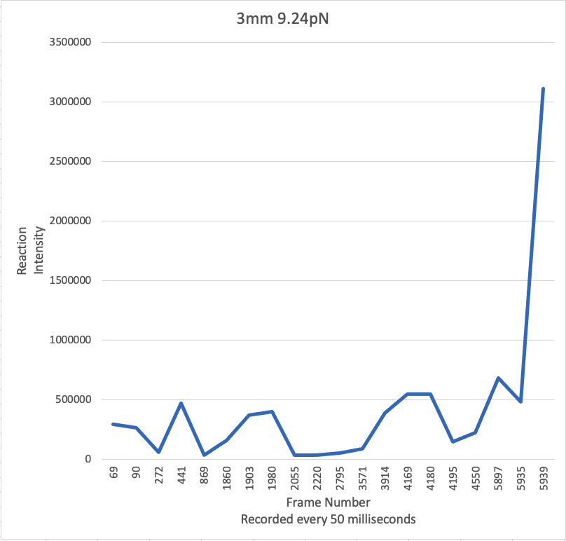

Single-molecule experiment data
Preprocessor
Spiking Neural Network
leaky integrate and fire layer
leaky integrate and fire layer
classification
layer
spike input layer
single experiment
spike train

