Slide 1
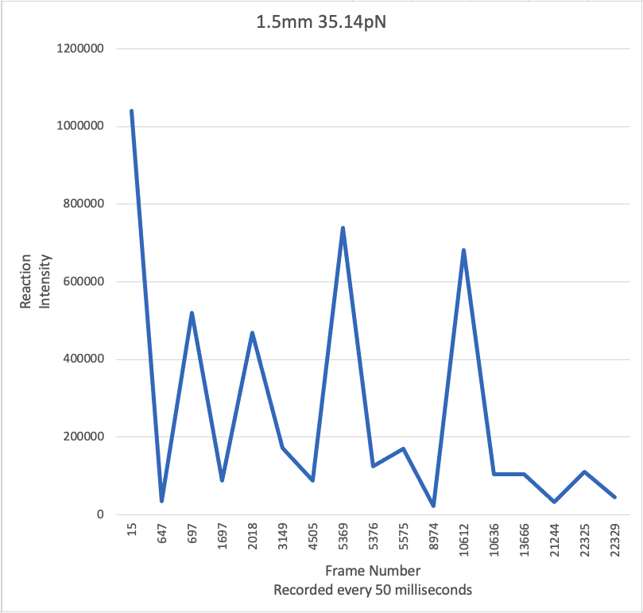
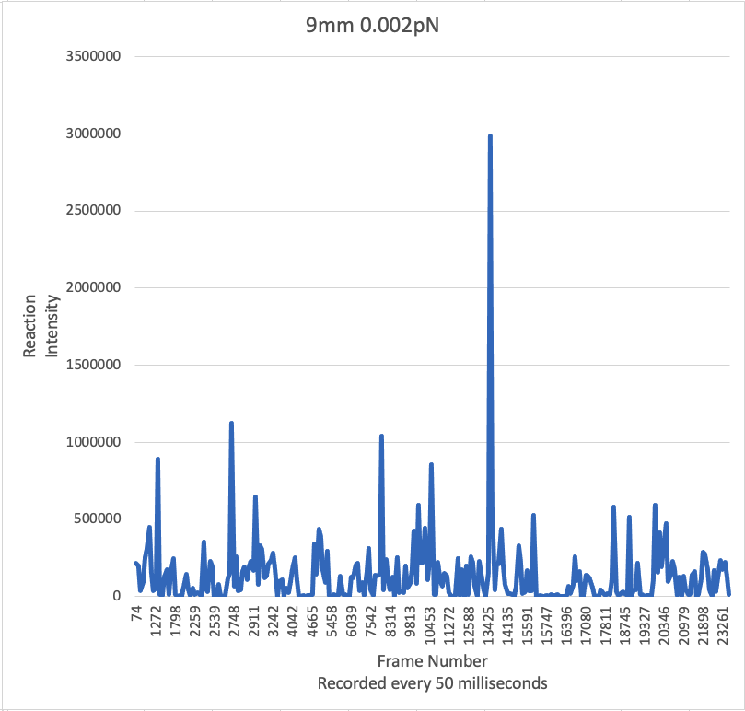
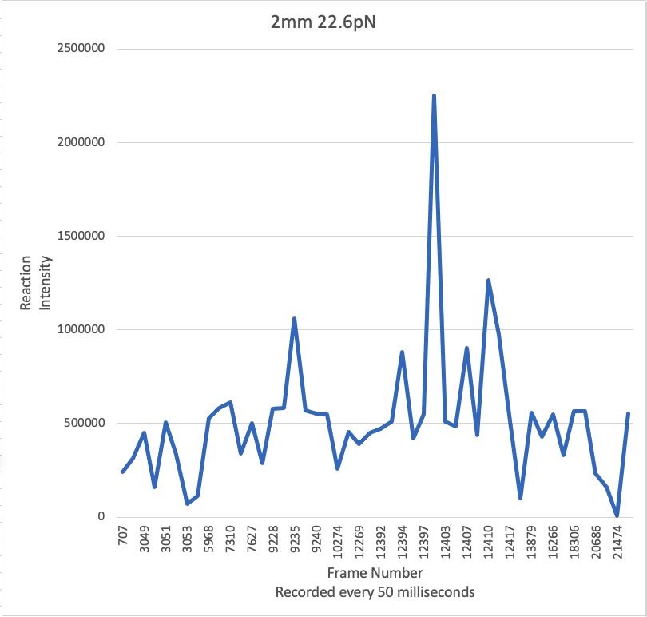
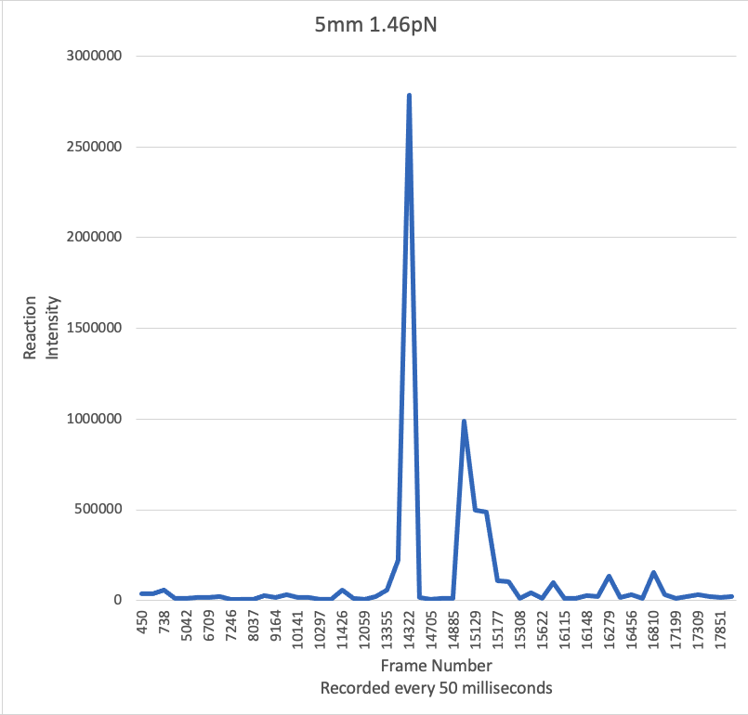
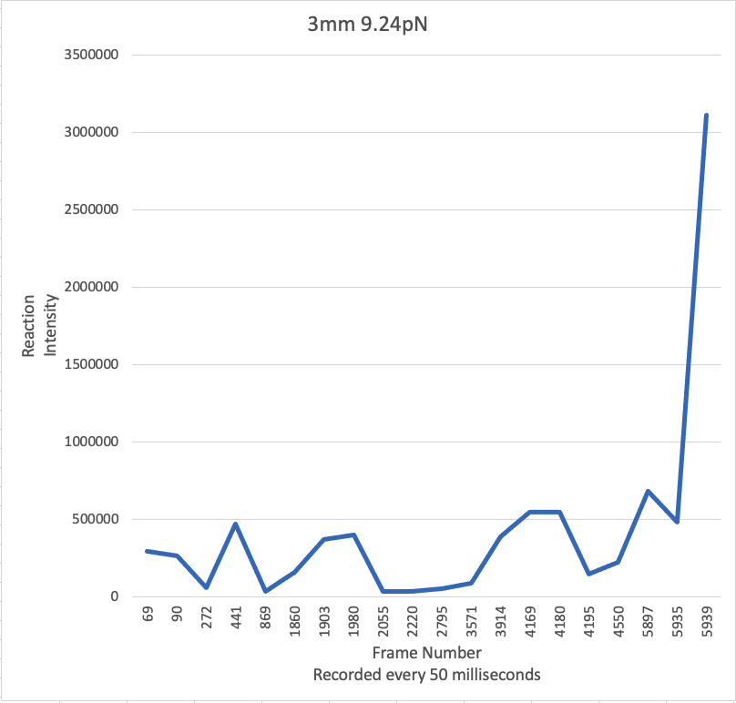
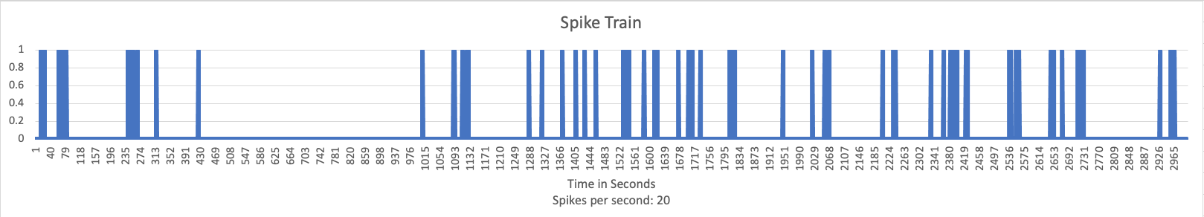
Single-molecule experiment data
Preprocessor
Spiking Neural Network
Dense
Layer
LIF
layer
Dense
Layer
LIF
layer
Dense
Layer
classification
layer
spike input layer
High
Medium
single experiment
spike train
Low

