Slide 1
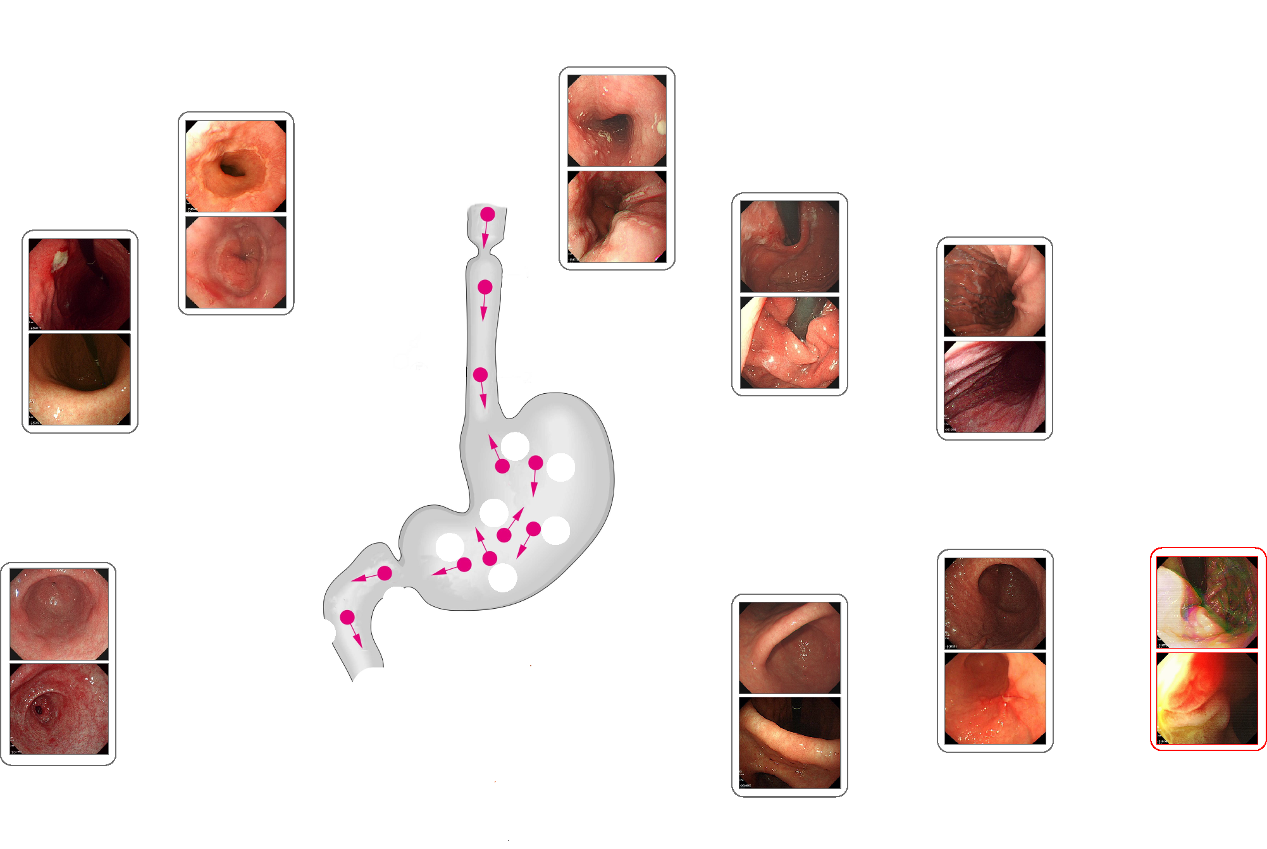
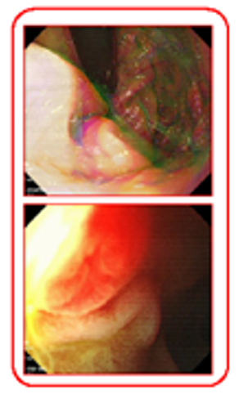
pharynx
1
1 - oesophagus
2 - junction
2
6 – fundus with retroflex view
6 – middle-upper body with retroflex view
6
3 - corpus
3
6
3
7 - unclassified
4 – pylorus/antrum
4
5
5 - angle
duodenum

