Slide 1
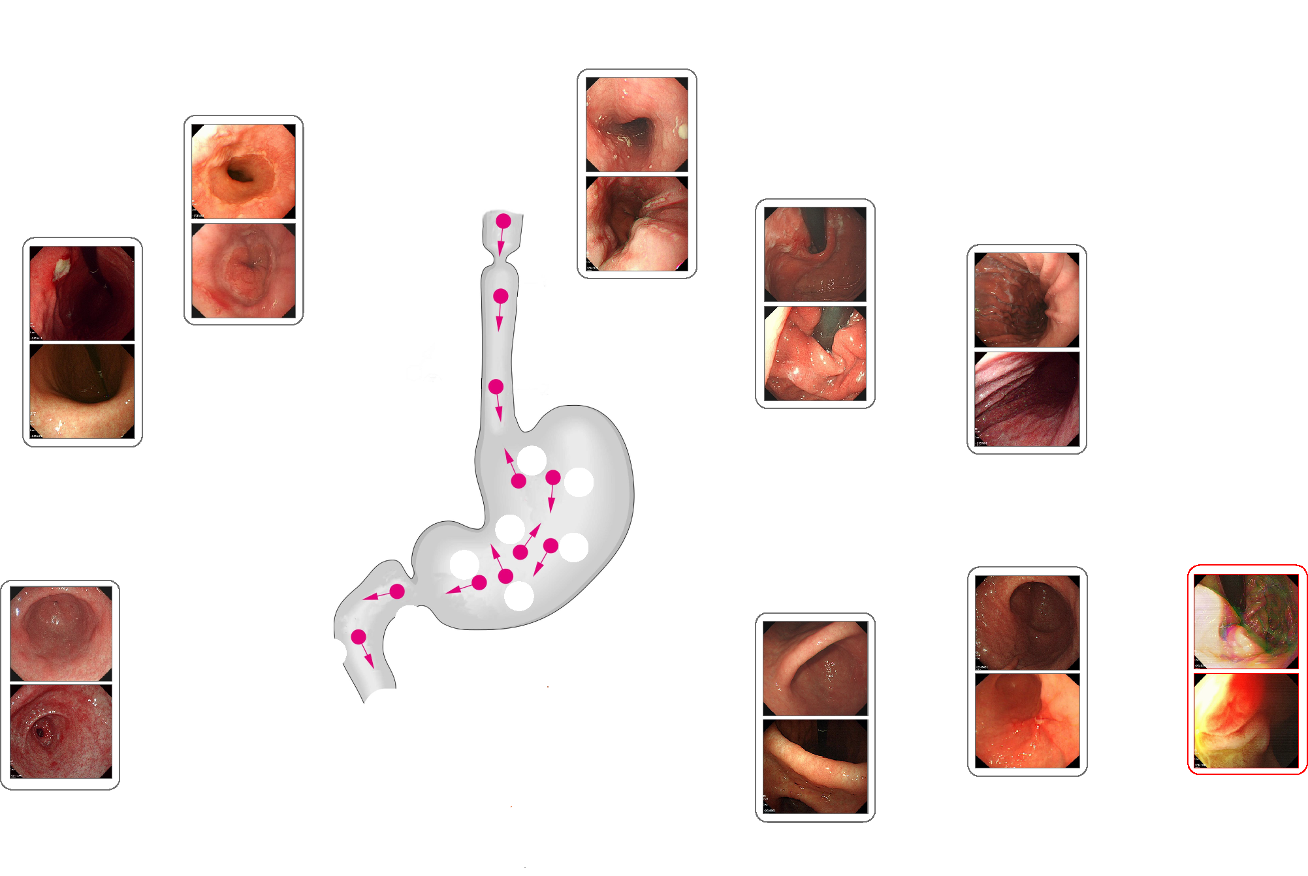
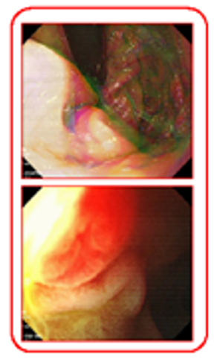
trachea
1
1 - oesophagus
2 - squamocolumnar junction
2
6 – fundus with retroflex view
6 – middle-upper body with retroflex view
6
3 - great curvature
3
6
4 – pylore/antrum
4
7 - unqualified
5
5 - angle
duodenum

