Slide 1
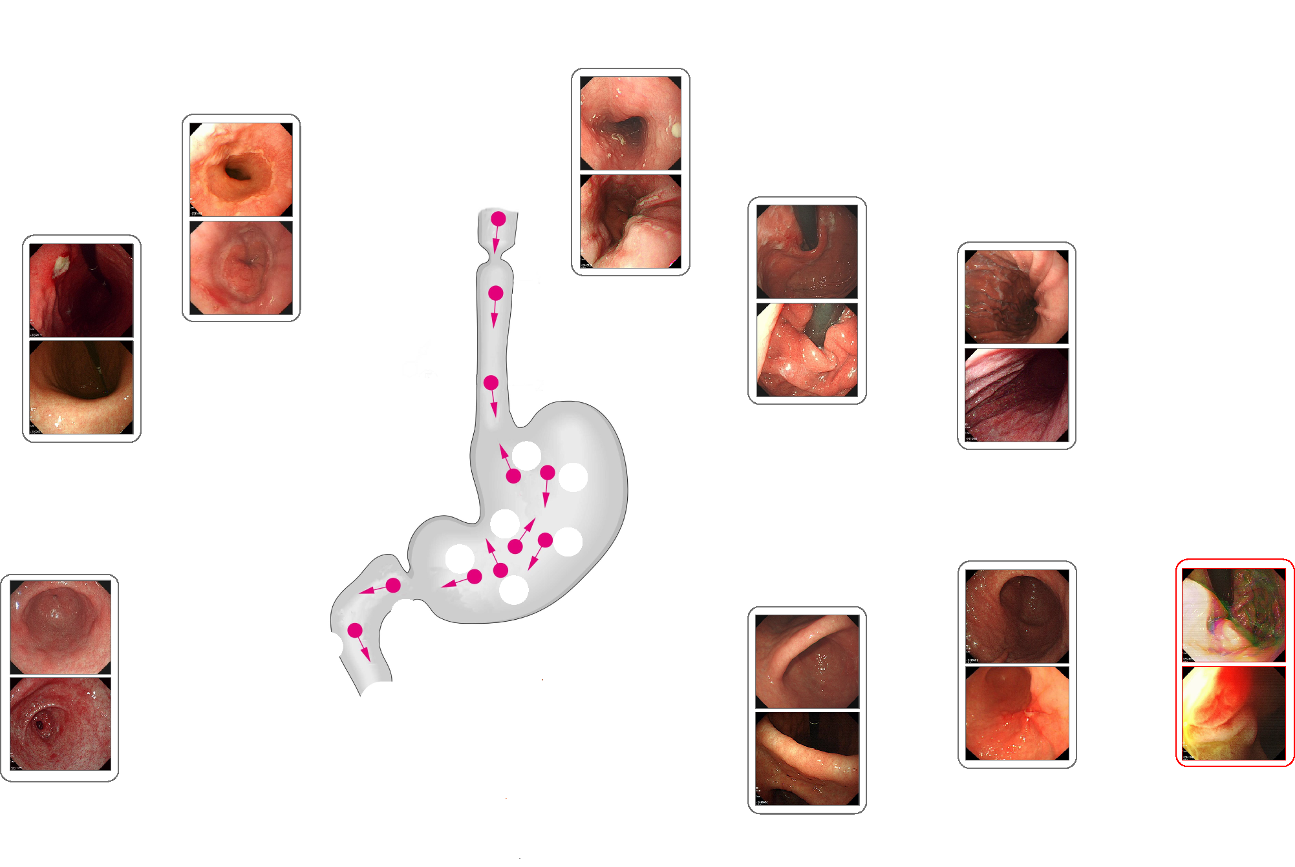
pharynx
1
1 - oesophagus
2 - squamocolumnar junction
2
7 – cardia with retroflew view
7 – middle-upper body with retroflew view
8
3 - large curvature
3
7
5
4
4 – lower body
9 - unqualified
5 - antrum
6
6 - angle
duodenum

