Slide 1
The role of AI in Software Engineering
by Mahdi Sanagostar, Parisa Mollahoseini, Zahra Khoramian

Slide 2
What are going to talk about?
Definition of Software Engineering (SE)

Slide 3
What are going to talk about?
Definition of Software Engineering (SE)
Definition of Artificial Intelligence (AI)

Slide 4
What are going to talk about?
Definition of Software Engineering (SE)
Definition of Artificial Intelligence (AI)
Overview on impacts of AI on SE

Slide 5
What are we going to talk about?
Definition of Software Engineering (SE)
Definition of Artificial Intelligence (AI)
Overview on impacts of AI on SE
The cases that AI helps SE

Slide 6
What are we going to talk about?
Definition of Software Engineering (SE)
Definition of Artificial Intelligence (AI)
Overview on impacts of AI on SE
The cases that AI helps SE
An AI-based overview

Slide 7
What are we going to talk about?
Definition of Software Engineering (SE)
Definition of Artificial Intelligence (AI)
Overview on impacts of AI on SE
The cases that AI helps SE
An AI-based overview
Fuzzy and probabilistic methods

Slide 8
What are we going to talk about?
Definition of Software Engineering (SE)
Definition of Artificial Intelligence (AI)
Overview on impacts of AI on SE
The cases that AI helps SE
An AI-based overview
Fuzzy and probabilistic methods
Computational search and optimization

Slide 9
What are we going to talk about?
Definition of Software Engineering (SE)
Definition of Artificial Intelligence (AI)
Overview on impacts of AI on SE
The cases that AI helps SE
An AI-based overview
Fuzzy and probabilistic methods
Computational search and optimization
Classification, learning and prediction

Slide 10

What is Software Engineering?
IEEE Computer Society Definition:
“Software Engineering is the application of a systematic, disciplined, quantifiable approach to the development, operation, and maintenance of software, and the study of these approaches; that is, the application of engineering to software.”

Slide 11
Maintenance
Development
Operation
An AI-based overview

Slide 12
What is Artificial Intelligence?
AI is concerned with getting computers to do tasks that would normally require human intelligence.

Slide 13
What is Artificial Intelligence?
AI is concerned with getting computers to do tasks that would normally require human intelligence.
“Artificial intelligence is a computerized system that exhibits behavior that is commonly thought of as requiring intelligence.”

Slide 14
What is Artificial Intelligence?
AI is concerned with getting computers to do tasks that would normally require human intelligence.
“Artificial intelligence is a computerized system that exhibits behavior that is commonly thought of as requiring intelligence.”
“Artificial Intelligence is the science of making machines do things that would require intelligence if done by man.”

Slide 15

The founding father of AI, Alan Turing, defines this discipline as:
“AI is the science and engineering of making intelligent machines, especially intelligent computer programs.”

Slide 16
Impacts of AI on SE
An Overview

Slide 17
Overview on impacts of AI on SE
Widespread increase in customer needs

Slide 18
Overview on impacts of AI on SE
Widespread increase in customer needs
Traditional software development is not designed to support rapid changes

Slide 19
Overview on impacts of AI on SE
Widespread increase in customer needs
Traditional software development is not designed to support rapid changes
Software companies must act on rapid behavioral changes to develop and release products with speed and accuracy.

Slide 20
Overview on impacts of AI on SE
Artificial Intelligence (AI)

Slide 21
Overview on impacts of AI on SE
Artificial Intelligence (AI)
Creating scalable, efficient and agile workflows

Slide 22
Overview on impacts of AI on SE
Artificial Intelligence (AI)
Creating scalable, efficient and agile workflows
Reduce time-to-market

Slide 23
Overview on impacts of AI on SE
Artificial Intelligence (AI)
Creating scalable, efficient and agile workflows
Reduce time-to-market
AI algorithms

Slide 24
Overview on impacts of AI on SE
Artificial Intelligence (AI)
Creating scalable, efficient and agile workflows
Reduce time-to-market
AI algorithms
Allow software development teams to make instant decisions using real-time data

Slide 25
Overview on impacts of AI on SE
Artificial Intelligence (AI)
Creating scalable, efficient and agile workflows
Reduce time-to-market
AI algorithms
Allow software development teams to make instant decisions using real-time data
Perform complex and intelligent functions associated with human thinking

Slide 26
Overview on impacts of AI on SE
Artificial Intelligence (AI)
Creating scalable, efficient and agile workflows
Reduce time-to-market
AI algorithms
Allow software development teams to make instant decisions using real-time data
Perform complex and intelligent functions associated with human thinking
Accurate code

Slide 27
According to the market research firm Tractica, revenue from the application of AI tools worldwide is expected to reach $119B by 2025.

Slide 28
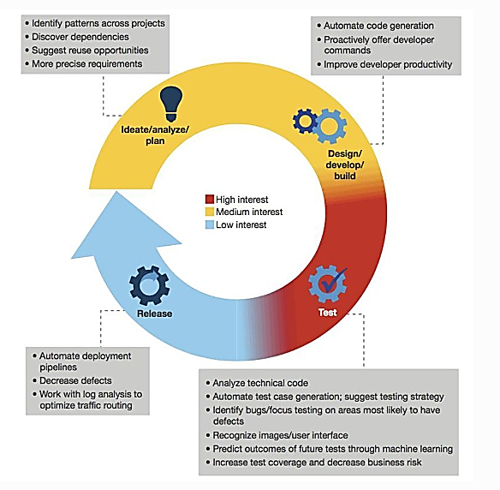
Level of interests of SE impacted by AI

Slide 29
Impacts of AI on SE
The cases that AI helps SE

Slide 30
1. Agile Project Management

Slide 31
2. Software Design

Slide 32

Impacts of AI on SE: Software Design
AIDA- The Artificial Intelligence Design Assistant

Slide 33
3. Software Testing

Slide 34

Impacts of AI on SE: Software Testing
Functionize
SapFix
DeepCode
Kite (for Python)

Slide 35
4. GUI Testing

Slide 36
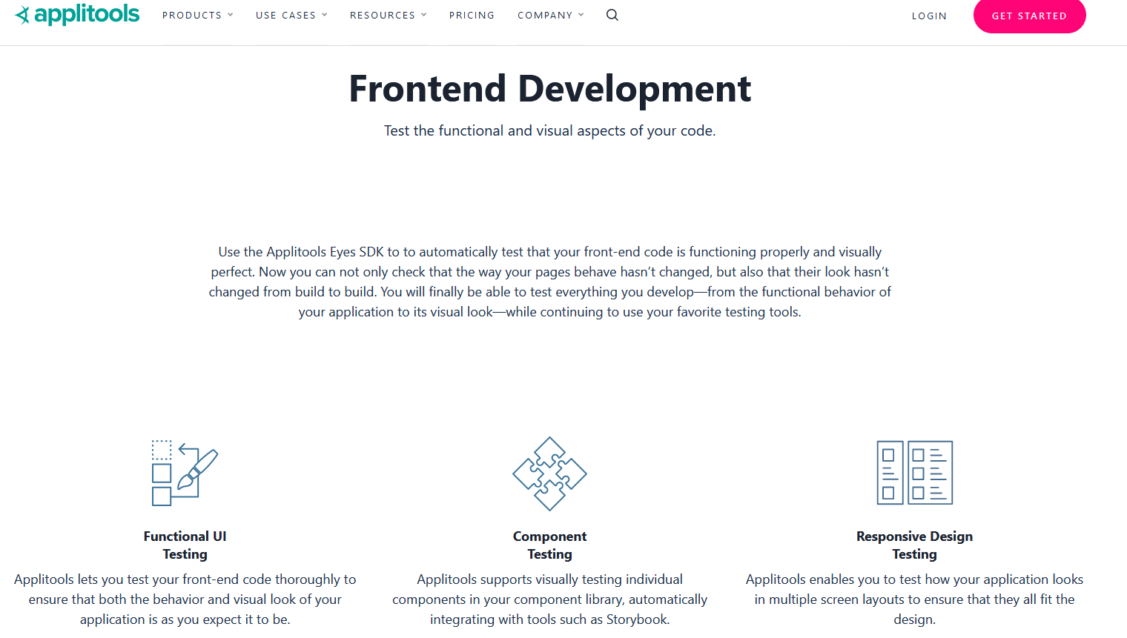
Impacts of AI on SE: GUI Testing
Applitools

Slide 37
5. Strategic Decision-Making

Slide 38
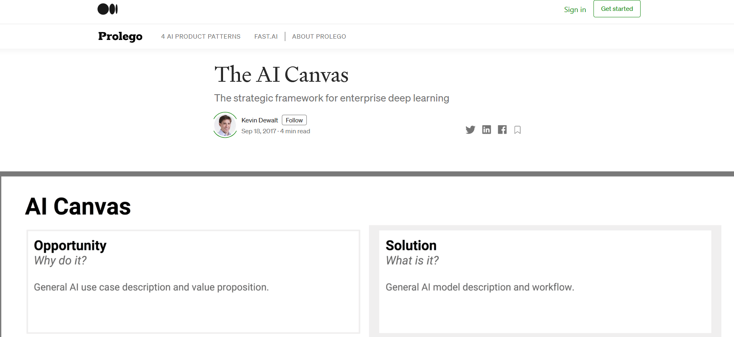
Impacts of AI on SE: Strategic Decision-Making
AI Canvas

Slide 39
6. Code Generation

Slide 40

Impacts of AI on SE: Code Generation
Bayou

Slide 41
7. Support

Slide 42
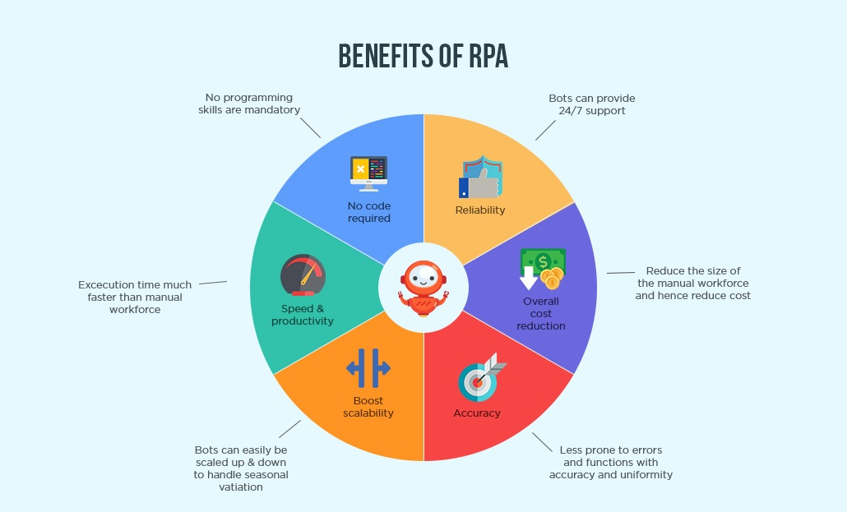
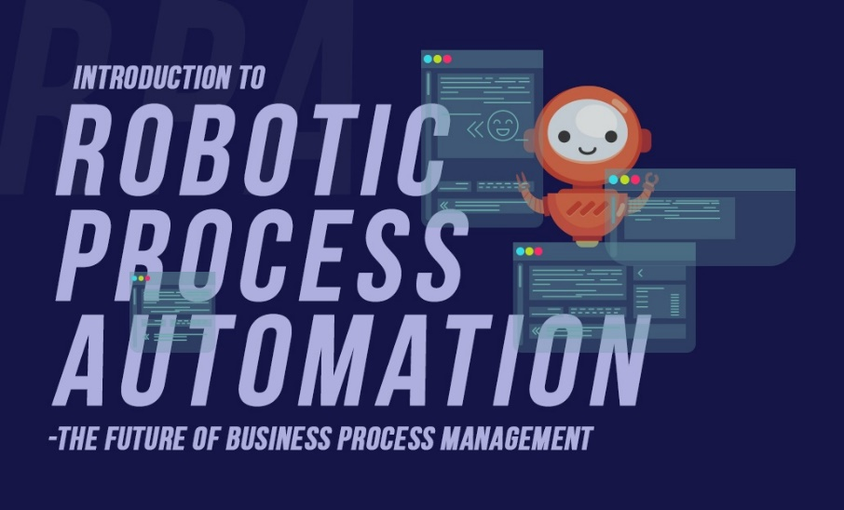
Impacts of AI on SE: Support
Robotic Process Automation (RPA)

Slide 43
An AI-based overview

Slide 44
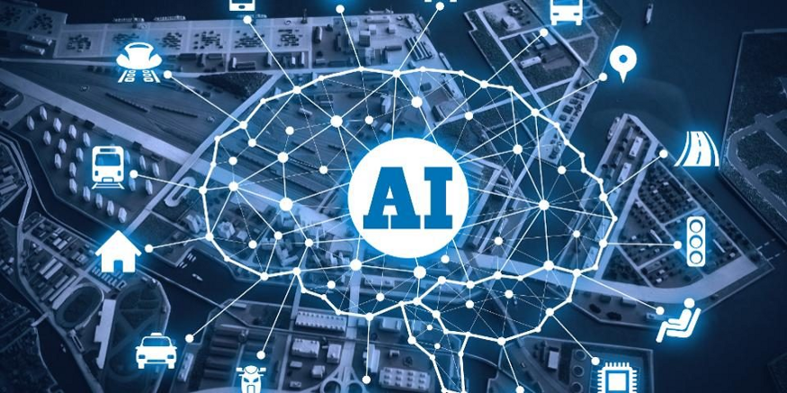
These AI algorithms and techniques find important and effective applications that impact on almost every area of software engineering activity. In particular, the SE community has used three broad areas of AI techniques:
Fuzzy and probabilistic methods for reasoning in the presence of uncertainty.
Computational search and optimization techniques (the field known as Search Based Software Engineering (SBSE).
Classification, learning and prediction

Slide 45
Fuzzy and probabilistic methods
In Fuzzy and probabilistic work, the aim is to apply to Software Engineering, AI techniques developed to handle real world problems which are, by their nature, fuzzy and probabilistic.
One example of a probabilistic AI technique has been the use of Bayesian probabilistic reasoning to model software reliability
Second example of the need for probabilistic reasoning comes from the analysis of users, inherently requiring an element of probability because of the stochastic nature of human behavior.

Slide 46
Computational search and optimization
In Search Based Software Engineering (SBSE) work, the goal is to re-formulate software engineering problems as optimization problems that can then be attacked with computational search.
Computational search has been exploited by all engineering disciplines, not just Software Engineering.
It has proved to be a widely applicable and successful approach, with applications from requirements and design to maintenance and testing.

Slide 47
Classification, learning and prediction
In classification, learning and prediction work there has been great interest in modelling and predicting software costs as part of project planning.
For example a wide variety of traditional machine learning techniques such as artificial neural networks, cased based reasoning and rule induction have been used for software project prediction, ontology learning and defect prediction.

Slide 48
The Future of Development
AI has enormous potential to reshape the future of software development. The availability of AI-enabled solutions allows software companies to deliver customer-driven experiences by providing application strategy according to business needs.

Slide 49
References
https://hub.packtpub.com/5-ways-artificial-intelligence-is-upgrading-software-engineering/
https://technative.io/ai-enabled-software-development/
https://www.clariontech.com/platform-blog/introduction-to-robotic-process-automation-rpa-the-future-of-business-process-management
https://www2.deloitte.com/se/sv/pages/technology/articles/part1-artificial-intelligence-defined.html
Harman, Mark. "The role of artificial intelligence in software engineering." In 2012 First International Workshop on Realizing AI Synergies in Software Engineering (RAISE), pp. 1-6. IEEE, 2012.
https://towardsdatascience.com/what-is-the-role-of-an-ai-software-engineer-in-a-data-science-team-eec987203ceb

Slide 50
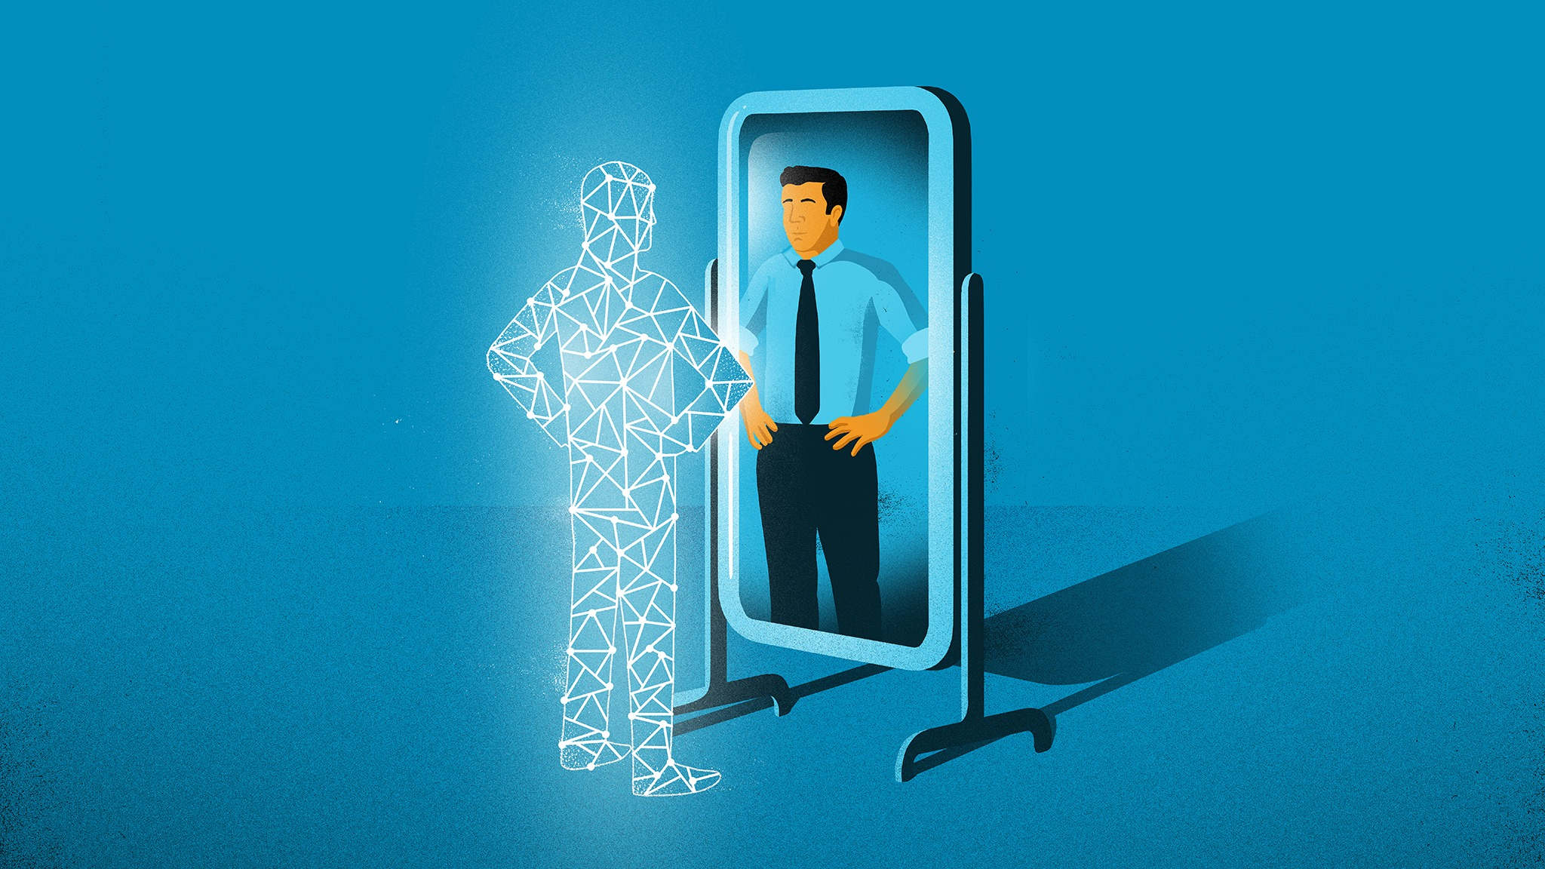
Thanks!
Any questions?

