Slide 1
The Role of AI in Software Engineering
by Mahdi Sanagostar, Parisa Mollahoseini, Zahra Khoramian

Slide 2
What are we going to talk about?
Definition of Software Engineering (SE)
Definition of Artificial Intelligence (AI)
Overview on impacts of AI on SE
The cases that AI helps SE
An AI-based overview
Fuzzy and probabilistic methods
Computational search and optimization
Classification, learning and prediction

Slide 3

What is Software Engineering?
IEEE Computer Society:
“Software Engineering is the application of a systematic, disciplined, quantifiable approach to the development, operation, and maintenance of software, and the study of these approaches; that is, the application of engineering to software.”

Slide 4
AI algorithms
Maintenance
Development
Operation

Slide 5
What is Artificial Intelligence?
AI is concerned with getting computers to do tasks that would normally require human intelligence.
“Artificial Intelligence is a computerized system that exhibits behavior that is commonly thought of as requiring intelligence.”
“Artificial Intelligence is the science of making machines do things that would require intelligence if done by man.”

Slide 6

The founding father of AI, Alan Turing, defines this discipline as:
“AI is the science and engineering of making intelligent machines, especially intelligent computer programs.”

Slide 7
Impacts of AI on SE
An overview

Slide 8
Overview on impacts of AI on SE
Widespread increase in customer needs
Traditional software development is not designed to support rapid changes
Software companies must act on rapid behavioral changes to develop and release products with speed and accuracy.

Slide 9
Overview on impacts of AI on SE
Artificial Intelligence (AI)
Creating scalable, efficient and agile workflows
Reduce time-to-market
AI algorithms
Allow software development teams to make instant decisions using real-time data
Perform complex and intelligent functions associated with human thinking
Accurate code

Slide 10
According to the market research firm Tractica, revenue from the application of AI tools worldwide is expected to reach $119B by 2025.

Slide 11
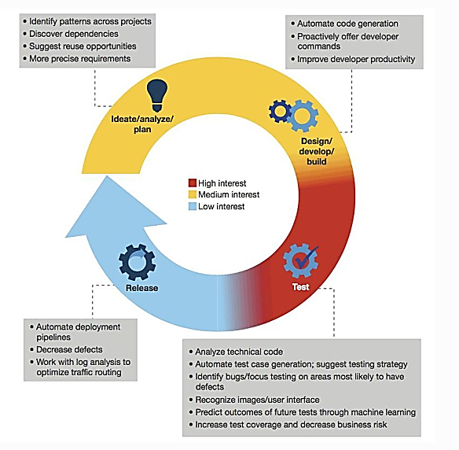
Level of interests of SE impacted by AI

Slide 12
Impacts of AI on SE
The cases that AI helps SE

Slide 13
1.
Agile Project Management

Slide 14
2.
Software Design

Slide 15

Impacts of AI on SE: Software Design
AIDA- The Artificial Intelligence Design Assistant

Slide 16
3.
Software Testing

Slide 17

Impacts of AI on SE: Software Testing
Functionize
SapFix
DeepCode
Kite (for Python)

Slide 18
4.
GUI Testing

Slide 19
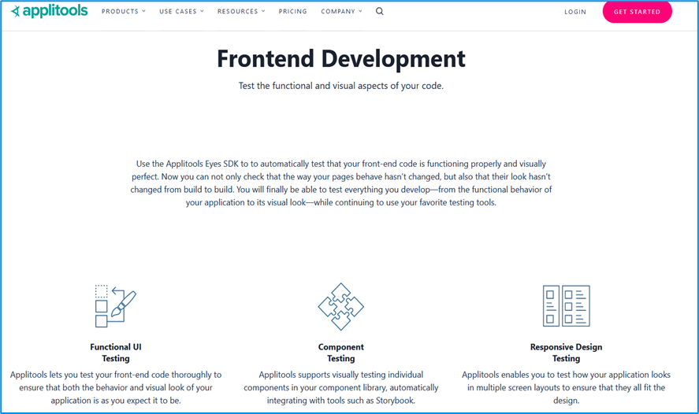
Impacts of AI on SE: GUI Testing
Applitools

Slide 20

5.
Strategic Decision-Making

Slide 21
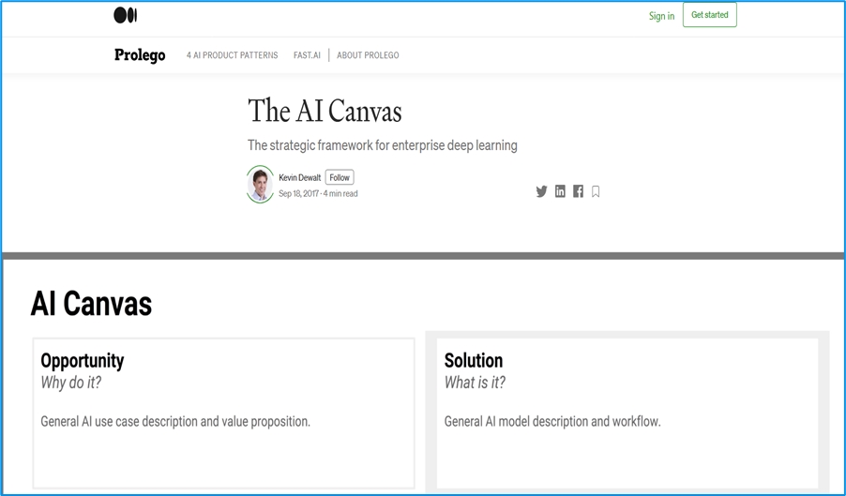
Impacts of AI on SE: Strategic Decision-Making
AI Canvas

Slide 22
6.
Code Generation

Slide 23

Impacts of AI on SE: Code Generation
Bayou

Slide 24
7.
Support

Slide 25
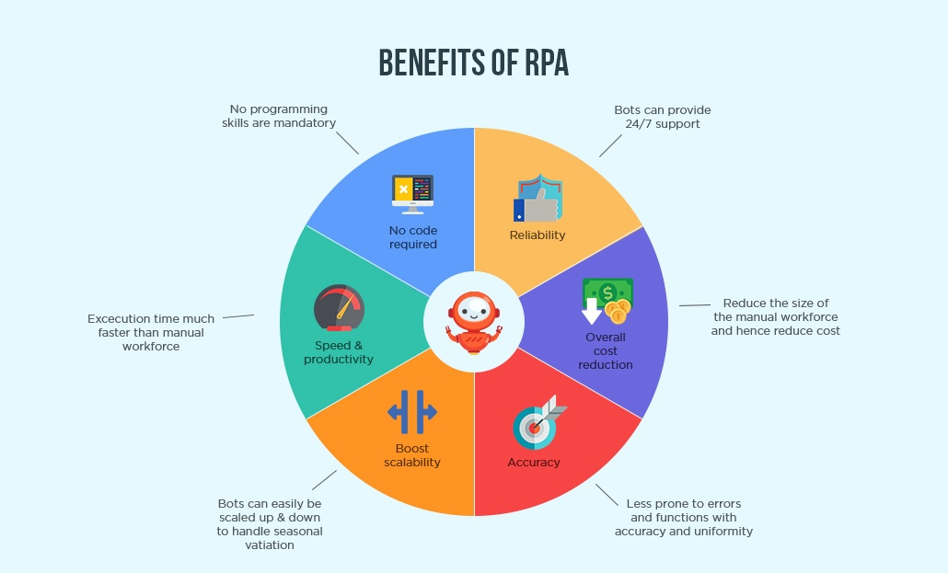
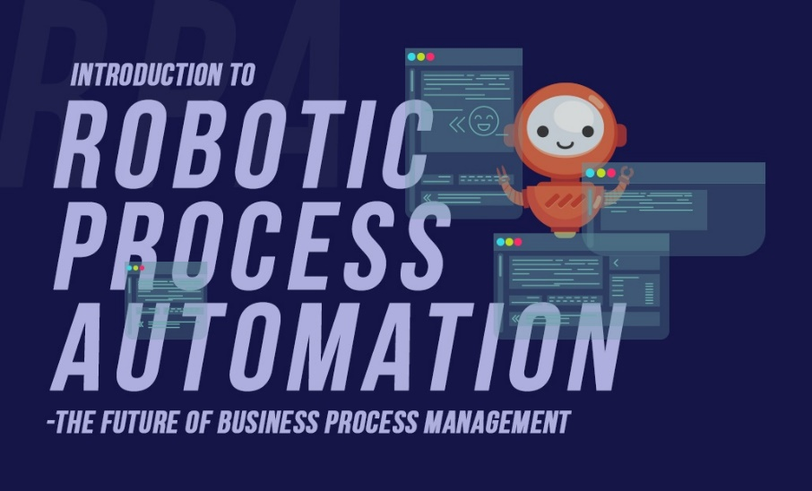
Impacts of AI on SE: Support
Robotic Process Automation (RPA)

Slide 26
An AI-based overview

Slide 27
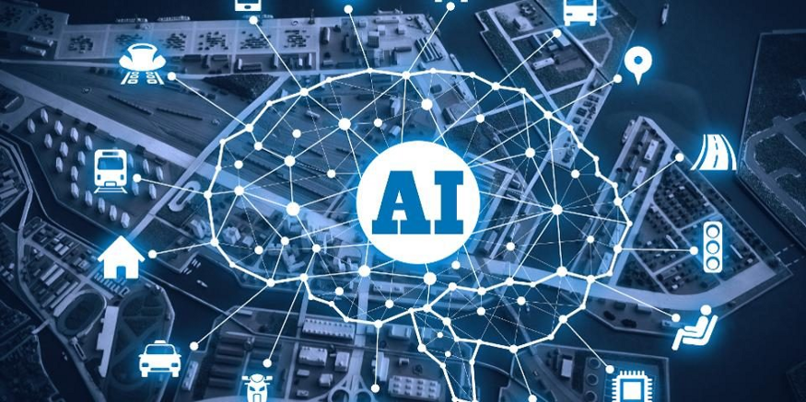
An AI-based overview
These AI algorithms and techniques find important and effective applications that impact on almost every area of Software Engineering activity. In particular, the SE community has used three broad areas of AI techniques:
Fuzzy and probabilistic methods for reasoning in the presence of uncertainty.
Computational search and optimization techniques (the field known as Search Based Software Engineering (SBSE)).
Classification, learning and prediction

Slide 28
Fuzzy and probabilistic methods
In fuzzy and probabilistic work, the aim is to apply to Software Engineering, AI techniques developed to handle real world problems which are, by their nature, fuzzy and probabilistic.
One example of a probabilistic AI technique has been the use of Bayesian probabilistic reasoning to model software reliability.
Second example of the need for probabilistic reasoning comes from the analysis of users, inherently requiring an element of probability because of the stochastic nature of human behavior.

Slide 29
Computational search and optimization
In Search Based Software Engineering (SBSE) work, the goal is to re-formulate Software Engineering problems as optimization problems that can then be attacked with computational search.
Computational search has been exploited by all engineering disciplines, not just Software Engineering.
It has proved to be a widely applicable and successful approach, with applications from requirements and design to maintenance and testing.

Slide 30
Classification, learning and prediction
In classification, learning and prediction work there has been great interest in modelling and predicting software costs as part of project planning.
For example a wide variety of traditional Machine Learning techniques such as Neural Networks, cased based reasoning and rule induction have been used for software project prediction, ontology learning and defect prediction.

Slide 31
The Future of Development
AI has enormous potential to reshape the future of software development. The availability of AI-enabled solutions allows software companies to deliver customer-driven experiences by providing application strategy according to business needs.

Slide 32
References
https://hub.packtpub.com/5-ways-artificial-intelligence-is-upgrading-software-engineering/
https://technative.io/ai-enabled-software-development/
https://www.clariontech.com/platform-blog/introduction-to-robotic-process-automation-rpa-the-future-of-business-process-management
https://www2.deloitte.com/se/sv/pages/technology/articles/part1-artificial-intelligence-defined.html
Harman, Mark. "The role of artificial intelligence in software engineering." In 2012 First International Workshop on Realizing AI Synergies in Software Engineering (RAISE), pp. 1-6. IEEE, 2012.
https://towardsdatascience.com/what-is-the-role-of-an-ai-software-engineer-in-a-data-science-team-eec987203ceb

Slide 33

Thanks!
Any questions?

