Slide 1
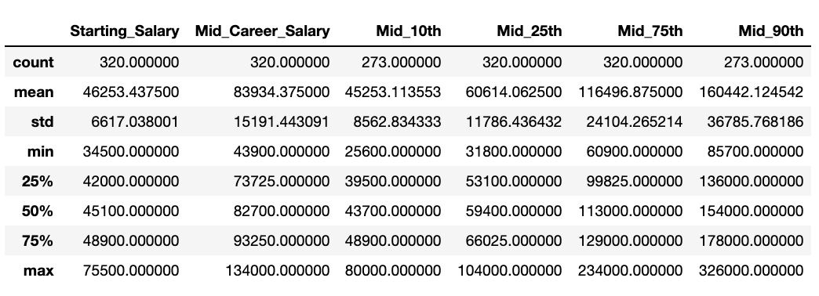

Slide 2
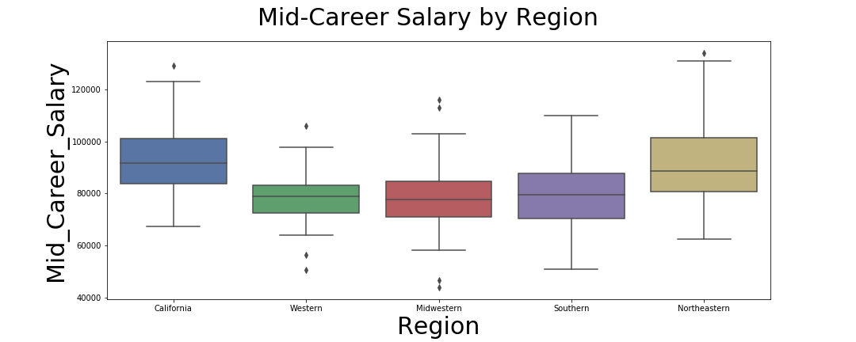
Salary Ranking:
California
Northeastern
Southern
Western
Midwestern
Notes:
Salary Ranking: California – Northeastern - Southern - Western - Midwestern
Boxplots were used to compare the dispersion of salaries among the regions. Based upon our analysis, there is a trend between the highest and lowest paying regions. The Western, Midwestern, and Southern Regions were the lowest earning regions at the start of their careers. After 10 years in their careers, they were still the lowest earning regions.
As it pertains to California and the Northeastern regions, they started their careers earning higher salaries and after 10 years in, they remained the top two earning regions.
When we conducted an ANOVA test to either reject the Null (no-difference) Hypothesis , or accept the Alternate (different) Hypothesis; Our results were outside of the normal distribution, rejecting the Null Hypothesis. Therefore, there is a significant difference in Starting Salary and Mid Career Salaries based upon region. What should you do if your motivated by money? Attend a college or university in the California or Northeast region.
KhanAcademy: Normal Distribution

Slide 3
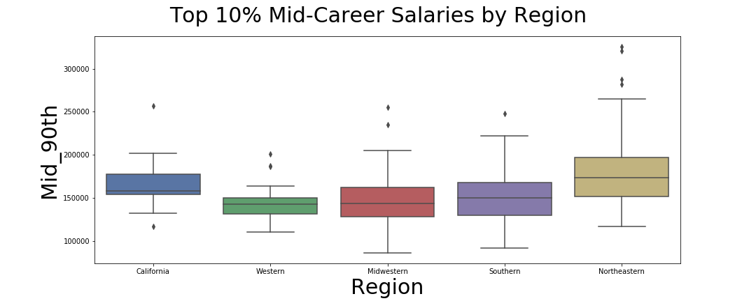
Salary Ranking:
Northeastern
California
Southern
Midwestern
Western
Notes:
Salary Ranking:
Northeastern
California
Southern
Midwestern
Western
From staring starting salary to mid career, the trend is the same. When we get to the top 10% of the mid-career salary people, we notice the overall trend seems the same, however California’s mean salary ranks 2nd to Northeastern. If you are looking to be among the top earners by mid-career, the Northeastern region would be a strong consideration for school a choice.

Slide 4
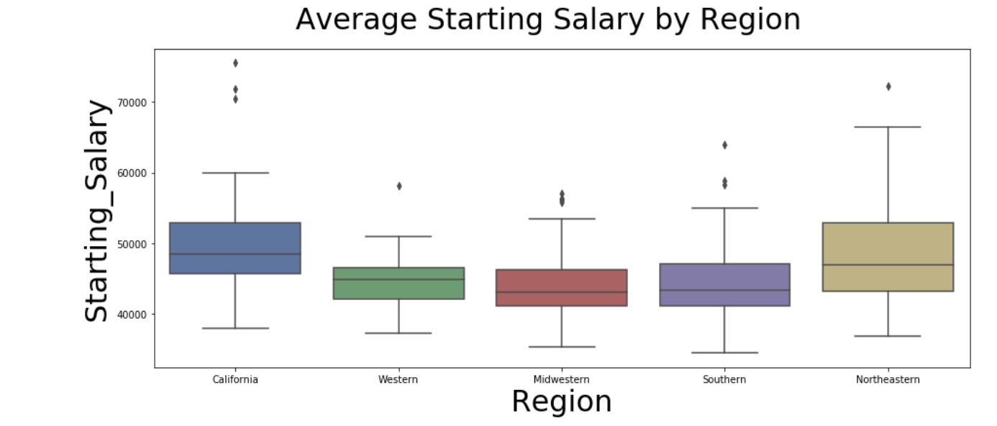
Salary Ranking:
California
Northeastern
Western
Southern
Midwestern
Notes:
Salary Ranking:
California
Northeastern
Western
Southern
Midwestern
As we transition from the areas of study that produce the highest earners, we turn our sights to the regions that produce the highest earners from the start to mid-career. We noticed that the lower earning regions had less disparity

Slide 5
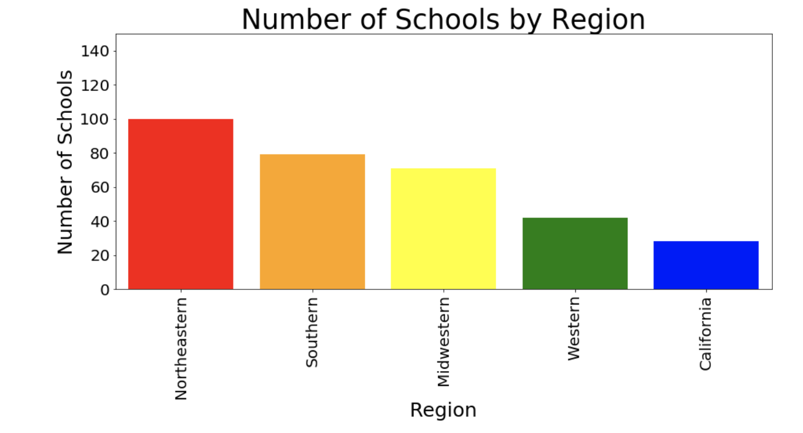

Slide 6
