Slide 1
Front End Lecture
Snap! Below the Line DeCal 2015 Fall

Slide 2
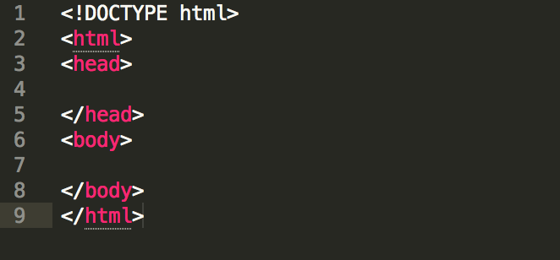
Intro
HyperText Markup Language = HTML
Most commonly used for front-end
Code looks like below

Slide 3
Anatomy of HTML file
<!DOCTYPE html> -> helps browser to display a web page correctly
Multiple tags such as <html>, <head> and <body>
<head> provides information about the document
<body> has visual page contents

Slide 4
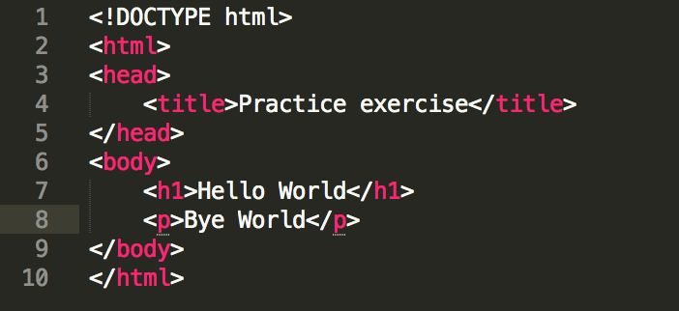
Anatomy of HTML file cont.
<title> provides title for the document
<h1> is a header styled font (<h1> … <h6>)
<p> is a paragraph tag
There are a lot of tags
How does it look like?

Slide 5
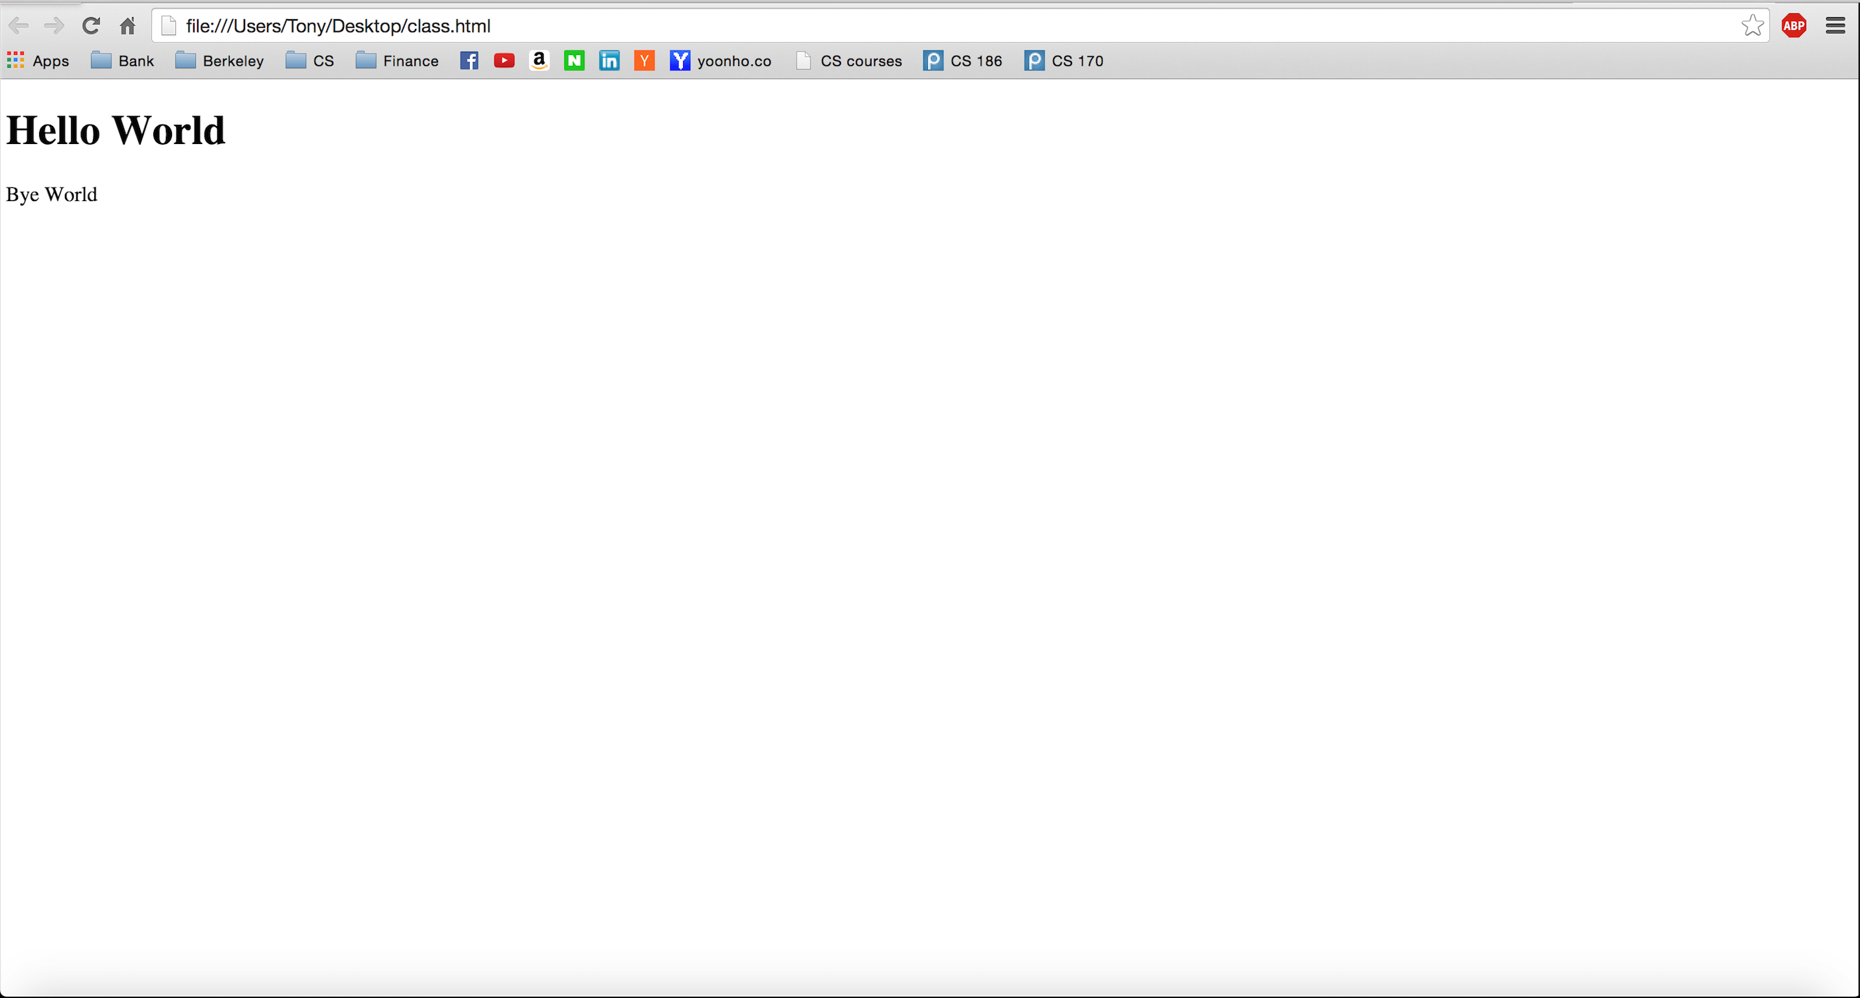

Slide 6
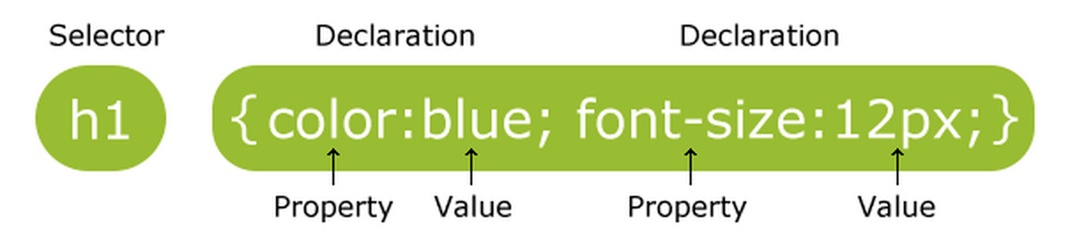
CSS
Cascading Style Sheets = CSS
CSS defines how html elements are displayed

Slide 7
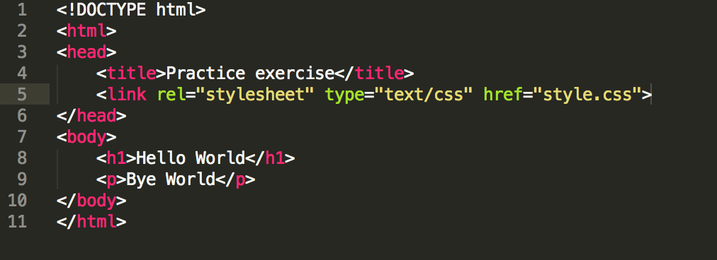
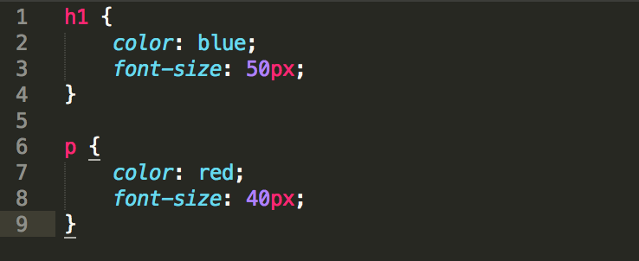
CSS cont.

Slide 8
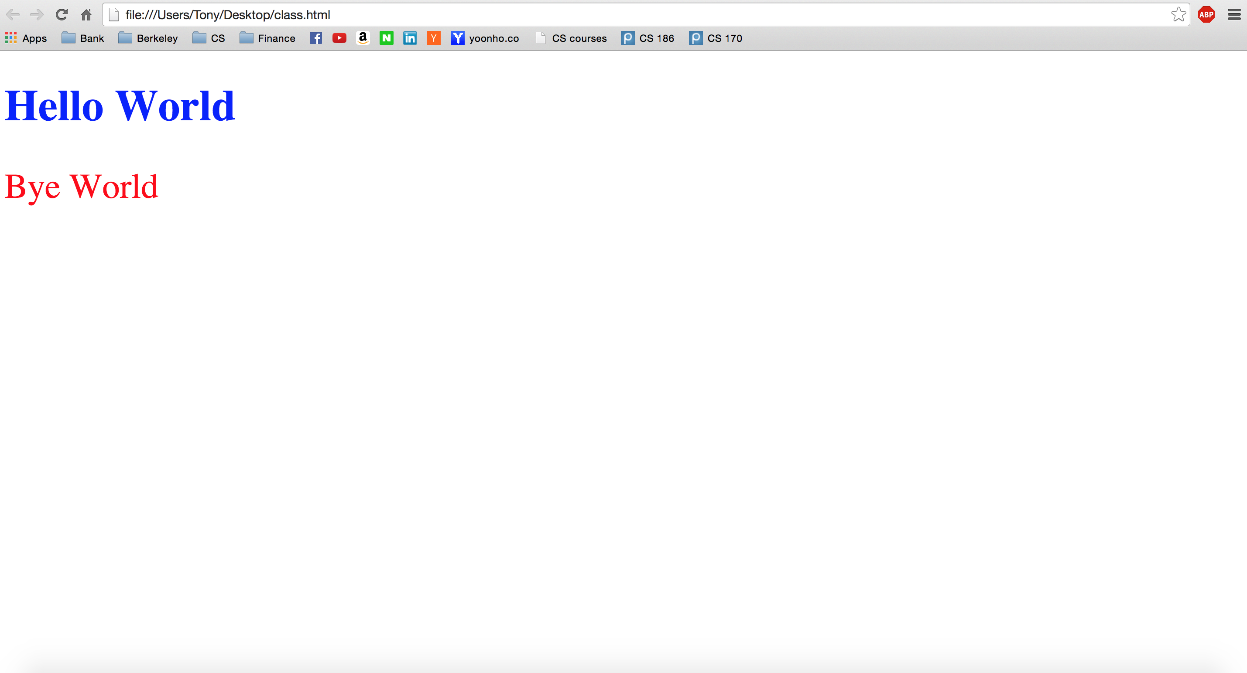
CSS cont.

Slide 9
Javascript
Programming language of HTML and the web.
Why learn Javascript?
Snap! is built using Javascript
Exercise:
http://www.w3schools.com/js/tryit.asp?filename=tryjs_myfirst

Slide 10
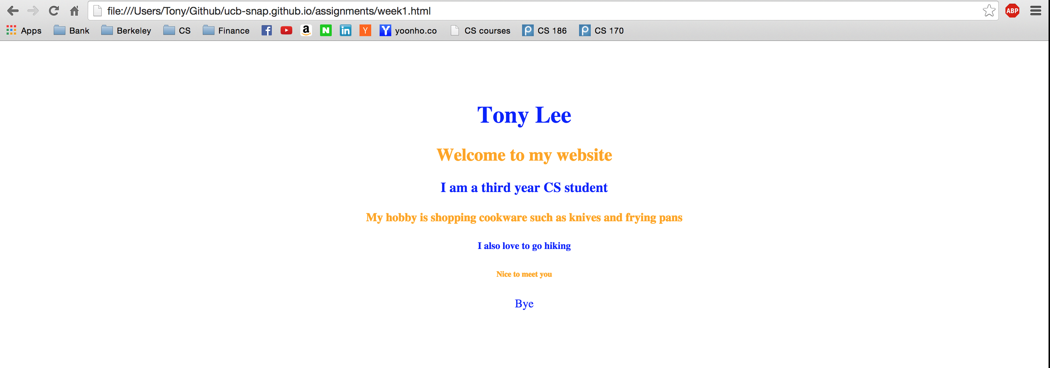
Week1 Assignment
Introduce yourself in your own HTML file using various tags
Make it pretty!

Slide 11
Summary
HTML defines the content of web pages
CSS to specify the layout of web pages
JavaScript to program the behavior of web pages
Majority of Snap! is JavaScript

Slide 12
Q & A

