Slide 1

Bank Personal Loan Modelling using Random Forest Algorithm
Created By :-
Kshitij Pawar MT22MCS018
Shreyas Bharadwaj S MT22MCS016

Slide 2
Contents
Problem Statement
What is random forest ?
Flowchart
Dataset
Acquiring data
Cleaning data
Box plot
EDA
Outputs
Result and analysis
Conclusion

Slide 3
Problem Statement
Model personal Bank loans using already existing data
Algorithm Type: Supervised
Chosen Algorithm: Random forest
Inputs: Dataset chosen-> Bank personal loan
Age
Experience
Income
Zip_code
Family
CCavgEducation
Mortgage
Personal Loan
Securities account
CD account
Online
Output :
Credit card

Slide 4
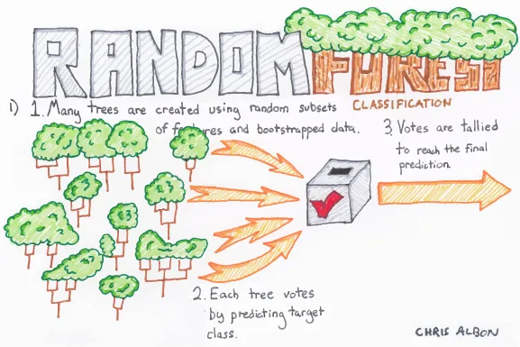
What is the Random Forest Algorithm?
A random forest is a supervised machine learning algorithm that is constructed from decision tree algorithms. This algorithm is applied in various industries such as banking and e-commerce to predict the behaviour and the outcome.

Slide 5
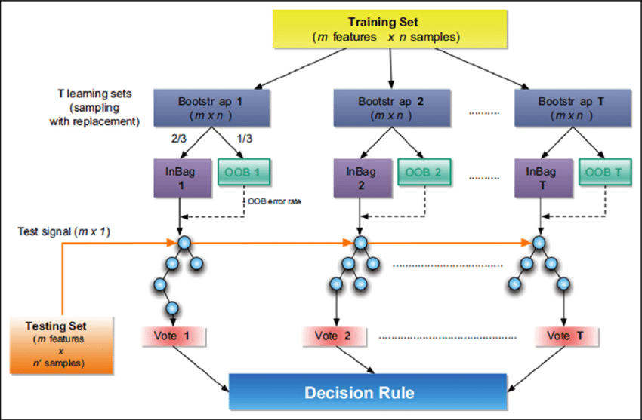
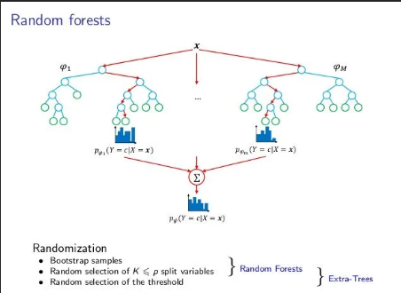
FlowChart and Working

Slide 6
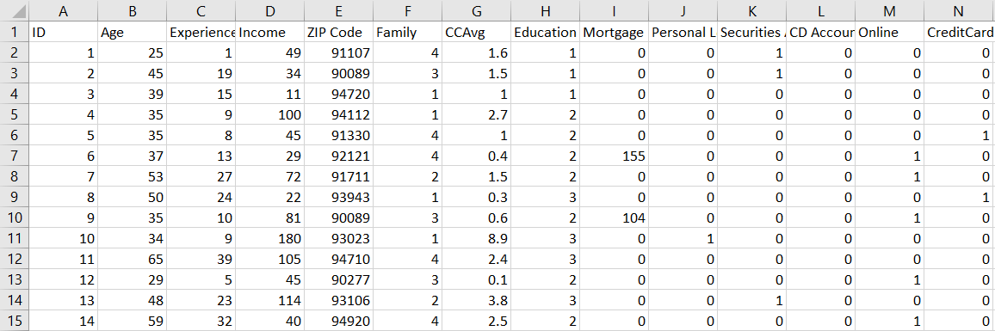
Dataset
Bank Personal loan dataset
Inputs: Dataset chosen-> Bank personal loan
Age
Experience
IncomeFamily
CCavgEducation
Mortgage
Personal Loan
Securities account
CD account
Online
Output :
Credit card

Slide 7
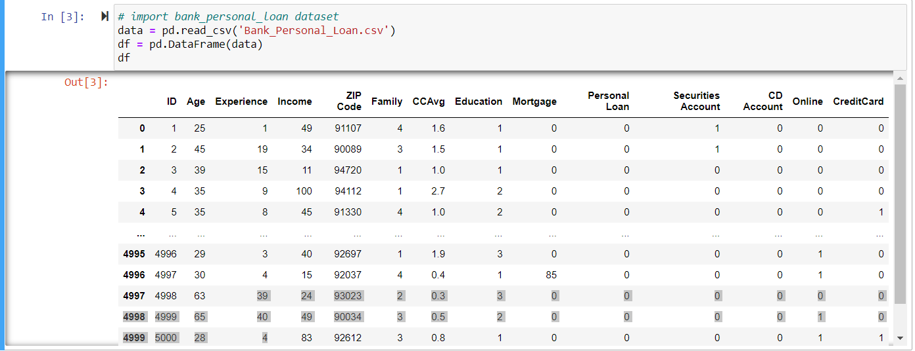
Acquiring data
Import data from Bank_Personal_Loan.csv into data frame

Slide 8
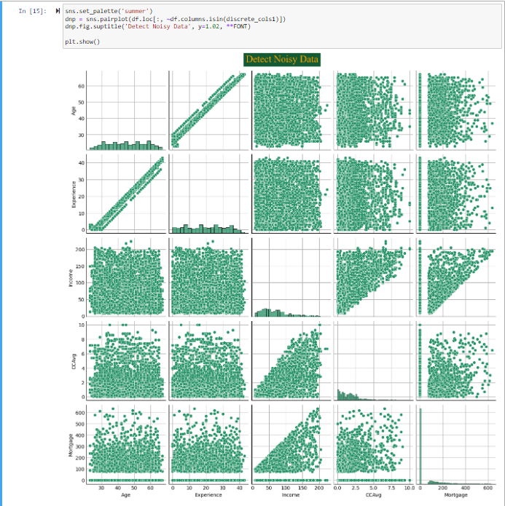
Cleaning the data
Check for negative values for experience column (Convert to positive if found).
Remove index and zip entries
Check and negate noises if any
Divide income by 12 to get income
per month

Slide 9
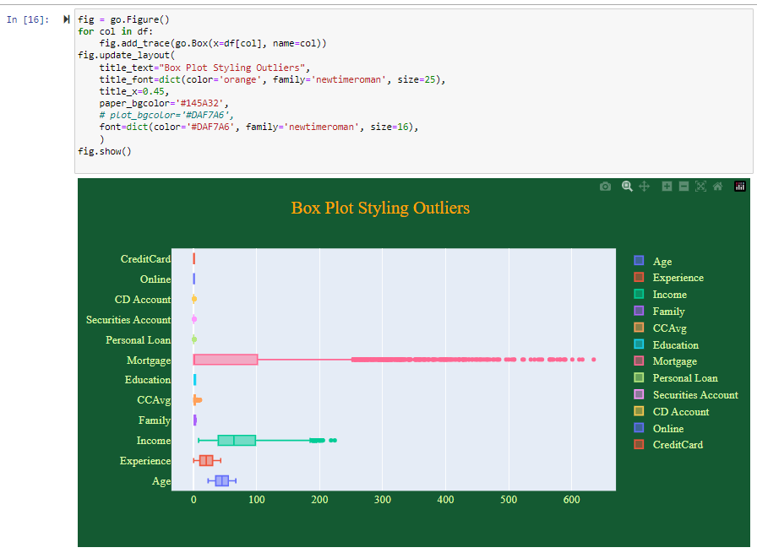
Box Plot Visualization

Slide 10
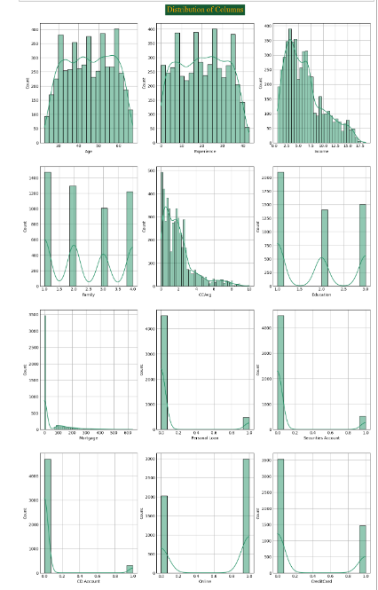
Exploratory Data Analysis

Slide 11
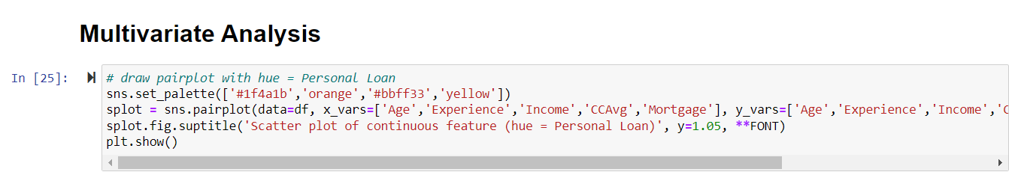
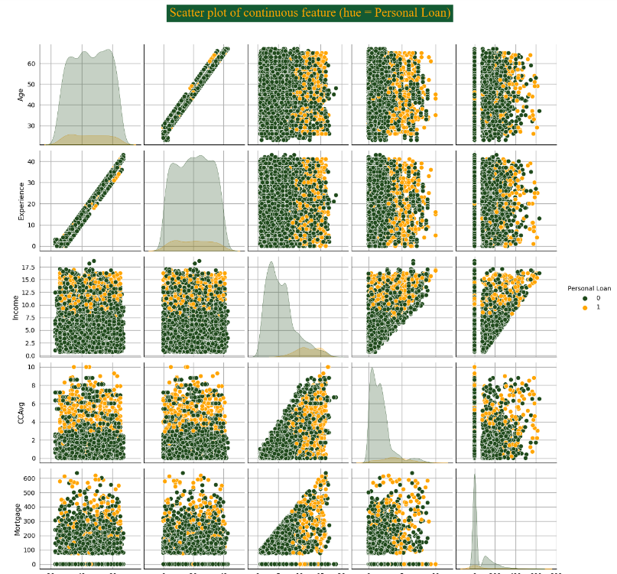
Multivariate Analysis

Slide 12
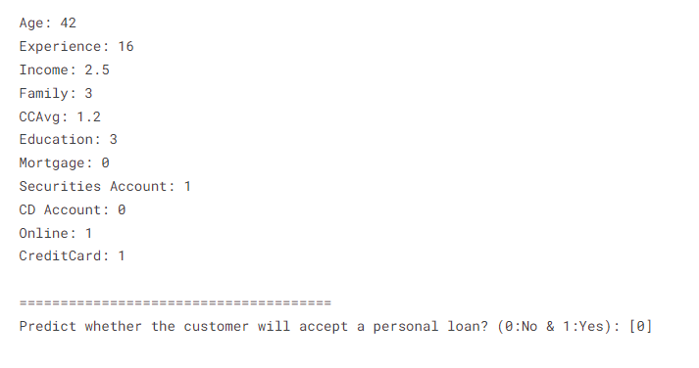
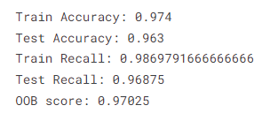
Outputs

Slide 13
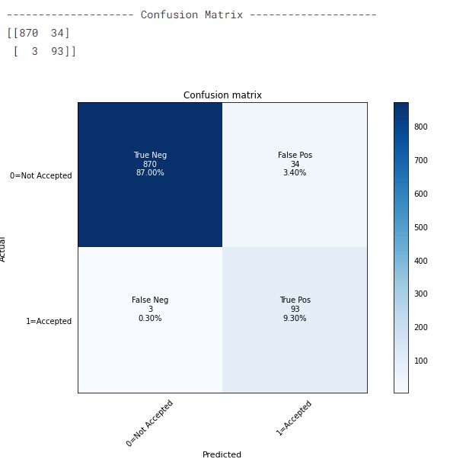
Result analysis - Confusion Matrix

Slide 14
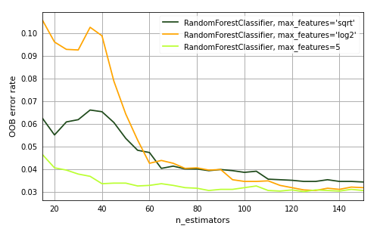
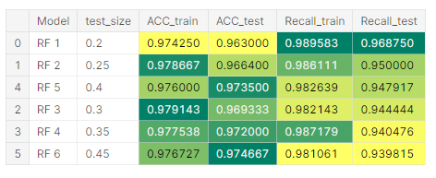
Result Analysis (OOB and RF models)

Slide 15
Conclusion
Observed RF Properties
It reduces overfitting in the Decision tree
Flexible for both classification and regression problems
Categorical and continuous values
Automates missing values in the data
Normalizing isn’t required as it uses rule-based approach
RF vs Others
Better than SVM, KNN at handling multivariate data
Better than decision tree in terms of avoiding overfitting

Slide 16
Thank You

