Slide 1
Presentation on Genetic, SLP and MLP
Kshitij pawar
EnRoll.NO. MT22MCS002
Id no. : 28439

Slide 2
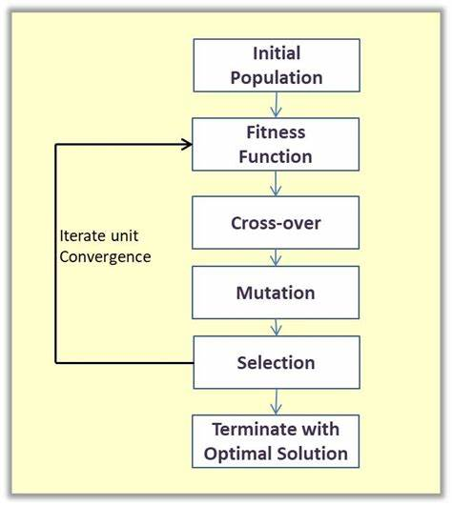
Genetic Algorithm
It is a search based optimization technique based on the principle of genetics and natural selection. (Survival of the fittest). The following flowchart briefs us about the steps in genetic algorithm.

Slide 3
Problem Statement
I have implemented the genetic algorithm optimization technique in Python based on a simple example in which we are trying to maximize the output of an equation. This code uses the decimal representation for genes, one point crossover, and uniform mutation.
The equation is shown below:
Y = w1x1 + w2x2 + w3x3
The equation has 3 inputs (x1 to x3) and 3 weights (w1 to w3) as shown and inputs values are (x1,x2,x3)=(4,-2,7). We are looking to find the parameters (weights) that maximize such equation.
The idea of maximizing such equation seems simple. The positive input is to be multiplied by the largest possible positive number and the negative number is to be multiplied by the smallest possible negative number.

Slide 4
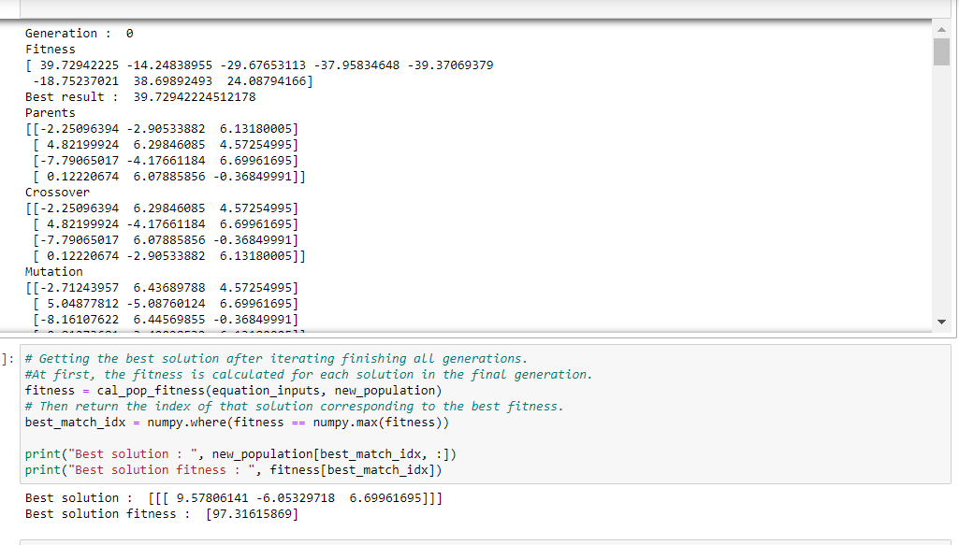
Output:

Slide 5
Single Layer Peceptron
The perceptron is a single processing unit of any neural network. As the name suggests, it has only one layer.
It works on linearly separable datasets.
Let W be matrix (Including bias in W) of weights and X be our input matrix.
If W^{T}X>=0, then it classifies as 1
Else it classifies as 0
And the dataset must be linearly separable for our algo to converge. Hence it is called Linear Binary Classifier.

Slide 6
Problem Statement
Using SLP and the features of MonkeyPox dataset, predict whether a given Patient has Monkey Pox.
Data Set Description:
This is a SYNTHETIC dataset generated based on a study published by thebmj: Clinical features and novel presentations of human monkeypox in a central London centre during the 2022 outbreak: descriptive case series.
Dataset consists of a CSV which have a record of 25,000 Patients with their corresponding features and a target variable indicating if the patient has monkeypox or not.
Features : Patient_ID, Systemic Illness, Rectal Pain, Sore Throat, Penile Oedema, Oral Lesions, Solitary Lesion, Swollen Tonsils, HIV Infection, and Sexually Transmitted Infection
Target Variable: MonkeyPox
The dataset currently contains boolean and categorical features and in future, we might add more data and features to help you identify the patients of Monkey-Pox.

Slide 7
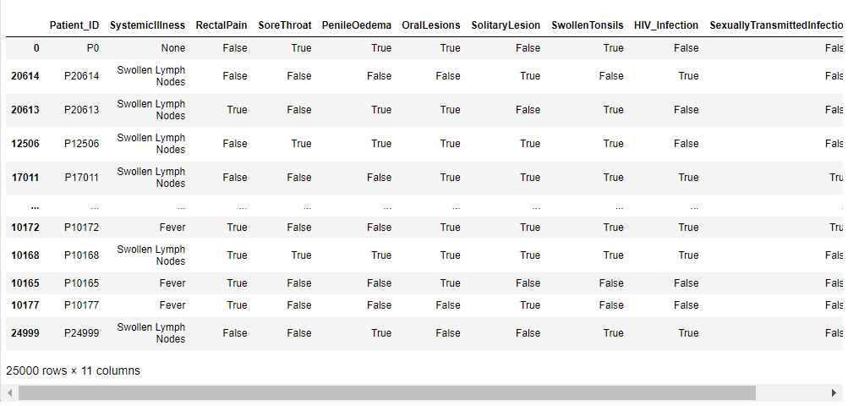

Slide 8
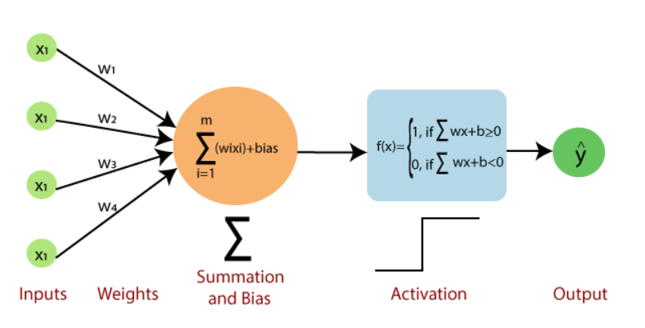
Implementation

Slide 9
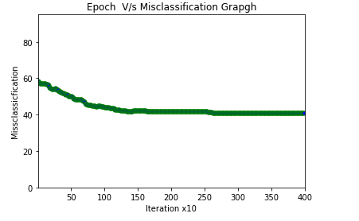
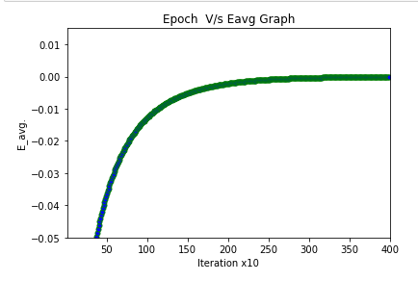
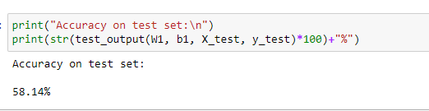
Result Analysis

Slide 10
Multi Layer Perceptron
Multi Layer Perceptron has 3 layers: 1. Input Layer 2. Hidden Layer 3. Output Layer
It has mainly 2 phases:
Forward Propagation:
Feeding the input to the succeeding layers of neurons
Error back propagation:
Back propagating error from the output neuron in order to update weights using gradient descent.
The gradient descent phase is the key phase where we try to minimize the error caused because of weights.

Slide 11
Problem Statement
Using MLP and the features of Monkey dataset, predict whether a given patient has monkey pox.
The description of data set is already given.

Slide 12
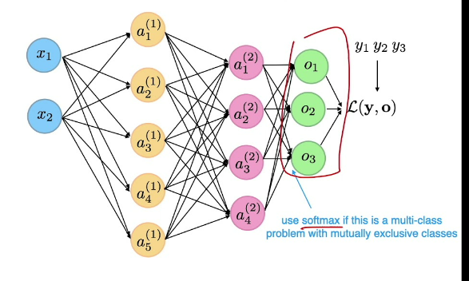
Implementation:
To do this, had to define functions for initialization of weights, forward propagation, backward propagation, activation function and their derivatives

Slide 13
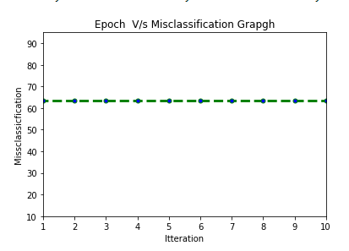
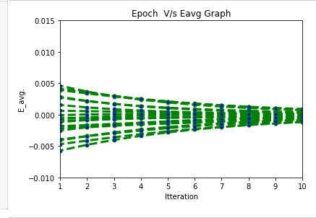
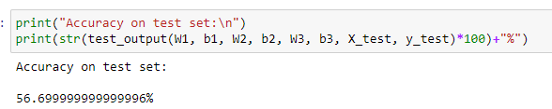
Result Analysis

