Slide 1

VISVESVARAYA NATIONAL INSTITUTE OF TECHNOLOGY
COMPUTER SCIENCE AND ENGINEERING
SESSION - 2022-23
Kernel Methods for Text Categorization
Course - MATHEMATICS FOR MACHINE LEARNING
Faculty- Dr. ASHISH TIWARI
Presented by: Kshitij Pawar
(Mtech First Year CSE)
Enroll No : MT22MCS018
Id No : 28438

Slide 2
Introduction
Text categorization is the task of assigning predefined categories to free-text documents. It can provide conceptual views of document collections and has important applications in the real world.
There are 2 main variants of Text Categorization:
Text Clustering :
Here desired number of clusters or groups is known in advanced.
No indication for the semantics of these groups
Text Classification :
Here input to the system consists of set of labels(classes). Eg: Noun, verb, etc. They usually consists of short language expressions whose membership or non-membership value for each class is known.
Here specification of semantics is indicated

Slide 3
Applications of Text Categorization
Document Organization
Text Filtering
Document Routing
Spam Filtering
Hierarchical classification and of web directory building
Word Sense disambiguation
Information Retrieval
Information Extraction

Slide 4
Text Categorization Techniques – Old
During 1980 - TC was based on Knowledge Engineering
Here engineers and domain expert work together to build a system capable of classifying text.
Set of “if …..then” rules.
High Human cost for :
Defining the Rule set
Maintaining and re-defining Rule set
Possible Subsequent addition, deletion of classes due to shift in the meaning of the existing classes.

Slide 5
Text Categorization Techniques – New
During 1990 – Use of Machine Learning for TC started gaining popularity
A general inductive process(learner) is fed with a set of examples(training) documents pre-classified according to categories of interest.
By observing the characteristics of the training document, the learner generates a model(classifier) of the conditions that are satisfied by the documents, belonging to the categories considered.
This model can subsequently be applied to new, unlabelled documents for classifying them according to these categories.

Slide 6
Pre-processing of text for Machine learning
Tokenisation – Extracting words and terms from document, stripping out administrative meta data and formatting element. Eg : Html tags from html document.
Lexical Analysis – Identifying word from a document
Stop Word Removal – Words with non linguistic view
Generic Stop Words – Eg : a, an, the
Mis-spelling stop words
Domain stop words – Words turn into stop words under specific domain knowledge. Eg : in document corpus discussing animals, automobiles, politics, computers, etc the word ’computer’ is not a stop word, but in a document corpus discussing different aspects of computers the word ‘computer’ becomes a stop word

Slide 7
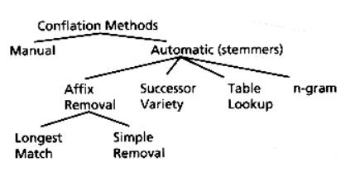
Pre-processing of text for Machine learning
Stemming - Stemming is a process to reduce the word to its root stem for example run, running, runs, runed derived from the same word as run.
Method used for stemming is Conflation Method

Slide 8
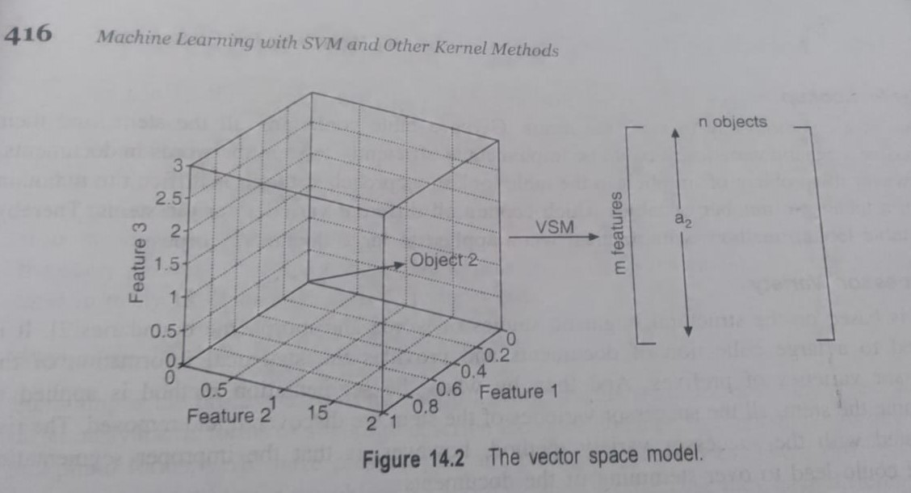
Text Representation – Vector space Model

Slide 9
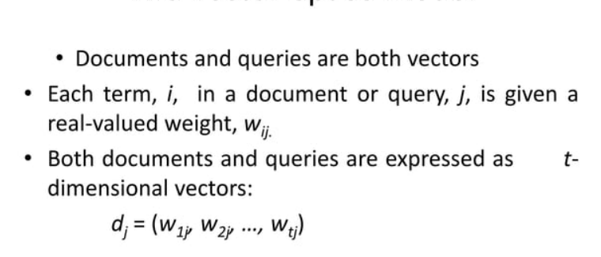
Text Representation – Vector space Model

Slide 10
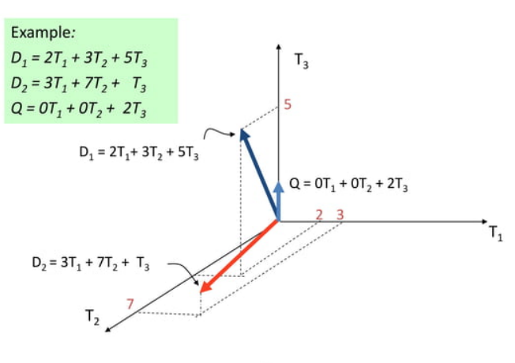
Graphical Representation

Slide 11
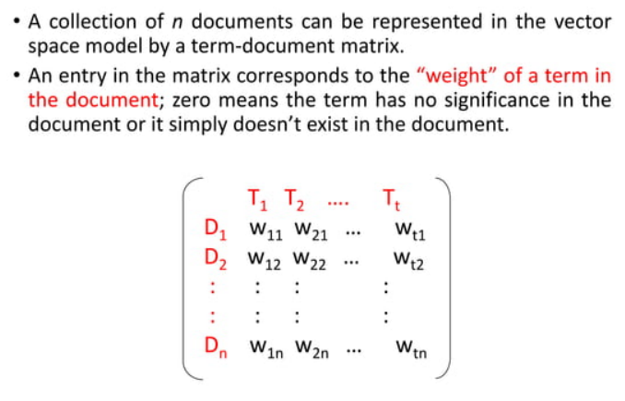
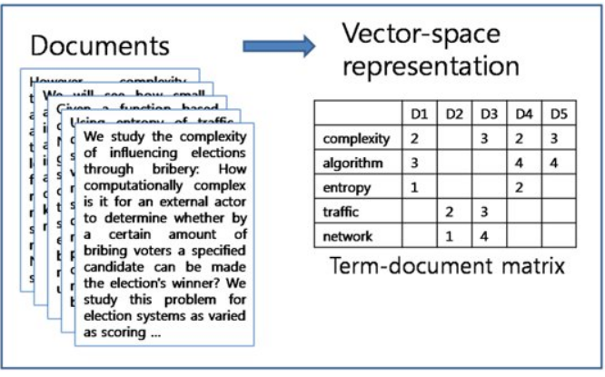
Document Collection

Slide 12
Term frequency (tf)
The term frequency tf_{t,d} of term t in document d is defined as the number of times that t occurs in d.
Raw term frequency is not what we want:
A document with 10 occurrences of the term is more relevant than a document with 1 occurrence of the term.
But not 10 times more relevant.
Relevance does not increase proportionally with term frequency.

Slide 13
Weigh calculation for tf
The log frequency weight of term t in d is
0 → 0, 1 → 1, 2 → 1.3, 10 → 2, 1000 → 4, etc.
Score for a document-query pair: sum over terms t in both q and d:
score
The score is 0 if none of the query terms is present in the document.

Slide 14
Document frequency (df)
Rare terms are more informative than frequent terms
Recall stop words
Consider a term in the query that is rare in the collection (e.g., arachno-centric)
A document containing this term is very likely to be relevant to the query arachno-centric
→ We want a high weight for rare terms like arachno-centric.
Frequent terms are less informative than rare terms
Consider a query term that is frequent in the collection (e.g., high, increase, line)
A document containing such a term is more likely to be relevant than a document that doesn’t
But it’s not a sure indicator of relevance.
→ For frequent terms, we want positive weights for words like high, increase, and line
But lower weights than for rare terms.
We will use document frequency (df) to capture this.

Slide 15
Inverse Document Frequency (idf)
df_{t} is the document frequency of t: the number of documents that contain t
df_{t} is an inverse measure of the informativeness of t
df_{t} ≤ N
We define the idf (inverse document frequency) of t by
We use log (N/df_{t}) instead of N/df_{t} to “dampen” the effect of idf.
Will turn out the base of the log is immaterial.

Slide 16
tf-idf weighting
The tf-idf weight of a term is the product of its tf weight and its idf weight.
Best known weighting scheme in information retrieval
Note: the “-” in tf-idf is a hyphen, not a minus sign!
Alternative names: tf.idf, tf x idf
Increases with the number of occurrences of term within a document
Increases with the rarity of the term in the collection

Slide 17
Example

Slide 18
Thank You

