Slide 1
HW3
Neural Network
ChinWei Huang
Po-Chih Kuo

Slide 2
Goal
Build your own deep neural network step by step
Implement all the functions required to build a deep neural network
Understanding forward propagation, backward propagation and update
Implement Binary Cross-Entropy loss, Categorical Cross-Entropy loss and Focal loss
Implement binary classifier (basic part) and multi-class classifier (advanced part)

Slide 3
Grading Policy
Item | Score
Basic Implementation | 55%
Advanced Implementation | 40%
Basic & Advanced Report | 5%

Slide 4
Overview
Layer with parameters
Layer without parameters
Dense layer
Activation function layer
initialize_parameters
forward
forward
backward
backward
update

Slide 5
Overview
Model
Dense layer
model_initialize_parameters
Activation function layer
model_forward
Dense layer
compute_cost
Activation function layer
…
model_backward
Dense layer
model_update_parameters
Activation function layer

Slide 6
Basic Implementation (55%)
Dense layer
Implement linear forward. (4%)
Implement linear backward. (4%)
Implement linear update parameters. (2%)
Activation function layer
Implement activation forward. (5%) (Sigmoid and ReLU)
Implement activation backward. (5%) (Sigmoid and ReLU)

Slide 7
Basic Implementation (55%)
Model
Implement model forward. (4%)
Implement model backward. (4%)
Implement model update parameters. (2%)
Compute the binary cross-entropy loss. (5%)
Implement a binary classifier (5%)
(You will get this part if your testing f1score >= 0.6)
Tune hyperparameter to get a good rank. (15%)

Slide 8
Advanced Implementation (40%)
Activation function layer
Implement activation forward. (5%) (Softmax)
Implement activation backward. (5%) (Softmax+CCE_loss)
Implement activation backward. (5%) (Softmax+Focal_loss)
Model
Compute the categorical cross-entropy loss. (5%)
Compute the Focal loss. (5%)
Implement a multi-class classifier and tune hyperparameter to get a good rank. (15%)

Slide 9
Basic & Advanced Report (5%)
Describe what problems you encountered and how did you solve them when implementing the basic and advanced functions. (2%)
Briefly describe the structure of your binary and multi-class classifiers. (2%)
Describe effort you put to improve your model (e.g., hyperparameter fine tuning, losses’ impact on the result). (1%)
What you do in the bonus. (Optional)
Do not exceed 1 page! Unless you do the bonus, in that case you can write 2 pages.
Name your report file as “report.pdf”.

Slide 10


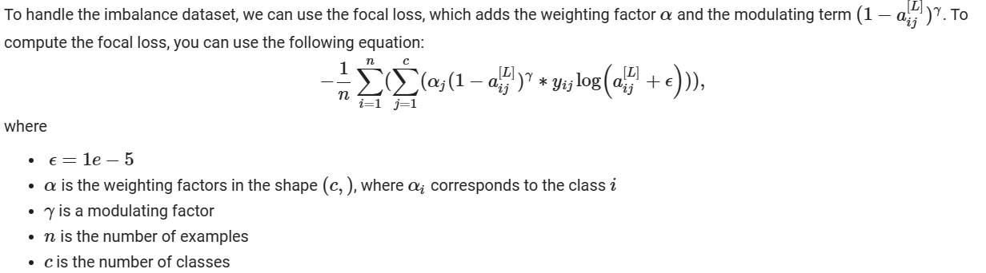
Focal loss

Slide 11

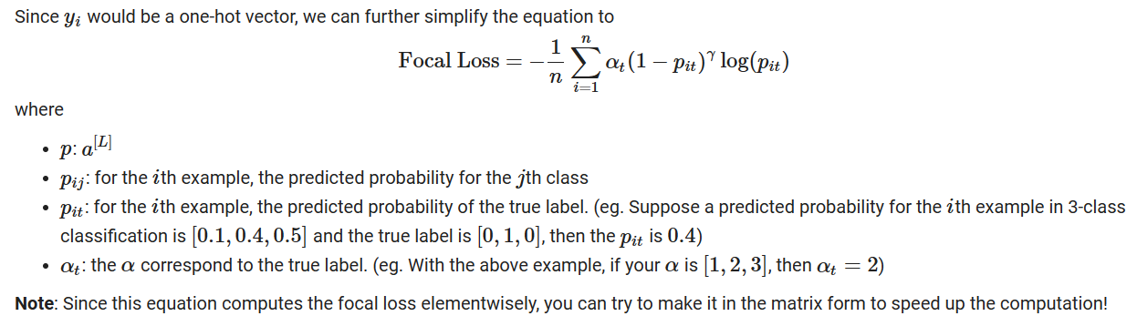
Focal loss

Slide 12
Loss function and Activation function
Warning: only the following 4 combinations are allowed!
1. binary classification: sigmoid + cross_entropy
2. binary classification: softmax + focal_loss
3. multi-class classification: softmax + cross_entropy
4. multi-class classification: softmax + focal_loss

Slide 13
Data
Binary classification: Predict patients’ health conditions
The data set consists of 353 samples (91 samples labeled as 1 and 262 samples labeled as 0). Ten real-valued features are provided and they have been processed by min-max normalization. The details of the training data is shown below:
shape of x_train: (353, 10); shape of y_train: (353, 1)
shape of x_test: (89, 10);

Slide 14
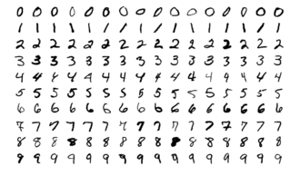
Data
Multi-class classification: MNIST handwritten digit dataset
The MNIST dataset contains around 70,000 small square 28×28 pixels grayscale images of handwritten single digits between 0 and 9. We resampled it to make it into imbalanced dataset.
The details of the training set and testing set:
shape of x_train: (31065, 28, 28)
shape of y_train: (31065,)
shape of x_test: (7767, 28, 28)

Slide 15
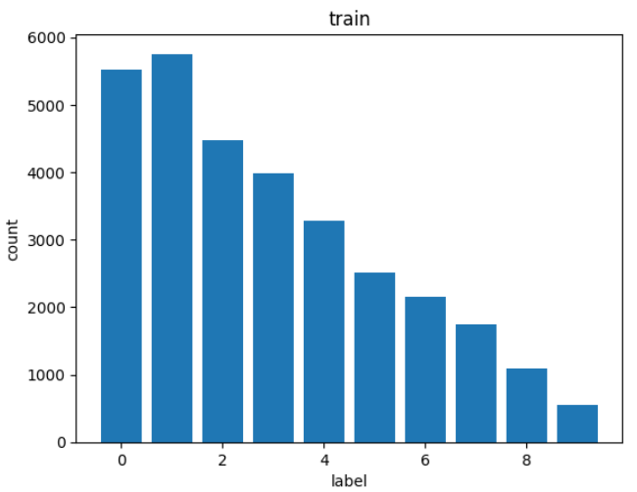
Data
Multi-class classification: MNIST handwritten digit dataset
The MNIST dataset contains around 70,000 small square 28×28 pixels grayscale images of handwritten single digits between 0 and 9. We resampled it to make it into imbalanced dataset.
The details of the training set and testing set:
shape of x_train: (31065, 28, 28)
shape of y_train: (31065,)
shape of x_test: (7767, 28, 28)

Slide 16
Data
Multi-class classification: MNIST handwritten digit dataset
The MNIST dataset contains around 70,000 small square 28×28 pixels grayscale images of handwritten single digits between 0 and 9. We resampled it to make it into imbalanced dataset.
The details of the training set and testing set:
shape of x_train: (31065, 28, 28)
shape of y_train: (31065,)
shape of x_test: (7767, 28, 28)
0
31065

Slide 17
Items for you
Template: HW3.ipynb (You are encouraged to use Colab!)
Basic data: basic_data.npz
Advanced data: advanced_data.npz
Sample output: sample_output.npy

Slide 18
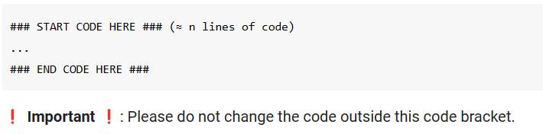
Template
Except for the imported packages in the template, you cannot use any other packages.
Remember to save the code file to HW3.ipynb

Slide 19
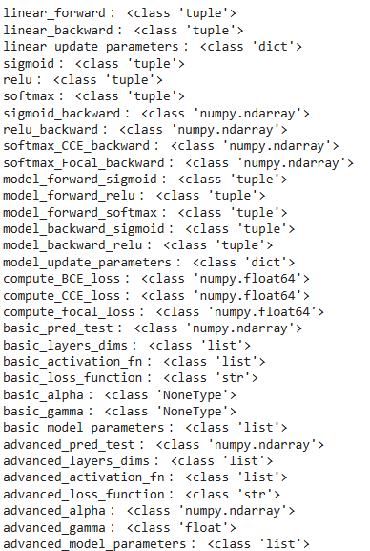
Output NPY File Format
Named as “output.npy”
This file is a dictionary that stores your output for each function and the binary and multi-class classification prediction. Note that the hyperparameter and weights of both classifiers will also be stored in the output file to check whether your predictions come from the same classifier you submitted.

Slide 20
The Evaluation Metric
In the basic and advanced function implementations, you will get a full score if your output is exactly the same as the standard answer, or else you will get a zero mark for each function implementation.
For the binary classifier and multi-class classifier, we will use F1 score to evaluate your classifier.
Binary classification: You will be compared with others who submit the basic prediction.
Multi-class classification: You will be compared with others who submit the advanced prediction.

Slide 21
Bonus
To further improve your ranking score, you are permitted to modify any part of the code in order to implement different techniques. However, this should be done in a separate file named HW3_bonus.ipynb.
If you want to do the bonus part, you should start by copying the template into a new file called HW3_bonus.ipynb. In this file, you are free to make any modifications you desire.

Slide 22
Bonus
Importing additional packages is still prohibited.
Ensure that your results are reproducible by simply executing 'Run all' in Colab.
Submitting format
HW3_bonus.ipynb
output_bonus.npy that stores a dictionary with the following two keys
basic_pred_test
advanced_pred_test
If you fail to meet these requirements, your bonus part may be considered invalid, in which case the predictions from your HW3.ipynb will be used for your ranking.

Slide 23
Requirement
Do it individually! Not as a team! (team is for final project)
Announce date: 2023/11/21
Deadline: 2023/12/5 23:59 (Late submission is not allowed!)
Hand in your files in the following format (Do not compressed!) - HW3.ipynb (Please keep your execution output) - HW3_bonus.ipynb (Please keep your execution output) (Optional) - output.npy - output_bonus.npy (Optional) - report.pdf
Note that Assignment 4 may be based on Assignment 3; it is recommended to put much effort into this assignment so you will have a good start for your next assignment.

Slide 24
Penalty
0 points if any of the following conditions:
Plagiarism
Late submission
Not using template or import any other packages
Incorrect input/output format
Incorrect submission format
Predictions mismatch (your predictions did not come from the same classifier you submitted)
Directly copy code from ChatGPT

Slide 25
Questions?
TA: ChinWei Huang 黃謹緯 (winston78934546@gmail.com)
No debugging service

